Slide 1

ESA Validation and Applications Preparation
R. Koopman, S. Rusli, M. Fielding, M. Janisková, T. Wehr, K. Wallace, M. Eisinger, D. Schüttemeyer, J. von Bismarck, C. Retscher, H. Baars, E. Marinou, N. Clerbaux, A. Velazquez Blazquez, D. Bernaerts, B. Frommknecht
Thursday – 26.05.2022

Slide 2
x
Validation Preparation

Slide 3


Presentation scope (1)
Each agency coordinates the validation of its own products
ATLID
BBR
MSI
CPR
ATLID
BBR
MSI
CPR
L1
L1
L1
L1
L2A
L2A
L2A
L2A
L2A
L2A
L2B
L2B
Scope of this presentation

Slide 4
Presentation scope (2)
Characterisation
Probing properties as a function of conditions – performed on-ground prior to launch but also in-orbit by engineering teams
Quantitavely establishing system response in response to controlled signal inputs - idem
Assessment whether a system meets its specification – performed on-ground prior to launch from stimuli and simulated datasets and in-orbit by analysing L0, L1, calibration, and L2 datasets by engineering teams and algorithm teams
Assessment of the data quality by independent means – performed by the validation teams with correlative (“external”) data
Calibration
Verification
Validation

Slide 5
ESA EarthCARE L2 data products

Slide 6
Data record continuity (aerosol, cloud/precip, radiation)
Aeolus
CALIPSO
++
EarthCARE
Aeolus 2
++
AOS
CloudSat
GPM
++
++
CERES
GERB
++
Libera
++

Slide 7
EarthCARE validation challenges
EarthCARE validation presents a unique combination of challenges
The large number of different products and their diversity
The heterogeneity of the validation community
Synergistic products -> synergistic validation
Difficult sampling

Slide 8
Validation approach
Pre-launch campaigns and Fiducial reference measurement development activities for radars and lidars (FRM4RADAR, eVe, EMORAL) and suborbital-to-orbital simulators
Announcement of opportunity for the validation community, incorporating PIs into the EarthCARE Validation Team, and fostering the interaction with national funding sources
Secure collocated airborne datasets, covering diverse scenes, through collaboration with campaigns
Collaboration with networks, e.g ACTRIS/ATMO-ACCESS
ESA-JAXA coordination through the joint Scientific Validation Implementation Plan
Lessons learned / best practice convergence on validation of aerosol, cloud and precipitation profiles in collaboration with CALIPSO, Cloudsat, Aeolus, and AOS scientists

Slide 9
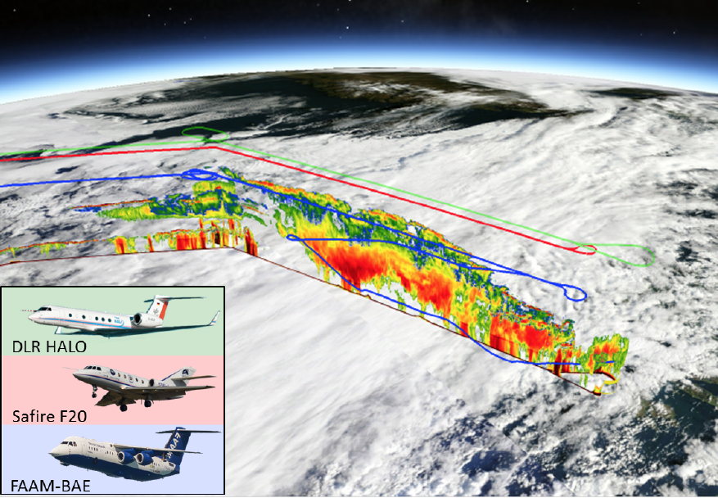
Pre-launch validation campaigns
Campaign | Venue | Date | Platform(Institute)Payload | EarthCARE Objective
CLARE | UK | 1998 | C-130(UKMO) in situ F27(IPSL) radar, ++ Falcon (DLR) lidar, ++ Ground radar,lidar, ++ | Mission pre-development
NARPEX | Arctic-Tropical Atlantic | 2013 2014 | HALO(DLR), radar, lidar, ++ | Synergistic retrieval, radar calibration verification, calipso/cloudsat underflights
EPATAN (part of NAWDEX) | Island | 2016 | Falcon(LATMOS) radar, lidar, TIR++ HALO(DLR) radar, lidar, imager, ++ FAAM(UKMO) in situ | L2 algorithm verification (cloud regimes), calipso/cloudsat underflights
A-CARE (part of A-LIFE) | Cyprus | 2017 | Falcon(DLR) in situ, ++ Ground radar,lidar, ++ | Microphysics, aersol classification verification, calipso/cloudsat underflghts
CADDIWA (part of JATAC) | Cape Verde | 2021, 2022 | Falcon(LATMOS) radar, lidar, in situ, ++ Ground radar, lidar, ++ Further datasets JATAC dataset also interesting also for EarthCARE: Cessna(UNG) in situ, CPEX-AW(NASA)radar++ | L2 algorithm verification, (cloud, maritime aerosol, and desert dust regimes)
ACTIVATE and IMPACTS data exchange | Western Atantic US East Coast | 2020 2021 2022 2020 | King Air (NASA), lidar, ++ Falcon (NASA) in situ, ++ ER-2 (NASA), multiple radars, ++ P-3 (NASA), in situ | ACTIVATE and IMPACT had no EarthCARE campaign objectives. collaboration between NASA teams and ESA algorithm teams on datasets for algorithm verification

Slide 10
In-orbit Validation planning
Early underflights for L1 and L2 validation
  First ~2 months after launch several instruments will not yet be in nominal mode.
  L1 product release to public is at L+6 months.
  Ground sites will have sparse collocated datasets by then: -> airborne remote sensing
  L1 validation requires precise collocation: -> airborne and mobile systems (also simultaneously: triple collocation)
  Retrievals assume particle properties -> airborne in situ (tandem flights)
  For land overpasses: low passes prior or after underflight, to measure albedo
Parallel ground-based network data acquisition, continuously, over the mission lifetime
  Accumulation of datasets, using statistical and advection methods to alleviate non-perfect collocation
  Simultaneous coverage of most regions and conditions, continuous coverage in time
  Synergistic validation with multiple collocated instruments
Further campaigns during the entire mission life time.
  Multiple campaigns under different conditions
  Synergistic validation aircraft and ground based instruments)
  Accumulate larger datasets in order to increase precision of quality assessment
Systematic monitoring of radar and lidar data with NWP model (see part 2 of this presentation).

Slide 11
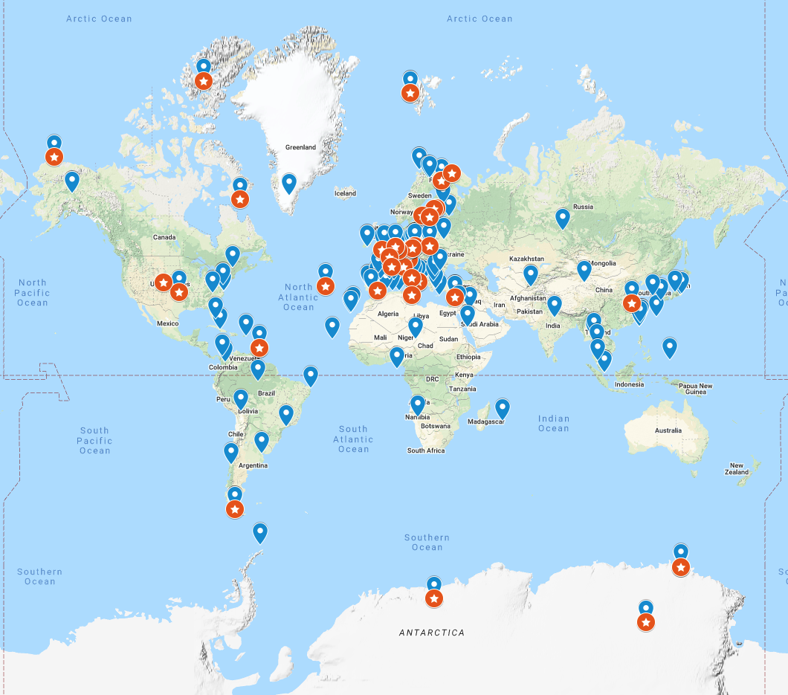
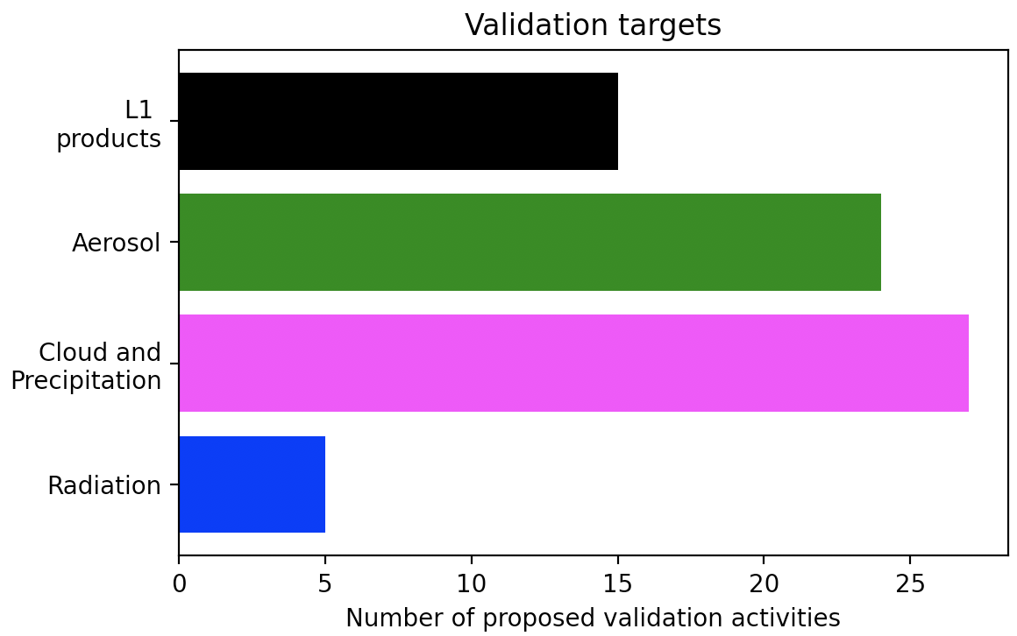
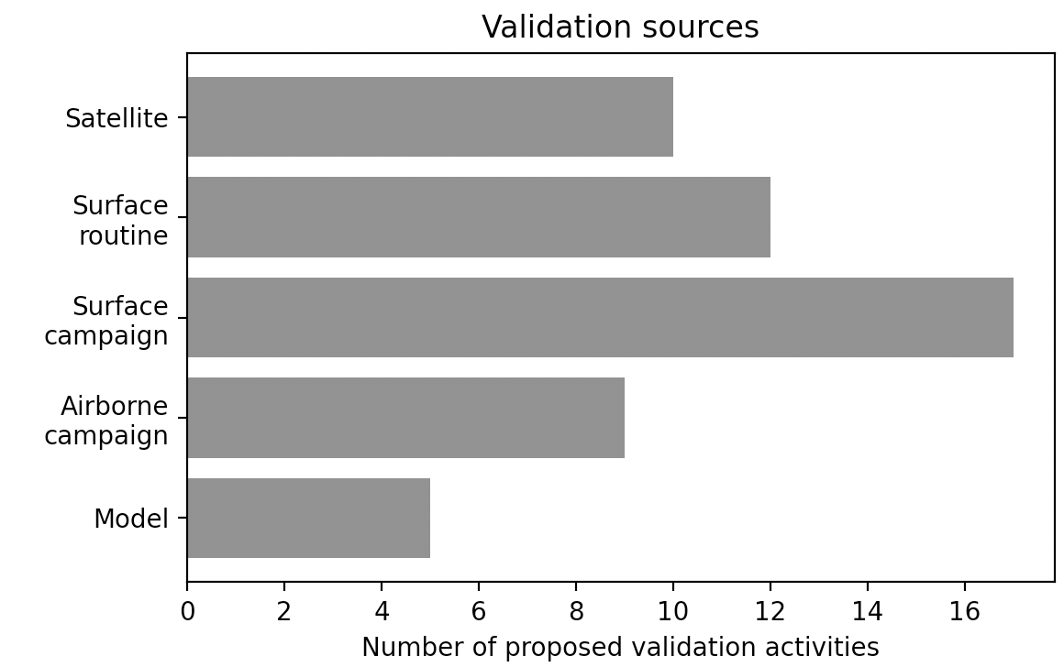
Coverage (geographical, targets, sources)
Geographical groundbased (for campaign coverage see next slide)
Ground based Radar stations (42)
Ground based Lidar stations (>100)

Slide 12







Campaign collaboration potential opportunities under consideration (assuming launch in Oct 2023)
2023
2024
Dec
Jan
Feb
Mar
Apr
May
Jun
Jul
Aug
Sep
CCRESTVAL
ARCSIX
Radar
EC-TOOC
Home base
Home
Base
MAESTRO
CCRESTVAL
PACE
PAX
Lidar
Asia AQ
ARCSIX
EC-TOOC
Home base
MAESTRO
Asia AQ
TBC
ARCSIX
PACE
PAX
In situ
(micro-
physics)
CCREST(VAL)
TBC
home base
LOAC soundings
MAESTRO
Home base
Legend:
Arctic
Imager
and/or
polarimeter
PACE
PAX
Mid-latitude
Tropics
EC-TOOC

Slide 13
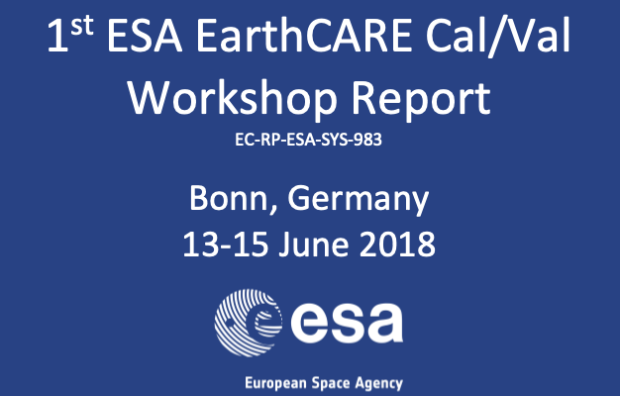
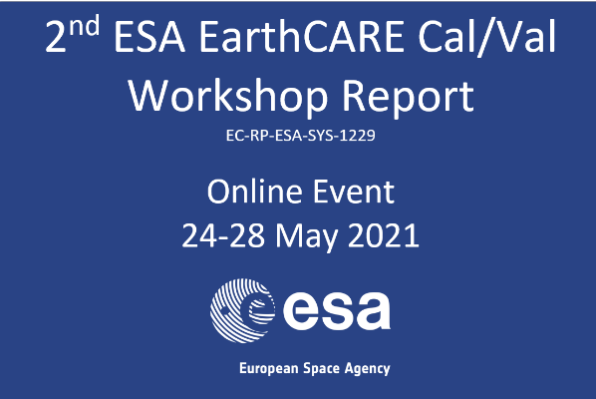
Past ESA EarthCARE validation workshops
The set of 30+ AO proposals form an adequate validation programme if full funding is achieved
Clear need for common protocols for cloud and aerosol profile validation
Enhance maturity and thoroughness of intercomparison methods
Guidance and knowledge transfer
Obtain broader assessment of EarthCARE validation gaps by engaging CloudSat, CALIPSO, AOS, Aeolus communities

Slide 14
Best practice for validation of cloud and aerosol profiles
Community consensus on approaches for e.g.
  data acquisition strategies
  data intercomparison methods/strategies
  combining remote sensing and in-situ measurements.
Different approaches can and should co-exist, but should be unambiguously distinguished when interpreting results
Not specific to EarthCARE; include lessons learned from past, current missions while keeping future missions in mind
A core working group has been formed, which includes international experts in cloud, aerosol, radar, and lidar
Poster in A1.09
Defining validation
protocols for
space-borne aerosol
and cloud profile
products
(Eleni Marinou et al.)
Contribution from the wider community is needed and invited!

Slide 15
Applications Preparation

Slide 16
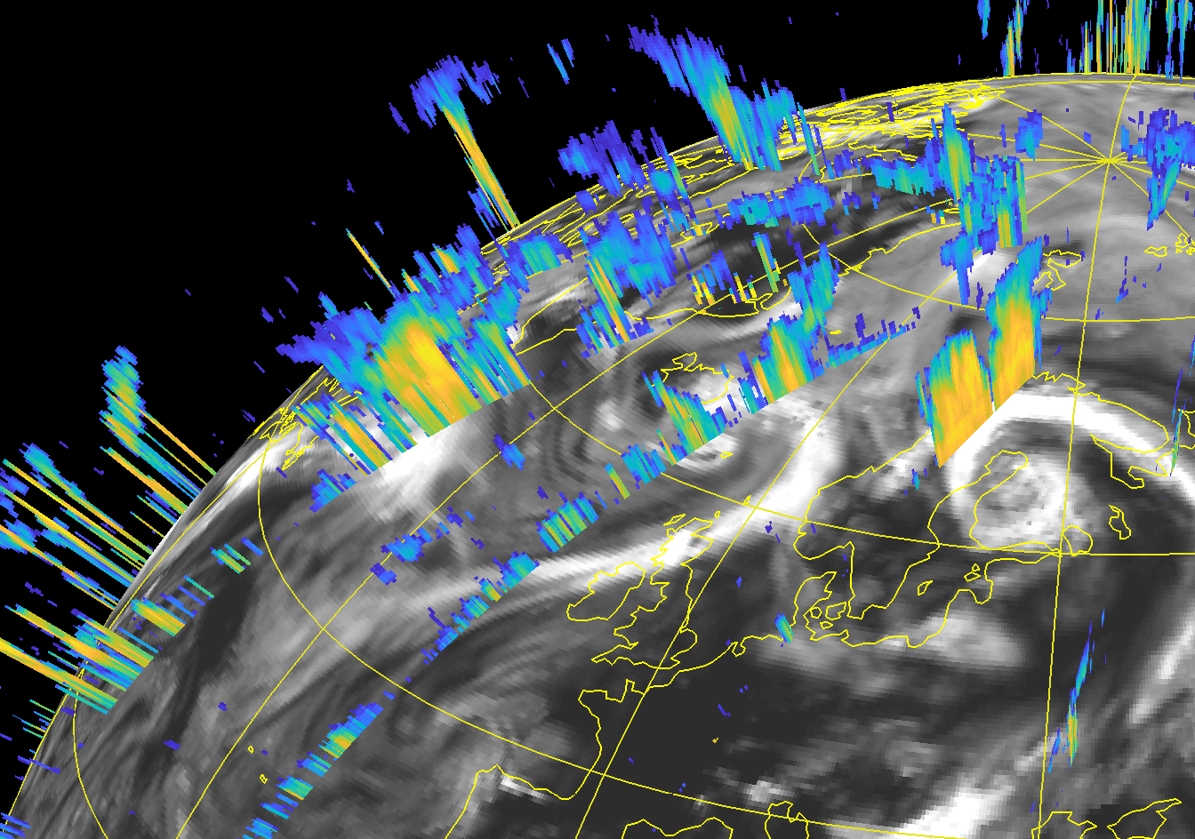



Preparations for EarthCARE assimilation – Radar and Lidar (PEARL)
European Centre for Medium-Range Weather Forecasts (ECMWF) is finalising preparations to assimilate EarthCARE observations thanks to the joint ECMWF-ESA project to maintain and improve developments for monitoring and potential assimilation of cloud radar reflectivity and lidar backscatter.
Three main benefits:
  Observation data quality monitoring
  Direct weather forecast improvements via data assimilation.
  Forecast model validation using observation operators as instrument simulators

Slide 17
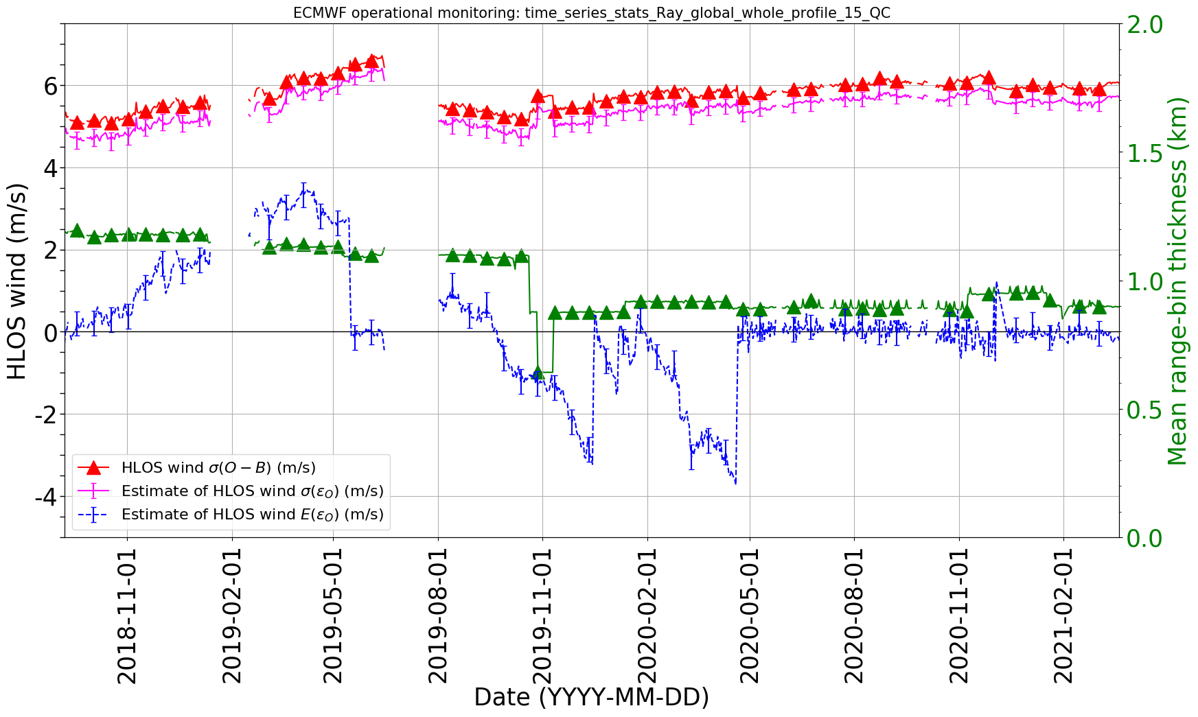
Observation data monitoring is a key component of data assimilation
All observations that are assimilated at ECMWF to produce the model initial conditions also enter data monitoring system:
  Assesses the availability and quality of observations by comparing them against NWP model in near real-time.
  Use in-house instrument simulators to monitor biases and variability within 12-hour data assimilation.
  Rapid detection of instrument issues that could affect analysis.
Thanks: Michael Rennie
Example: Long-term Aeolus L2B HLOS wind quality monitoring
Monitoring and correction of Aeolus horizontal line of sight (HLOS) winds against ECMWF model was pivotal to mission success!
Degradations in HLOS winds improved due to telescope-mirror temperature dependent bias correction.

Slide 18
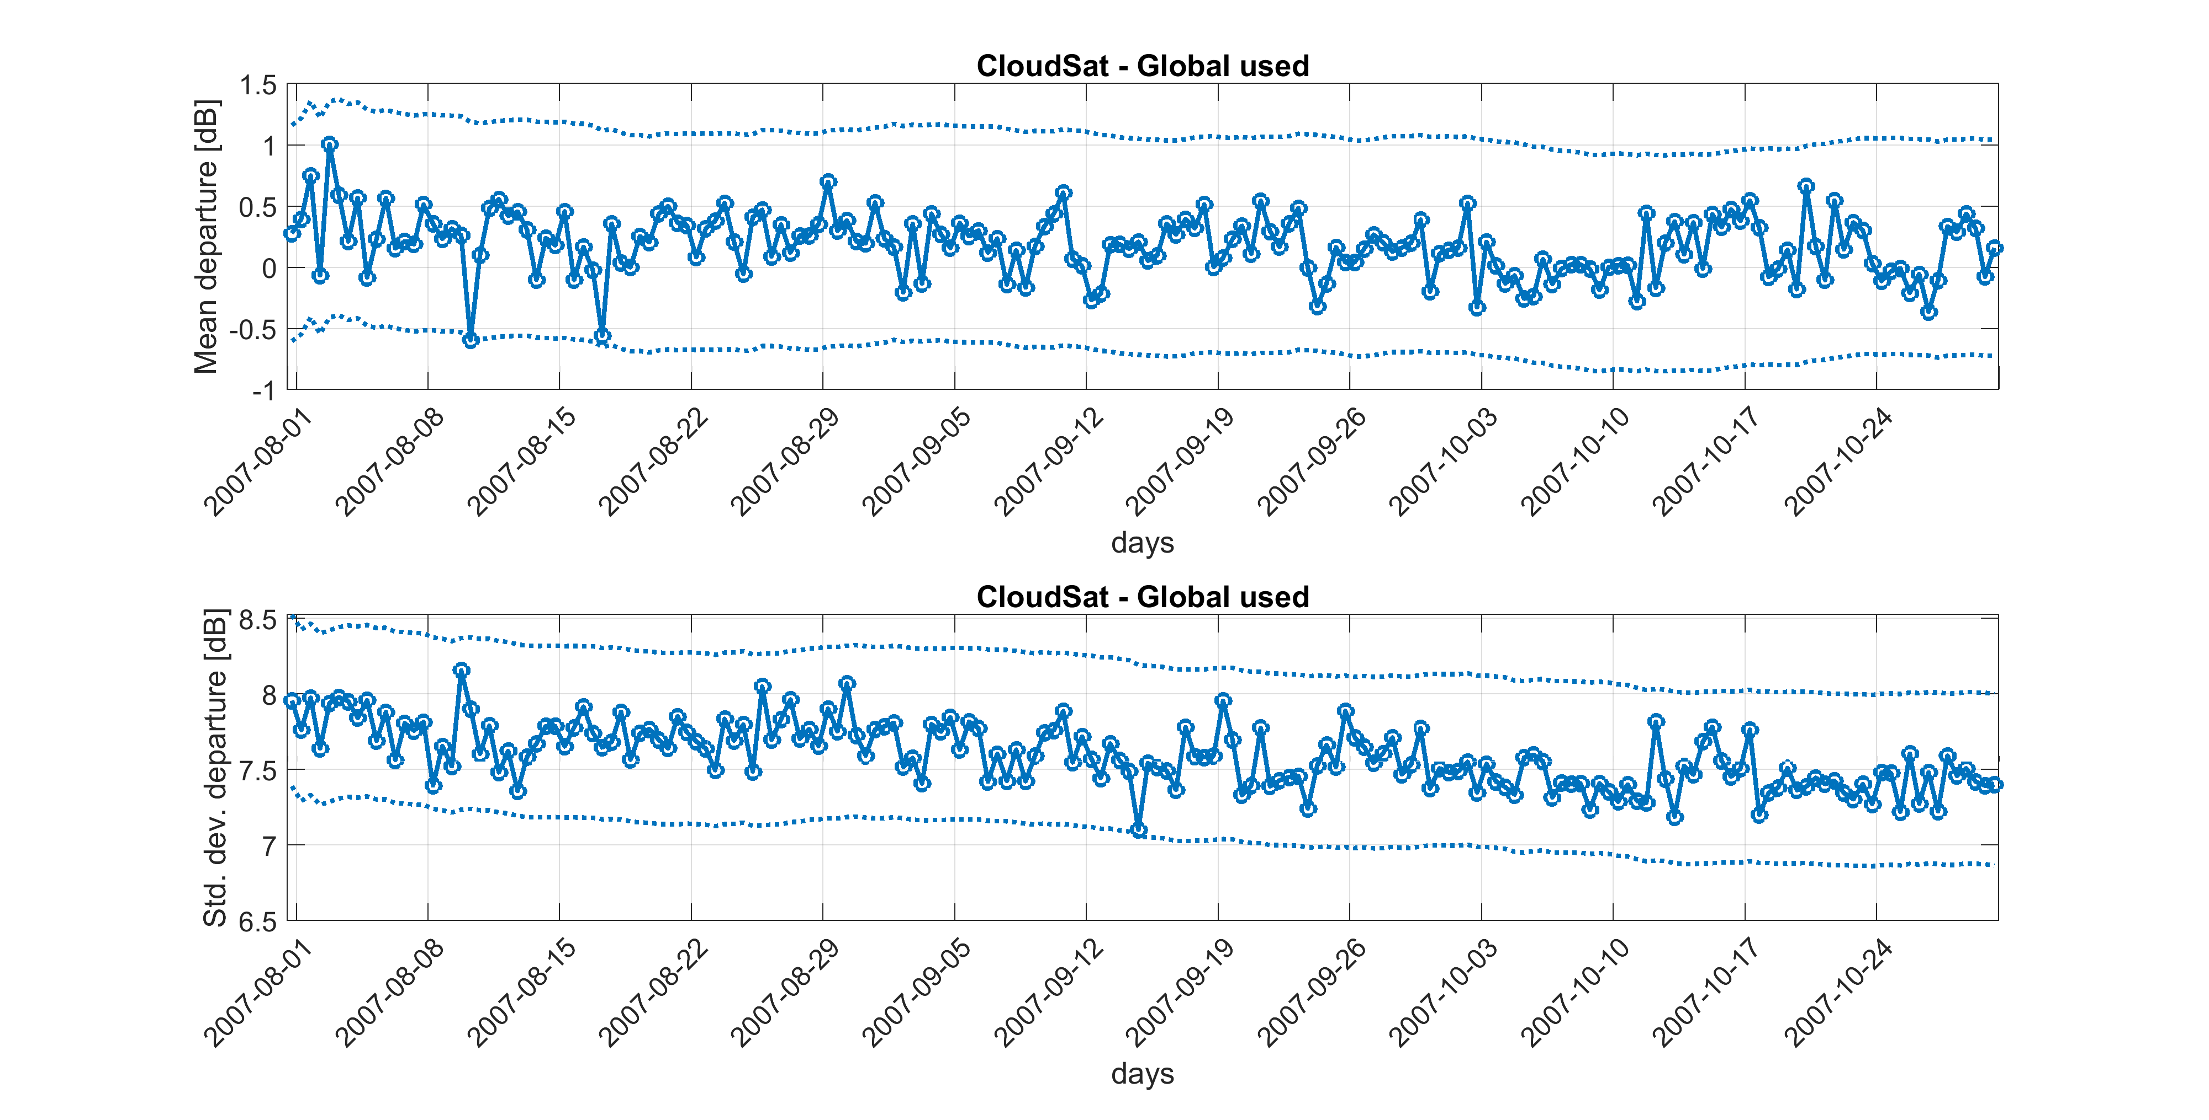
Monitoring cloud radar reflectivity from CloudSat against ECMWF model
Subtle changes or drifts in calibration can be detected because of low variability in global mean, e.g., 1 dB biases in radar reflectivity would trigger ‘alarm’ within days.
Global
mean
±3 s.d.
Global
Std. dev.
Each point represents 12-hour global statistics for all observations passing screening

Slide 19
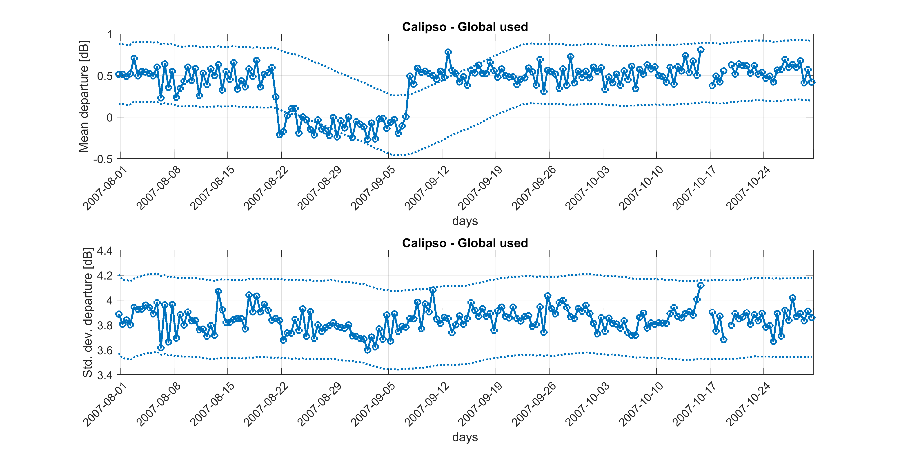

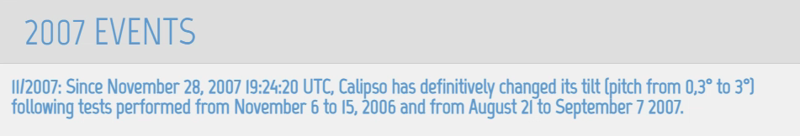
Change in CALIPSO lidar tilting angle immediately detected
Global
mean
Global
Std. dev.
Reduction in specular reflection from ice crystals when lidar pointing off-nadir

Slide 20
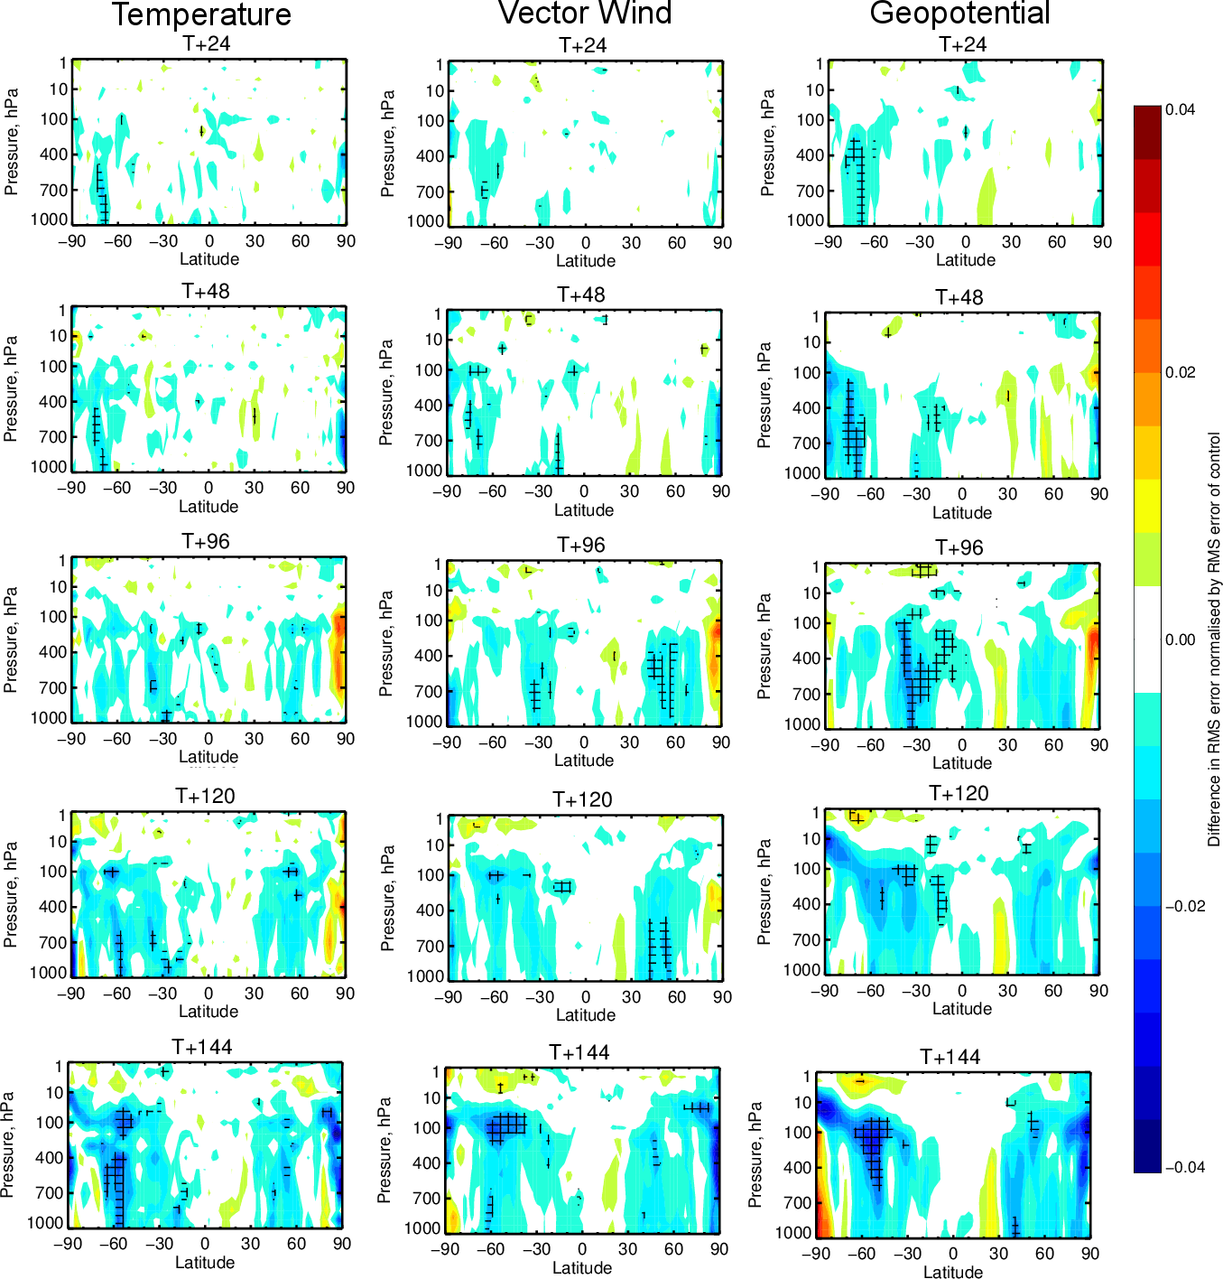
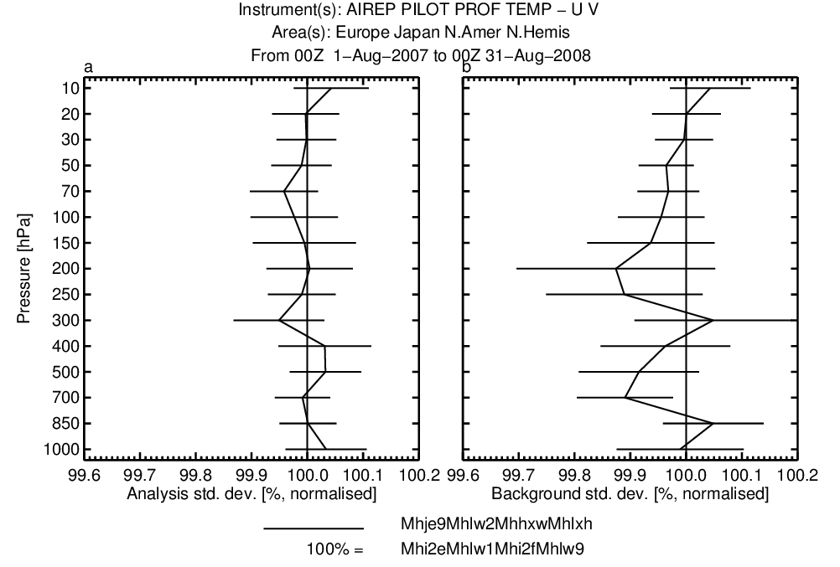
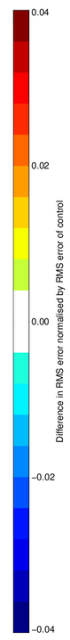
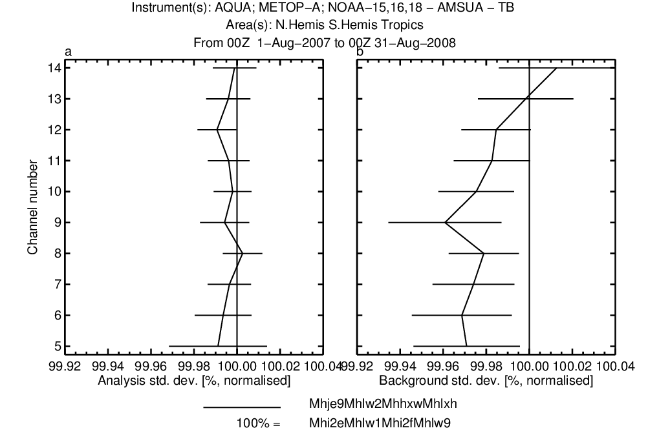
What direct benefits can we expect from assimilating EarthCARE?
OSE: 11-month combined (01.08.2007 and 31.08.2008) CloudSat and CALIPSO observations in addition to regularly assimilated observations vs control
Improvements to medium-range FC skill
Improves fit to other assimilated observations
Temperature (T)
In-situ wind - Global
RED
worse
Wind
AMSUA - Global
0.04
Temperature
Vector Wind (VW)
0.02
Difference in RMS error normalised by RMS error of control
0.0
Geopotential (Z)
-0.02
-0.04
BLUE
better
significant 0.5 - 1% improvements in global winds and temperature at day 5-6!
See also: Janisková and Fielding, 2020: Direct 4D‐Var assimilation of space‐borne cloud radar and lidar observations.
Part II: Impact on analysis and subsequent forecast. QJRMS https://doi.org/10.1002/qj.3879

Slide 21
Further Scientific Expoitation

Slide 22
Scientific Exploitation: ATMOS’21 Recommendations
An extract of the many recommendations of the 2021 ATMOS conference
R-21 | ESA to establish scientific community activities on stratospheric aerosol profiles, as they are currently not adequately covered in CCI+ and other ESA programs.
R-23 | Beyond Multi-Angle Polarimeter prepare for future missions having the capability to measure aerosols such as EarthCARE, Aeolus follow-up, Sentinel-4, Sentinel-5, CO2M, and invest in well-defined aerosol products, which can also be validated with ground-based observations.
R-25 | Promote synergy of retrievals from various space-borne instruments to compensate for individual weaknesses. Further bring aerosol communities together (e.g. IR, UV, troposphere, stratosphere).
R-26 | ESA to further invest in synergetic retrievals from space-borne and ground-based instruments.
Various | Studies that enable improvements to cloud and aerosol retrievals from passive sensors
ESA will follow up (formulate a response to) the ATMOS recommendations from 2023 onwards. Many of these recommendations will be implemented under the Atmosphere Science Custer (next slide)

Slide 23
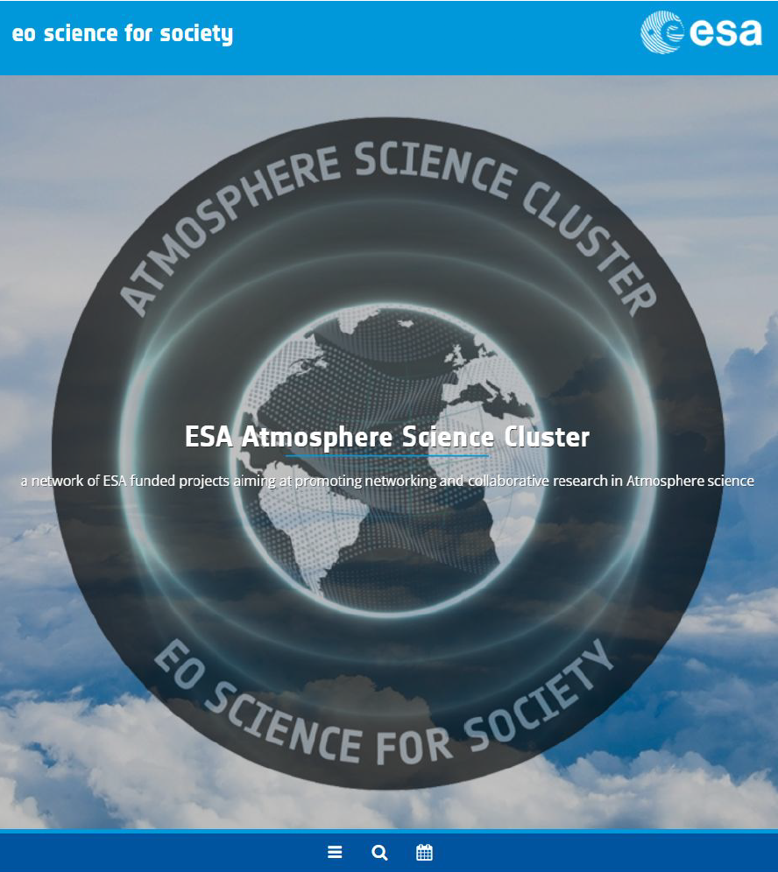
Scientific Exploitation: eo4society Atmosphere Science Cluster
Promoting networking, collaborative research, and fostering international collaboration in Atmospheric science;
Involves ESA-funded projects and activities bringing together different expertise, data, and resources in a synergistic manner;
ESA is contributing to establish a strong European Atmosphere research are in close collaboration with the European Commission Directorate General for Research and Innovation and other European and international partners.
https://eo4society.esa.int/communities/scientists/esa-atmosphere-science-cluster/

Slide 24
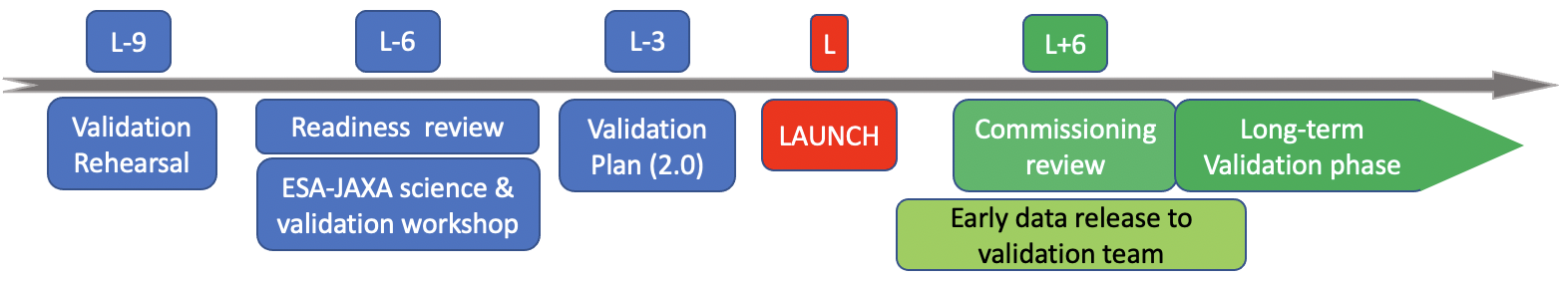
In closing
Extensive validation preparations, involving a large community, on track for the intended October 2023 launch, and the detailed plan will be consolidated when there is clarity on launcher way forward
Initiative to converge on best practices for aerosol and cloud profiles validation → POSTER!
Near real-time monitoring of EarthCARE observations is an invaluable tool for validation of EarthCARE
Assimilation of ATLID and CPR data is expected to have a significant positive impact on medium-range weather forecasts → POSTER!
Scientific exploitation will be fostered by, e.g. Atmosphere Science Cluster, Climate Change Initative, …
Milestones:

Slide 25
Posters
EarthCARE Poster session
Defining validation
protocols for
space-borne aerosol
and cloud profile
products
(E. Marinou et al.)
Progress in preparations towards monitoring & assimilation of EarthCARE observations at ECMWF
(M. Janisková & M. Fielding)

