Slide 1
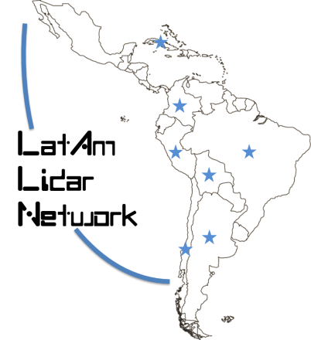


LALINET CAL/VAL for EarthCARE Atmospheric Lidar Instrument
Eduardo Landulfo, Instituto de Pesquisas Energéticas e Nucleares – IPEN/CNEN
São Paulo, Brazil
August 25 2021

Slide 2
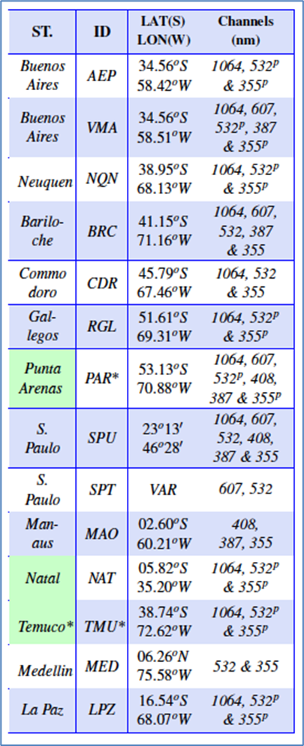
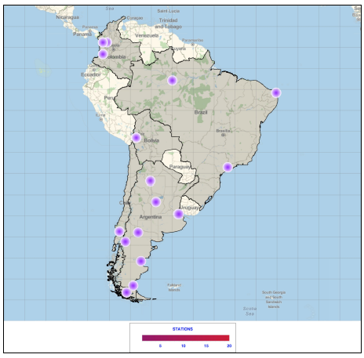
WHAT IS LALINET ?
The Latin America Lidar Network (LALINET a.k.a ALINE) is a Latin American coordinated lidar network measuring aerosol backscatter coefficient and aerosol extinction profiles for climatological studies of the aerosol distribution over Latin America, as well as other atmospheric species such as ozone and water vapor. This federative lidar network aims to establish a consistent and statistically sound database for enhancement of the understanding of the aerosol distribution over the continent and its direct and indirect influence on climate.

Slide 3
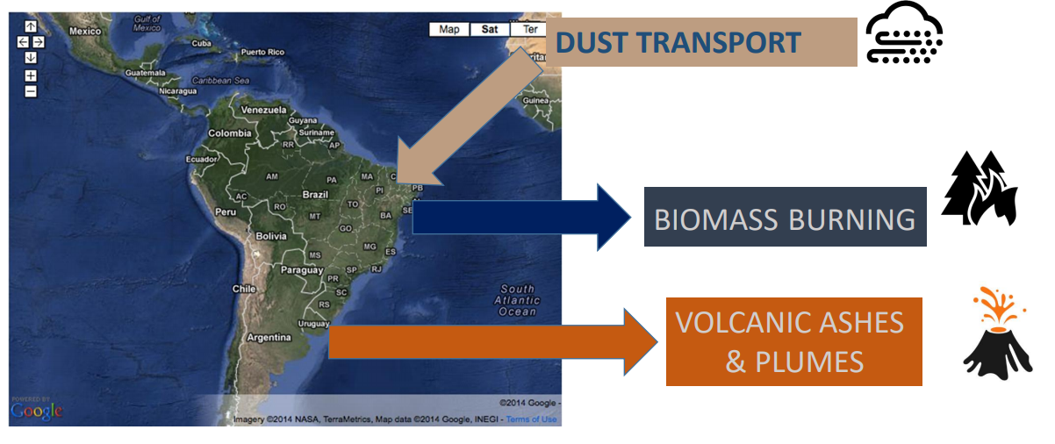

Slide 4
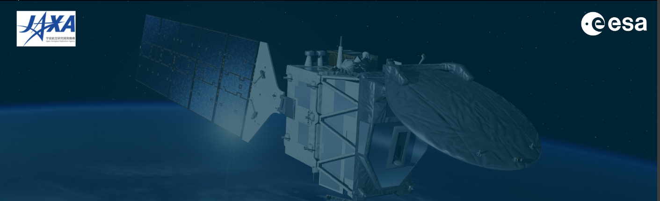
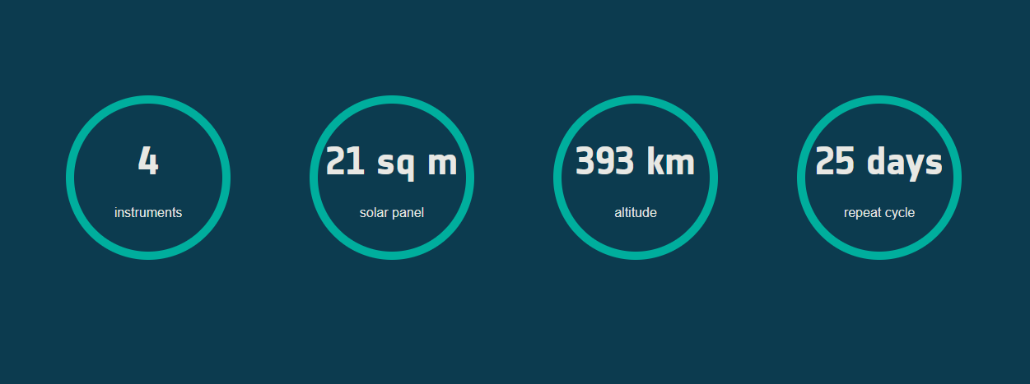
The mission
The Earth Cloud Aerosol and Radiation Explorer (EarthCARE) satellite mission will advance our understanding of the role that clouds and aerosols play in reflecting incident solar radiation back out to space and trapping infrared radiation emitted from Earth’s surface.
The launch
Date: 2023
Site: Kourou, French Guiana
Launcher: Soyuz

Slide 5
The EarthCARE mission aims to improve the representation and understanding of the Earth's radiative balance in climate and numerical weather forecast models by acquiring vertical profiles of clouds and aerosols, as well as the radiances at the top of the atmosphere. Aerosols control cloud properties, while clouds control the production of precipitation and convection influences stratospheric humidity. The observations of EarthCARE will therefore lead to more reliable climate predictions and better weather forecasts through the improved representation of processes involving clouds, aerosol and radiation.
EarthCARE , ESA’s Clouds, Aerosols and Radiation Explorer mission developed in co-operation with JAXA, the Japanese Aerospace Exploration Agency, will address the need for a better understanding of the interactions between cloud, radiative and aerosol processes that play a role in climate regulation. That ESA-JAXA Joint mission was selected as the 6th Earth Explorer Mission and 3rd ESA Earth Observation Core Mission during the Granada ESA meeting in October 2004.

Slide 6
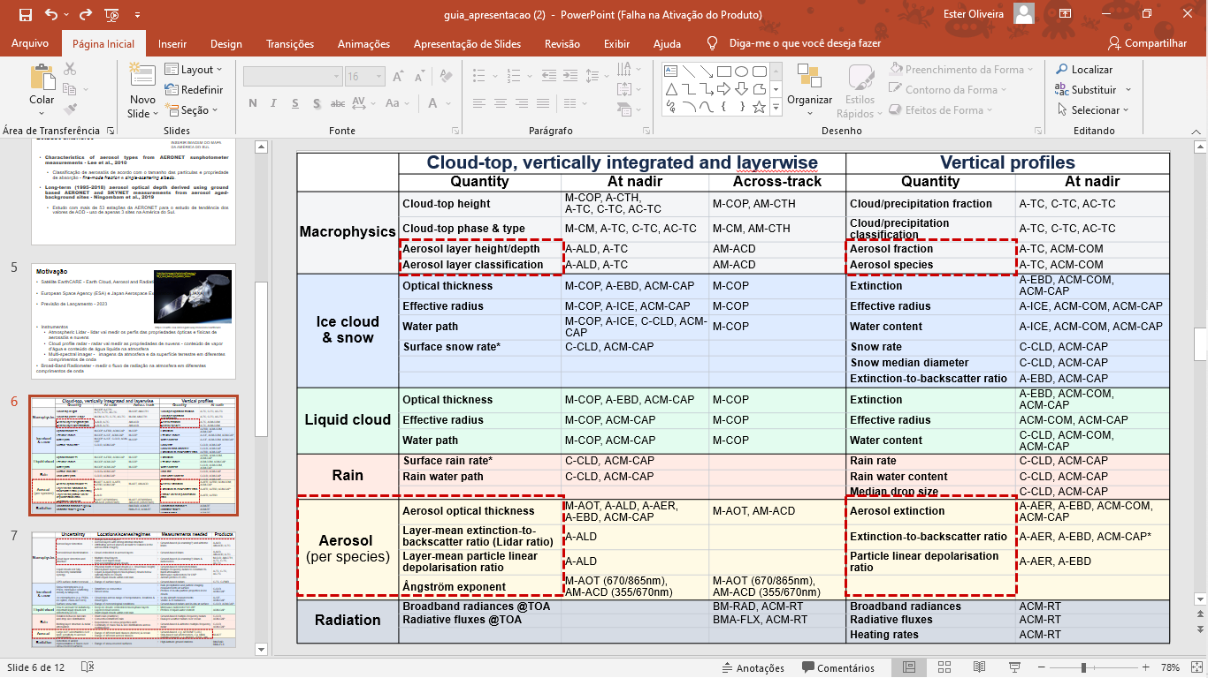

Slide 7
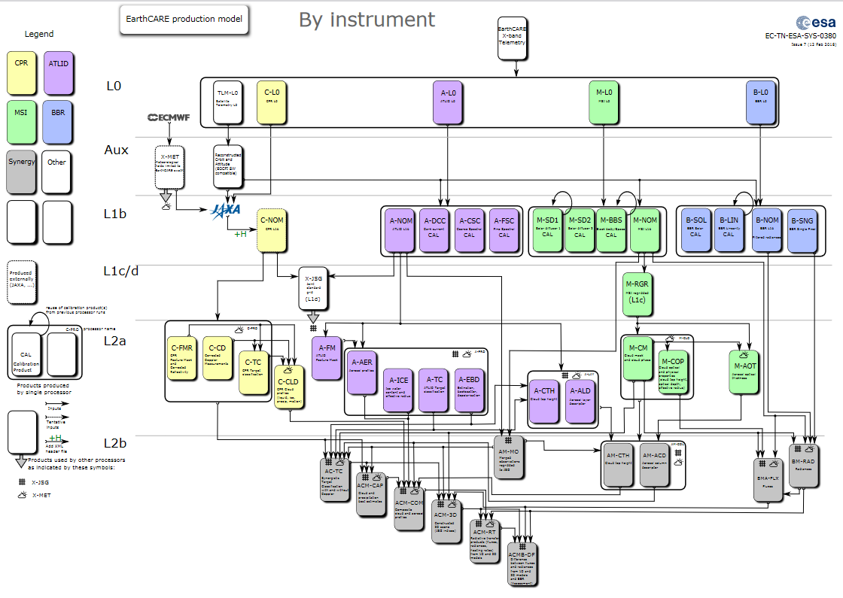
CPR – Cloud Profilier Radar
ATLID – ATmospheric LIDar
MSI – Multi-Spectral Imager
BBR – BroadBand Radiometer
EarthCARE
Project
Ground Segment
EarthCARE
Production Model

Slide 8
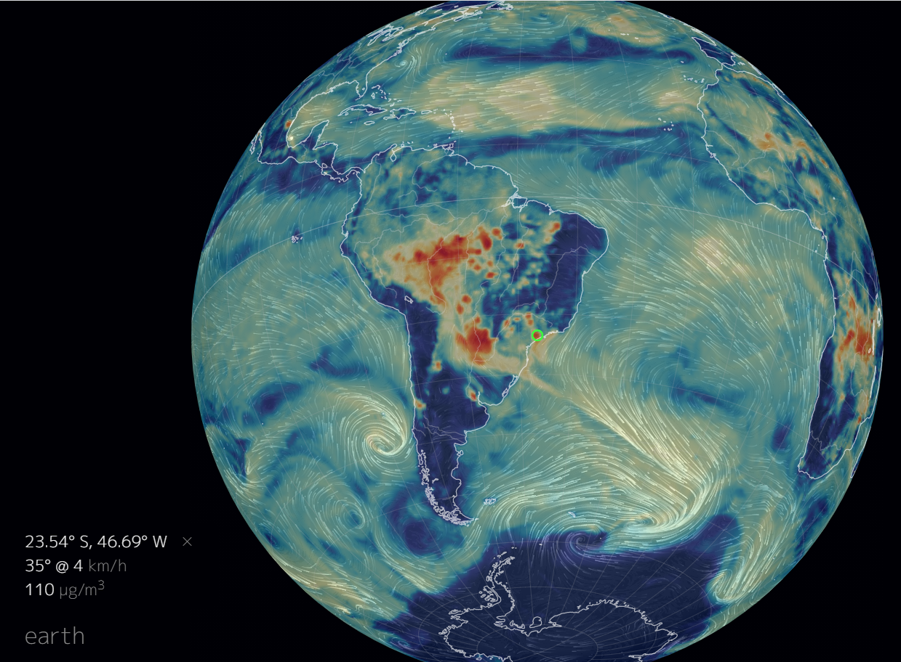
Measurements of 1064 nm, 532 nm and 355 nm from elastic and multi-wavelength lidar systems in order to retrieve backscatter, extinction, lidar ratio profiles, plus backscatter and extinction Ansgtrom Exponent and Color ratio.
3+ hour measurements centered on the closest approach of EarthCARE for each station - for overpasses within horizontal range distances of 120 km for each station .
Statistical validation - for at least 7 stations distributed over South America, i.e., Manaus-Brasil, São Paulo-Brasil, Medellin-Colombia, Buenos Aires-Argentina, Punta Arenas-Chile, Temuco-Chile, La Paz-Bolivia.
How LALINET can
contribute with
EARTHCARE ?

Slide 9
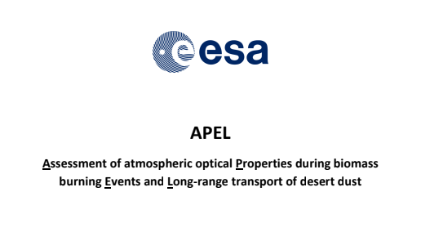
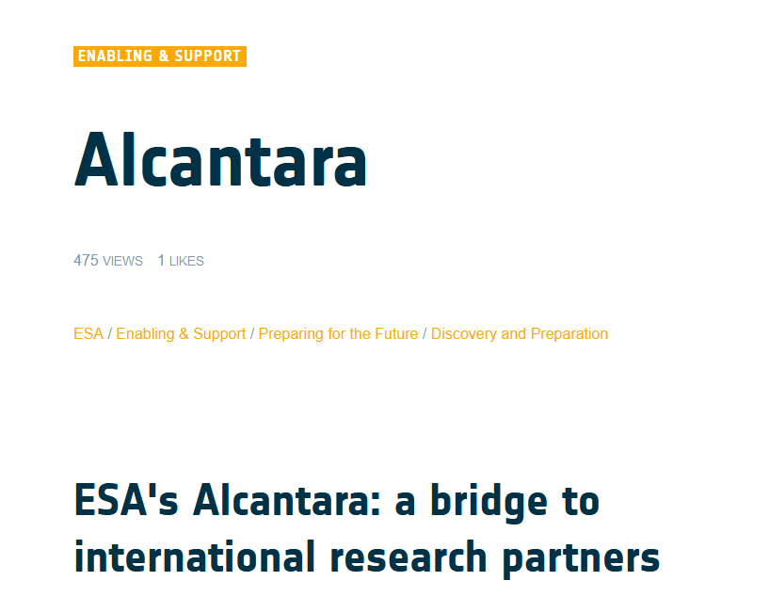
The need for this facilitation has motivated the creation of ESA’s
Alcantara (القنطرة,'bridge' in arabic) initiative: a dedicated instrument
to support research promotion, that recognises the critical role in such
effort of leading academic institutions inside and outside Europe.
The initiative acknowledges the constraints and challenges that these entities
often face in terms of e.g. administrative resources, and builds on previous successful
ESA experiences.

Slide 10
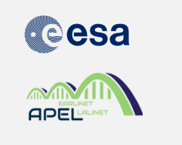
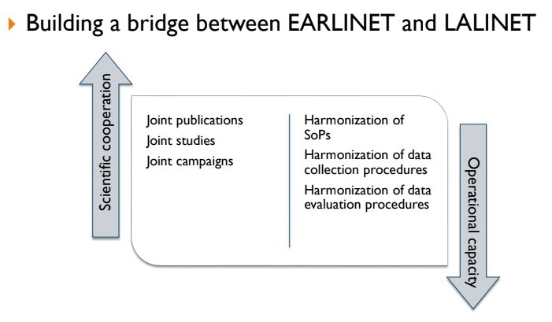
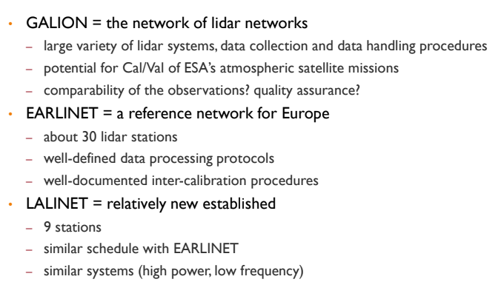
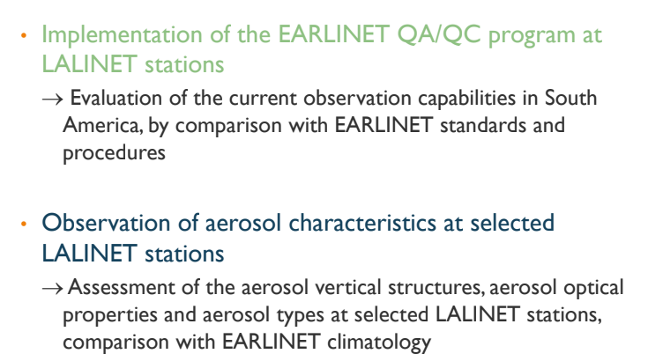

Slide 11
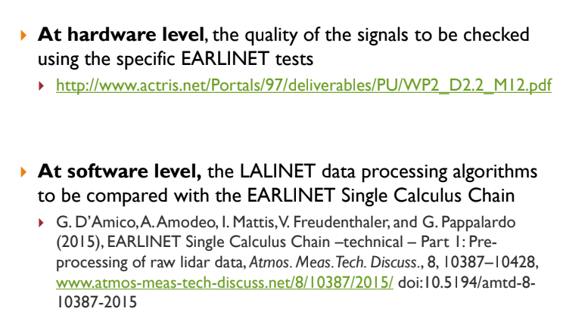
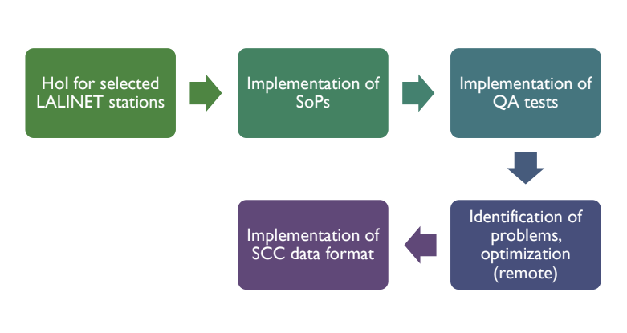

Slide 12
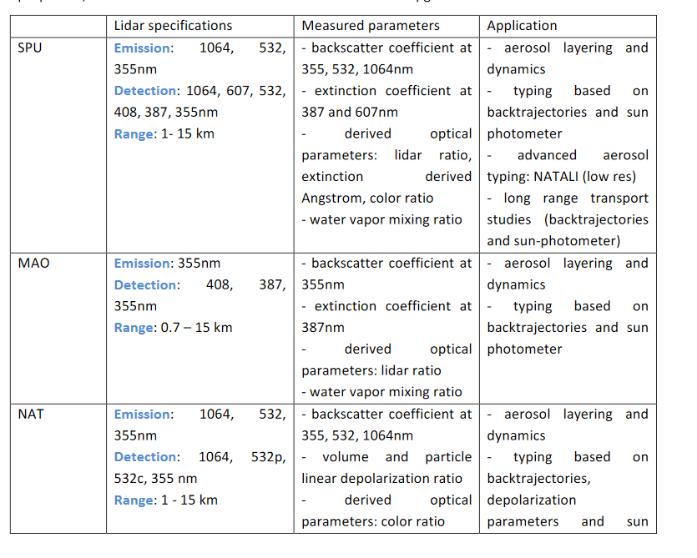
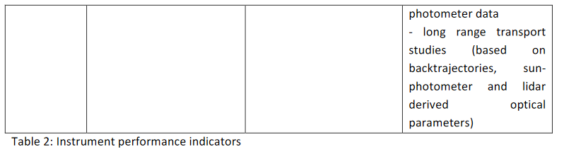
Doina Nicolae, INOE
Juan Luis Rascado, UGR
Livio Belegante, INOE
Volker Freudenthaler, LMU
Eduardo Landulfo, IPEN
Fábio Lopes, IPEN
Lucas Alados Arboledas, UGR
Diego Gouveia, MAO
Henrique Barbosa, MAO
Gregori de Arruda Moreira, IPEN
Anderson Guedes, NAT
Marcos Paulo Araújo, NAT
Judith Hoelzemann, NAT
Anne Grete Straume, ESA
Alexander Geiss, ESA
2016 2017-2018

Slide 13
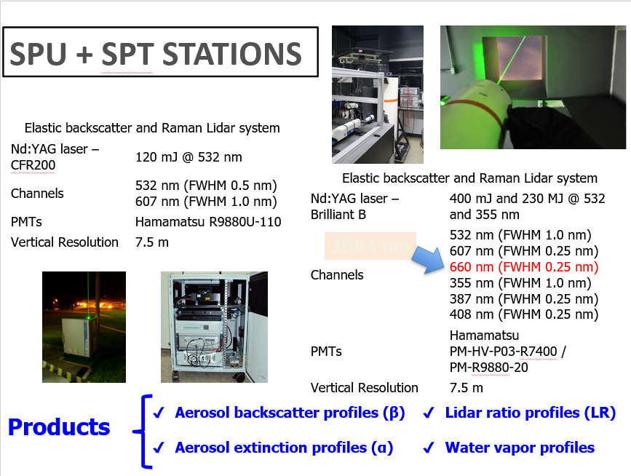
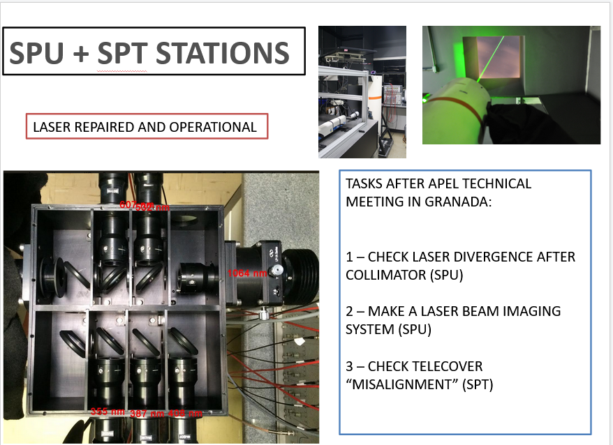

Slide 14
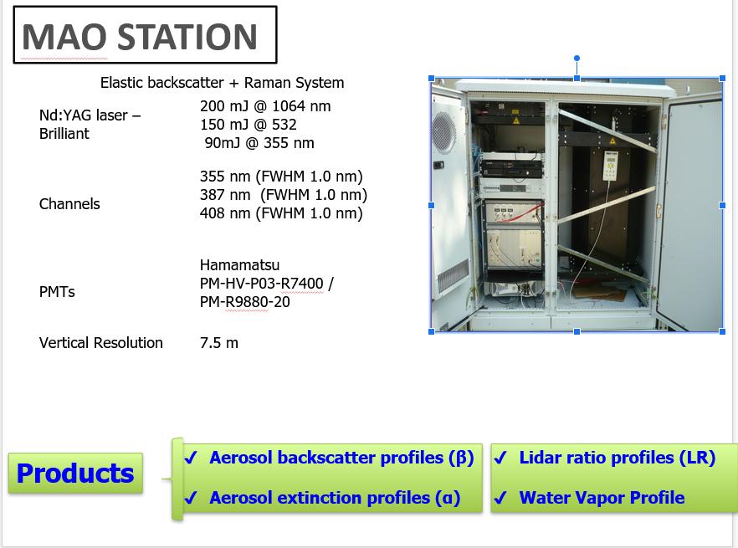
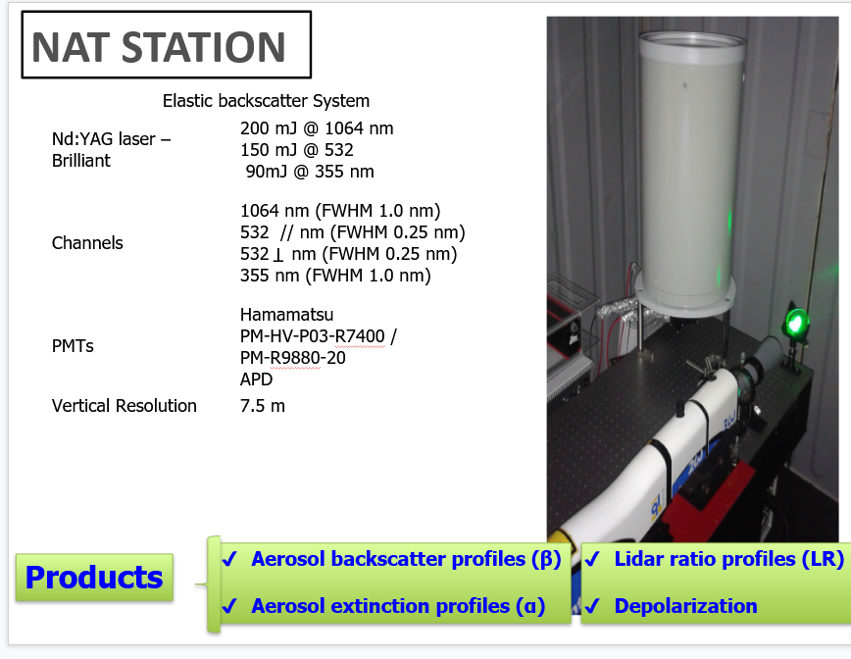

Slide 15
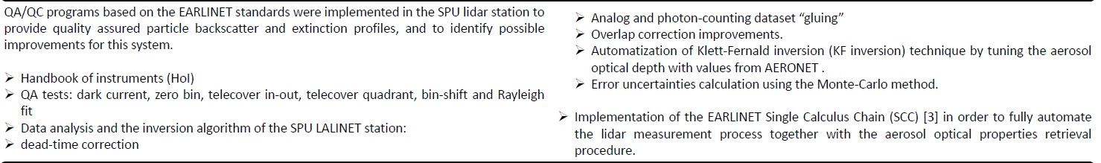
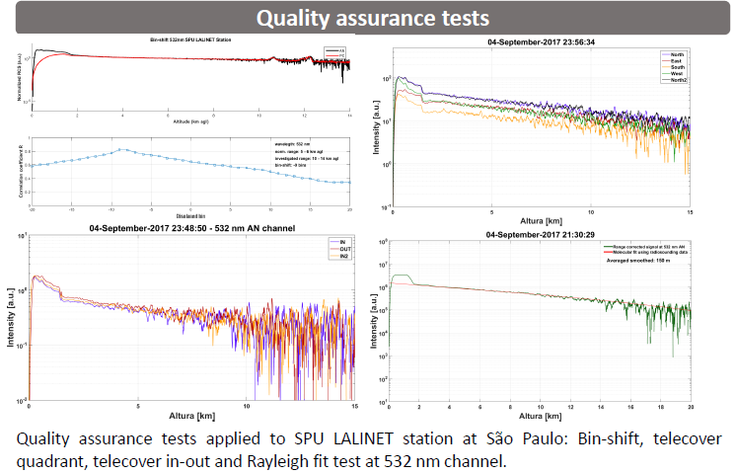
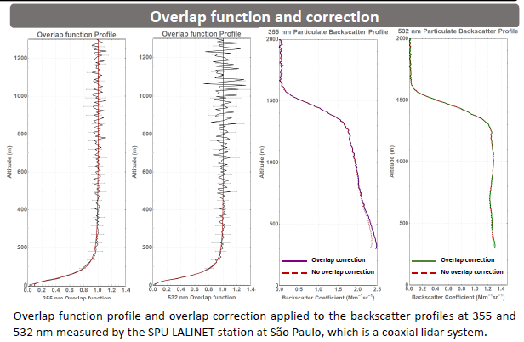

Slide 16
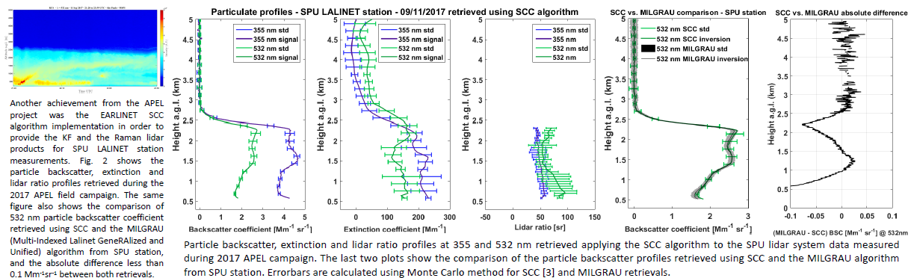
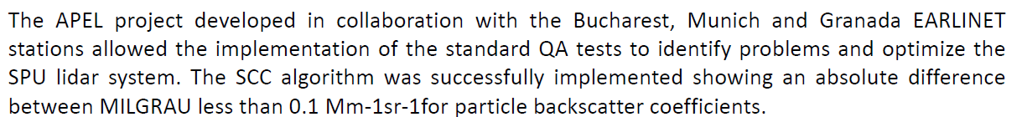

Slide 17
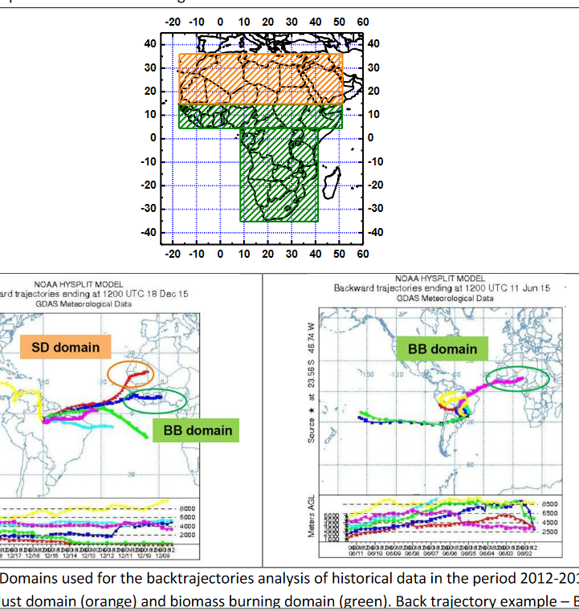
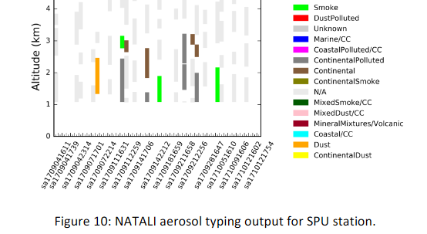
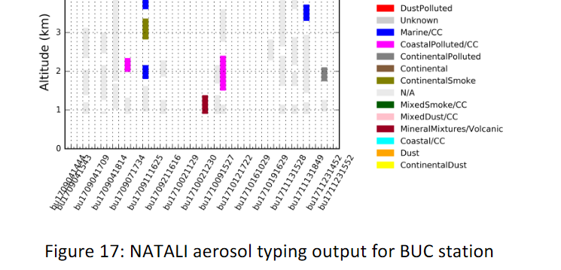

Slide 18
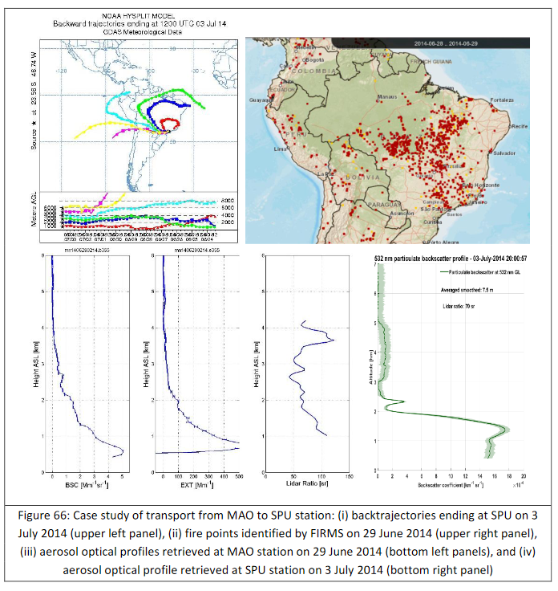
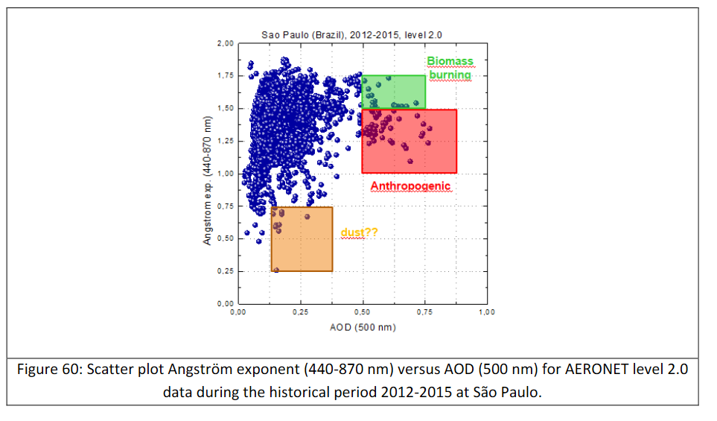

Slide 19
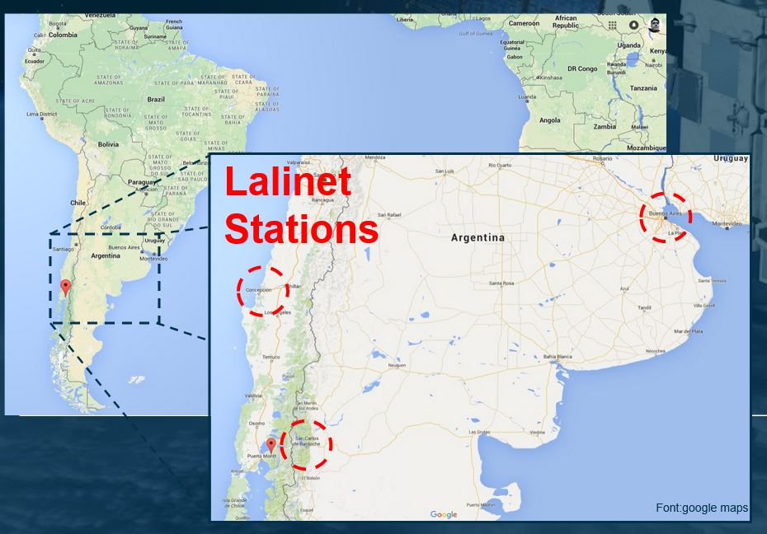
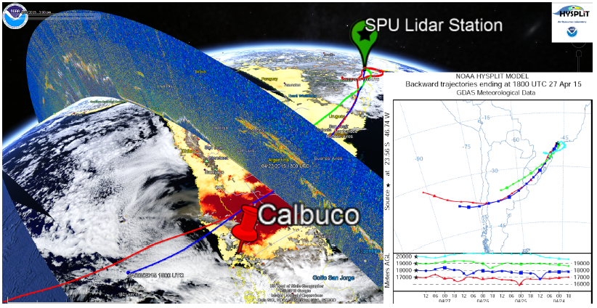
VOLCANIC ASHES & PLUMES
Remote Sens. 2019, 11, 195; doi:10.3390/rs11020195
22nd – 23rd of April, 2015 – Calbuco volcano began eruption
First eruption since 1972
Ash cloud achieved above 15 km of altitude

Slide 20
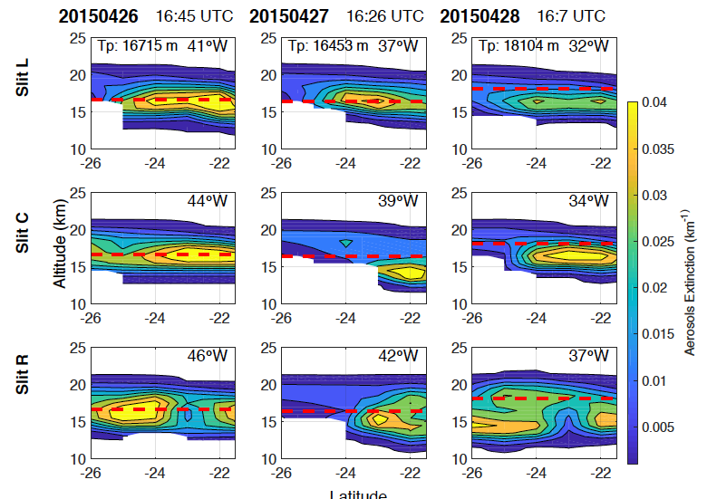
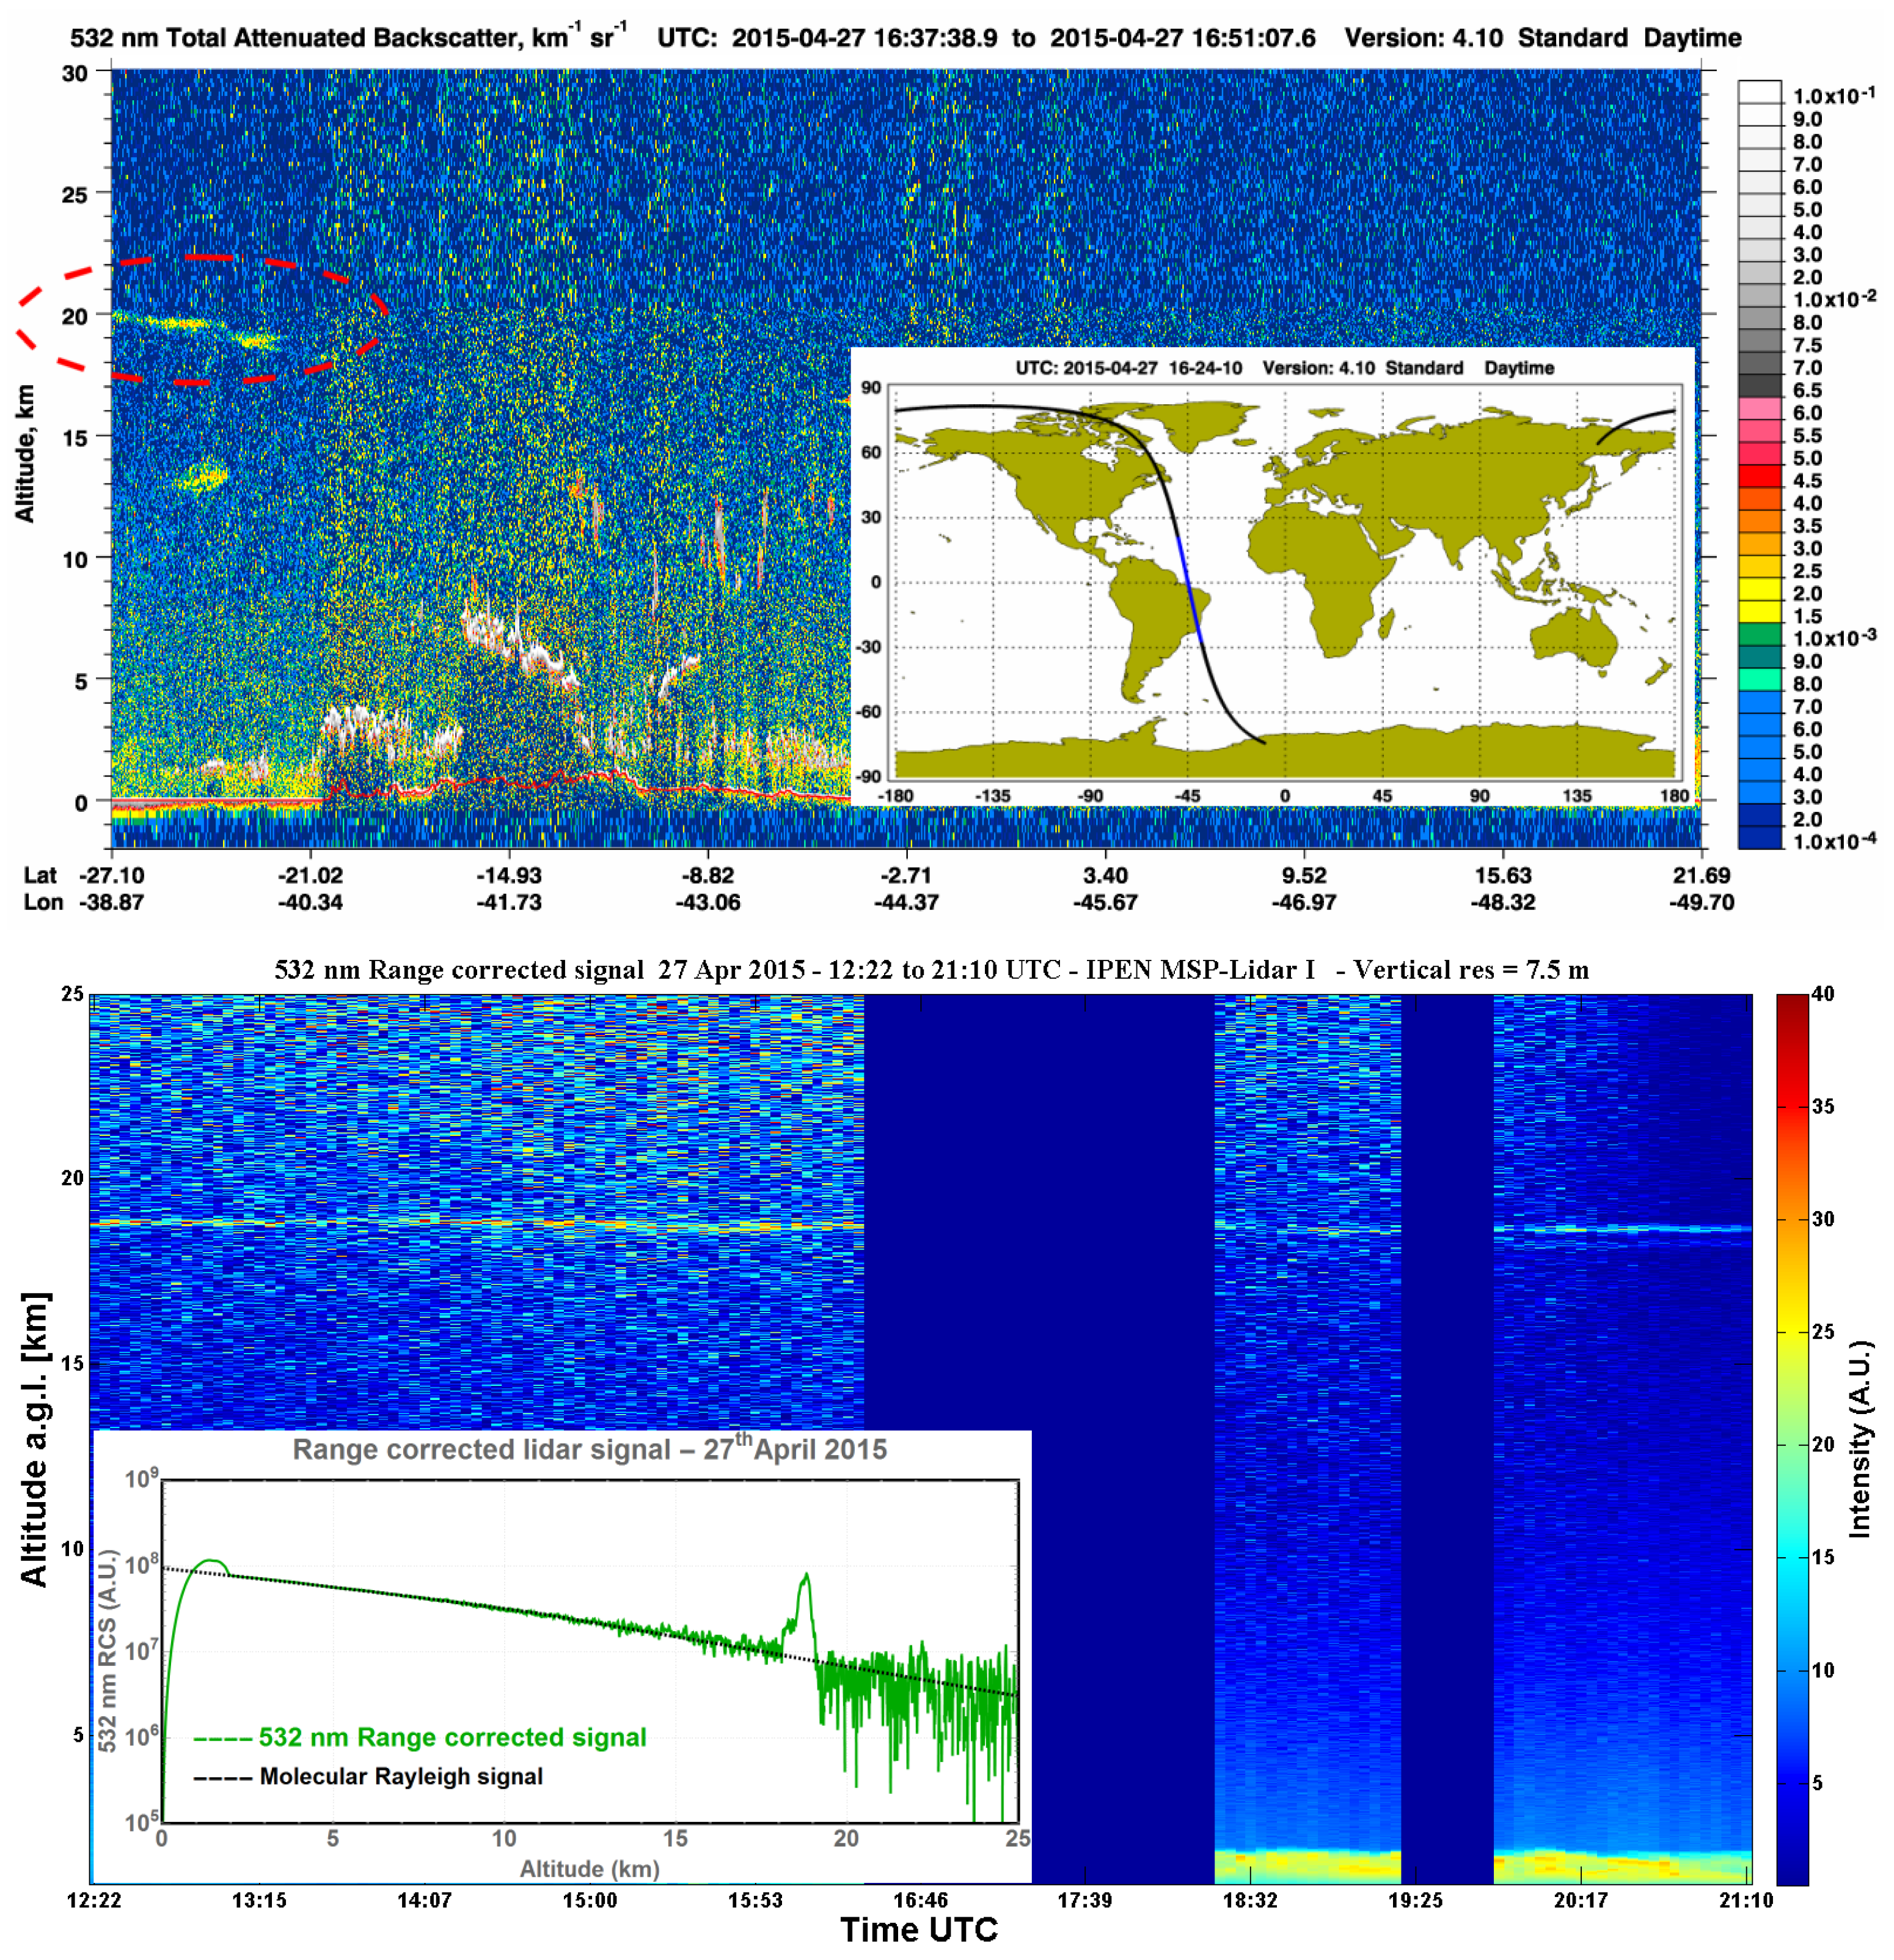
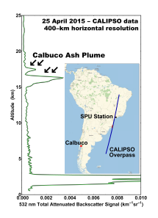
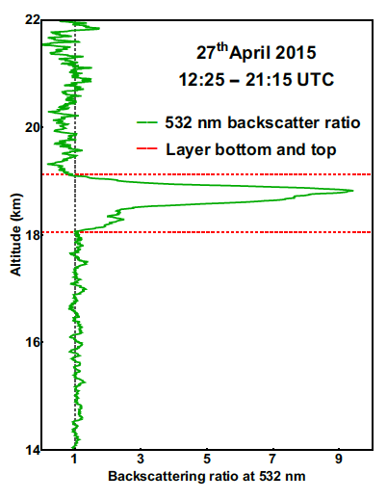
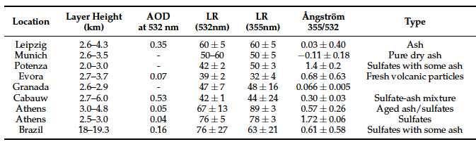

Slide 21
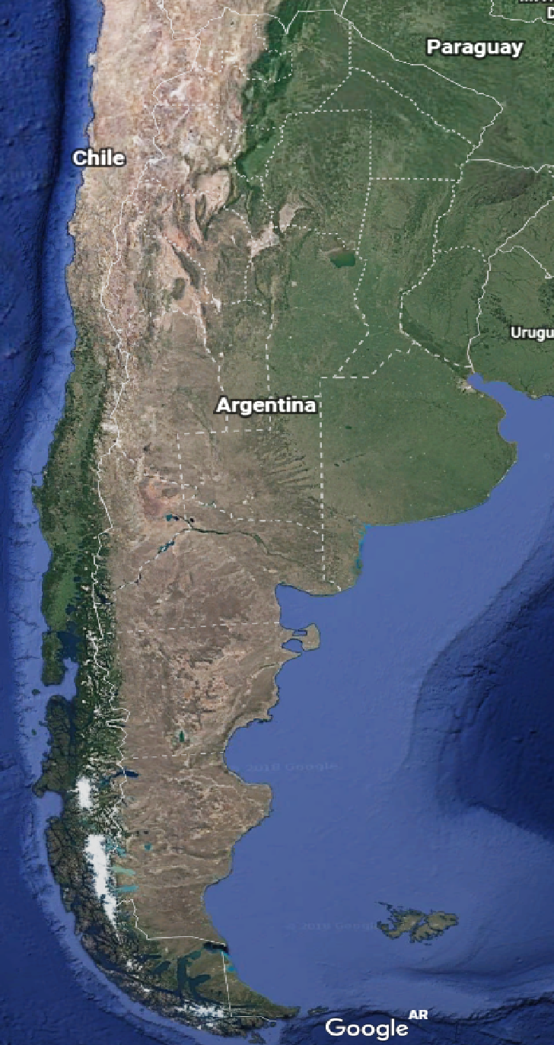
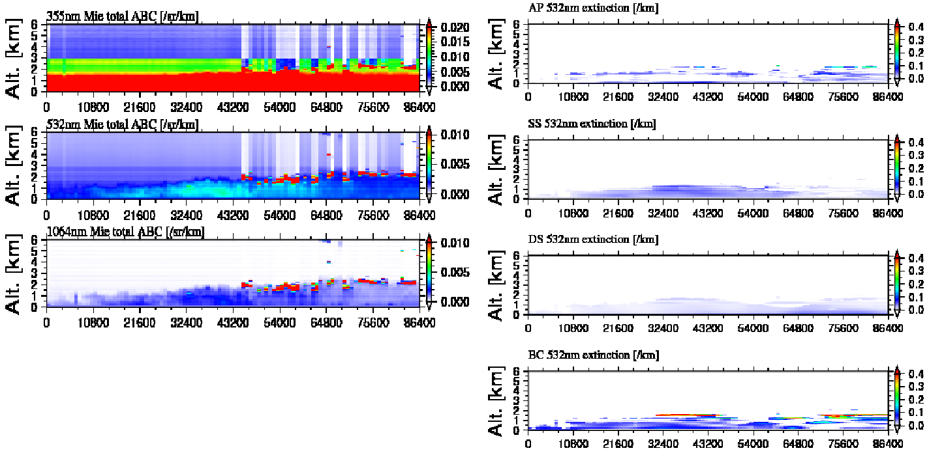
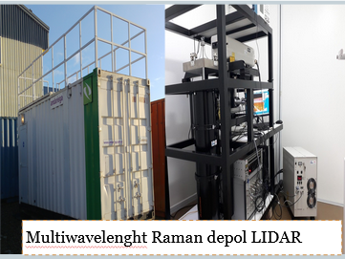
AEROSOL TYPING
PUNTA ARENAS

Slide 22
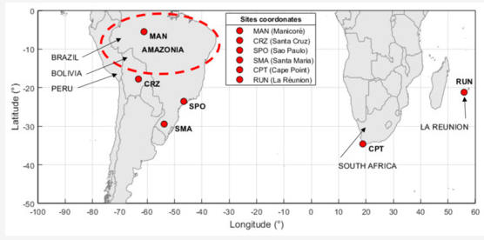
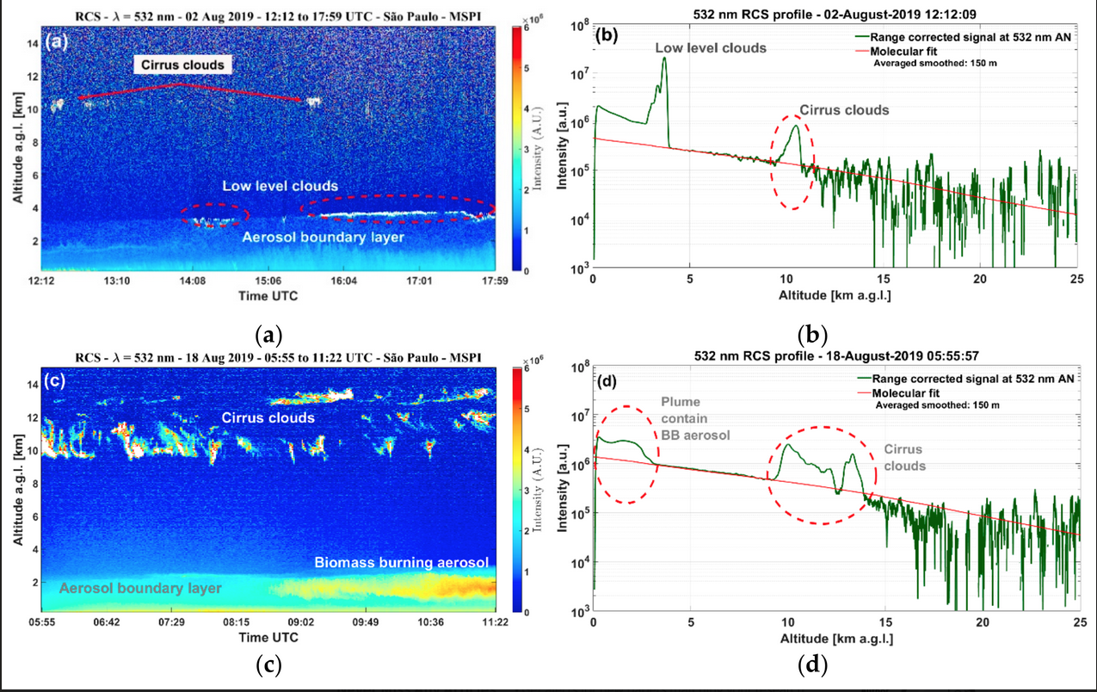
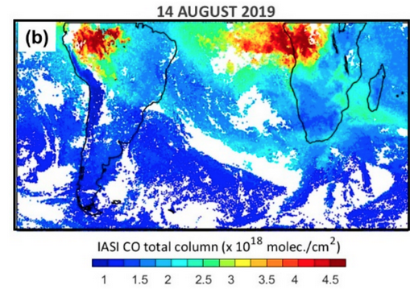
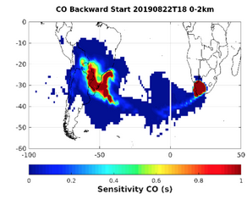
FOREST FIRES & BIOMASS BURNING
Remote Sens. 2020, 12(22), 3846; https://doi.org/10.3390/rs12223846

Slide 23
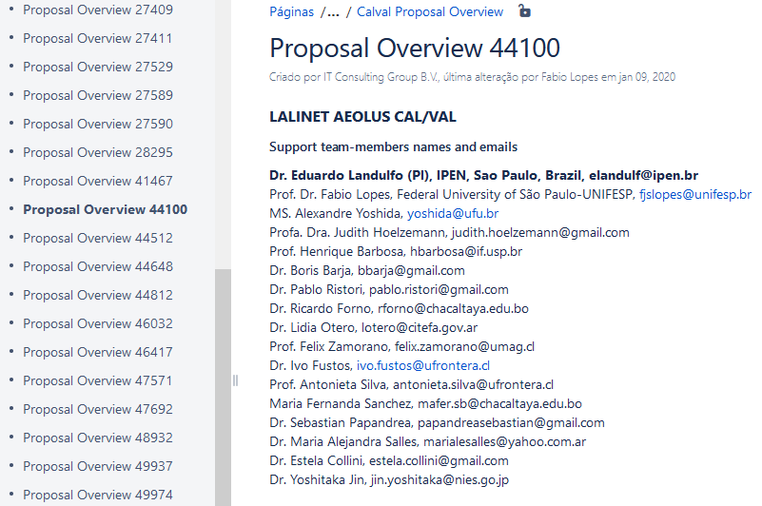
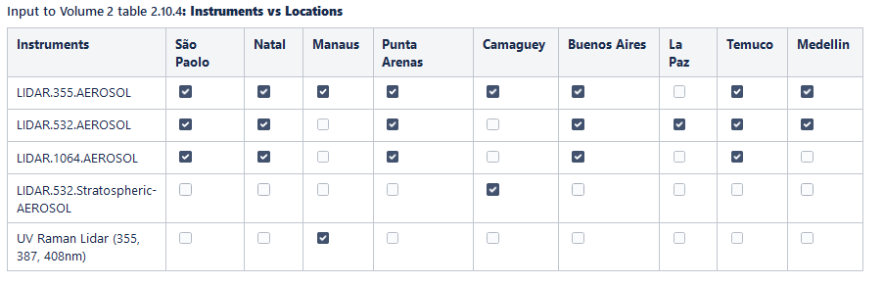
AEOLUS & EARTHCARE VALIDATION PROJECTS

Slide 24
AEOLUS & EARTHCARE VALIDATION PROJECTS
HYSPLIT air masses trajectories on 1000, 2000, 3000, 4000, 5000, and 6000 m a.g.l for 48 hours backtrajectories arriving São Paulo city on September 13, 2020, 21 UTC.
Range corrected signal from SPU Lidar Station on September 13, 2020, showing several aerosol layers around 2000 to 6000 meters a.g.l., detached from the aerosol boundary layer. The red line and red box represent the Aeolus overpass over São Paulo-Brazil.
Example of Aeolus overpass at São Paulo lidar station on September 13, 2020. The green curves represent the backscatter and extinction coefficients, and the extinction-to-backscatter ratio retrieved from Aeolus and the purple curves are the same profiles retrieved by SPU Lidar Station.

Slide 25
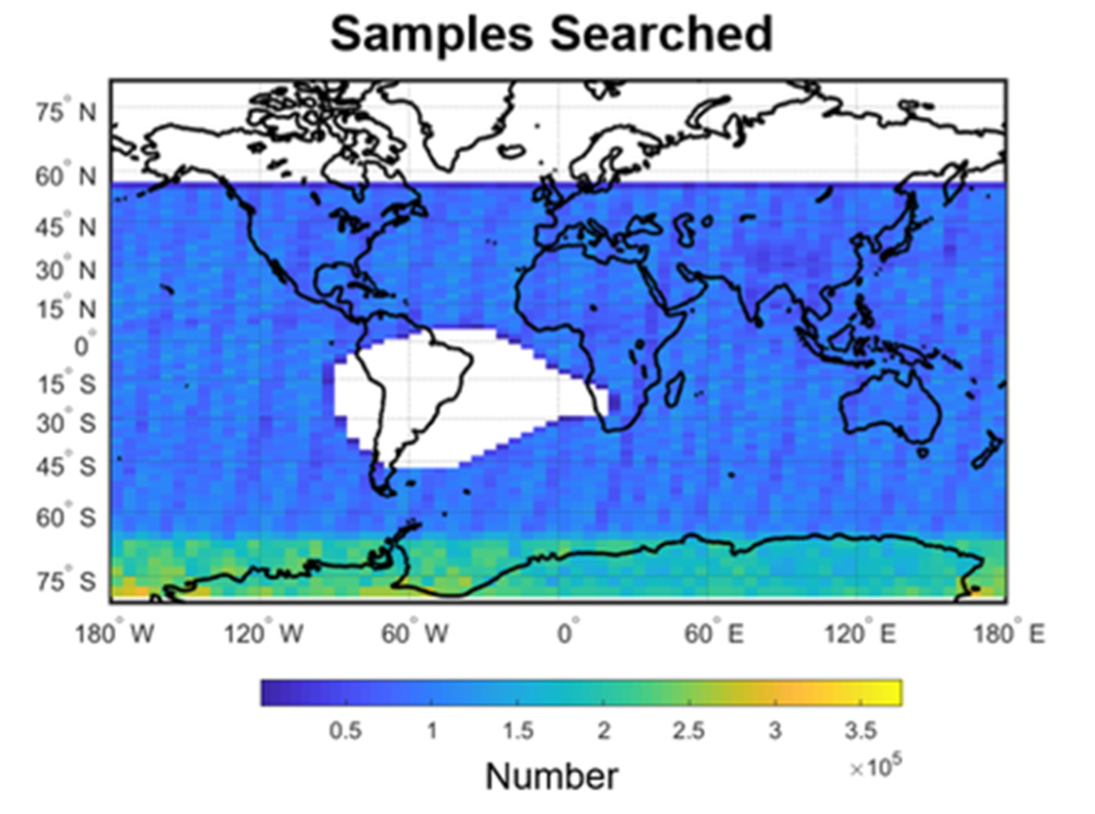

When exposed to cosmic radiation, the photomultipliers can produce current pulses that are as much as two orders of magnitude larger than pulses due to single photoelectrons, resulting in increased noise levels and possible biases in the measured backscatter signals. This figure is a color-coded plot of the photomultiplier RMS dark noise as a function of geographic location for all night orbits over a sixteen day repeat cycle in the fall of 2006.
South Atlantic Anomaly (SAA)
CALIPSO EXPERIENCE
David Winker, William Hunt, Carl Weimer, "The on-orbit performance of the CALIOP LIDAR on CALIPSO," Proc. SPIE 10566, International Conference on Space Optics — ICSO 2008, 105661H (21 November 2017); https://doi.org/10.1117/12.2308248

Slide 26



On June 20, 2018 CALIOP is experiencing an elevated frequency of low energy laser shots within and near the South Atlantic Anomaly (SAA) region which has degraded the science quality of affected profiles since September 2016.
Since September 2016, CALIOP has been experiencing low energy laser shots due to decreased pressure inside the laser canister. These low energy shots primarily occur over the South Atlantic Anomaly (SAA) region and have significant impact on data quality for affected profiles.
2011
2020

Slide 27



2011
2020

Slide 28


Slide 29

ACKNOWLEDGEMENTS
Eduardo Landulfo¹, Albeht Rodríguez Vega², Alexandre Calzavara Yoshida^{1,3}, Alexandre Cacheffo^{1,3} Alvaro Bastidas⁴ Amanda Vieira dos Santos⁵, Antonieta Silva⁶, Antonio Arleques Gomes¹, Boris Barja Gonzalez⁷ , Carlos Andrés Melo-Luna⁹, Carlos D. Hoyos⁹,
Cristina Tobler de Souza Rae¹⁰, Daniel Camilo¹⁰, David Vivas⁹,
Diego Alves Gouveia⁵, Elian Wolfram¹¹, Estela Collini¹², Ester de Jesus¹,
Fábio J. S. Lopes¹, Gregori de Arruda Moreira¹, Henrique de Melo Jorge Barbosa⁵,
Hernan Ciminari¹², John H. Reina⁹, Jonatan João da Silva¹,
Jonnathan Céspedes⁹, Juan Carlos Antuña Marrero², Juan Luis Guerrero Rascado¹⁴ ,
Juan Pallotta¹¹, Judith Hoelzemann¹⁰, Lucas Alados Arboledas¹⁴,
M.Alejandra Salles¹², Marcos Paulo Araújo da Silva¹⁰,
Renata Sammara^{1,10}, Ricardo N. Forno¹³, Sebastian Papandrea¹²

Slide 30

ACKNOWLEDGEMENTS

