Slide 1


Solar and thermal radiative flux estimation for the EarthCARE BBR instrument
BMA-FLX
Carlos Domenech¹, Almudena Velazquez-Blazquez², Nicolas Clerbaux², Edward Baudrez², Nils Madenach³, Jürgen Fischer³
¹GMV Aerospace & Defence
²Royal Meteorological Institute of Belgium (RMI)
³Free University of Berlin (FUB)
cdomenech@gmv.com

Slide 2
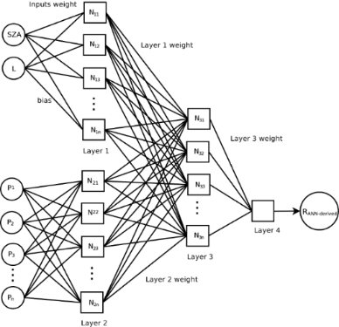
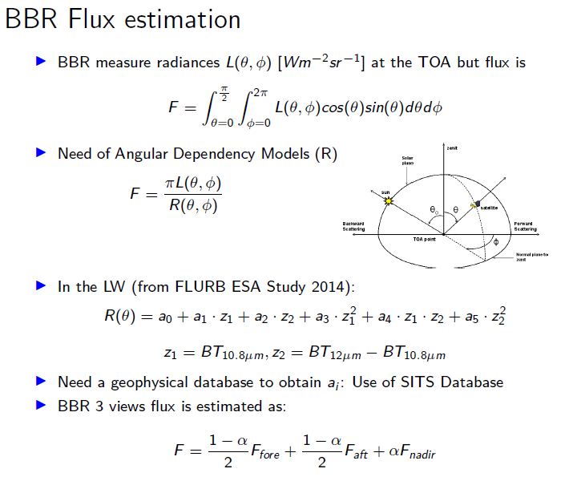



Summary
In the SW
Need a geophysical database for network training: CERES flux/radiance (SSF Ed. 4), ERA-20C, MODIS albedo climatology and AERONET climatology
BBR 3 views flux is estimated as
ADMs are feed-forward back-propagation artificial neural networks. Inputs selected with variable importance tests

Slide 3
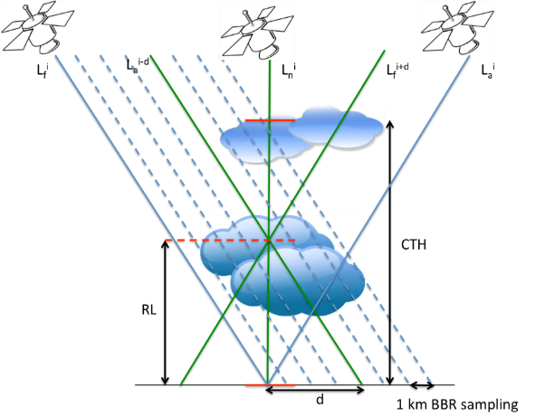
Reference Level for SW and LW regimes
Co-registration of LW radiances
The reference defined by CTH derived from brightness temperature, e.g. M-COP, is a good estimator to co-register the BBR radiances in the thermal regime
RL is defined as the 90th percentile of the altitude of the highest cloud in the BBR domain
Co-registration of SW radiances
SW radiances cannot be co-registered using BT-derived CTH. In average co-registration errors are higher than using the default surface co-registration
Views are co-registered at a RL defined as the vertical level in the atmospheric nadir domain that minimizes the flux differences between the nadir, aft and fore flux retrievals
All oblique radiances crossing the atmosphere between the surface and the MSI CTH (averaged for the BBR resolution) defined by the nadir observation are selected for flux processing. Then RL is obtained minimizing the set of computed fluxes

Slide 4
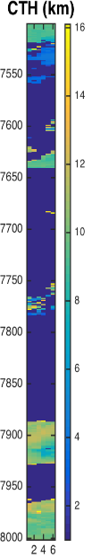
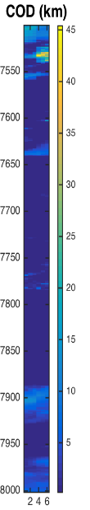
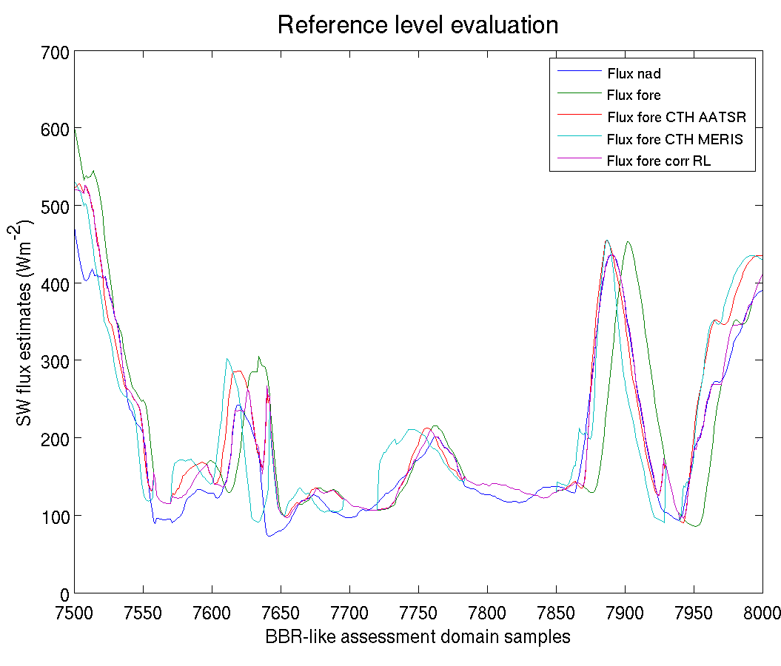
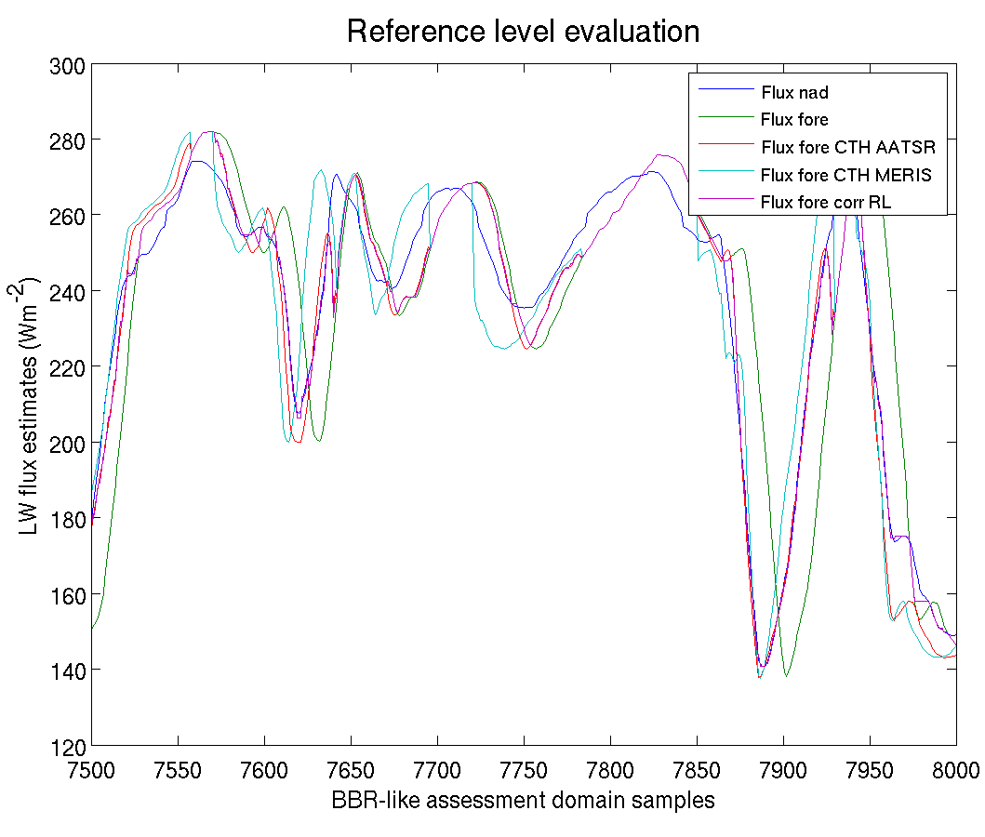
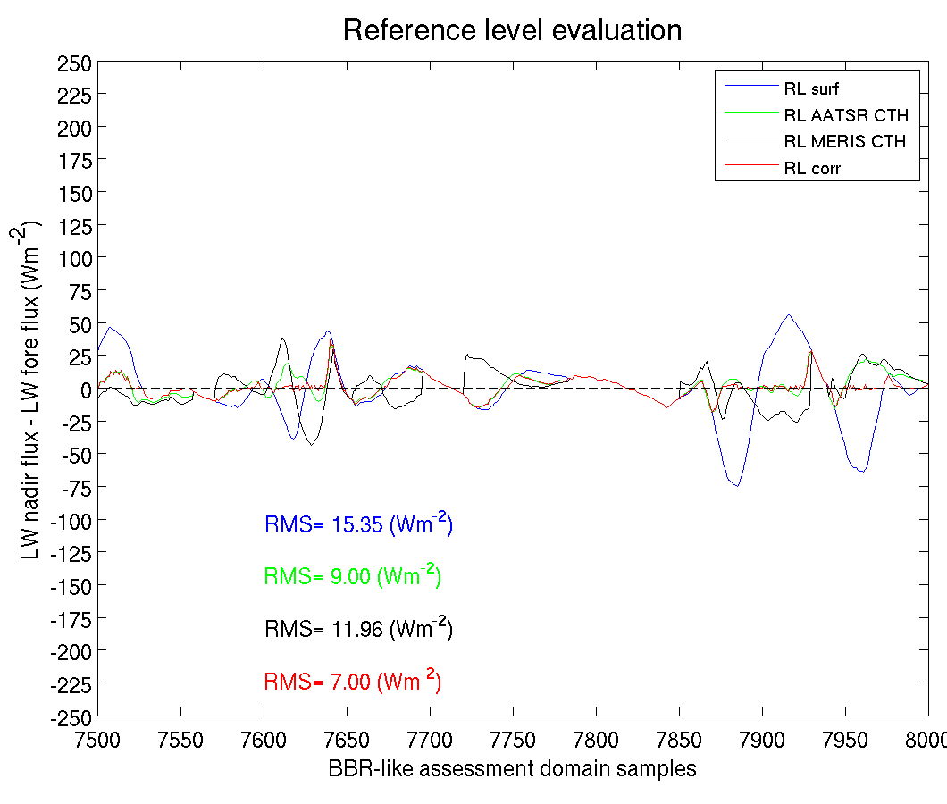
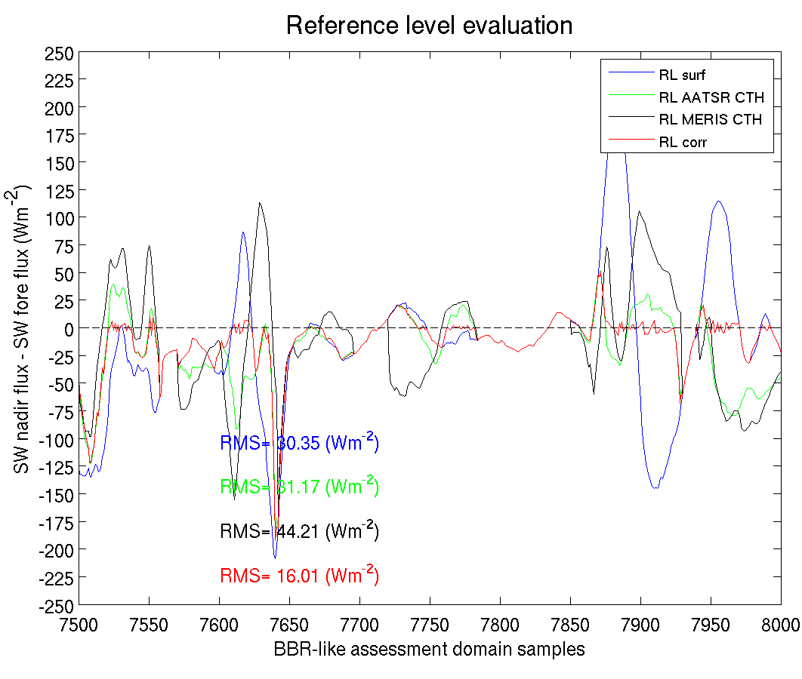
Reference Level: case study
CTH improves the collocation for LW radiances
In SW, a Ref. lev. is necessary since imager-derived CTH overestimate radiatively effective cloud tops

Slide 5
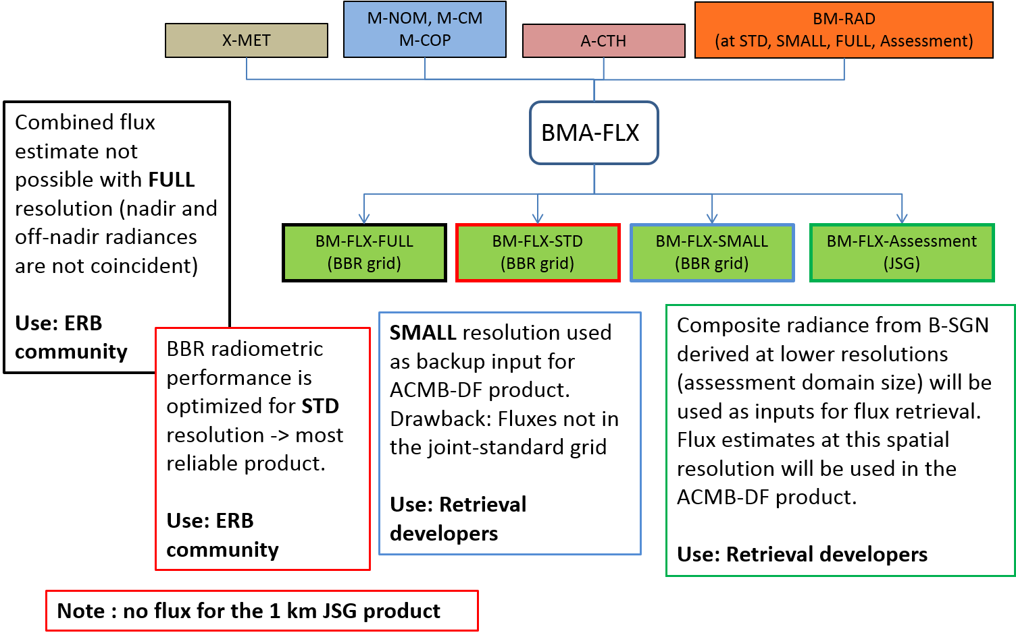
M-RGR, M-CM, M-COP

Slide 6
BMA-FLX inputs: detailed description
L1 EarthCARE products
M-RGR
MSI radiances and brightness temperatures
L2 EarthCARE products
BM-RAD
SW unfiltered radiances (MSI-based and BBR stand-alone)
Illumination and viewing geometry
Pixel elevation
M-CM
Cloud mask
M-COP
Cloud top height
A-CTH
Cloud top height
Ancillary data
Common databases
MODIS VIS and NIR BRF climatology
IGBP
AeroCom (aerosol climatology)
EarthCARE X-MET (results from ECMWF IFS model)
LAI low vegetation
LAI high vegetation
10m wind-speed
Surface roughness
Total column ozone
Total column water vapour
Tropopause height
Notes:
Whenever ATLID and MSI CTHs over cold surfaces are not consistent, ATLID prevails and the cloud cover and CTH used in the processing (parallax detection and reference level determination) are changed accordingly.
If MSI does not detect the cloud according to ATLID retrievals (A-CTH > 0 and M-CTH = 0)
MSI misidentifies clouds due to inversions in the atmospheric temperature profile. A cloudy scene with thin clouds is misclassified as clear-sky.
Verification failed. Cloud top and cloud cover are set to undefined.
The scene cannot be defined for the ADM. Thus, the BBR sample is not processed.
If MSI detects a non-existent cloud according to ATLID retrievals (A-CTH = 0 and M-CTH > 0)
MSI misidentifies snow/ice scene due to similar reflectivity
Verification failed. CTH and cloud cover are set to 0.
Processing of BBR sample continues as clear-sky case.

Slide 7
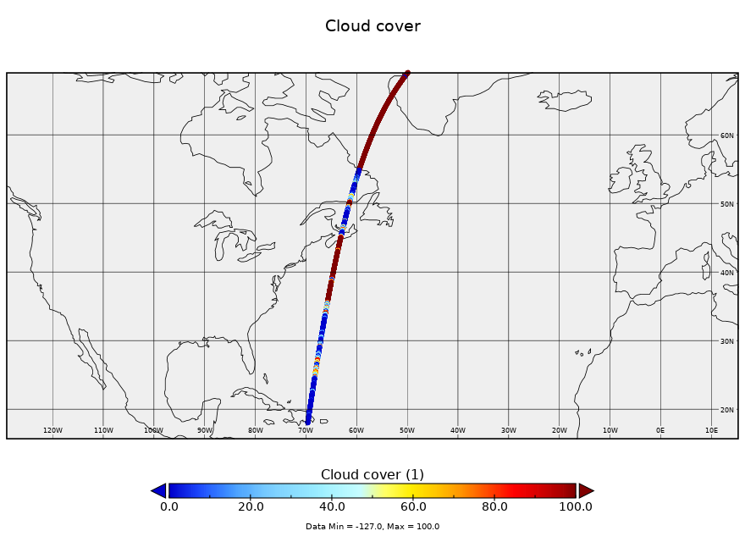
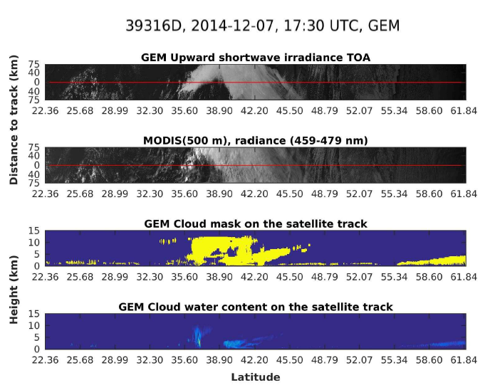
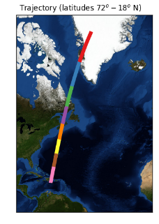
BMA-FLX results for Halifax test scene
Regions with snow and ice surfaces
ICERAD FM BMA-FLX
10/03/2021
Page 7

Slide 8
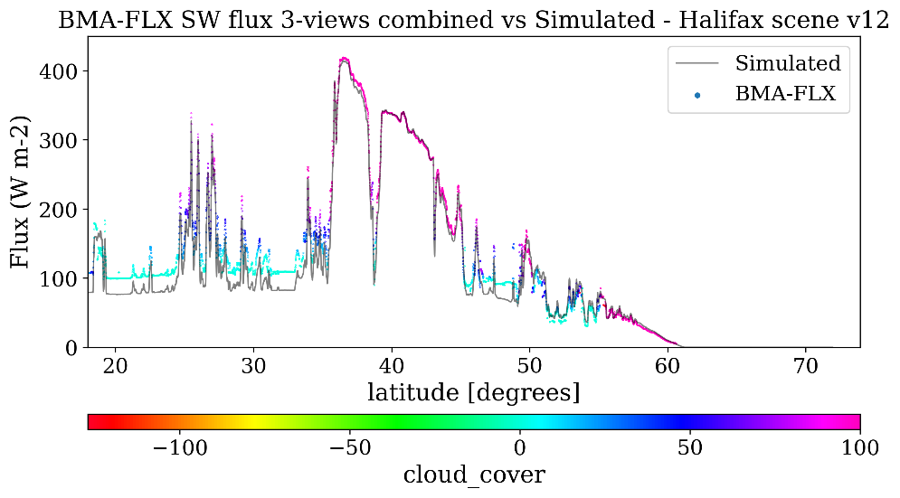
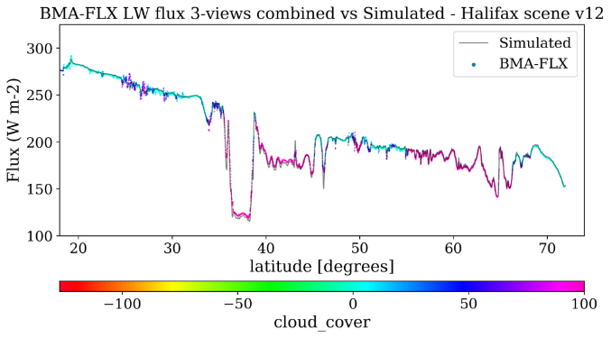
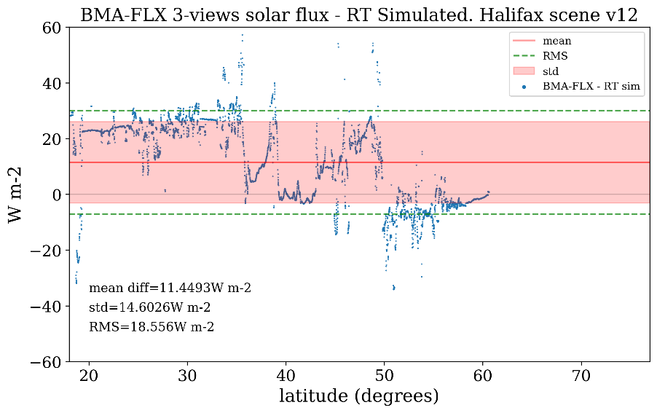
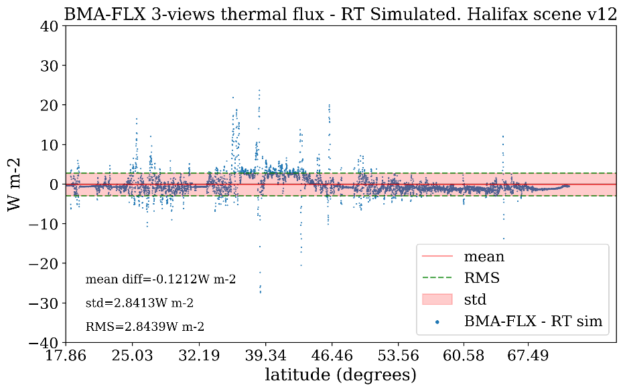
BMA-FLX results for Halifax test scene
Work in progress
ICERAD FM BMA-FLX
10/03/2021
Page 8

