Slide 1



ICERAD & CLARA
Executive summary
Carlos Domenech¹, Almudena Velazquez-Blazquez², Nicolas Clerbaux², Edward Baudrez², Nils Madenach³, Jürgen Fischer³, Howard Barker⁴, Jason Cole⁴, Zhipeng Qu⁴, Mark Shephard⁴
¹GMV Aerospace & Defence
²Royal Meteorological Institute of Belgium (RMI)
³Free University of Berlin (FUB)
⁴ Environment and Climate Change Canada (ECCC)
cdomenech@gmv.com

Slide 2
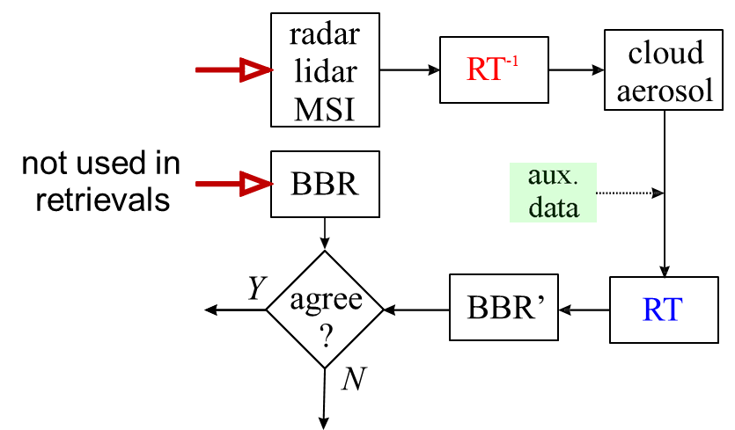
ICERAD & CLARA objective
EarthCARE primary scientific goal
Retrieve cloud/aerosol properties such that TOA radiative fluxes can be modelled to within ~10 W m-2 for ~100 km2 regions
CLARA and ICERAD contributes to mission verification
Continuous radiative closure assessment by retrieving and comparing model and BBR-based fluxes
purpose: feedback to algorithm developers and guidance to users
compare simulated fluxes and radiances to BBR data
pre-launch end-to-end simulations
in-orbit continuous assessment

Slide 3
ICERAD & CLARA in the production model
L1b
L1c/d
L2a
L2b

Slide 4
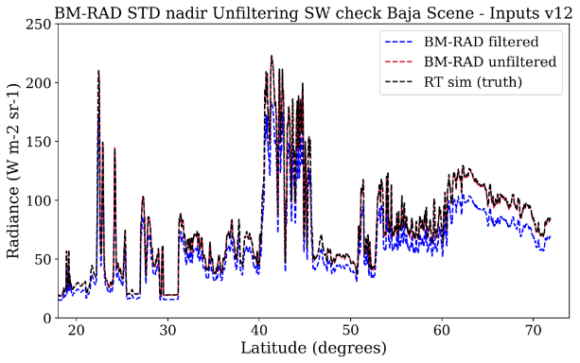
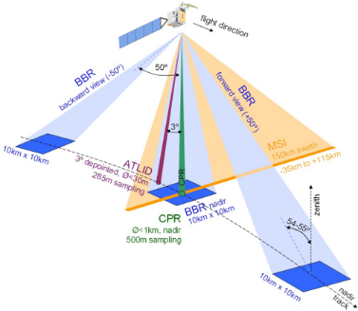
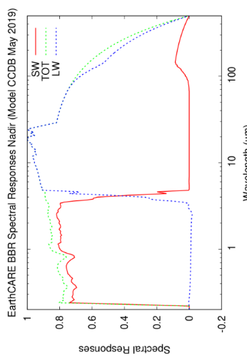
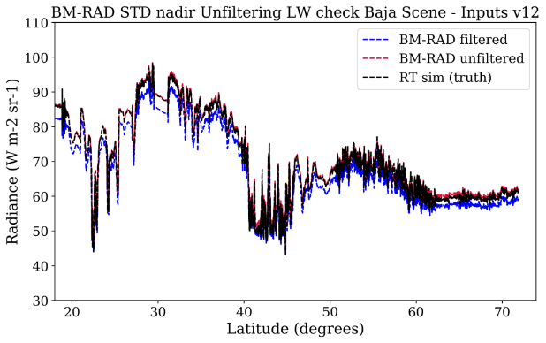
Radiance unfiltering
BM-RAD
The BBR will measure SW (0.2 - 4µm) and TW (0.2 - >50µm) radiances at three fixed viewing zenith angles
To reduce the effect of a limited and non-uniform spectral response the processor converts the SW and TW measurements of the BBR into solar and thermal unfiltered radiances
Two unfiltering algorithms:
  Stand-alone : BBR L1 and land use classification (SW & LW)
  SW MSI-based: SW BBR L1 and MSI cloud mask and cloud phase
The unfiltering is based on a large RT-based database of fine spectral resolution SW and TW radiances convolved with the spectral responses of the BBR channels
Unfiltering is crucial in the BBR processing
→ Errors in the unfiltering propagate to fluxes (BMA-FLX)
Unfiltering + contamination errors
  < 1% in the SW
  < 0.5% in the LW

Slide 5
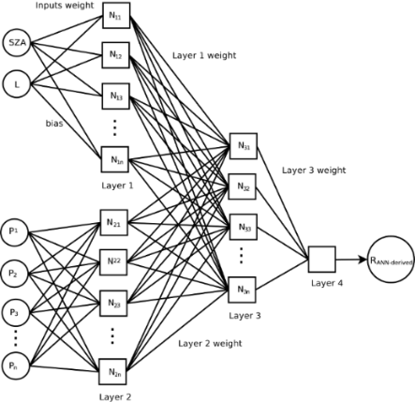
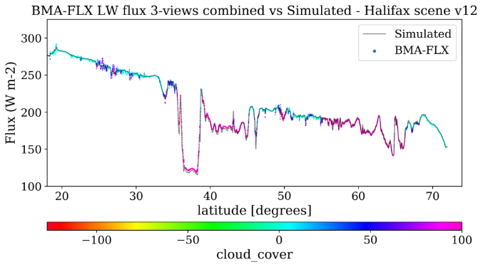
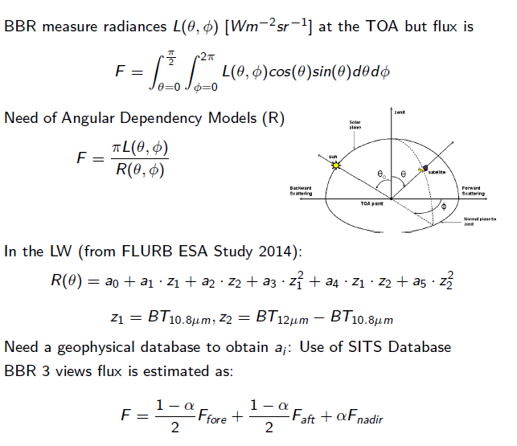
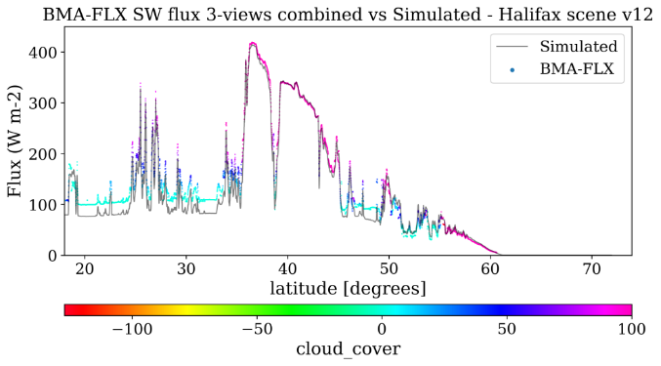

Flux retrieval
BMA-FLX
In the SW
Need a geophysical database for network training: CERES flux/radiance (SSF Ed. 4), ECMWF reanalysis, albedo and aerosol climatology
BBR 3 views flux is estimated as
ADMs are feed-forward back-propagation artificial neural networks. Inputs selected with variable importance tests

Slide 6
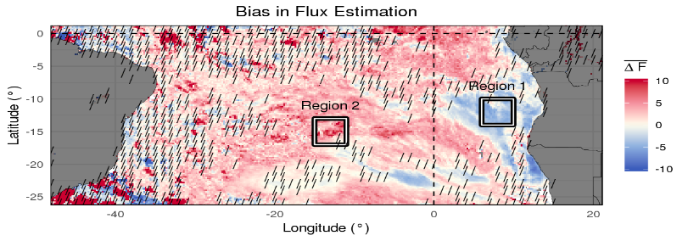
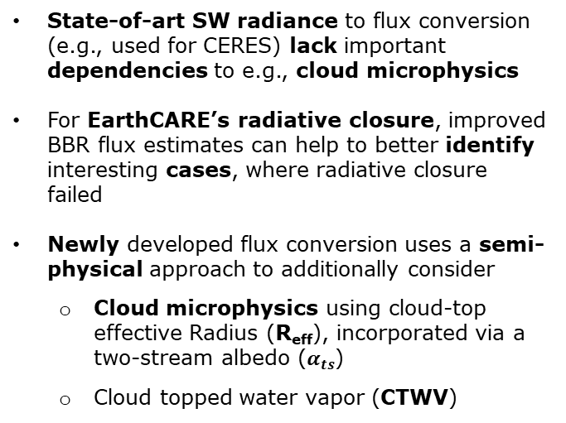
Beyond flux retrieval state-of-the-art
Semi-physical log-linear radiance to flux conversion
State-of-art SW radiance to flux conversion (e.g., used for CERES) lack important dependencies to e.g., cloud microphysics
For EarthCARE’s radiative closure, improved BBR flux estimates can help to better identify interesting cases, where radiative closure failed
Newly developed flux conversion uses a semi-physical approach to additionally consider
  Cloud microphysics using cloud-top effective Radius (R_{eff}), incorporated via a two-stream albedo ($α_{ts}$)
  Cloud topped water vapor (CTWV)
Results:
Additional sensitivity to cloud microphysics and CTWV
Reduced radiance residuals
Deviations of up to ±25 W/m² for instantaneous SW fluxes and ± 10 and ±5 W/m² for daily and monthly means, respectively
Largest deviations due to extremes in R_{eff} and CTWV
Daily fluxes of new approach minus operational radiance to flux conversion on July 11th 2007 for GERB-SEVIRI observations (Tornow et al. 2021)
Executive Summary
11/03/2021

Slide 7
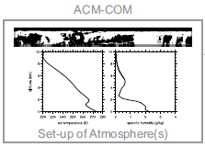
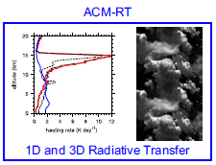
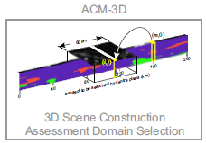
Radiative Transfer simulations
ACM-RT
Create L2a composite atmosphere, in addition to ACM-CAP
Prepare both atmosphere/surface profiles for ACM-RT
Perform 1D and 3D RT calculations (HR profiles)
TOA radiances and fluxes to be used in ACMB-DF
Construct 3D scenes (~5 x 21 km) for ACM-RT
Screen & rank assessment domains

Slide 8
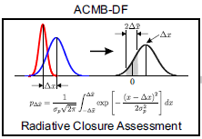
Closing the loop: Radiative closure
BMA-FLX
Assessment domain size (MxN)
Reference level height for LW and SW regimes
Fluxes at the assessment domain
Collocated radiances at the assessment domain
ACMB-DF
Receives:
    Simulated 1D fluxes at JSG pixel from ACM-RT to be averaged to the assessment domain
    Simulated 3D collocated radiances at assessment domain from ACM-RT
    Retrieved fluxes at assessment domain from BMA-FLX
    Collocated BBR radiances at assessment domain from BMA-FLX
Provides:
  Compare model radiances to BBR observations
  Compare model fluxes to BMA-FLX
  Mission goal: Dx < 10 W m-2
ACM-RT
1D/3D simulated fluxes at assessment domain
Simulated collocated radiances at the assessment domain
ACMB-DF
(L* vs L)
(F* vs F)

Slide 9
Summary
EarthCARE’s primary scientific goal: retrieve cloud and aerosol properties such that TOA radiative fluxes can be modelled to within ~10 Wm-2 for ~100 km regions;
Goal verification: TOA radiative closure assessment
  apply 1D and 3D RT models to ‘expanded’ domains of retrieved cloud and aerosol properties
  compare modelled radiances and fluxes to BBR radiances and inferred fluxes (not used for retrievals);
First ‘operational’ application of 3D radiative transfer models in the atmospheric sciences;
EarthCARE-specific ADM models for inference of TOA solar and thermal radiative fluxes;
All processors compatible with PDGS requirements (interfaces, naming, etc.);
Successful chaining of CLARA/ICERAD processors

