Slide 1
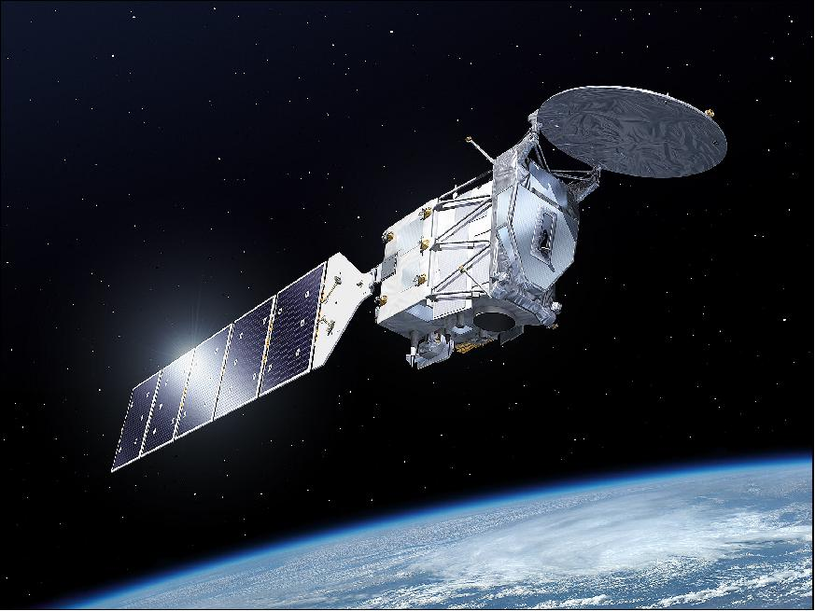



ATLID Featuremask
Gerd-Jan van Zadelhoff
zadelhof@knmi.nl
Notes:
1

Slide 2


Processor | A-FM (ALTID Feature Mask)
Input Products | A-NOM
Output Products | ATLID Featuremask Retrieved Lidar Surface pixels, surface backscatter and detection of temporal gaps in observations Feature Free mean Co/Cross Mie & Rayleigh signals
Royal Netherlands
Meteorological Institute
Ministry of Infrastructure
and Environment.
Brief Description
Goals:
  Retrieve a mask which detects regions of “significant returns” or “features”. No difference between aerosols and clouds is made within the algorithm!
  Retrieve information on high resolution, preferably a single shot mask, to enable binning strategies to increase SNR of signal (output is on the A-NOM spatial grid)
Calculation Steps (Based on Image Reconstruction Techniques):
  Determine the lidar surface altitude
  Calculate signal probability based on the measured signals and noise
  Perform a Median Hybrid calculation to find the strong coherent structures within the image
  Convolve the remaining signals iteratively to enhance signal to noise ratio.
  Retrieve low signal features by fitting a multi-Gauss fitting procedure to the derived image histogram in order to distinguish signal from noise

Slide 3
Featuremask algorithm Outputs
 | Output product | Usable for:
I | Lidar Surface altitude | Ensuring that no surface signals are binned with aerosol signals
II | Surface returns for the 3 channels (Sigma-0) | Retrieval of surface winds and AOT over ocean and land (i.e. SODA type algorithm)
III | Detection of data gaps | Signal binning constraints
IV | Featuremask | Feature and attenuation Detection mask
V | Feature free Mean channel signals | L1b cross talk correction check and channel calibration

Slide 4
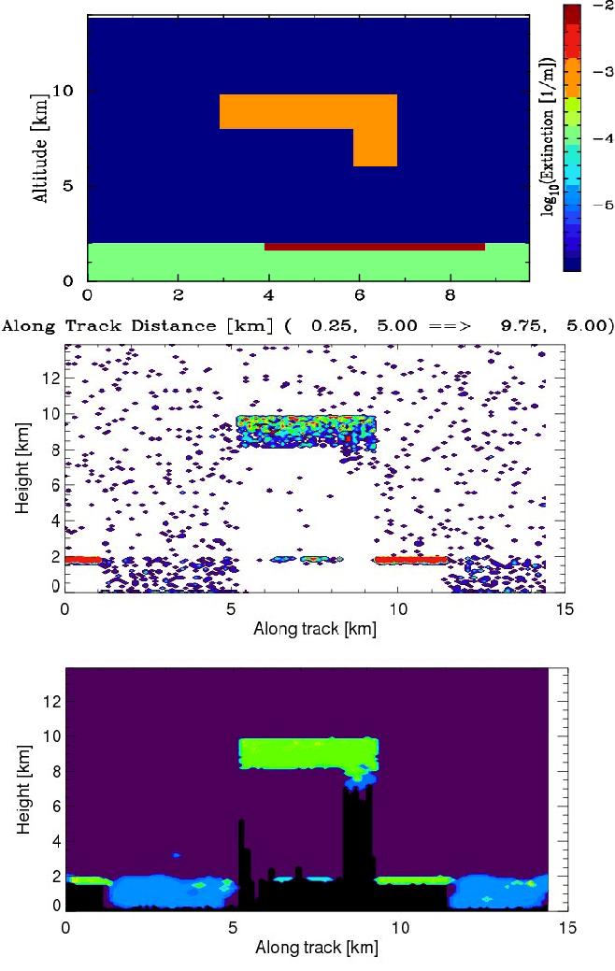
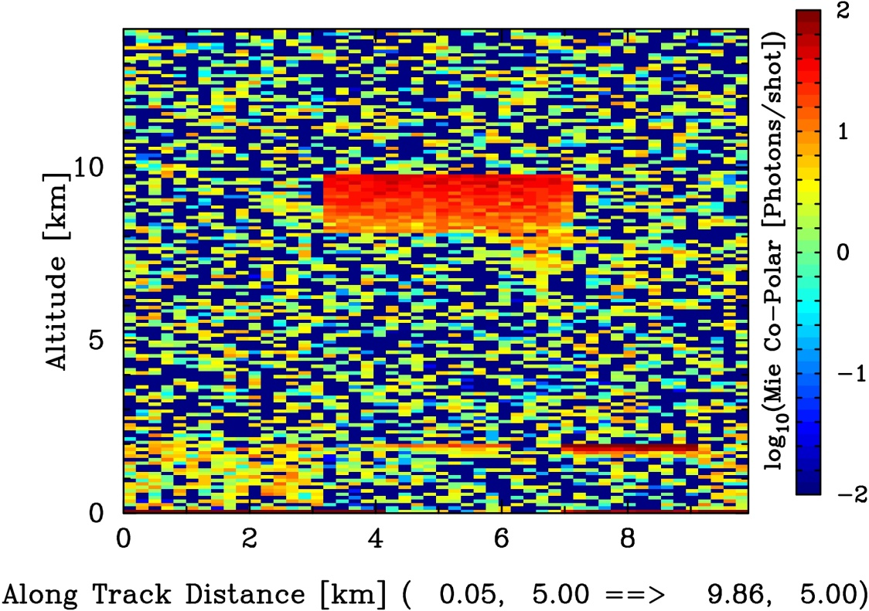
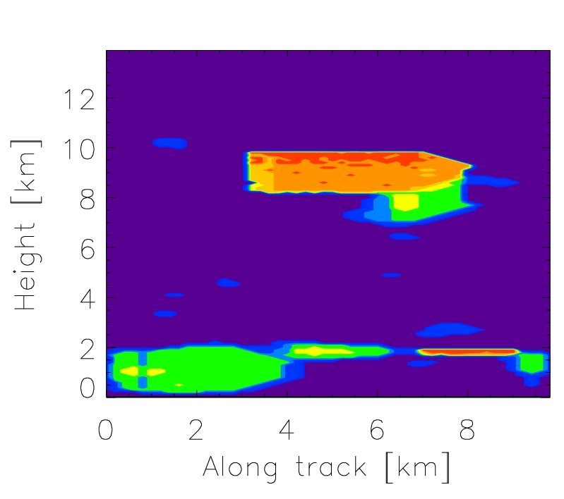
A-FM at start of APRIL
(2014)
The modelled test scene was really simple.
But all Features are retrieved
This scene is still used in a number of the functional tests
(blue:4, lightblue:5, green:6, yellow:7, orange-red (8 -10)

Slide 5
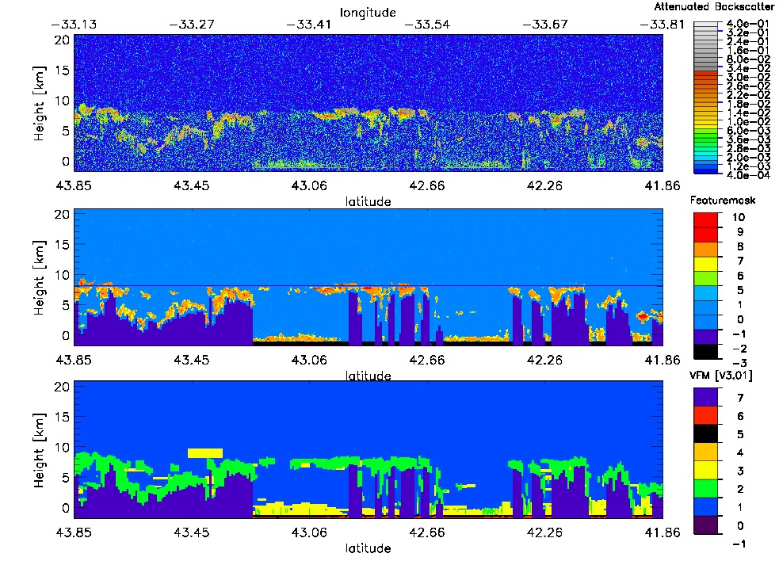
Calipso 1064nm CAL_LID_L1_ValStage1-V3-(2014) 01.2010-04-18T04-23-44ZN
The 2014 featuremask code was also capable of processing CALIPSO data (1064nm : Mie channel, 532nm: Rayleigh info).
Should have improved and published this!!!!! (a CALIPSO featuremask paper was published a few weeks ago; Thibault Vaillant de Guélis et al.)

Slide 6
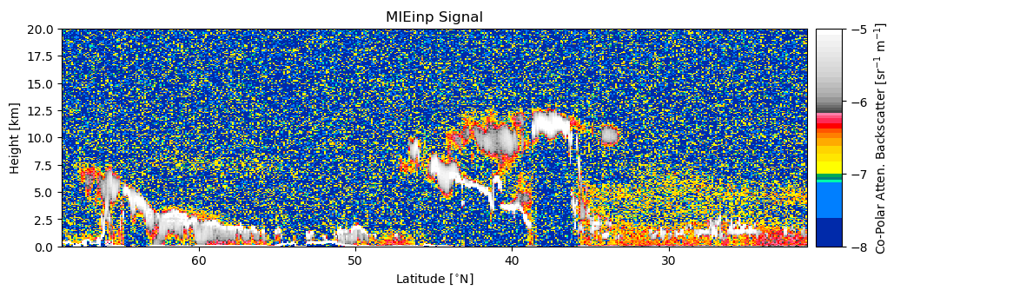
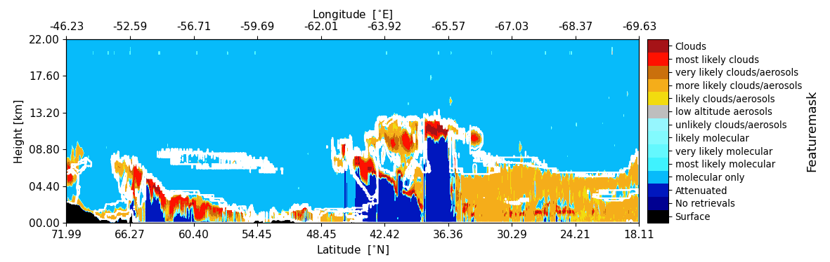
FM V8.0 Halifax Results
Halifax Scene

Slide 7
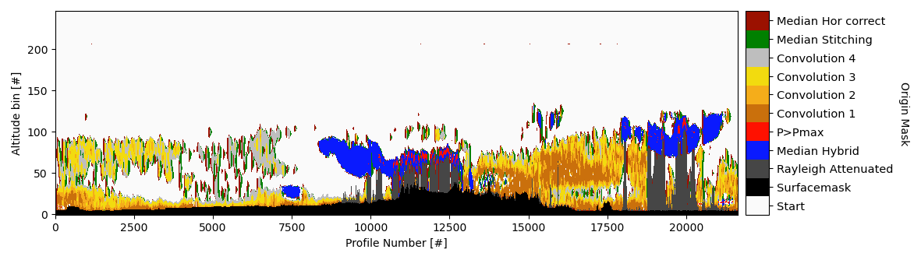
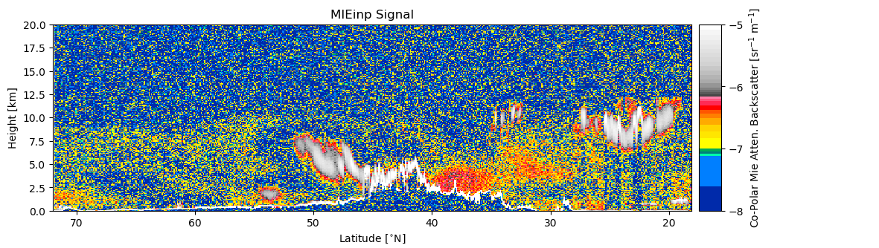
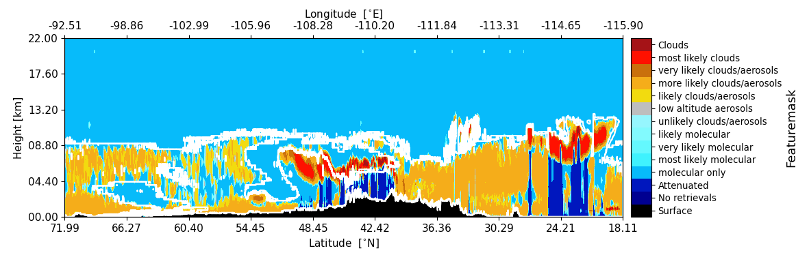
FM V8.0 Baja Results
Baja Scene Origin mask
Baja Scene

Slide 8
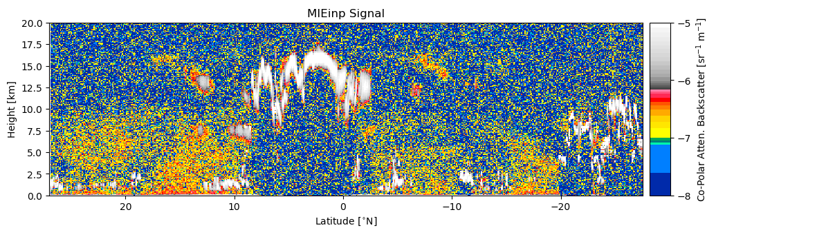
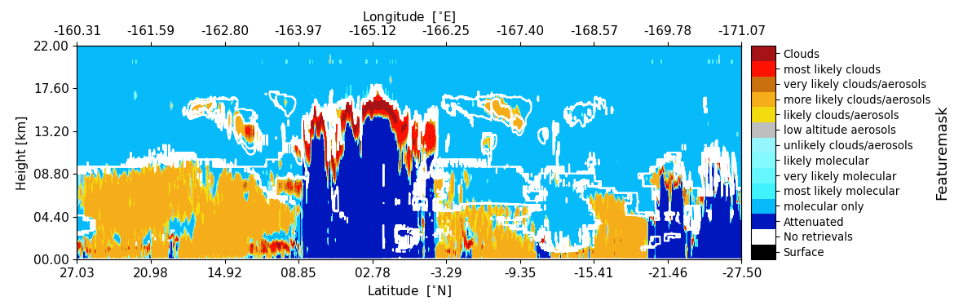
FM V8.0 Hawaii Results
Hawaii Scene

Slide 9
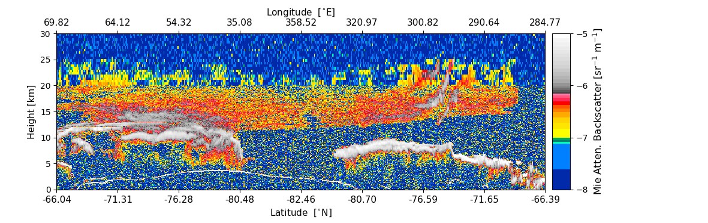
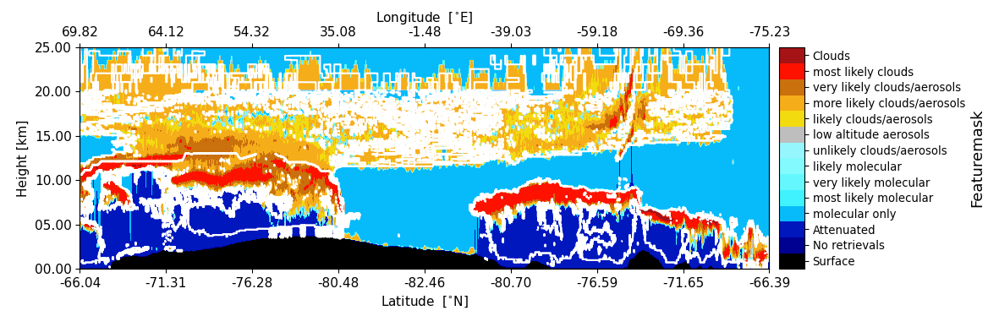
FM V8.0 Stratospheric Results
Hawaii Scene
PSC Scene

Slide 10
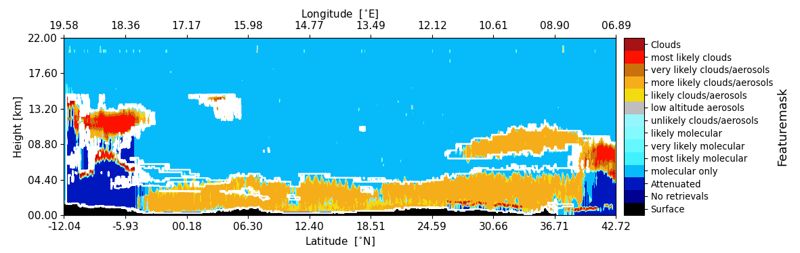
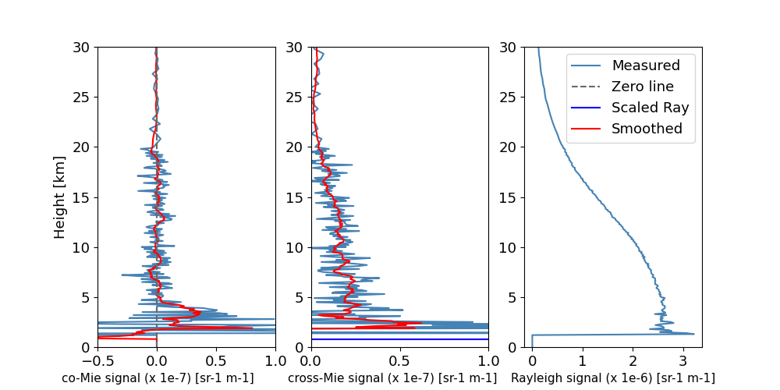
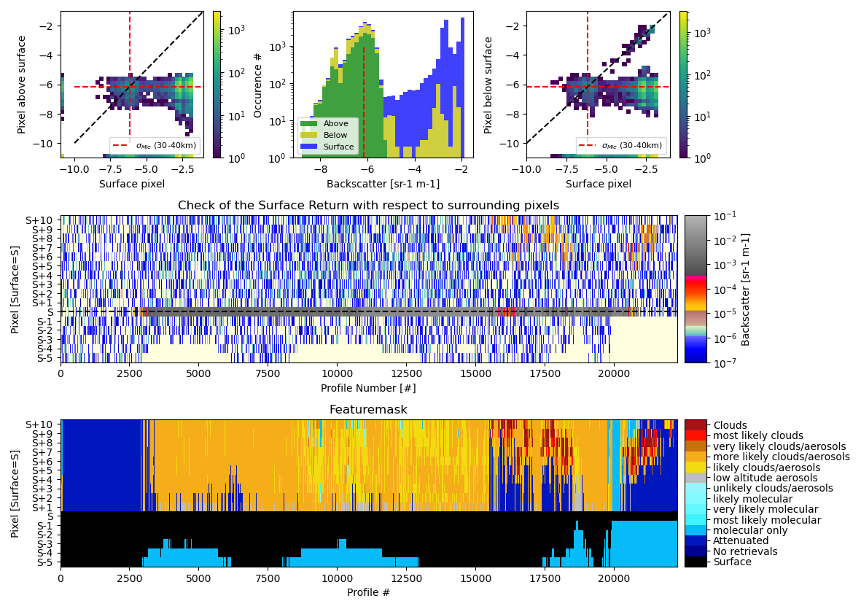
MACC Scene (Dust over Sahara)
Averaged Feature free profile
Surface detection and masking

Slide 11
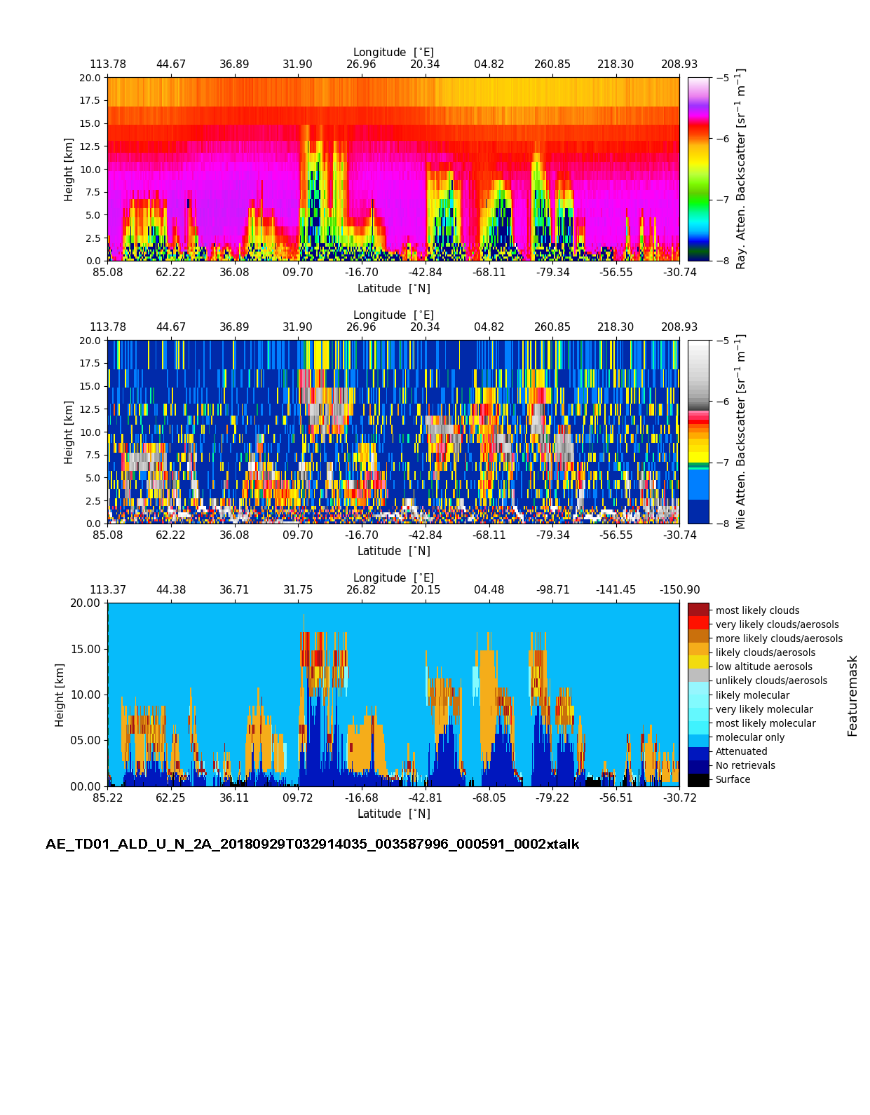
Aeolus Featuremask (AEL-FM)
The A-FM module has recently been transferred into an Aeolus L2 algorithm.
A new Mie, Rayleigh separation algorithm including the retrieval of the local noise have been created by Dave.
The AEL-FM will be evaluated in the coming months and updated where necessary.

Slide 12
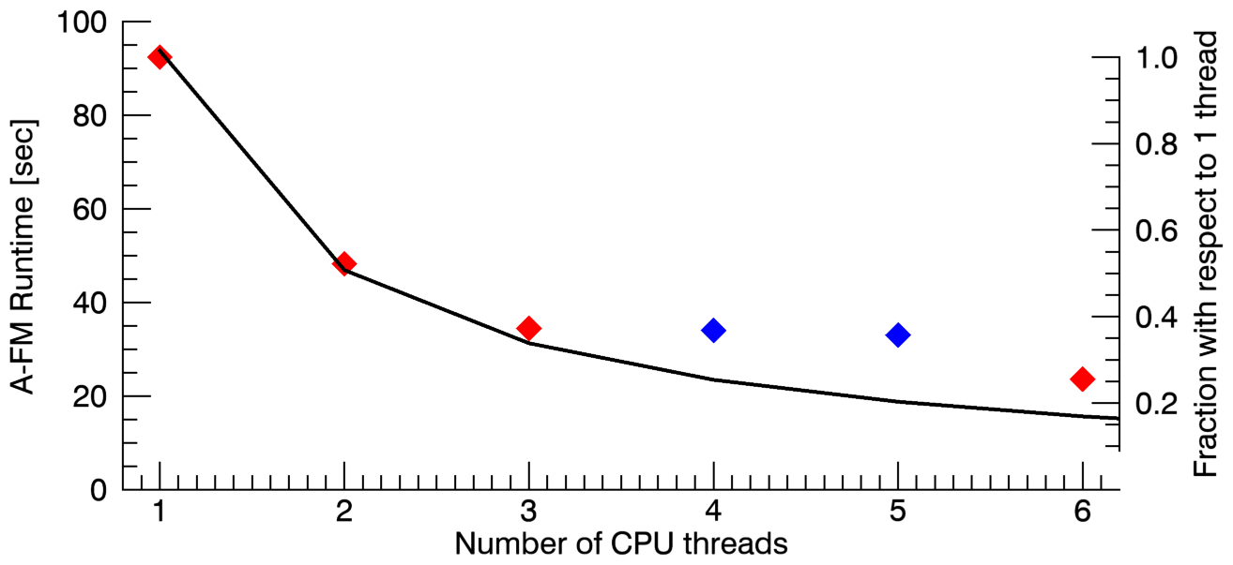
  Conclusions
  A-FM has transformed during APRIL from a relatively simple code into an integrated EarthCARE module.
  On the outside the information looks the same on the inside the code has changed drastically.
  The output is beside the FeatureMask also the surface detection and (-integrated signals) and a feature-free averaged profile for each channel which can be used for ATLID calibration.
  The A-FM code can run parallel and takes ~30 seconds per frame.
  In the coming period we hope to learn from the use of Aeolus data (Ael-FM) to improve the A-FM code.

