Slide 1


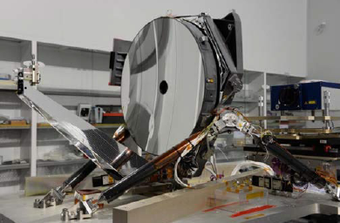
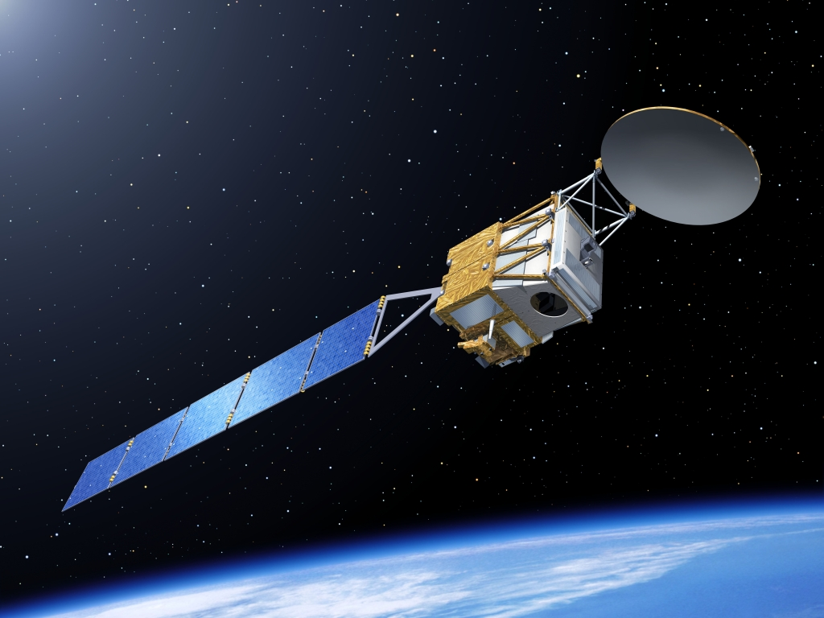
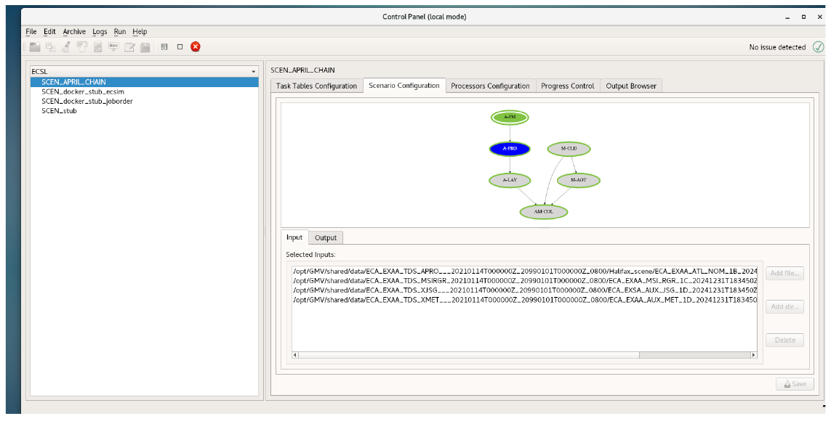
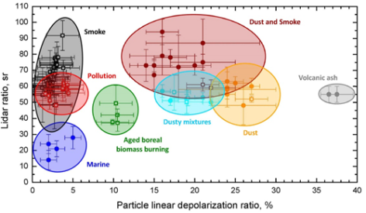
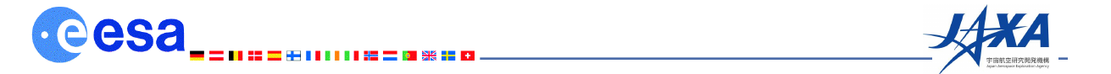
APRIL (Atmospheric Products from Imager and Lidar) Overview
D. P. Donovan¹, Gerd-Jan van Zadelhoff¹, J.E. Williams¹
U. Wandinger^{2,} M.Haarig², A. Hünerbein²
N. Doctor³, R. Preusker³
M. Ángel Ruiz Saldaña⁴, C. Bos⁴
(as well as numerous members of the L2 development teams and ESA staff)
¹Royal Netherlands Meteorological Institute (KNMI), Utrecht, Netherlands,
²Leibniz Institute for Tropospheric Research. Leipzig, Germany
³ Free University of Berlin
⁴ GMV U.K.

Slide 2
APRIL goals
Scientific development and implementation of
  ATLID Algorithms
  MSI Algorithms
  ATLID+MSI synergy algorithms
Creation of realistic test data sets
Support to ATLID+MSI instrument testing
  E.g. ATLID reviews and polarization issues, MSI smile related issues.

Slide 3
ECARE-PROCESSORS
Processor | Description
A-FM | ATLID Feature Mask
A-PRO | ATLID Profiles of extinction, lidar-ratio and target/aerosol type
A-LAY | ATLID Layer products
C-PRO | CPR Profiles of (corrected) Ze, Vd and Target class
C-CLD | CPR Cloud and Precipitation properties
M-CLD | MSI Cloud properties
M-AOT | MSI Aerosol products
AM-COL | ATLID+MSI Synergetic Cloud heights and aerosol column properties along+cross-track
AC-TC | ATLID+CPR Target Classification
ACM-CAP | ATLID+CPR+MSI synergetic cloud+aerosol+precip. nadir profiles.
BM-RAD | BBR+MSI unfiltered LW and SW radiances.
BMA-FLX | BBR TOA radiative flux processor
ACM-COM | Construct atmospheric scene based on products (1-D)
ACM-3D | Construct 3-D atmospheric scene
ACM-RT | 1 and 3D broad-band fluxes and Radiances
ACMB-DF | Closure assessment (Delta Flux)

Slide 4
ECARE-APRIL: PROCESSORS
Processor | Description
A-FM | ATLID Feature Mask
A-PRO | ATLID Profiles of extinction, lidar-ratio and target/aerosol type
A-LAY | ATLID Layer products
C-PRO | CPR Profiles of (corrected) Ze, Vd and Target class
C-CLD | CPR Cloud and Precipitation properties
M-CLD | MSI Cloud properties
M-AOT | MSI Aerosol products
AM-COL | ATLID+MSI Synergetic Cloud heights and aerosol column properties along+cross-track
AC-TC | ATLID+CPR Target Classification
ACM-CAP | ATLID+CPR+MSI synergetic cloud+aerosol+precip. nadir profiles.
BM-RAD | BBR+MSI unfiltered LW and SW radiances.
BMA-FLX | BBR TOA radiative flux processor
ACM-COM | Construct atmospheric scene based on products (1-D)
ACM-3D | Construct 3-D atmospheric scene
ACM-RT | 1 and 3D broad-band fluxes and Radiances
ACMB-DF | Closure assessment (Delta Flux)

Slide 5
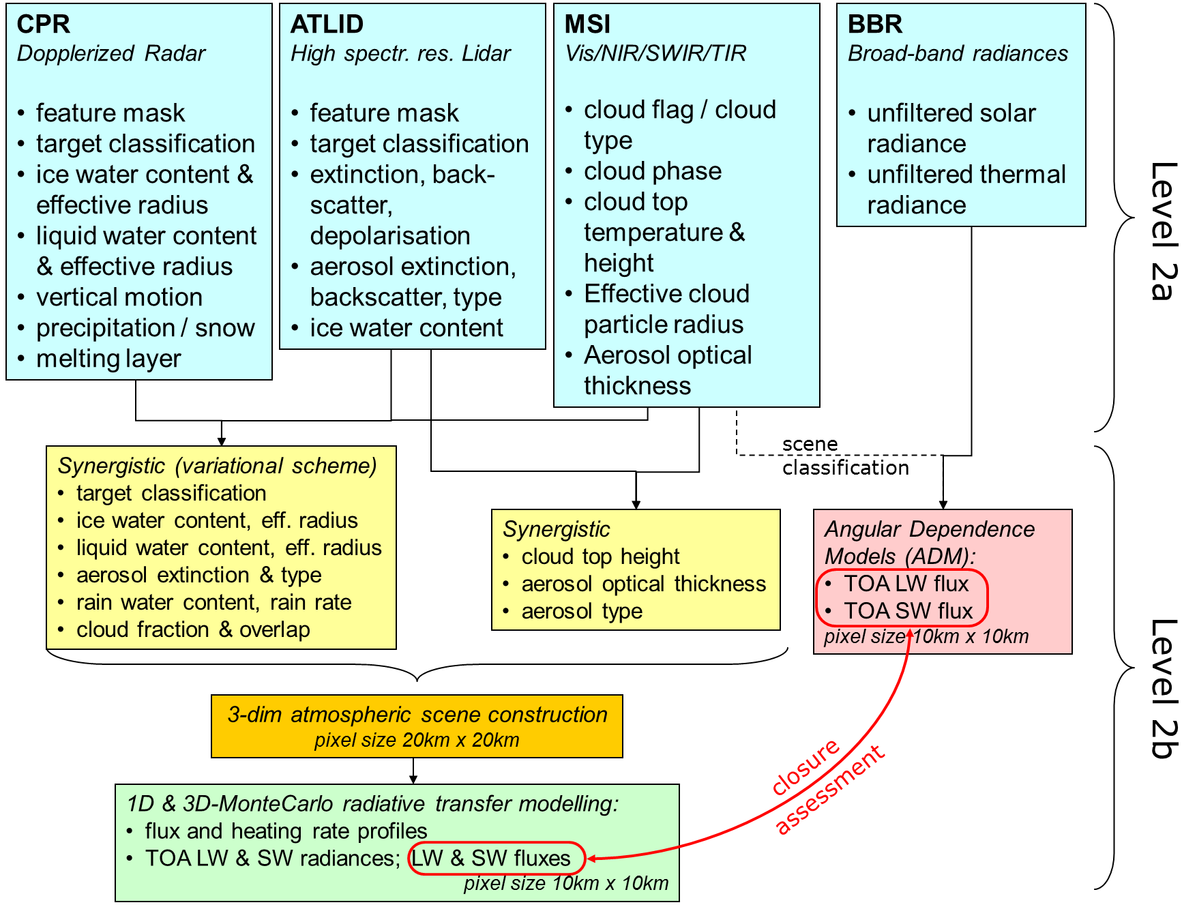
Simplified EarthCARE product structure

Slide 6
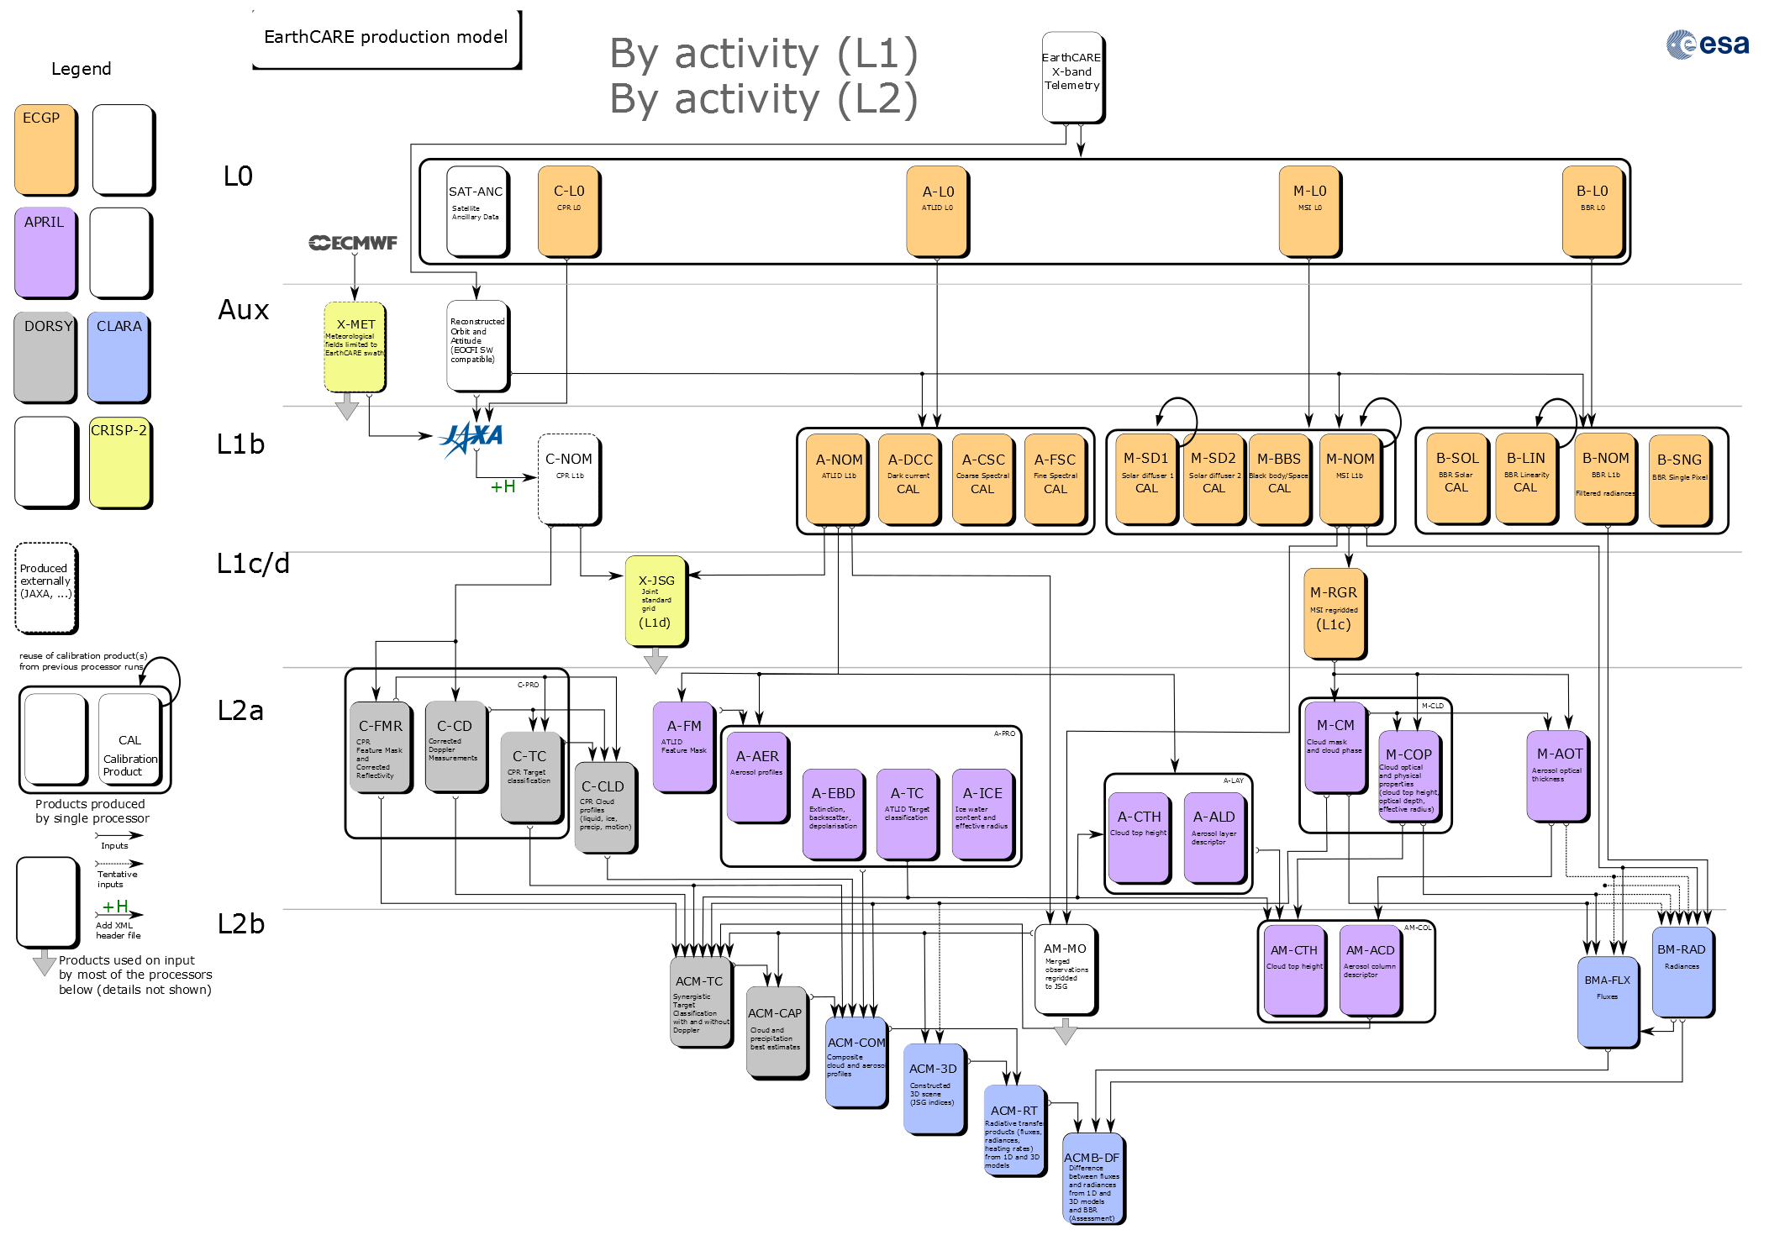

Slide 7
Back at the start, most of the algorithms were not much past the “toy-code” level of development.
A few algorithms were already coded to ECSIM conventions so there was some kind of structure but this was far away from being operational but it gave us a starting point.
All of the algorithms needed a large degree of scientific development.
All of the APRIL algorithms codes now use a common interface library and are coded to operations standards and produce output data according to common standards.
Decision to use NetCDF-5/HDF-5 was important.

Slide 8
M-CLD v8.0
M-CLD products combine visible to infrared MSI channels to determine cloud microphysical and macro-physical properties for each pixel (500m, swath width 150km)
Baseline-products comparable to Modis products (follow-on A-Train)
  cloud cover (M-CF), cloud type (M-Ctyp) and cloud phase (M-CP)
  cloud optical thickness (M-COT), cloud effective radius (M-REF), cloud top height (M-CTH) and cloud water path (M-CWP)
M-CLD developments in APRIL:
M-CLD algorithms have been adapted to passive imager instruments onboard polar and geostationary satellites (MODIS and SEVIRI) and verified successfully against state-of-the-art algorithms
Start
APRIL
IDL codes for M-COP
and some fortran snipped from CASPER project for M-CM
M-CLD processor build:
V1.0 took 20 min (150 second goal)
Forward operator simplification, improvements, verification with ECSIM test scenes …
M-CLD v8.0

Slide 9

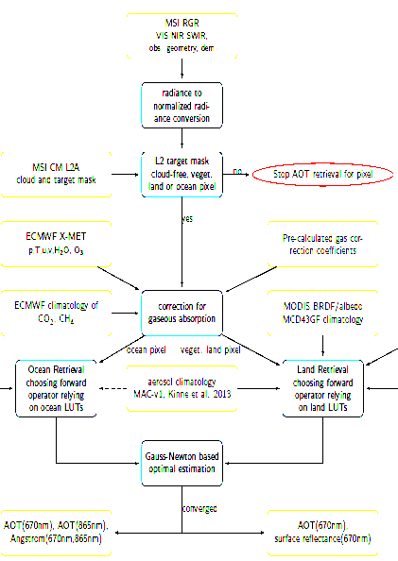
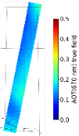
M-AOT
M-AOT status at the start of APRIL
old IRMA documents of the MSI aerosol retrieval
revised-IRMA concept of M-AOT:
biggest difference was the then planned optimal
estimation based approach
FU Berlin in-house radiative transfer model MOMO
optimal estimation module written in python
Coding of M-AOT processor concept within the first year of APRIL with
refinements of the aerosol optical thickness retrieval approach along the way
M-AOT status at the end of APRIL
Fortran based processor for the aerosol optical thickness
retrieval over ocean and, where possible, land that uses
multi-spectral imager measurements assuming one central
wavelength per VNS band
optimal estimation based approach used
M-AOT LUTs are following HETEAC aerosol classification
to ensure consistency between EC different instruments
Newly developed empirical land surface parameterization
based on MODIS BRDF/albedo climatology
new, not yet operationally implemented, approach for aerosol
component mixing choice over ocean
M-AOT tested with ECSIM and (successfully) with MODIS L1 based inputs

Slide 10
EarthCARE has always emphasis Synergy (➔cooperation ➔ harmonization)….
In APRIL(and the other studies) large strides were made in terms of technical and scientific synergy.
Referring to the technical side of things
At the start of APRIL all algorithms used their own product conventions and there was no real `Chaining’ possible
Now….NetCDF/HD5 is used along with CFI conventions and a coherent common grid (X-JSG) is being used to allow for chaining !
Common io/messaging SW base, common install procedures etc..

Slide 11
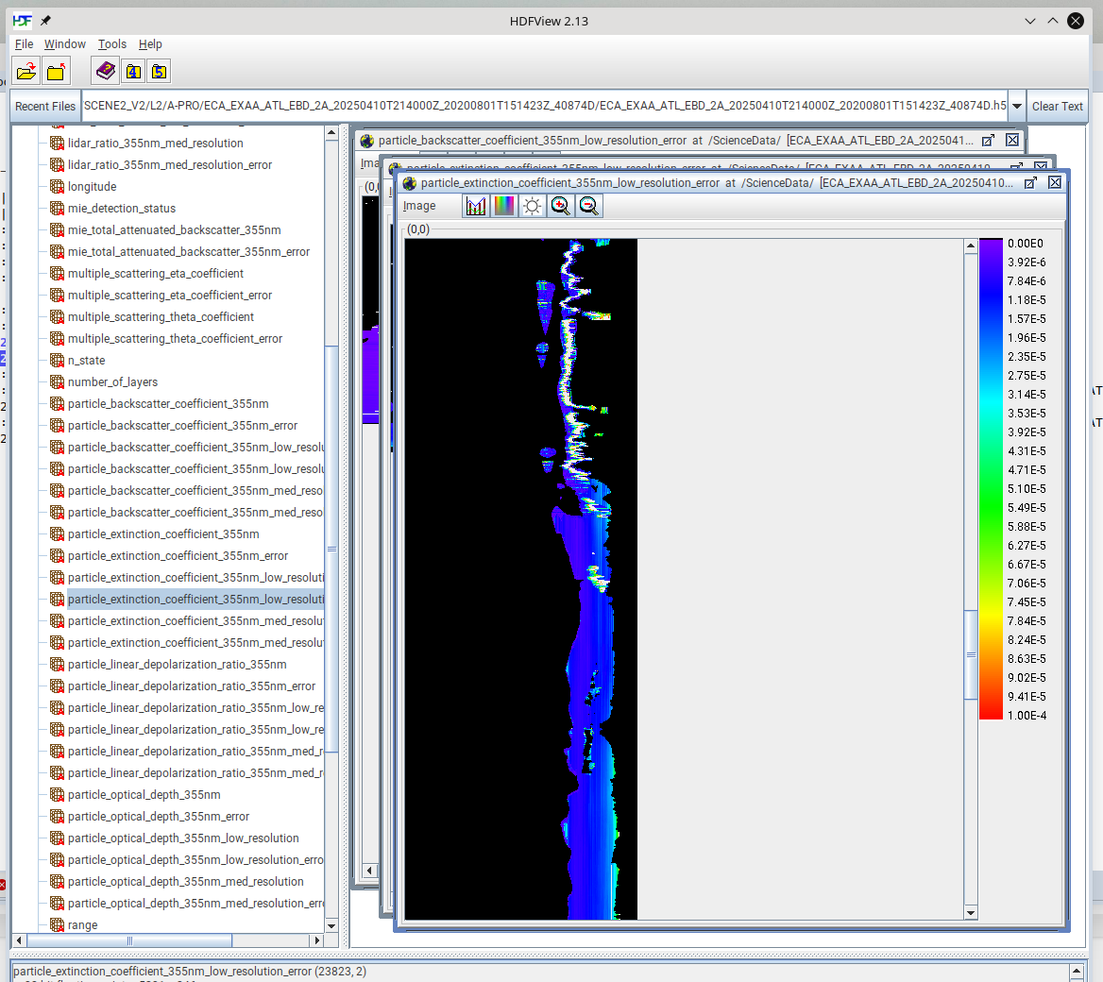
At the start of APRIL all algorithms used their own product conventions and there was no real `Chaining’ possible
Now….NetCDF/HD5 is used along with CFI conventions and a coherent common grid (X-JSG) is being used to allow for chaining.

Slide 12
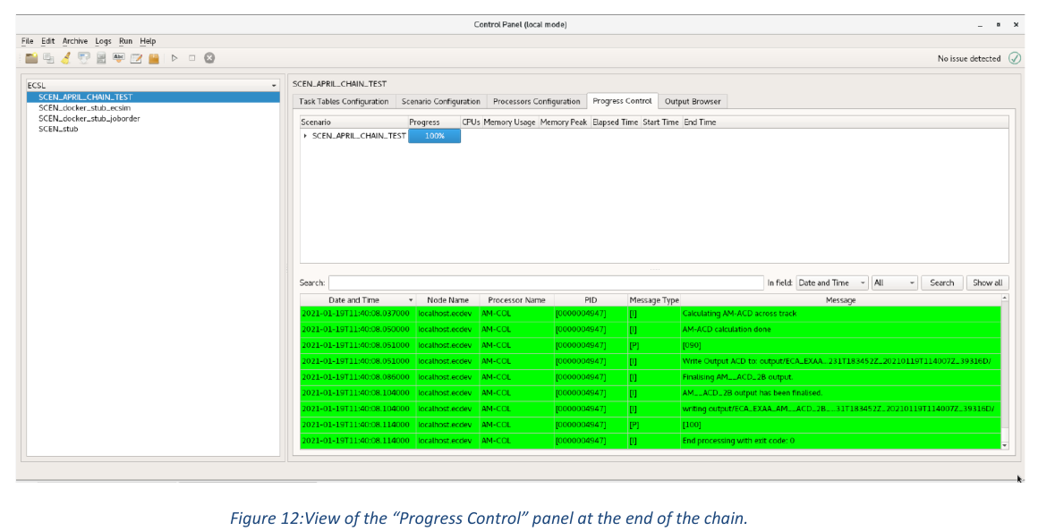
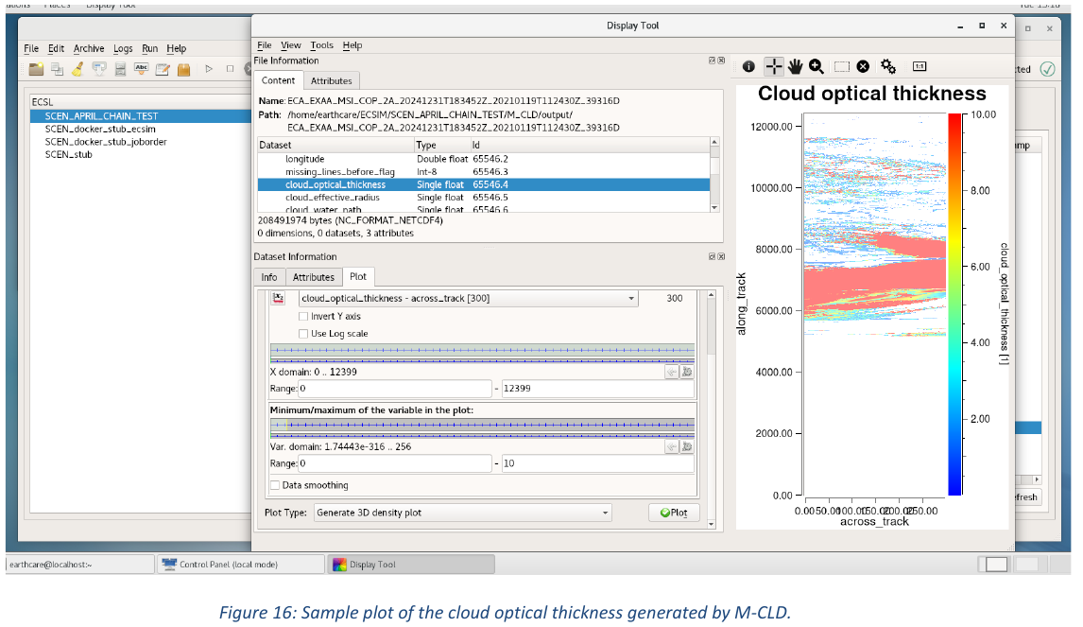
ALL ARPIL models have been demonstrated to run in a proper Chain with in the E3SIM environment !

Slide 13
Not only technical unification is necessary !
The Scientific framework must be appropriately consistent !
ECSIM was used to create physically consistent simulations across all the instruments.
Scientific assumptions document was created to track the assumptions/methodology used by the different models
e.g. Ice cloud phase function, aerosol-types etc..
Heteac was formulated in part to fulfil this need

Slide 14
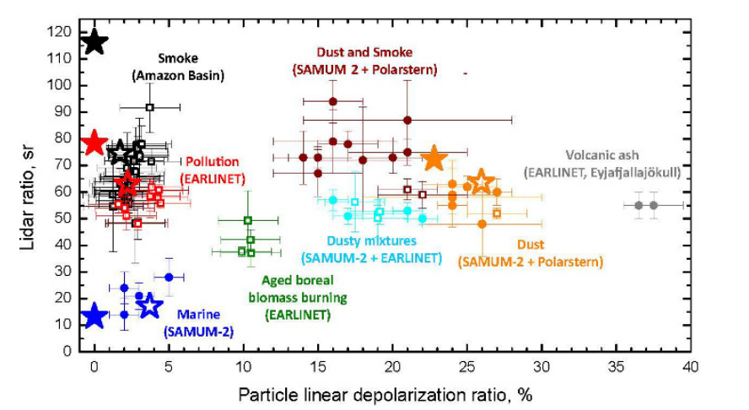
How to unify the treatment of Aerosols (lidar,MSI and RT calculations)
Hybrid End-To-End Aerosol Classification (HETEAC)
Using a limited number of basis types the phase-space of optical behavior of observed aerosol can be well spanned !

Slide 15
Scenes
Once upon a time 100 km long-scenes was a big-deal !
Now 6000km will soon be far too small.
That was then….

Slide 16
Scenes
Once upon a time 100 km long-scenes was a big-deal !
Now 6000km will soon be far too small.
This is now….

Slide 17
Achievements (an incomplete list..)
Development and implementation of a suite of state-of-the-art lidar + imager retrieval algorithms.
Development of a unified Aerosol scheme.
Development of a suite of unique physically consistent high resolution test scenes.
Participation in ATLID review
  Detailed Investigation of ATLID polarization response.
Investigation of MSI smile effect.
Demonstration of ARPIL chain running on a set of common bias inputs (e.g. no fudging or cheating).
and yet the work is not done……..

