Slide 1


DOppler Radar and SYnergy Products for EarthCARE
DORSY PROCESSORS
C-PRO & C-CLD
Science Presentation
L2 Earth CARE Science Presentation Meeting
10.03.2021
Pavlos Kollias
Wanda Szyrmer
Aleksandra Tatarevic
Bernat P. Tresseras
David Burns
Alessandro Battaglia

Slide 2
CPR PROCESSORS AND DATA PRODUCTS
C-FMR : CPR Feature Mask and Reflectivity
C-CD : Quality Controlled Doppler Measurements
C-TC : Target Classification
C-CLD : Cloud and precipitation retrieval
C-APC : Antenna pointing characterization
C-PRO
C-NOM
C-FMR
C-APC
C-CD
C-TC
X-MET
C-CLD
C-CLD

Slide 3
SUMMARY OF WORK FOR C-PRO v5 & v6
Work on C-PRO interfaces (v5 & v6)
  C-PRO & C-NOM product developed by McGill & JAXA
  C-PRO & C-APC aux file & antenna mispointing
Scientific testing & algorithm refinements
  C-FMR: PIA and reflectivity estimates (v5)
  C-CD: focus on correction for mispointing (v5 & v6)
  & sedimentation velocity best estimate (v6)
  C-TC: various improvements and changes in definition of classification variables (v5 & v6)

Slide 4
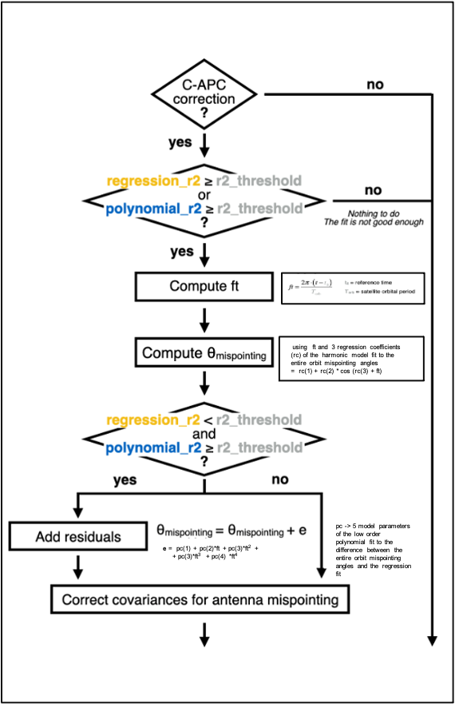
C-APC & mispointing correction
C-APC parameters:
r2_threshold -> value to assess the goodness of the antenna mispointing fit
regression_r2 -> regression r-square statistic
polynomial_r2-> polynomial r-square statistic
reference time -> fixed timestamp for any processor execution
satellite orbital period -> time for satellite to complete one full orbit around the Earth
3 regression coefficients of the harmonic model fit to the entire orbit mispointing angles
5 polynomial coefficients of the polynomial fit to the difference between the entire orbit mispointing angles and regression fit
=> computation of mispointing angle 𝛉_{mispointing}
C-CD
doppler_velocity_pointing_bias (Va): Doppler velocity component introduced by
pointing : Va = Vsat * sin 𝛉_{mispointing}
doppler_velocity_corrected_for_mispointing
Correction phase 𝛉c = Va * 4 𝛑/ ( 𝛌 PRF)
R[Ra] = | R[R] + I[R] | cos ( atan2 (R[R],I[R]) ) - 𝛉c )
I [Ra] = | R[R] + I[R] | sin ( atan2 (R[R],I[R]) ) - 𝛉c )
Vd_a = 𝛌 PRF/ (4 pi) atan2 (R[Ra],I[Ra])
Real and imaginary parts of the lag-1 autocovariance of the complex radar signal corrected for antenna mispointing
Doppler velocity corrected for antenna mispointing

Slide 5
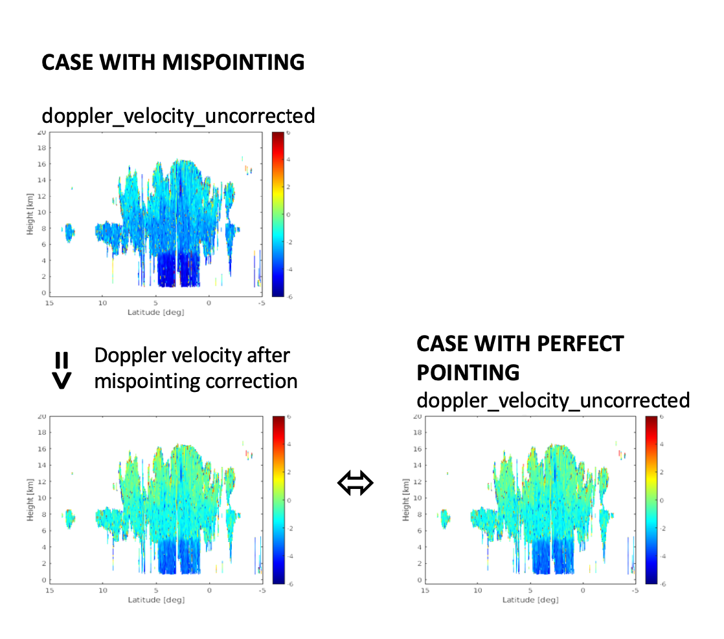
C-APC & mispointing correction

Slide 6
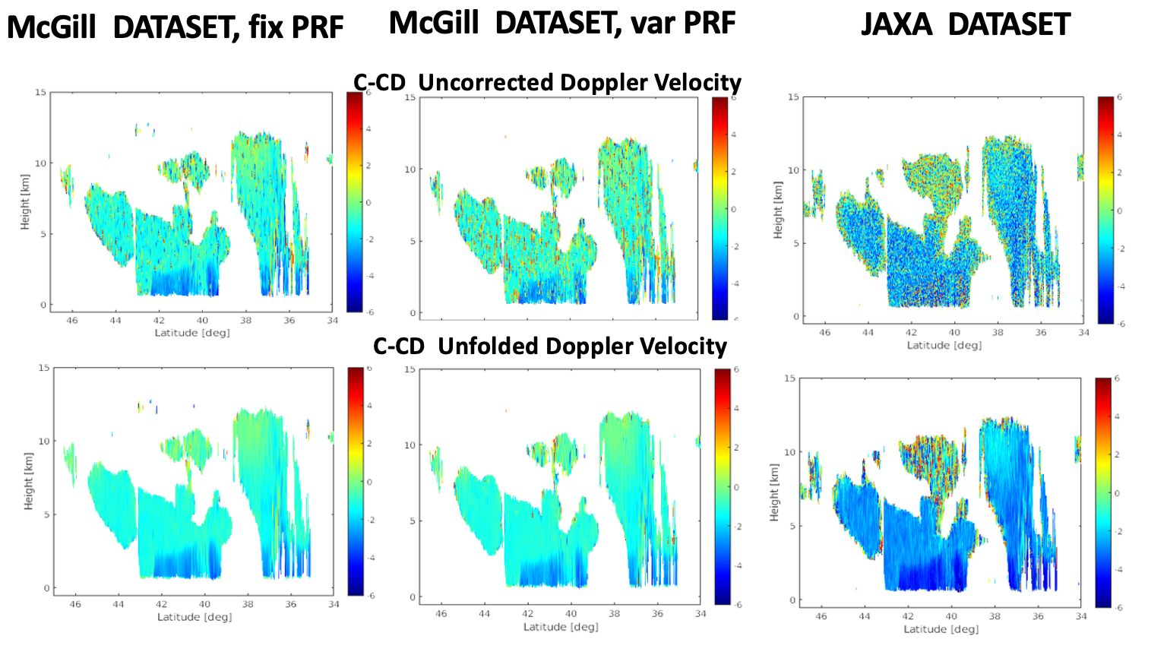
C-CD Doppler Estimates : fix PRF, varPRF & JAXA dataset
After horizontal sampling and prior to any correction
After all corrections:
Doppler Velocity Best Estimate

Slide 7
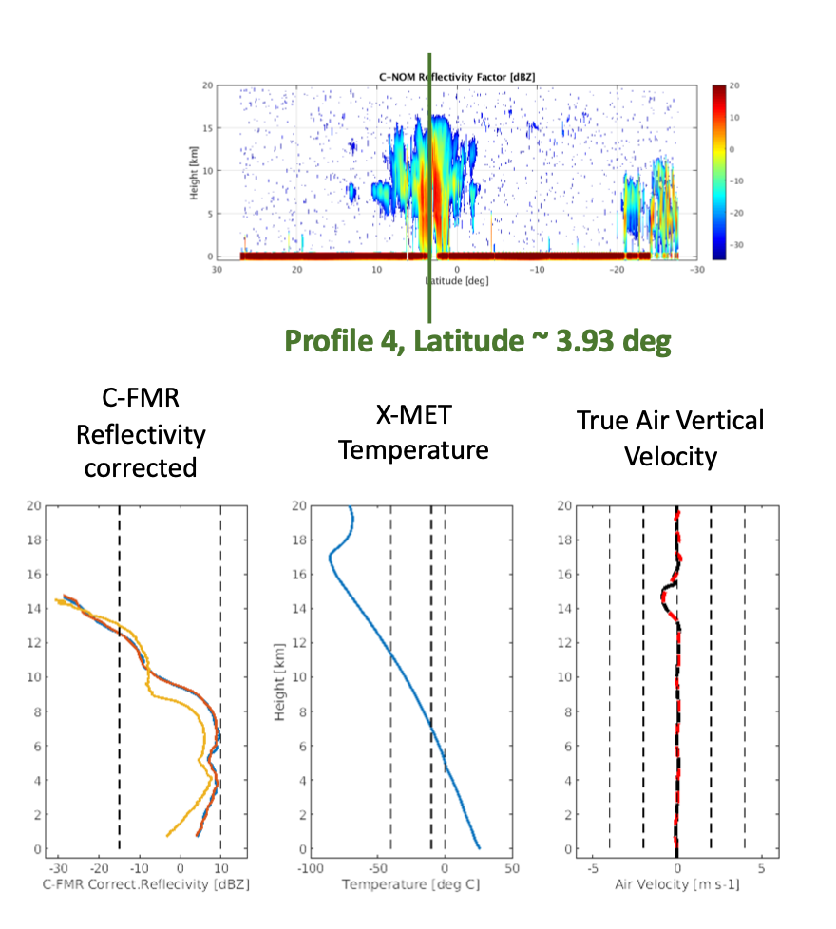
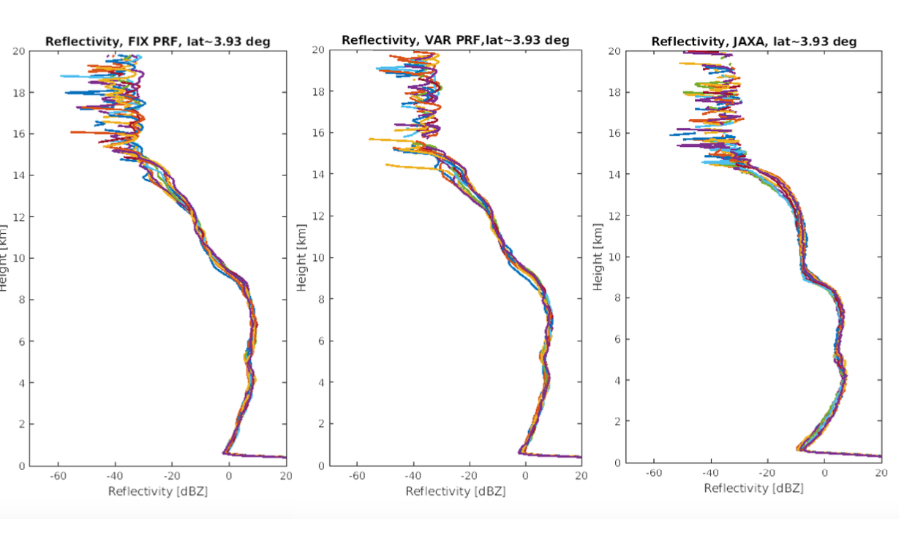
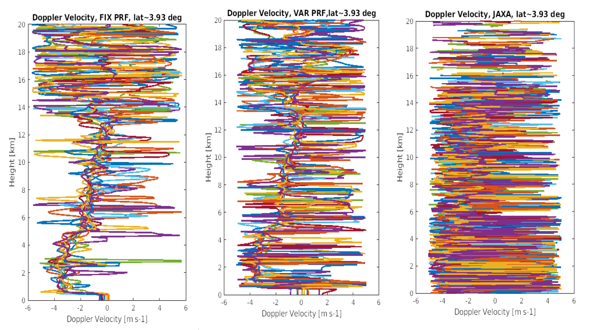
C-CD Doppler Estimates : fix PRF, varPRF & JAXA dataset
FIX PRF
VAR PRF
JAXA
C-NOM Reflectivity
C-NOM Doppler

Slide 8
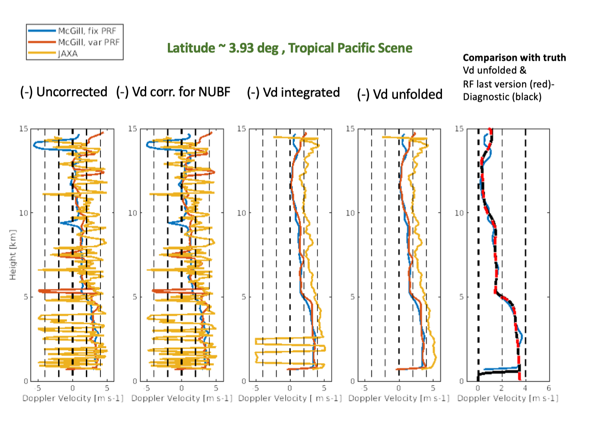
C-CD Doppler Estimates : fix PRF, varPRF & JAXA dataset

Slide 9
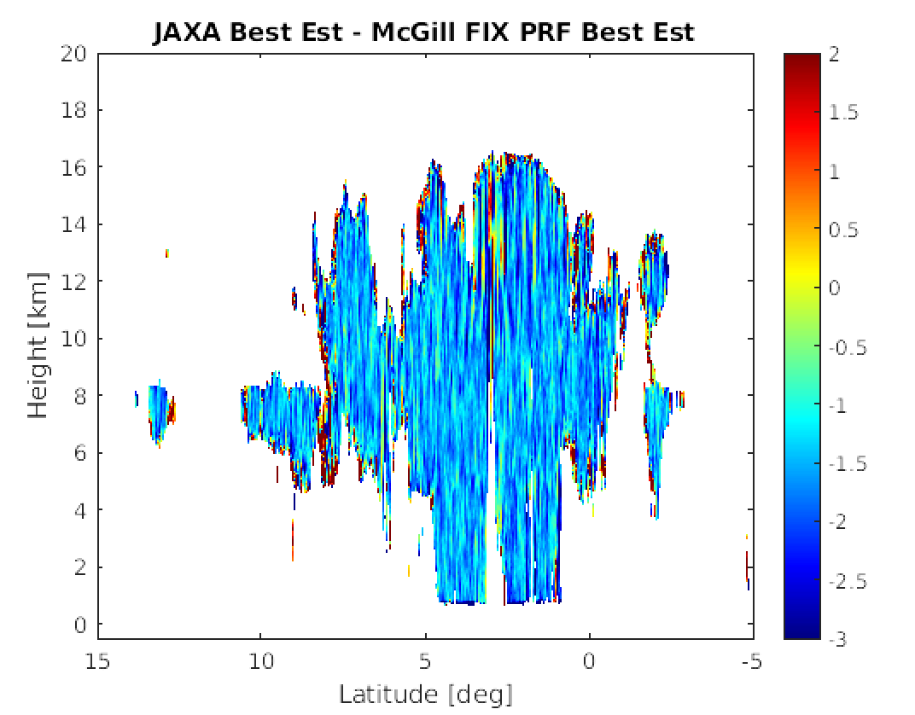
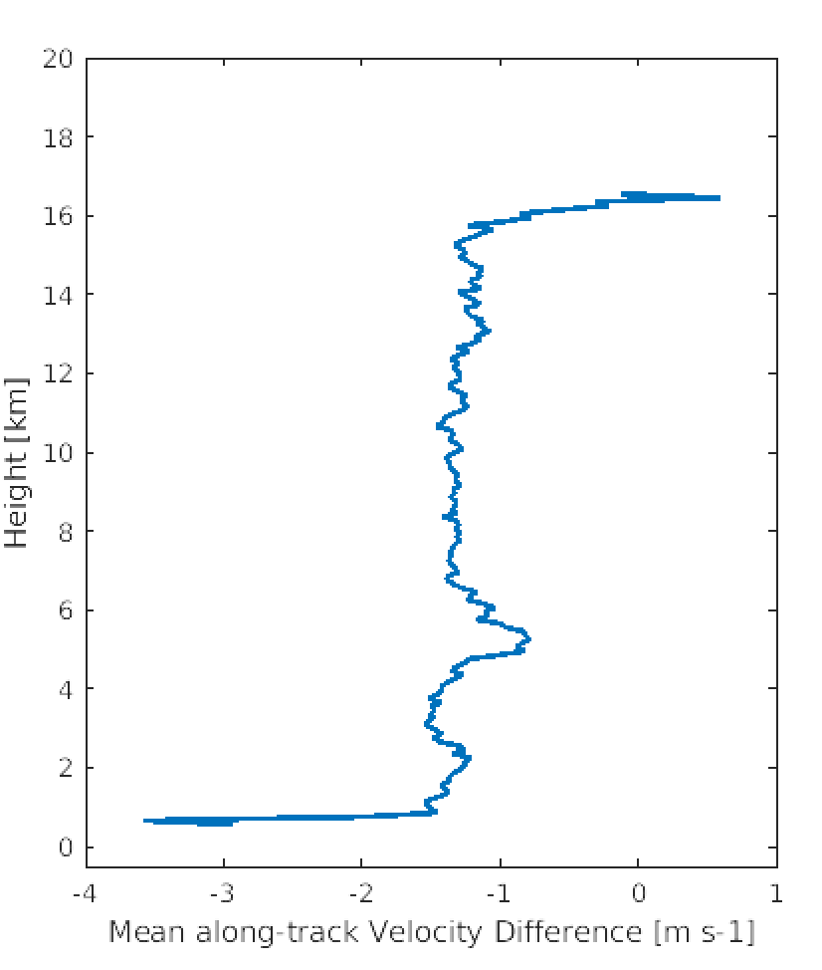
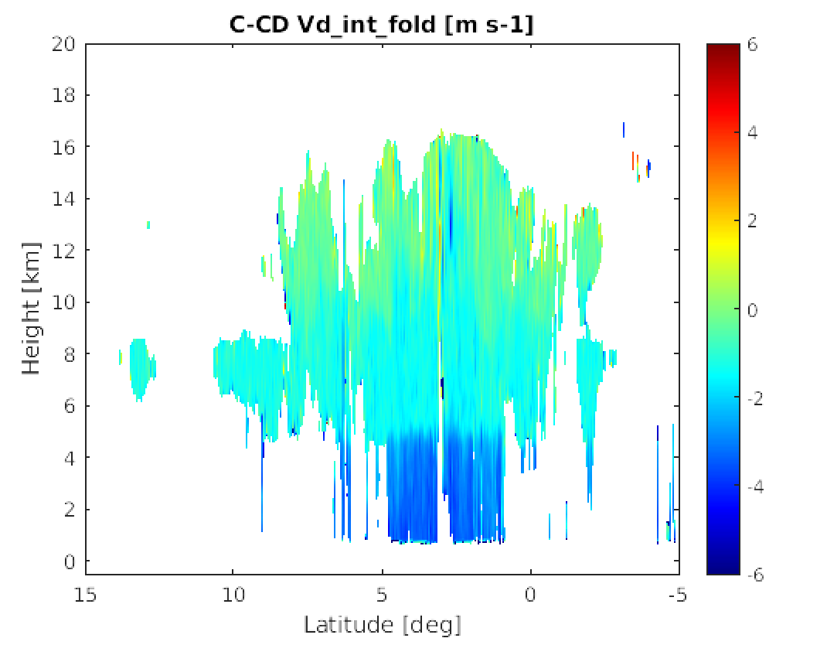
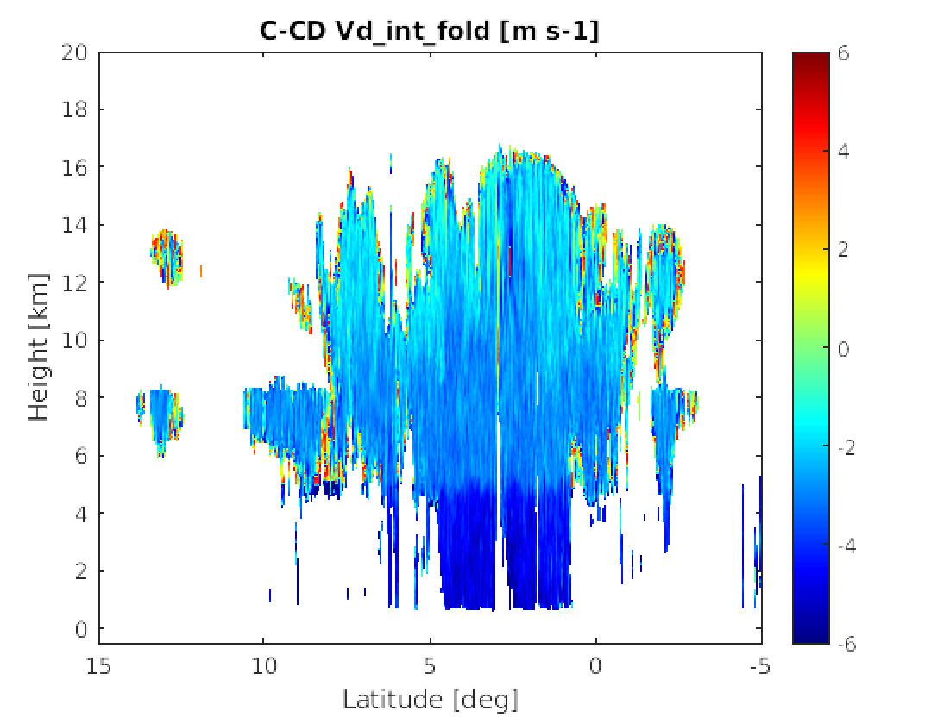
C-CD Doppler Estimates : fix PRF, varPRF & JAXA dataset
C-CD Unfolded Doppler Velocity
VELOCITY DIFFERENCE
C-CD JAXA FINAL VELOCTY ESTIMATE – C-CD McGill FINAL VELOCTY ESTIMATE
MEAN PROFILE OF
VELOCITY DIFFERENCES
FOR ALONG-TRACK SEGMENT Lat=-15 deg to Lat =5 deg
McGill DATASET,
fix PRF
JAXA DATASET

Slide 10
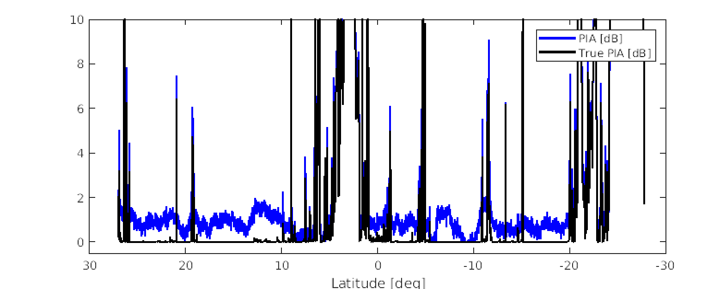
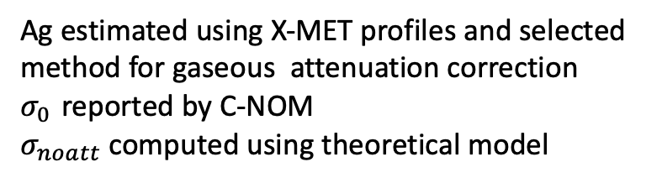

C-FMR PIA ESTIMATION
Ag estimated using X-MET profiles and selected method for gaseous attenuation correction
$σ_{0 }$reported by C-NOM
$σ_{noatt}$ computed using theoretical model
$$PIA+A_{g}=σ_{noatt}− σ_{0 }$$
Problem with C-FMR PIA estimates in version 4.x

Slide 11
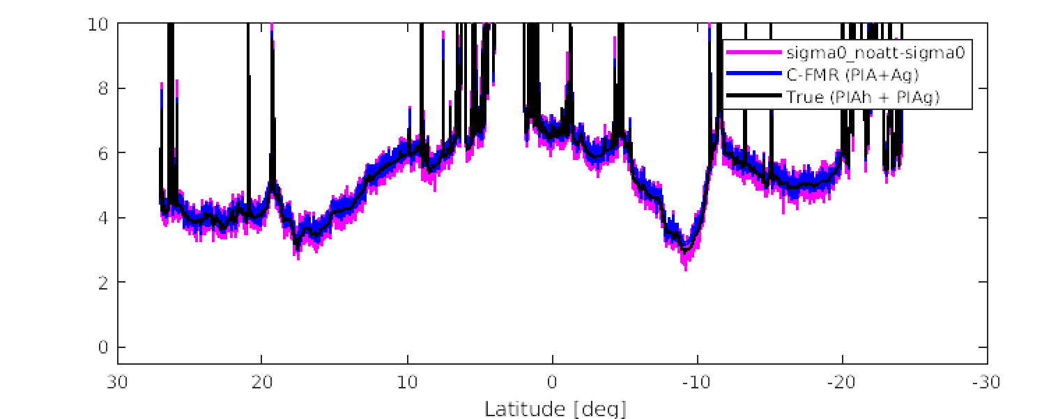


C-FMR PIA ESTIMATION
Ag estimated using X-MET profiles and selected method for gaseous attenuation correction
$σ_{0 }$reported by C-NOM
$σ_{noatt}$ computed using theoretical model
$$PIA+A_{g}=σ_{noatt}− σ_{0 }$$
C-FMR
$$σ_{noatt}− σ_{0 }$$
versus
TRUE
$$σ_{noatt}− σ_{0 }$$
=>
Problem in Ag estimates

Slide 12
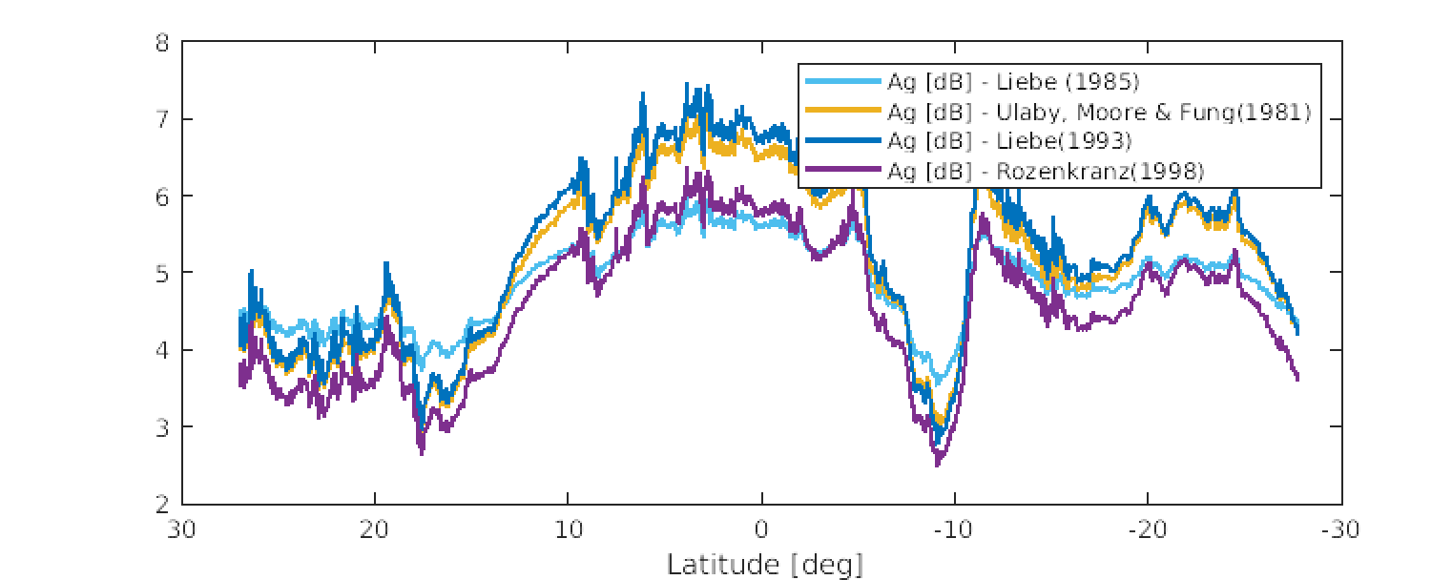
C-FMR PIA ESTIMATION
Ag estimated using X-MET profiles and selected method for gaseous attenuation correction
$σ_{0 }$reported by C-NOM
$σ_{noatt}$ computed using theoretical model
$$PIA+A_{g}=σ_{noatt}− σ_{0 }$$
DIFFERENCES BETWEEN DIFFERENT METHODS FOR ATMOSPHERIC ATTENUATION
Notes:
Differences can be around 1dB => uncertainty around 1 dB in Ag estimation only because of selecting specific method for Ag computation

Slide 13
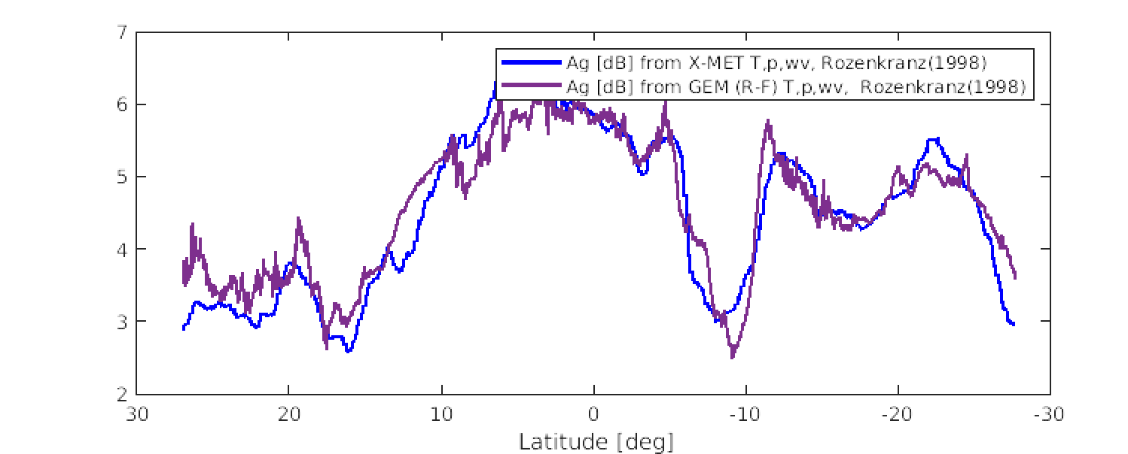
C-FMR PIA ESTIMATION
Ag estimated using X-MET profiles and selected method for gaseous attenuation correction
$σ_{0 }$reported by C-NOM
$σ_{noatt}$ computed using theoretical model
$$PIA+A_{g}=σ_{noatt}− σ_{0 }$$
DIFFERENCES in Ag estimates when using X-MET and GEM datasets
ROZENKRANZ (1998) method
differences can reach 1 dB
Notes:
uncertainty around 1 dB in Ag estimation because of variability in temperature, pressure and humidity fields

Slide 14
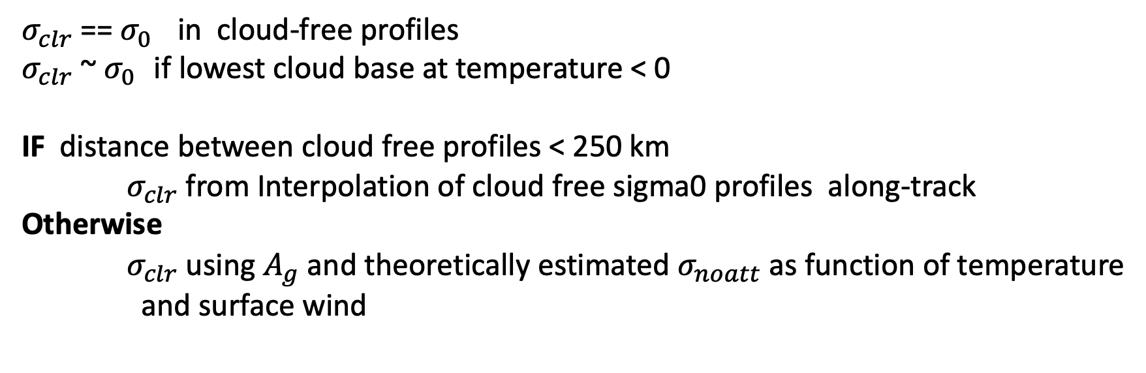

C-FMR PIA ESTIMATION – NEW METHOD
$$PIA+A_{g}=σ_{noatt}− σ_{0 }$$
$$PIA= \left(σ_{noatt} −A_{g}\right) − σ_{0 }= σ_{clr} − { σ}_{0 }$$
$σ_{clr}$ == $σ_{0 }$ in cloud-free profiles
$σ_{clr}$~ $σ_{0 }$ if lowest cloud base at temperature < 0
IF distance between cloud free profiles < 250 km
$σ_{clr}$ from Interpolation of cloud free sigma0 profiles along-track
Otherwise
$σ_{clr}$ using $A_{g}$ and theoretically estimated $σ_{noatt}$as function of temperature
and surface wind

Slide 15
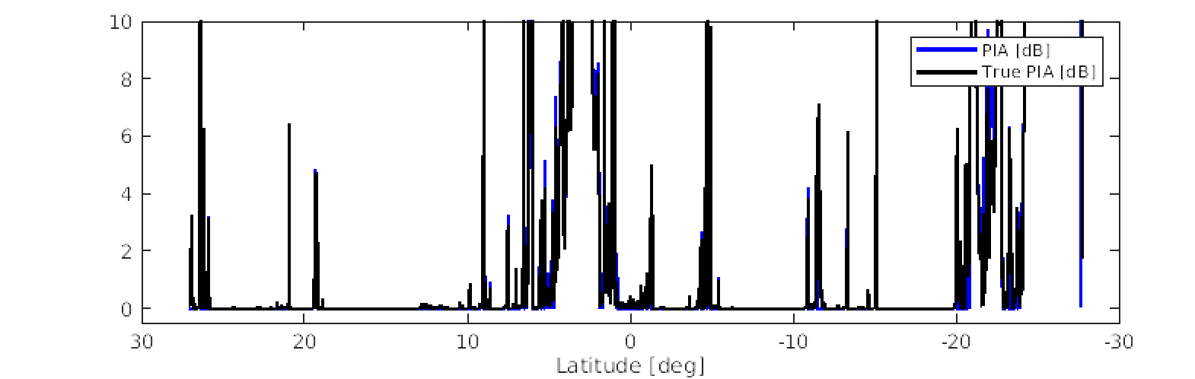



C-FMR PIA ESTIMATION
OLD METHOD
$$PIA=σ_{noatt}− σ_{0 }−A_{g}$$
NEW METHOD
Combination of old method and
$$PIA=σ_{clr} − { σ}_{0 }$$
$σ_{clr}$ from observations

Slide 16
C-CD Sedimentation velocity estimate
ALGORITHM DESCRIPTION
VALID INPUT
  reflectivity regime : > -21 < Z < 21 dBZ, divided into 3 dB
  temperature regime: -60 < T < 0 deg C ,divided into 2 deg bins
  Input velocity estimate: Doppler velocity corrected for non-uniform beam filling
METHOD
For each pixel inside of valid Z,T regime, we construct a sampling window (100 km x 300 m)
A sample of velocity created from velocity values in the reflectivity and temperature bins corresponding to central point
Sedimentation velocity computed as mean velocity of the sample
Sedimentation velocity error computed as sample standard deviation

Slide 17
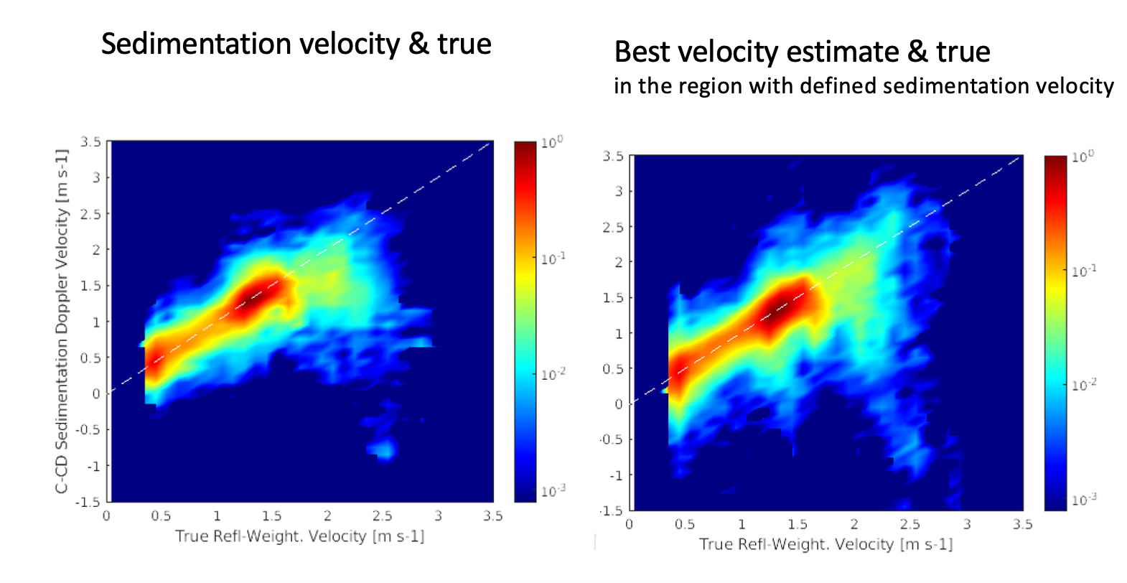
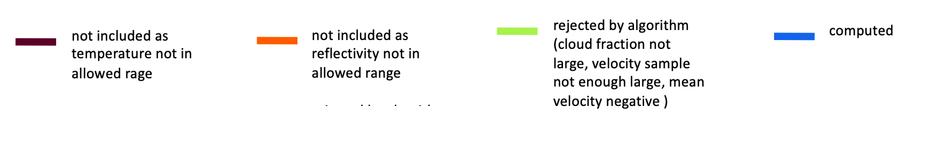
C-CD Sedimentation velocity estimate
Notes:
0 = very confident values of sedimentation velocity,sd < 0.5 mean sd
1 = confident values of sedimentation velocity, sd between 0.5 mean sd and 1 mean sd
2 = somewhat confident values of sedimentation velocity, sd between 1 mean sd and 2 mean sd
3 = not confident values of sedimentation velocity, sd > 2 mean sd
10 = rejected as velocity estimate < 0,
11 = rejected as velocity sample not large enough,
12 = not included as cloud fraction not enough large,
20 = not included as reflectivity below threshold ,
30 = not included as temperature not in required range

Slide 18
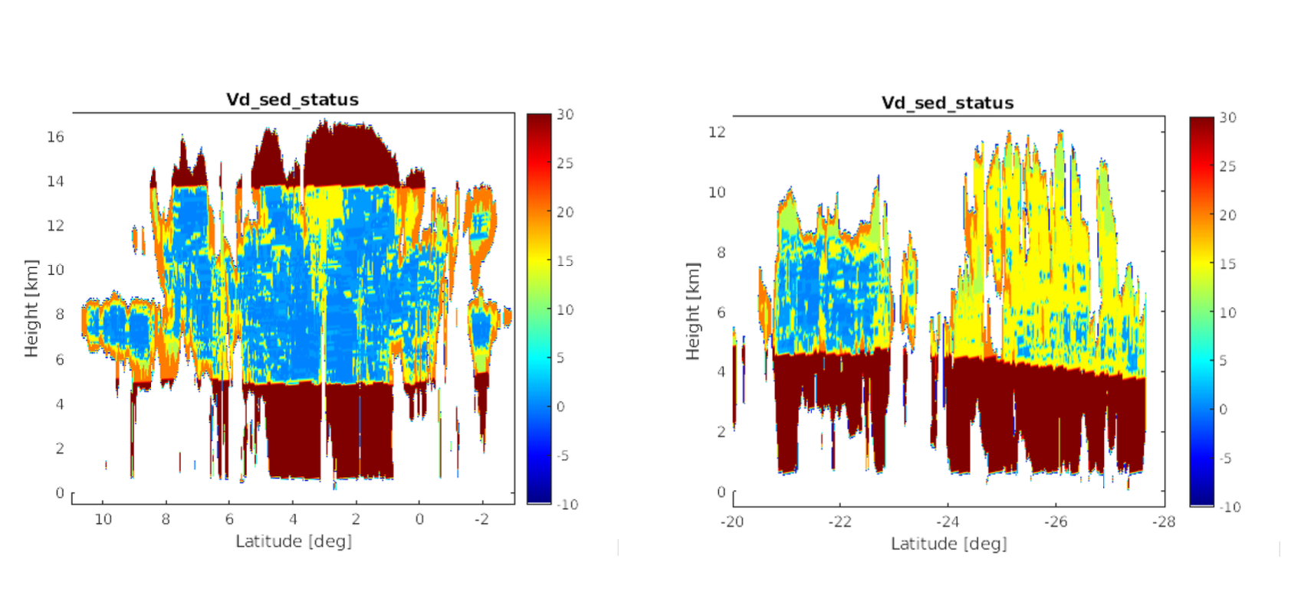
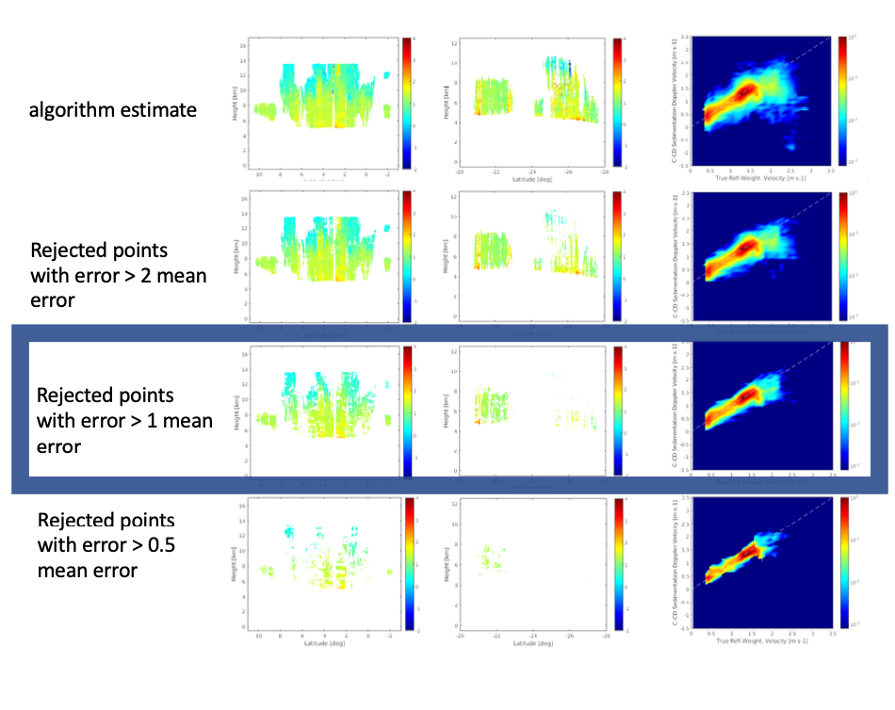
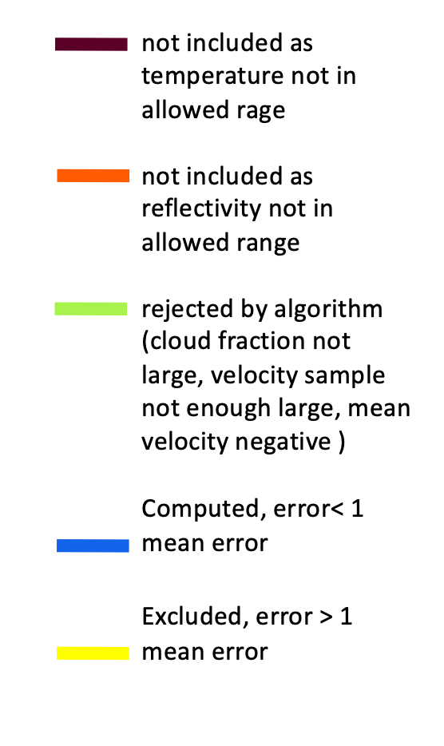
C-CD Sedimentation velocity estimate
Notes:
BLUE - sd < sd_mean
Yellow, Sd > sd_mean excluded

Slide 19
C-CD Sedimentation velocity estimate
How to populate gaps ?
  -> Use average value of sedimentation velocity computed using running window
      Size of running along track window: 10 km along track and 300 m vertical
      Mean value computed if number of pixels with sed. velocity > 50 % of max number
      Number of iteration: 30
  Results deteriorate:
      large size of along track window
      low value of threshold for computation of the mean
      small number of iteration

Slide 20
C-CLD: Summary of development
v5-v6:
  C-CLD code optimization (parallelisation): The processor’s source code has been restructured to allow an easier implementation of multithreading . The performance requirements are met for Halifax and Baja scene.
  Maintaining the interface with C-PRO products (modified definition of height coordinate in all C-XXX products, changes in definition of the C-TC variables )
  C-CLD retrieval has been verified for physical consistency using three nominal test scenes (fixPRF and varPRF)
  Refinements of different algorithms (improved stability of the solution when retrieving the profiles with cold rain and ice/snow layer due to low quality of the input Doppler measurements)
Notes:
handling of frame margins, maintaining interfaces with C-PRO products

Slide 21
C-CLD – BRIEF DESCRIPTION AND OVERVIEW
from C-TC classification
retrieval method
C-CLD
Ice
Snow
Rimed snow
Rain from melting
Warm rain
Drizzle free cloud
Cloud with light drizzle
-OE technique, with/without Doppler
-Measurement vector: reflectivity, Doppler velocity (as proxy of reflectivity weighted velocity)
-State vector: logarithms of water content and mean mass-weighted diameter
ice
-OE technique, with/without Doppler; with/without PIA
-Measurement vector: reflectivity, Doppler velocity (as proxy of reflectivity weighted velocity)
-State vector: logarithms of water content and mean mass-weighted diameter
-Warm rain subcategories: heavy drizzle and very light rain, light rain, moderate rain
- PIA and melting layer used as constraints
rain
-Retrieval based on the empirical relationships ( reflectivity and liquid water content and effective radius, reflectivity and precipitation rate, cloud profile from adiabatic model, …)
-Separation of the profiles into two categories is due to inapplicability of Z-LWC relationship in the presence of drizzle-sized drops
-Separate methods for PIA available and not available
-Retrieved: cloud water content and effective radius
cloud

Slide 22
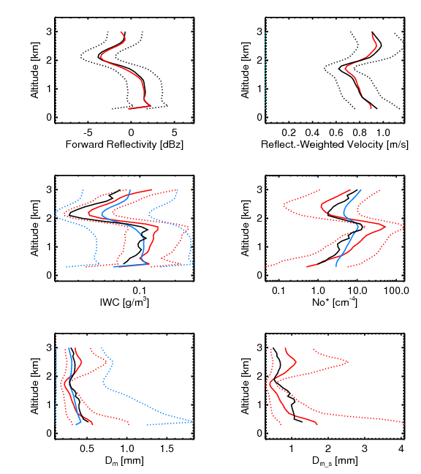
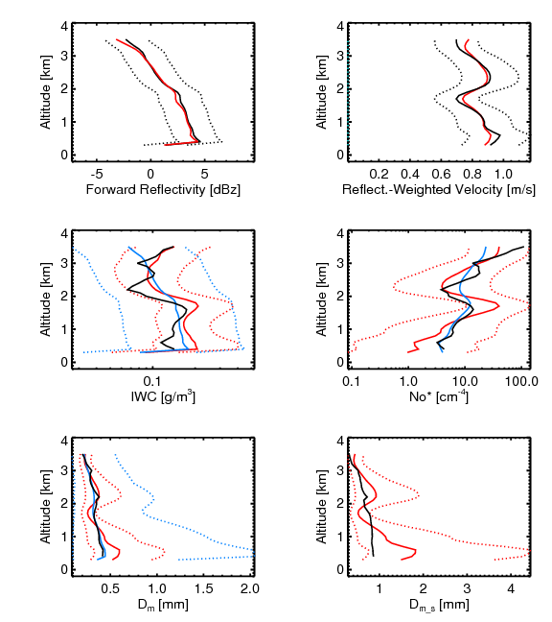
C-CLD Retrieval Example – Precipitating Snow
Input
input ± input error
input modified, Uin*
Uin*± error
forward
true profiles*
apriori
apriori ± error
retrieved
retrieved ± error
Obtained using collocated X- and W‑band vertically pointing Doppler radars
Microphysical calculations in validation profiles different from CLD-model microphysical relations

Slide 23
C-CLD Retrieval Example – Precipitating Snow
Input Doppler Velocity = a proxy for reflectivity weighted velocity
  Uncertainty in retrieval due to presence of the vertical air motion
    when we are in transition regime and convective situations, we do not have reliable Doppler measurements and this will impact our retrieval ( Dm mainly)
  In addition, an unknown presence of LWC (CPR only measurements ) will make impossible to account for attenuation and restore unatenuated Z (Dm and WC)
  => Retrieval results progressively less trusting/confiding when entering into transition regime from stratiform to convective
For CPR reflectivity < ~ -21 dBZ , measured Doppler velocity doesn’t provide any information
Input
input ± input error
input modified, Uin*
Uin*± error
forward
true profiles*
apriori
apriori ± error
retrieved
retrieved ± error
Obtained using collocated X- and W‑band vertically pointing Doppler radars
Microphysical calculations in validation profiles different from CLD-model microphysical relations

Slide 24
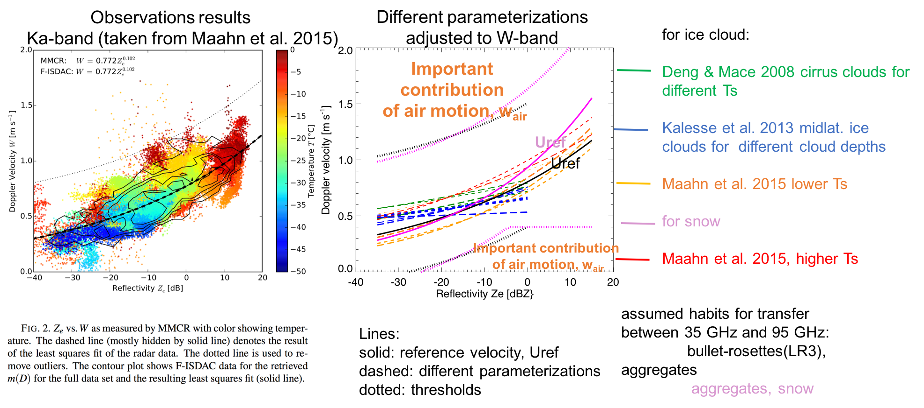
C-CLD : contribution of air motion to Doppler velocity
identification of profile parts with important contribution of air motion (w_{air}) to the input Doppler velocity, U_{d}, deduced from the deviation of U_{d} from the reference reflectivity-weighted hydrometeor velocity U_{ref} (computed from average empirical relationships between reflectivity-weighted velocity and reflectivity).
Line Color:
Ice:
Deng & Mace 2008 cirrus clouds for different Ts
Kalesse et al. 2013 midlat. ice clouds for different cloud depths
Snow:
Maahn et al 2015 lower Ts
Maahn et al. 2015, higher Ts
Assumed habits for transfer from Ka-band to W-band: bullet-rossetes for ice, aggregates for snow

Slide 25
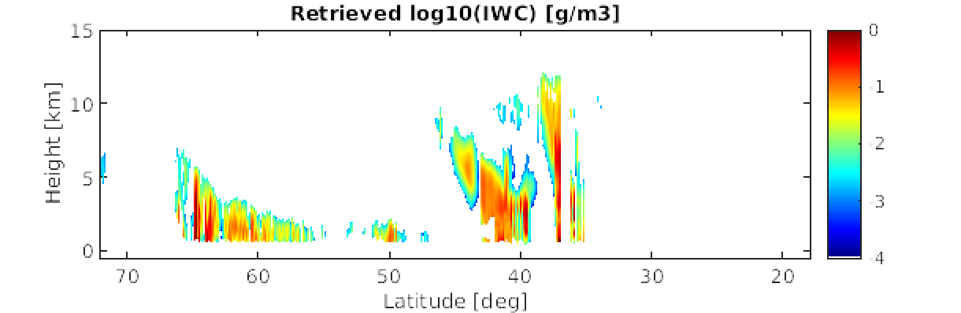
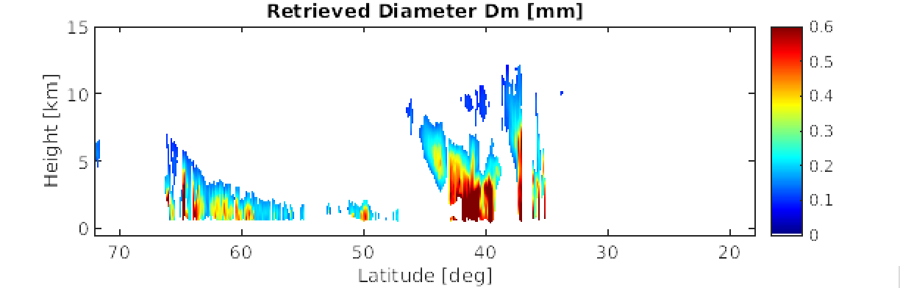
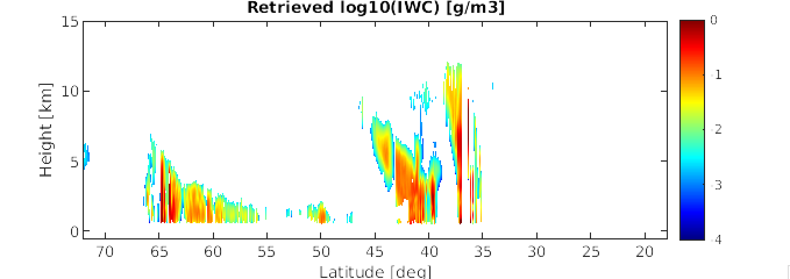
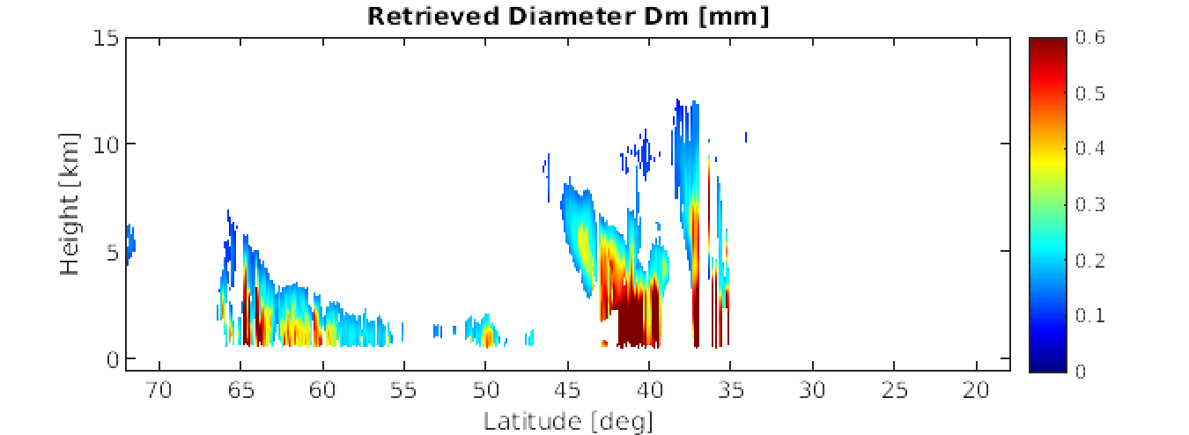
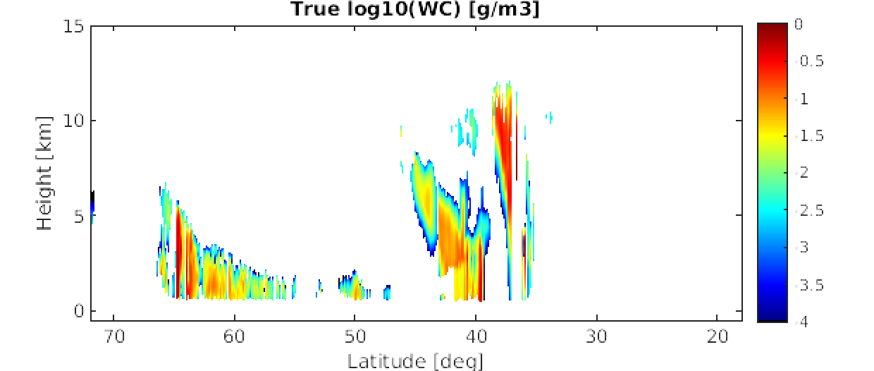
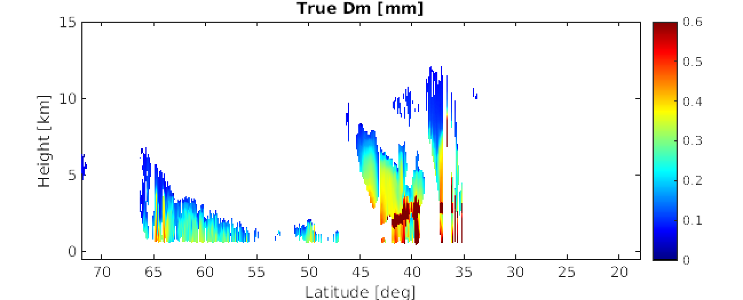
C-CLD : retrieved water content & particle size
Fix PRF
Var PRF
True

Slide 26
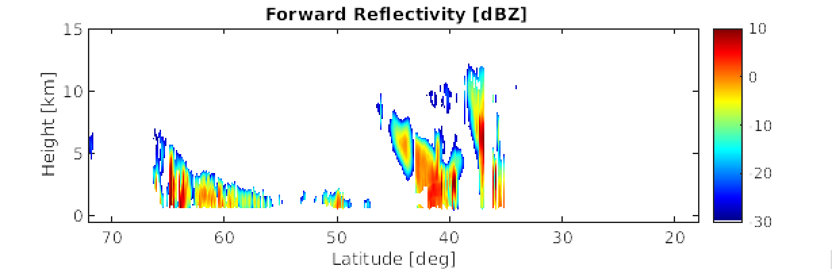
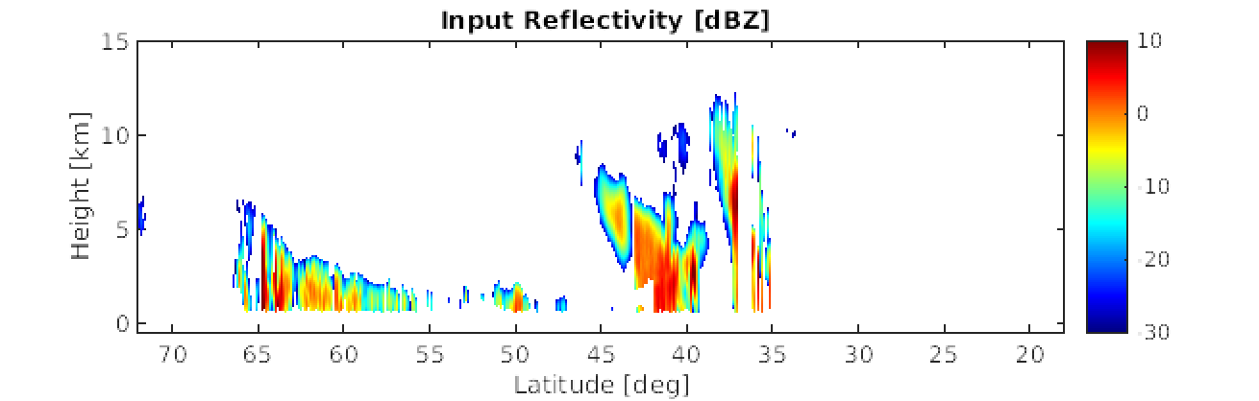
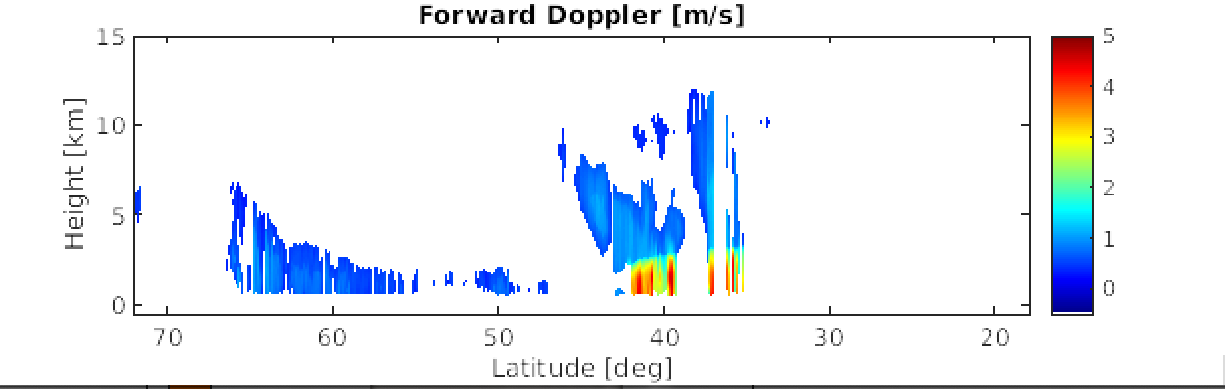
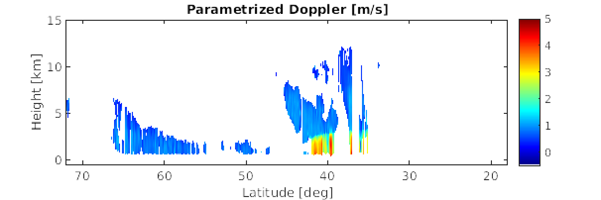
C-CLD : Forward-modelled Reflectivity & Doppler
Doppler Velocity used in C-CLD

Slide 27
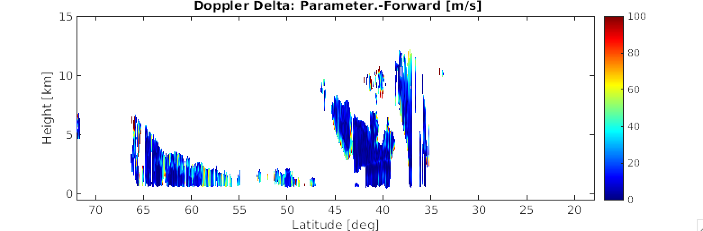
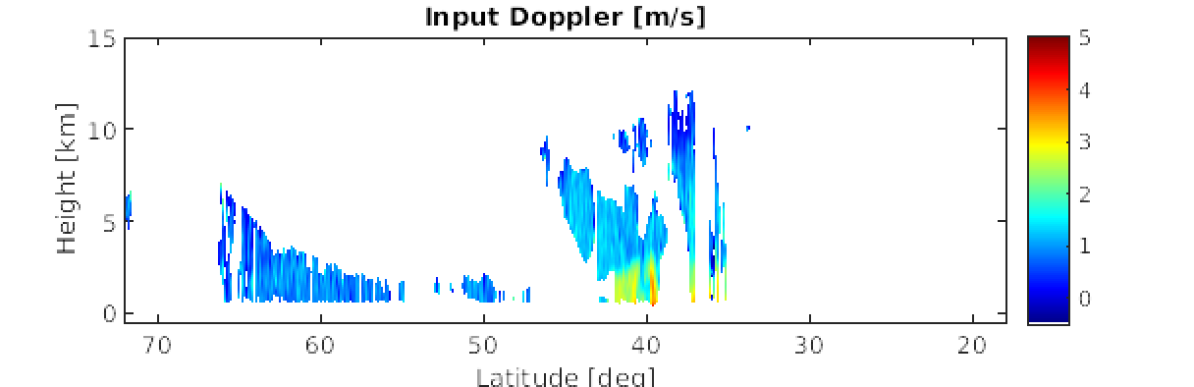
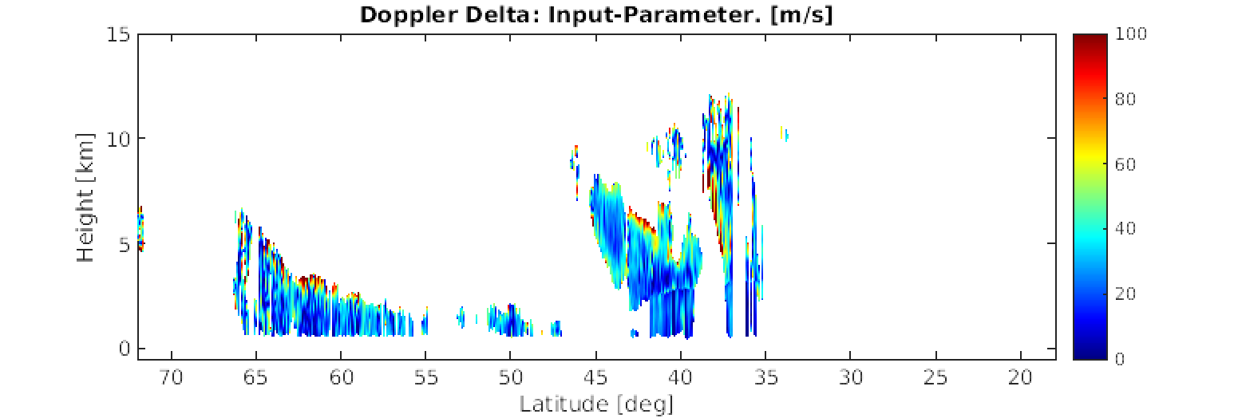
C-CLD : Doppler velocity used in the retrieval
100x|Vpar.-Vfor|/Vfor
Vpar
Doppler Velocity used in C-CLD
100x|Vin-Vpar|/Vpar
Vin
C-CD Best Estimate Velocity

Slide 28
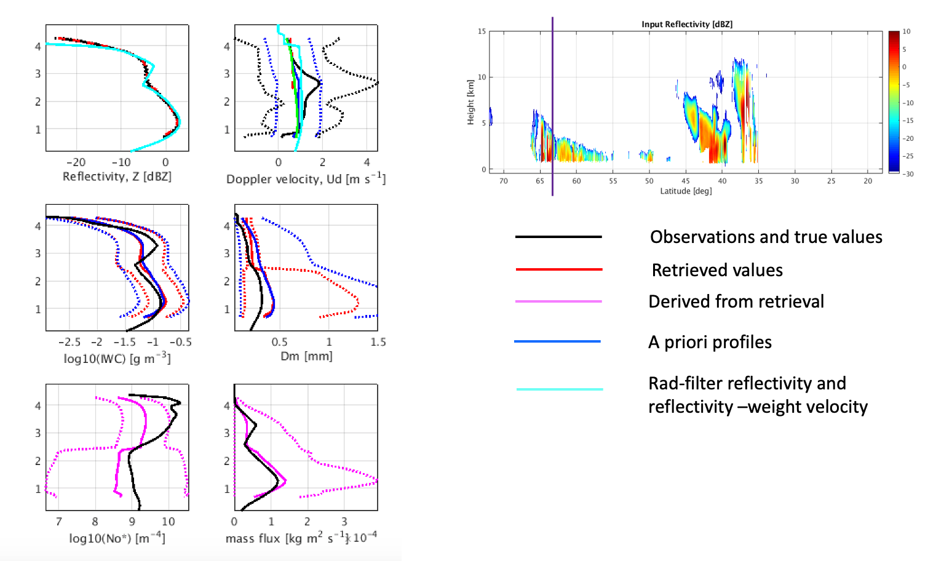
C-CLD : Doppler velocity used in the retrieval

Slide 29
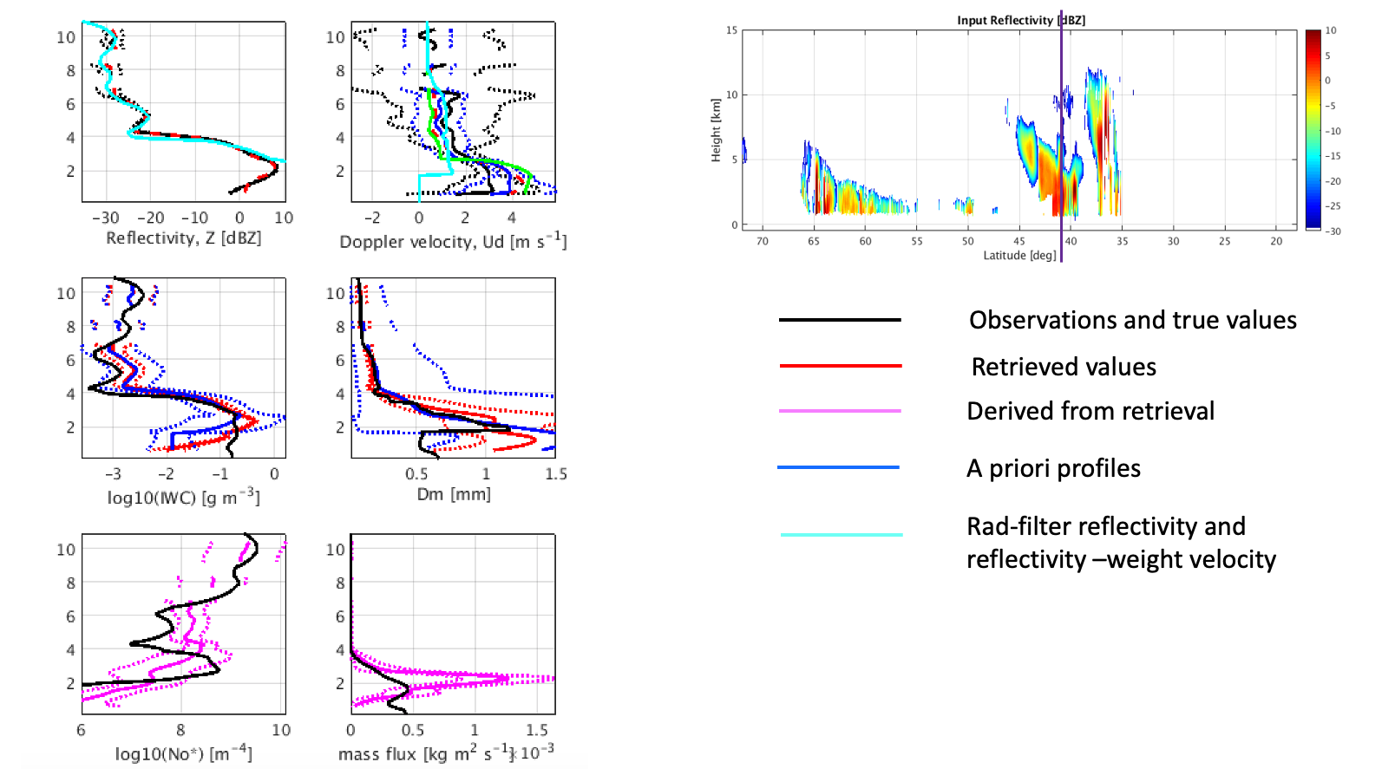
C-CLD : Doppler velocity used in the retrieval

Slide 30
Summary of our developments
C-FMR: Improved C-FMR reflectivity and PIA estimates
C-CD: Verified processing of Doppler velocity and ongoing work on sedimentation_velocity_best_estimate
C-TC: Improved definition of classification variables
C-CLD: processor parallelization and other technical work, starting faze of algorithm verification and improvement
the algorithm for mispointing correction introduced and completed interface with C-APC product
Interface with L1 CPR data completed to the best of our knowledge (McGill’s C-NOMs ~ C-NOMs produced by JAXA)

Slide 31
THANK YOU

