Slide 1
EarthCARE Geophysical Data Products and Retrievals
Final Presentation of APRIL, DORSY, CLARA/ICERAD Contracts
European Space Agency

Slide 2
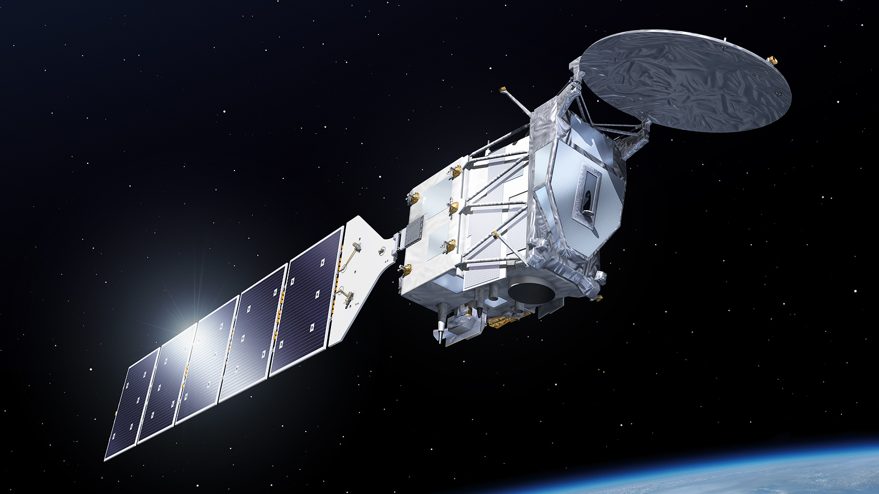





ESA’s sixths Earth Explorer Mission, implemented in cooperation with JAXA
Mission goal: relationship of clouds, aerosol and radiation
Observations:
Cloud profiles
Aerosol profiles
Broad-band radiation and heating rates related to clouds/aerosols
Launch: March 2023
ESA: satellite, lidar, radar radiometer, launch, operations
JAXA: radar instrument
ESA UNCLASSIFIED - For Official Use
ESA UNCLASSIFIED – For Official Use

Slide 3
EarthCARE
Payload & Level 1 Products
HSR Lidar
λ=355nm: Rayleigh, Mie, depol. channels
Level 1: attenuated backscatter profiles*
94GHz Radar, with Doppler (JAXA/NICT)
Level 1: Reflectivity* and Doppler profiles
*planned assimilation at ECMWF
Multi-spectral Imager:
4 solar + 3 thermal IR channels
Level 1: TOA radiances and brightness temperatures in 7 spectral bands
Broad-band Radiometer:
3 fixed FoV
Level 1: Solar and thermal TOA radiances (filtered, unfiltered as Level 2 product)

Slide 4
EarthCARE Scientific Exploitation
(1) Geophysical data retrieved from Lidar, Radar, Imager, Radiometre:
operational production of complex and comprehensive set of geophysical products (ESA, JAXA) → APRIL, DORSY, CLARA/ICERAD
(2) Operational Assimilation by ECMWF
radar reflectivity, lidar backscatter, more
data monitoring → quality feedback → assimilation in oper. NWP
(3) Climate Model Evaluation
EarthCARE Climate Products (CLIMP), Project of LMD/IPSL
Related to CFMIP (Cloud Feedback Model Intercomparison Project)
Notes:
Note on CPR
Baseline delivery date April 2021 refers to the delivery of the CPR with redundant High Power Transmitters (HPT)
JAXA indicated new issues with one the HPTs (HPT-A). This could have schedule impact.
Work-around under consideration in order to maintain launch schedule: delivery of CPR to Airbus with non-redundant HPT configuration at target delivery date, so that integration/testing can proceed. Later replace dummy HPT with spare transmitter once it becomes available.
HPT repair also affected by closure of “non essential” industries in Italy

Slide 5
CPR Level 1b (JAXA)
Radar reflectivity and Doppler velocity profiles
ATLID Level 1b (ESA)
Attenuated backscatter in
Rayleigh channel
Co-polar Mie channel
Cross-polar Mie channel
MSI Level 1b/c (ESA)
TOA radiances for four solar channels, TOA brightness temperatures for three thermal channels
BBR Level 1b (ESA)
Filtered TOA short-wave and total-wave radiances
Note: uncorrected for instrument effects
CPR Level 2a
Radar echo product, feature mask, cloud type, liquid and ice cloud properties, vertical motion, rain and snow estimates, ...
ATLID Level 2a
Feature mask and target classification, extinction, backscatter & depol. profiles, aerosol properties, ice cloud properties, ...
MSI Level 2a
Cloud mask, cloud micro-physical parameters, cloud top height, aerosol parameters, ...
BBR Level 2b
Unfiltered top-of-atmosphere radiances, short-wave and long-wave fluxes
Products are enhanced by using MSI
Synergistic Level 2b
Target classification, cloud & aerosol prof. at x-sectn, …
EarthCARE
Data Production
Model
Operational software developed directly by science teams
3D Scenes Construction
Expand syn. retrievals across-track using MSI; ≈40km wide
Assessment
Comparison of calculated fluxes and radiances to BBR observations
Radiative Transfer Products
calculated radiances, fluxes, heating rate profiles
Slide 5

Slide 6
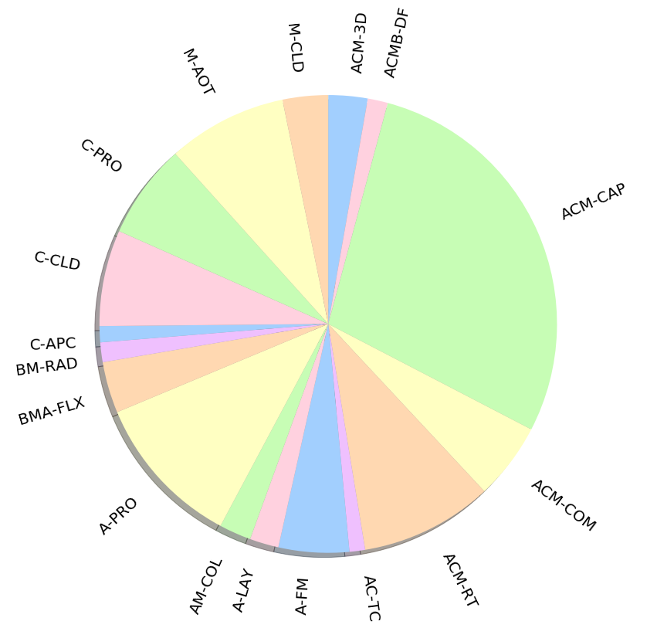
APRIL/CLARA/DORSY in numbers
9
institutions
17
processors
25
data products
>158
documents
>26
scientists
174k
lines of code
>1000
parameters
Notes:
Note on CPR
Baseline delivery date April 2021 refers to the delivery of the CPR with redundant High Power Transmitters (HPT)
JAXA indicated new issues with one the HPTs (HPT-A). This could have schedule impact.
Work-around under consideration in order to maintain launch schedule: delivery of CPR to Airbus with non-redundant HPT configuration at target delivery date, so that integration/testing can proceed. Later replace dummy HPT with spare transmitter once it becomes available.
HPT repair also affected by closure of “non essential” industries in Italy

Slide 7
End-to-end simulator and software support
Not part of today’s presentation but essential part of the EarthCARE L2 developments:
Parallel activity “ECS-L” with GMV-NSL (UK)
developing
end-to-end simulator framework E3SIM
common software library used by all EarthCARE L2 processors
common test tools
and providing continuous software review and support to L2 developers.
Notes:
Note on CPR
Baseline delivery date April 2021 refers to the delivery of the CPR with redundant High Power Transmitters (HPT)
JAXA indicated new issues with one the HPTs (HPT-A). This could have schedule impact.
Work-around under consideration in order to maintain launch schedule: delivery of CPR to Airbus with non-redundant HPT configuration at target delivery date, so that integration/testing can proceed. Later replace dummy HPT with spare transmitter once it becomes available.
HPT repair also affected by closure of “non essential” industries in Italy

Slide 8
From CASPER to CARDINAL
CASPER
ATLAS
APRIL
CARDINAL
== ATLID and ATLID/MSI synergy ==
IRMA
== MSI (clouds and aerosols) ==
RATEC
VARSY
DORSY
== CPR and ATLID/CPR/MSI synergy ==
FLURB
CLARA
== BBR, radiation and assessment ==
2007
2009
2011
2014
2021
2023
Notes:
Note on CPR
Baseline delivery date April 2021 refers to the delivery of the CPR with redundant High Power Transmitters (HPT)
JAXA indicated new issues with one the HPTs (HPT-A). This could have schedule impact.
Work-around under consideration in order to maintain launch schedule: delivery of CPR to Airbus with non-redundant HPT configuration at target delivery date, so that integration/testing can proceed. Later replace dummy HPT with spare transmitter once it becomes available.
HPT repair also affected by closure of “non essential” industries in Italy

Slide 9
Agenda
1. Opening remarks (ESA) - 10 min.
2. Executive summary (APRIL/CLARA/DORSY) - 3x15 min.
3. Scientific achievements
a. Common reference scenes (presented by APRIL project) - 15 min.
b. APRIL: ATLID, MSI and ATLID/MSI synergy - 60 min.
Break - 20 min.
c. DORSY: CPR and ATLID/CPR/MSI synergy - 50 min.
d. CLARA: BBR, radiation and assessment - 60 min.
e. Cross-project intercomparisons (presented by DORSY project) - 10 min.
Adjourn 1200 ET/1700 GMT/1800 CET/200 JST
Notes:
Note on CPR
Baseline delivery date April 2021 refers to the delivery of the CPR with redundant High Power Transmitters (HPT)
JAXA indicated new issues with one the HPTs (HPT-A). This could have schedule impact.
Work-around under consideration in order to maintain launch schedule: delivery of CPR to Airbus with non-redundant HPT configuration at target delivery date, so that integration/testing can proceed. Later replace dummy HPT with spare transmitter once it becomes available.
HPT repair also affected by closure of “non essential” industries in Italy

