Slide 1


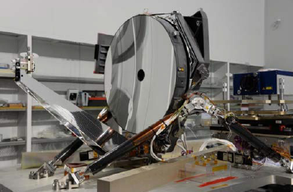
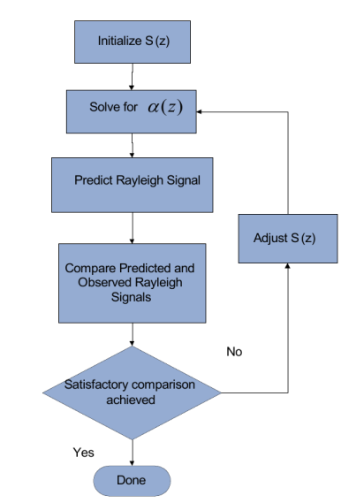
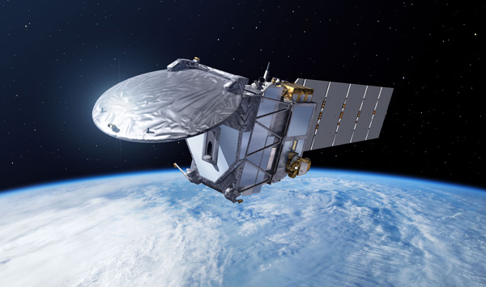
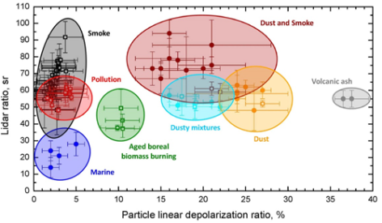
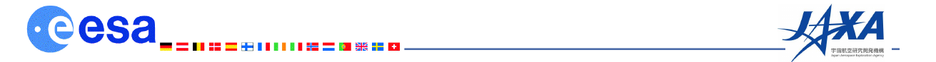
Royal Netherlands
Meteorological Institute
Ministry of Infrastructure
and Environment.
ATLID L2a Extinction Backscatter and Depolarization Profile (APRO) Algorithms.
D. P. Donovan¹, Gerd-Jan van Zadelhoff¹, J.E. Williams¹, U. Wandinger²
¹Royal Netherlands Meteorological Institute (KNMI), Utrecht, Netherlands,
²Leibniz Institute for Tropospheric Research. Leipzig, Germany

Slide 2


Processor | A-PRO (ATLID Profile processor)
Input Products | FeatureMask ATLID L1 3. Auxiliary Met data
Output Products (reported on Joint standard Grid grid) | Aerosol and cloud optical properties. Target Classification Aerosol type
Royal Netherlands
Meteorological Institute
Ministry of Infrastructure
and Environment.
Brief Description
Two Step approach to deriving optical properties:
  “Conventional” HSRL techniques applied to smoothed fields.
  High resolution “Optimal Klett-like” retrievals aimed at clouds.
Cloud/aerosol discrimination and aerosol typing based on using Backscatter thresholds as well as S and linear depolarization ratio.
Cloud phase determination via layer integrated backscatter-vs-integrated depolarization ratio.

Slide 3

A-EBD: Optimal-Estimation: Hybrid Mie-Rayleigh High-resolution Extinction Retrieval
Goal is to find the “best” Klett-like inversion that yields an extinction and S profile that allows one to best match the observed Rayleigh signal.
Cast in an optimal estimation framework.
Priors are a combination of expected values and S values derived by the conventional HSRL inversion (pervious step).
Multiple-scattering effects are accounted for.

Slide 4
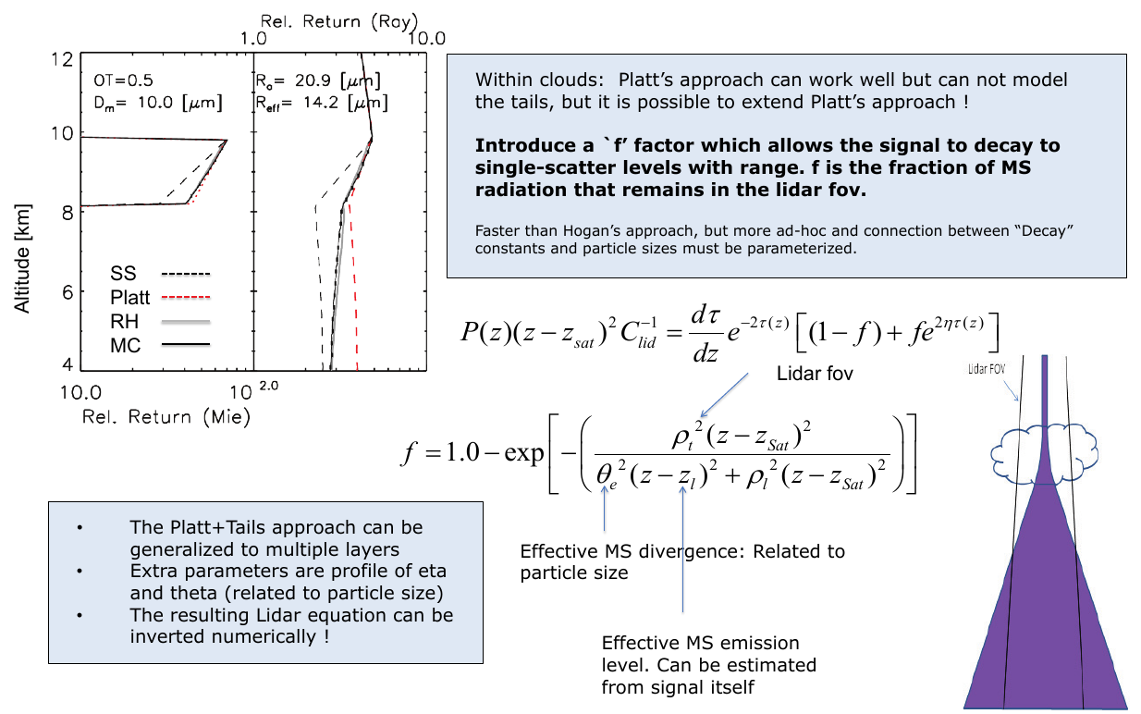
A simple approach for dealing with Multiple-Scattering

Slide 5
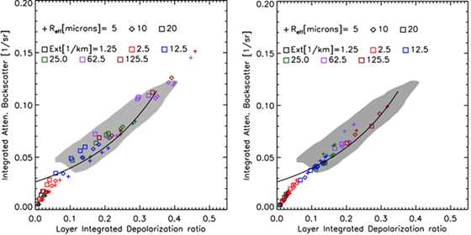

Target Classification (A-TC)
-Cloud/Aerosol separation based on combination of thresholds
and, in the case of thin-ice-vs-aerosol, depol. and lidar-ratio
Cloud phase based on integrated depol. -vs-integrated attenuated backscatter
Aerosol type based on depol.-vs-lidar-ratio
U. Wandinger has formalized a scheme for ECARE using certain base aerosol classes.

Slide 6
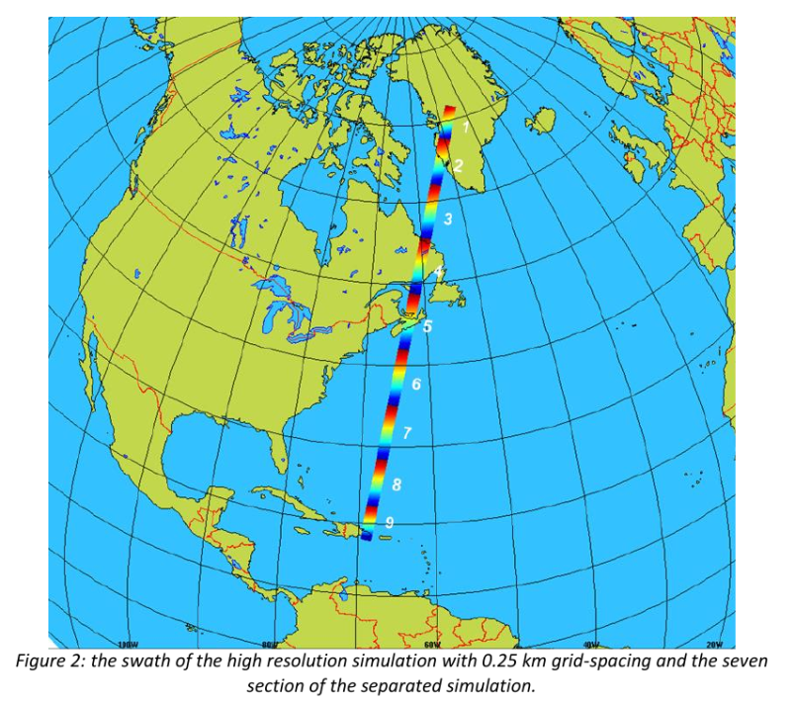
Some Examples based on simulated scenes
Scenes have been built using ECSIM using Environment Canada’s high-res global NWP model run at 0.25 km hor. res.
Clouds/precip. are handled by a two-mode bulk scheme (Milbrandt-Yau)
No Aerosols in provided fields ➔ Merge with ECMWF CAMS fields.
Example (Halifax Scene)

Slide 8
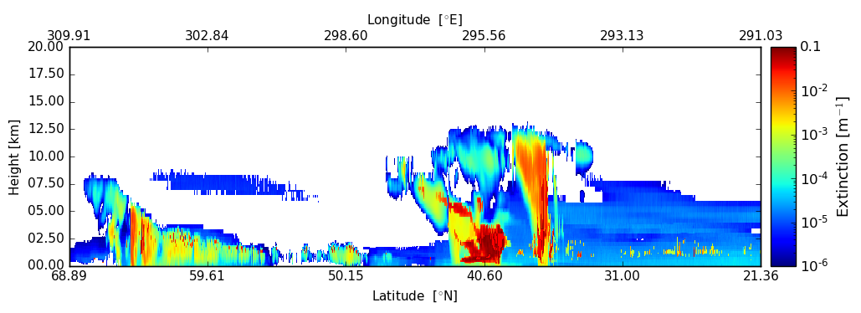
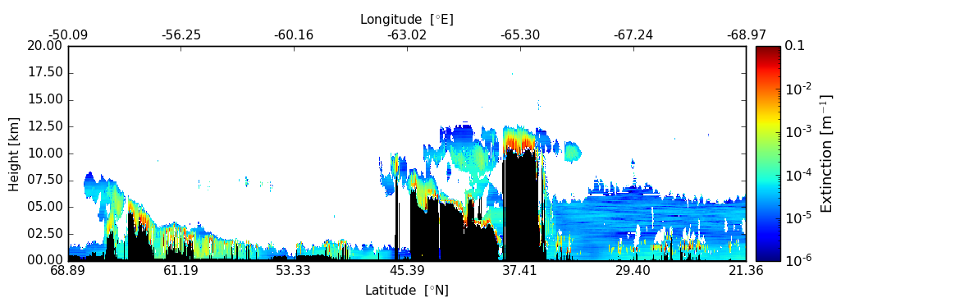
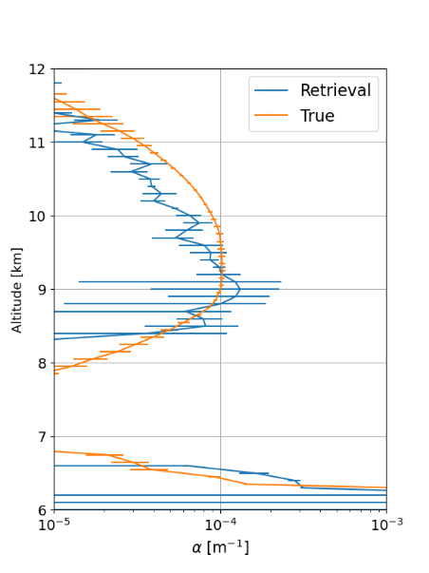
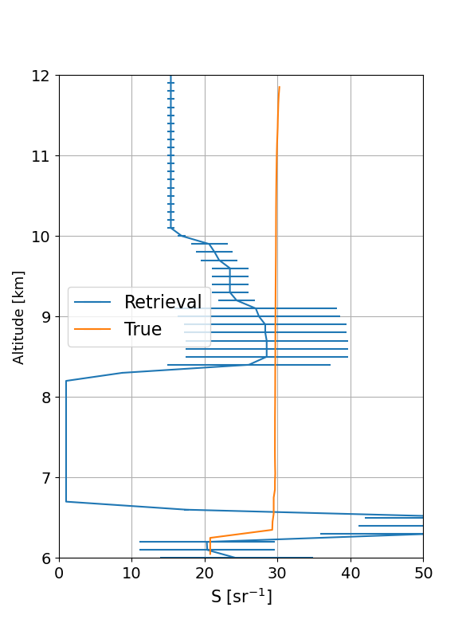
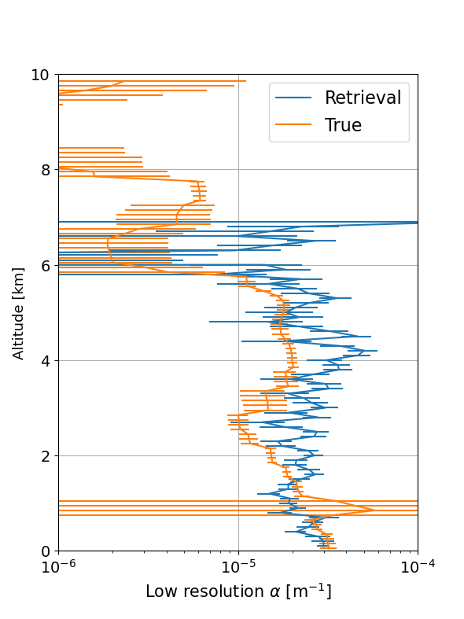
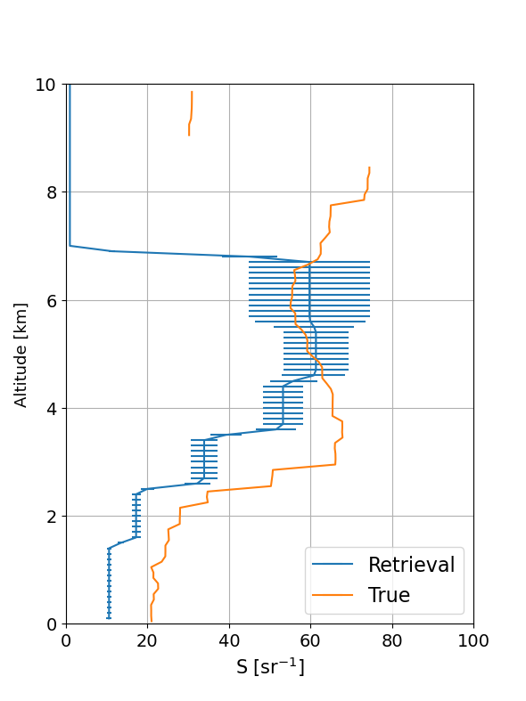
Model Extinction Field
Results are good but can and will improve !
(e.g., there may be biases present)
-Averaging intervals ?
-Improper screening ?
-a-prior weightings ?
-Bugs ?
Retrieved Cloud and Aerosol Extinction

Slide 9
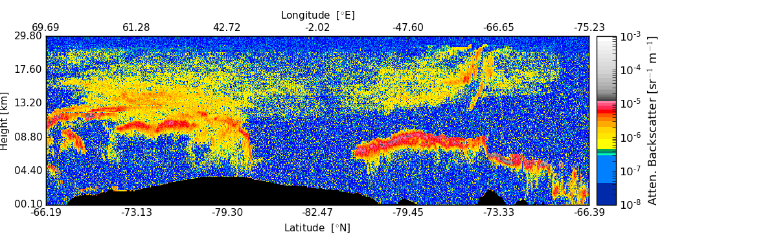
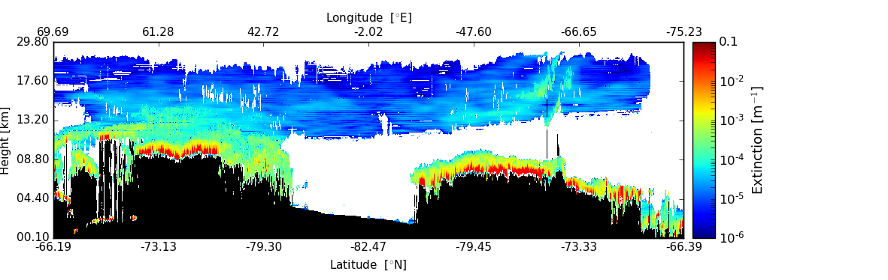
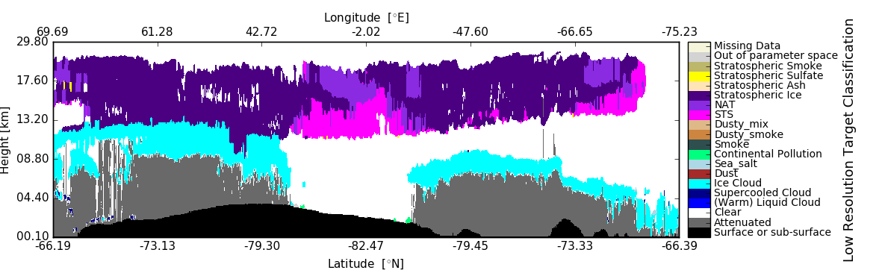
Recent Example of a PSC scene built using CALIPSO/CSAT retrievals
ATLID signals generated using CSAT/CALIPSO retrieval products as a basis for a ECSIM scene.
Retrieved particulate extinction
A-TC output with stratospheric types implemented.

Slide 10
Summary
A multi-scale approach is required.
  Identify “strong-features” at as high a resolution as possible
  Smooth over weak (e.g. aerosol and thin cloud) features.
    This then allows one to apply direct methods.
  Output from above provide constraints for high resolution retrievals of both cloud and aerosols.
Retrieved S and depol. ➔ cloud-phase and aerosol typing.
ATLID specific algorithm has been coded for operation processing
  As well as using simulations, certain code modules and many of the concepts are being tested using ALADIN data.

Slide 11
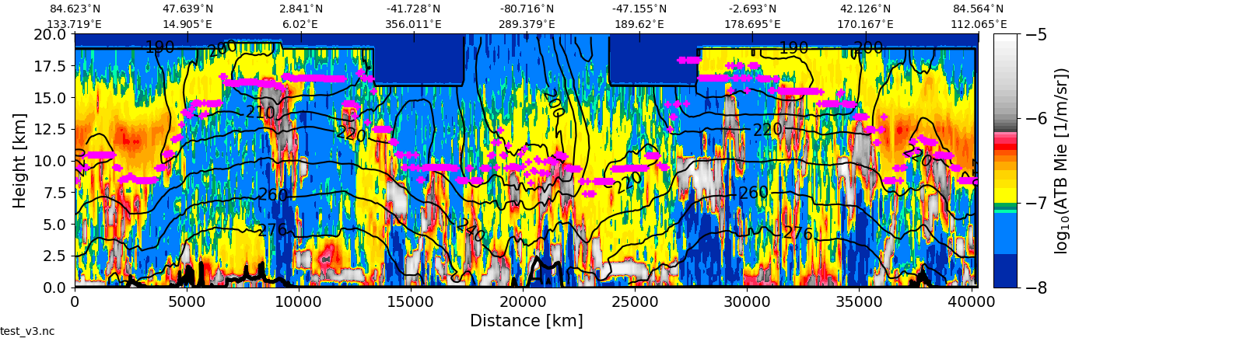
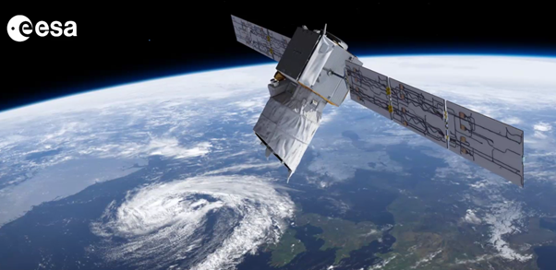
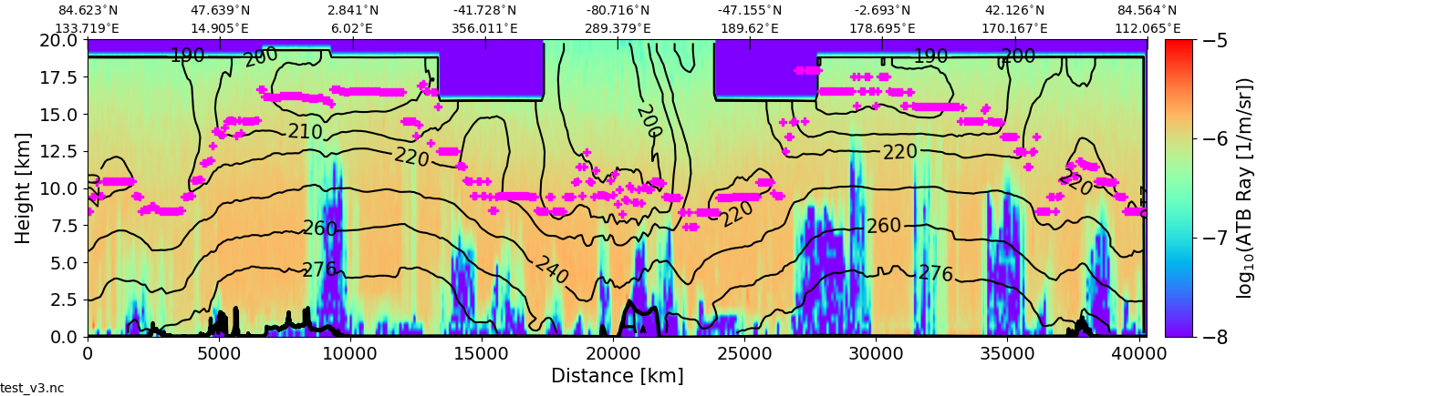
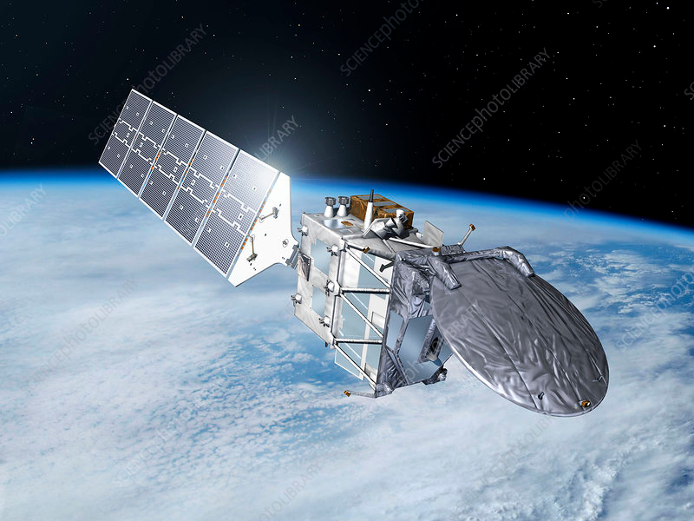
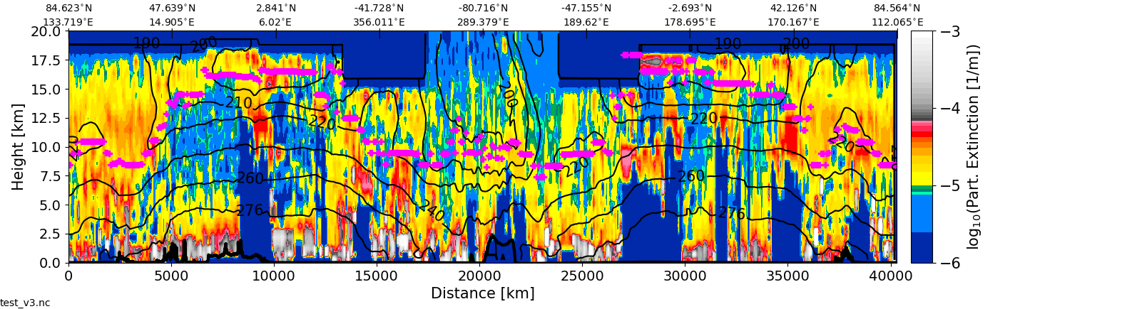
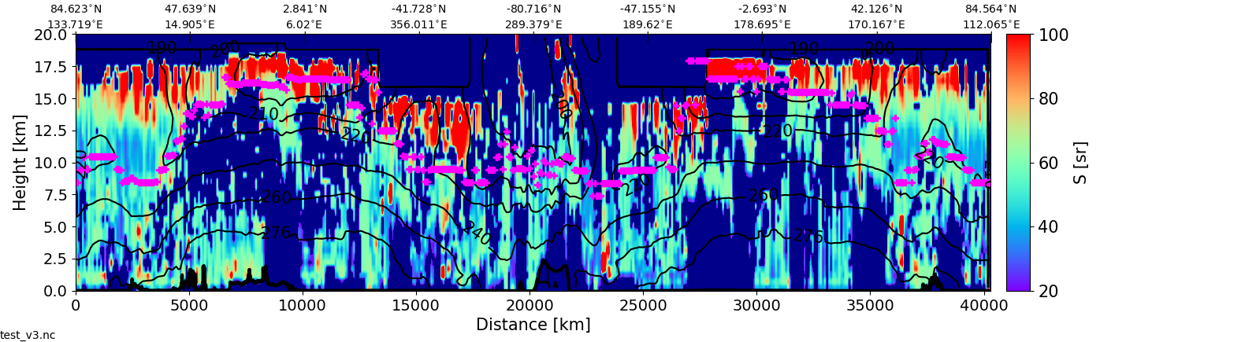

Slide 12
Backup Slides

Slide 13
A-EBD: Optimal-Estimation: Hybrid Mie-Rayleigh High-resolution Extinction Retrieval
Goal is to find the “best” Klett-like inversion that yields an extinction and S profile that allows one to best match the observed Rayleigh signal.
Cast in an optimal estimation framework.
Priors are a combination of expected values and S values derived by the conventional HSRL inversion (pervious step).
Multiple-scattering effects are accounted for.

Slide 14
Aerosol Models
 | Coarse mode: Dust | Coarse mode: Sea salt | Fine mode: Weakly absorbing | Fine mode: Strongly absorbing
r_{eff}, µm | 1.94 | 1.94 | 0.14 | 0.14
m_{R} | 1.56 1.53 | 1.40 1.36 | 1.40 1.45 | 1.50 1.55
m_{I} | 0.005 0.003 | 0.0 | 0.003 | 0.043 0.030
Shape | Dubovik’s spheroid distribution | Spherical 10% prolates with axis ratio 1.1 | Spherical 100% prolates with axis ratio 1.1 | Spherical 100% prolates with axis ratio 1.1
S, sr | 72.5, 63.7 | 13.3 17.1 | 78.3 63.0 | 116.9 74.6
δ, % | 22.8 26.0 | 0.0 3.7 | 0.0 2.2 | 0.0 1.7
ω₀ | 0.81 0.87 | 1.00 1.00 | 0.98 0.98 | 0.81 0.86

Slide 15
A-PRO Components
ATLID-only Aerosol Extinction, Backscatter and Type (A-AER):
-Adaptively averages “non-cloud” signals to derive large hor. scale (10-100 km) aerosol properties.
-Aerosol classification based on depol, S etc.. as well as geography etc.
ATLID-only HRSL Extinction, Backscatter and Depolarization (A-EBD):
-Cloud/aerosol extinction and backscatter on the 1 km hor. scale using an hybrid optimal estimation based combined Rayleigh-Mie technique.

Slide 16
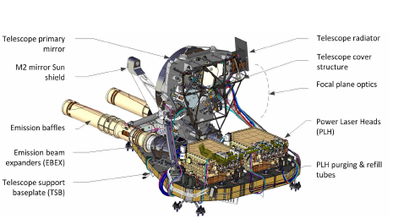
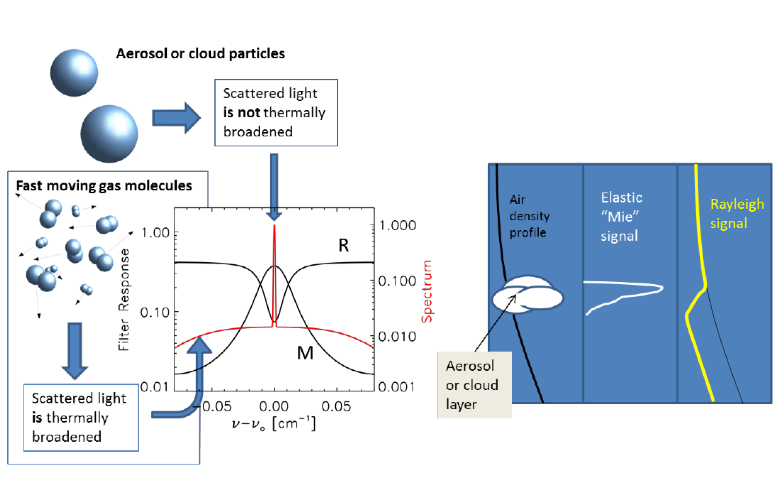
ATLID: Atmospheric Lidar
355 nm High Spectral Resolution Lidar
Compared to CALIPSO
Direct measurement of aerosol extinction
Measurement of extinction-to-backscatter ratio
Improved daylight performance.

Slide 17
Note on averaging
Mixing of strong (e.g. cloud) and weak (e.g. aerosol) returns is NOT desirable.
Cloud returns get blurred out !
Extinction profiles can become meaningless.
(Very) High OT
Low OT
Averaging must be done in a smart manner !
One also needs a ``solver’’ that works at high-hor. res.

Slide 18
Optimal-Estimation: Hybrid Mie-Rayleigh High-resolution Extinction Retrieval
Given a trial S(z) profile (and a way to account for MS) we can predict what should be seen in the Rayleigh channel (i.e.)
Goal is to find the “best” Klett-like inversion that yields an extinction and S profile that allows one to best match the observed Rayleigh signal.
Cast in an optimal estimation framework.
Priors are a combination of expected values and S values derived by the conventional HSRL inversion (pervious step).
Multiple-scattering effects are accounted for.

Slide 19
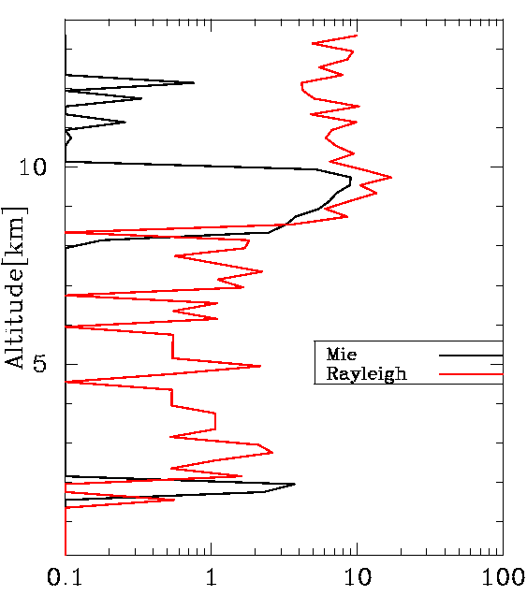
HSRL Extinction , Backscatter and Depolarization
How to use the HSRL info at high hor. res. and deal with Noise ?
-Using the Rayleigh channel signal profile one finds directly that
(1)
-This approach is direct but, signal is too noisy at 1 km scale !
-As mentioned earlier, one can not just simply average to increase the SNR.
-MS factor also should be addressed.
But one the other hand……..

Slide 20
Using the Total signal, one can apply a Klett-like inversion and get useful results even for noisy signals.
(2)
Where is the total signal corrected for Rayleigh extinction
(sum of cross-polar+Mie+Ray signals➔ X-talk coefficients must be specified )
But need to specify Extinction-to-backscatter ratio (and still account for MS)

Slide 21
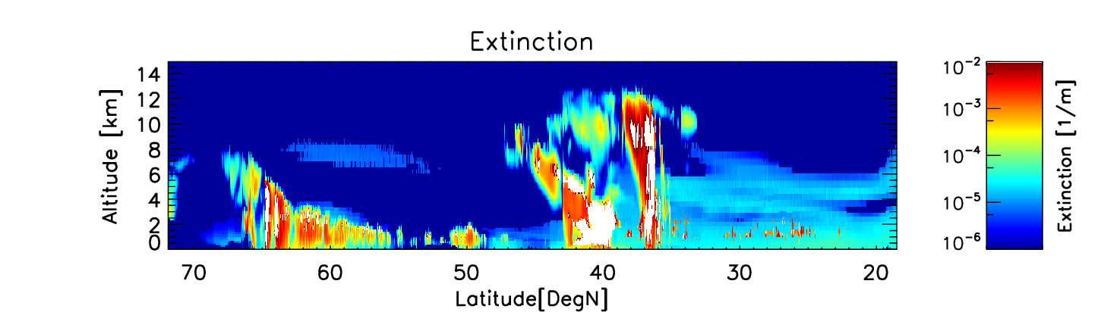
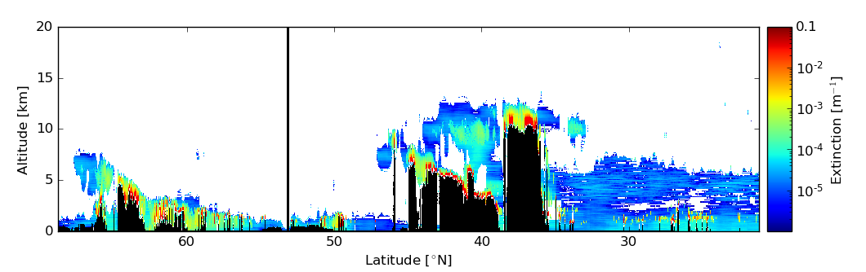
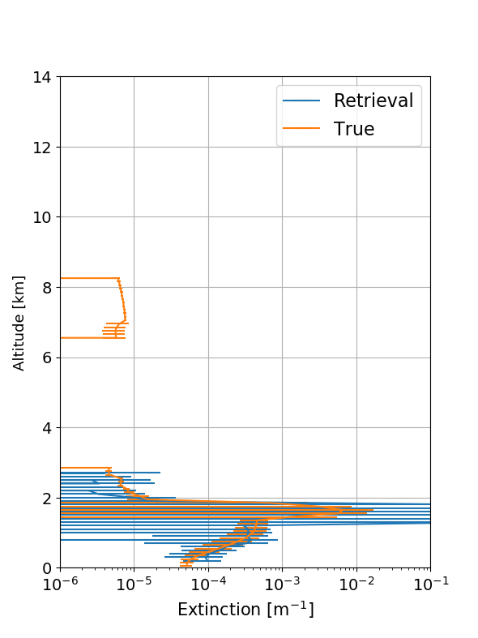
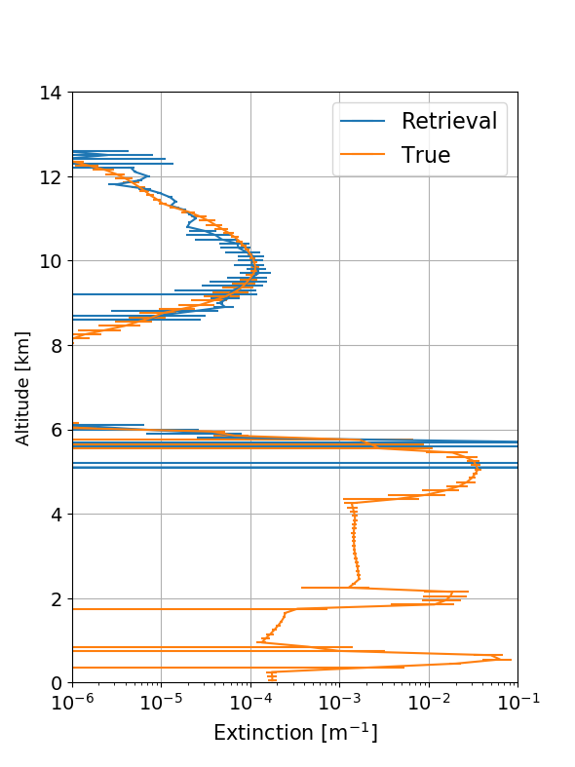
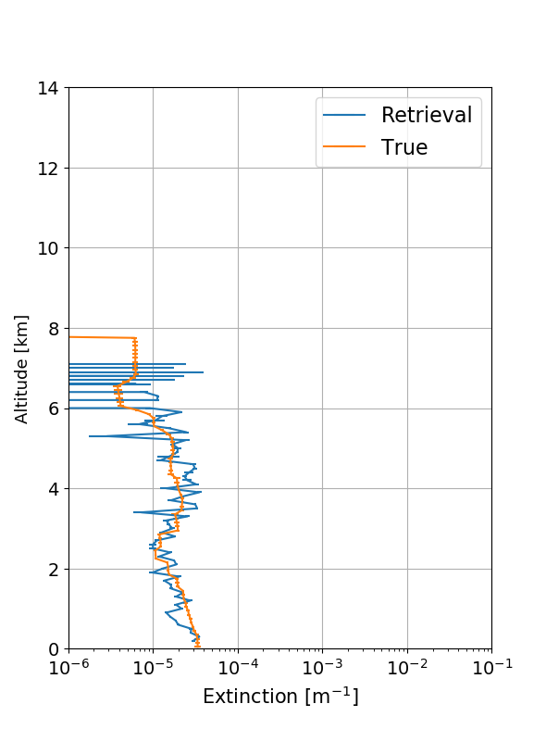
Model Extinction Field
Retrieved Cloud and Aerosol Extinction

