Slide 1
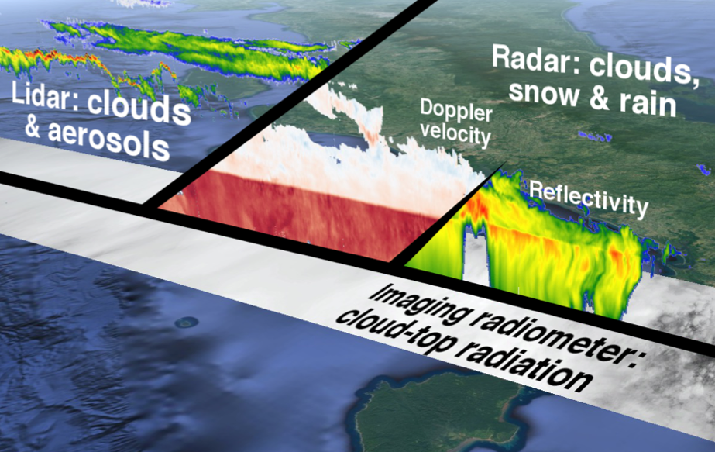
ACM-CAP
Synergistic cloud, aerosol and precipitation retrieval from ATLID, CPR and MSI onboard EarthCARE
Robin Hogan, Shannon Mason & Alessio Bozzo
Thanks to Aleksandra Tatarevic, Abdenour Irbah, Pavlos Kollias, Julien Delanoe and other DORSY collaborators
r.j.hogan@ecmwf.int
Tools developed
Improved retrievals
Radiative evaluation

Slide 2
CAPTIVATE: Cloud, Aerosol and Precipitation from mulTiple Instruments using a VAriational TEchnique
1. Define state variables to be retrieved (x)
Use classification to specify variables at each gate
Ice and snow: extinction coefficient, N₀’, lidar ratio, riming factor
Liquid: water content and number concentration
Rain: rain rate and N_{w}
Aerosol: number concentration
FLOTSAM
Fast solar radiance model
2. Forward model
2a. Radar model
With multiple scattering, Doppler and PIA
2b. Lidar model
Including HSRL channels and multiple scattering
2c. Radiance models
Solar & IR channels
4. Iteration method
Derive a new state vector: Levenberg-Marquardt scheme (quasi-Newton also available)
TSSF
IR radiance model
SSRGA
Microwave ice scattering model
3. Compare to observations (y)
Check for convergence
Not converged
Adept 2.1
Fast automatic differentiation
Converged
5. Calculate retrieval error
Error covariances & averaging kernel
Proceed to next ray

Slide 3
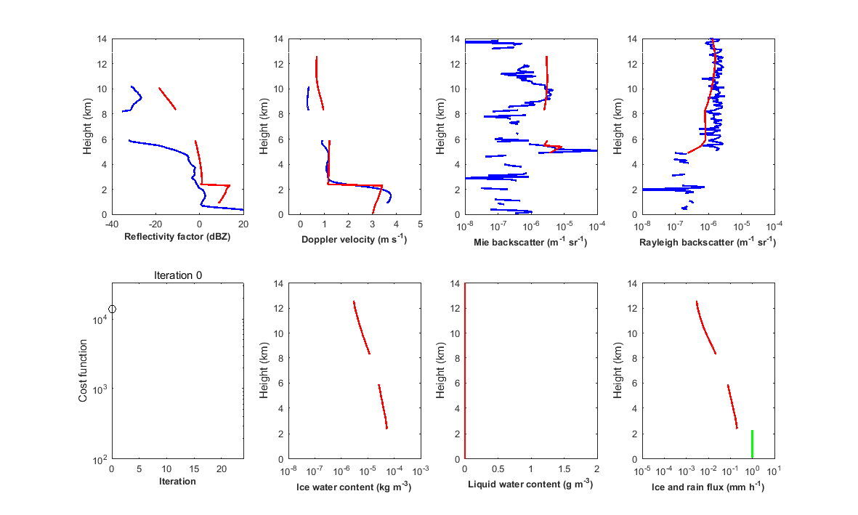
Illustration of iterative retrieval in profile containing liquid, ice and rain
1-sigma error reported in final state; ice & rain fluxes join well
Observations
Forward model
Past iterations
Retrieved variables Observations

Slide 4

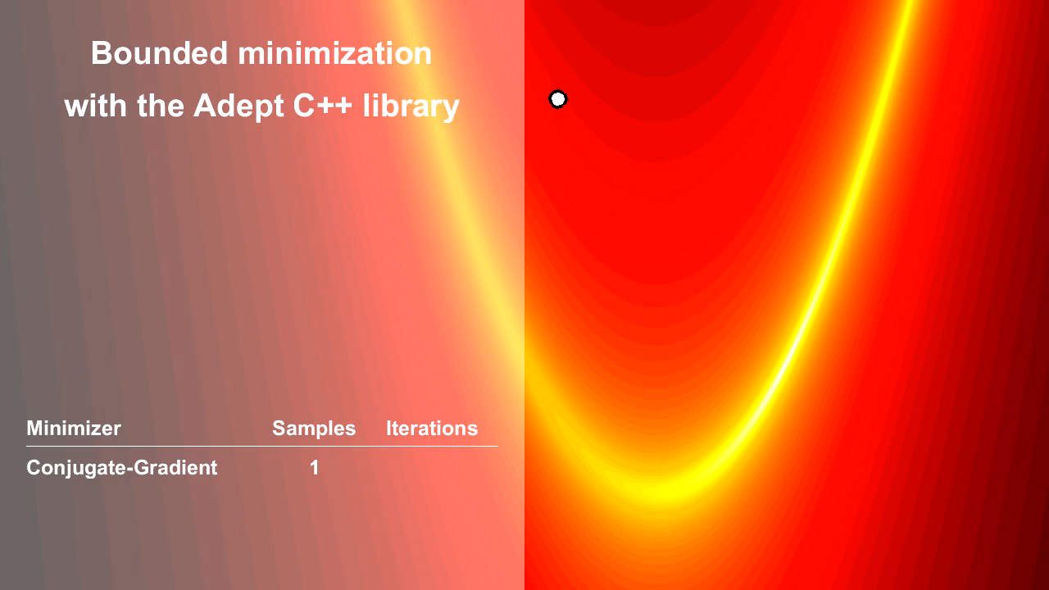
Adept 2.1: Combined array, automatic-differentiation and optimization library in C++
Variational retrieval algorithms require the derivative of the forward model
Adept 1.1 C++ library (Hogan 2014) enabled this to be done automatically, speeding up development, but was slow when combined with array library for whole-array expressions (like Fortran 90, Python etc)
In DORSY we developed Adept 2.0 combining the two: 7x faster for differentiation of array expressions
Adept 2.0 later added OpenBLAS for matrix operations, 8x faster than GSL-CBLAS
Adept 2.1 added bounded and unbounded minimization algorithms
Adept has been used for financial modelling, medical imaging, physical chemistry, parameter optimization and computational fluid dynamics as well as meteorology
  github.com/rjhogan/Adept-2
Computational cost relative to inactive C-style loops

Slide 5
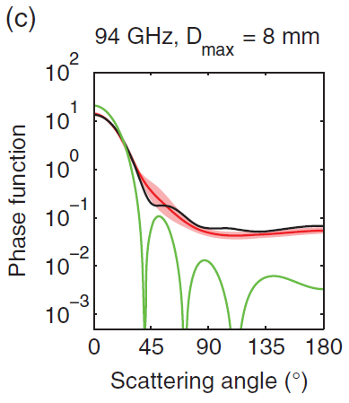
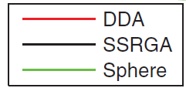
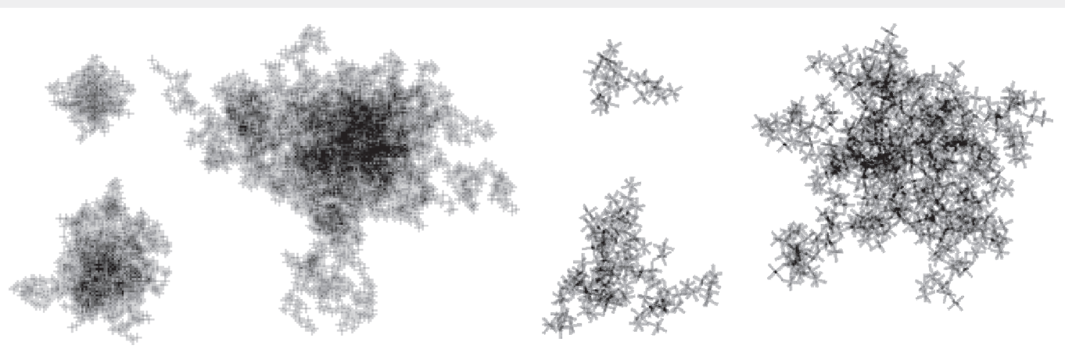
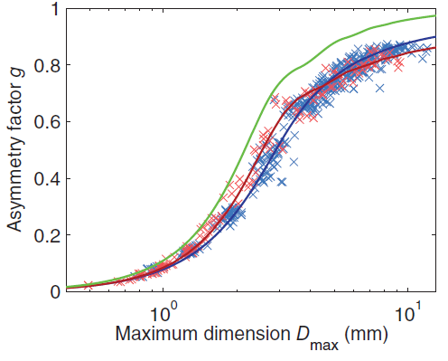
Self-Similar Rayleigh Gans Approximation (SSRGA)
Hogan and Westbrook (2014) developed the fast SSRGA method to compute radar backscatter from ensembles of ice aggregates using a statistical description of the internal structure
In DORSY we extended this to compute the phase function and asymmetry factor (Hogan et al. 2017), needed for radar multiple scattering as well as microwave radiance modelling
Westbrook aggregates
Nowell aggregates
Nowell aggregates
Westbrook aggregates

Slide 6
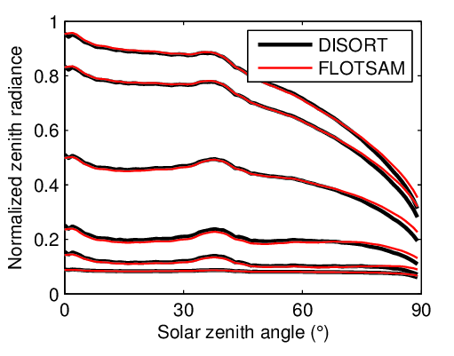

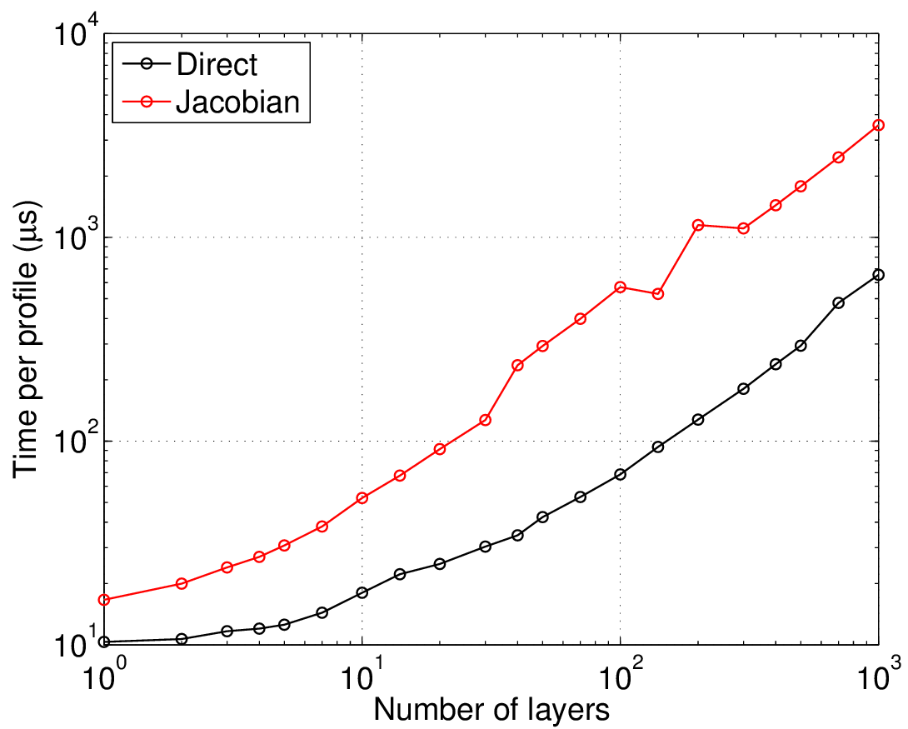






FLOTSAM fast solar radiance model
$$τ=100$$
For solar radiances, the discrete ordinate method (DOM) is slow while look-up tables are inflexible
The Forward-LObe Two-Stream rAdiance Model (FLOTSAM) takes advantage of most phase functions being dominated by a wide forward lobe, and allows arbitrary layering of scatterers
Use Adept for differentiation, and each radiance calculation takes of order 0.1 milliseconds (with Jacobian)
$$τ=31$$
$$τ=10$$
F₀
$$τ=3.1$$
F₁
$$τ=1$$
ζ₀
$$τ=0.1$$
ζ₁

Slide 7
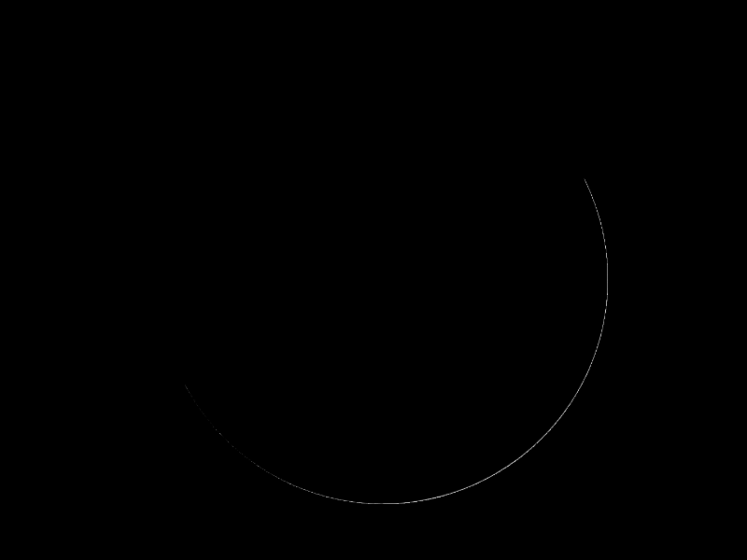
Simulation of visible imagery using cloud fields from the operational ECMWF model and the FLOTSAM solar radiance model

Slide 8
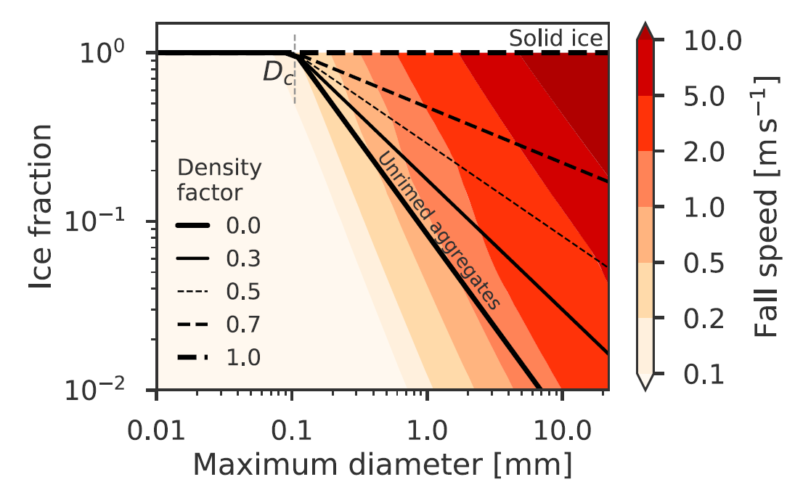
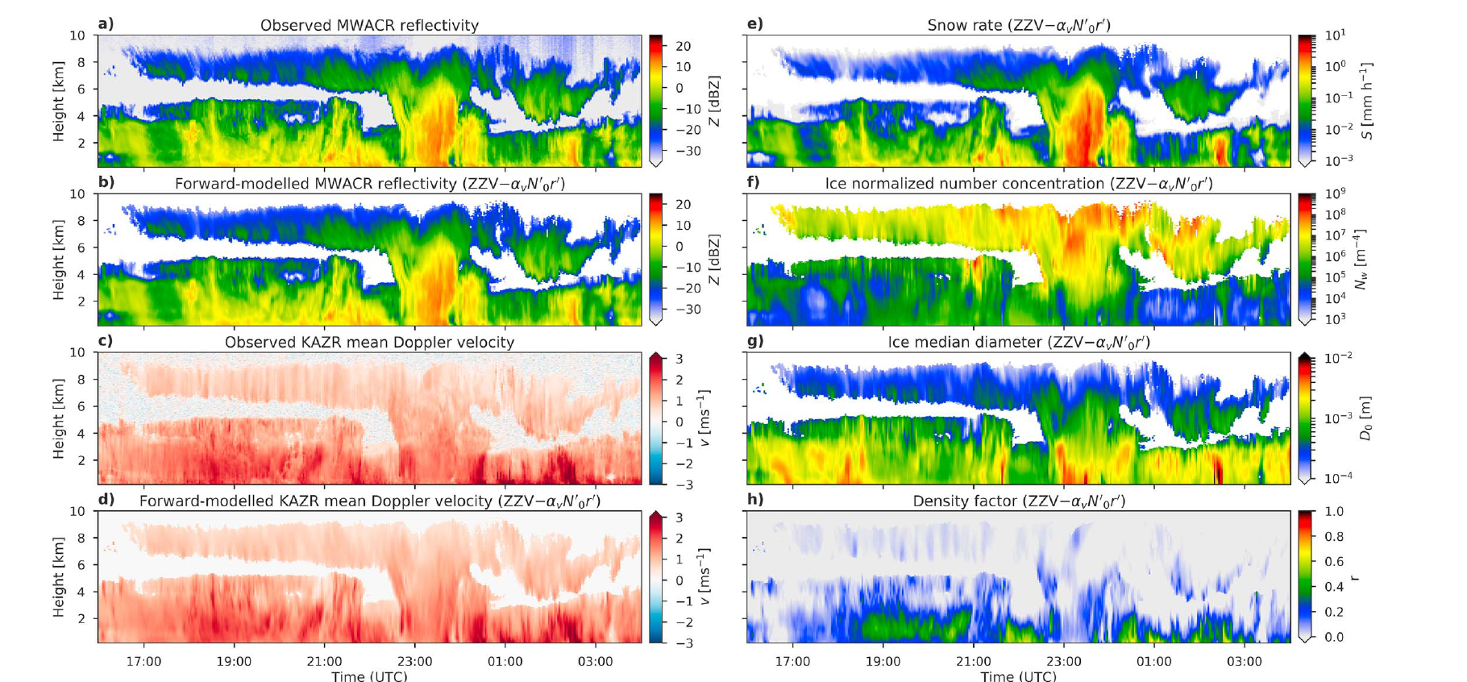
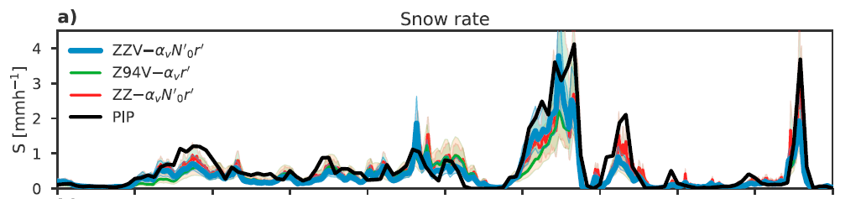
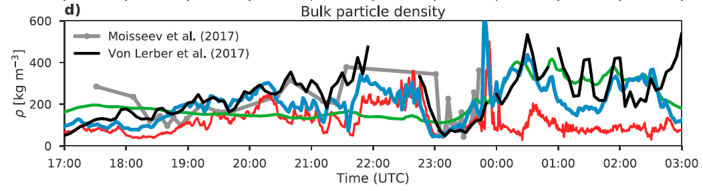
Can Doppler help retrieve snow rate and riming?
Use Finland case study with surface evaluation data (Mason et al. 2018)
Best retrievals with 35+94 GHz Z + Doppler (riming and size distribution)
For snow rate the instrument combinations perform similarly well
Ice aggreates
Rimed ice

Slide 9
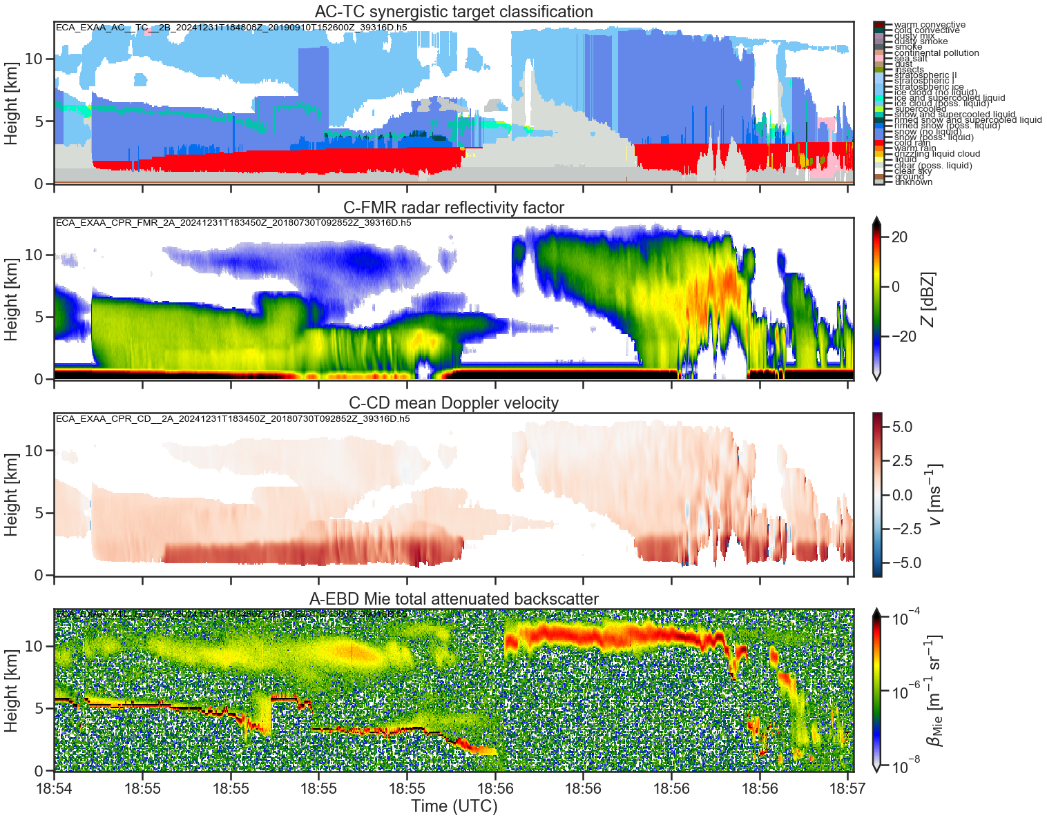
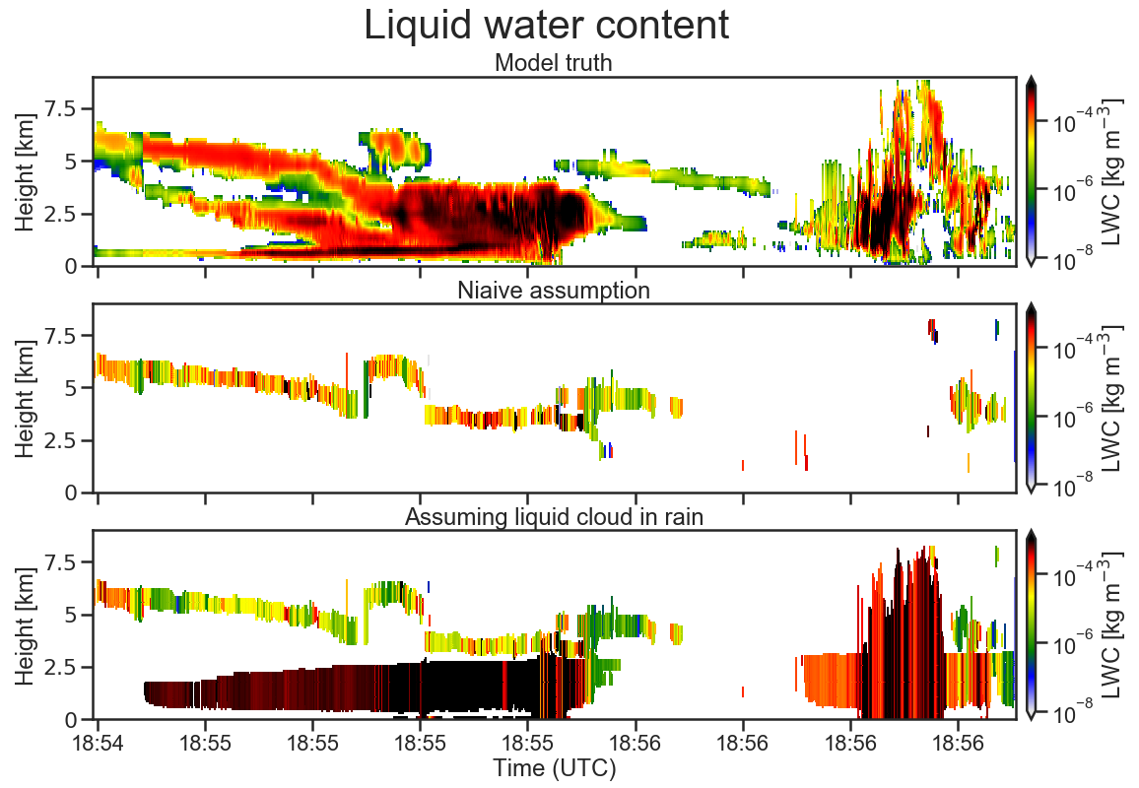
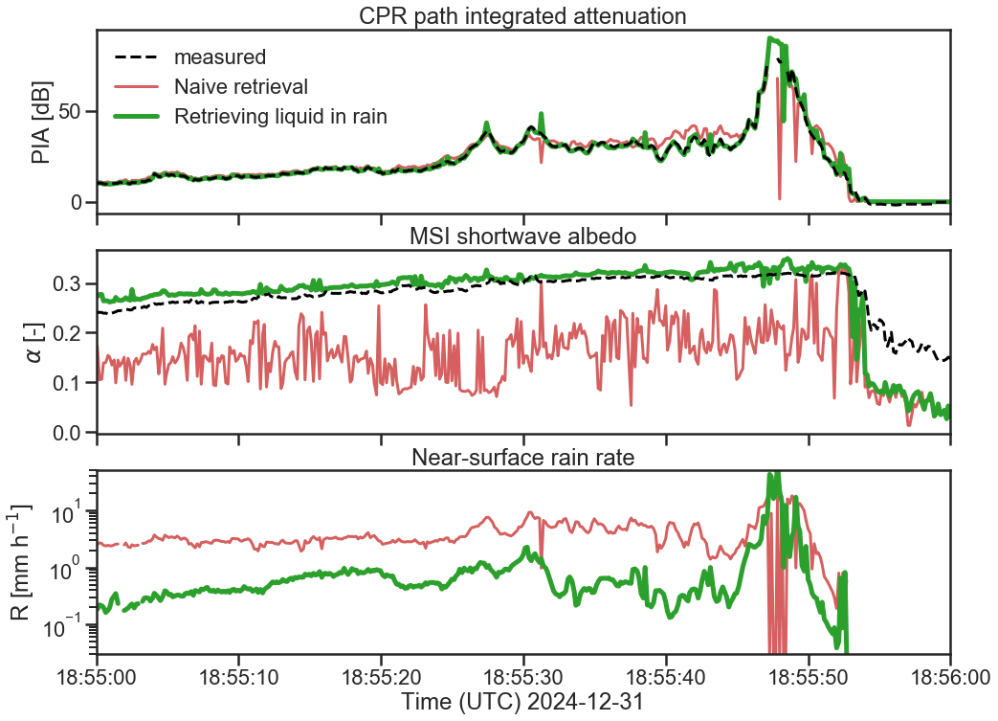
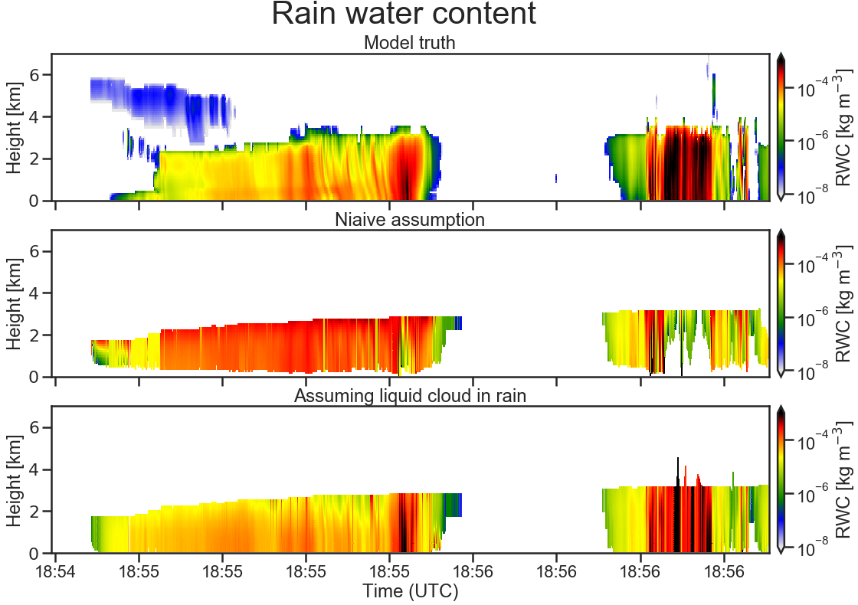
EarthCARE simulator: solar radiance and PIA constraints on liquid cloud embedded in ice and rain
Liquid cloud often falls in a synergistic
blind-spot:
  due to lidar extinction, the presence or vertical distribution of liquid cloud is unknown within deep or layered scenes
Passive and integrated constraints on liquid:
  Rain rate and liquid water path should both contribute to PIA
  Solar radiances will include ice cloud aloft, but maybe also information about very reflective liquid layers below
Using a simulated EarthCARE scene, we have access to model “truth”
  Significant supercooled, mixed-phase and warm liquid cloud
  Naïve retrieval only retrieves liquid water in cloud layers seen by the lidar
  Could assume warm liquid cloud wherever there's rain
Retrieval is now able to represent both PIA and solar radiances
  Leads to a decrease in retrieved rain rate (more PIA now due to liquid cloud)
  Lighter rain is a better fit to model “truth”
?
?
✗
✓

Slide 10
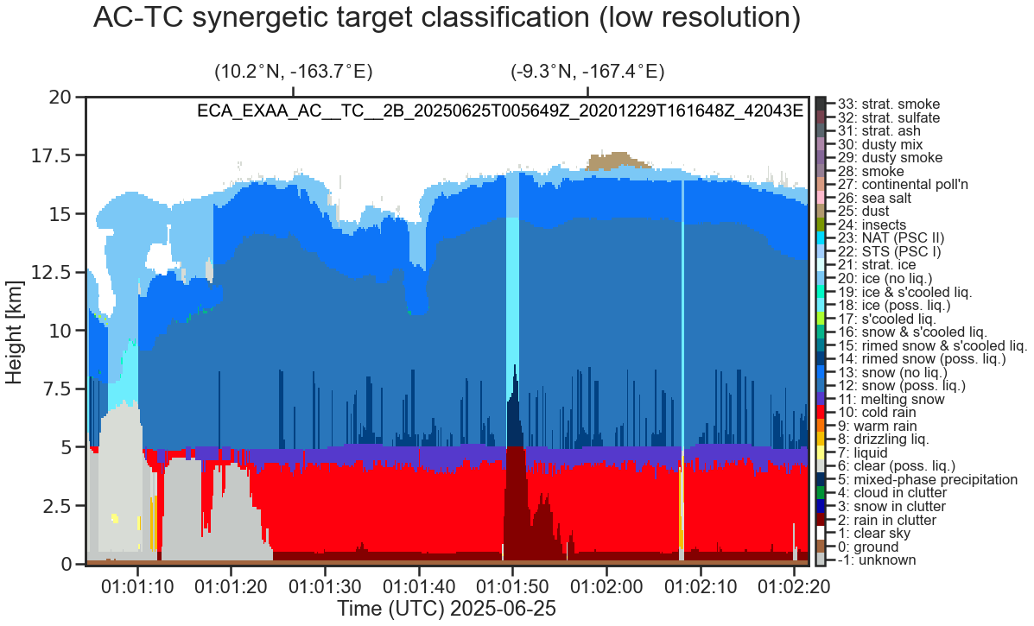
Improving retrievals in tropical deep convection
Simulated EarthCARE “Hawaii” scene includes large-scale tropical precipitation, where the model truth can be used for evaluation
  CPR and ATLID both fully extinguished
  CPR path-integrated attenuation and MSI solar channels saturated
Physical assumptions:
  In C-TC & AC-TC: when CPR extinguished, make the assumption that mixed-phase precipitation (T < 0C) or rain (T > 0C) exists below
  In C-FMR: when CPR does not detect surface echo, return a “saturated” PIA measurement (+85 dB) that can be assimilated
  In ACM-CAP:
    Precipitation mass flux should be conserved across the melting layer
    Assume profile of liquid cloud water co-located with rain, where LWC is a function of rain rate
Even with limited measurements available, ACM-CAP makes a continuous and reasonable retrieval when evaluated against model truth
  Rain water content: when CPR is fully extinguished, retrieved large (but under-estimated) RWC—and a large reported uncertainty
  Liquid water content: smoother than model truth & over-estimated in convective core, but an improved match to passive/integrated constraints than when liquid cloud within rain not assumed
AC-TC target classification

Slide 11
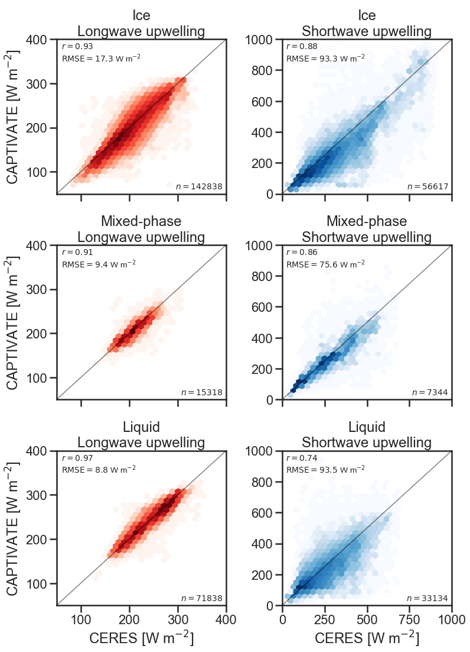
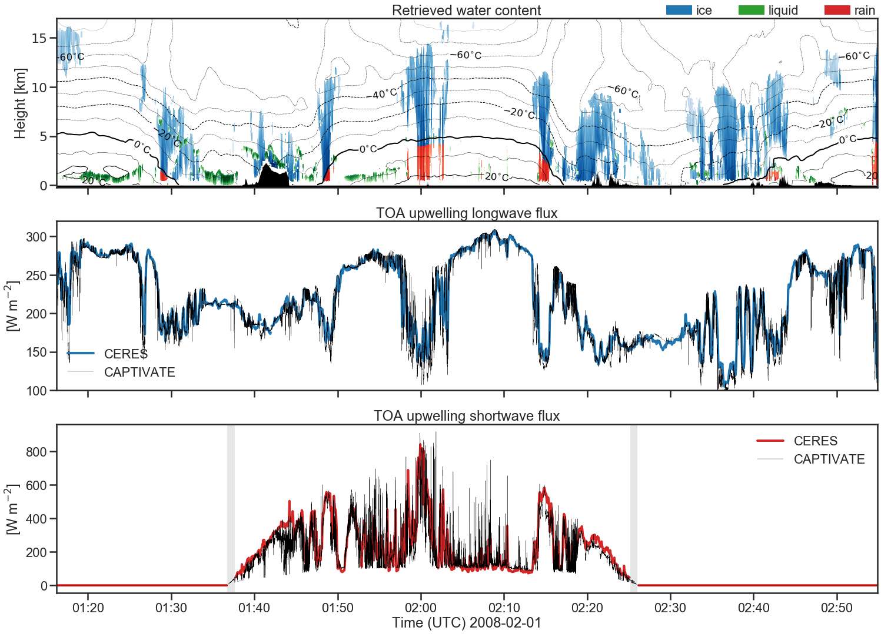
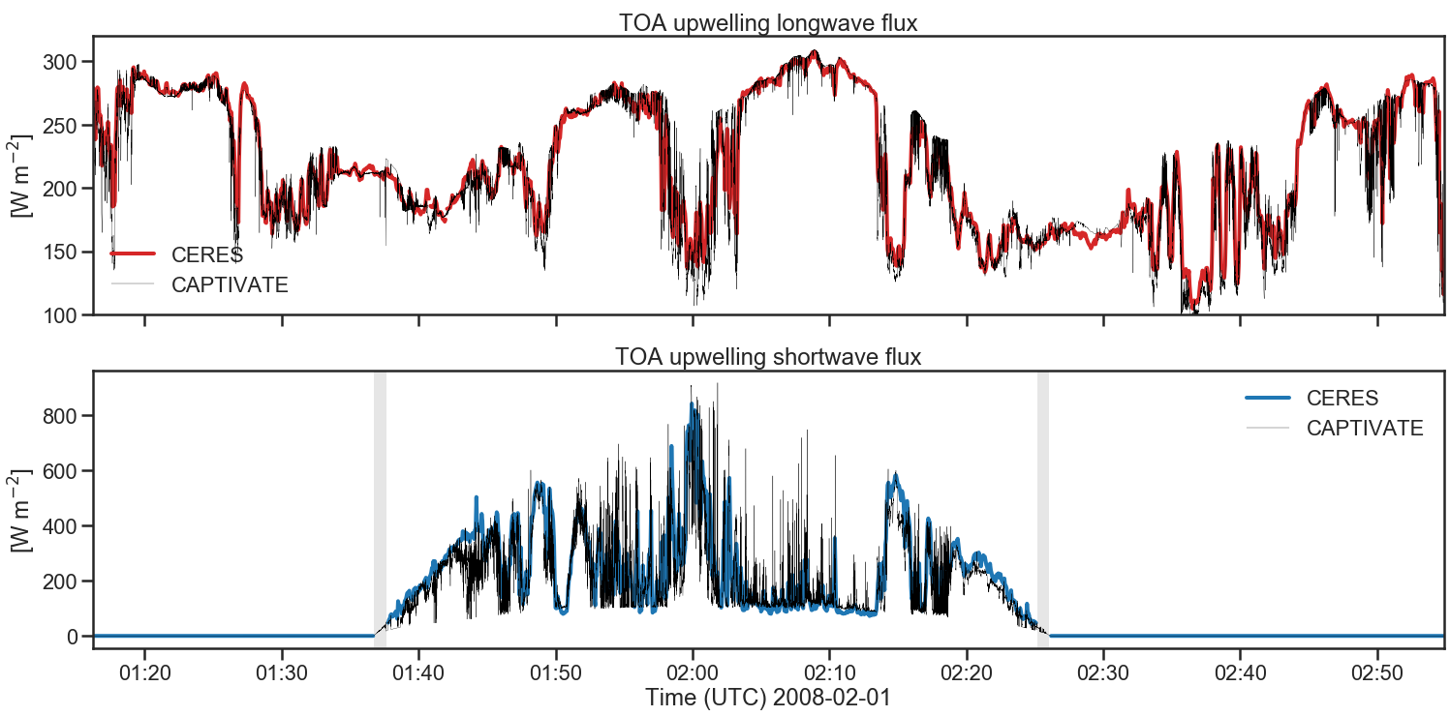
Radiative closure
Ice
Retrieved water content and effective radii as input to ecRad:
  Model top-of-atmosphere LW and SW fluxes for each A-Train footprint (~1km)
  Comparison against CERES
  (~20 km footprint);
Evaluation by cloud-top thermodynamic phase (~20 orbits):
  Ice fluxes sensitive to microphysical assumptions
  Greatest SW uncertainties in liquid clouds
  Not shown: clear-sky errors related to characterising surface albedo
Mixed-phase
Liquid

Slide 12
Summary
ACM-CAP’s unified retrieval allows passive and integrated measurements to be used together
  Passive information from radiances and radar attenuation can be used together to infer rain rates and column cloud liquid water content
  Doppler measurements can be interpreted in terms of rimed ice and raindrop size
  Radiative closure demonstrated using A-Train data
Several useful tools developed in DORSY
  Adept 2.1 automatic differentiation and array library
  Microwave phase function of ice aggregates: SSRGA
  FLOTSAM and TSSF radiance models

