Slide 1
Global coverage and long-term global mission support by observational netweorks and stations
-Session Summary & Discussion
D. Donovan, U. Wandinger, J.v. Bismarck
EarthCARE Cal/Val Workshop
Bonn, 15.06.2018

Slide 2
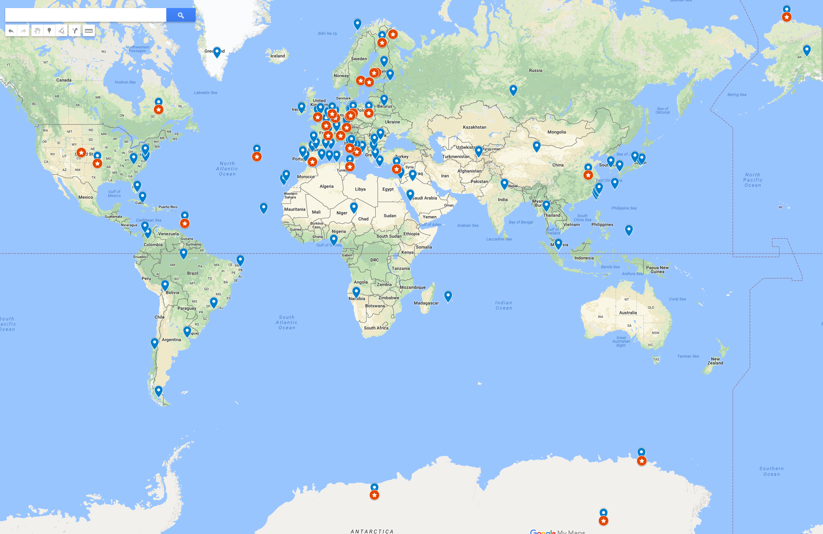
AO sites highlighting lidars & radars

Slide 3
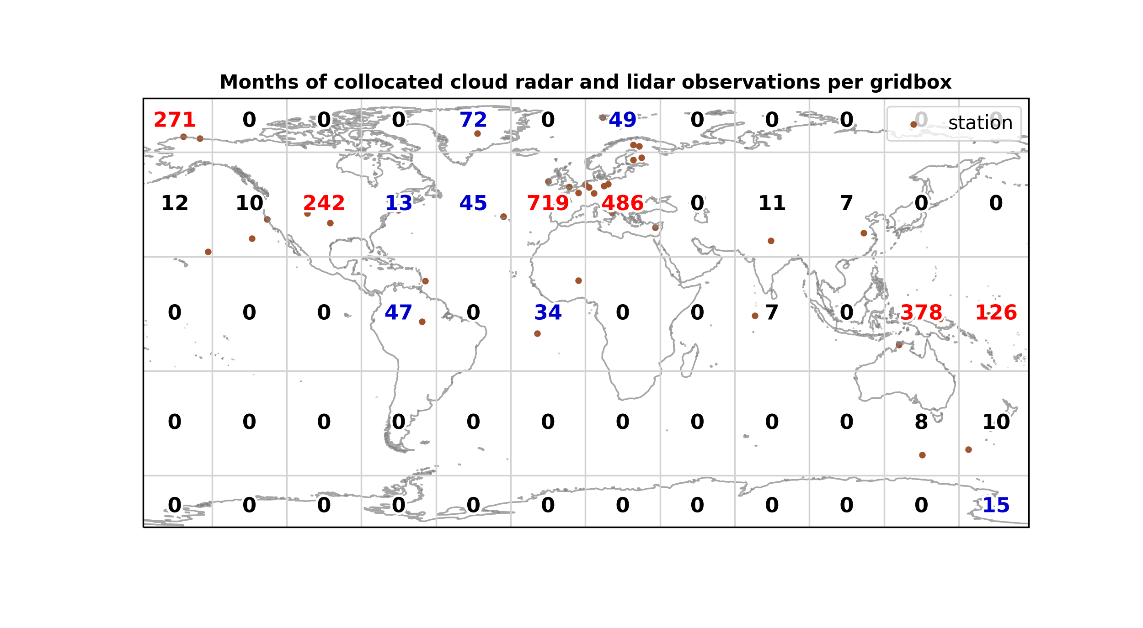

Slide 4
Questions
Sufficient global coverage? Gaps over oceans and in tropics?
New CPR-like ground-based W-band radars, -how is global coverage evolving? Synergy with Earlinet Lidars? Will mobile systems be of interest for direct comparisons in addition to statistical approaches? What is the latest evolution of the ground based systems calibration procedures?
How should/can international assets/network stations and associated efforts and planned contributions to EarthCARE Cal/Va; be made more visible?
Should specific Cal/Val products be developed for the networks?
Multiwavelength radar complement needed to address Cal/Val needs wrt precipitation pruducts?

