Slide 1
THEME FIVE - “ VALIDATION USING MODELS”
“earthcare use to validate of climate and NWP models”
Rather different from the other themes…..
Three proposals identified. One of them addressed this issue:
Franco Marenco - Met Office comparing the predicted profile of cloud
fraction in the tropics from two climate models with slightly different
cloud microphysics with the CloudSat cloud fraction profiles.
“need them to agree if the observations are to be assimilated in NWP”
Also a theme in “GIVE”

Slide 2
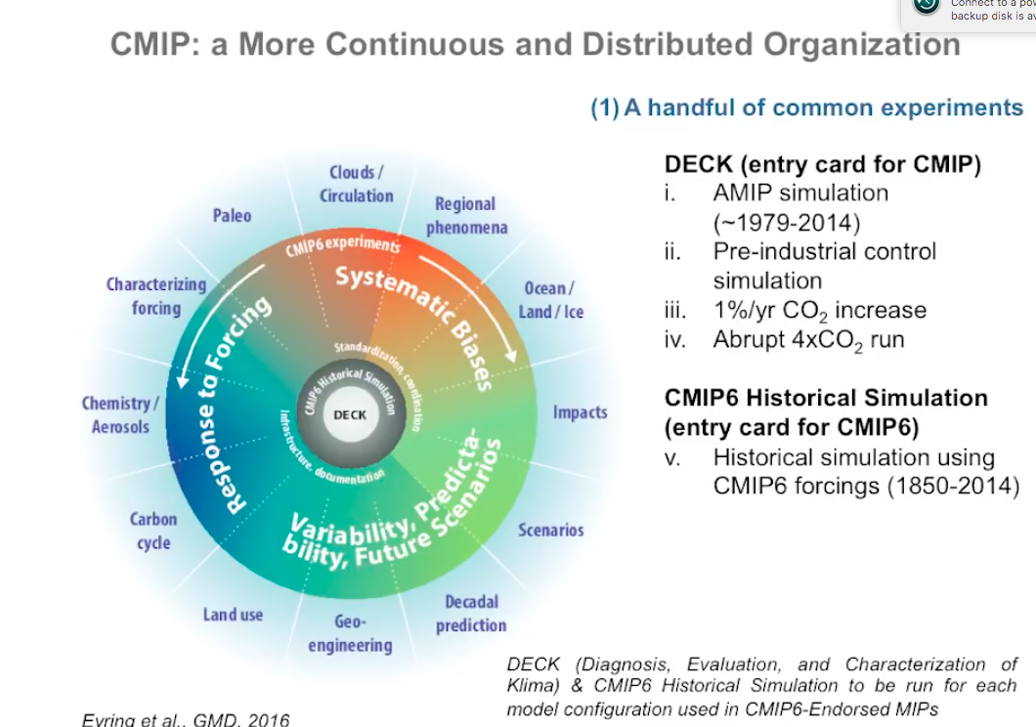
WCRP Coupled Model Intercomparison Project (CMIP)
AeroCOM
Climate based

Slide 3
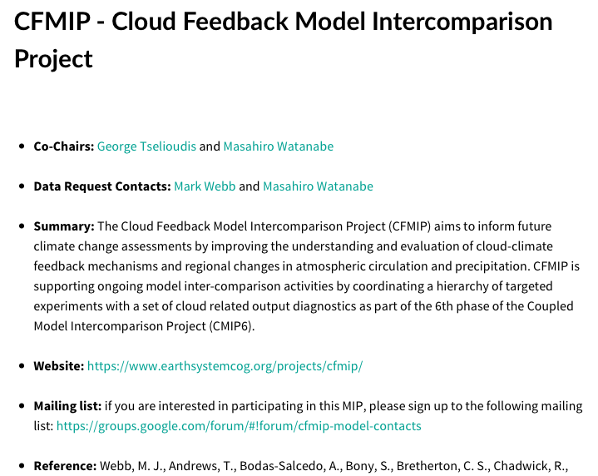
(Helene Chepfer

Slide 4
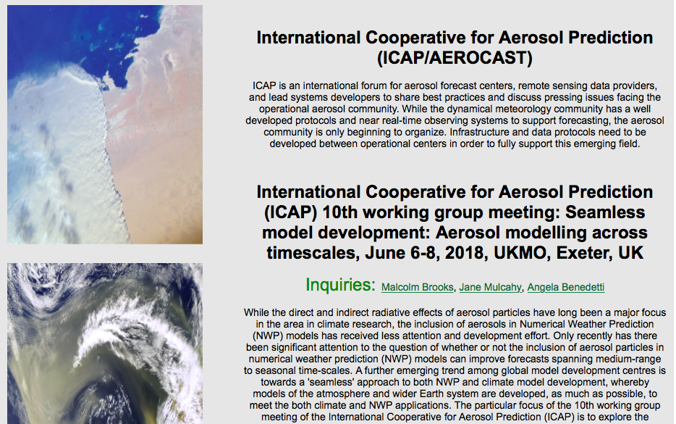
So – why did nobody from ICAP
attend this meeting?
Answer – the level three data
will be available in four years
Need to say what is new

