Slide 1
EarthCARE Campaign Coordination
Dirk Schuettemeyer

Slide 2
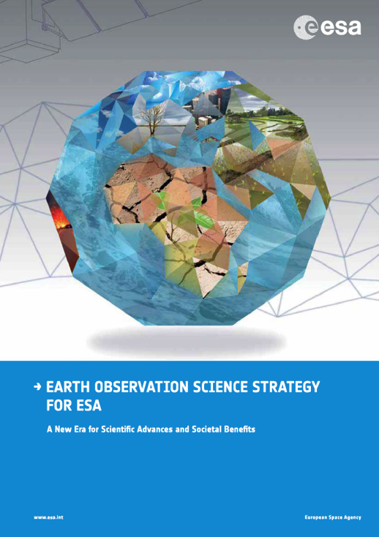
Programmatic Background
ESA campaign activities started in 1981
  130 campaigns so far
  Typically 6-10 campaigns/year
Strategic objectives:
  Support strategic goals of new EO Science Strategy
  Transnational access to airborne facilities in member states
  Foster partnerships with national and international organisations
Campaign activities address:
  Testing technology/Observing techniques
  Optimising requirements/design and reducing mission risk
  L1-L2 Algorithm prototyping/Product simulation
  Calibration/Validation
Campaign data archive supporting science and applications
Notes:
ESA campaigns strongly linked to EO missions (various phases of development)
Dynamic program
Partnerships to be as effective as possible

Slide 3
Campaigns for different project phases
ESA campaigns are performed during full life cycle of a typical ESA space mission
Different types of campaigns are performed during specific phases of a space mission (concept, feasibility, development and operations)
 | Pre-Phase A | Phase A Feasibility | Phase B Design | Phase C/D Development | Phase E1 Commissioning | Phase E2 Operation | Data Archive
Technology | X | X
Mission Development (Geophysical) | X | X | X | X
Mission Development (Simulation) | X | X | X | X
Cal/Val |  |  |  | X | X | X
Science/ Applications |  |  |  |  |  | X | X

Slide 4
Core Campaign Activities
Ongoing Activities directly related to EarthCARE cal/val preparations:
NARPEX Campaigns (co-funded by ESA)
EPATAN Campaign (co-funded by ESA)
A-CARE campaign (co-funded by ESA)
Ongoing Activities coupled to EarthCARE cal/val preparations:
MULTIPLY, Romanian Special Initiative
POLIMOS, Polish Special Initiative
RadSnowExp, Arctic Precipitation (Nov. 2018)
Foreseen Activities:
=> To be Defined

Slide 5

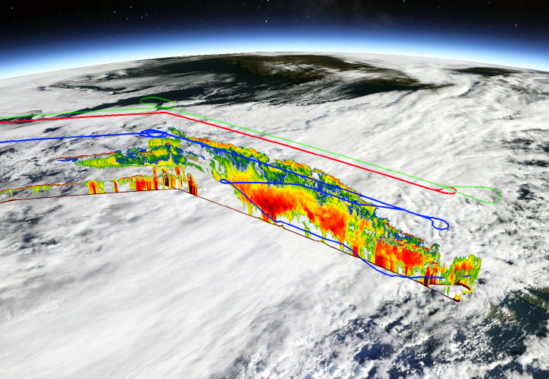
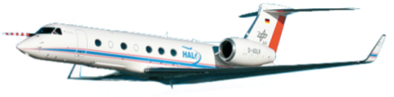
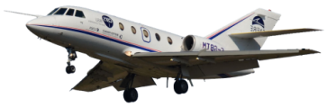
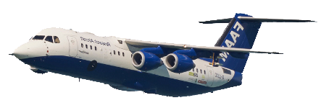



Coordinated HALO – FF20 flight + A-Train underpass
Comparison with specMACS and in-situ measurements
NAWDEX RF06 – 14 October 2016
DLR HALO
Safire F20
FAAM-BAE

Slide 6
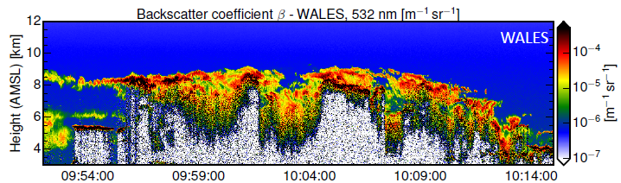
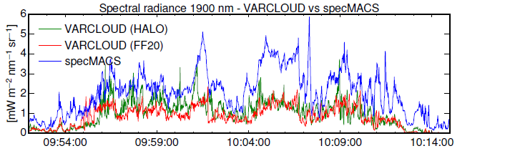
Closure study
Comparison with specMACS
NO agreement of simulated and measured spectral radiance at 1900 nm

Slide 7
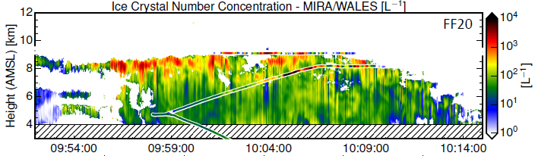
Closure study
Comparison with specMACS
NO agreement of simulated and measured spectral radiance at 1900 nm
In-situ measurements: G. Vaughan

Slide 8

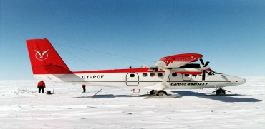
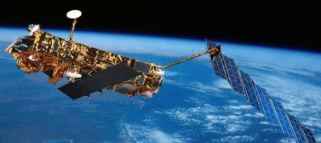

Example from CryoSat: The issue of scale?
The issue of coverage
Polar Explorer or Polar Scientist
Speed: 20km/day
Measurements: Points or profiles along the way (cm resolution)
Endurance: 12h/day or approx 20km (depends on food, good health, holidays, equipment, weather conditions)
Twin Otter
Speed: 175km/hour
Coverage: Depends on instrument, generally swaths of 1m-1km with resolution from cm to meters
Endurance: 600 km or 5 flight hours before refueling (dependent on flight permissions, pilots, weather conditions)
CryoSat
Speed and coverage:
23000 km/hour with resolution at 100s of meters
Endurance: 6 years and counting, operates 24 hours/day, no flight permission, don’t care about weather…

Slide 9
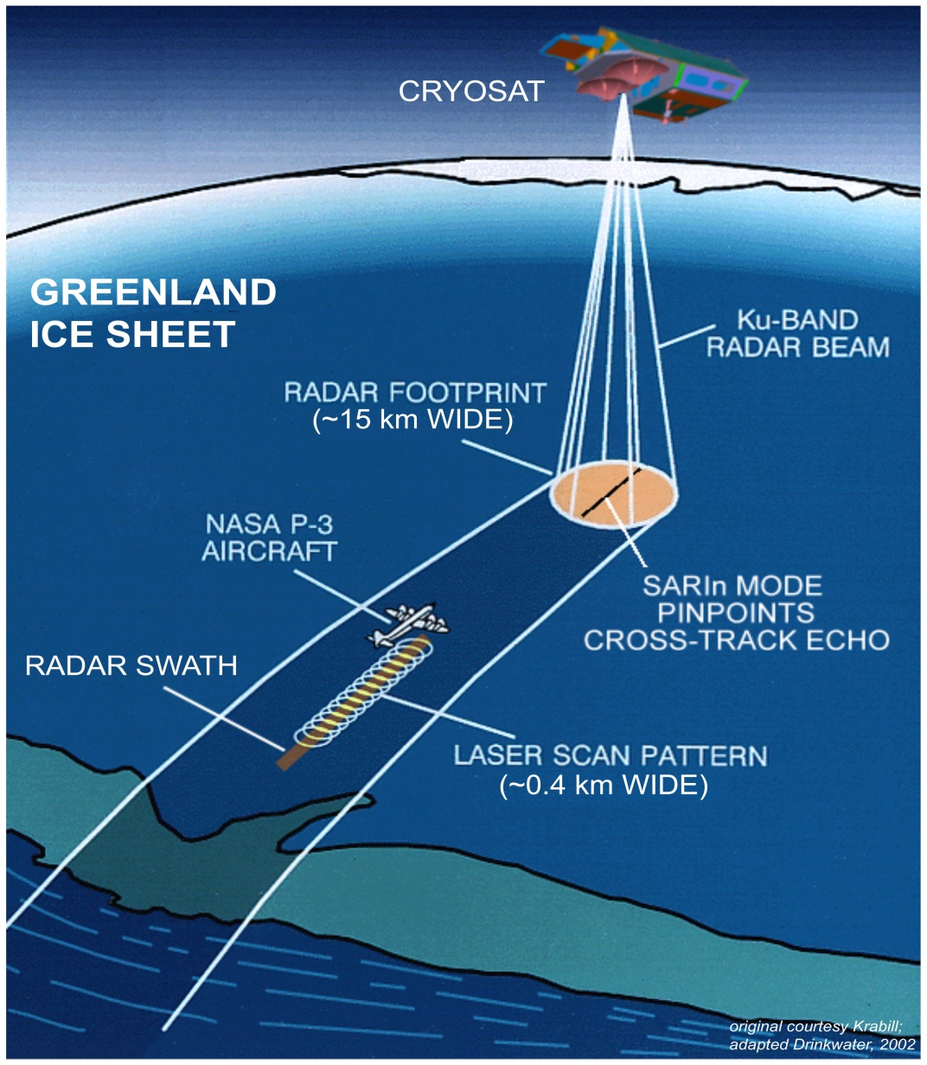
CryoSat experimental concept
Coordinated airborne and ground measurements required to bridge the spatial scales between ground and satellite measurements
Airborne instrumentation configuration:
  ASIRAS – airborne radar altimeter which serves as a proxy for SIRAL on-board Cryosat
  Laser scanner – to address error sources due to penetration
  Support instruments (DGPS, data recorders, cameras)
Aircraft
Ground experiments

Slide 10
Recall AO Objectives and Setup
Specific areas in which the contribution of the participants is sought are:
validation using other satellite, airborne or ground-based experiments providing independent measurements of wind profiles, clouds and aerosols;
experiments to assess accuracy, resolution, and stability of the Aeolus instrument Aladin;
assessment and validation of the Aeolus retrieval and processing
Setup:
Terms of Reference are consistent with past EE Accepted CAL/VAL teams will have access to EarthCARE data products starting at Level 1b up to Level 2b, including auxiliary data.
During the satellite commissioning phase data access will be limited to these teams.
Funding of the activities solicited through this AO shall be covered by national/institutional resources. There will be no funding available via the Agency.

Slide 11
EarthCARE Validation Team Objectives
Integration of your proposed work within a wider scientific and technical framework, and the establishment of collaboration between specialists
Participation in the establishment of detailed validation planning in advance of the launch
Participation in post-launch data product and retrieval algorithm validation, and planned monitoring of satellite performance and data quality
Support to the Agency in the planning and execution of special satellite operations in conjunction with ground experiments
Support to the Agency in the definition, in the light of post launch experience, of reprocessing algorithms to be applied to the level 1b, level 2a, and 2b data
Support to ESA in dedicated meetings and workshops
Participation in pre-launch rehearsal activities

Slide 12
Conclusions
Validation experiments from ongoing missions good example of collaboration between ESA and wider community to address mission validation needs
EarthCARE pre-launch cal./val. activities to prepare launch
  Overall experiment concept verified
  Address sources of error and calibration
  Instrumentation and data processing capacity (established)

Slide 13
Any questions?
Thank you!

