Slide 1
EVDC
ESA Atmospheric Validation Data Centre
Ann Mari Fjaeraa, amf@nilu.no
1st ESA EarthCARE Cal/Val Workshop, 13-15 June 2018, Bonn

Slide 2

Outline
About EVDC
EVDC for data submitters
- Support
- Data formatting
- Tools
EVDC for data users
- Database services

Slide 3
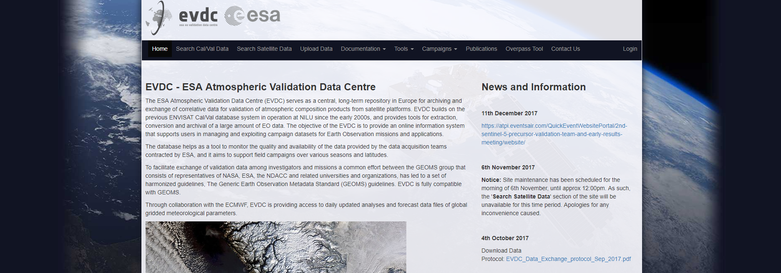
EVDC - ESA atmospheric Validation Data Centre
The ESA atmospheric Validation Data Centre (EVDC)
is the official ESA repository for validation and campaign datasets.

Slide 4
EVDC - ESA atmospheric Validation Data Centre
The ESA atmospheric Validation Data Centre (EVDC)
is the official ESA repository for validation and campaign datasets.
https://evdc.esa.int
Cal/Val database for campaign data from ENVISAT, Sentinel-5P, ADM-Aeolus and EarthCARE and network data from projects and monitoring programs such as NDACC, EARLINET, TOLNet, TCCON. Data uploaded to EVDC on a daily basis (near-real-time) and after campaigns (offline).
EVDC serves the needs of both data submitters (e.g. ESA AO campaign teams) and data users (i.e. both ESA AO campign teams and international science community).
EarthCARE Cal/Val is considered for 'campaign use‘, which implies that data will only be circulated within the EarthCARE Cal/Val Team.

Slide 5
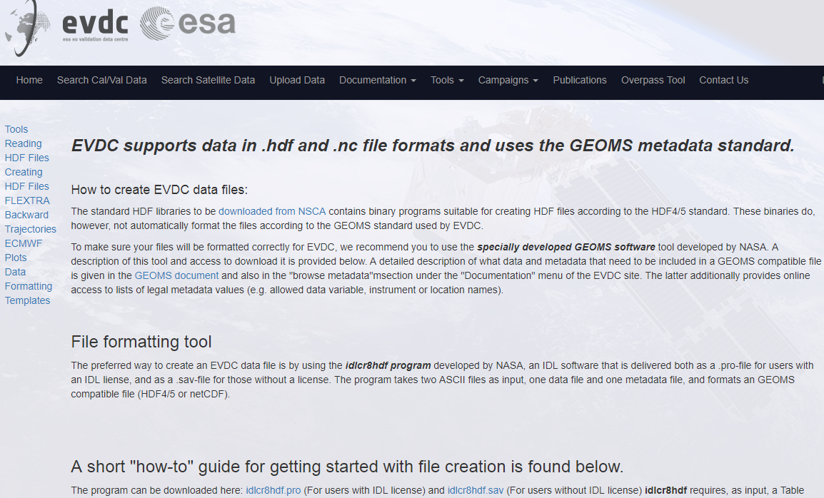
EVDC – Support for data submitters
On request EVDC support role to the EarthCARE Cal/Val Teams
Definition of data formatting templates.
Definition of GEOMS metadata entries
  describing the dataset of the PI.
Provision of data conversion scripts.
Assistance with data upload after
  campaigns.

Slide 6
EVDC – Harmonised data
Behind the scenes
Harmonised data and metadata, and documentation
- ensure that your data will be understood and interpreted by any user.
- explain how your data was created, what the context is for the data, structure of the data and its contents, and any manipulations that have been done to the data.
- lead to proper acknowledgements and more visibility for organization or agency who funded the research, and names and institutions of the people who created the data.

Slide 7
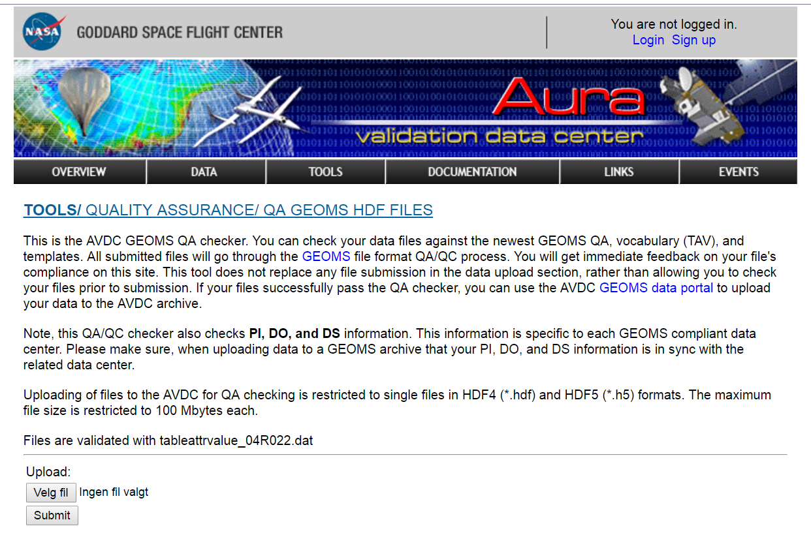

EVDC – Metadata standard
GEOMS data:
The Generic Earth Observation Metadata Standard (GEOMS) is used in EVDC.
GEOMS is developed in collaboration with ESA, NASA, and NDACC, for the implementation of a uniform data exchange standard.
Documentation, templates and tools for creating and
reading the EVDC files available online.
First line support for new users.
Non-GEOMS data:
Ongoing activities to define proper metadata formats for
data conversion from non-GEOMS to GEOMS.

Slide 8
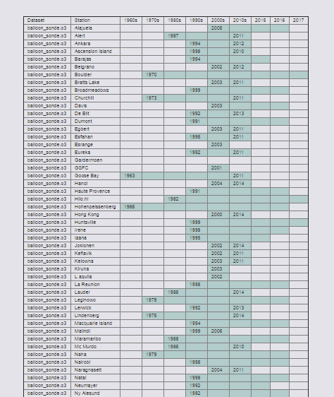
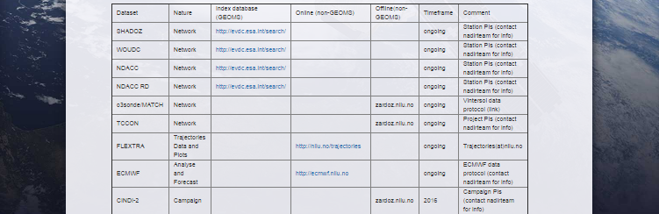
EVDC – Metadata standard
Aircraft data from Falcon and Geophysica,
Assimilation data from GOME measurements
Balloon data such as e.g. sonde.o3
Ground based data such as e.g. FTIR and LIDAR
Satellite data
Data harvested also from AVDC/NDACC/SHADOZ/TCCON
Online tables for overview of GEOMS and non-GEOMS

Slide 9
EVDC – Added value
EVDC, and the harmonised dataset that it will host will allow to extract maximum benefit from Cal/Val campaign:
- Fosters collaboration within EarthCARE validation teams (ECVT)
- Independent analysis of a larger dataset: helps anomaly detection and characterisation
- Helps communication with algorithm and instrument teams
- Serves as a reference for QC of future algorithm updates (reprocessing)

Slide 10
EVDC – Benefits of central archive
Benefits of having a central data centre
- Ensure long term, backed-up archive
- Avoid multiple file versions
- Data displayed to more users
- Larger contribution rate in publications
- Controlled data access: protection of data originators rights
- Relieves resources for scientific work
- Supporting services
There are currently 1 071 904 searchable files in the EVDC archive, and increasing.
Data from Sentinel-5P campaigns already available in the web portal.

Slide 11
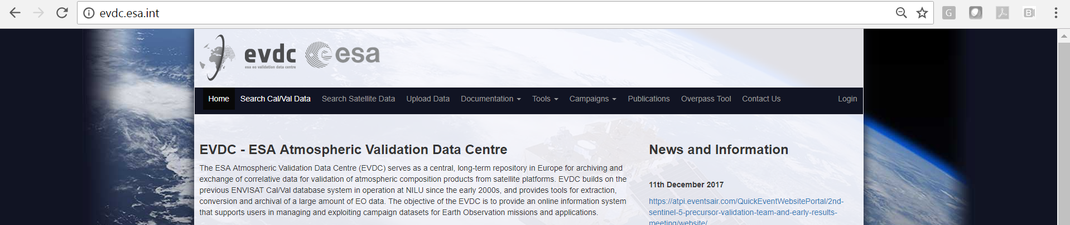
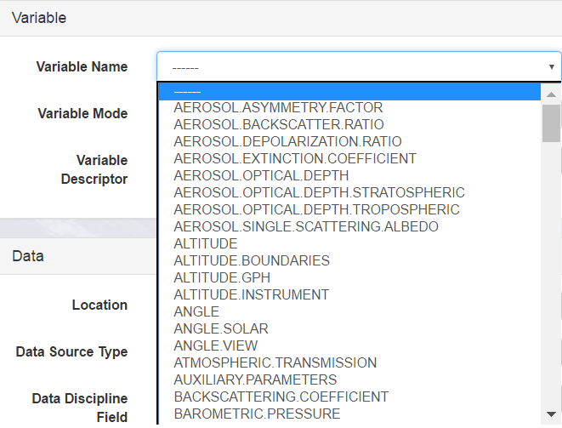
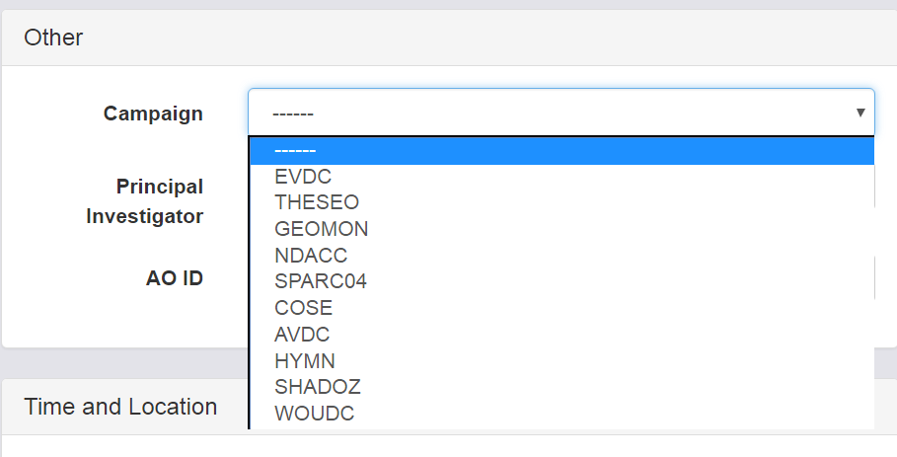
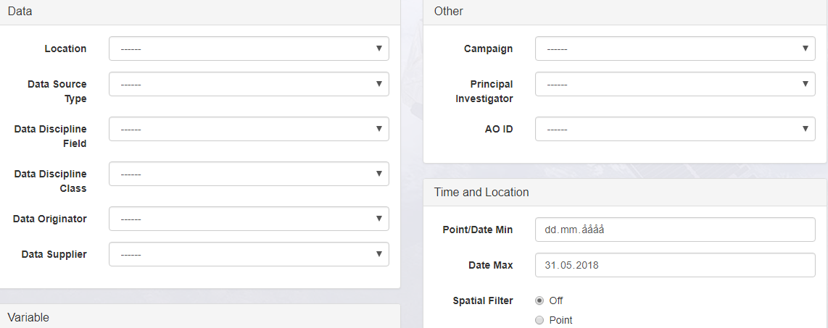
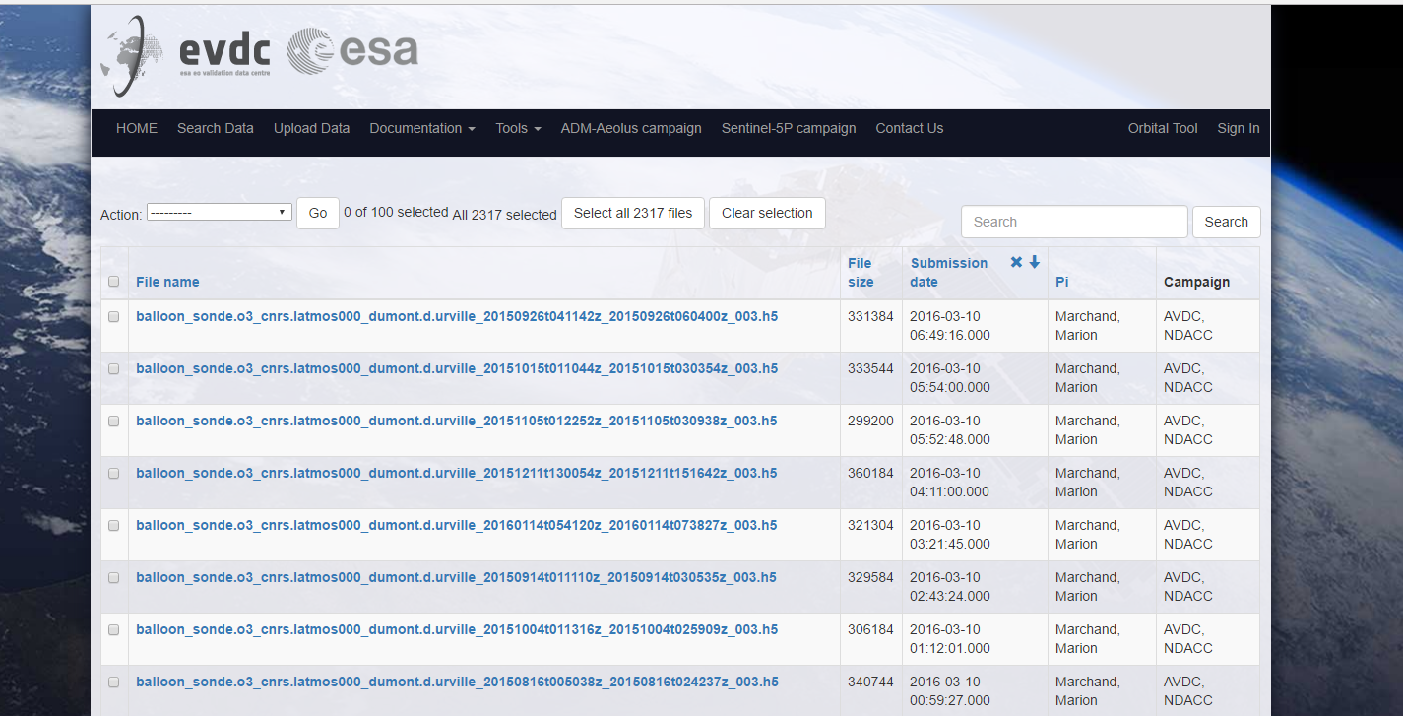
Web portal – Available services
https://evdc.esa.int
Search and download functionality for in-situ Cal/Val data.

Slide 12
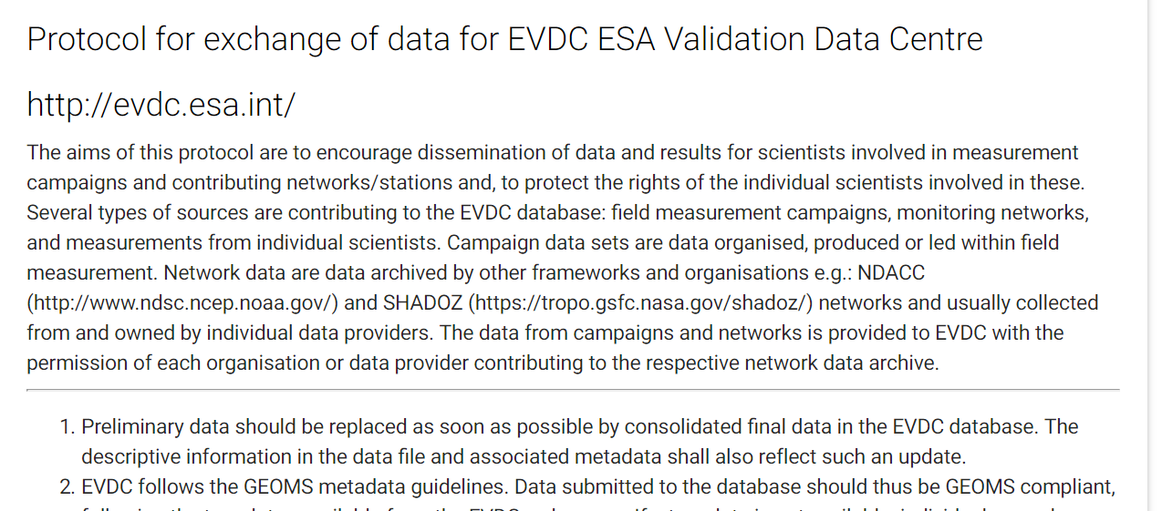
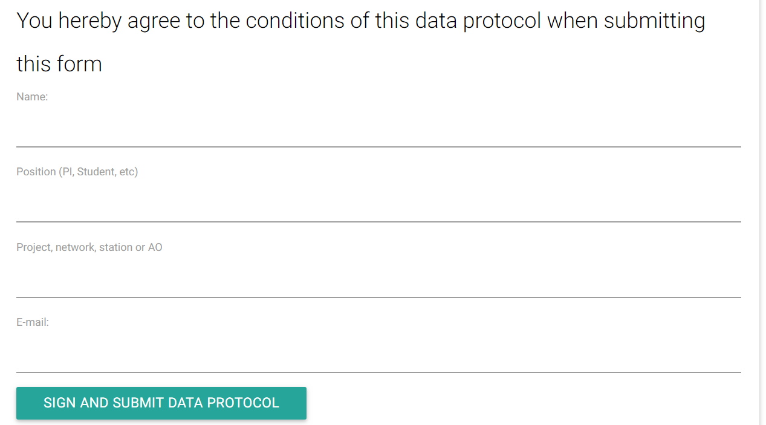
Web portal – Data protocols
Data protocols to protect the
Intellectual Property Rights of each dataset
Access to data granted to those who has signed the data protocol
Access given in agreement with the Cal/Val teams
Online, digital protocol
https://protocol.evdc.nilu.no/

Slide 13
Web portal – Data protocols
1) Preliminary data should be replaced as soon as possible by consolidated final data in the EVDC database. The descriptive information in the data file and associated metadata shall also reflect such an update.
2) EVDC follows the GEOMS metadata guidelines. Data submitted to the database should thus be GEOMS compliant, following the templates available from the EVDC web pages. If a template is not available: individual procedures may apply. Please contact the data centre for more information.
3) The ownership of the data remains with the data originator.

Slide 14
Web portal – Data protocols
4) Each EVDC user can visualize the whole data content but only download some parts of the database, e.g.: users belonging to a specific campaign can share and access all the data within this campaign, but the other users will have, generally, no access to these data. Any publication resulting from use of EVDC data requires prior written permission from the data owner.
5) Access to the EVDC data hosted at NILU is granted only after having signed this protocol. Access is strictly personal through nominative login and password. Re-distribution of data to third parties by the data user is nominally not allowed and requires written permission from ESA and the data originator. Users already registered on EVDC are not requested to sign this data exchange protocol because it does not change the agreement established with the previous version of this document.

Slide 15
Web portal – Data protocols
6) The data reported as preliminary or final, are available to those with access to the EVDC at no cost for non-commercial scientific use. By using these data, the data user accepts that an offer for co-authorship will be made through personal contact with the data providers or owners whenever substantial use is made of their data. In the case of network data it is also necessary to reproduce the acknowledgements as formulated in the respective network data policy.

Slide 16
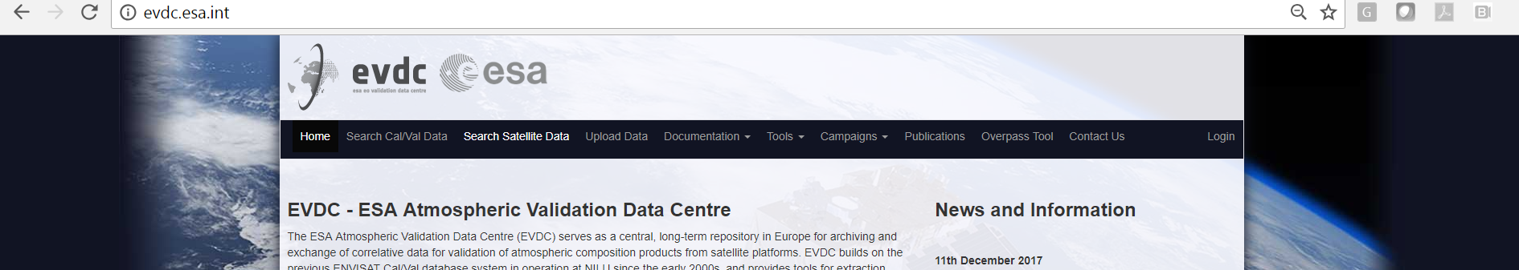
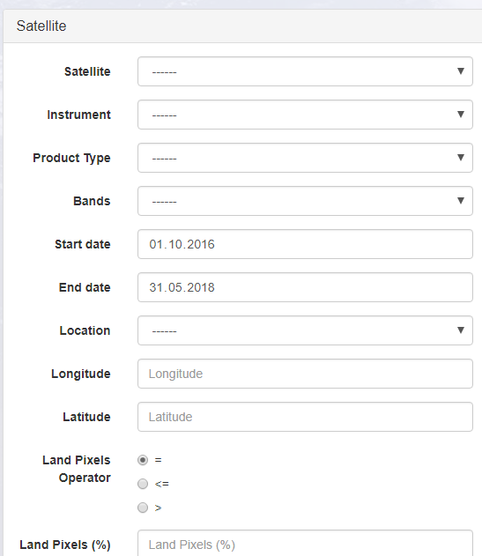
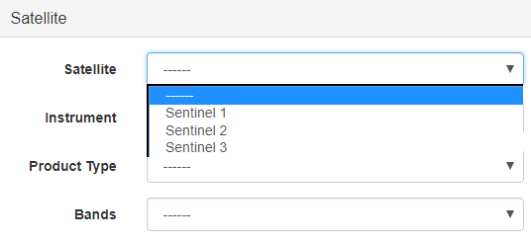
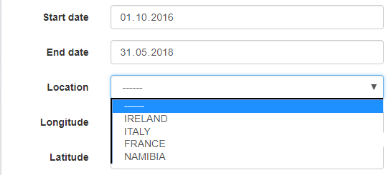
Web portal – Available services

Slide 17
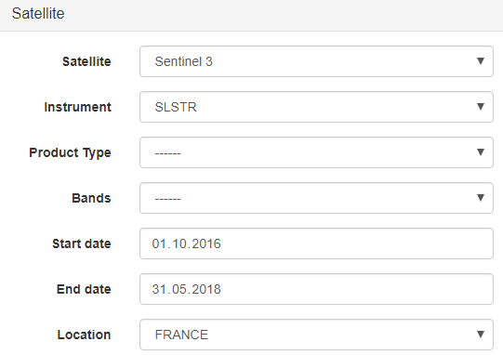
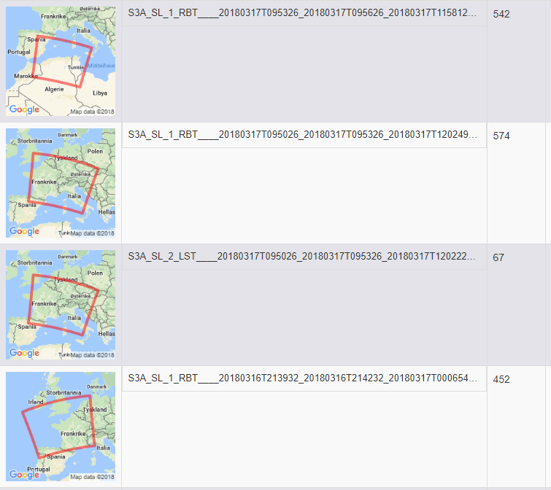

Web portal – Available services
    Note: at present it is not known whether EarthCARE data will become available also through the EVDC. The nominal access foreseen for EarthCARE data is through the Payload Data Ground Segment

Slide 18
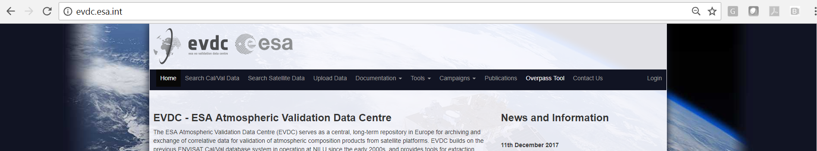
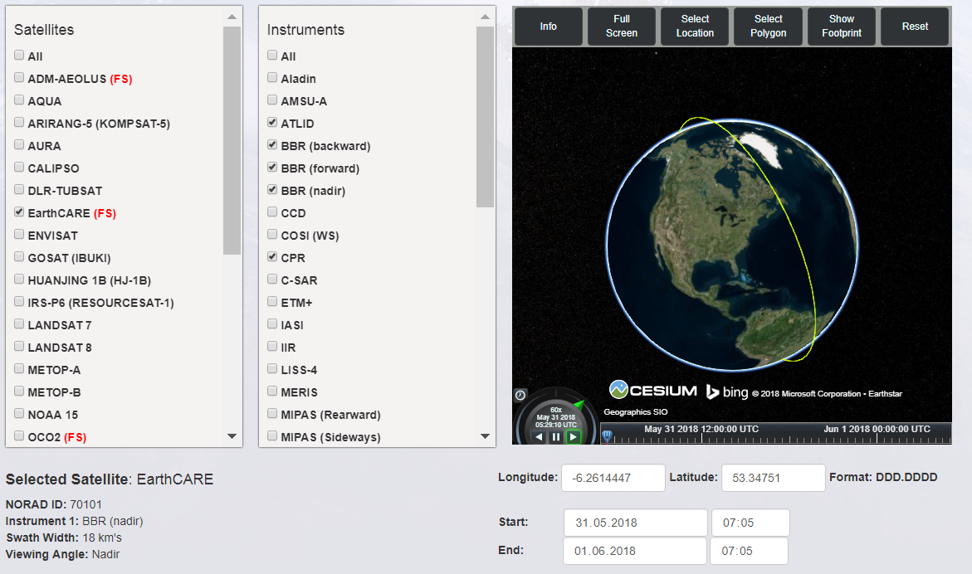
Web portal – Available services
Overpass Predictor and Orbit Tool
Search for overpass based on instument
Display more than one overpass
Search for overpasses between satellittes
EarthCARE is included
DEMO VIDEO!

Slide 19
Web portal – Available services
Selection of EarthCARE satellite
Instruments and latest TLE
All instruments are unselected except MSI
Selection of the qeographical location
Temporal window definition
Get Spatial Overpass
Show the Overpass (also full screen)
Download of the Overpass (CSV format)
VIDEO to be added to this slide

Slide 20
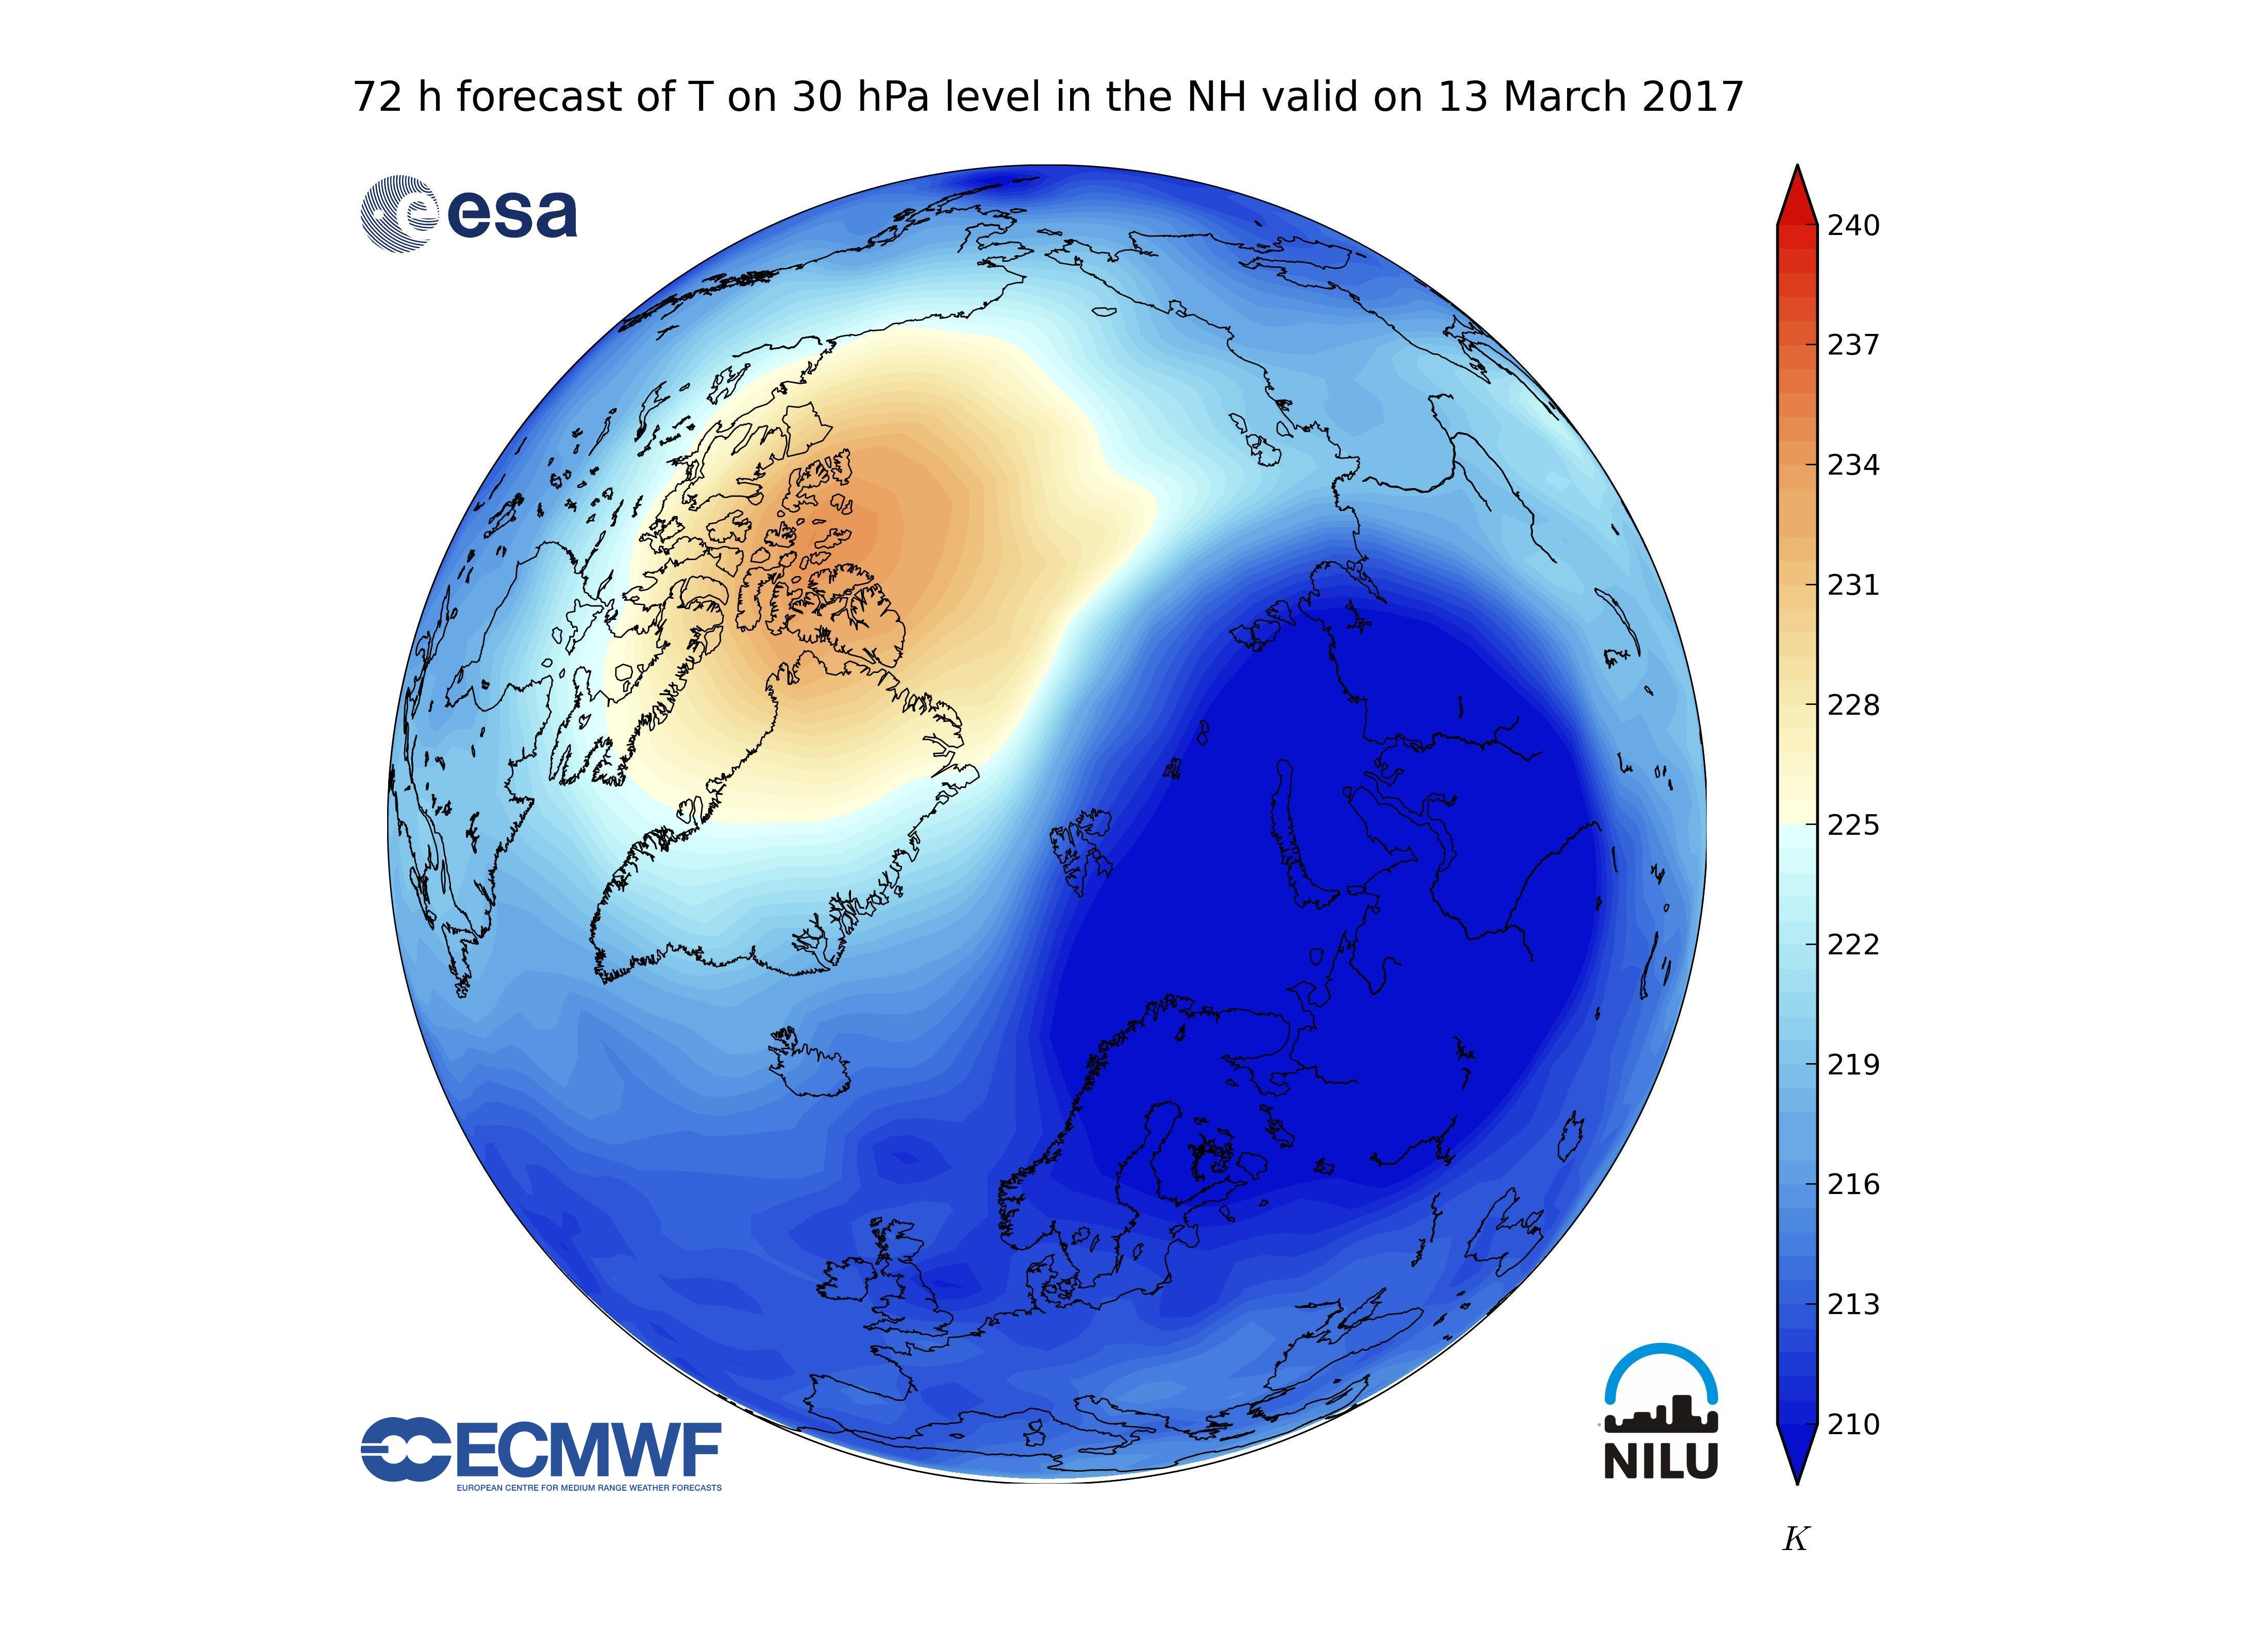
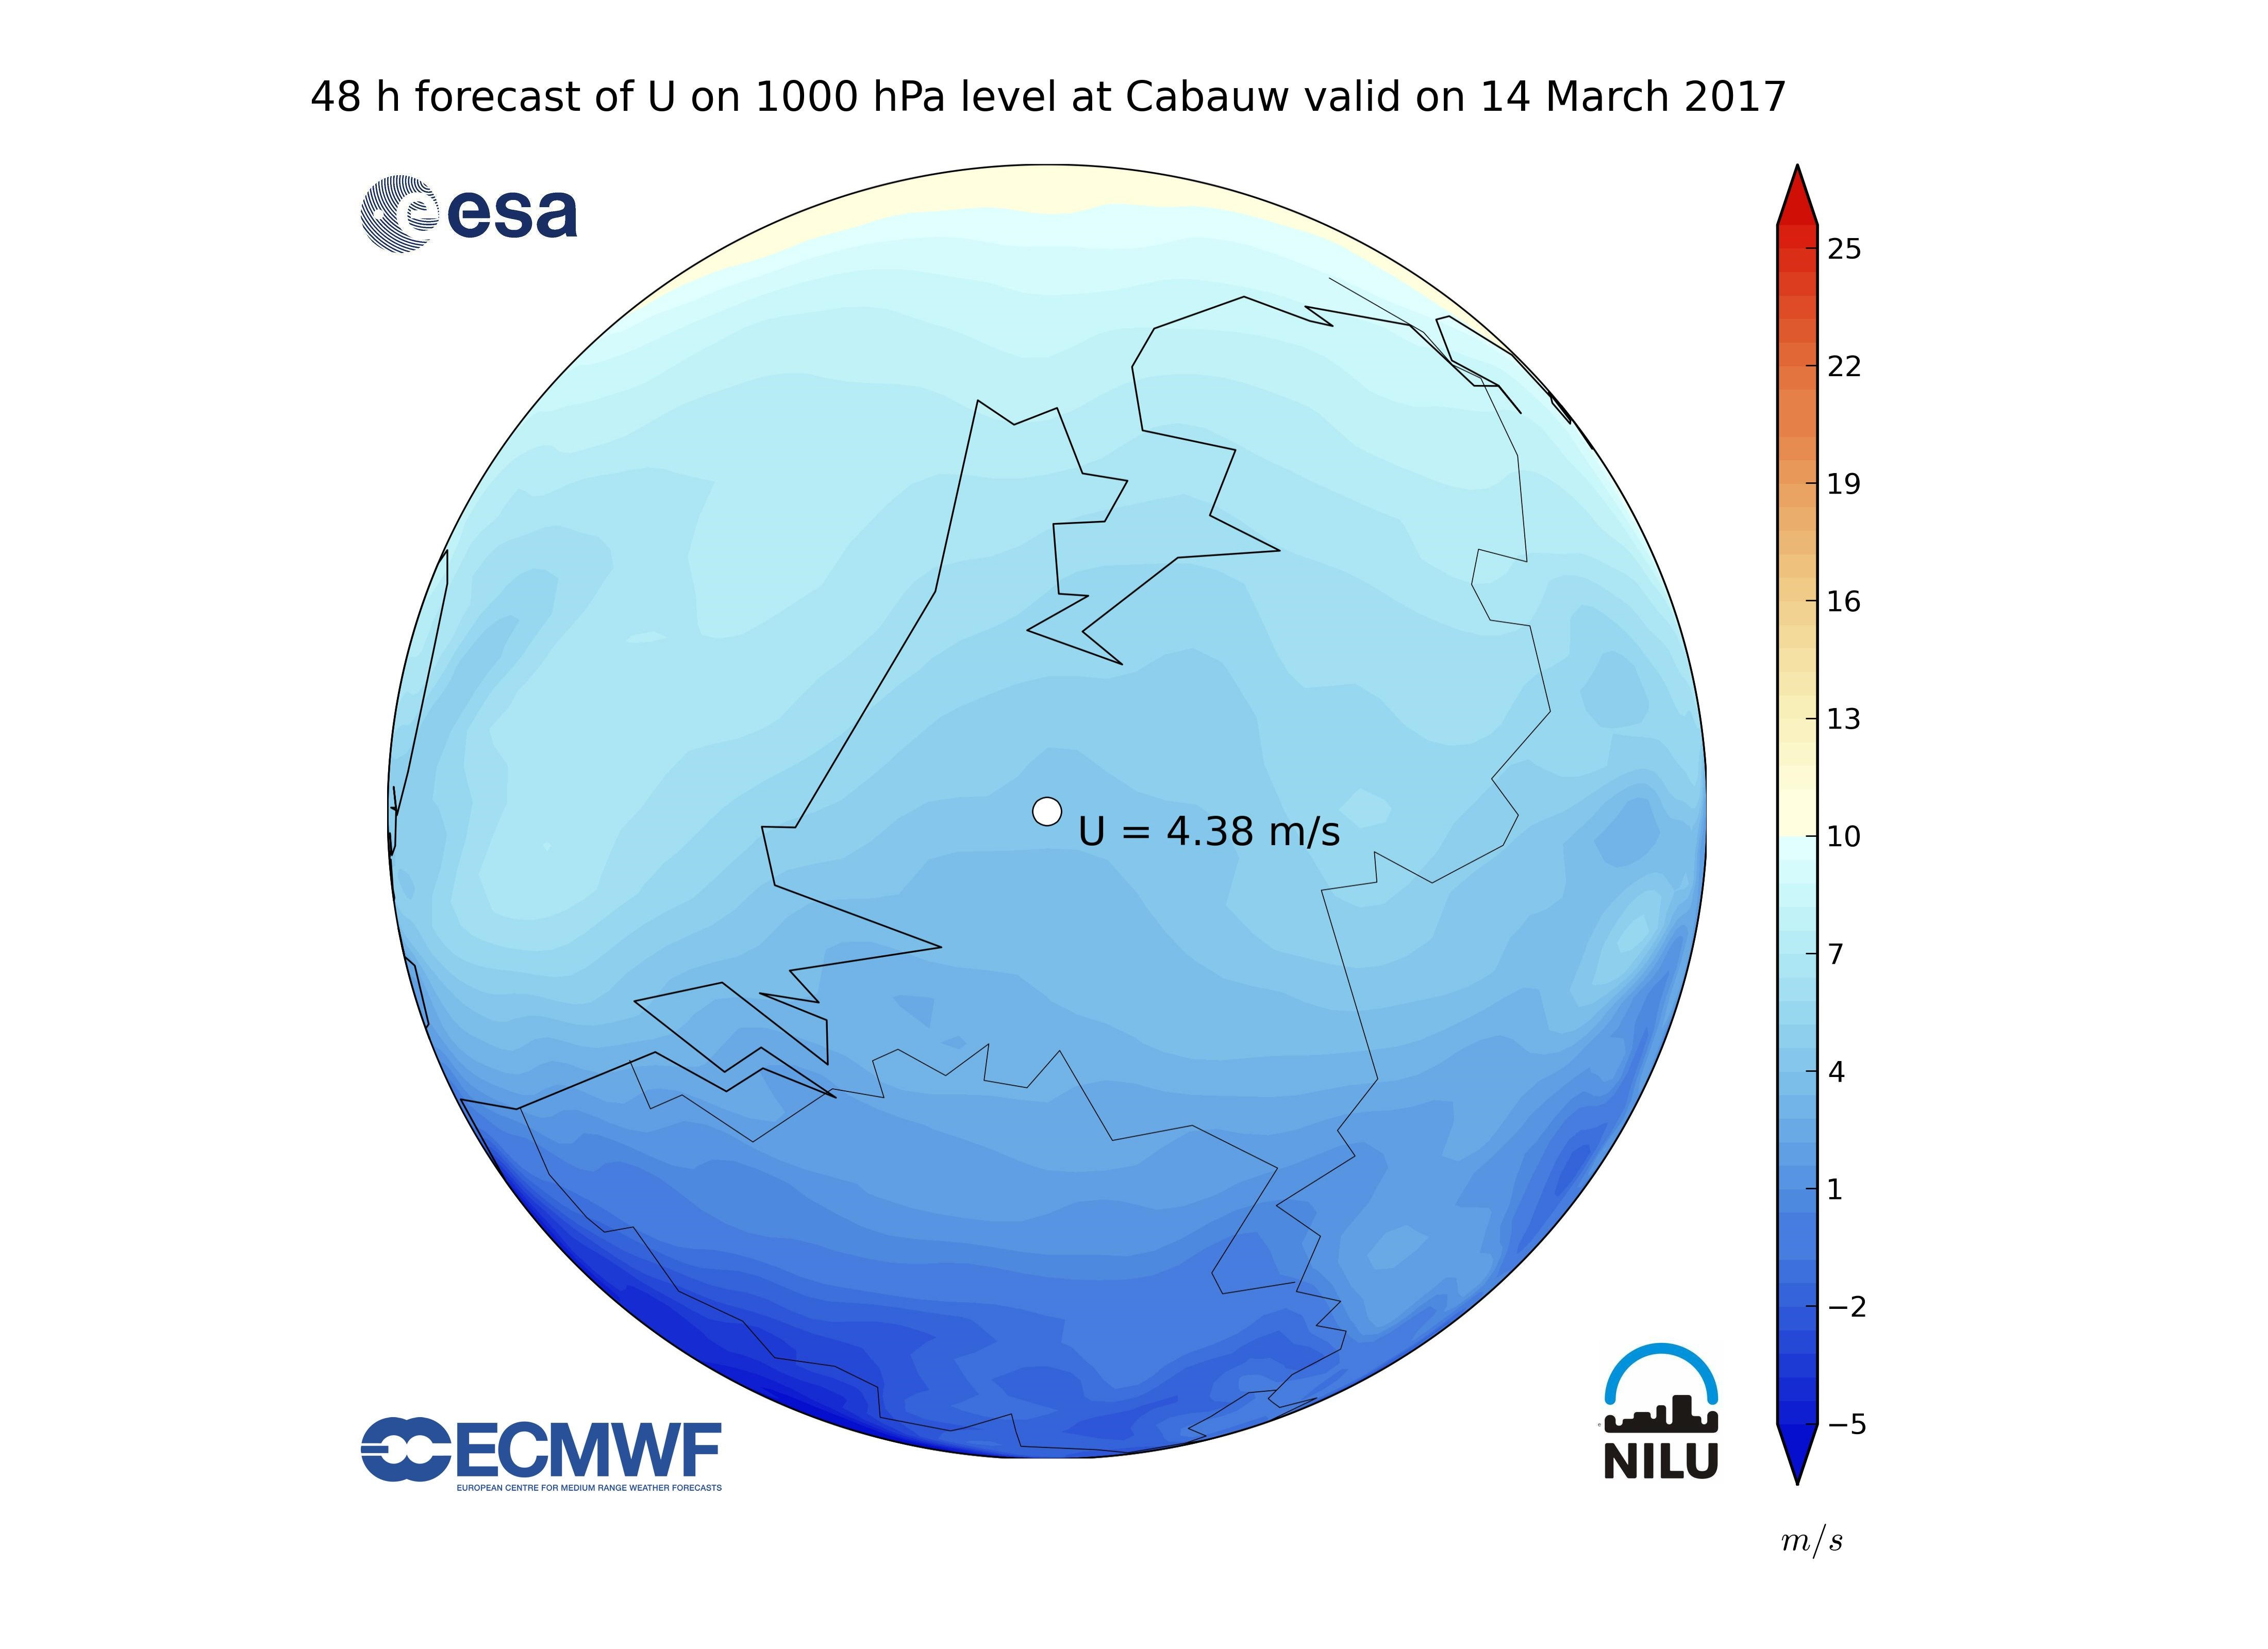
Web portal – Available services
ECMWF service
https://ecmwf.nilu.no/ (password protected area)
Through collaboration with the ECMWF, EVDC is providing access to daily updated analyses and forecast data files of global gridded meteorological parameters, such as temperature, geopotential height, zonal wind and meridional wind. Analysis and forecast up to 240 hours for levels are updated on a daily basis. Data for both the Northern hemisphere and the Southern hemisphere are available.
System service for custom designed plots
for e.g. campaigns and stations

Slide 21
Possibilities for all Cal/Val teams to contribute
Added value for sharing your data
…what else do Cal/Val teams get in return?
- Access to all data in EVDC.
- Access to other resources: EVDC is a placeholder for other results and tools (publications, derived products such as air mass trajectories, model results).
- EVDC can issue DOIs, inclusion of data in EVDC can make the work of groups and individual scientists more visible and sitet.
- First hand support with data formatting.
- Access to ECMWF data during campaigns.
- Access to overpass tool.
- Access to satellite segment.

Slide 22
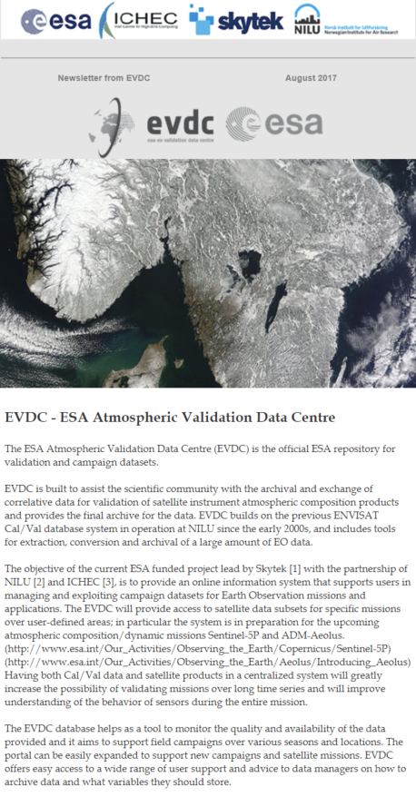
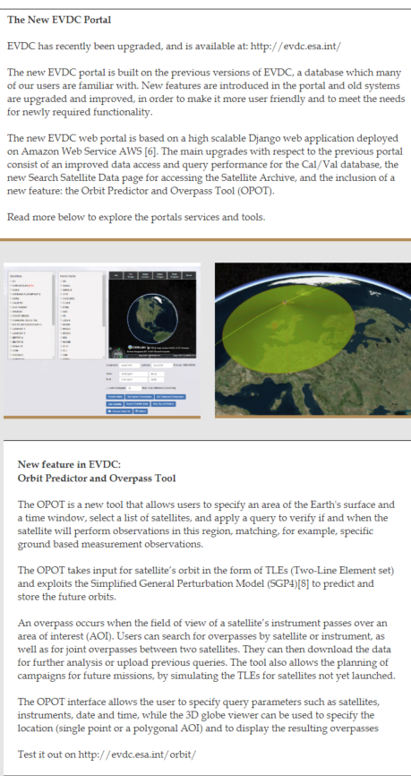
Newsletter and contact
EVDC Newsletter
E-mail: nadirteam@nilu.no
Twitter: @nadirteam_nilu
Subscription to e-mailing list
(contact nadirteam for info)

