Slide 1
ESA Atmospheric Toolbox (ATS)
Sander Niemeijer (S&T)
13 June 2018

Slide 2
Introducing the ESA Atmospheric Toolbox
direct product reading interface
CODA (was BEAT-I before 2008)
data harmonization interface
HARP (was BEAT-II before 2016)
visualization & analysis application
VISAN
All Free, Open Source (BSD/GPL) and Cross Platform!

Slide 3

CODA
Common Data Access reading interface for earth observation data products
Single interface to read any data from a product
Same interface for ascii/binary, xml, netcdf, hdf4, hdf5, cdf, grib, ...
Best solution for reading raw binary data (ESA ENVISAT, EUMETSAT EPS)
Uses 'codadef' files for format definition and product detection
Can perform format verification (also for netcdf, hdf, etc.)
Originally developed for atmospheric products, but now used for many other types of data: BRAT (Radar Altimetry), SWARM, Sentinel-1 (SAR), etc.

Slide 4
CODA
codadd
codacheck
codaeval
codadump
Fortran interface
Python interface
Java interface
IDL interface
MATLAB interface
codafind
codacmp
CODA C library
bin/ascii
backend
XML backend
netCDF backend
CDF backend
GRIB backend
HDF4 backend
HDF5 backend
RINEX backend
SP3 backend
Mission #1 codadef
HDF4 library
HDF5 library
Mission #2 codadef
Mission #3 codadef

Slide 5
CODA
CODA website:
http://stcorp.nl/coda/
GitHub:
https://github.com/stcorp/coda
codadef files are included with HARP and VISAN packages
... but also separately available on http://stcorp.nl/coda/ and https://github.com/stcorp/....

Slide 6
HARP
HARP - Toolset for Harmonization of Products
Dimensions
Names
Units
Time
Location
Resolution
Facilitates comparison through harmonization and collocation functions
Focuses on (but not limited to) atmospheric data products

Slide 7
HARP
harpconvert
harpdump
harpcollocate
other...
Python interface
Matlab interface
IDL interface
harpmerge
harpcheck
other...
other...
HARP C library
Unit
conversion
Derived
variables
Collocation
Ingestion modules:
Sentinel 5P, OMI/TES/MLS/HIRDLS, GOME-2/IASI, GOMOS/MIPAS/SCIAMACHY, GOSAT, Odin/OSIRIS, Atmospheric CCI, CAMS, NDACC, ...
Filtering
Regridding
Import/
Export
CODA C library
HDF4 library
HDF5 library

Slide 8
HARP
Import of data products to common data format
Introduces HARP data format standard
https://cdn.rawgit.com/stcorp/harp/master/doc/html/conventions/
Conventions on top of netCDF, HDF4, HDF5
Focus is not on being descriptive, but on being able to standardize automated operations on data
This means: variable naming, dimension naming/ordering, units

Slide 9
HARP
HARP product ingestion using Python:
  >>> product = harp.import_product(......)
  >>> print(product)
  source product = 'MIP_NL__2PODPA20020925_010931_000060262009_00418_02977_0147.N1'
  double datetime {time=74} [seconds since 2000-01-01]
  double altitude {time=74, vertical=17} [km]
  double latitude {time=74} [degree_north]
  double longitude {time=74} [degree_east]
  double pressure {time=74, vertical=17} [hPa]
  double pressure_uncertainty {time=74, vertical=17} [hPa]
  double temperature {time=74, vertical=17} [K]
  double temperature_uncertainty {time=74, vertical=17} [K]
  double O3_number_density {time=74, vertical=17} [molec/cm^3]
  double O3_number_density_uncertainty {time=74, vertical=17} [molec/cm^3]
  double O3_volume_mixing_ratio {time=74, vertical=17} [ppmv]
  double O3_volume_mixing_ratio_uncertainty {time=74, vertical=17} [ppmv]
  long index {time=74}

Slide 10
HARP
Filters:
latitude<=10;latitude>=-10;longitude-range(179,-179)
point_distance(52.012, 4.357, 3 [km])
valid(aerosol_optical_depth)
exclude(aerosol_extinction_coefficient)
keep(latitude, longitude)
Regridding:
regrid(vertical, altitude [km], 10, 0.5, 1.0)
bin_spatial(181,-90,1,361,-180,1)
Derived variables:
derive(<variable> <datatype> <dimensions> <unit>)
You can combine these into small `scripts` that are performed during import:
derive(solar_zenith_angle {time});solar_zenith_angle<80;exclude(solar_zenith_angle)

Slide 11
HARP
What if you want to generate the total column AOD from extinction profiles?
"derive(aerosol_optical_depth {time} [])"
aerosol_optical_depth {time} [] from
aerosol_optical_depth {time, vertical} [] from
aerosol_extinction_coefficient {time, vertical} [1/m] from
altitude_bounds {time, vertical, 2} [m] from
altitude {time, vertical} [m] from
altitude {vertical} [m] from
altitude {vertical} [km]

Slide 12
HARP
Collocation example
harpcollocate -d 'datetime 12 [h]' -d 'point_distance 500 [km]' -ny point_distance
-nx datetime .../sat_data_dir .../ref_data_dir collocations.csv
harpmerge -a 'collocate_left("collocations.csv")' .../sat_data_dir sat_data.nc
harpmerge -a 'collocate_right("collocations.csv")' .../ref_data_dir ref_data.nc
You can then further manipulate the data (e.g. smoothing, profile -> column, ...)
harpconvert –a '.....' data.nc data_modified.nc

Slide 13
HARP
HARP Version 1.0 was released September 2017
All initial features implemented (BEAT-II will now be phased out)
Supports latest formats of L1b and L2 products of Sentinel-5P
GitHub:
https://github.com/stcorp/harp
Used in QA4ECV, CAMS-84, and S5P-MPC projects for fully automated routine validation

Slide 14
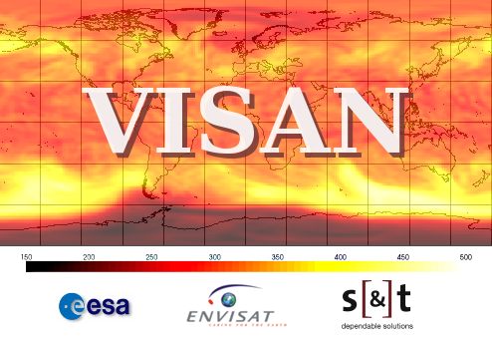
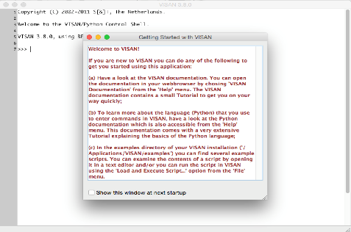
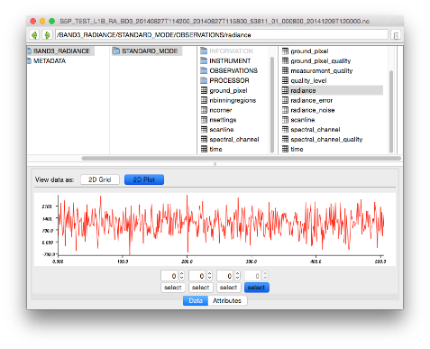
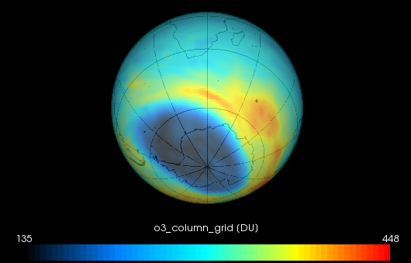
VISAN
VISAN provides interactive Python environment
Ingest data using CODA and HARP
With one function call, create interactive 2D and World plot visualizations of your data
Includes simple (CODA) product browser
Binary packages for Windows, Linux, and macOS.

Slide 15
ESA Atmospheric Toolbox
Plans for the coming year:
New toolbox web portal with forum and tutorials
Migrate VISAN to Python 3 and wxPython 4
R interface for CODA and HARP
Python Conda packages for CODA, HARP, VISAN
Expand tool collection: QDOAS
EarthCARE support will come later (requirements input)

Slide 16
ESA Atmospheric Toolbox
Find me at the demo for
more information
Wednesday 18:10 – 18:30
Thursday 11:05 – 11:35

