Slide 1
NASA assets (Data, Instruments, Platforms) that could support EarthCARE Cal/Val activities
Felix Seidel & Hal Maring
Earth Science Division
Science Mission Directorate, NASA
Felix.C.SeidelCaprez@nasa.gov
June 2018

Slide 2
More airborne & ground data!
EarthCARE Science workshop takeaway #1:
  MORE AIRCRAFT / GROUND BASED WORK WITH HSRL
NASA has performed a LOT of campaigns and most data are publicly available with data descriptions and ATBDs for L2 products. Many of those data are directly relevant to EarthCARE

Slide 3
Cal/Val collaboration between ESA & NASA: current activities and future considerations
=> Talk by Dirk Schüttemeyer today
Summer 2018 airborne field work in Europe
  HyTES to support FLEX mission preparation
  AVIRIS-ng to support Sentinel 3B Cal/Val, Copernicus Hyperspectral Imaging Mission for the Environment (CHIME) mission performance analysis plus on board cloud screening effort, and FLEX mission preparation
FLARE 2018 campaigns
Summer 2019 Sentinel-5P/TROPOMI Field Work
AEOLUS Validation (with DAWN lidar) for 2018—2020 (TBD)
EarthCARE ? (launch 2021)
Continuation of Current Efforts
  Operation Ice Bridge/CryoSat (expanded to include ICESat-2)
  Integrative Science

Slide 4
Airborne Validation Measurements
Ground-based Validation Measurements
L1 Vicarious calibration
L2 product calibration & validation
  Sun photometer network (Aeronet) for column AOD, SSA, size
  Lidar network (MPLnet) for vertical profile
=> Talk & Poster by Lewis on Friday
L1 data & L2 product development, calibration & validation
  HSRL2 355nm (P-3, ER-2) for ATLID
  AVIRISng & HyTES (ER-2, B200, etc.) for BBR and MSI (L1 only)
  APR-3 94GHz (P-3, DC-8) for CPR
  AirMSPI & RSP (ER-2, etc.) Aerosol & Cloud Products (L2 only)
=> Talk by Sy on Thursday at 11:55am

Slide 5
Cross-Satellite Validation
Cross-Satellite L1 inter-calibration / validation
Cross-Satellite L2 product validation / inter-comparison
  MODIS/VIIRS & MISR Aerosol & Cloud Products
  CALIPSO for ATLID Aerosol Product (if still operational)
  MAIA Aerosol Products (after 2021)
  TSIS-1 for BBR
  And more

Slide 6
Ground-based Examples

Slide 7
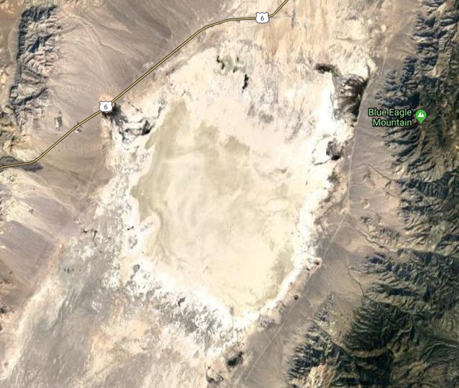
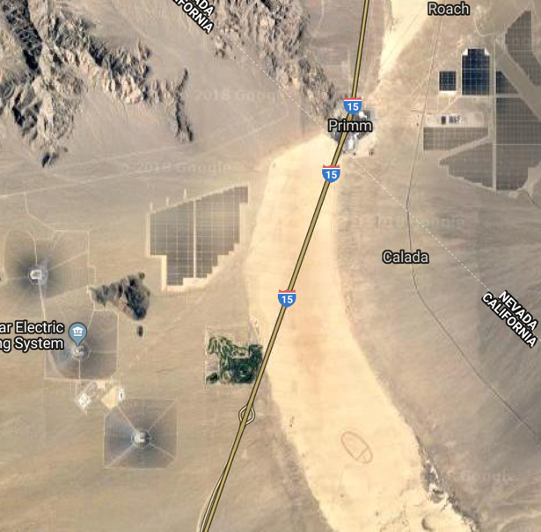
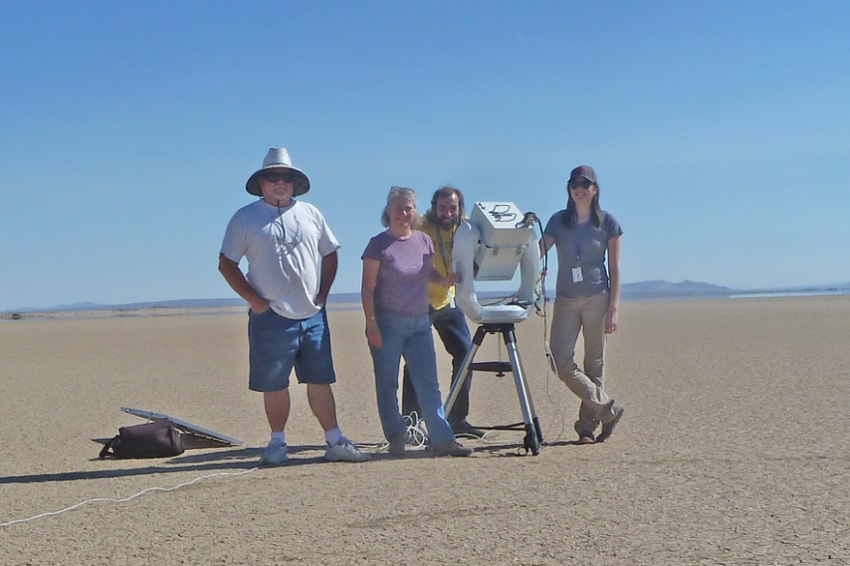
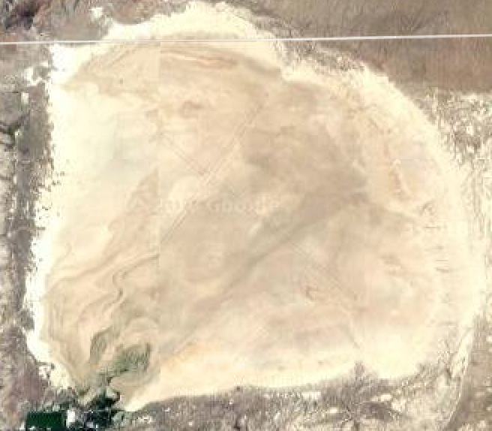
Vicarious Calibration for MSI & BBR
Spectrally stable ground sites:
*Railroad Valley (2 sites, fully instrumented, automated)
*Ivanpah Playa
Rosamond dry lake
*Frenchman Flat
*CEOS Reference Standard Test Sites

Slide 8

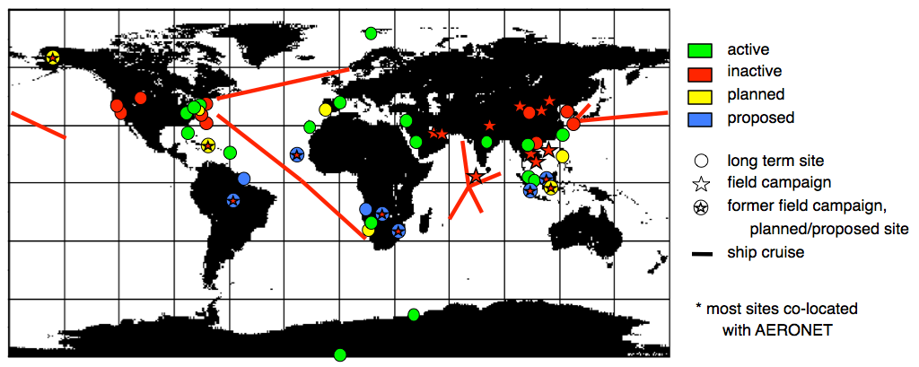
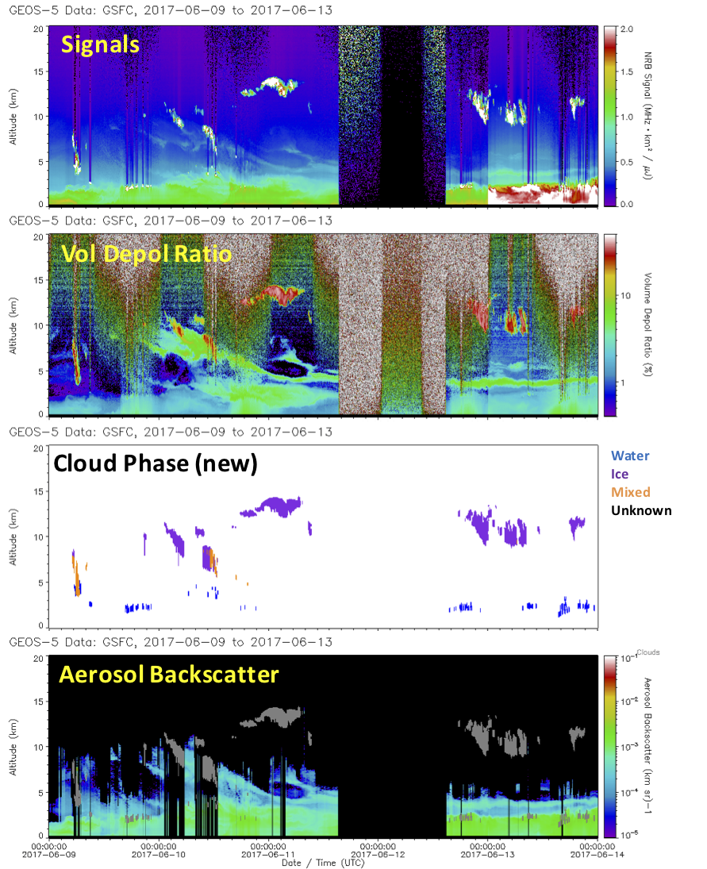
Micro Pulse Lidar Network (MPLNET)
Continuous, long term, global lidar network to profile aerosol and cloud vertical distribution and properties
Continuous 24/7 lidar profiles: 1 min , 30 or 75 m resolution
NRT product delivery (< 1.5 hours)
Currently: 20 long term sites (all upgraded with polarized lidars)
PI: Ellsworth Judd Welton, NASA GSFC
http://mplnet.gsfc.nasa.gov
EarthCARE Validation:
Cloud heights and phase, PBL heights
=> Talk & Poster by Lewis on Friday

Slide 9
Airborne Examples

Slide 10
Polarimeter Campaigns
Name | Approx. Date | Location | Purpose | AirHARP | AirMSPI | RSP | SPEX | Aircraft | Other instruments (not comprehensive)
Birmingham? | Sep-08 | Alabama | Air quality? |  |  | yes
RACORO | Jun-09 |  |  |  |  | yes
Chesapeake? | Sep-09 | Chesapeake Bay | ? |  |  | yes
CALNEX | May-10 | Calfornia | Air quality |  |  | yes |  | B-200, NOAA P-3 | HSRL
CARES | Jun-10 | California | Aerosols & air quality |  |  | yes |  | B-200 | HSRL
COCOA | Aug-10 | Caribbean | clouds and aerosols, satellite validation |  |  | yes |  | B-200 | HSRL
DEVOTE | Oct-11 | US east coast | Satellite validation |  |  | yes |  | B-200, UC-12 | HSRL, LARGE
TCAP | Jul-12 | Cape Cod | Pollution |  |  | yes |  | B-200
AZORES | Oct-12 | Azores | Maritime aerosols, clouds |  |  | yes |  | B-200 | HSRL
PODEX | Jan-13 | S. California | ACE test/validation | PACS (no data) | yes | yes |  | ER-2 | CPL, SSFR
SEAC4RS | Aug-13 | CONUS, Gulf of Mexico | Pollution, forest fires, liquid/ice clouds |  | yes | yes |  | ER-2, DC-8 | HSRL, CPL, eMAS, many others
HyspIRI '13 | Oct-13 | US west coast | Ocean color, aerosols over land |  | yes | yes |  | ER-2 | AVIRIS-c, RSP&AirMSPI not coincident
HyspIRI '14 spring | Apr-14 | US west coast | Ocean color, aerosols over land |  | yes | yes |  | ER-2 | AVIRIS-c
Pre-PACE | Apr-14 | US west coast | Ocean color, aerosols over land |  | yes |  |  | ER-2, Twin Otter | AVIRIS-c, MASTER / PRISM on Twin Otter
Bermuda (name?) | Jun-14 | Bermuda | Ocean color, lidar (?) |  |  | yes |  | B-200?
SABOR | Jul-14 | Atlantic | Ocean color |  |  | yes |  | B-200 | HSRL, ship
HyspIRI '14 fall | Oct-14 | US west coast | Ocean color, aerosols over land |  |  | yes |  | ER-2
CalWater2 | Jan-15 | California | Atmospheric rivers, aerosols |  | yes |  |  | ER-2 | CPL
NAAMES '15 fall | Nov-15 | NW Atlantic | Ocean color, clouds |  |  | yes |  | C-130 | HSRL, GCAS, ship
RADEX/OLYMPEX | Nov-15 | Washington state | Clouds |  | yes |  |  | ER-2 | CPL, radar
SPEX-PR | Feb-16 | US west coast | SPEX check flights |  | yes |  | yes | ER-2 | AVIRIS
NAAMES_201605 | May-16 | NW Atlantic | Ocean color, clouds |  |  | yes |  | C-130 | HSRL, GCAS, ship
ImPACT-PM | Jul-16 | US west coast | Air quality |  | yes |  | yes | ER-2, Twin Otter | CPL / In-Situ Aerosol Twin Otter (Seinfeld)
ORACLES_2016 | Sep-16 | SE Atlantic | Clouds, aerosols above clouds |  | yes | yes |  | ER-2, P-3 | HSRL, eMAS, radars
LMOS | May-17 | Lake Michigan | Ozone, air quality | yes |  |  |  | Twin Otter
ORACLES_2017 | Aug-17 | SE Atlantic | Clouds, aerosols above clouds |  |  | yes |  | P-3 | HSRL, radars
NAAMES_2017 | Sep-17 | NW Atlantic | Ocean color, clouds |  |  | yes |  | C-130 | HSRL, GCAS, ship
ACEPOL | Nov-17 | S. California | ACE test/validation | yes | yes | yes | yes | ER-2 | HSRL, CPL

Slide 11
Lidar Campaigns
Name | Approx. Date | Location | Purpose | CPL | DIAL/HSRL | HSRL-1 | HSRL-2 | Aircraft | Other instruments (not comprehensive)
CATS/CALIPSO val. | Jan-07 | Eastern US | Validation |  |  | yes
San Joaquin Valley | Feb-07 | California |  |  |  | yes
CHAPS/CLASIC | Jun-07 | Oklahoma |  |  |  | yes
Caribbean 1 | Jan-08 | Caribbean |  |  |  | yes
ARCTAS Spring | Apr-08 | Alaska |  |  |  | yes
ARCTAS Summer | Jun-08 | NW Canada |  |  |  | yes
Birmingham | Sep-08 | Alabama |  |  |  | yes
CALIPSO Validation | Jan-09 | Eastern US |  |  |  | yes
RACORO | Jun-09 | Oklahoma |  |  |  | yes
Ocean Subsurface | Sep-09 | East Coast |  |  |  | yes
CALIPSO Validation | Apr-10 | Eastern US |  |  |  | yes
CALIPSO Gulf Oil Spill | May-10 | Gulf of Mexico |  |  |  | yes
CalNEX | May-10 | Los Angeles |  |  |  | yes
CARES | Jun-10 | Sacramento |  |  |  | yes
Caribbean 2 | Aug-10 | Caribbean |  |  |  | yes
DISCOVER-AQ | Jul-11 | DC-Baltimore |  |  |  | yes
EPA | Aug-11 | SE Virginia |  |  |  | yes
DEVOTE | Oct-11 | SE US |  |  |  | yes
ATTREX 2011 | Nov-11 | West Coast, Pacific | TTL cirrus & composition | yes |  |  |  | GlobalHawk | SSFR, others
CALIPSO Validation | Mar-12 | Eastern US |  |  |  | yes
DC3 | May-12 | Central US |  |  | yes
TCAP | Jul-12 | Cape Cod |  |  |  |  | yes
HS3 2012 | Sep-12 | VA, Atlantic Ocean | Hurricanes and SAL (dust) | yes |  |  |  | GlobalHawk | S-HIS, Dropsondes, HIWRAP, others
Azores | Oct-12 | Azores |  |  |  | yes
DISCOVER-AQ | Jan-13 | Central CA |  |  |  |  | yes
PODEX | Jan-13 | S. California | ACE test/validation | yes |  |  |  | ER-2 | AirMSPI, RSP, MASTER
ATTREX 2013 | Feb-13 | West Coast, Pacific | TTL cirrus & composition | yes |  |  |  | GlobalHawk | SSFR, others
SEAC4RS | Aug-13 | CONUS, Gulf of Mexico | Pollution, forest fires, liquid/ice clouds | yes | yes |  |  | ER-2, DC-8 | AirMSPI, RSP, eMAS, many others
HS3 2013 | Aug-13 | VA, Atlantic Ocean | Hurricanes and SAL (dust) | yes |  |  |  | GlobalHawk | S-HIS, Dropsondes, HIWRAP, others
DISCOVER-AQ | Sep-13 | Houston |  |  |  |  | yes
ATTREX 2014 | Jan-14 | Guam, Pacific | TTL cirrus & composition | yes |  |  |  | GlobalHawk | SSFR, Hawkeye, others
CALIPSO Validation | Jun-14 | Eastern US |  |  |  | yes
SABOR | Jul-14 | Atlantic Ocean | Ocean color |  |  | yes |  | B-200 | RSP, Ship
DISCOVER-AQ | Jul-14 | Denver |  |  |  |  | yes
HS3 2014 | Aug-14 | VA, Atlantic Ocean | Hurricanes and SAL (dust) | yes |  |  |  | GlobalHawk | S-HIS, Dropsondes, HIWRAP, others
CalWater2 | Jan-15 | Calfornia | Atmospheric Rivers and aerosols | yes |  |  |  | ER-2 | AirMSPI, AVIRIS
CCAVE | Aug-15 | Calfornia | CATS & CALIPSO Validation | yes |  |  |  | ER-2 | ACATS
NAAMES | Nov-15 | W North Atlantic |  |  |  | yes
RADEX/OLYMPEX | Nov-15 | Washington state | Clouds | yes |  |  |  | ER-2 | AirMSPI, CRS, others
KORUS-AQ | May-16 | South Korea |  |  | yes
NAAMES | May-16 | W North Atlantic |  |  |  | yes
ORACLES '16 | Aug-16 | Namibia/ S East Atlantic |  |  |  |  | yes
ORACLES '17 | Aug-17 | Saõ Tomé/ S East Atlantic |  |  |  |  | yes
NAAMES | Sep-17 | W North Atlantic |  |  |  | yes
ACEPOL | Nov-17 | S. California | ACE test/validation | yes |  | yes | yes | ER-2 | AirHARP, AirMSPI, RSP, SPEX

Slide 12

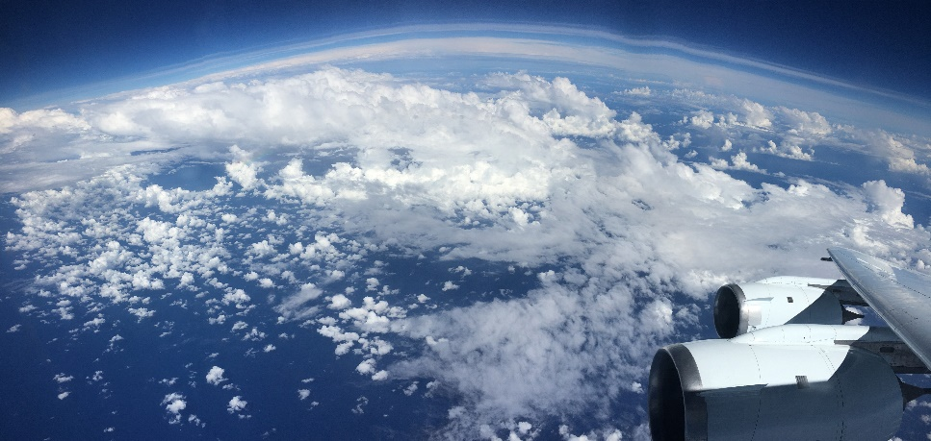
APR3: Airborne Precipitation and Cloud Radar
Ku+Ka+W, Scanning, Doppler, Dual Pol
June 19, 2017
Gulf of Mexico
APR3 on P-3
APR2 Ku-band vertical structure
Sea surface
convective storm
initiation, organization, growth, and dissipation
=> See talk by Sy on Thursday at 11:55am

Slide 13
Radar Definition Experiment (RADEX)
Goals:
  Develop algorithms for ACE Ka-/W-band Doppler radar.
  Precipitation algorithm improvement (GPM)
Observation platforms: GPM/Terra (space), DC-8/ER-2/Learjet (airborne), WX radar, etc. (ground)
ER-2 is instrumentation:
  3 radars (EXRAD, HIWRAP, CRS)(X, Ku, Ka, W bands)
  Profiling lidar (CPL)
  Advanced Precipitation Microwave Radiometer (AMPR)
  Polarimeter (AirMSPI)
  MODIS Airborne Simulator (eMAS)
DC-8 instrument relevant to EarthCARE
  Cloud in-situ sampling
  Airborne Precipitation and Cloud Radar (APR3)
Ka
Ku

Slide 14
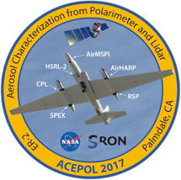
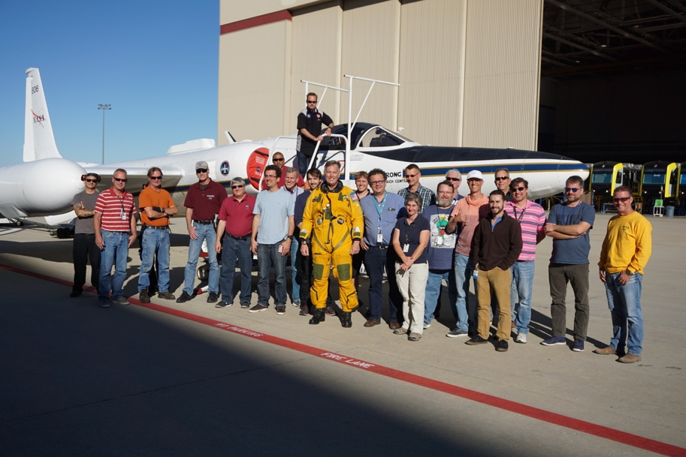
ACEPOL
Aerosol Characterization from Polarimeter and Lidar
Collaboration with SRON (Netherlands) to fly and test airSPEX as a simulator for the contributed European polarimeter to NASA’s PACE satellite mission.
Successful demonstration for future Cal/Val activities for 3MI (EPS-SG), SPEXone, EarthCARE, MAIA, Decadal Survey missions, etc.
Campaign Objectives
Engineering: Assess performance of instruments and algorithms developed for ACE pre-formulation mission & PACE with ground and space based reference data.
Science: Link column-integrated and vertically-resolved aerosol properties. Hypothesis: Polarimeter-Lidar combination enables characterization of elevated dust/smoke and boundary layer smog.
Campaign Details
Dates: Oct-Nov 2017, Region: California & Arizona, USA
Aircraft & Flights: NASA ER-2, 9 Flights, 40 Hours
Instruments on ER-2:
  Polarimeters: AirMSPI, RSP, AirHARP, airSPEX
  Lidars: HSRL-2, CPL
Instruments on ground: Sunphotometers, Lidar, Polarimeter
Under-flights with: CALIPSO, MISR, MODIS, CATS (ISS)

Slide 15
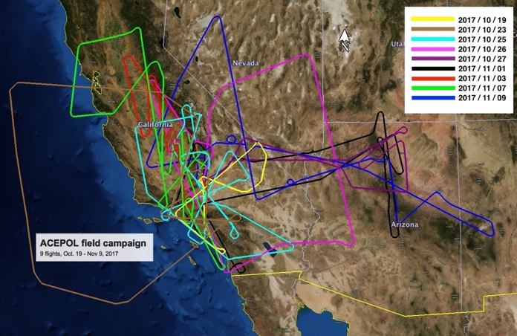
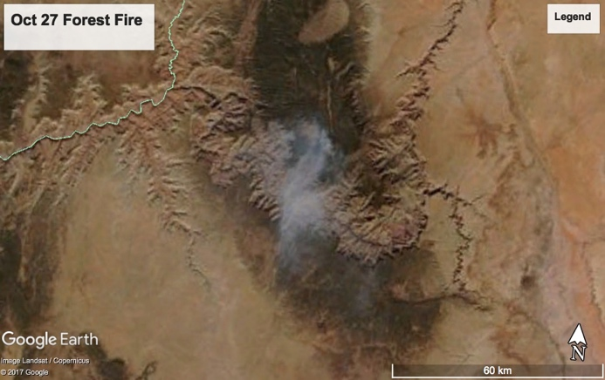
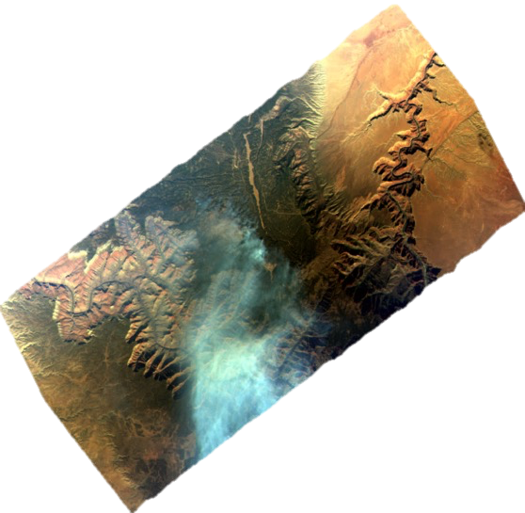
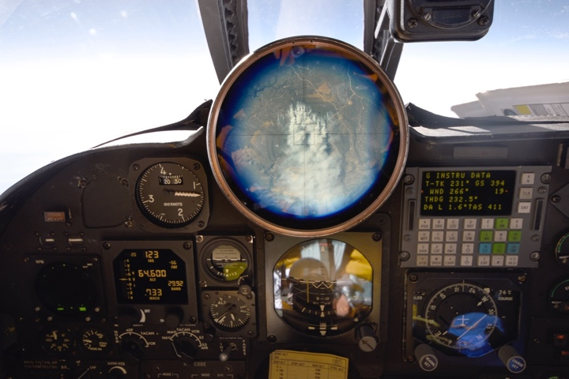
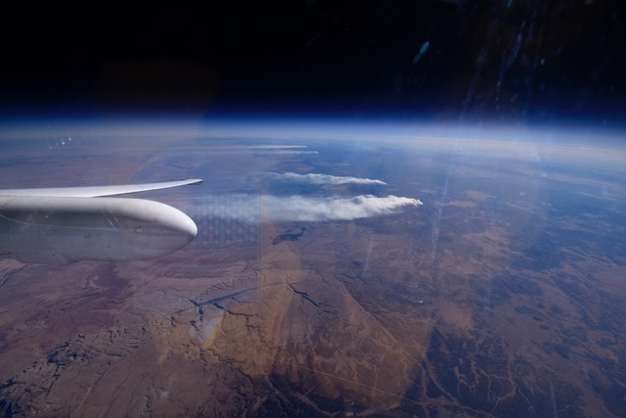
ACEPOL
Aerosol Characterization from Polarimeter and Lidar
AirHARP & AirSPEX
AirHARP
AirSPEX
airSPEX & AirHARP
superimposed on Google Earth
Flight Tracks
HSRL-2
PRELIMINARY DATA

Slide 16
BB Aerosols above clouds: ORACLES
HSRL-2 aerosol backscatter data showing aerosol layer above marine cloud deck.
Aerosol plume from biomass burning in Africa observed by MODIS-Aqua over marine clouds in the Atlantic in Sept. 2016.
AOD Above Cloud
AOD Above Cloud
Cloud Thickness
Great agreement on retrieved aerosol and cloud properties from polarimeter (AirMSPI, RSP) and Lidar (HSRL-2).
Xu, F., van Harten, G., Diner, D.J., Davis, A.B., Seidel, F.C., Rheingans, B., Tosca, M., Alexandrov, M.A., Cairns, B., Ferrare, R.A., Burton, S.P, Fenn, M.A., Hostetler, C.A., Wood, R., Redemann, J., Coupled Retrieval of Liquid Water Cloud and Aerosol Above Cloud Properties using the Airborne Multiangle SpectroPolarimetric Imager (AirMSPI). JGR-Atmospheres. http://dx.doi.org/10.1002/2017JD027926
Cloud Optical Depth
Cloud Droplet Radius
Cloud Droplet Variance

Slide 17
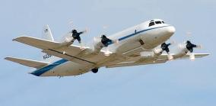

Cloud and Aerosol Monsoonal Processes: Philippines Experiment
(CAMP²Ex) Late August to early October 2019
Science Questions formulated around aerosol, clouds, precipitation, and land use changes focused on the Monsoon in SE Asia.
Aerosol & Cloud remote sensing (polarimeter)
  aerosol & cloud optical depth
  aerosol & cloud optical/microphysical properties
Cloud/precip remote sensing
  94 GHz radar, 18-27 GHz radar
Aerosol profiles (lidar)
Solar and IR radiation
Aerosol in-situ microphysics:
  size distribution
  black carbon
  cloud condensation nuclei
  dry & ambient aerosol scattering
Cloud in-situ microphysics
  droplet/ice particle size
  precipitation
Tracer Gases
State variables:
  in-situ & profile
  sea surface temperature
Observations
NASA P-3B
SPEC
Lear 35

Slide 18
Felix.C.SeidelCaprez@nasa.gov

Slide 19
Backup

Slide 20
2018+ Field Work in Europe
AVIRIS-ng to support Sentinel 3B Cal/Val, Copernicus Hyperspectral Imaging Mission for the Environment (CHIME) mission performance analysis plus on board cloud screening effort, and FLEX mission preparation
HyTES to support FLEX mission preparation

Slide 21
2018 EGU Calibration/Validation Session
NASA and ESA co-chaired a special session at the 2018 EGU meeting focusing on satellite calibration/validation
Nearly 12 talks and 18 posters
  Airborne Campaigns for the Validation of ESA’s Aeolus Mission – C. Lemmerz et al.
  Preparation of the ADM-Aeolus mission using 355nm high spectral resolution Doppler LIDAR and a Doppler cloud radar – A. Irbah et al.
  Global Sea-Surface Temperature Fields from MODIS and VIIRS – P. Minnett et al.
  Innovative retrieval methods of aerosol and cirrus cloud optical depth above water clouds and ocean surface, and its application for ATLID calibration/validation activities – Y. Hu et al.
  Airborne Lidar for calibration and validation of spaceborne forest biomass and height products: Examples from NASA’s Carbon Monitoring System, AfriSAR and GEDI Missions – L. Duncanson et al.
  Elevation and freeboard calibration/validation of IceBridge and five different CryoSat-2 retrackers for coincident sea ice observations - D. Yi et al.

Slide 22
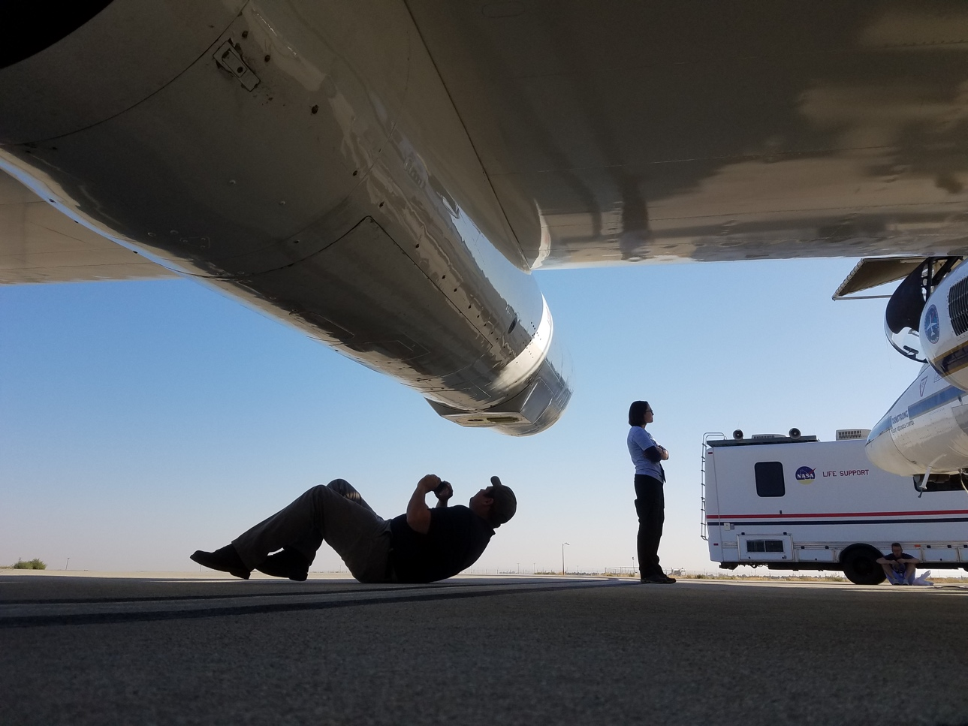
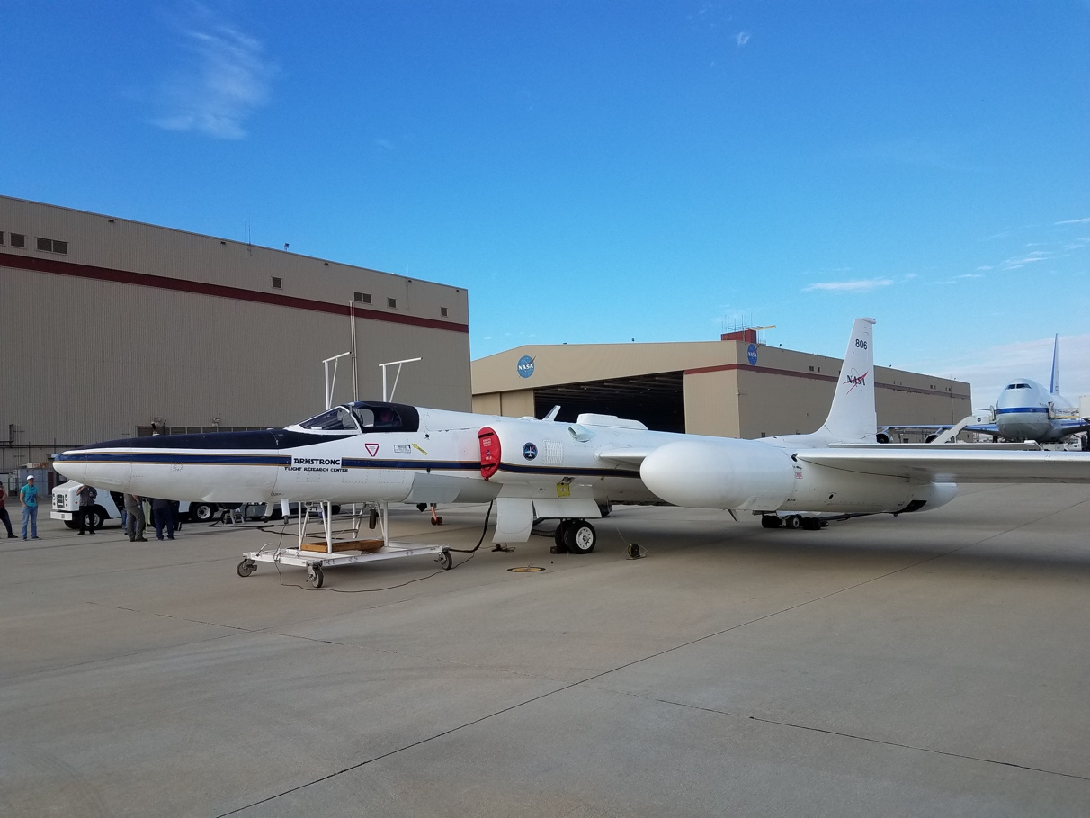



Slide 23
TROPOMI Cal/Val
NASA and ESA collaboration on the ground-based Pandora Instrument and Pandonia Global Network (comparable to AERONET, but for trace gases)
NASA Pandora instruments and the NASA GeoTASO airborne UV/VIS imager participated in several cal/val projects.

