Slide 1


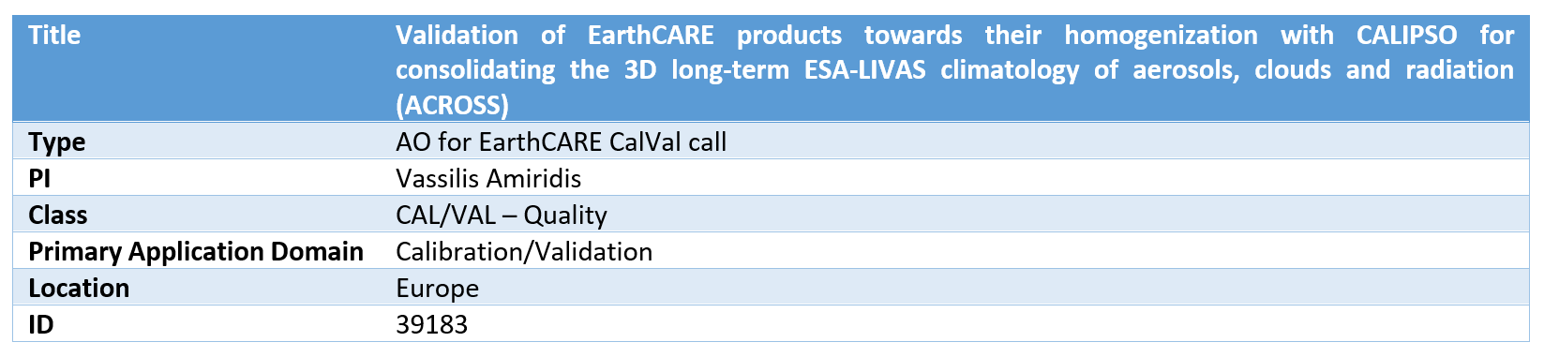
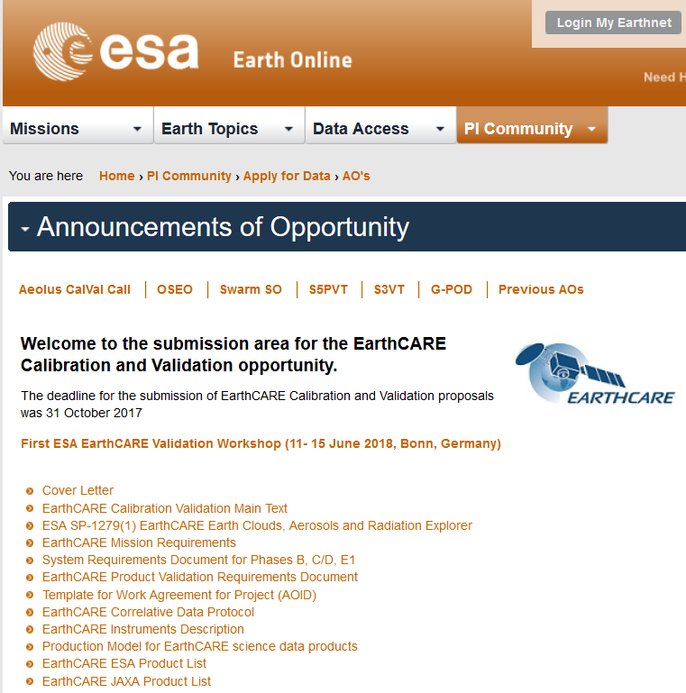
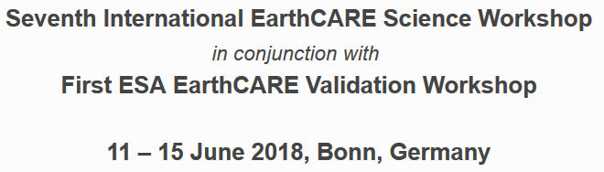
ACROSS Cal/Val project
Emmanouil Proestakis
National Observatory of Athens, IAASARS
proestakis@noa.gr
and
the ACROSS-Team

Slide 2
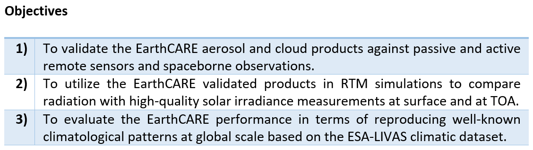
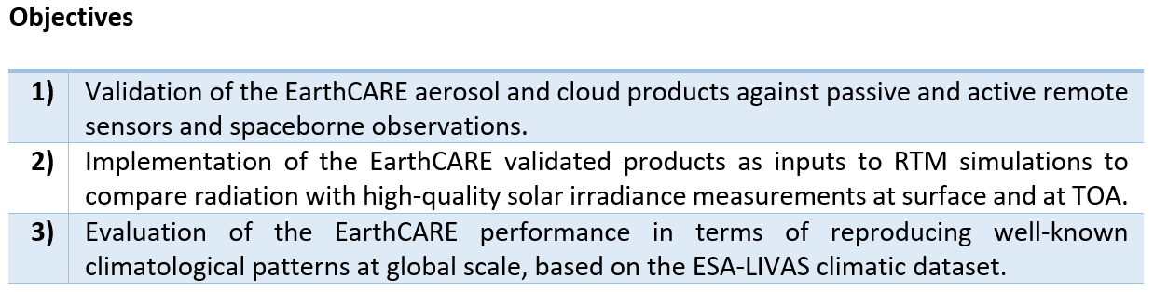
ACROSS Cal/Val project

Slide 3
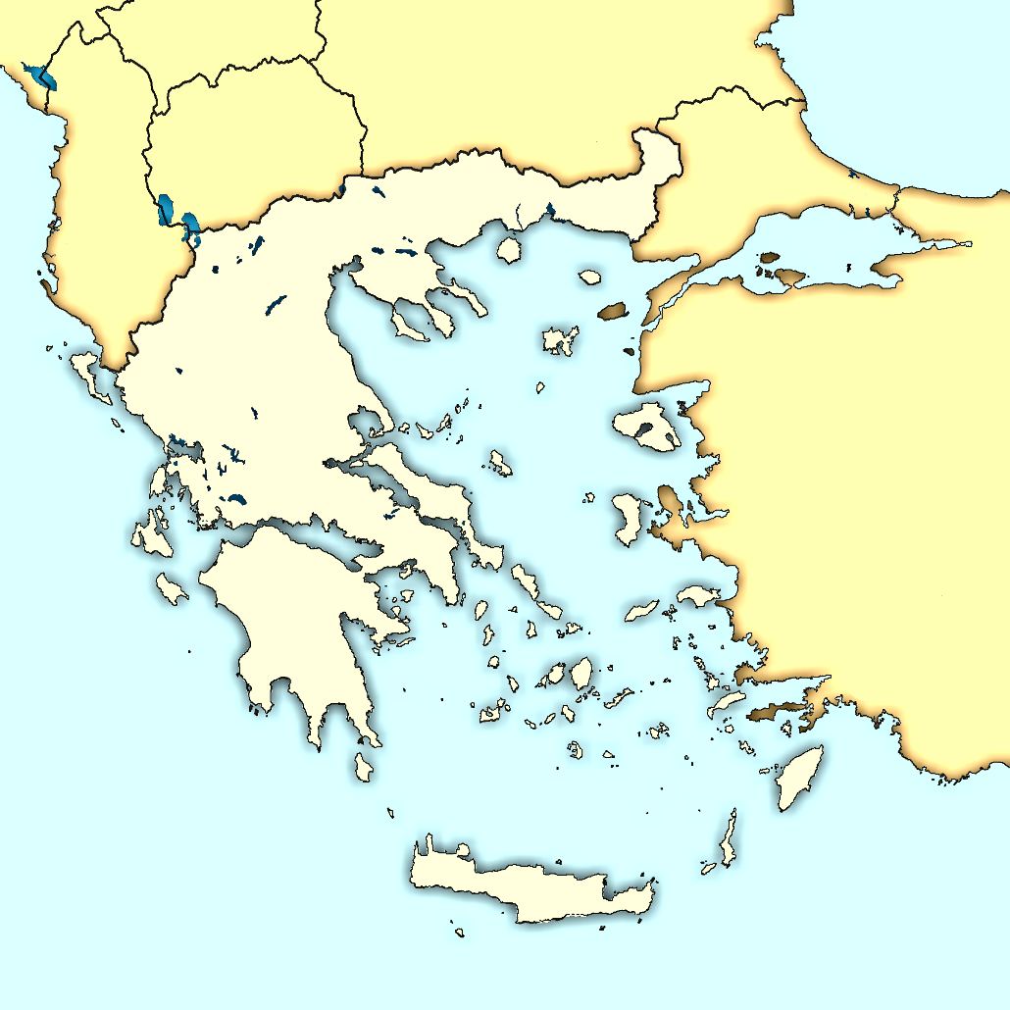




ACROSS Cal/Val project
PI: Dr. Vassilis Amiridis
National Observatory of Athens, IAASARS
vamoir@noa.gr
Prof. Nikos Mihalopoulos
National Observatory of Athens, IERSD
nmihalo@noa.gr
Dr. Stelios Kazadzis
National Observatory of Athens, IERSD
kazadzis@noa.gr
Prof. Dimitris Balis
Aristotle University of Thessaloniki - Laboratory of Atmospheric Physics
balis@auth.gr
Prof. Maria Kanakidou
ECPL, Department of Chemistry, University of Crete
mariak@chemistry.uoc.gr
Prof. Alexandros Papayannis
National Technical University of Athens, Laser Remote Sensing Unit
apdlidar@central.ntua.gr
Dr. Elina Giannakaki
University of Athens, Physics Department, Environmental Physics – Meteorology, PHYS IV
elina@phys.uoa.gr
+ Post Doc / PhD / MSc students (Part of the groups of the
ACROSS Consortium)
NOA
ACROSS Consortium
AUTH
UoC
NTUA
UoA

Slide 4
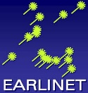
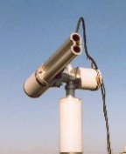


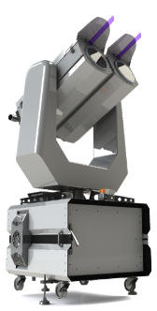
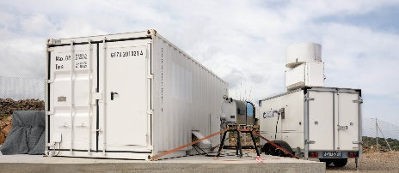
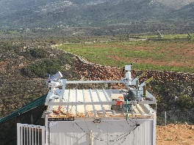

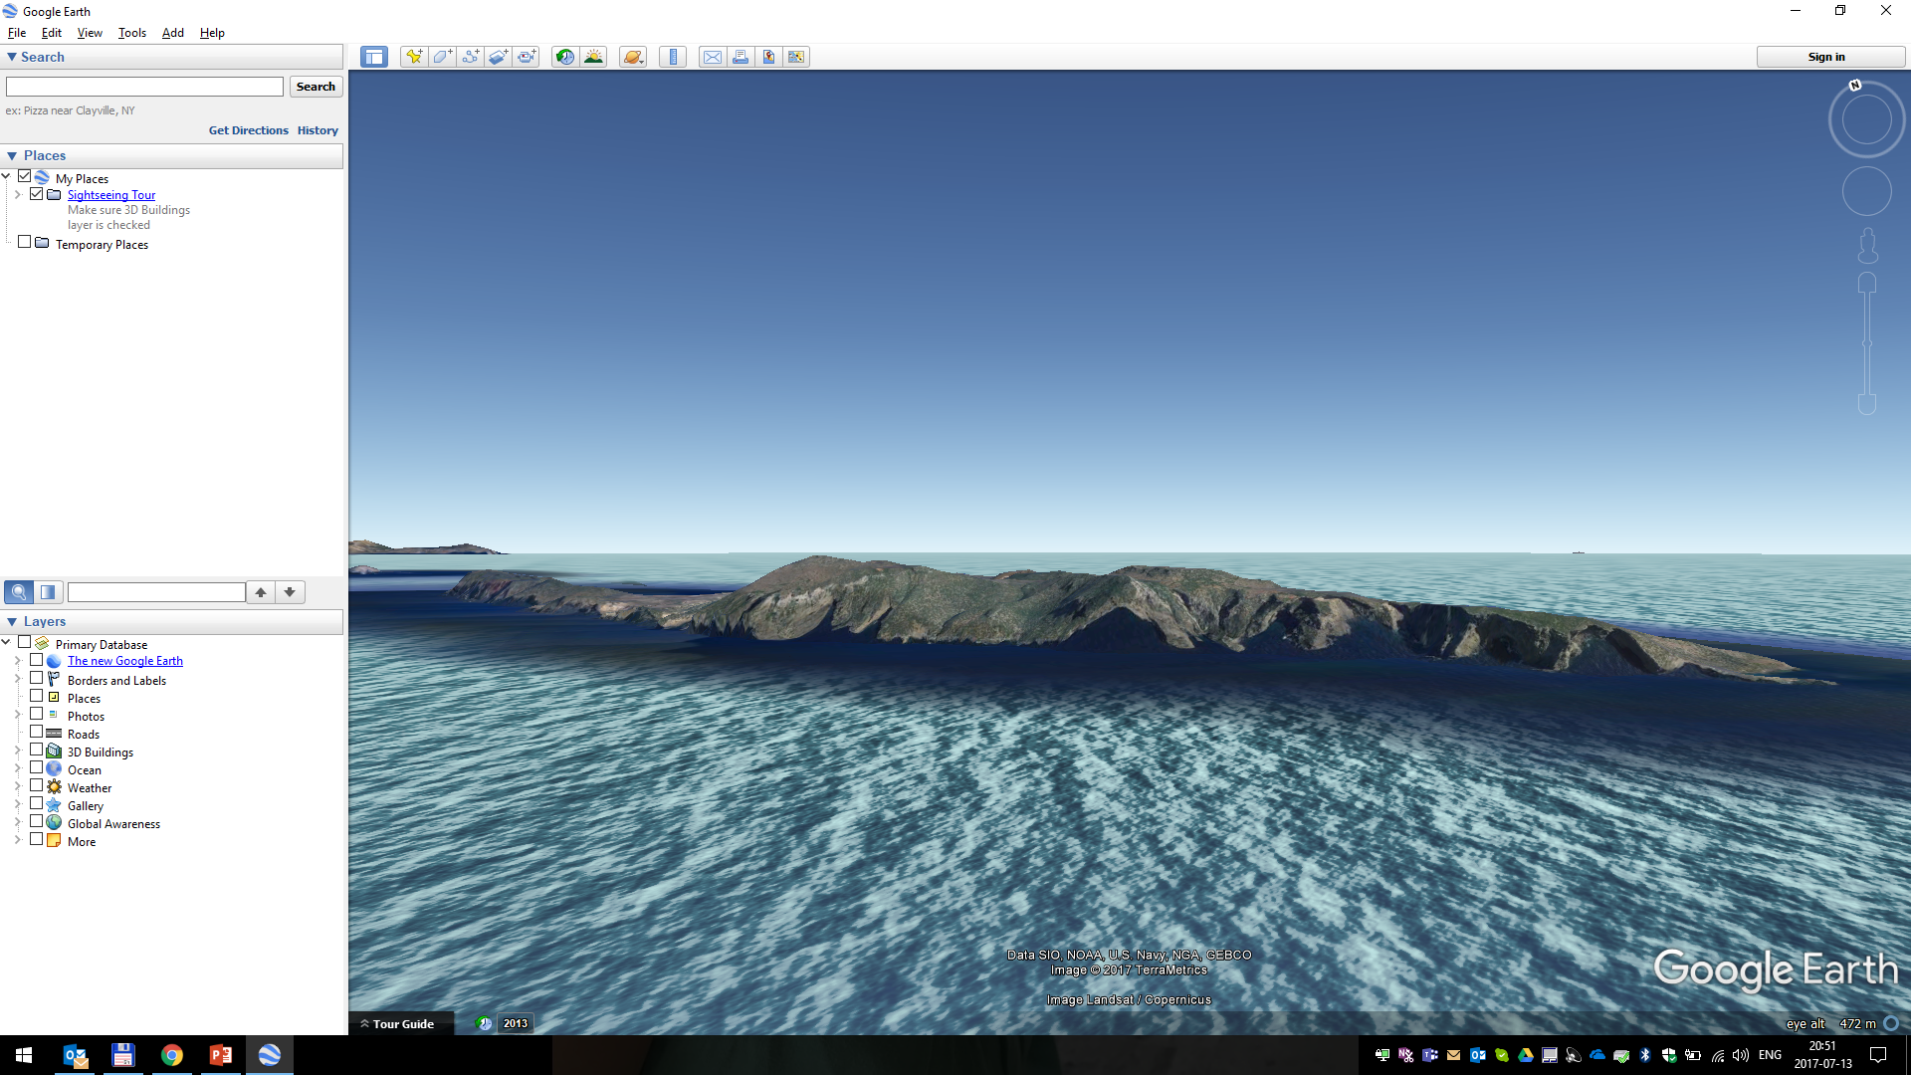
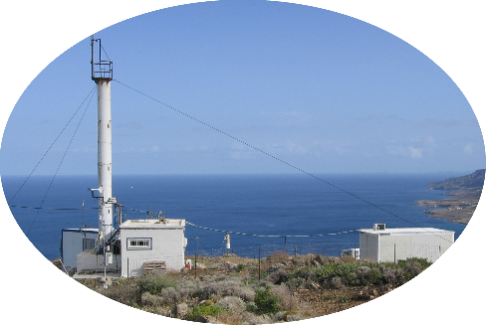
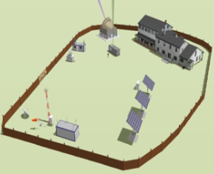

ACROSS Cal/Val project
ACROSS Contribution
NTUA
UoA
NOA
AUTH
D-TECT project
Vassilis Amiridis
UoC
PANGEA Observatory
Finokalia Observatory
Elevation: $\sim$ 90m

Slide 5
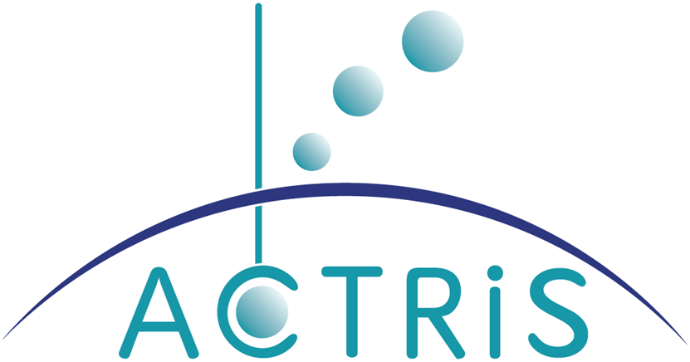
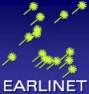


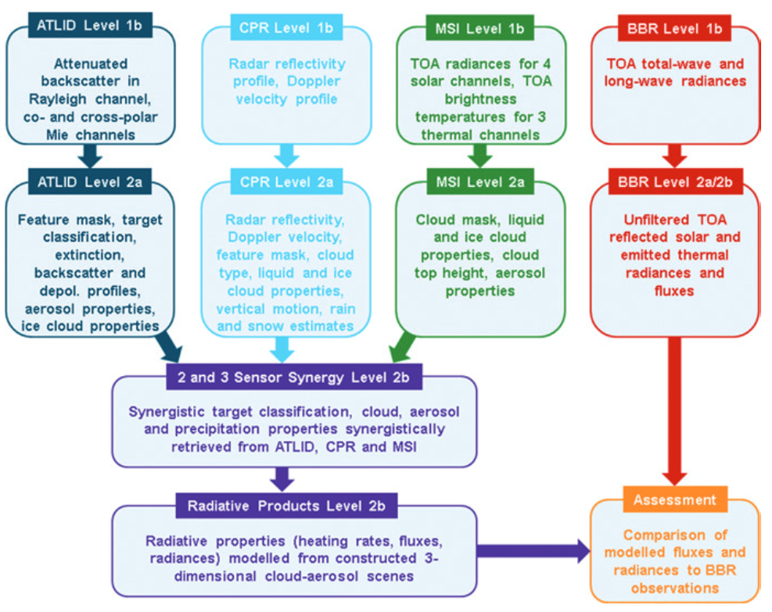

ACROSS Cal/Val project
 | ATLID | CPR | MSI | BBR
EarthCARE Products | FM, AER, ICE, TC, EBD, CTH, ALD | FMR, CD, TC, CLD | CM, COP, AOT
Fiducial measurements | Three EARLINET stations (at/no/th) Mobile lidar infrastructure (NOA) | Cloud Unit | Multiple sunphotometric instruments AERONET CIMEL, Yankee UV-MFR radiometer, Solar Broadband Detectors, PSR Spectroradiometer, Pandora spectrometer, MAX-DOAS, Brewer
Evaluation | ESA-LIVAS Mobile lidar infrastructure (NOA/NTUA) |  | Satellite-based sensors (MODIS/VIIRS/Setinel-3) | CERES MSG GERB/SEVIRI
Source: Illingworth et al, 2015

Slide 6
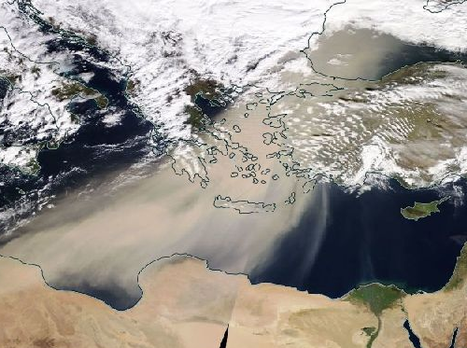
ACROSS Cal/Val project
Performance of radiative closure experiments:
Selection of atmospheric scenes at Antikythera island characterized by different aerosols’ regime (i.e. dust)
EarthCARE products ➔ inputs to RTMs (libRadtran, SBDART) ➔ assessment of reproduced radiation fields at the ground and at TOA
Relative and absolute validation of RTMs outputs versus fiducial reference measurements (BSRN, PSR) and corresponding satellite observations (CERES, GERB)
Sensitivity analysis on RTM inputs ➔ bias reduction ➔ potential “corrections” on EarthCARE retrievals
PANGEA
Observatory

Slide 7
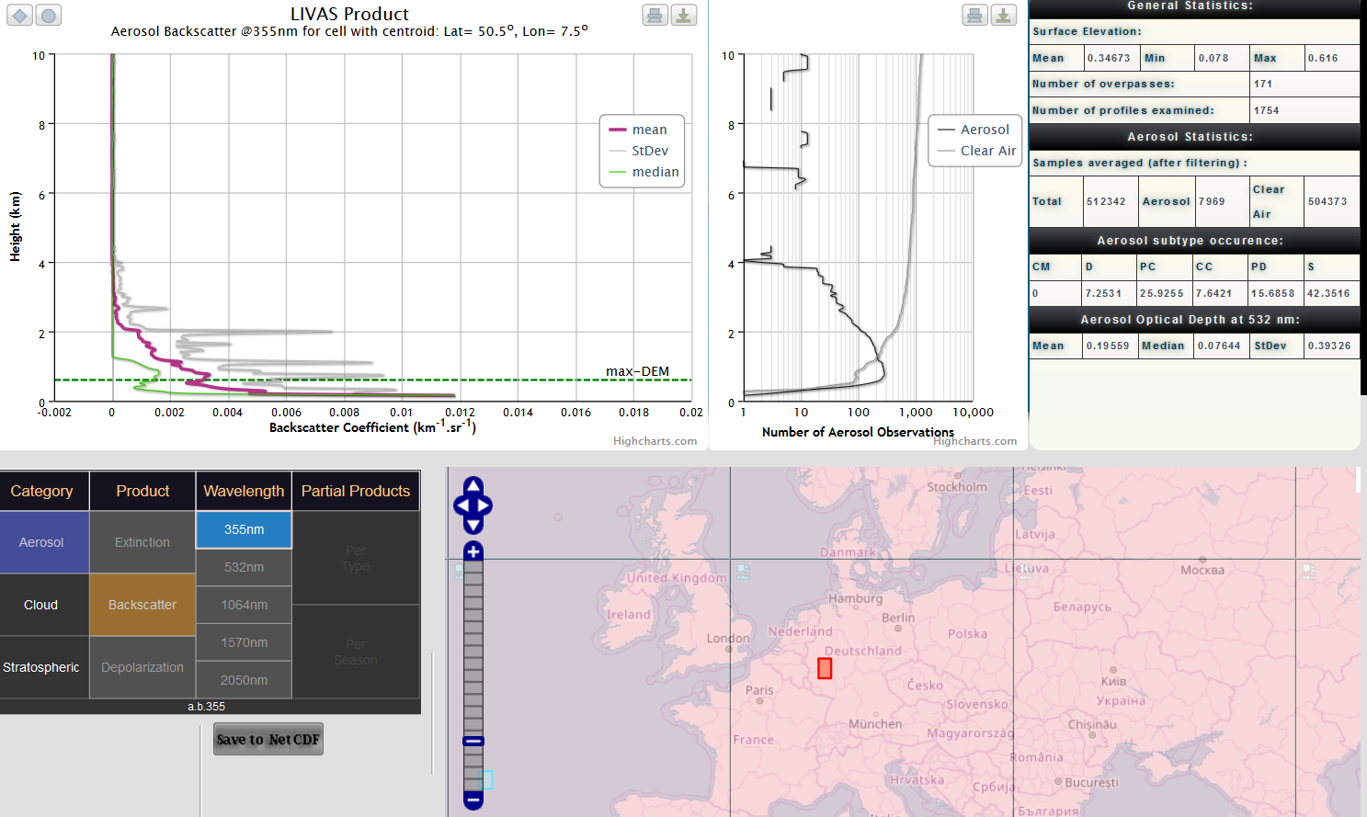
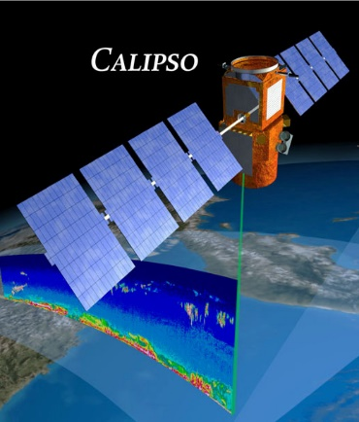
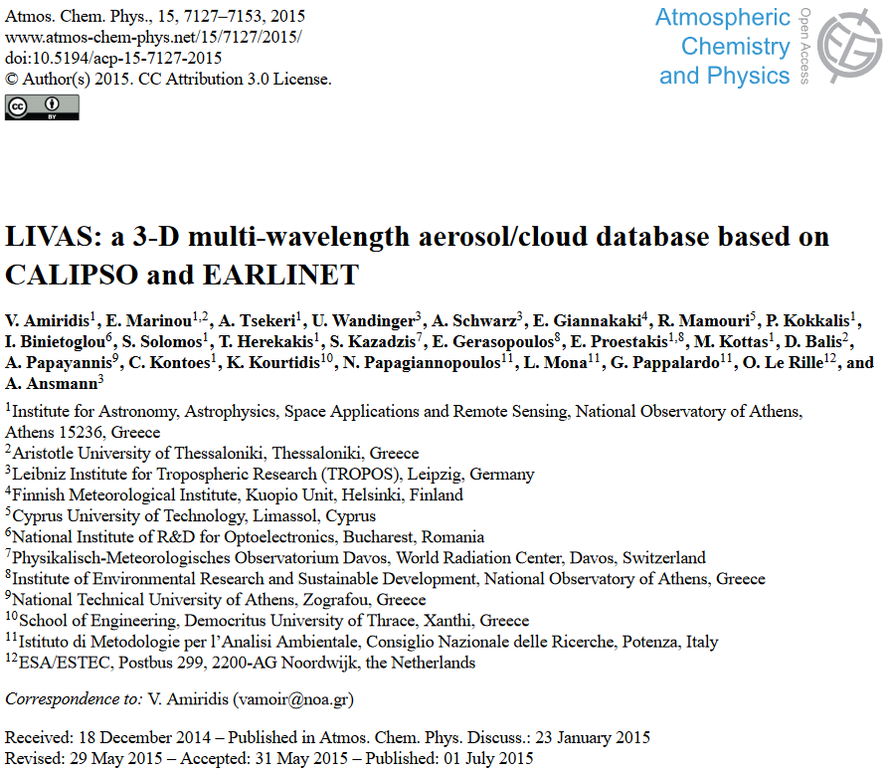

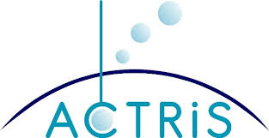
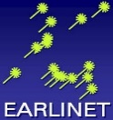



ACROSS Cal/Val project
The LIVAS project
Lidar Climatology of Vertical Aerosol Structure for
Space-Based Lidar Simulation Studies
CALIOP observations at 532 nm → Quality Filtering →
→ Conversion Factors →
→ Climatology at 355 nm
Bonn - Germany
Source: http://lidar.space.noa.gr:8080/livas/climatology.html

Slide 8
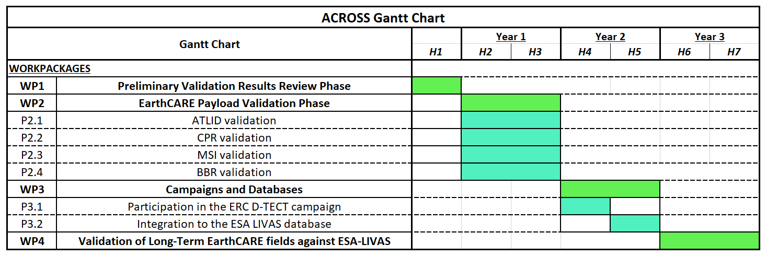
ACROSS Cal/Val project
Schedule
From L-4 to L: Pre-launch rehearsal
From L to L+6m: Preliminary Validation Results Review Phase of EarthCARE
From L+6m to End-of-Mission: Long-term Validation Phase of EarthCARE
*L: Launch day

Slide 9
ACROSS Cal/Val project
Funding - Allocated
Personnel: Key Researchers/ Group leaders hold permanent positions in the participating Institutes.
Instrumentation: Operated in the framework of participation in European Networks (EARLINET, AERONET) and the ACTRIS RI (operation and maintenance under PANACEA).
Cal/Val Experiments: synchronized with the campaigns of the ERC project D-TECT of Vassilis Amiridis at PANGEA Observatory.
Funding – In Risk
Acquisition of the Cloud Remote Sensing National Facility: Hellenic Foundation for Research & Innovation (http://www.elidek.gr/en/homepage/) – ongoing effort.
Young Researchers: high risk with respect to EarthCARE launch-postponements.
Additional funds will have to be allocated to cover the expenses for:
the operation of the mobile facilities on EarthCARE ground-track
the radiative closure experiments
the upgrade of the ESA-LIVAS climatic dataset
(in discussion with the Hellenic Authorities)
Thank you for your time,
The ACROSS team

