Slide 1
Balloon Aerosols Instruments for the Validation of EarthCare
(BAIVEC)
Jean-Baptiste RENARD, LPC2E, Orléans, France
Albert HERTZOG, LMD, Palaiseau, France
Gwenaël BERTHET, Fabrice JEGOU, LPC2E-CNRS, Orléans, France
François RAVETTA, LATMOS, Paris,France
Hélène CHEPFER, Artem FEOFILOV, Vincent NOEL, LMD, Palaiseau, France

Slide 2
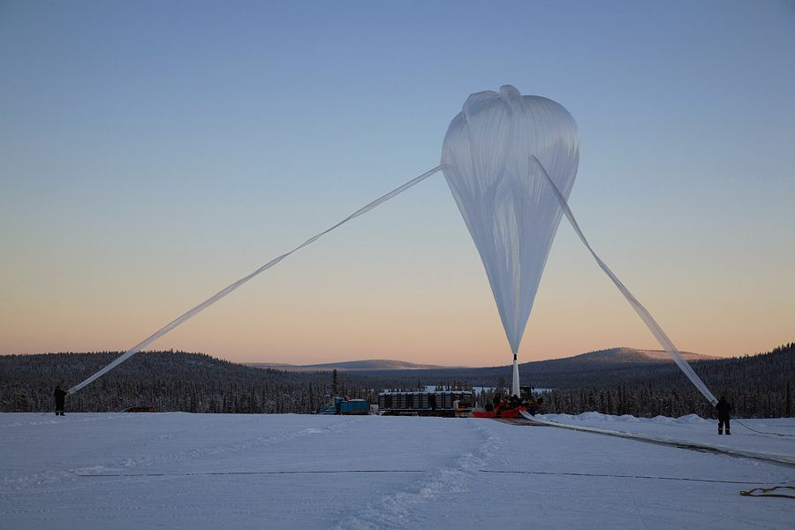
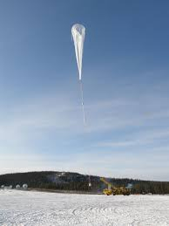
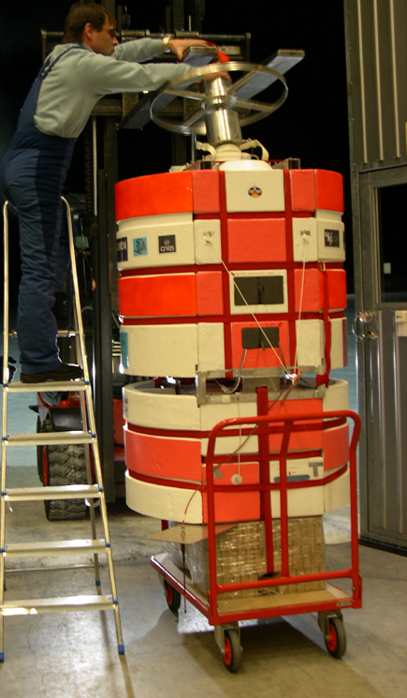
Validation of EarthCare aerosol measurements, during good temporal and spatial coincidences with balloon-borne measurements
Already successful strategy in the past for the validation of chemistry instruments onboard Envisat, with the launch of “big” balloons by the CNES at different latitudes
UV-visible spectrometer SALOMON

Slide 3
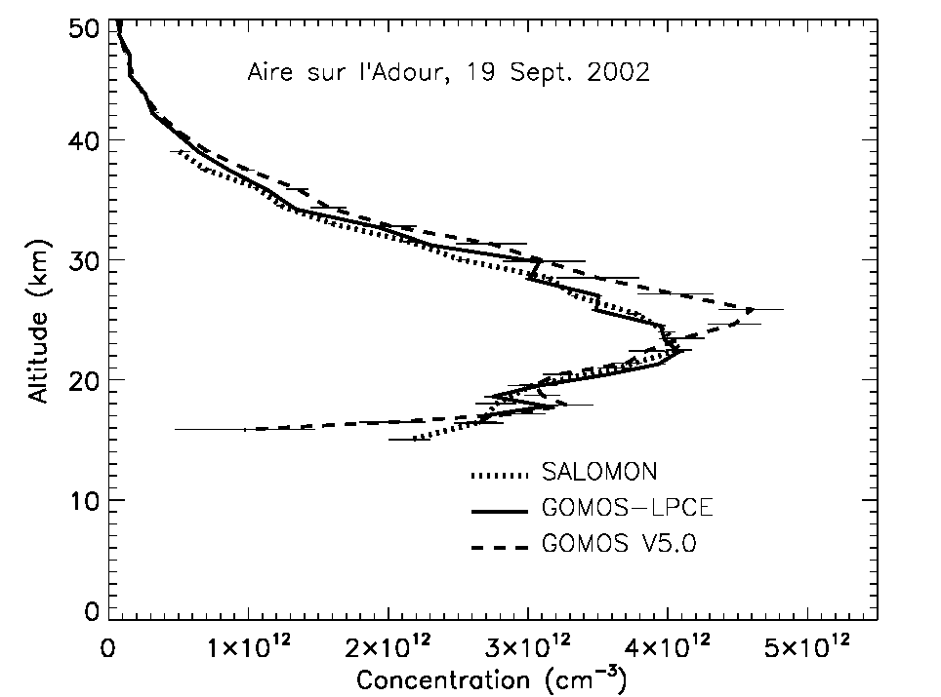
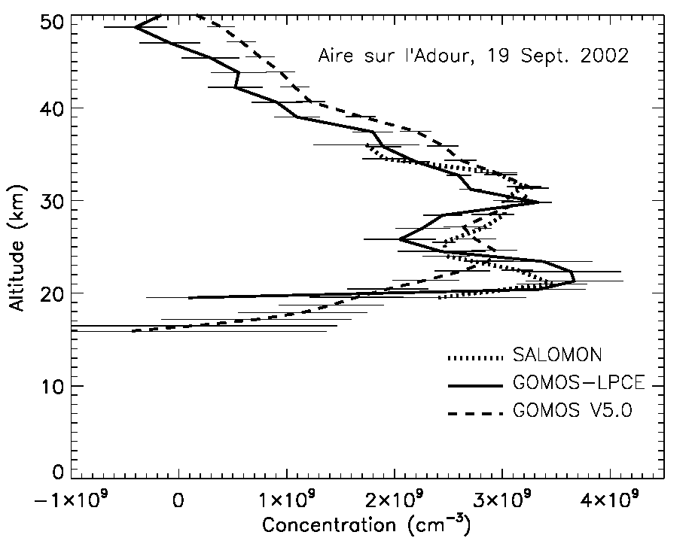
Example of validation of the O₃ and NO₂ GOMOS measurements with the balloon-borne UV-visible spectrometer SALOMON, from south-west of France, colocation of about 100 km and 1 hour
Validation exercise has been useful to improve the GOMOS algorithm
O3
NO2

Slide 4
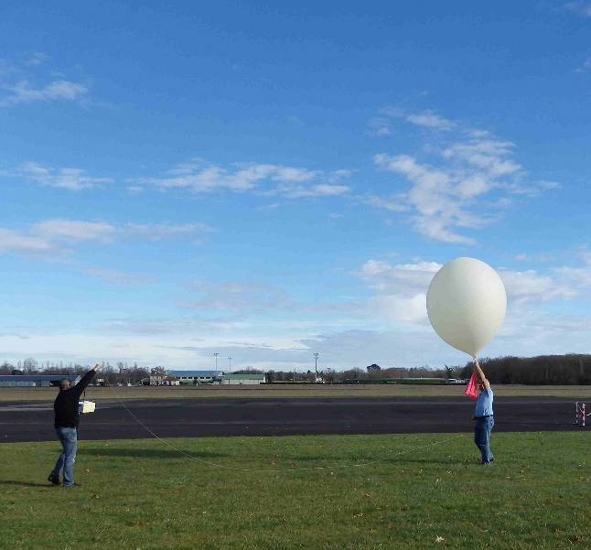
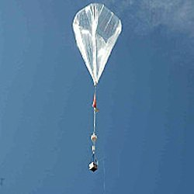
We propose here an easy-to -conduct strategy:
Use of the LOAC aerosol counter under « Light Dilatable Balloons » (weather balloons)
Coincidence opportunity with the aerosol measurements onboard the long-duration balloons of the Strateole project

Slide 5
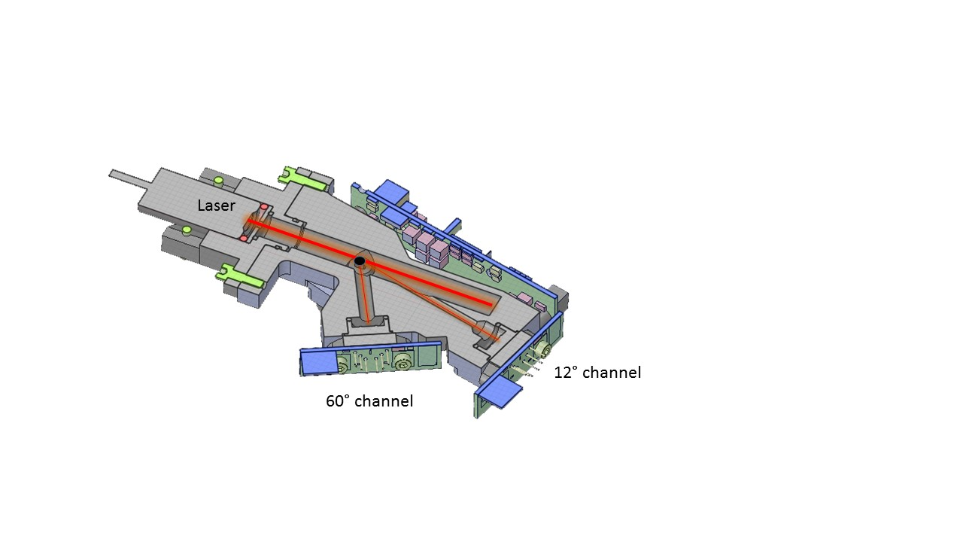
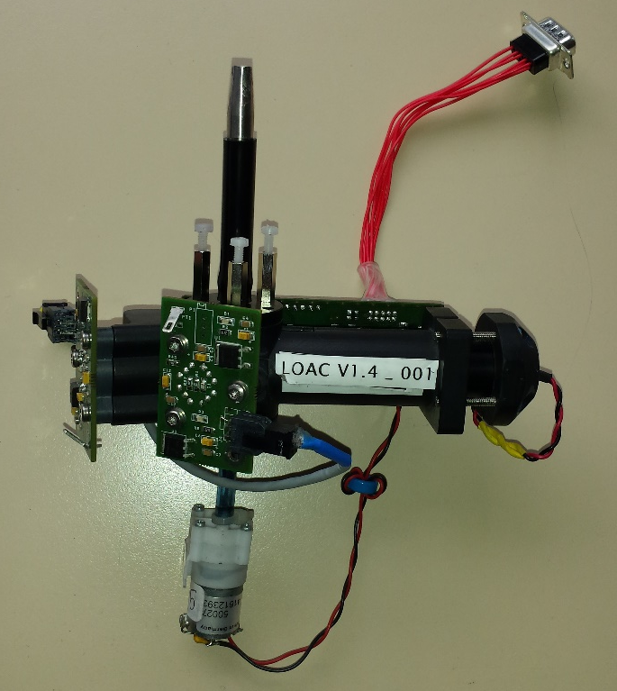
Light Optical Aerosols counter (LOAC)
Size distribution for 19 size classes in the 0.2 – 50 μm range
Measurements at 2 scattering angles (field of view of few degrees)
~12°, insensitive to the refractive index of the particles (mainly diffraction)
=> accurate size determination and counting
~60°, strongly sensitive to the refractive index of the particles
=> indication of the typology of the particles

Slide 6
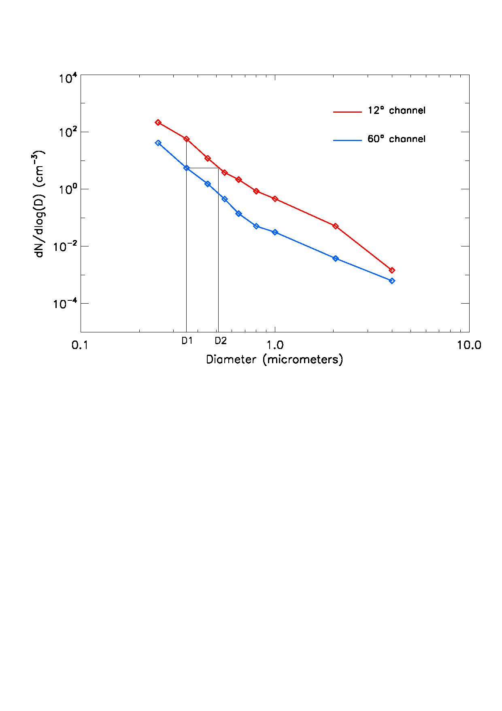
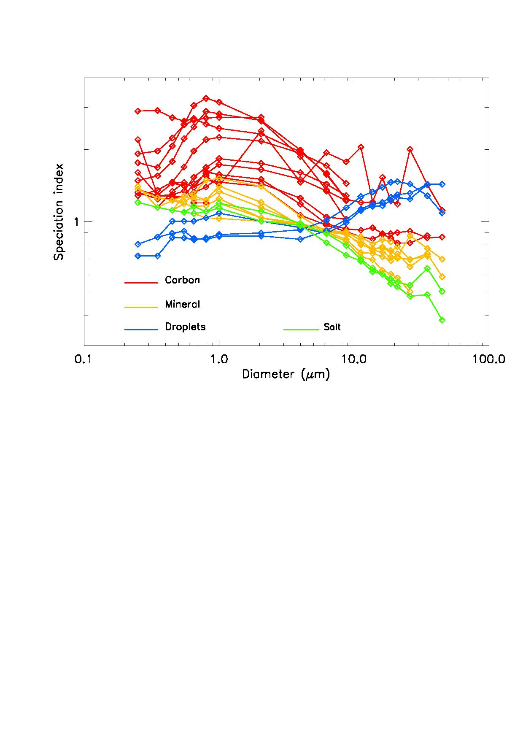
Indication of typology of the aerosols:
The 60° measurements are sensitive to the refractive index of the aerosols
More absorbing are the particles, lower is the scattered flux;
the measurements at 60° are often lower than the measurements at 12°
The ratio of the 2 size distributions varies with the light-absorbing properties of the particles (“speciation index”)
Comparison of the measured “speciation index” with laboratory measurements of pure particles, to provide reference speciation zones

Slide 7
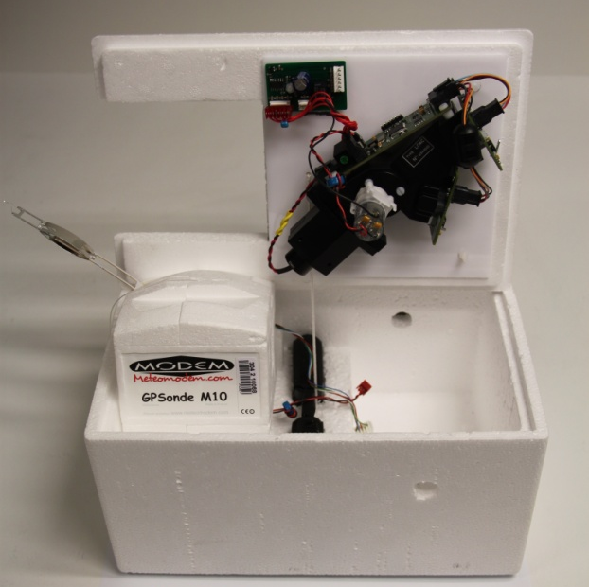
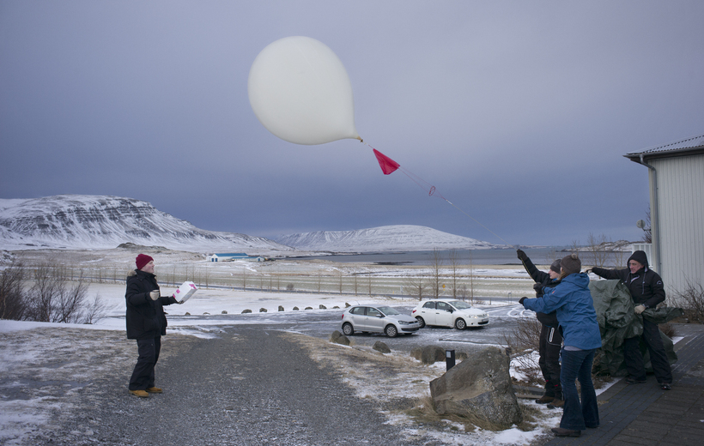
Since 2013, about 150 LOAC launches from different latitudes, even in difficult weather conditions !
Measurements from ground to the middle stratosphere

Slide 8
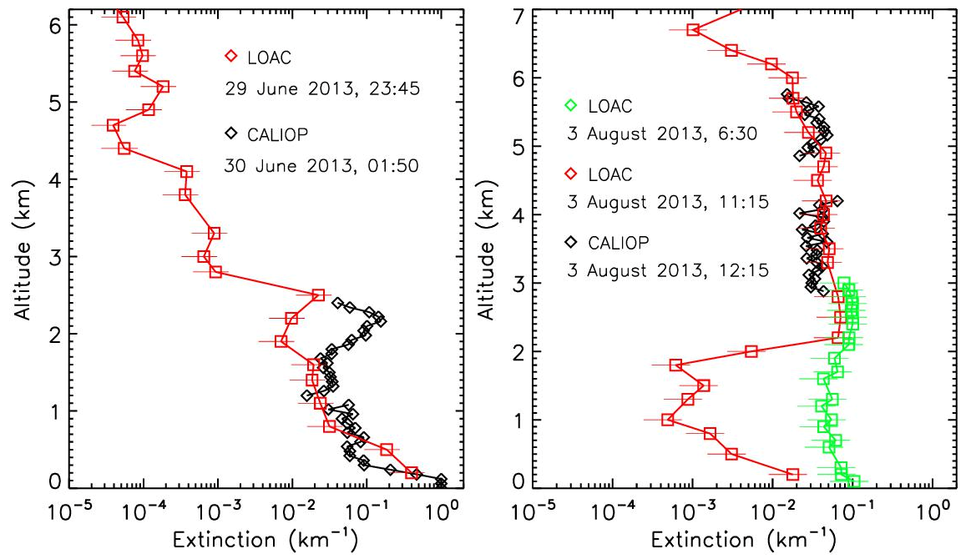
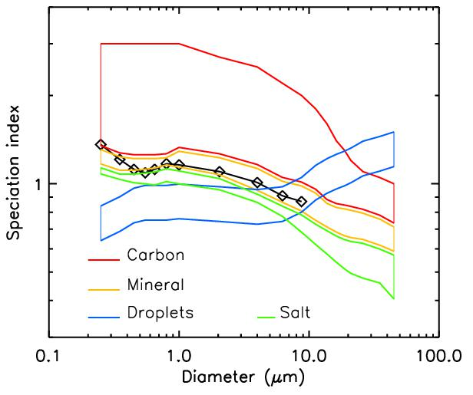
Conversion of the LOAC counting to extinctions, using the estimated typology for the choice of the refractive index
Example of comparison of LOAC with Caliop/Calispo during dust events above the Mediterranean sea, with same typology identification by the 2 instruments, during a good coincidence (< 200 km and < 2 hours)
LOAC typology identification

Slide 9
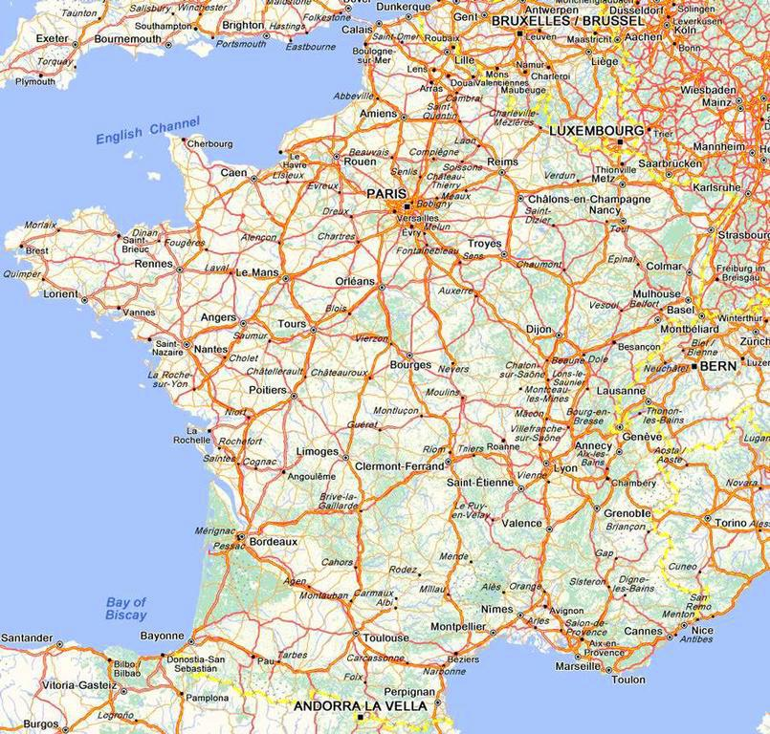
Another approach: Statistical comparison between 23 LOAC flight above the South-West of France in 2014-2015 (background conditions only) and Caliop extinctions in same location and conditions
Mean values and dispersion of the measurements

Slide 10
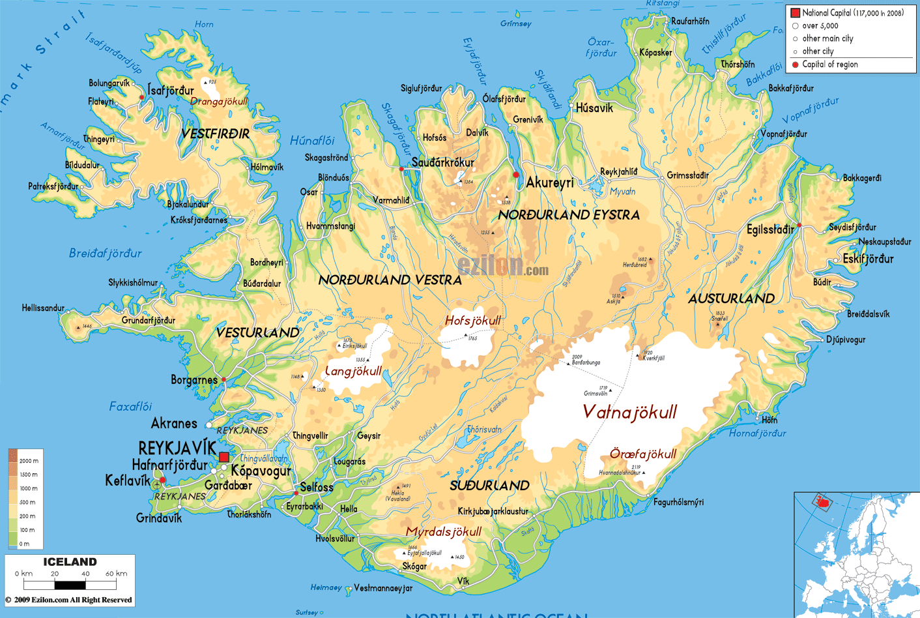
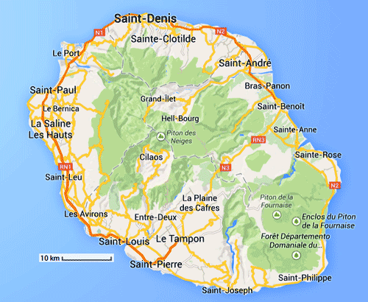
BAIVEC project
Preparation
Several LOAC flights per year in good coincidence with Caliop from South-West of France, performed by CNES (from summer 2018)
Campaign
- ~15 flights per year in South-West of France (CNES) in good coincidence, and flights under alert in specific conditions like dust event, pollution
- Opportunity flights at other latitudes (Ile de la Réunion, Iceland, …) in the frame of the other LOAC scientific campaigns
- Comparison with EarthCare extinctions profiles

Slide 11
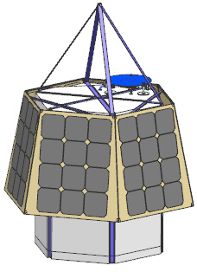
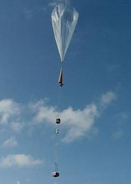
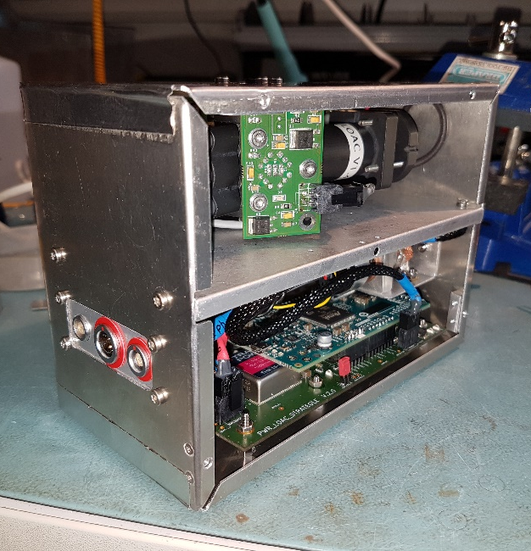
Also opportunity coincidences with the measurements onboard the Strateole balloons (France – USA project) launched by CNES
Long duration balloon flights of 3 months in the tropical region, 2020-2023 (tests campaign in 2019, then 2 campaigns), altitude of 16-20 km, thousands of coincidences expected
  LOAC
  Lidar BeCOOL
  Backscatter sounding
Validation of EarthCare backscatter, scattering ratio and extinction profiles

Slide 12

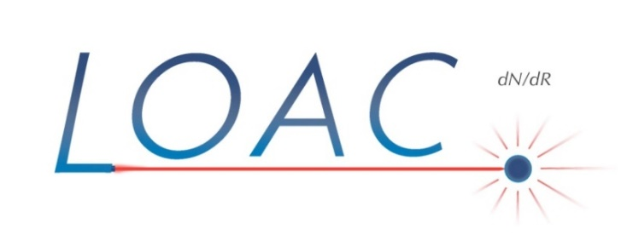
LOAC instrument fully operational and use in routine since 5 years, data from « Light Dilatable Balloons » available just after the flights
2 to 4 reports provided per year
Strateole data available at the end of each campaigns
Reports after each Strateole campaign

