Slide 1
CNES support to French research community activities in relation with EarthCARE Cal/Val
Pierre TABARY
Programme Manager for Atmosphere, Meteorology and Climate
CNES, Directorate for Innovation, Applications, Science
EarthCare Science & Cal/Val workshop
Bonn
June 2018

Slide 2
Generalities on the CNES support to French EO research activities
  CNES supports the French user communities in the preparation and exploitation of EO missions through:
    Post-doctoral grants (typically 12 / year)
    PhD grants (typically 12 / year) – Co-funding required
    Support to R&T :
      PhD grants
      Funding of R&T specific actions (partnership between CNES, the industry and French labs)
    Funding of research proposals submitted every year in the frame of a dedicated Call for Proposal
      > 300 proposals coming from > 50 Labs are received and funded each year
    Support to strategic in-situ networks:
      Balloons : CNES balloon infrastructure
      Aircrafts : French research aircraft fleet Safire
      Ground-based networks : Aéronet (aerosols), NDACC (ozone), instrumented super-sites (SIRTA, CO-PDD, OPAR, …)
    Support to national data and services centres (AERIS, THEIA, FORMATER, ODATIS)
  Support allocated and directed according to the recommendations of a committee of recognized, high-level experts of the various fields (TOSCA)

Slide 3
  FR Assets for Cal/Val :
    Instrumented supersites (incl. lidars) : SIRTA (Paris), Lille, OHP (Provence), Clermont-Ferrand and OPAR (La Réunion)
    Aeronet/Photons
    Mobile validation station : mobile lidars and / or radars (LSCE, LATMOS, …)
    Airborne fleet (Safire) and related in-situ and remote-sensing instruments
      Doppler HSR lidar LNG
      94 GHz Cloud radar, …
    CNES Balloon infrastructure and related instruments (e.g. aerosol counter LOAC)
    Model – Observation comparisons :
      Climate models (GOCCP, …)
      Meteorological & Air Quality models (MOCAGE)
    Multi-mission comparisons
    Experience with Calipso Cal/Val activities
  Experience, expertise, link with international community, storage and processing facilities (Aéris), …

Slide 4
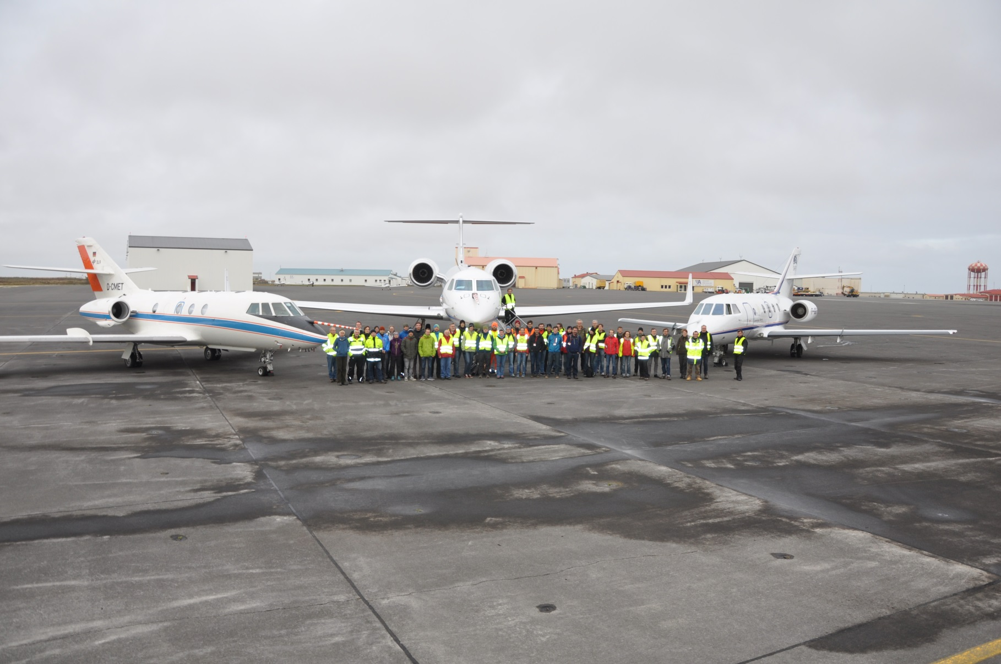
FR Aircrafts (Safire) & Instruments
  Doppler airborne lidar LNG onboard the French Safire Falcon20
  355 (HSR) / 532 / 1064 nm
  Coupled with a 94GHz cloud Doppler radar
  Photo taken last fall during the NAWDEX-EPATAN field campaign in Iceland
  From left to right : DLR’s Falcon, DLR’s HALO and Safire’s Falcon
  A remarkable illustration of a fruitful international partnership (ESA + DLR + CNES + …)
  → Something to reproduce in the future !
  → See Jacques Pelon (LATMOS) presentation on Wednesday mornng (09.10 – 09.20)

Slide 5
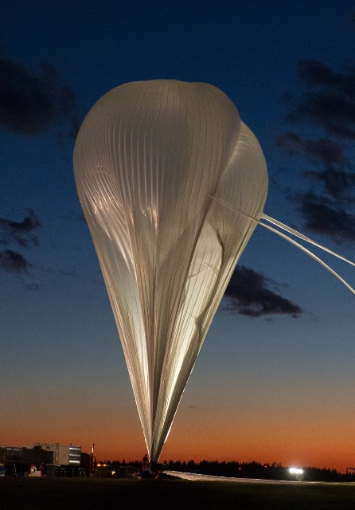
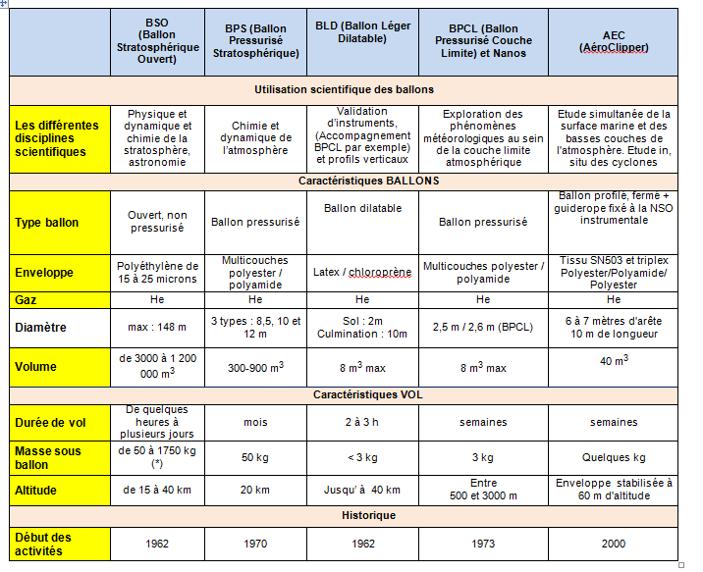
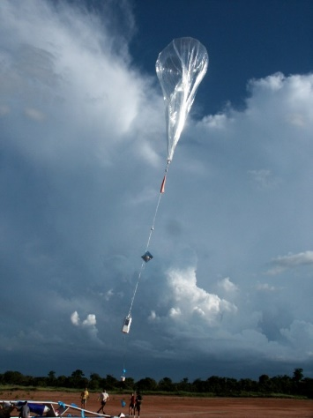
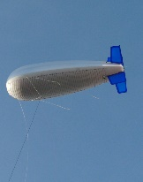
CNES Balloon Infrastructure

Slide 6
CNES-supported responses to EarthCare Cal/Val AO
ESA ID | Name of the proposal | PI and lab | Keywords
38836 | ACTRIS-FR proposal for EarthCARE Cal/Val | P. Goloub (LOA). | ground-based stations, long-term, overpasses
38816 | VECARE: Validation of EarthCARE Aerosol products over key REgions with a focus on high latitudes | G. Ancellet (LATMOS) | Arctic, Aerosols
38623 | SPACECARE: Study of Precipitation in the AntarctiC with Earthcare | C. Genthon (IGE) | Antarctic, Precipitations
38810 | MORECALVAL: MObile Radar-Lidar-Radiometer EarthCare CAL/VAL project | J. Delanoë (LATMOS) | Mobile, Airborne
38809 | BAIVEC: Balloon Aerosols Instruments for the Validation of EarthCare | J.-B. Renard (LPC2E) | Balloons, troposphere, stratosphere
39184 | STACCATO: STatistically bAsed Calibration/validation Control of ATlid | H. Chepfer (LMD) | Statistical approach
39217 | MMP: Monitoring MSI/EarthCARE L1 performances using concomitant intercalibration and stand-alone approaches | N. Scott (LMD) | MSI
  Huge effort → Coordination of supports is mandatory

