Slide 1

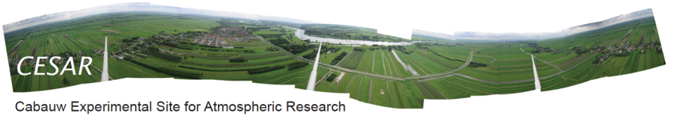
Cabauw Lidar observations for ATLID L1 and L2a product evaluation.
Royal Netherlands
Meteorological Institute
Ministry of Infrastructure
and Environment.
PRINCIPAL INVESTIGATOR INFORMATION
D.P. Donovan
CO-INVESTIGATORS
-Gerd-Jan van Zadelhoff
-Arnoud Apiluley
-Martin de Graaf.

Slide 2
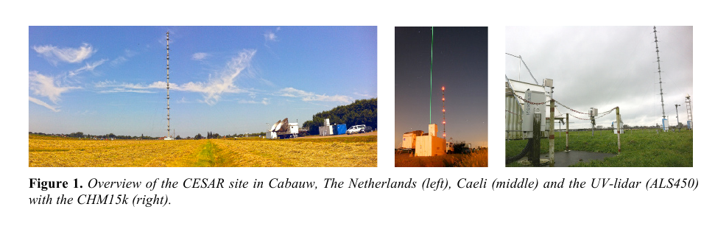
Primary Objective
ATLID L2a profiles of aerosol/cloud extinction backscatter and depolarization (A-PRO and ACM-CAP)
Primary Means:
Use Lidar measurements at Cabauw in the central Netherlands
24/7 ground-based 355nm (elastic)depolarization lidar observations
Multi-wavelength (non-24/7) Raman lidar observations
Supported by other instruments on site (e.g. BSRN site, cloud radar etc..)

Slide 3
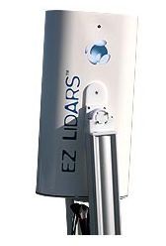
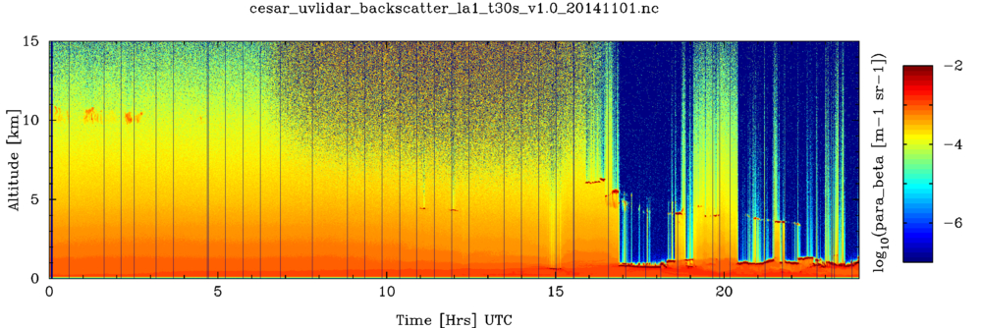
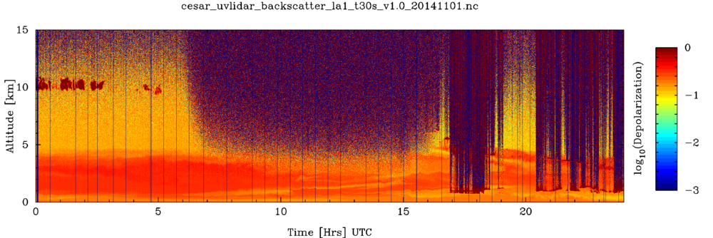
The UV (355nm) depolarization lidar operating at Cabauw is a Leopsphere ALS-450 system in operation for a number of years. It operates on a 24/7 all-weather basis. The 24/7 operation facilitates the acquisition of data which can be compared with EarthCARE overpasses.
Focus on two types of cases: 1) Aerosol cases
An example of dust aerosol observations at Cabauw made with the UV lidar.
Top: Attenuated backscatter
Bottom: Linear depolarization ratio. Dust aerosol is clearly present up to near 5km.

Slide 4
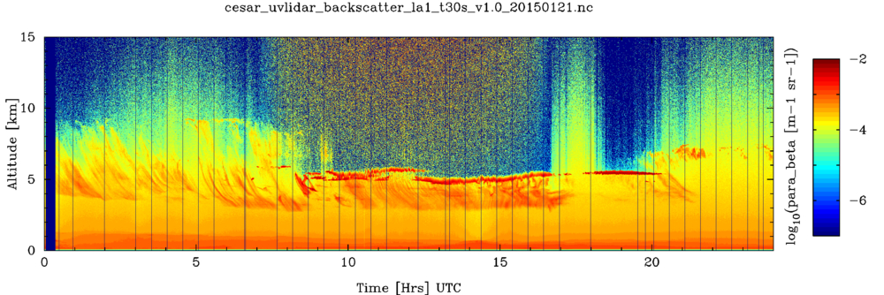
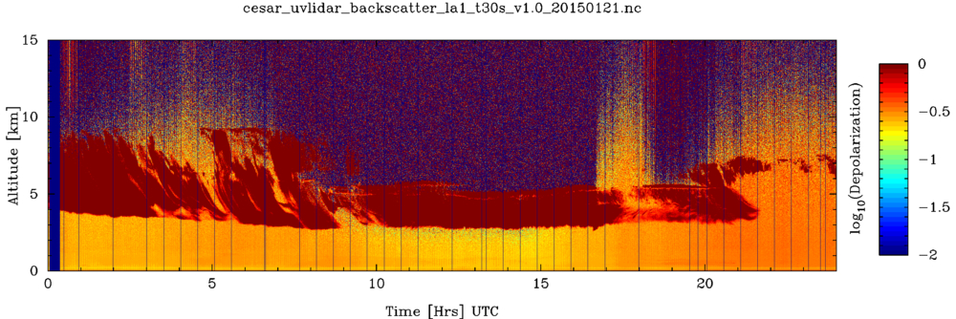
The UV (355nm) depolarization lidar operating at Cabauw is a Leopsphere ALS-450 system in operation for a number of years. It operates on a 24/7 all-weather basis. The 24/7 operation facilitates the acquisition of data which can be compared with EarthCARE overpasses.
Focus on two types of cases: 2) “Thin” cirrus cases
An example of extended “thin” cirrus observations at Cabauw made with the UV lidar. Supercooled water layers are also present.
Top: Attenuated backscatter
Bottom: Linear depolarization ratio.

Slide 5
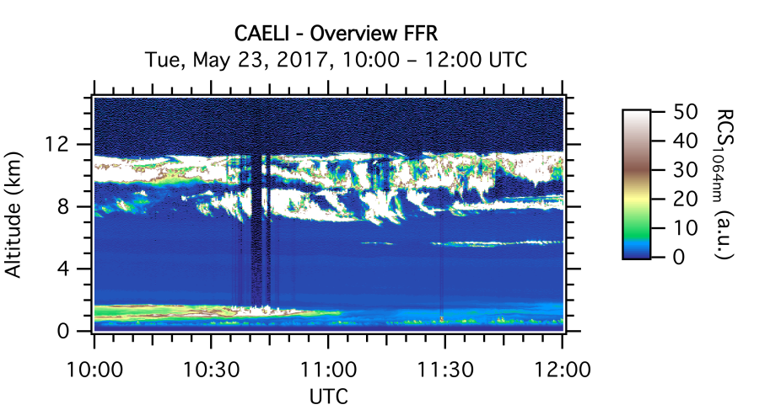
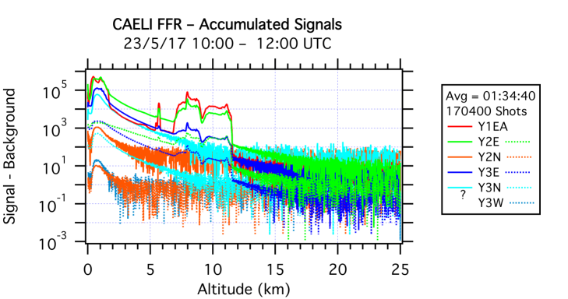
CAELI is a powerful multi-wavelength Raman lidar (including a water vapor channel) transmitting 355, 532 and 1064 nm. It is moving towards remote operation but is currently only capable of manned operation limiting its coverage. An example CAELI 1060nm quick-look is shown below along with the corresponding average profiles for each of the detection channels.
Detection Channels
1064 nm (Elastic)
607 nm (N₂ Raman shifted 532nm)
532 nm (Elastic)
407 nm (H₂O Raman shifted 355nm)
387 nm (N₂ Raman shifted 355nm)
355 nm (Elastic)
532 nm Para.
532 nm Perp.

Slide 6
Elastic depolarization lidar
Raman lidar
Medium/long-term activity
Overpasses within 100-150 km
Preliminary results will be reported

Slide 7
Work Break-Down
Work Package | Notes
WP-1: Measurement Planning (T0➔T0+1m) | Allocation of resources. Anticipated state of Raman lidar w.r.t. (semi-)autonomous operation is an important factor
WP-2: Database set-up and data exchange (T0➔T0+3) | Inc. participation in cal/val rehearsal
WP-3: Processing tool upgrades (T0+2➔T0+6) | Upgrade of tools to semi-automatically select and process ground-based lidar data
WP-4: Data acquisition (T0+8➔T0+36) | Hopefully timed with launch
WP-5: Data analysis (T0+10➔T0+36)
WP06 Reporting (T0➔T0+36) | Preliminary results will be made available

