Slide 1
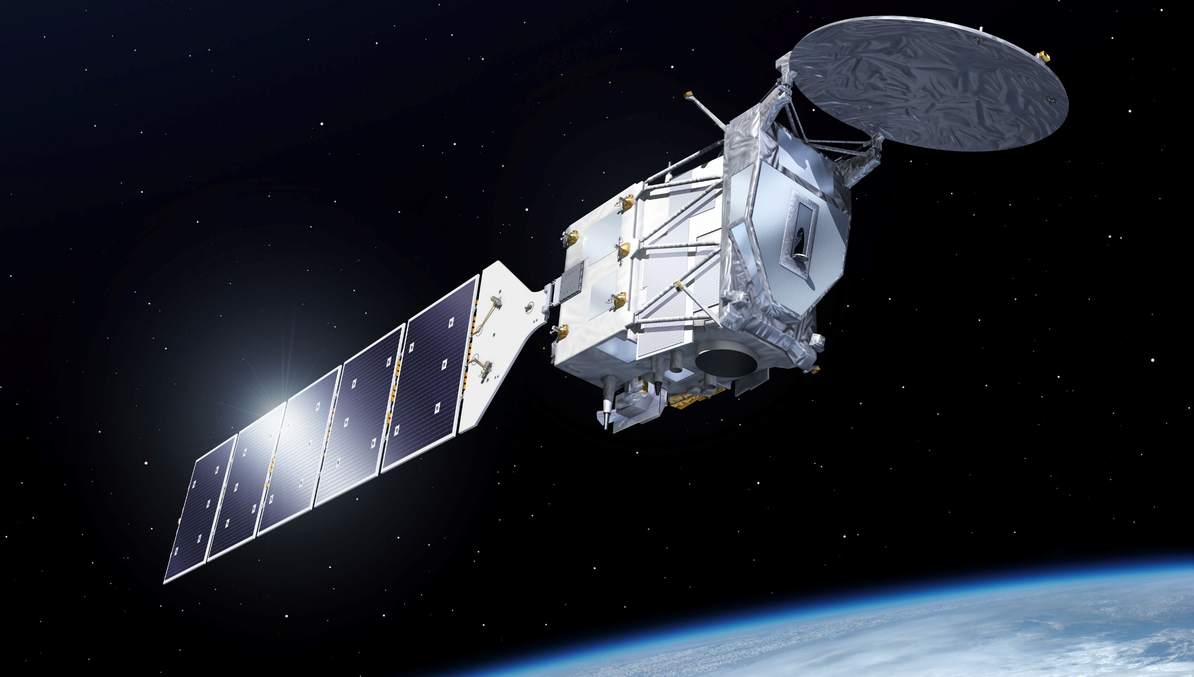



Cross-scale evaluation of ground precipitation derived from the ACM-CAP and C-CLD data products over Europe
First EarthCARE Validation Workshop
Bonn, 13-15 June 2018
Y. Markonis, F. Strnad, P. Máca, V. Kotroni, K. Lagouvardos, J. Kropácek, T. Nikolopoulos & M. Hanel

Slide 2
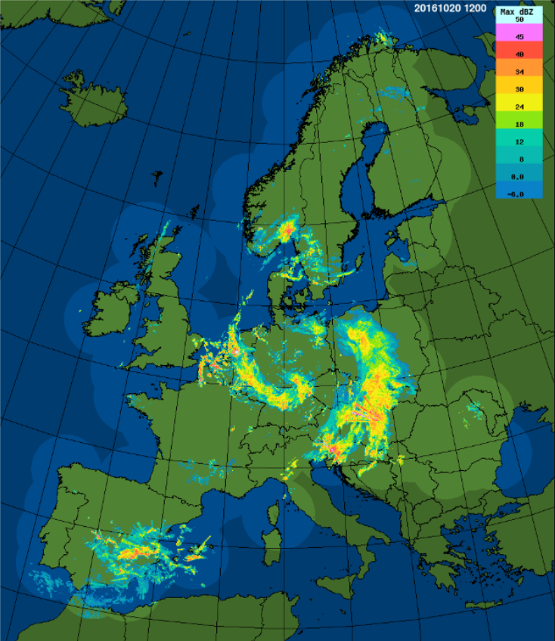
Contribution
Data Products
C-CLD (L2) & ACM-CAP (L2b) | Ground precipitation
EUMETNET – OPERA
Surface Routine Networks
Operational Programme for the Exchange of Weather Radar Information (OPERA)
NOANN network (335 stations, 10 min)
Objectives
Capitalize on the existing high-resolution gridded or in-situ data products
Take full advantage of the available validation techniques in meteorology, climatology and hydrology
Extend existing statistical analyses to capture spatiotemporal homogeneity/heterogeneity more efficiently

Slide 3
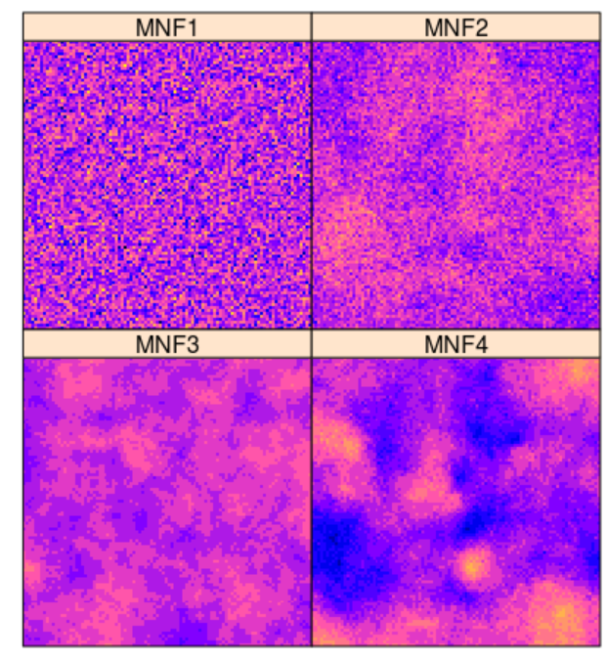
Methodology
Validation metrics
Validation practices for satellite‐based Earth observation data across communities [Loew et al. 2017, Rev Geophys]
a
b
Measures of systematic differences
Mean/Median difference
Measures of statistical spread
RMSD (Root Mean Square Deviation)
Statistical dependency measures
Pearson's R
Binary comparison
Intersection plots
Comparison of extremes
Gumbel probability
c
d
Cross-scale analysis
Extension of the variogram technique in the temporal domain for different statistical measures to investigate spatiotemporal correlation structure [Markonis & Koutsoyiannis 2016, NCC; Markonis et al. 2018, NCOM]

Slide 4
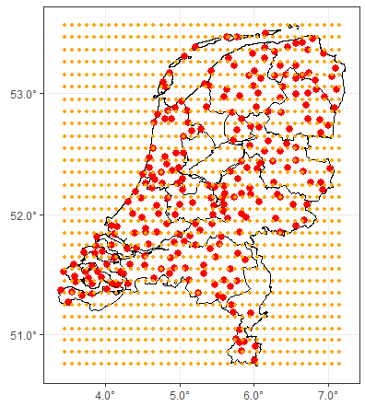
Case study
Netherlands (land only)
Period: 01/10/2015 – 30/09/2016
Temporal Resolution: 1 day
Satellite Data
Dataset: NASA GPM IMERG Level 3 Precipitation
Spatial Resolution: ≈10 km
Radar Data
Dataset: KNMI RAD NL25 RAC MFBS 24H
Spatial Resolution: 1 km
Station Data
Dataset: KNMI homogenized
Spatial Resolution: ≈20 km (range 5 – 40 km)

Slide 5
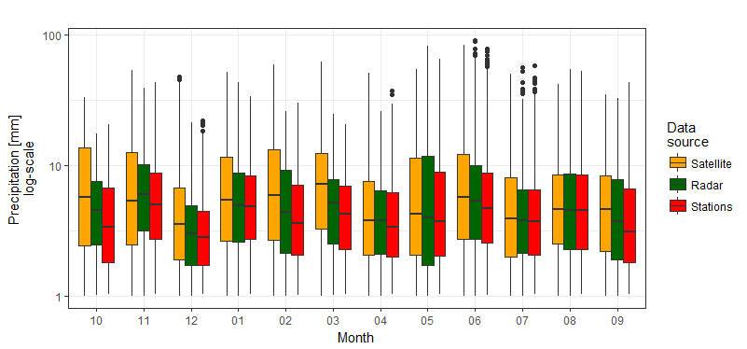
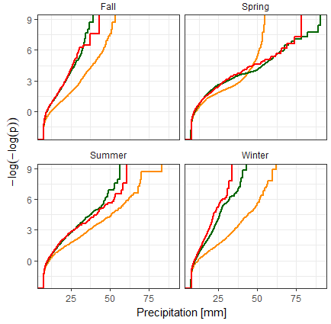
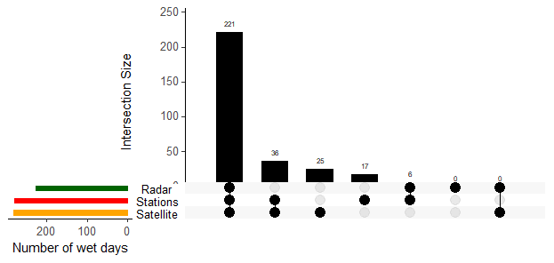
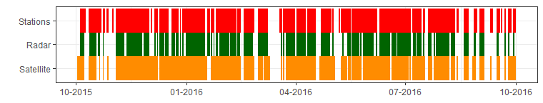
Exploratory Data Analysis
a
b
d
c
WET DAYS (P > 1 mm for min 5% grid cells)
Radar: No false positives, more false negatives (10%)
GPM: similar false positives & negatives (7%)

Slide 6
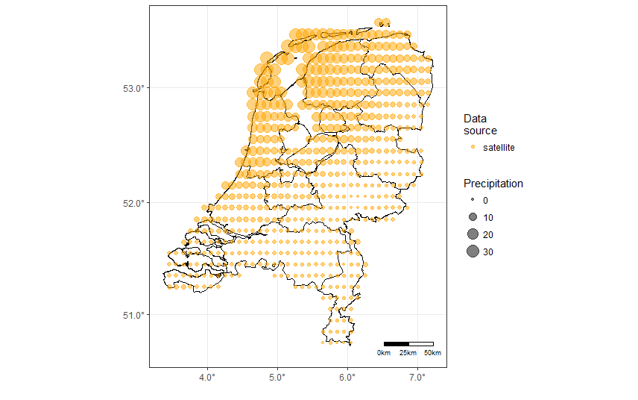
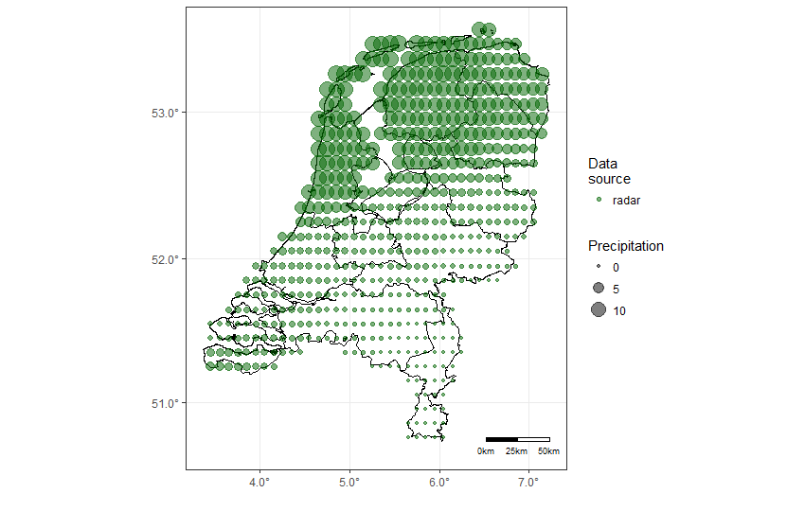
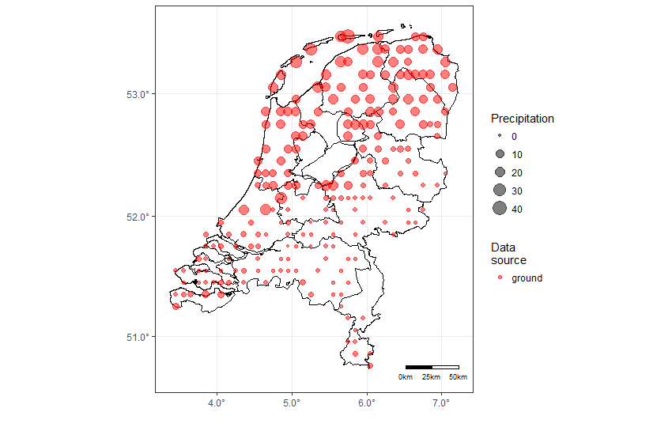
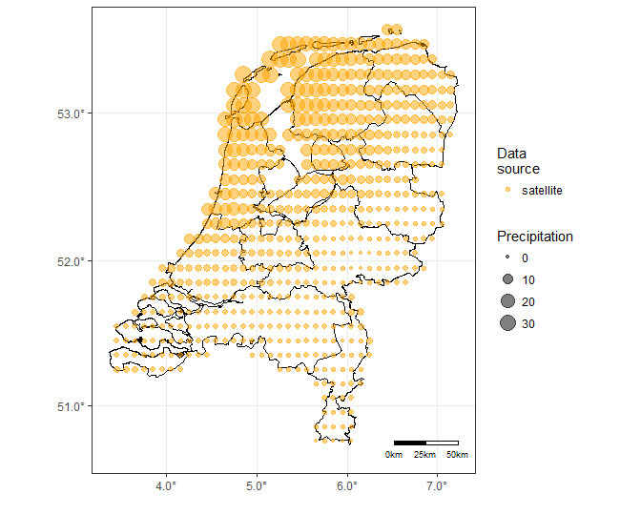
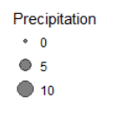
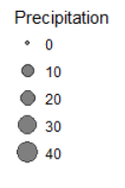
Cross-scale analysis
03-09-2016 Event
GPM IMERG
KNMI Radar
KNMI Stations

Slide 7
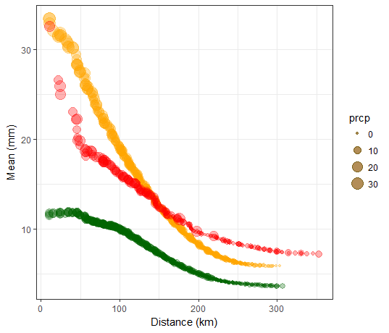
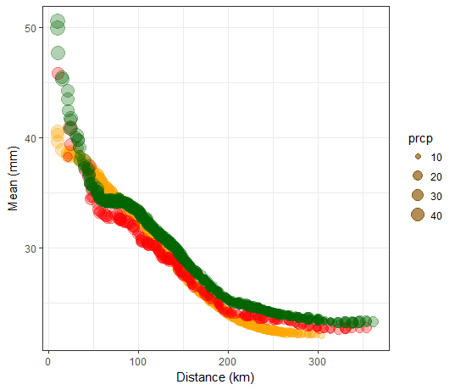
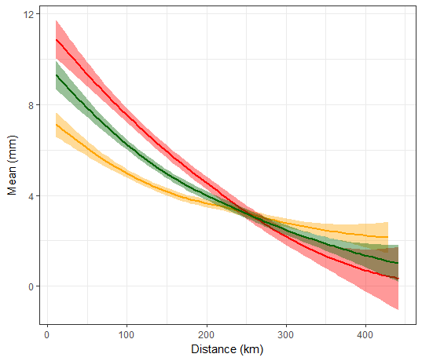
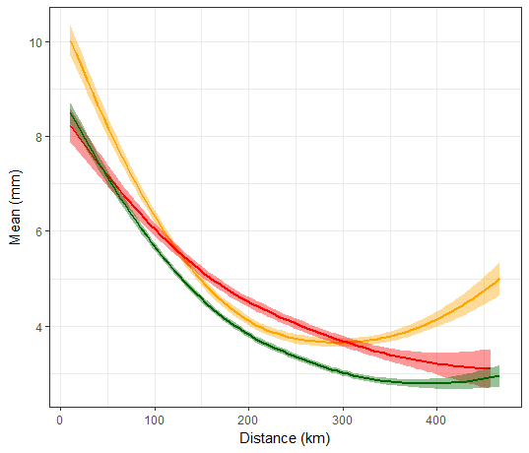

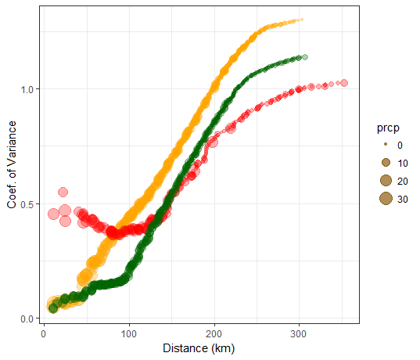
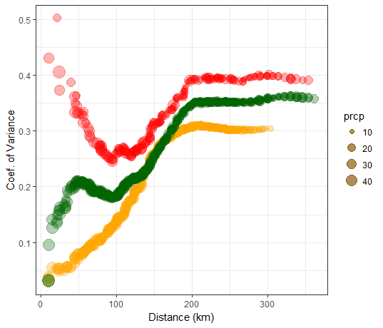
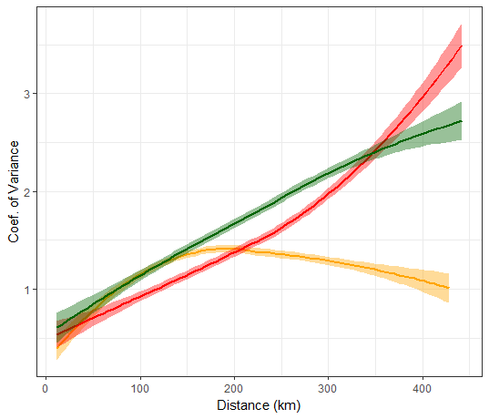
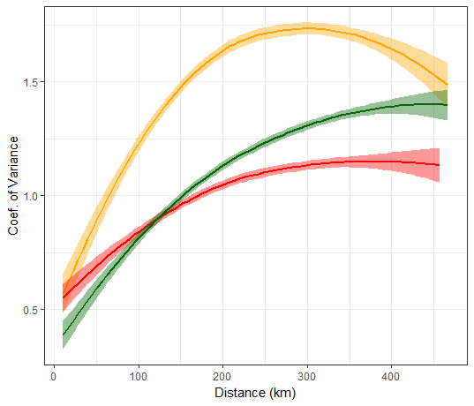
Cross-scale analysis
Daily time scale
Monthly time scale
Mean daily (September)
Mean daily (2015-16)
Mean (mm)
Coef. of Variation

Slide 8
Further steps
Application of OPERA composite dataset (finer scales)
Acquisition of other high-resolution ground station networks at satellite overpasses
Utilization of EarthCARE Simulator
Increase computational efficiency, integrate to a distributed computing architecture (e.g., SPARK)
Launch an R package with the cross-scale validation scheme
Go vertical?
Thank you!

