Slide 1

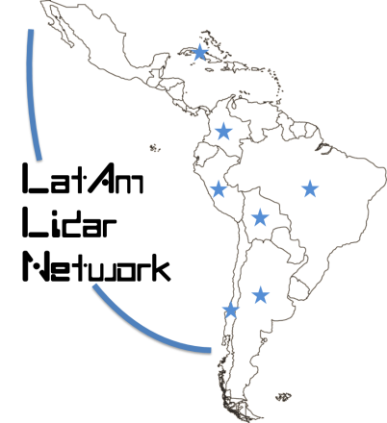
LALINET EARTHCARE CAL/VAL
Eduardo Landulfo, Alvaro Bastidas, Antonieta Silva, Boris Barja, Doina Nicolae,
Fabio Lopes, Henrique Barbosa, Juan C. Antuña-Marrero, Juan L. Guerrero-Rascado,
Judith Hoelzemann, Lucas Alados-Arboledas, Marcos Andrade, Pablo Ristori, Ricardo Forno
https://bit.ly/2l3n2XD

Slide 2
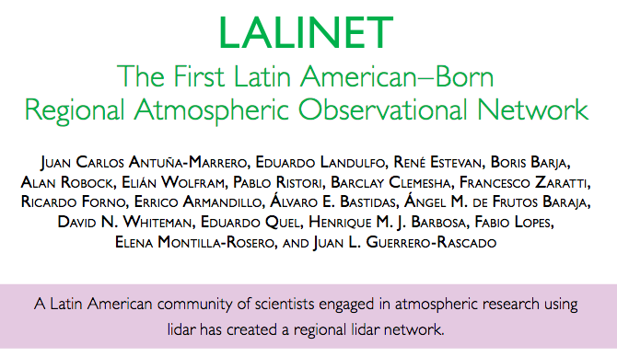

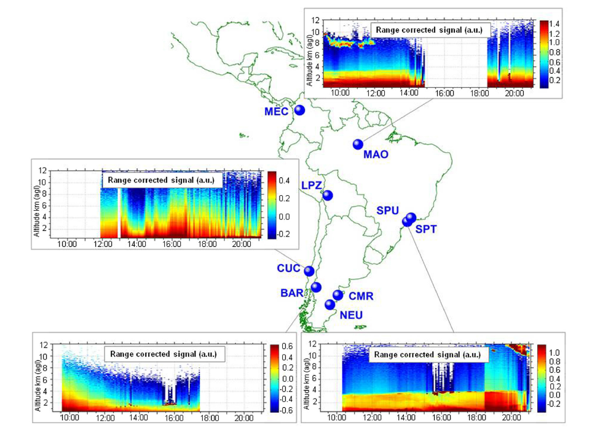
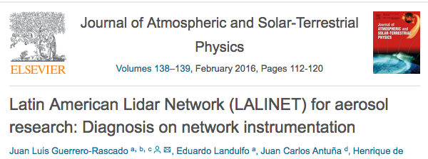
https://bit.ly/2l3n2XD
LALINET INTRODUCTION
Eduardo Landulfo

Slide 3
https://bit.ly/2l3n2XD
LALINET’s OPERATIONAL DRIVES
Perform measurements and data acquisition following established protocols
Maintain a QA/QC routine among all participating stations
Apply an unified data analysis routine common to all stations, e.g., Single Calculus Chain
Create a scientifically significant distributed database, e.g., lidar ratio, particle extinction, backscatter, angstrom exponents and particle depol. regional values
Eduardo Landulfo

Slide 4
https://bit.ly/2l3n2XD
LALINET’s OPERATIONAL DRIVES
Guarantee the continuity of LALINET’s biannual workshops by the intensification of its role as a mechanism of transfer of knowledge, evaluation of joint actions conducted and agreements on how to continue under the new evolving situations. In 2018 second semester, the host site should be in Medellin, Colombia
Search inter-network exchange, ACTRIS 1 and ACTRIS 2, SAVERNET
Eduardo Landulfo

Slide 5
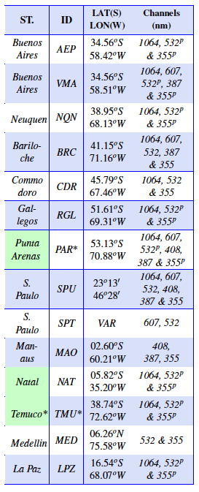
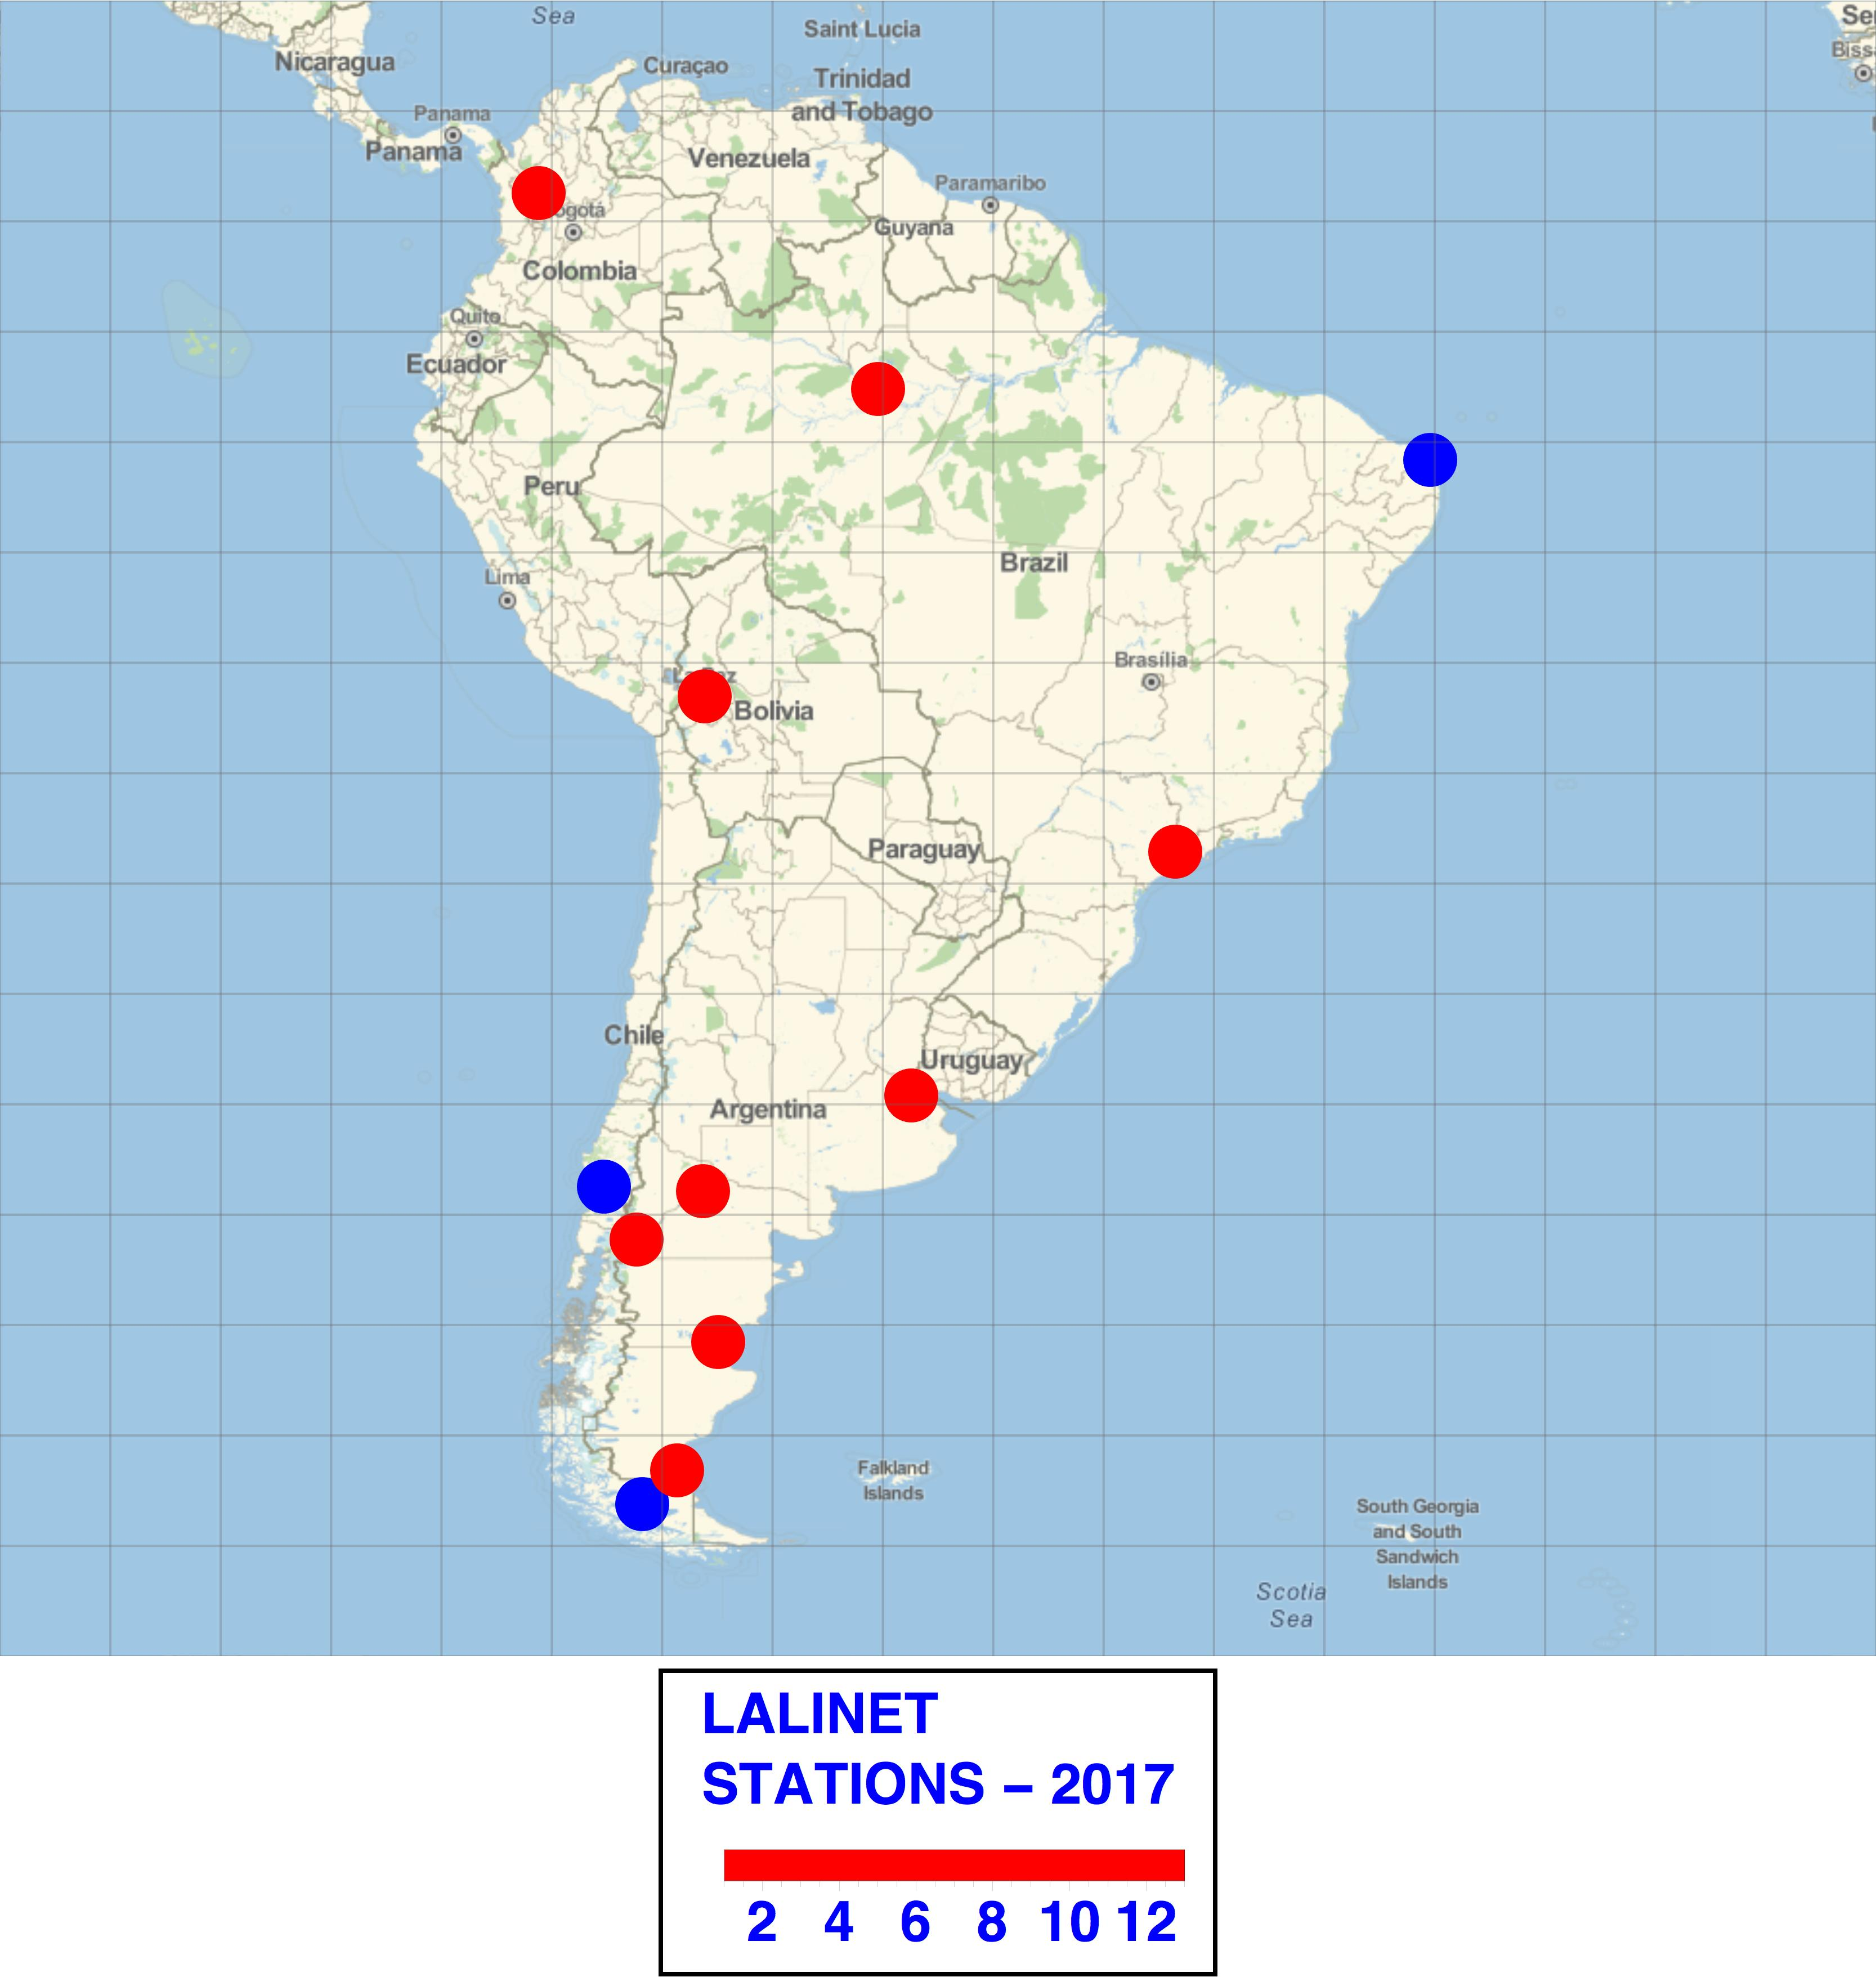
https://bit.ly/2l3n2XD
LALINET STATIONS
AREA GT 18 Mkm²
Eduardo Landulfo

Slide 6
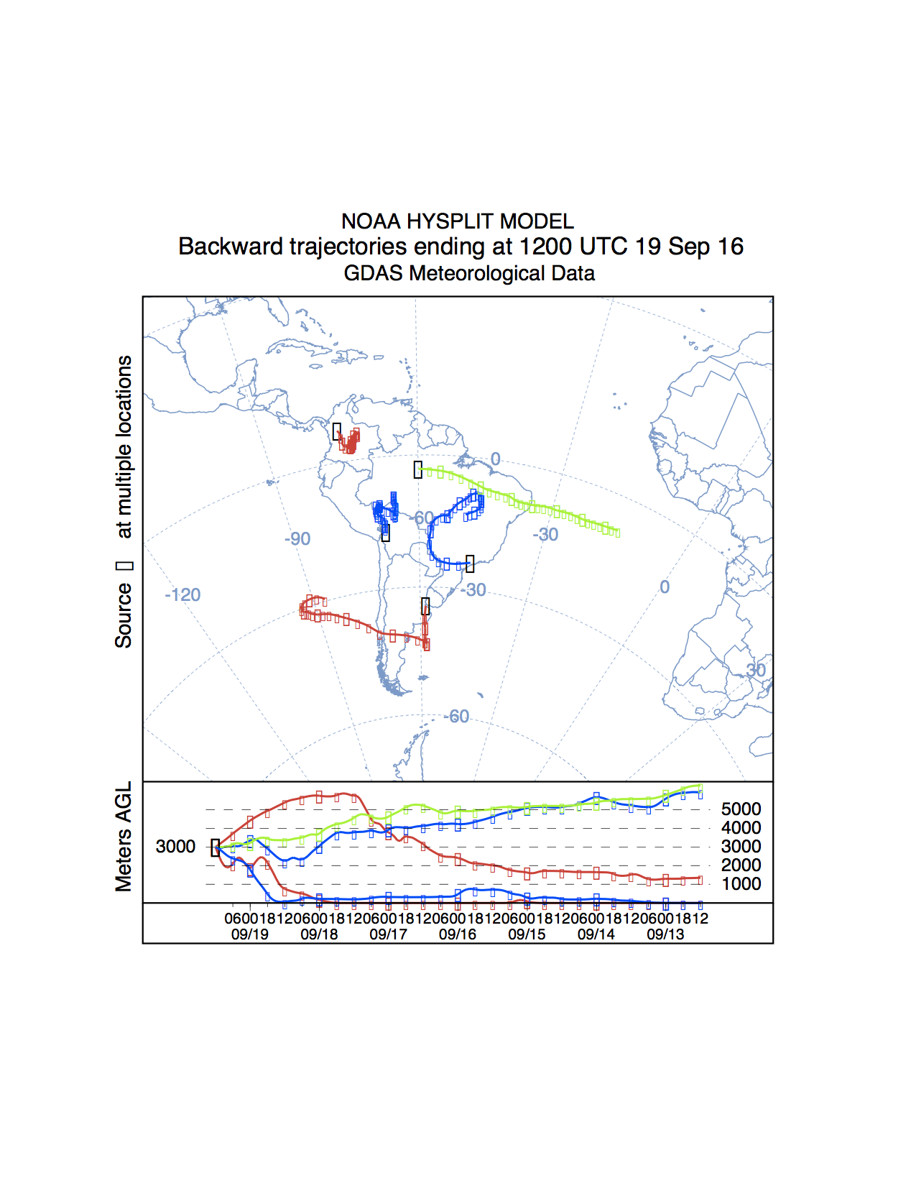
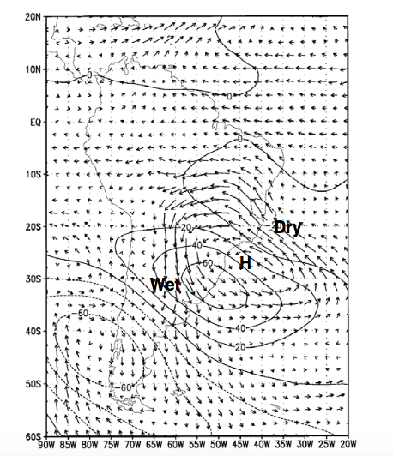
https://bit.ly/2l3n2XD
SOUTH AMERICAN AIR CIRCULATION
200 hPa height difference and
850 hPa winds during austral
summer.

Slide 7
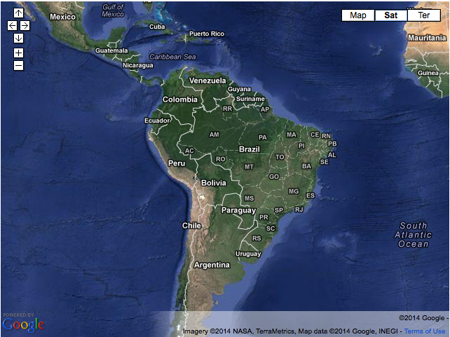
https://bit.ly/2l3n2XD
NETWORK SCIENTIFIC DRIVES
CLOUD STUDIES
AEROSOL LONG RANGE TRANSPORT
HIBISCUS
TROCCINOX
VOLCANIC ASHES
BIOMASS BURNING
SCAR-B
AIR QUALITY
GoAMAZON
SAMMBA
APEL
Eduardo Landulfo

Slide 8
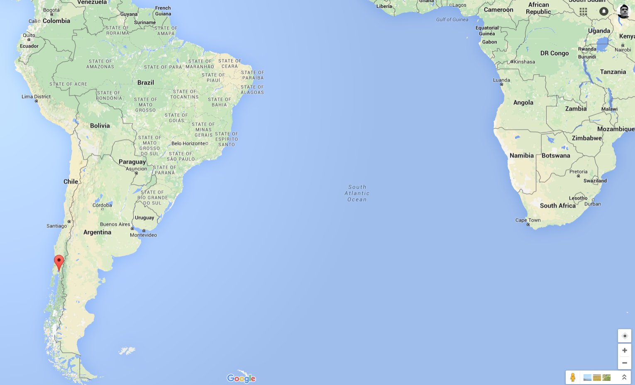
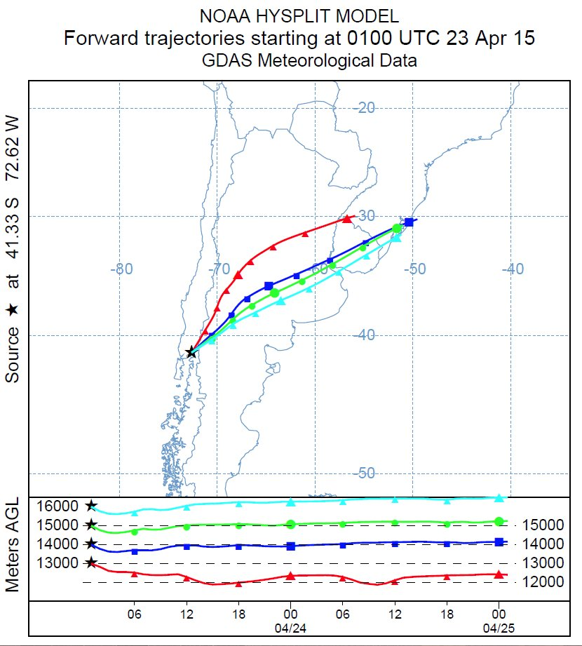
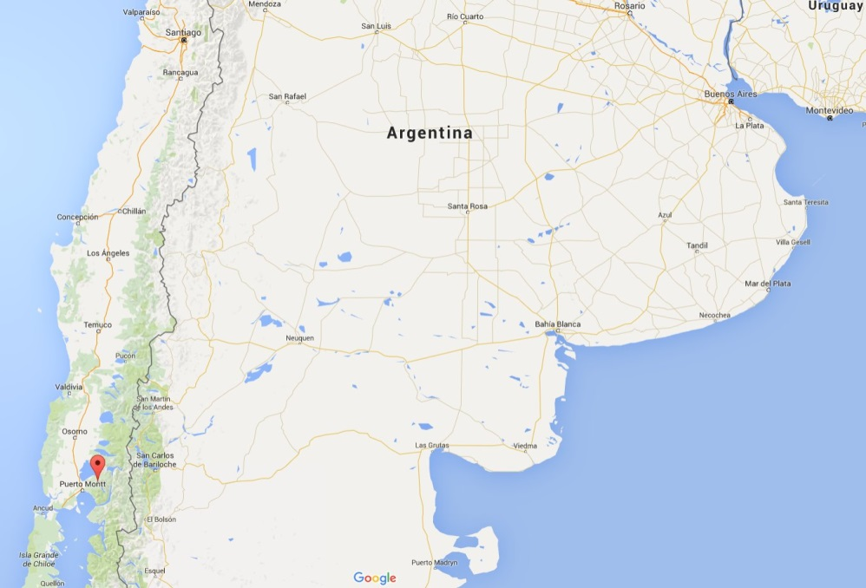
https://bit.ly/2l3n2XD
VOLCANIC ASHES & PLUMES
22nd – 23rd of April, 2015 – Calbuco volcano began eruption
Lalinet Stations
Font:google maps
First eruption since 1972
Ash cloud achieved above 15 km of altitude
Eduardo Landulfo

Slide 9
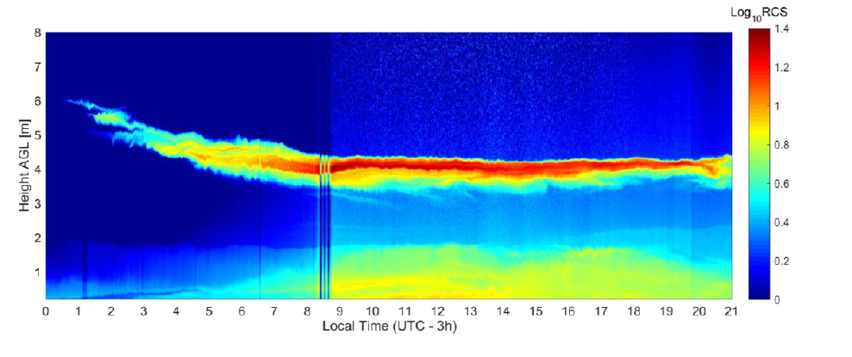
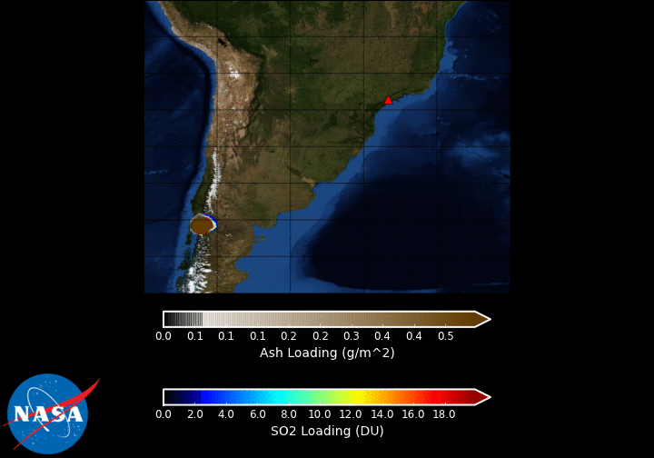
https://bit.ly/2l3n2XD
VOLCANIC ASHES & PLUMES
GOES-5 / GOCART Simulation
of the Calbuco Eruption – April 2015
Model Grid Resolution: .5º x .5º
Plume Top: 18km
Based on CALIPSO Obs.
Plume Thickness: down to 8km Based on satellite obs.
Ash Emission Rate: 5x10⁴ Kg/s
SO₂ Emission Total: 300 Kt
Based on satellite observations
Timing: Two Eruption Pulses
(1) 04/22 21:38Z – 23:38Z
(2) 04/23 04:38Z – 10:08Z
Based on GOES IR and Reports
Simulation run with GOES-5 Replay Meteorology (not forecast)
GEOS-5 Ash plotted ontop SO₂
28th International Laser Radar Conference - Bucharest Eduardo Landulfo

Slide 10
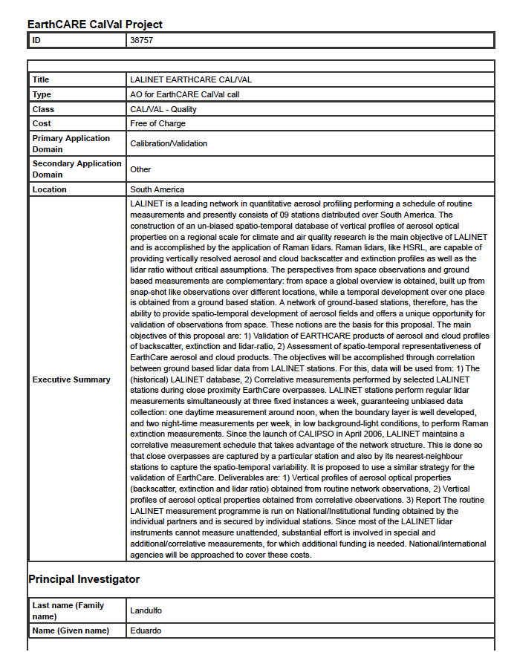
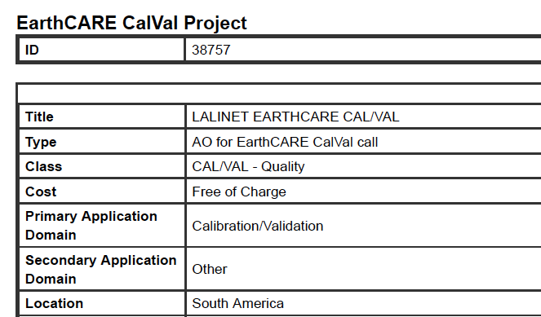
https://bit.ly/2l3n2XD
LALINET VS CALVAL

Slide 11

LALINET VS CALVAL
Alvaro Bastidas – Colombia
Boris Barja – Chile
Antonieta Silva – Chile
Judith Hoelzemann – Brasil
Fabio Lopes – Brasil
Henrique Barbosa – Brasil
Pablo Ristori – Argentina
Ricardo Forno – Bolivia
Marcos Andrade – Bolivia
Juan Carlos Antuña – Cuba
Doina Nicolae – Rumania
Juan Luis Guerrero-Rascado – Spain
Lucas Alados Arboledas - Spain

Slide 12
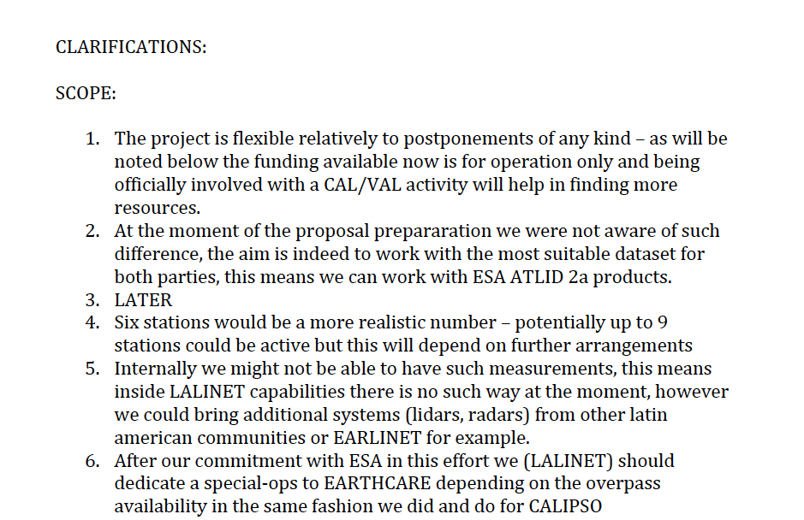
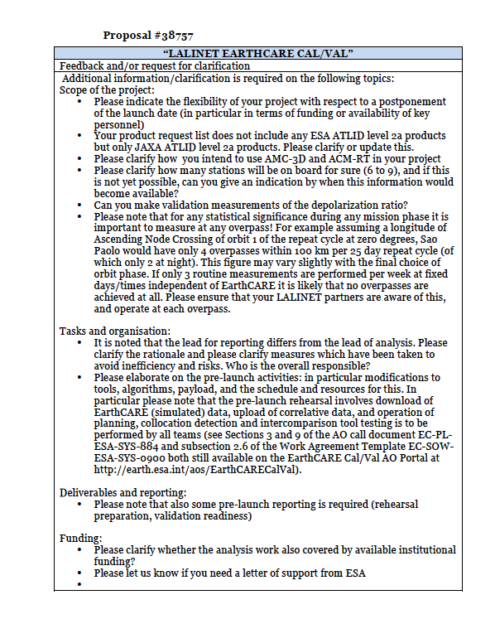
LALINET VS CALVAL

Slide 13
LALINET will closely follow all EC related activities and is flexible to changes in schedule
LALINET should pursue to include all available products ESA/JAXA related
SOME of the current stations (3/9) will be able to make depolarization ratio
SPECIAL OPS to extend possibilty of measure effectively in coordination with EC overpasses following specific cycles
TEAMS should work on Matricial form:
PI’s
GM: SPU
MAO
BUE
PAR
MP
AD
DI

Slide 14
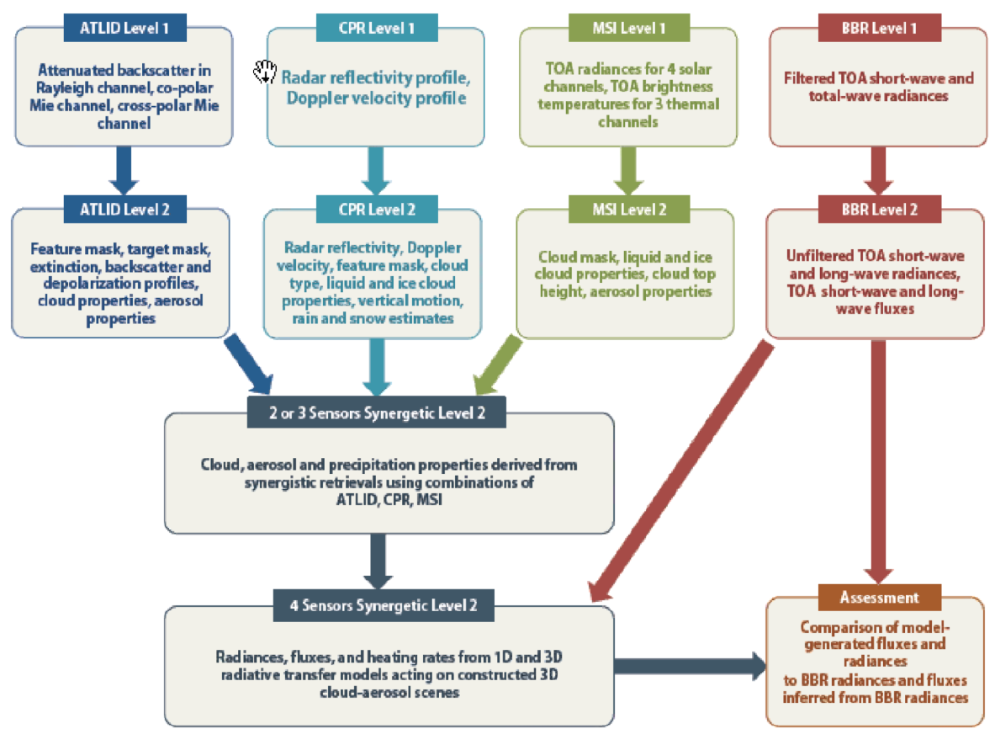

Slide 15
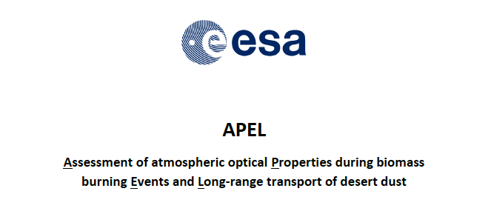
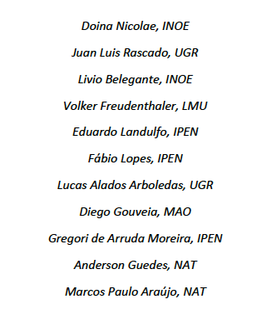
ALCANTARA INITIATIVE: INTERNATIONAL R&D STUDIES ANNOUNCEMENT OF OPPORTUNITY
EARLINET
Anne-Grete Straume
Dirk Schuettemeyer
LALINET
Eduardo Landulfo

Slide 16
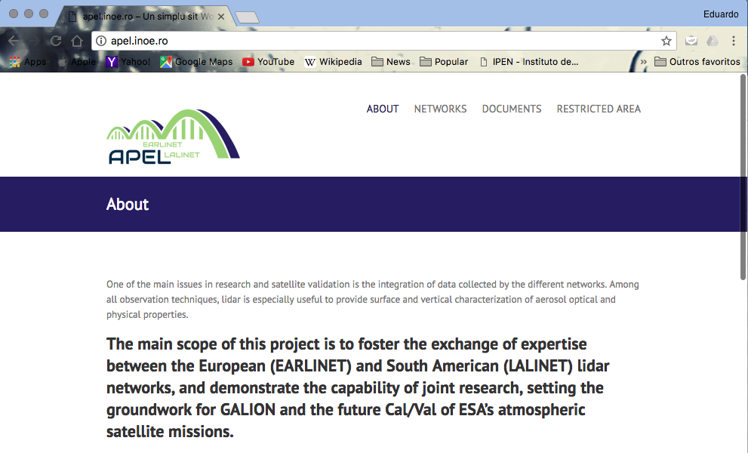
https://bit.ly/2l3n2XD
apel.inoe.ro
Eduardo Landulfo

Slide 17
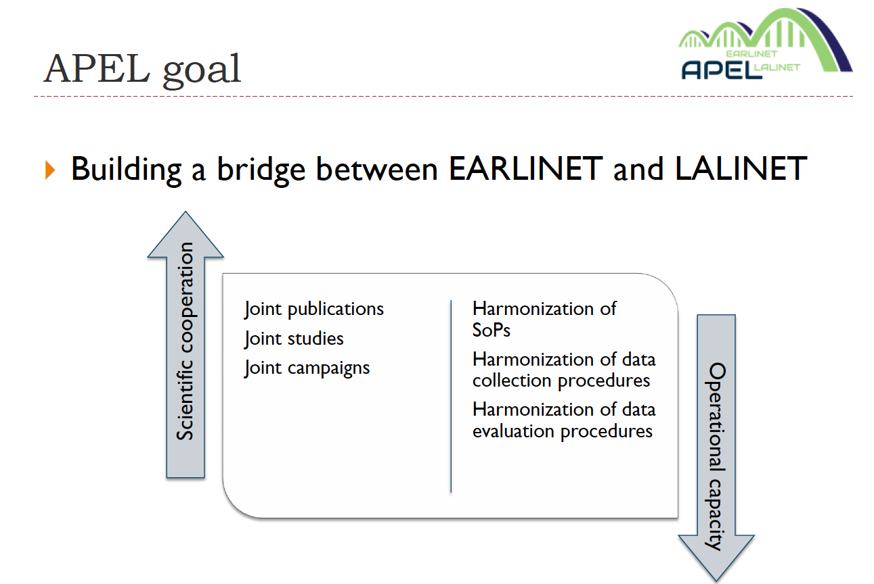
https://bit.ly/2l3n2XD
Eduardo Landulfo

Slide 18
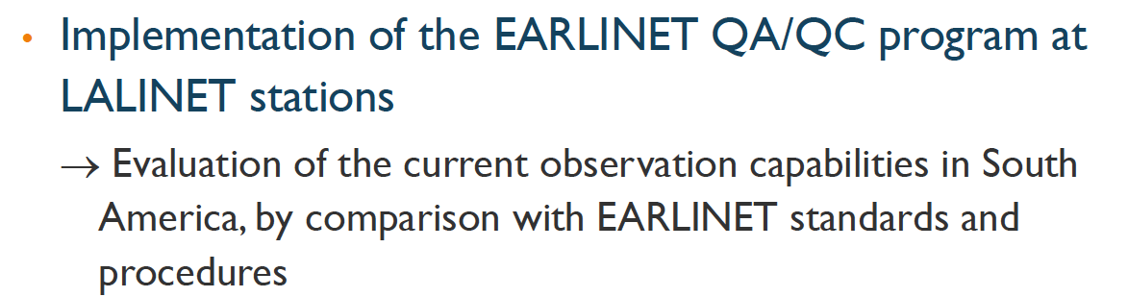
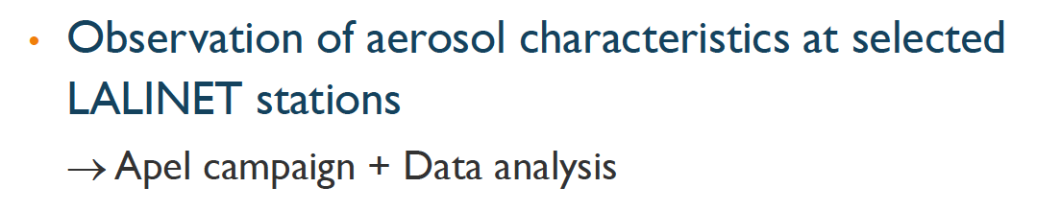
https://bit.ly/2l3n2XD
Eduardo Landulfo

Slide 19
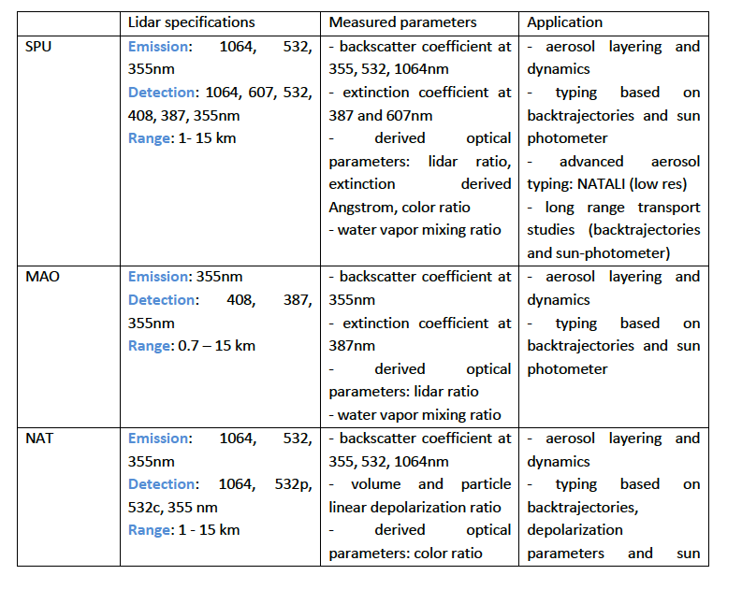
https://bit.ly/2l3n2XD
Eduardo Landulfo

Slide 20
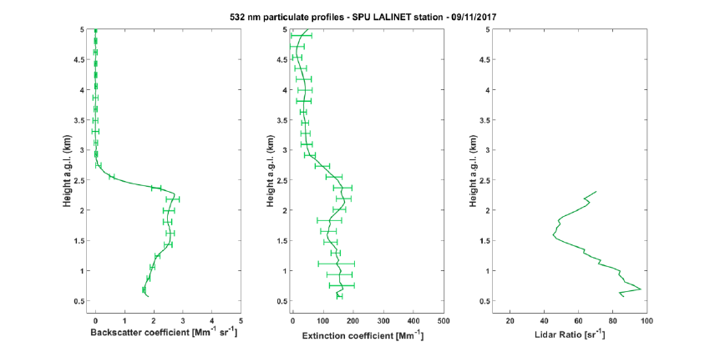
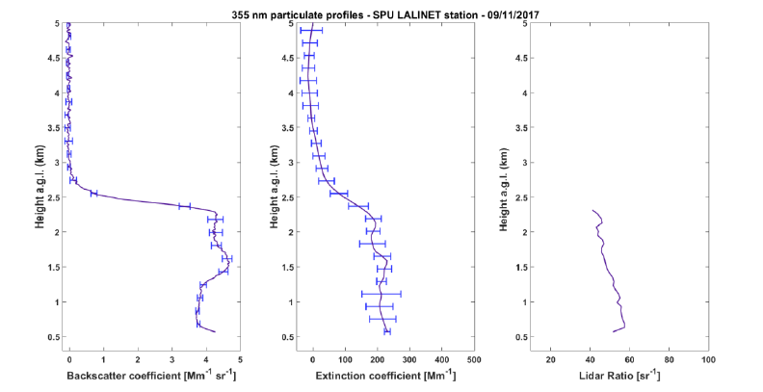
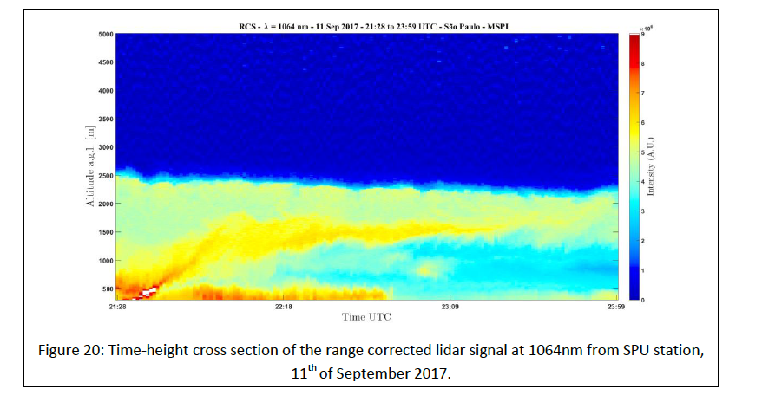
https://bit.ly/2l3n2XD
Eduardo Landulfo

Slide 21
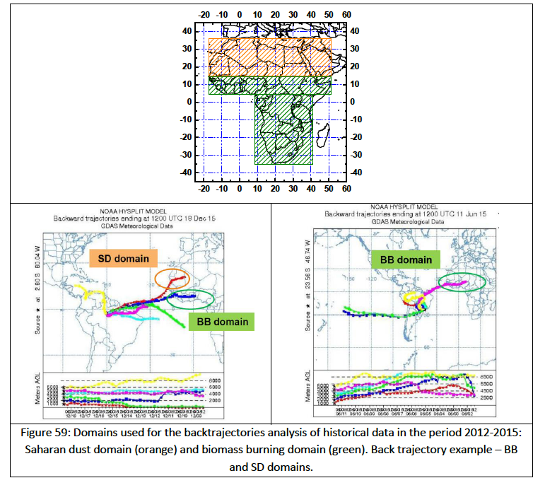
https://bit.ly/2l3n2XD
LONG RANGE TRANSPORT STUDIES
Eduardo Landulfo

Slide 22
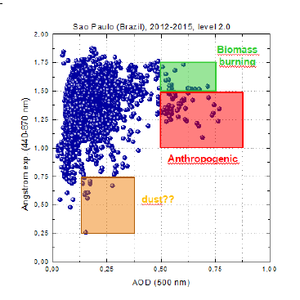
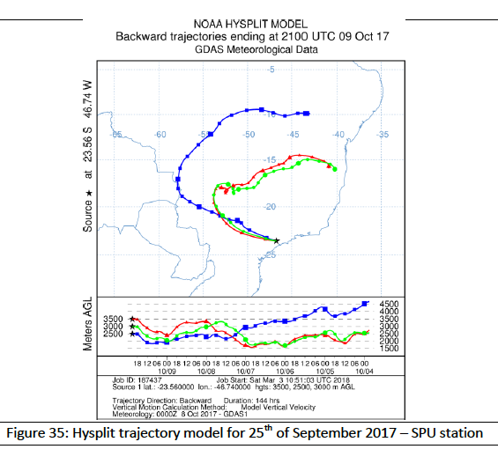
https://bit.ly/2l3n2XD
AEROSOL TYPING
Eduardo Landulfo

Slide 23
https://bit.ly/2l3n2XD
THE SEARCH FOR FUNDING
LOCAL FUNDING AGENCIES FOR EACH FEDERATION
REGIONAL FUDING AGENCIES: CONSORTIA
INTERNATIONAL FUNDING
RUN CAMPAIGNS, HIRE PEOPLE (STUDENT AND TECHNICAL),
MAINTAIN & UPGRADE, EXPAND NETWORK
Eduardo Landulfo

Slide 24

















https://bit.ly/2l3n2XD
ACKNOWLEDGEMENTS
Eduardo Landulfo

Slide 25
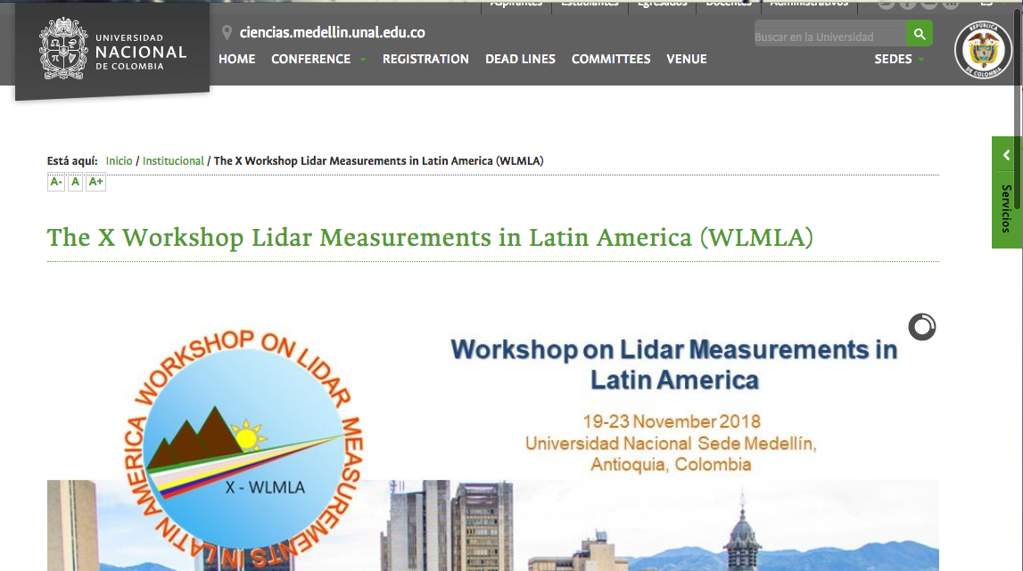
https://bit.ly/2JCvKqq
aebastid@unal.edu.co
landulfo@gmail.com
http://ciencias.medellin.unal.edu.co/eventos/wlmla/index.php/2-institucional/6-home

