Slide 1
Status and future plan of the JAXA Validation activity
Takuji Kubota
Earth Observation Research Center (EORC)
Japan Aerospace Exploration Agency
First ESA EarthCARE Cal/Val Workshop
June 2018, Bonn Germany
Notes:
1

Slide 2
Current status & future plan of JAXA Validation activity
JAXA 1st Validation Research Announcement (RA) from Apr. 2013 to Mar. 2015 selected 14 Validation PIs.
  The main objective of this 2-year period was to prepare the implementation plan for the validation activity after launch.
Building JAXA Validation Team during the 1st RA
  Validation Leader : Prof. Y. Fujiyoshi (Hokkaido Univ.)
    CPR Echo/Doppler group (Leader : Yuichi Ohno, NICT)
    Cloud/Aerosol/Radiation group (Leader : Prof. Takashi Y. Nakajima, Tokai Univ.)
During Apr. 2015-Mar. 2018 , the Validation Planning Sub-committee works to exchange information.
  Validation Sub-committee Leader : Prof. N. Takahashi (Nagoya Univ.)
The 2nd RA including the validation study will start from April 2019 as 3-year-period (up to Mar. 2022), which will be released on Sep. 2018 (TBD).
  Validation Leader : Prof. N. Takahashi (Nagoya Univ.)

Slide 3
EarthCARE JAXA Science Team (JFY2013-2014, Validation)
EarthCARE JAXA Project Scientist
Hajime Okamoto (Kyusyu Univ.)
Validation
Algorithm
Validation Leader
Yasushi Fujiyoshi
(Hokkaido Univ.)
CPR Echo/Doppler Group
Cloud/Aerosol/Radiation Group
CPR L1b
CPR L2a
CPR/ATLID/MSI L2a
2 Sensors/3 Sensors/4 Sensors Synergy L2b
Group Leader
Group Leader
Yuichi Ohno
(NICT)
Takashi Nakajima
(Tokai Univ.)
Masayuki Yamamoto (Kyoto Univ)
Kaoru Sato
(Univ. of Tokyo)
Masahiko Hayashi
(Fukuoka Univ.)
Makoto Koike
(Univ. of Tokyo)
Tadayasu Ohigashi
(Nagoya Univ.)
Yasushi Fujiyoshi
(Hokkaido Univ.)
Toshiaki Takano
(Chiba Univ.)
Simone Tanelli
(JPL)
Kazuaki Yasunaga
(Toyama Univ.)
Masataka Shiobara
(NIPR)
Nobuo Sugimoto
(NIES)
Itaru Sano
(Kinki Univ.)
Kazuaki Yasunaga
Simone Tanelli
Toshiaki Takano
Winker
Andrew Heymsfield (UCAR)

Slide 4
List of PIs in JAXA1st Validation RA
Name | Title | Institution | Job Title | Country
Nobuo Sugimoto | Study on validation of ATLID products and ATLID-CPR and ATLID-MSI synergy products using ground-based lidar and radiometer networks. | National Institute for Environmental Studies (NIES) | Section head | Japan
Simone Tanelli | Validation of Scientific Data Products from EarthCARE’s Cloud Profiling Radar | Jet Propulsion Laboratory, California Institute of Technology | Sr. Eng. | USA
Andrew J. Heymsfield | Evaluation of Ice Cloud Retrieval Algorithms for the JAXA/NICT Spaceborne Cloud Profiling Radar | University Corporation for Atmospheric Research | Sr. Scientist, Section Head | USA
Yasushi Fujiyoshi | In situ observations of vertical profiles of air quality using gliders | Hokkaido University | Prof. | Japan
Masayuki Yamamoto | Validation of EarthCARE product using vertical wind measurement by wind profiler radars | Kyoto University | Assistant Professor | Japan
Itaru Sano | Validation of the retrieved aerosol products based on other satellite and ground measurements | Kinki University | Professor | Japan
Kaoru Sato | A study of possible validation methods of EarthCARE based on observations with fine-resolution from the PANSY radar in the Antarctic and A-train satellite | University of Tokyo | Professor | Japan
Masataka Shiobara | Preliminary study for ground truth of EarthCARE products from the polar sites operated by NIPR | National Institute of Polar Research (NIPR) | Associate Professor | Japan
Makoto Koike | Feasibility studies on validations of satellite-derived cloud and aerosol properties using in-situ and ground-based radar/lidar measurements around Japan and in the Arctic | University of Tokyo | Associate Professor | Japan
Tadayasu Ohigashi | Development of a method deriving microphysical quantities for cloud droplets and ice crystals using a new-type hydrometeor videosonde | Nagoya University | Designated Assistant Professor | Japan
Kazuaki Yasunaga | Toward in-situ observation to validate ATLID and CPR for oceanic aerosols and clouds | Toyama University | Professor | Japan
Toshiaki Takano | Validation plan of CPR/EarthCARE for estimating radiation budget and the feasibility study | Chiba University | Professor | Japan
Masahiko Hayashi | Size distribution of aerosol and cloud particles by in-situ observations using UAV | Fukuoka University | Professor | Japan
David M. Winker | Validation of EarthCARE Data Products using Satellite and Airborne Measurements | NASA Langley Research Center | Senior Scientist | USA

Slide 5
Key issues for validation planning
From experiments from 1st RA, following elements have been understood as keys in the planning, and need to be considered further in the 2nd RA.
  Launch date
    Delays of the launch date have caused severe influences on the validation planning, although these were inevitable.
    We need to adjust the planning to a latest launch date.
  Orbit
    Orbit information is essential in validations, in particular, because active sensors in the EarthCARE observes only a nadir.
    Actually, we have calculated visits for specific locations of the GV site and intersections with other satellites using the orbit information.
    We continue to consider this also in the 2nd RA.

Slide 6
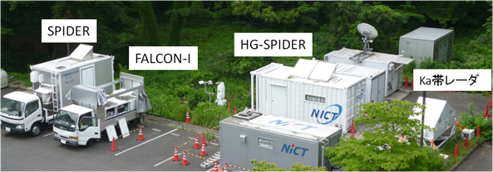
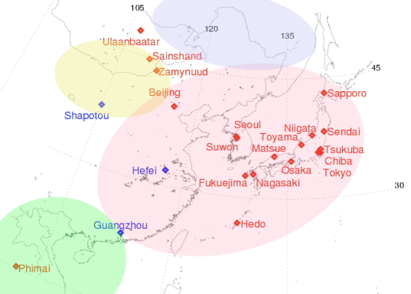
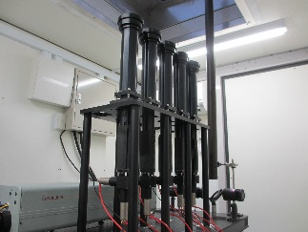
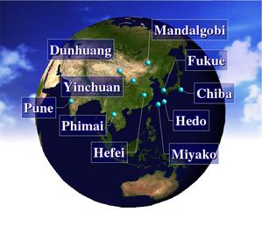
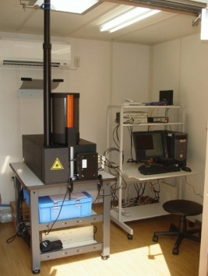
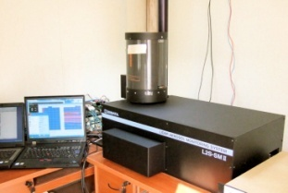
Overview of JAXA validation activities
A field campaign
(ECARE validation site)
Long-term observation network
Lidar network (AD-Net) by the National Institute for Environmental Studies (NIES)
SKYNET observation stations (Hedo, Chiba, etc.)
Ground-based doppler CPR at Ny-Ålesund, Norway
Nagoya Univ. Ka radar, MU radar, EAR, PANSY radar etc.
Ground-based doppler CPR
  developed by the NICT
MFMSP Lidar
key instrument in our CPR validation
SKYNET
(11 stations in Japan,
13 stations in overseas)
NIES Lidar Network (AD-Net)
developed by
Kyusyu-Univ.
& NIES
will collocate at NICT Tokyo
with other Instruments; wind profiler, microwave radiometer, all-sky camera, etc...
.
Comparison with other satellite data
(CloudSat, CALIPSO, MODIS, SGLI, VIIRS, CERES, Himawari-8, etc.)
Notes:
Multi-Field of View Multiple Scattering Polarization Lidar (MFMSPL)

Slide 7
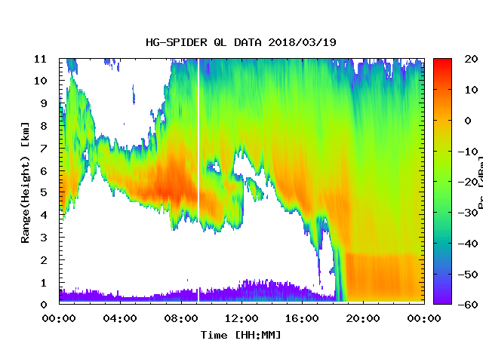
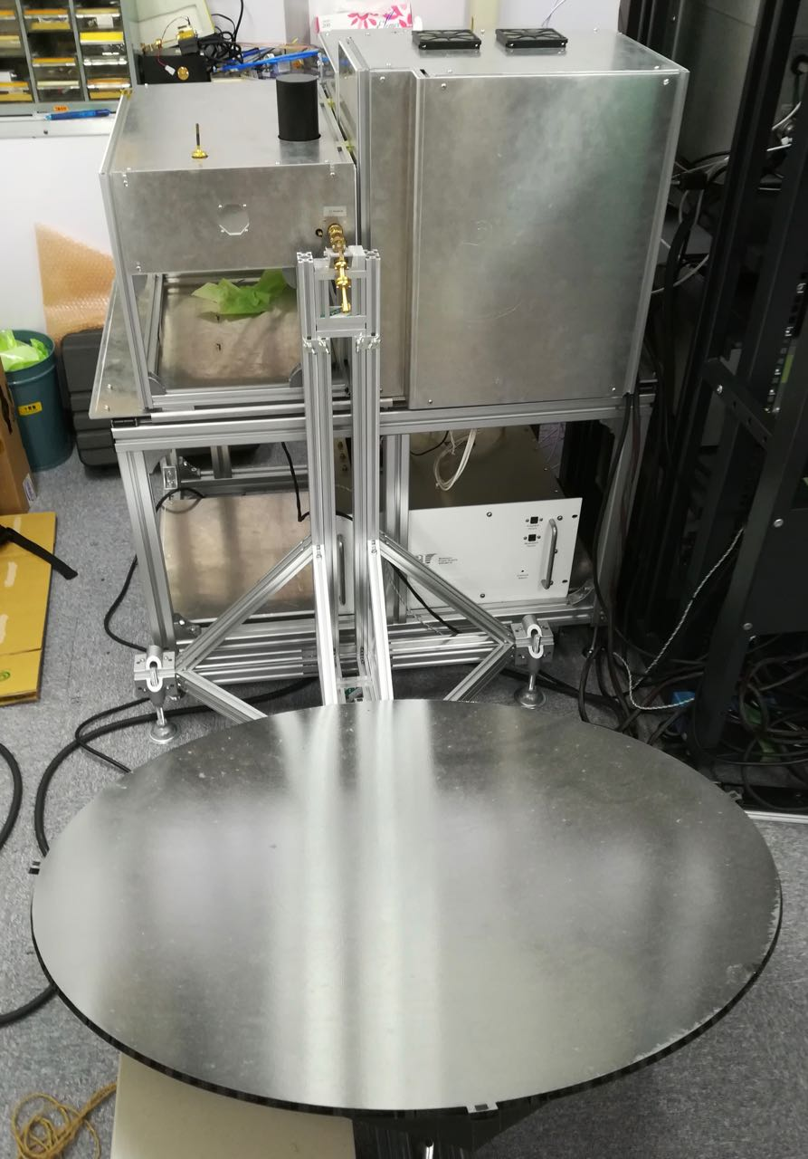
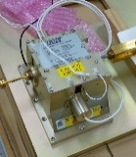
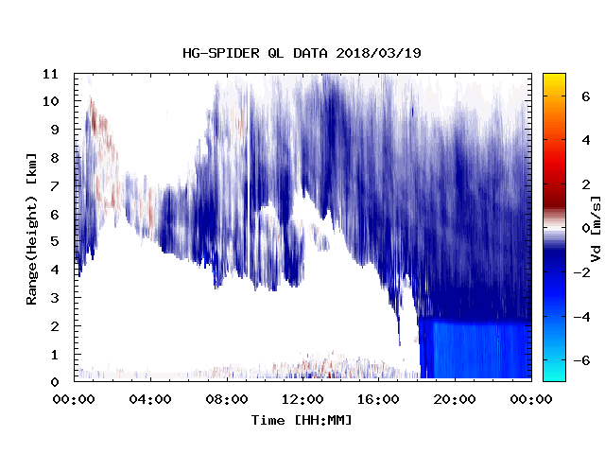
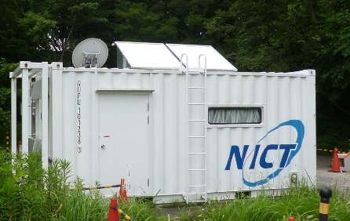
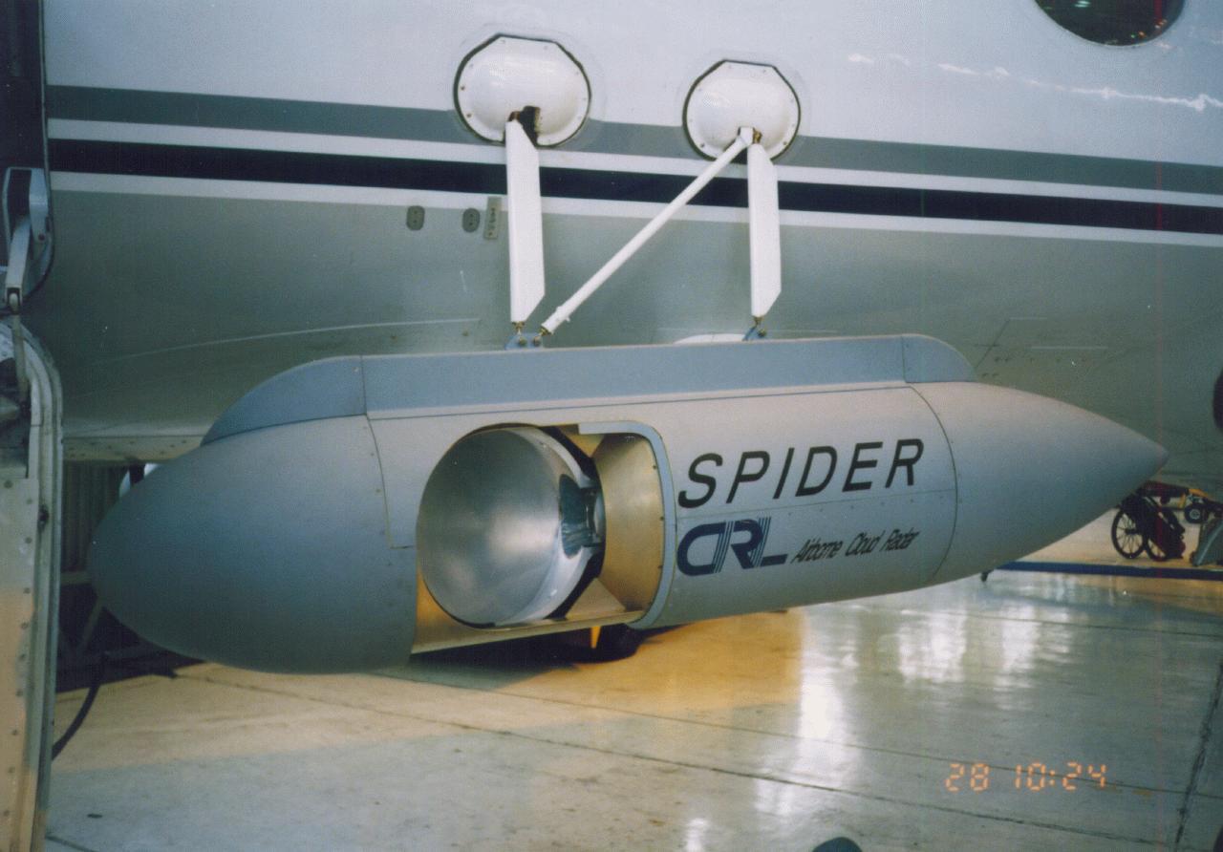
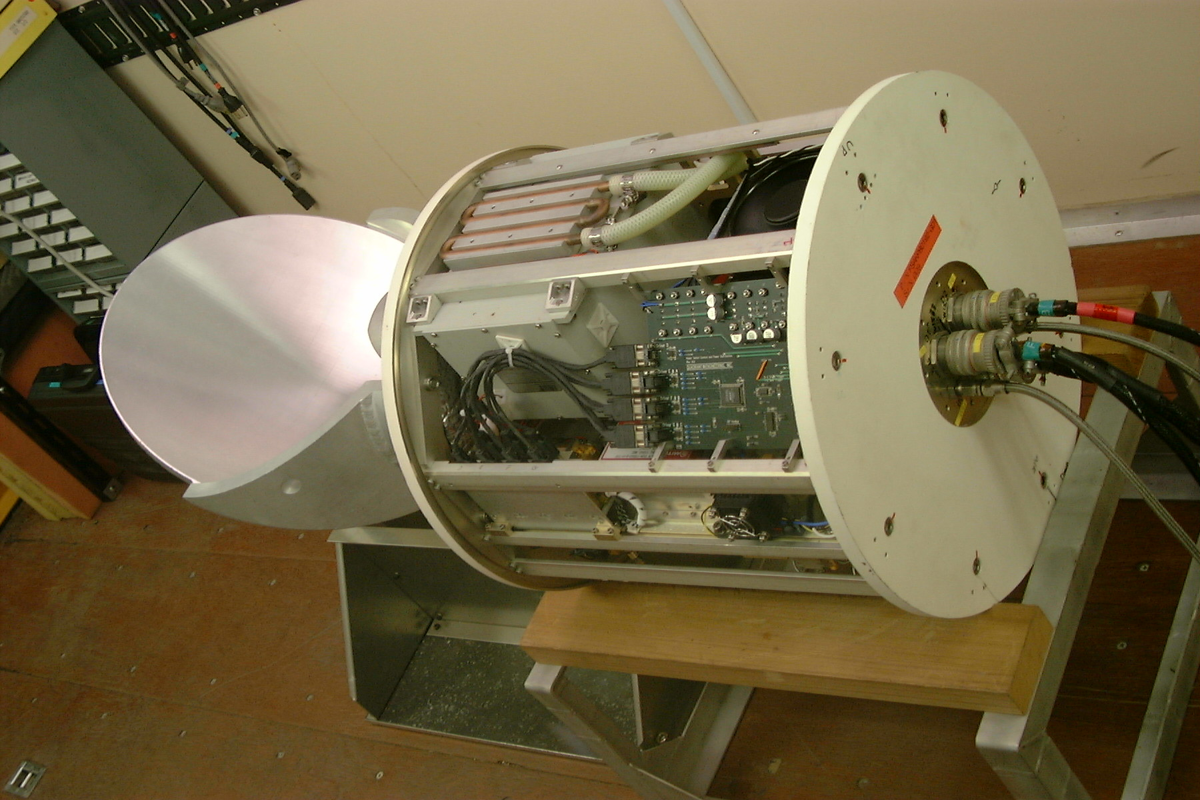
HG-SPIDER ( NICT's Ground-based validation CPR )
HG-SPIDER: High sensitivity Ground-based SPIDER (CPR)
Z factor
Item | Specification
Frequency | 94.090GHz
Tx Power | 1500W at EIK (peak)
Antenna Gain | 55.9 dBi
Beam Width | 0.3 degrees
Polarization | Linear Polarization
Pulse Width | 0.5/1.0/2.0μs
PRF | 3,000 - 10,000 Hz
Sensitivity | -40dBZ@15km (Integ. 1sec.)
Antenna Scanning | Fixed (zenith pointing)
Range | 150m - 20km
Doppler Function | Pulse-Pair Processing
Receiver
Transmitter
Feed-horn
EIK
Doppler Velocity
Antenna dish (80cmφ)
Better sensitivity than EarthCARE/CPR
・ Realtime Monitoring Transmitting Power
・ Receiver Gain Correction by Noise Diode
・ Located NICT Koganei (Validation Site)
with other Instruments; wind profiler,
microwave radiometer, lidar, all-sky camera,
etc...
SPIDER: Developed in 1998
Sensitivity: -30dBZ at 5km

Slide 8
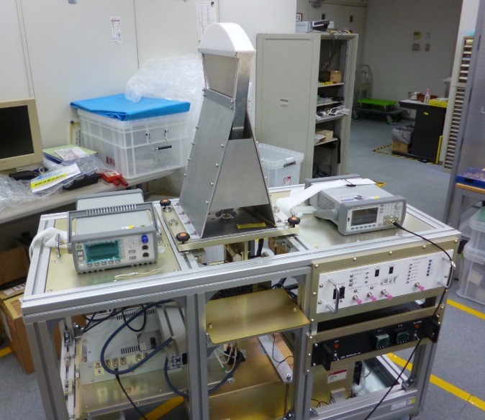

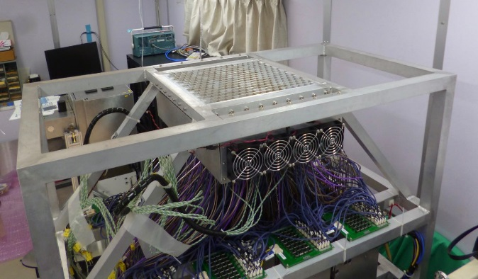
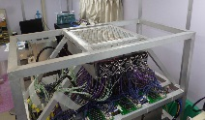

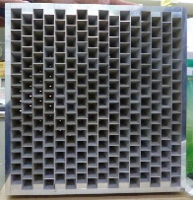
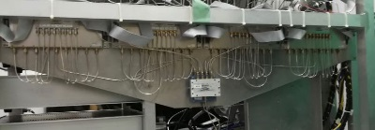
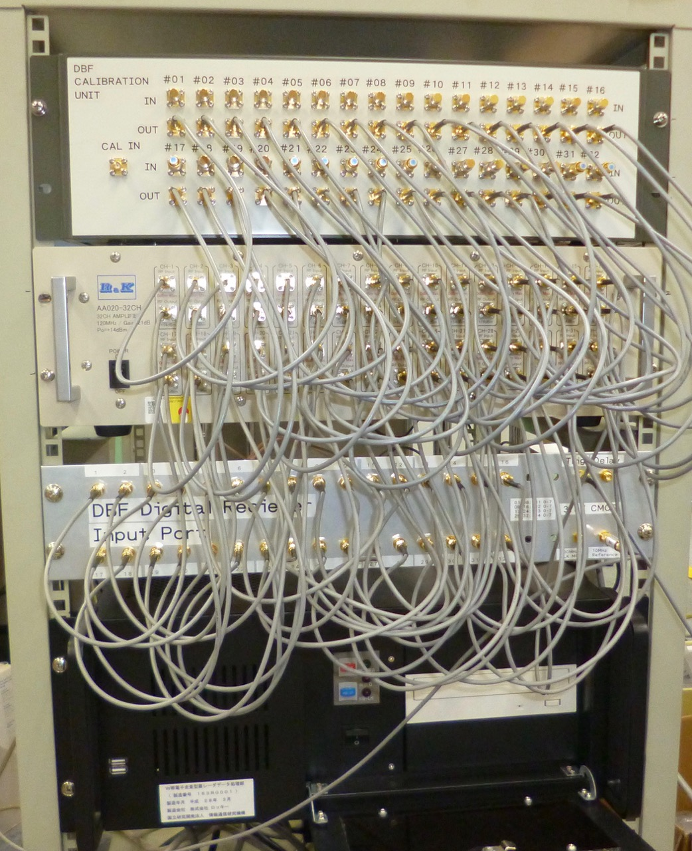
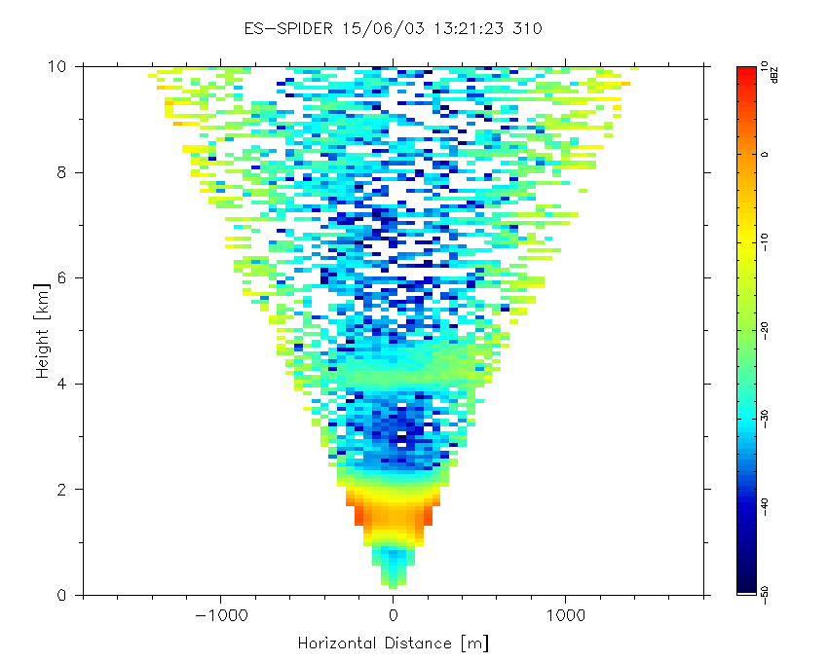
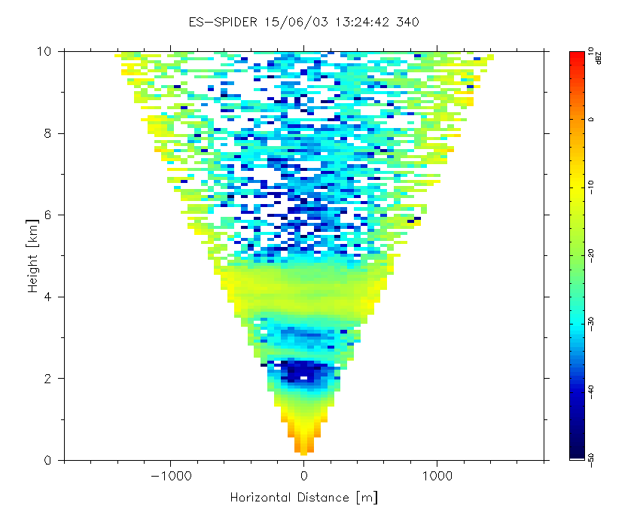
ES-SPIDER (NICT's Ground-based CPR to measure non-uniformity)
ES-SPIDER: Electronic Scanning ground-based SPIDER (CPR)
Item | Specification
Frequency | 94.020GHz (or 95.040GHz)
Tx Power | 1500W at EIK (peak)
Antenna Gain | Tx: 37.8 dBi ^{@ boresight} Rx: 48.6 dBi ^{@ boresight}
Beam Width | Tx: 0.6 x 8.5 deg. Rx: 0.5 x 0.5 deg.
Antenna element | 20x20mm each, 8 by 32
Pulse Width | 0.5/1.0/2.0μs
PRF | 4,000 - 10,000 Hz
Sensitivity | -27dBZ@5km ^{(@integ. 1sec., DBF)}
Antenna Scanning (Rx) | +/-4.5deg.(1-Dimention.)
Range | 150m - 20km
Doppler Function | Pulse-Pair Processing
Transmitter
Concept of ES-SPIDER
Transmitting Antenna
Tx beam
Rx beam
UP/Con
Controler
Scanning Width:
more than ±4.5 deg.
EIK
Receiver
To measure non-uniformity of clouds
8 by 32 elements
Test Result (7 sec. / plate, Integ. 0.1 sec, 63 angle bins )
UP: Current System (sequential scan) - 32ch phase shifter and combiner
Right: Upgrade System (simultaneous scan) - 32ch digital receiver for Digital Beam Foaming (DBF)
13:21:23
13:24:42
Under development

Slide 9
Collaboration with other JAXA mission
Validation collaboration with other JAXA missions
  Global Change Observation Mission - Climate (GCOM-C)
    Launch: 23th Dec. 2017
    Instrument: SGLI (Second Generation Global Imager)
  Greenhouse gases Observing SATellite-2 (GOSAT-2)
    Launch: JFY2018
    Instrument: FTS-2 (Fourier Transform Spectrometer 2) and CAI-2 (Cloud and Aerosol Imager 2)
In particular, validation collaboration has been discussed between EarthCARE and GCOM-C.
  Common cloud algorithms by Prof. T. Y. Nakajima (Tokai Univ.) between the EarthCARE/MSI and the GCOM-C/SGLI.
  Discussions about validation data exchange and possible joint field campaigns

Slide 10
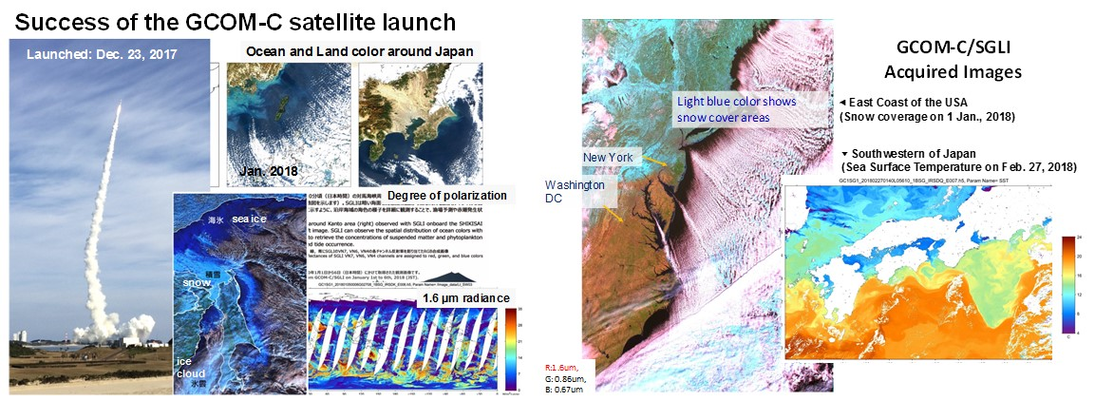
Global Change Observation Mission - Climate "SHIKISAI" (GCOM-C)
JAXA launched GCOM-C on December 23, 2017.
JAXA opened the first light image to public on January 12, 2018 from the following web site. http://suzaku.eorc.jaxa.jp/GCOM_C/index.html
On orbit checkout phase finished at the end of March.
We will release the SGLI products to the public at the end of this year via G-Portal.
GCOM-C SGLI characteristics
Launch Date | Dec. 2017
Weight | 2,000kg
Orbit | Sun-synchronous (descending local time: 10:30), Altitude: 798km, Inclination: 98.6deg
Mission Life | 5 years (3 satellites; total 13 years)
Scan | Push-broom electric scan (VNR: VN & P) Wisk-broom mechanical scan (IRS: SW & T)
Scan width | 1150km cross track (VNR: NP & POL) 1400km cross track (IRS: SWIR & TIR)
Spatial resolution | 250m, 500m, 1km
Polarization | 3 polarization angles for POL
Along track tilt | Nadir for VN, SW and TIR, & +/-45 deg for POL

Slide 11
Summary
  JAXA Validation status and coming schedule
    1st RA (Validation) during JFY2013-2014 (14 PIs)
    2nd RA including the validation study during JFY2019-2021 will be released on Sep. 2018 (TBD).
Overview of JAXA validation activities
  Our planning consists of long-term observation network, a field campaign, and comparison with other satellite data.
  In particular, Ground-based doppler CPR developed by the NICT (HG-SPIDER & ES-SPIDER) at the NICT Tokyo will be key instruments in our CPR validation.
We’re discussing the validation collaboration with other JAXA missions such as the GCOM-C.
The JAXA & NICT and PIs selected in the JAXA 2nd RA will intensify to collaborate validation plans with the ESA.

