Slide 1
Validation Of EarthCARE Level2 Radar Products In High-latitude And Arctic Climates
Dmitri Moisseev
University of Helsinki
Finnish Meteorological Institute
Ewan O’Connor
Finnish Meteorological Institute

Slide 2
GV plans
Validation of EarthCARE Level2 CPR and synergetic products
Main emphasis on mixed-phase (ice) clouds and winter precipitation (e.g. C-CLD, C-TC products)
Also other CPR products such as C-CD, C-FMR will be considered
Foreseen challenges: shallow clouds, low melting layer, ice microphysics retrievals, linking physical and scattering properties

Slide 3
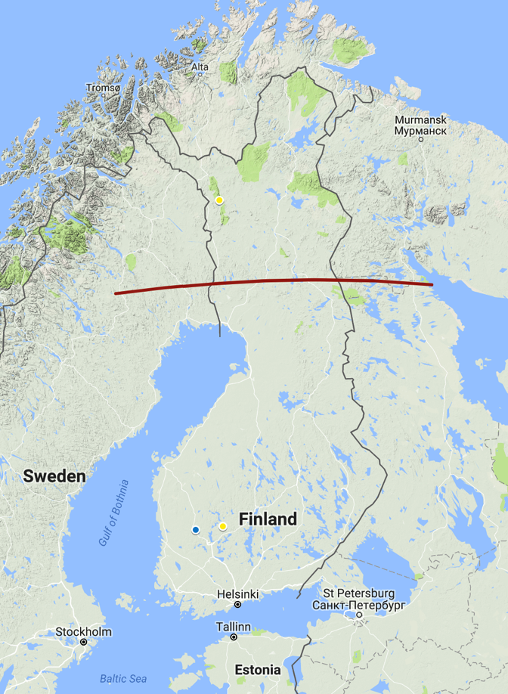
Measurement sites
UH Hyytiälä Station
(61.84 N , 24.29 E)
ACTRIS Cloud profiling station
Extensive precip. measurements
GPM GV site
FMI Pallas-Sodankylä station
(67.98 N, 24.25 E)
ACTRIS in situ cloud measurement station
Cloud profiling capabilities on campaigns basis
FMI Ikaalinen weather radar
(61.77 N, 23.08 E)
Pallas
Arctic circle
IKA
Hyytiälä

Slide 4
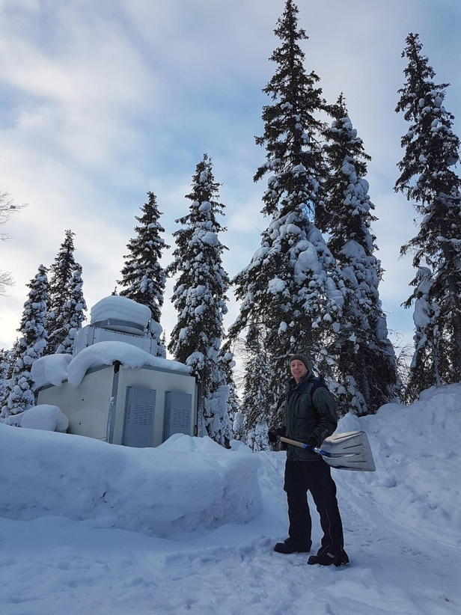
PALLAS-SODANKYLÄ STATION(s)
Remote sensing (on campaign basis)
Ka band radar
Doppler lidar / ceilometer
Microwave radiometer
In situ cloud observations

Slide 5
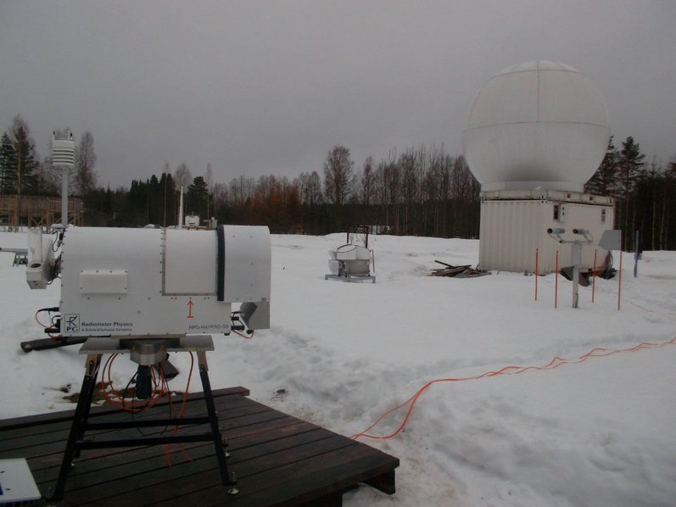
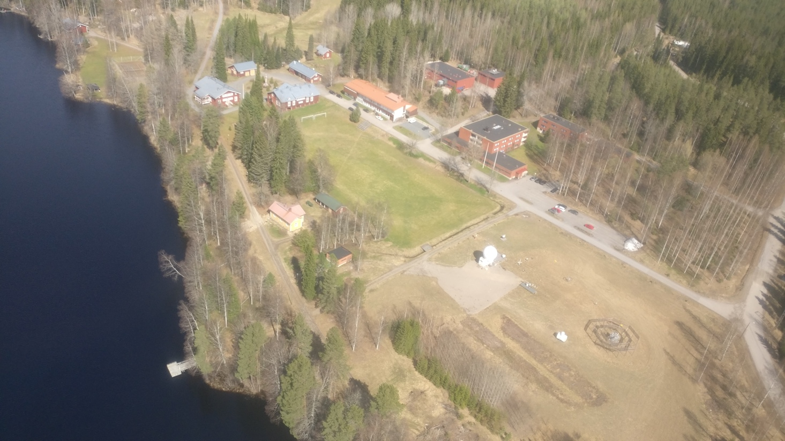
Hyytiälä Station
Remote sensing
C/W band radars
Ka band (on campaign basis)
Microwave radiometer
Doppler lidar
Cloud boundaries, IWC, LWC, LWP, T and RH profiles, precipitation intensity
Ground-sensors
DFIR
2x Weighing gauges
Ott Parsivel, 2D-video disdrometer
NASA PIP
Precipitation intensity, v(D), particle images, PSD

Slide 6
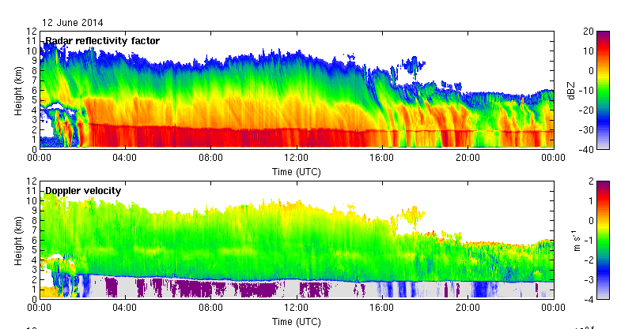
CLOUDNET target classification
ACTRIS Cloudnet products will form the basis for the GV studies
Some algorithm development will be done to utilize new measurement capabilities: e.g. Doppler spectra, multi-frequency radar observations

Slide 7
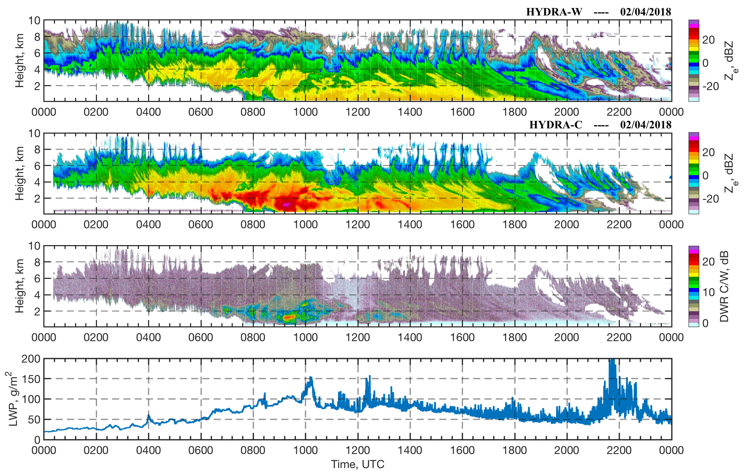
Algorithm development:
Multi-Frequency Radar Retrievals
Multi-frequency radar observations (C, Ka, W -bands) will be used to improve the retrievals
and applied to ice (mixed-phase) clouds
Validation of C-CLD (e.g. IWC, Dm) products

Slide 8
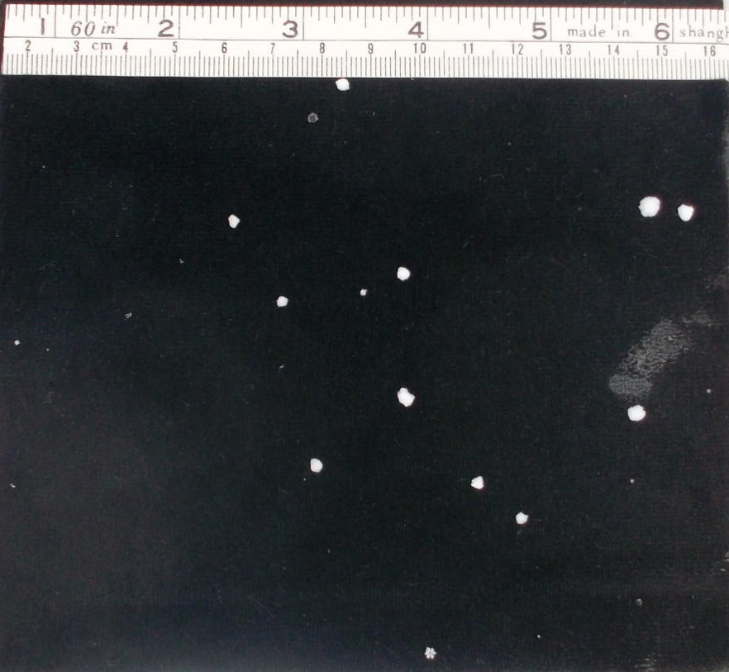
(Data for) physical validation

Slide 9
Collocation
We will follow two collocation approaches:
statistical validation by comparing statistics of retrieved cloud and precipitation properties
direct comparison
For direct comparison, FMI Ikaalinen weather radar observations will be used to provide the spatial context.

Slide 10
Example: validation of GMI snowfall product
Point measurements are used to derive Ze-S relations applied to IKA observations
Snowfall rate estimate uncertainties are also computed
von Lerber, A., D. Moisseev, D.A. Marks, W. Petersen, A. Harri, and V. Chandrasekar, 2018: Validation of GMI Snowfall Observations by Using a Combination of Weather Radar and Surface Measurements. J. Appl. Meteor. Climatol., 57, 797-820, https://doi.org/10.1175/JAMC-D-17-0176.1

Slide 11
Example: Validation of GMI Snowfall intensity product
Product V05 performs better than V04
GMI underestimates snowfall intensity even using the latest product version

Slide 12
Challenge / Algorithm development:
Ice retrievals during rain
Melting layer (+ radome and rain) attenuation correction is needed
Multi-frequency spectra observations show a promise in mitigating this challenge

Slide 13
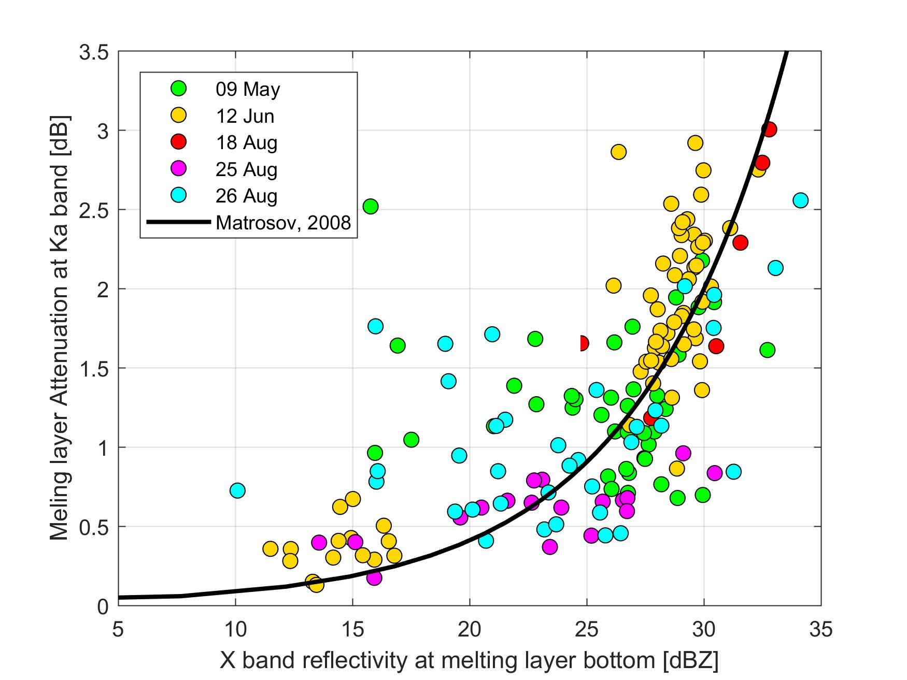
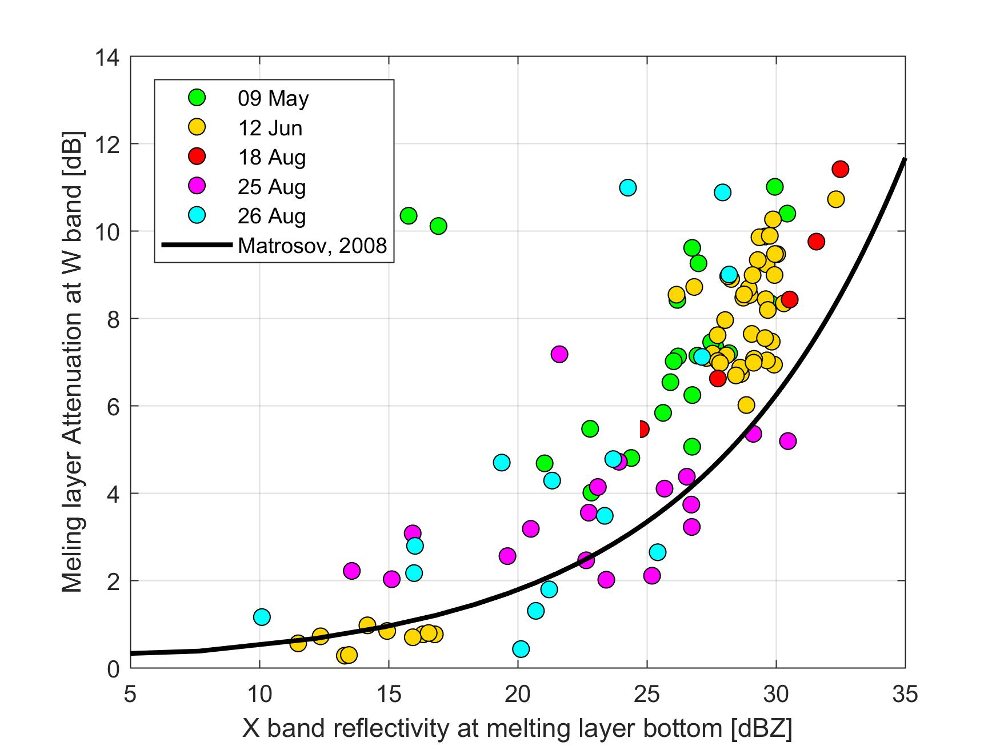
Challenge / Algorithm development:
Ice retrievals during rain
Melting layer (+ radome and rain) attenuation correction is needed
Multi-frequency spectra observations show a promise in mitigating this challenge

Slide 14
Data availability
ACTRIS Cloudnet stores and distributes radar, MWR and lidar data (open access)
UH together CSC is in process of developing storage and data access system for all UH data
All the data will be using netcdf file format

Slide 15
Summary
Given the measurement site location and available instrumentation we are uniquely positioned for validation of EarthCARE products at high-latitudes
The measurement setup also allows physical validation of existing and development of new retrieval algorithms

