Slide 1
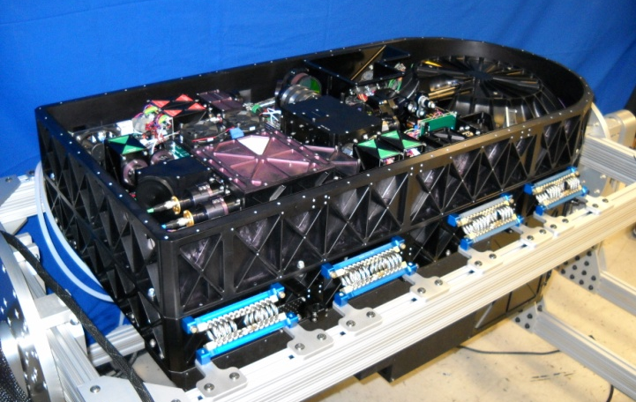
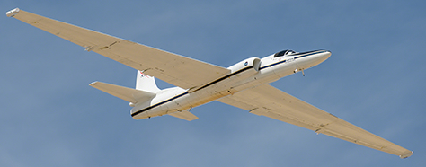
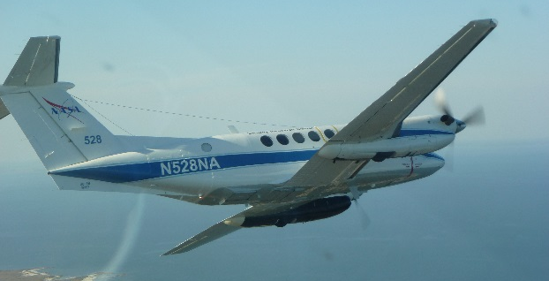
EarthCARE Calibration and Validation Using an Airborne HSRL
PIs: Chris Hostetler, Sharon Burton, John Hair, and Rich Ferrare
Presented by Dave Winker
HSRL-2

Slide 2
ATLID and MSI products to be validated with HSRL-2
ATLID | Level 1 | ATL-CA-1 | Calibration of Mie co-polar and Rayleigh channels
 |  | ATL-CA-4 | Spectral cross-talk in Rayleigh channel
 |  | ATL-CA-5 | Spectral cross-talk in Mie channel
 |  | ATL-CA-6 | Polarization cross-talk in Mie co-polar channel
 |  | ATL-CA-7 | Polarization cross-talk in Mie cross-polar channel
 | Level 2 | A-FM | Feature Mask
 |  | A-AER | Aerosol backscatter, extinction, and depolarization, 10-km scale
 |  | A-EBD | Aerosol backscatter, extinction, and depolarization, 1-km scale
 |  | A-TC | Target Classification
 |  | A-CTH | Cloud Top Height
 |  | A-ALD | Aerosol Layer Descriptor
MSI | Level 2 | AM-CTH | Cloud top height
 |  | AM-ACD | Aerosol column descriptor

Slide 3
HSRL-2 instrument and past experience in CALIOP validation

Slide 4
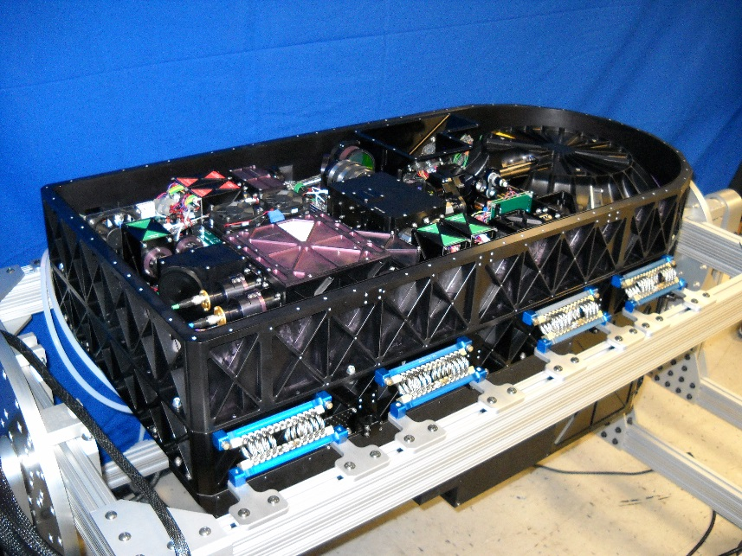
Airborne HSRL-2 instrument
Multi-wavelength HSRL
  Aerosol/cloud extinction: 355, 532 nm
  Aerosol/cloud backscatter: 355, 532, 1064 nm
  Aerosol/cloud depolarization: 355, 532, 1064 nm
Flown on 8 field campaigns since 2012
Aircraft options:
  B200 King Air (9 km altitude)
  P3-B (6 km altitude)
  ER-2 (19 km altitude)
  Other options possible
Measured/Retrieved Parameter | Resolution | Uncertainty
Particulate Backscatter Profiles (355/532/1064 nm) | 30 m/1.5 km* | 0.2 Mm⁻¹sr⁻¹
Particulate Extinction Profiles (355/532 nm) | 150 m/4.5 km* | 0.01 km⁻¹
Particle Depolarization (355/532/1064 nm) | 30 m/1.5 km* | 1%
Aerosol Optical Depth (355/532 nm) | 150 m/4.5 km* | 0.02
Mixed Layer Height | 30 m/1.5 km* | ~100 m
Qualitative Aerosol Type | 150 m/4.5 km* | -
Effective Radius | 150 m/4.5 km* | 30%
Number Concentration | 150 m/4.5 km* | 100%
Surface Concentration | 150 m/4.5 km* | 30%
Volume Concentration | 150 m/4.5 km* | 50%
Cloud Top Height | /75 m | 5 m
Cloud Top Extinction | /500 m | 30-50%
Cloud Top Lidar Ratio (extinction-to-backscatter) | /500 m | 0.5
§ Uncertainties, which represent a combination of measurement precision and accuracy, are presented for typical measurement conditions * “x m / y m” indicates x-m vertical resolution and y-m horizontal resolution.

Slide 5
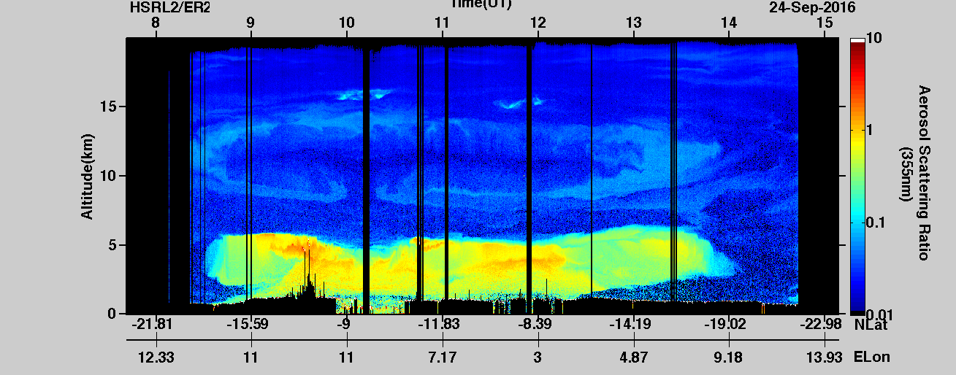
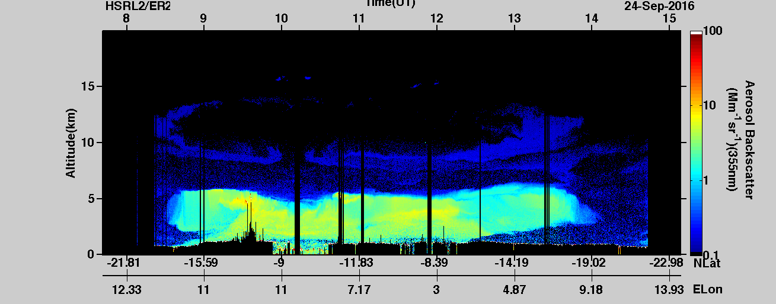
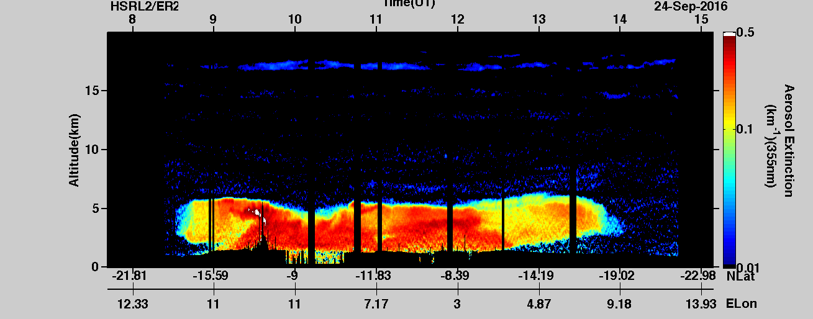
HSRL-2 355 nm aerosol extensive products
Data from Sept. 24, 2016 during NASA ORACLES mission in SE Atlantic Ocean.
Shown is the prominent smoke layer over marine stratus clouds.
HSRL-2 deployed from NASA ER-2 high-altitude aircraft
Aerosol scattering ratio
Aerosol Backscattering
Aerosol Extinction

Slide 6
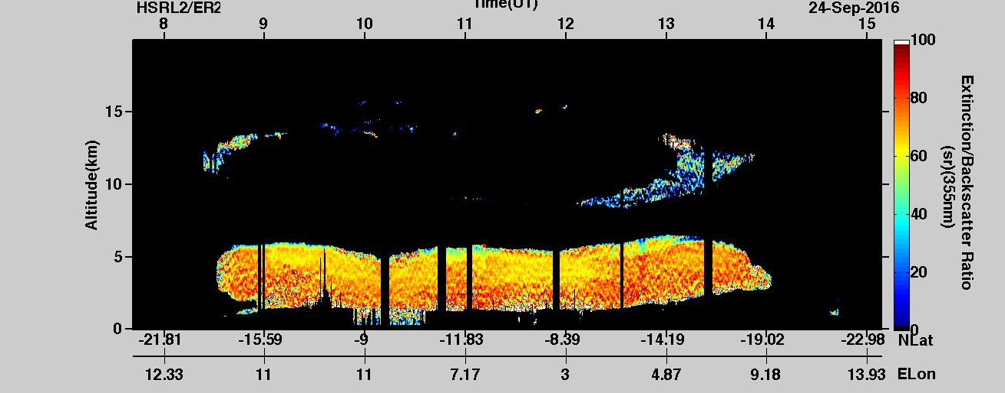
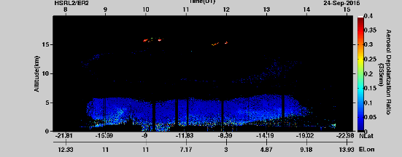
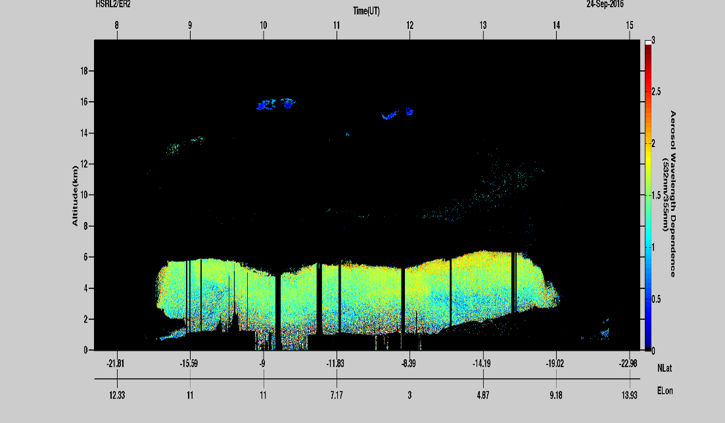
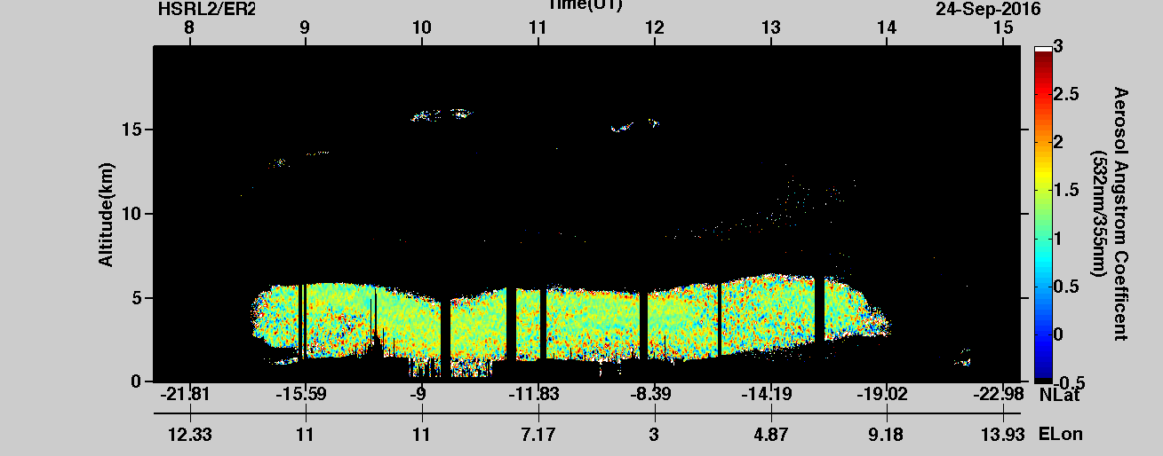
HSRL-2 355 nm aerosol intensive products
Lidar ratio
Particulate depolarization
Backscatter
Angstrom Exponent
(355/532 nm)
Extinction
Angstrom Exponent
(355/532 nm)

Slide 7
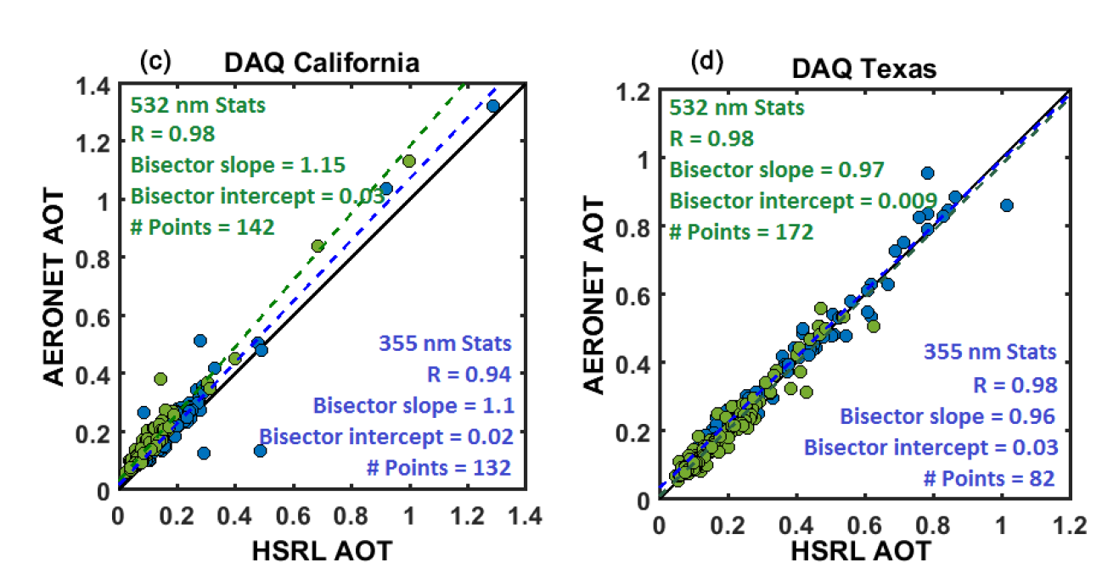
Comparisons with AERONET provide high confidence in HSRL-2 aerosol extinction and optical depth products
HSRL 0-7 km layer AOD values compare well with column AOD (355 and 532 nm) values from AERONET “DRAGON” stations when HSRL was within 2.5 km of site and 10 minutes from measurement
Sawamura et al., 2017, ACP

Slide 8
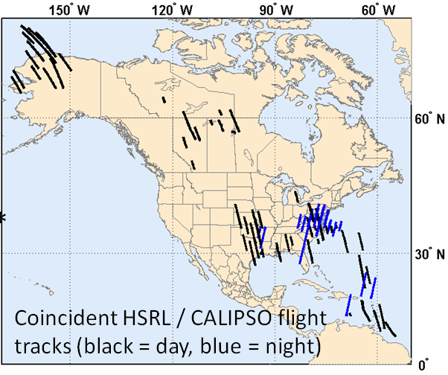
Will follow approach used for CALIOP validation
>100 underflights of CALIPSO satellite
HSRL-1 instrument used to validate CALIOP
  Calibration
  532 nm backscatter
  532 nm extinction
  Lidar ratio
  Aerosol type
See
  Rogers, R. R., et al. (2011), Assessment of the CALIPSO Lidar 532 nm attenuated backscatter calibration using the NASA LaRC airborne High Spectral Resolution Lidar, Atmos. Chem. Phys., 11(3), 1295-1311, doi:10.5194/acp-11-1295-2011.
  Rogers, R. R., et al. (2014), Looking Through the Haze: Evaluating the CALIPSO Level 2 Aerosol Layer Optical Depth using Airborne High Spectral Resolution Lidar Data, Atmos. Meas. Tech. , 7, 4317-4340, doi:10.5194/amt-7-4317-2014.

Slide 9
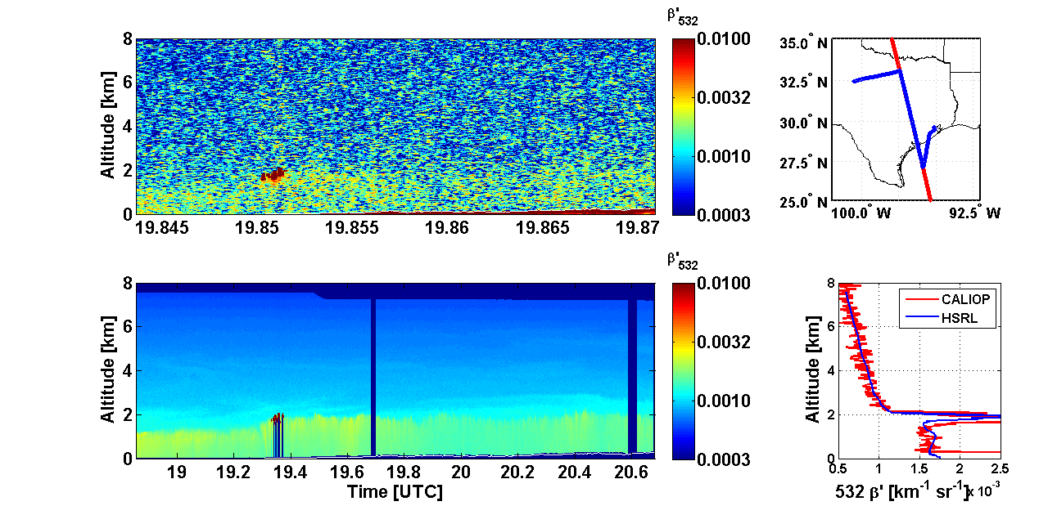
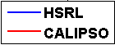
Example – 09/20/2006: L1 calibration
[km⁻¹sr⁻¹]
CALIPSO
[km⁻¹sr⁻¹]
bias =
2.4%
HSRL

Slide 10
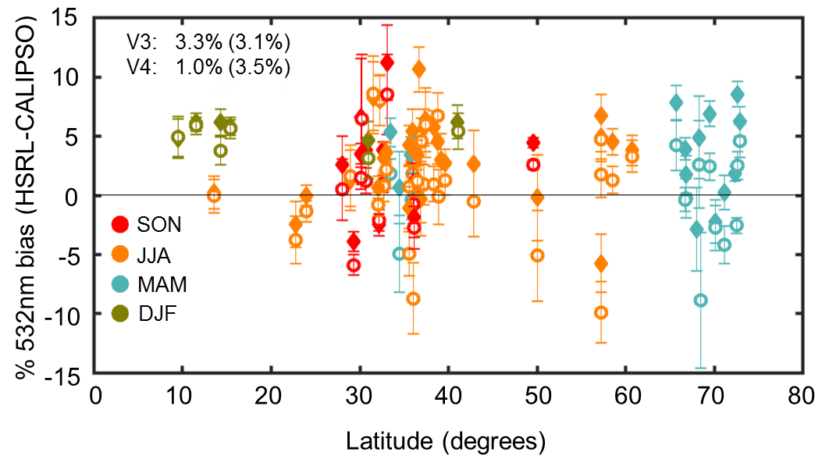
Level 1 Calibration Evaluation
Bias of the daytime 532 nm attenuated backscatter measured between HSRL and CALIPSO for several over-flight campaigns between 2006 and 2014 broken by season and latitudes. The comparisons used both V3 (solid diamonds) and V4 (open circles) L1 data. Each point represents the mean and uncertainty of the HSRL-CALIPSO difference for each of the 62 flights conducted.

Slide 11
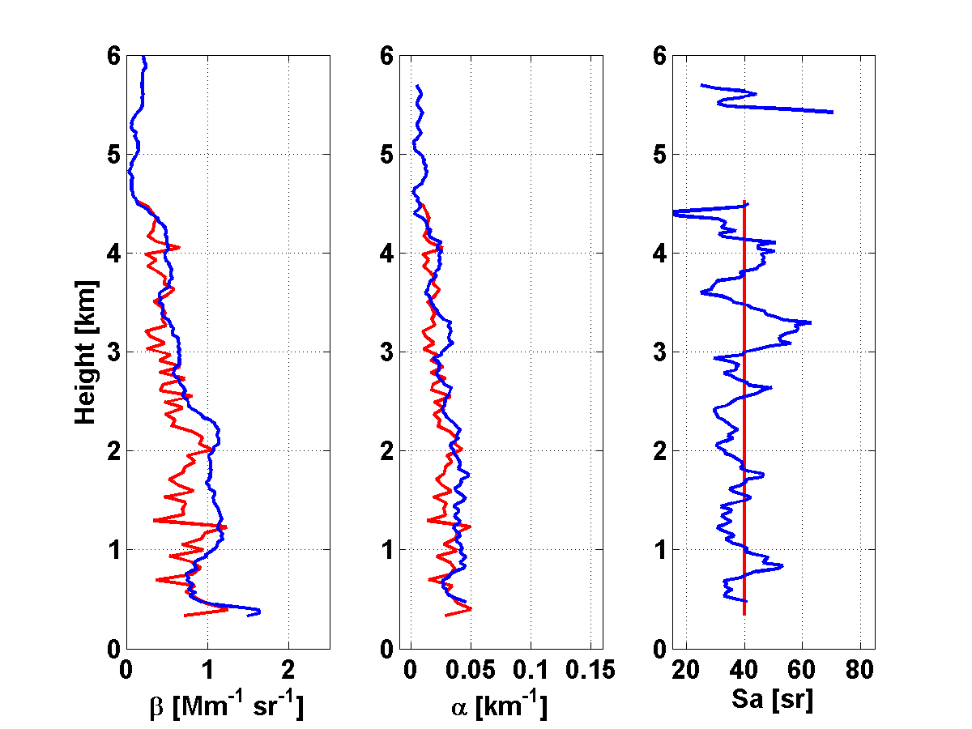
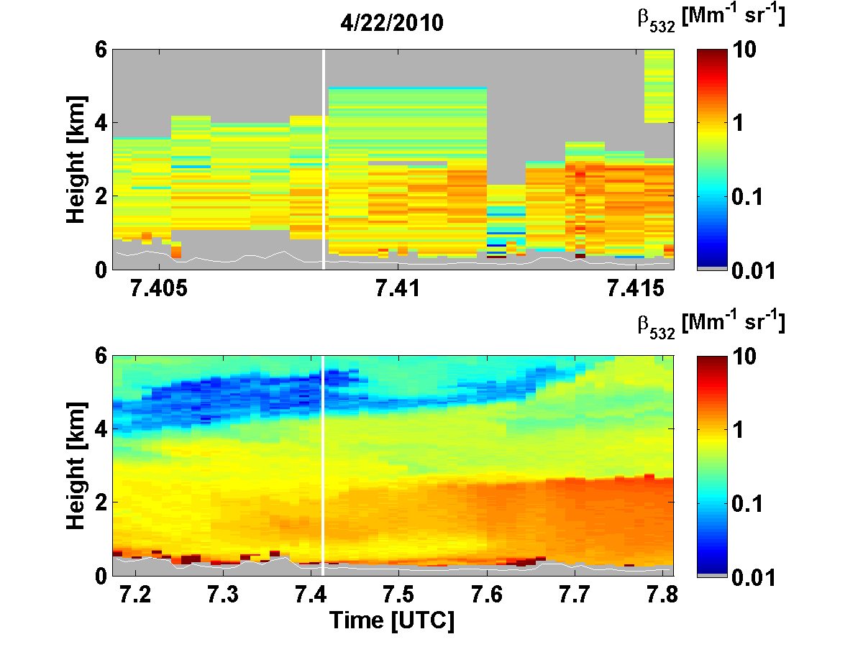
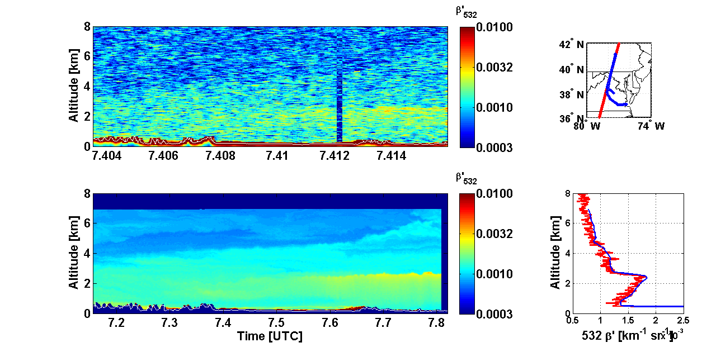
Level 2 Aerosol Profile: Aerosol Backscatter
CALIPSO
HSRL

Slide 12
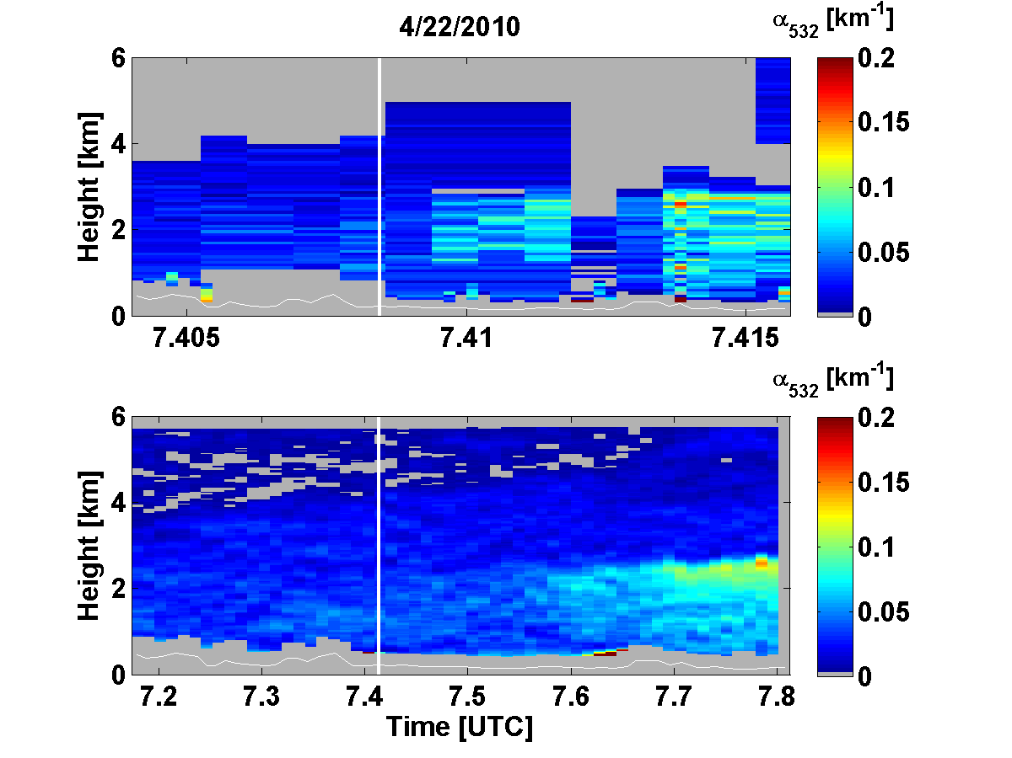
Level 2 Aerosol Profile: Aerosol Extinction
CALIPSO
HSRL

Slide 13
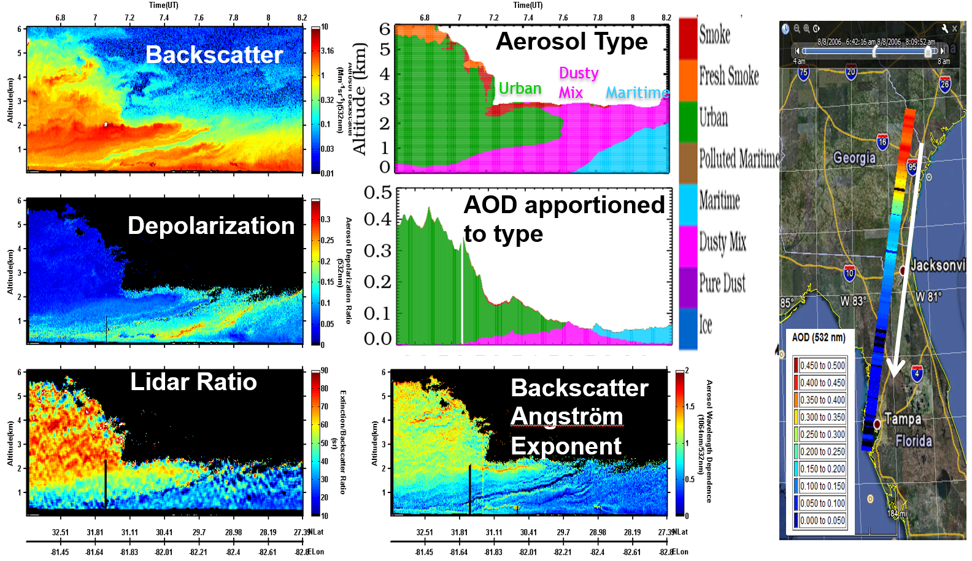
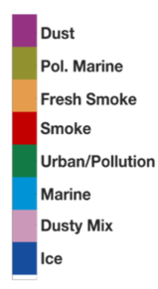
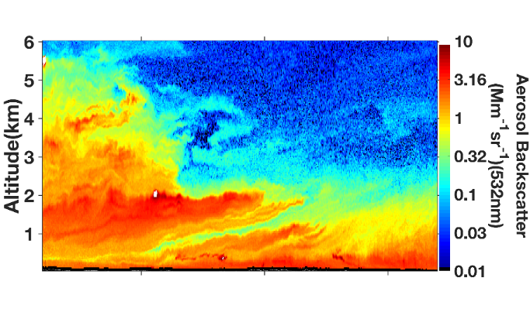
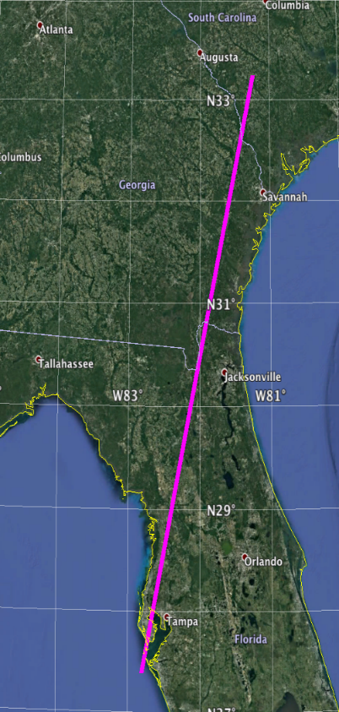
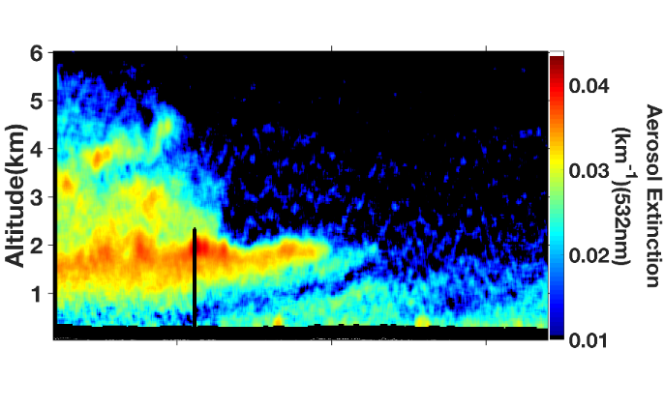
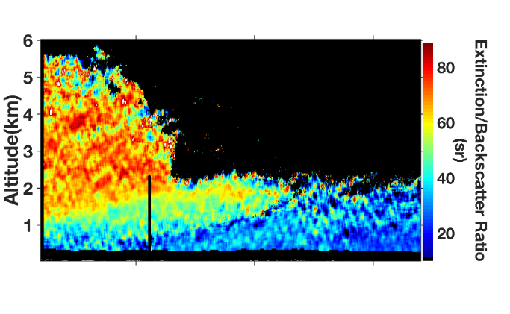
Identification of aerosol type and partitioning AOD by type
Backscatter
Altitude (km)
Extinction
Altitude (km)
Extinction-to-
Backscatter
Ratio
Altitude (km)
0
Distance
665 km
0
Distance
665 km
Intensive observables:
Independent of aerosol amount
Depends only on aerosol type
Burton et al., 2012, AMT
Notes:
In addition to our fundamental products, the advanced instruments provide great skill in determining aerosol type, for instance, whether the aerosol is pollution or smoke or desert dust or marine sea salt aerosol.
Here is an example from a flight from South Carolina to Tampa. We see our standard backscatter product, the magnitude of which is determined by aerosol amount and type.
Because we have at least two wavelengths and have channels sensitive to the degree that particles depolarize the laser light, we also measure several intensive properties, i.e., properties that are independent of aerosol amount and depend only on aerosol type. Here are three of these properties. I’ll highlight the lidar ratio, which is the ratio of extinction to backscatter. Because we measure extinction and backscatter independently, we can look at the ratio of the two to make inferences on aerosol type. Just by looking at the colors here along our flight curtain, you can see that there is something different going in with aerosol type as we fly from north to south.
Running the data through our algorithms we get this curtain of aerosol type, in which we see pollution dominating the northern segment then run into a jag of dust that happened to be transported across the Atlantic from the Sahara desert, and finally the influence of marine aerosols from the Gulf of Mexico as we skirt the coast near Tampa. Because we measure extinction, we can partition the overall optical depth (a metric of radiative forcing) by aerosol type.
In the future, global measurements like these would be extremely valuable for assessing and improving the predictions of chemical transport models, i.e., make sure they are getting the right amount of aerosol of the right type in the right location. This will improve predictions of radiative effects and climate impacts as well as inform air quality forecasts. Different aerosol types have different radiative effects and impacts on public health.

Slide 14
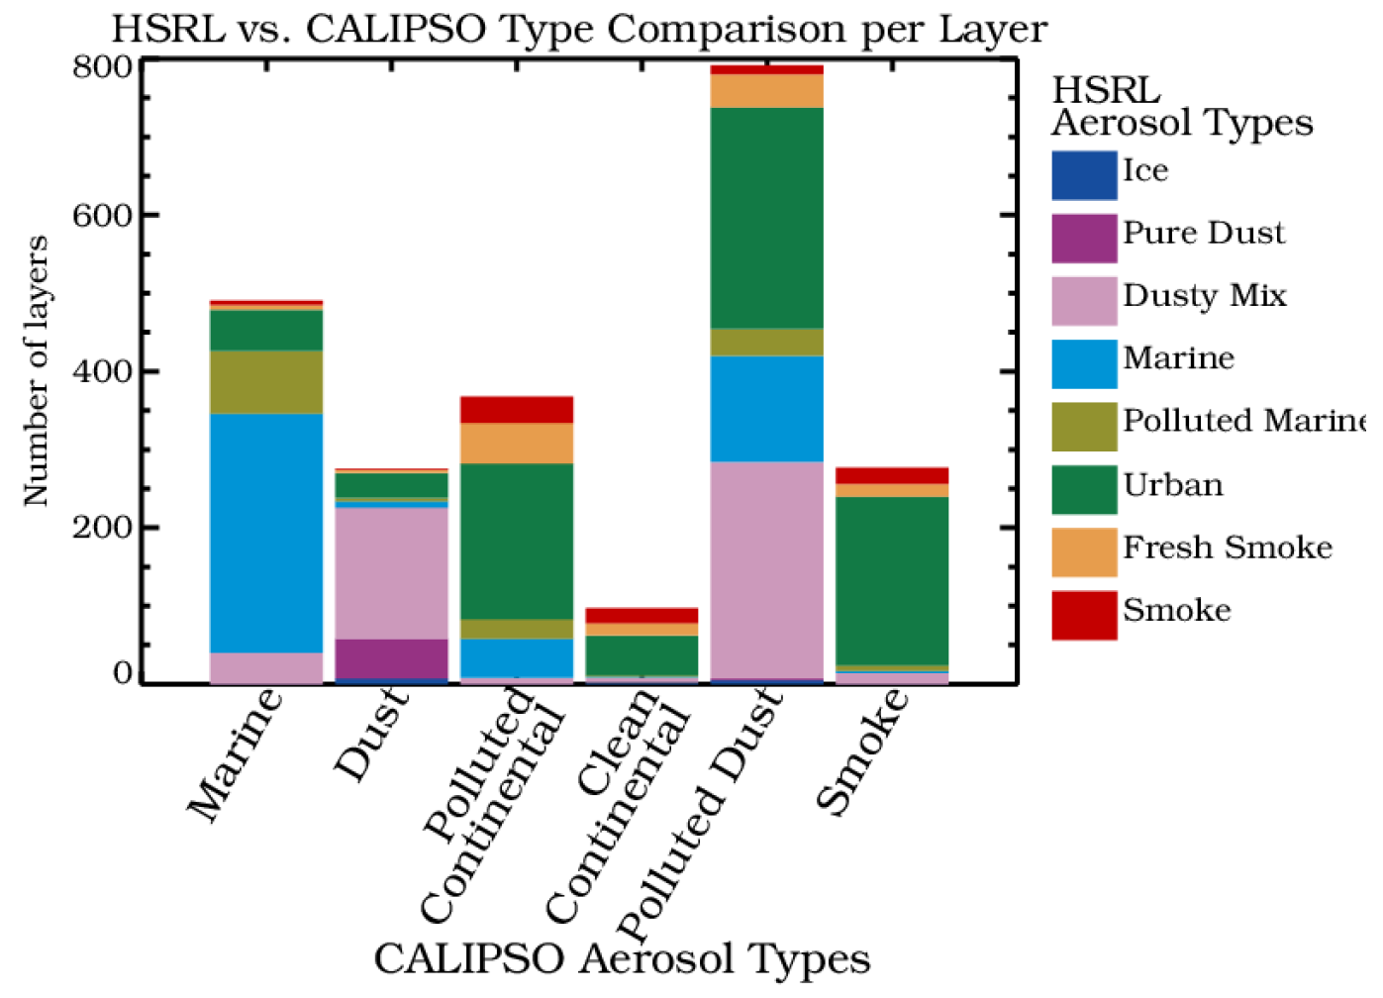
Comparison of aerosol typing: HSRL-1 vs. CALIOP

Slide 15
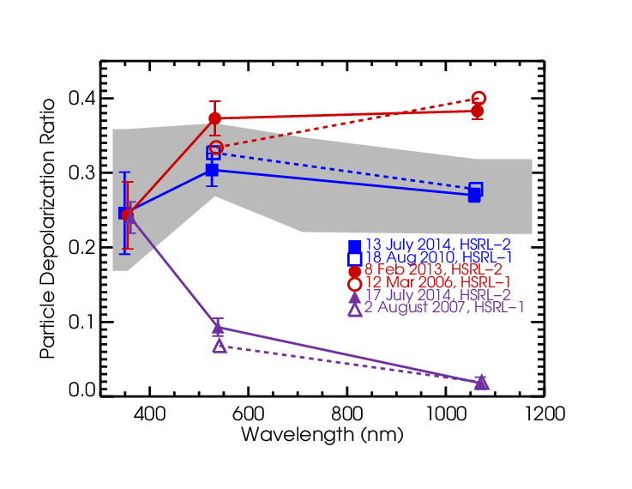
HSRL-2 has 3-λ depolarization
Spectral dependence of depolarization depends on particle size
Dust at source
Wavelength dependence of particle depolarization reveals information about particle size
North American dust at the source includes very large particles, monotonically increasing depolarization
Transported Saharan dust cases peak at mid-wavelength, largest particles were lost during transport
Non-spherical smoke particles (coated soot aggregates) have decreasing wavelength dependence, smaller particles
355 nm particulate depolarization alone (ATLID) not sufficient for separating dust and smoke
Transported dust
Smoke
3 case studies from HSRL-2 (3 wavelength)
+ 3 from HSRL-1 (2 wavelength)
Burton et al., ACP, 2015

Slide 16
Status
Potential options for validation flights
  Dedicated NASA-funded EarthCARE flights on NASA aircraft
  EarthCARE underflights conducted during NASA-funded science-focused field missions
  Potentially could fly on ESA-funded European aircraft
Analysis options
  Performed by HSRL team
  Performed by ESA teams using HSRL-2 data sets
  Both of the above
Validation efforts will depend on NASA funding
  Funding required for flights and analysis
  Funding is not yet secured
HSRL team willing to assist with airborne validation campaign planning and advocating EarthCARE underflights to NASA-funded field missions

