Slide 1
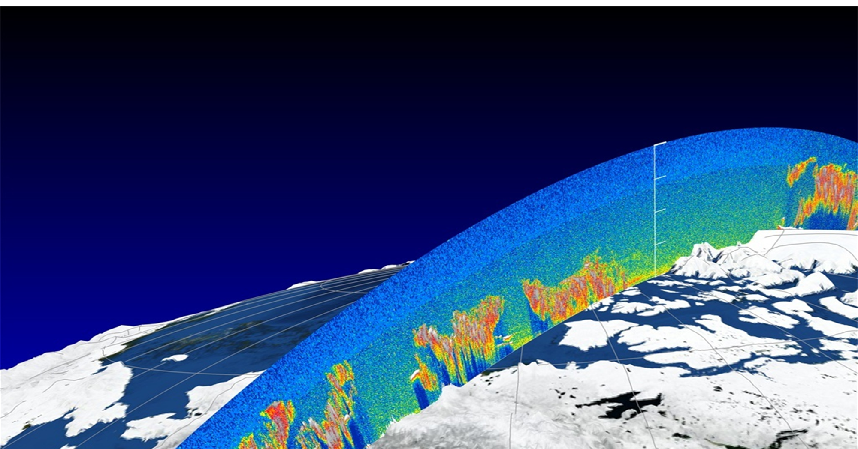
Innovative retrieval methods of aerosol and cirrus cloud optical depth above water clouds and ocean surface, and its application for EarthCare’s ATLID calibration/validation
Damien Josset, Yongxiang Hu, Jacques Pelon, Ali Omar and Weilin Hou
Supported by NASA R&A programs

Slide 2
molecular backscatter and HSRL
We can estimate molecular backscatter theoretically:
Molecular backscatter = F(molecular density) = F(P, T)
Application:
  Calibration of backscatter
  aerosol/cloud optical depth calculation

Slide 3
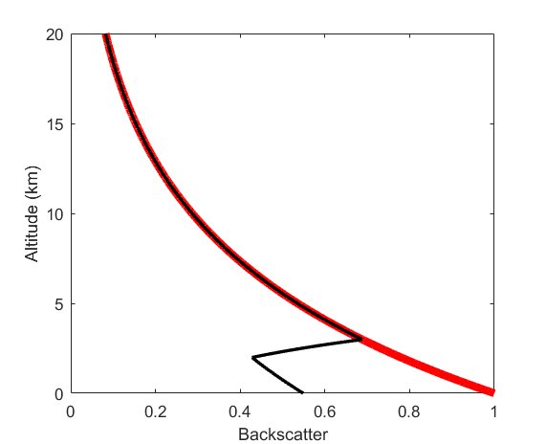
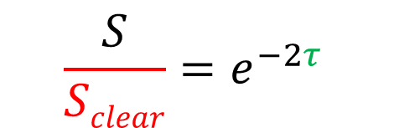
What’s new with ATLID comparing with CALIOP: molecular backscatter for estimating optical depth τ of aerosol and transparent cloud
$$\frac{S}{Sclear}=e^{−2τ}$$
aerosol
Sclear
S
Applications of lidar measurements of molecular backscatter: calibrations and optical depth estimates

Slide 4


Other well-understood objects similar to molecular backscater: (1) ocean surface, and (2) water clouds
We can accurately estimate lidar backscatter
from (1) ocean surface, and (2) water clouds
ocean surface backscatter = F(ocean surface wind speed, or surface signal from radar measurement)
water cloud backscatter = F(depolarization ratio)

Slide 5
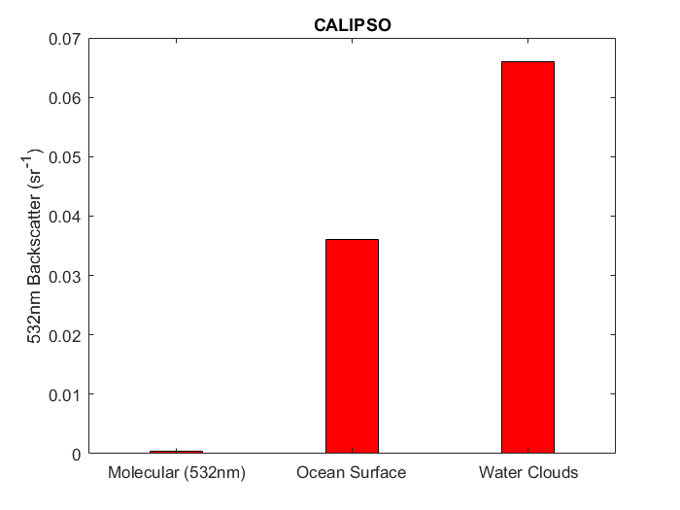
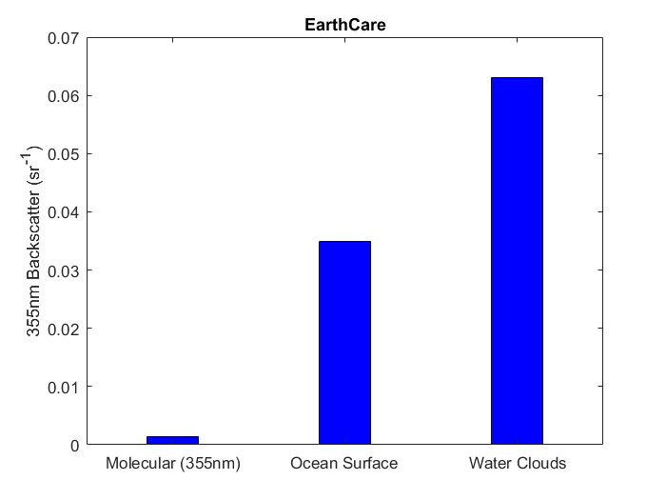
Advantage and disadvantage of ocean surface and water clouds over molecular backscatter: significantly stronger signal; column optical depth only

Slide 6

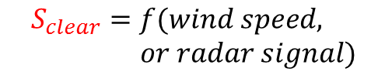
Using ocean surface for aerosol/cloud optical depth caluclation
$$\frac{S}{Sclear}=e^{−2τ}$$
$$S_{clear}=f(wind speed,$$
$or radar signal)$

Slide 7

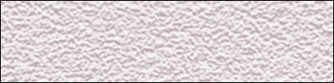
Sea surface wind speed from CALIPSO:
The signal: ocean surface lidar backscatter signal from specular reflection
The physics: higher wind → rougher surface → lower backscatter
  (nadir pointing laser; 2% sea surface reflection at 1064nm wavelength; higher probability of laser beam normal to sea surface at lower wind speed, thus more chance of specular return back to the lidar system)
Low Wind Speed
High Wind Speed

Slide 8
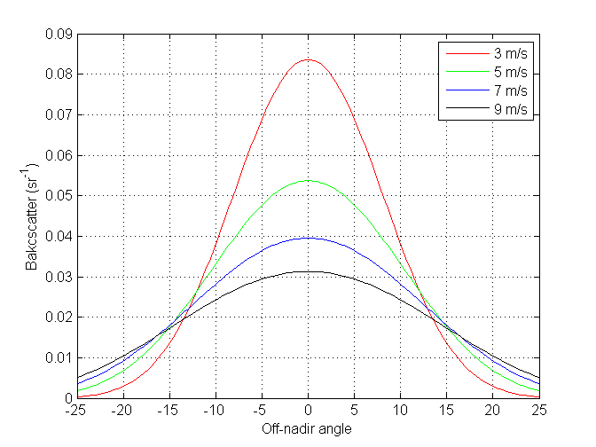
Mean square wave slope (and wind speed) is inversely proportional to CALIPSO lidar backscatter of ocean surface
Sea surface lidar backscatter (after a few corrections) = c / [<s²>]
Linear relation between wind speed and wave slope variance [<s²>] (Cox-Munk):
Lidar backscatter from ocean surface = c / [<s²>] = c / (a+b*wind)

Slide 9
Deriving wind speed and AOD from CALIPSO
Integrated atmospheric backscatter at 532nm
Integrated atmospheric backscatter at 1064nm
Perpendicular backscatter at 532nm
Ocean surface/subsurface backscatter at 532nm
Ocean surface/subsurface backscatter at 1064nm
Perpendicular backscatter at 532nm
Neural Network
Surface wind speed
Using one month of data to train the neural network
Deriving wind speed for the entire 12 year of CALIPSO observations using the neural network trained from one month data, results agree perfectly with AMSR-E and AMSR-2 wind speed
Aerosol optical depth:
    (1) -0.5 log[ CALIPSO measurement / f(wind) ];
    (2) -0.5 log[ CALIPSO measurement / CloudSat measurement ];

Slide 10
CALIPSO ocean surface wind speed vs AMSR-E

Slide 11
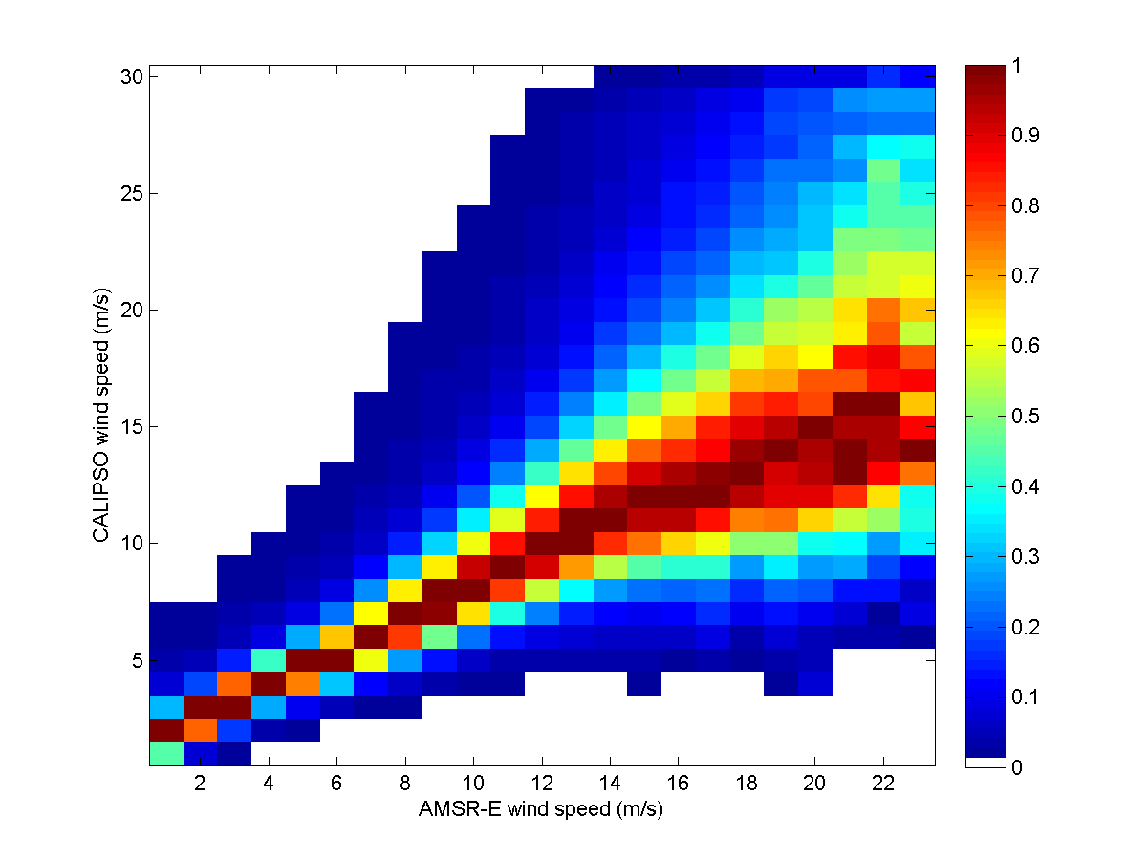
CALIPSO (wind speed measurement at 90 m footprint) captures wind gust and wind speed distributions within AMSR-E footprint

Slide 12
Using lidar and radar data for demonstration of aerosol/thin-cloud optical depth calculations from lidar backscatter by ocean surface and water clouds

Slide 13
Comparisons of AOD derived from ocean surface backscatter (Black)
with MODIS (R), PARASOL (G) and CALIPSO L2 (B)

Slide 14
Comparisons of AOD derived from ocean surface backscatter (x-axis)
with MODIS and PARASOL AOD (y-axis)

Slide 15
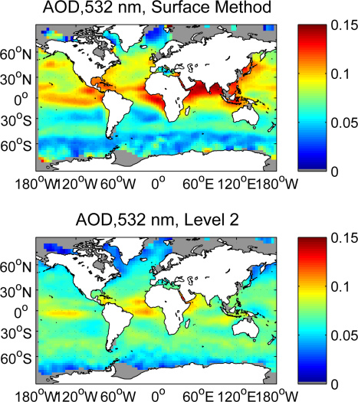
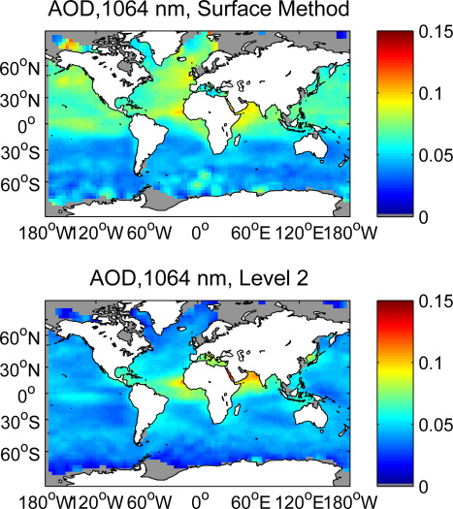
Comparisons of 532nm and 1064nm AOD derived from
ocean surface backscatter (upper panels) with CALIPSO L2 (lower panels)

Slide 16
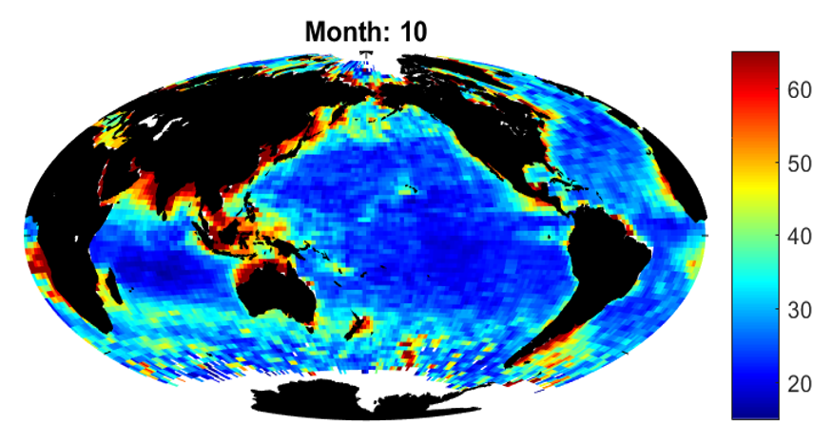
Marine Aerosol Lidar Ratio
Extinction cross section: ocean surface and atmospheric backscatter
Backscatter cross section: atmospheric backscatter – molecular backscatter
(Oct 2016)

Slide 17
Water cloud backscatter is well-understood too:
Water cloud backscatter: single scatter:
0.026 sr⁻¹ + O(r_{e})
Multiple scattering enhances water cloud backscatter:
0.026 / η(δ) (sr⁻¹) + O(r_{e})
Using water clouds for aerosol/cloud optical depth calculation

Slide 18
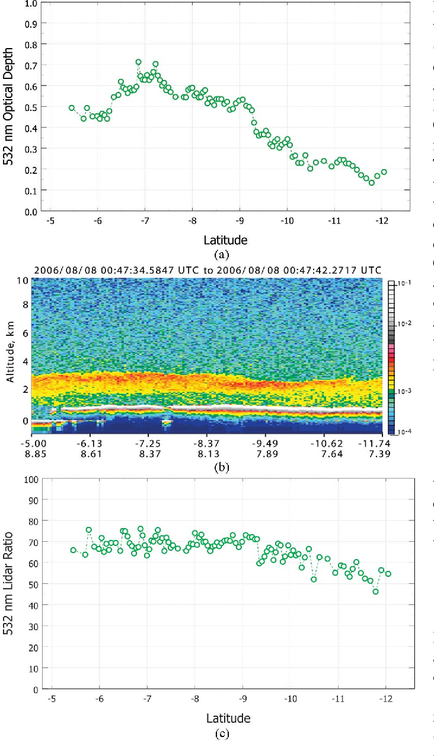
Deriving aerosol optical depth above water clouds from lidar measurements of the water clouds
Hu, Y. et al., 2007: Retrieving optical depths and lidar ratios for transparent layers above opaque water clouds from CALIPSO lidar measurements. IEEE Geoscience Remote Sensing Letters, 4, 523-526

Slide 19
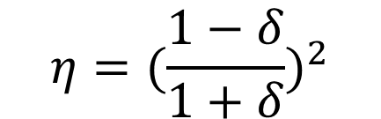
Multiple scattering factor η is a function of depolarization ratio
$$η=({\frac{1−δ}{1+δ})}^{2}$$

Slide 20
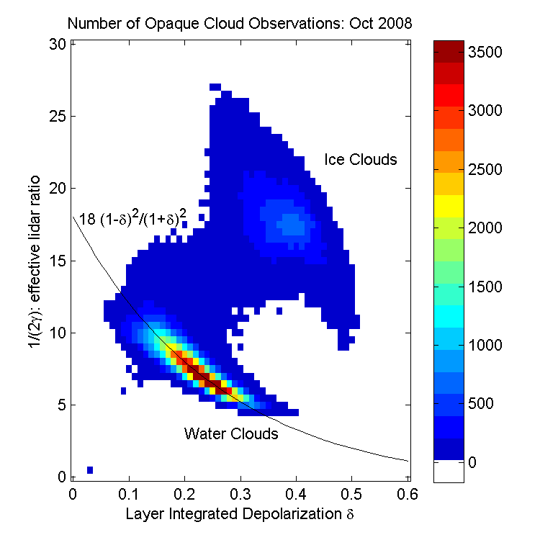
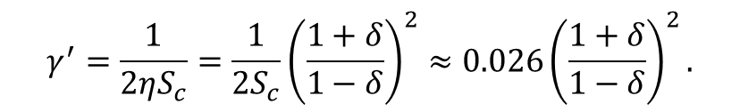
$$γ^{′}=\frac{1}{2ηS_{c}}=\frac{1}{2S_{c}}{\left(\frac{1+δ}{1−δ}\right)}^{2}≈0.026{\left(\frac{1+δ}{1−δ}\right)}^{2}.$$

Slide 21
Comparison of aeorol optical depth above water clouds: I. CALIPSO water cloud method (blue) vs HSRL molecular measurements (black), and CALIPSO L2 (Red) (Ferrari et al., 2018)

Slide 22
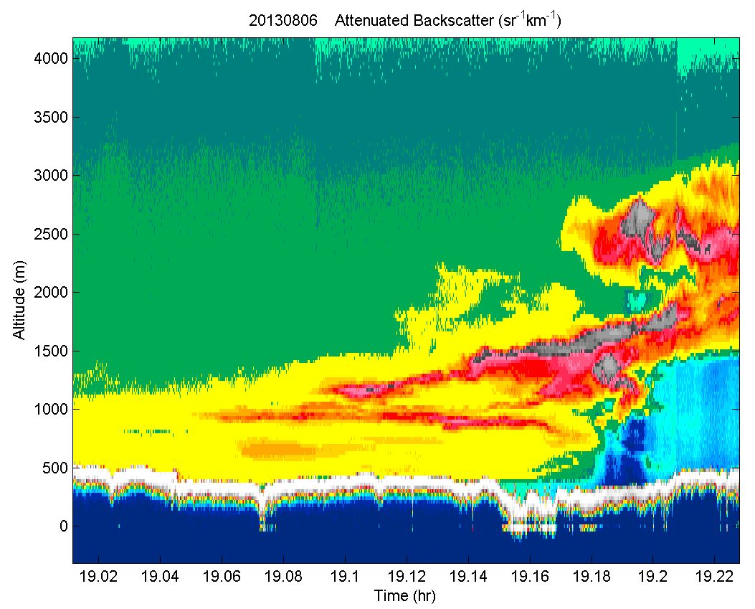
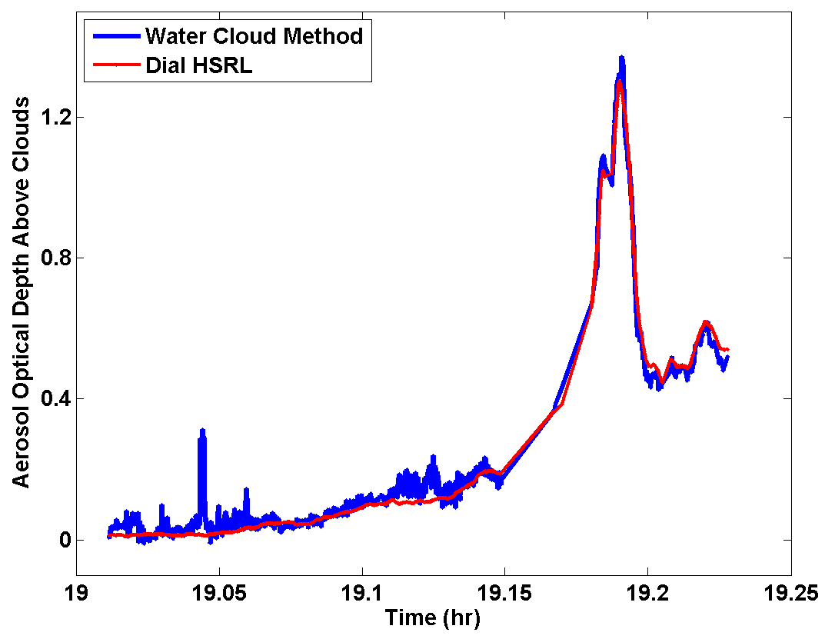
AOD above water clouds:
II. HSRL water cloud method vs HSRL molecular method

Slide 23
Advantage and disadvantage of ocean surface and water clouds over molecular backscatter: significantly stronger signal; column optical depth only

Slide 24
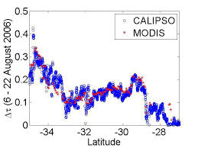
Recent development: using land surface backscatter for retrieving aerosol and cloud optical depths
Josset et al., 2018: On the Use of CALIPSO Land Surface Returns to Retrieve Aerosol and Cloud Optical Depths. IEEE Transactions on Geoscience and Remote Sensing, 56, p 3256 – 3264.

Slide 25
Take home message
Lidar backscatter from ocean surface and water clouds can be used for deriving optical depth of aerosols and clouds above them
These optical depth measurements can be used for validate ATLID L2 aerosol and cloud optical depth data product. It is also possible to use the ocean surface and water cloud measurements to validate ATLID’s L1 data product as well (not enough time to discuss here)
Lidar backscatter from ocean surface and water clouds is orders of magnitude stronger than molecular backscatter and thus are complimentary to the HSRL measurements by providing column optical depth

Slide 26
Summary
Targets for lidar calibrations and optical depth estimates: backscatter from molecules, water clouds and ocean surface
Backscatter signal from water clouds and ocean surface are orders of magnitude higher than molecular backscatter
The aerosol and cirrus cloud optical depth estimate method are demonstrated using CALIPSO measurements of backscatter from water clouds and ocean surface below the aerosol/cirrus clouds, and verified by aircraft based HSRL measurements
Similar to CALIPSO, EarthCare can also use the water cloud and ocean surface backscatter method for validations of ATLID molecular method for aerosol/cirrus cloud optical depth retrievals

