Slide 1






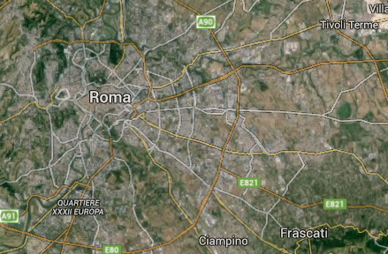

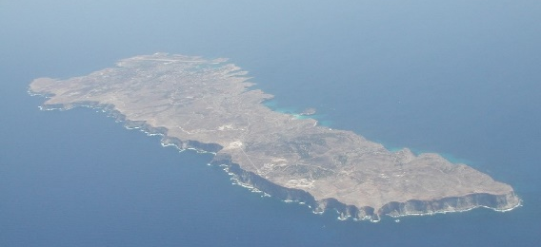
An Italian coordinated contribution to the Validation of EarthCARE products from three atmospheric observatories in the Central Mediterranean Sea.
L.Baldini¹, F.Barnaba¹, C.Bommarito^{2b}, M.Cacciani³, M.Campanelli¹, S.Casadio⁴, T.Di Iorio^{2a}, L.Di Liberto¹, A.di Sarra^{2a}, D.Dionisi¹, G.P.Gobbi¹, A.M.Iannarelli⁴, G.L.Liberti¹, D.Meloni^{2a}, F. Monteleone^{2b}, M.Montopoli¹, G.Pace^{2a}, D.Sferlazzo^{2c}
⁽¹⁾ Institute for Atmospheric Physics and Climate (ISAC), CNR, Roma, Italy.
⁽²⁾ Laboratory for Observations and Analyses of Earth and Climate, ENEA, Roma^{(a)}, Palermo^{(b)}, Lampedusa^{(c)}, Italy.
⁽³⁾ Physics Department, “Sapienza” University of Rome, Roma, Italy
⁽⁴⁾ Serco, SpA.
CONTACT: g.liberti@isac.cnr.it
78
BAQUNIN
BACKGROUND
Scientific interest
Availability of time series of relevant observations (>10 yrs)
Complementary competences
Well established collaborations
CIRAS
Lampedusa

Slide 2
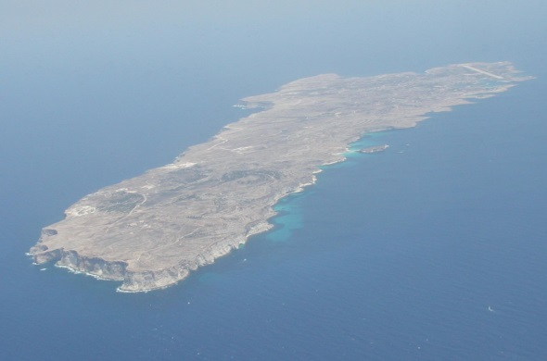
Lampedusa
Meteorological and radiosounging station (temperature, pressure, humidity, wind, Vaisala Digicora III)
Aerosol Raman lidar (together with University of Rome; aerosol backscattering and depolarization profiles)
CGR4 pyrgeometer and CMP21 pyranometer (downward longwave and shortwave irradiance, Kipp & Zonen)
VIS Multi Filter Rotating Shadowband Radiometer (VIS-MFRSR; AOD, column water vapor, aerosol SSA)
CE-318 sun-photometer (AOD, diffuse-to-direct ratio, size distribution, aerosol SSA, Cimel, AERONET)
UV Multi Filter Rotating Shadowband Radiometer (UV-MFRSR; AOD, diffuse-to-direct ratio)
SP02 (SP02-L) sun-photometer (wide (narrow ) FOV, AOD , water vapour, Middleton)
Brewer MK III spectrophotometer (total ozone, spectral UV irradiance, AOD)
CHP1 pyrheliometer direct normal irradiance (Kipp & Zonen)
Total sky imager cloud cover
HATPRO MWR , temperature profiles, LWP, IWV (RPG)
> 150 ISI papers using Lampedusa observations -> www.lampedusa.enea.it
Lampedusa
35.5°N, 12.6°E

Slide 3
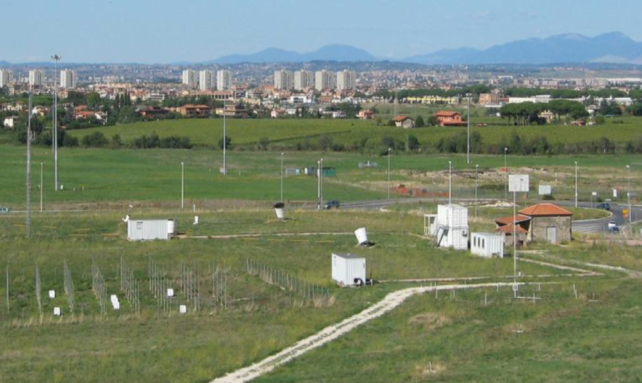
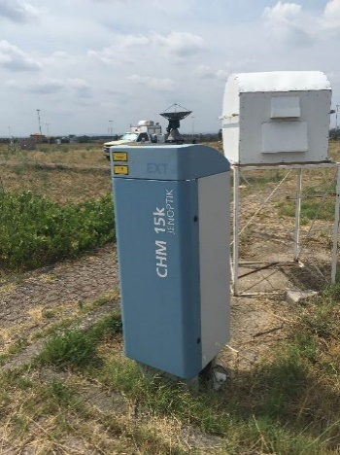
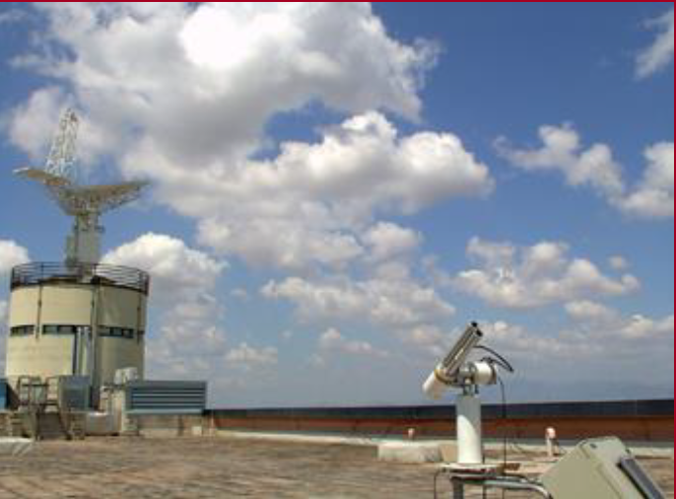
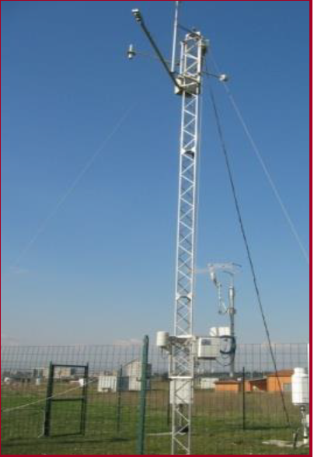
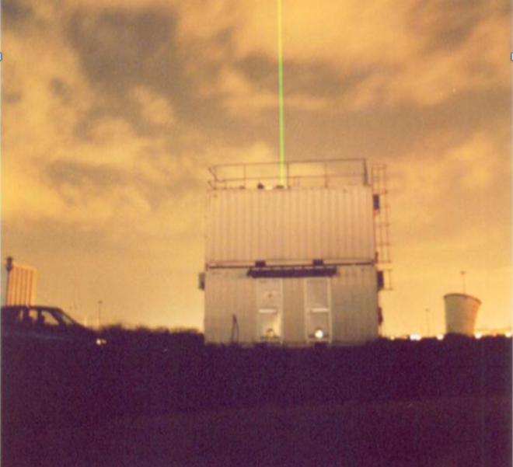
Rome Tor Vergata: CIRAS
CIMEL photometer (aerosols)
PANDORA Spectrometer (O3, NO₂)
RAMAN-MIE-RAYLEIGH LIDAR, (aerosols, H₂0, clouds)
ELASTIC LIDAR/CEILOMETER (aerosols)
RADARS (precipitation & cloud)
LASER DISDROMETERS (precipitation)
SODAR (wind profiles in PBL)
METEO STATION (T, P, RH, wind)

Slide 4
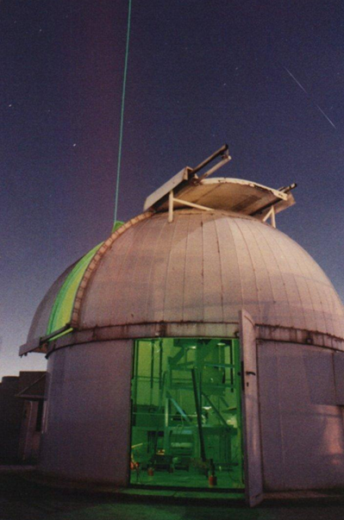
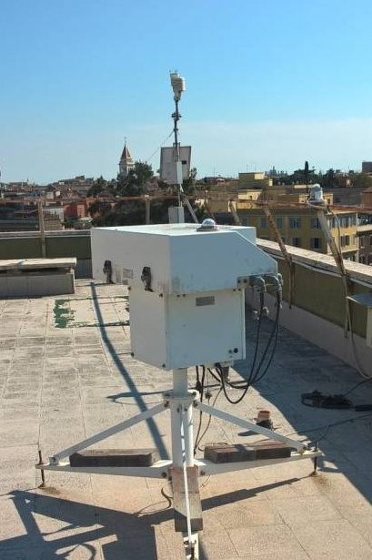
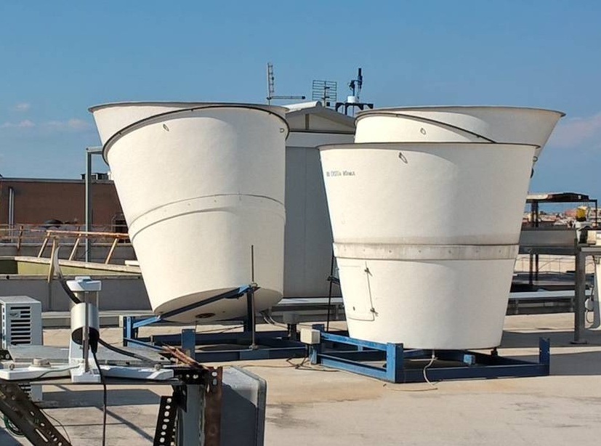
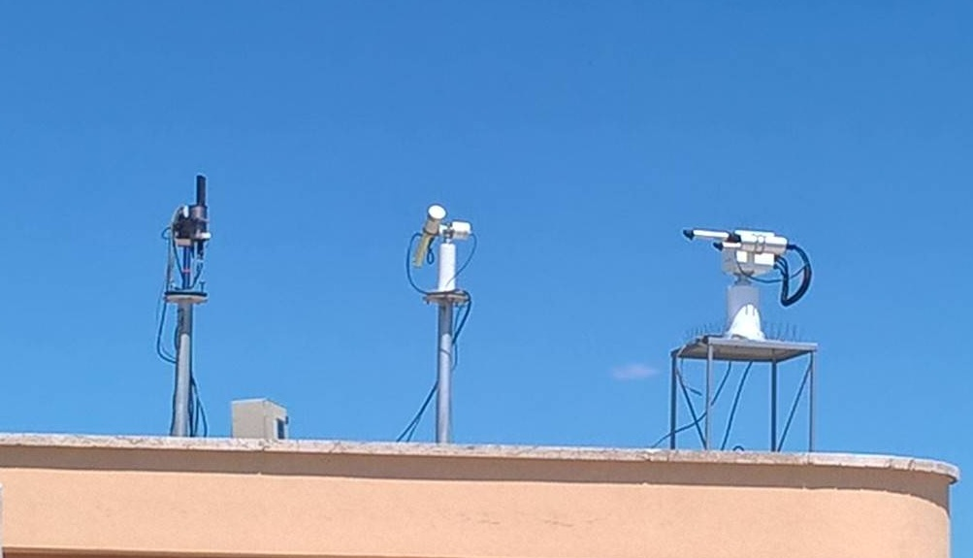
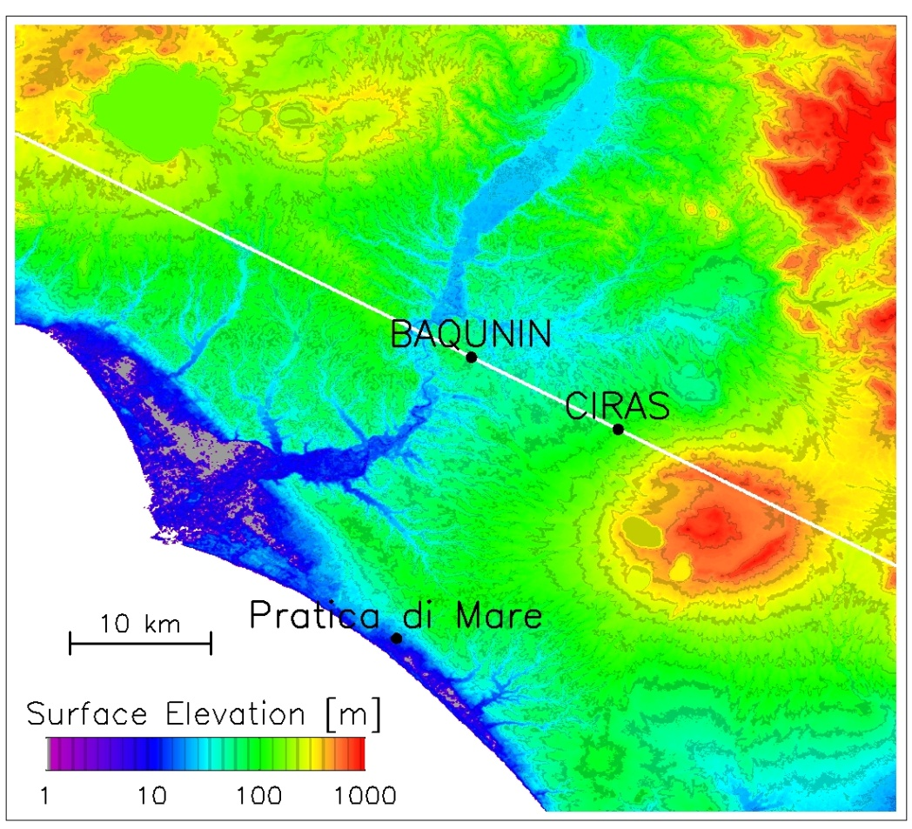
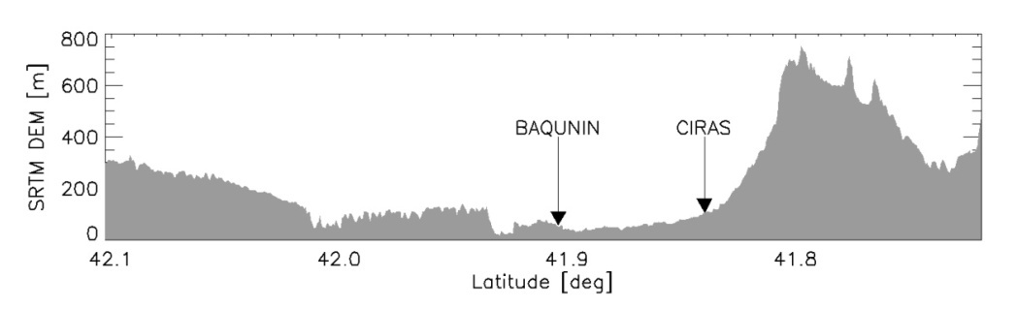
Rome ‘La Sapienza’: BAQUNIN
Rome
Pandora 2S Spectrometer #115
Pandora 2S Spectrometer #117
Cimel Photomer
Prede Pom 01 Sun-sky radiometer
MFRSR Radiometer
Pyranometer Radiometer
Sky Cam Day night vis pictures
Brewer Spectrophotometer
Yes Broad-band UV Radiometer
Meteorological Sensors
All Sky Camera
LIDAR Raman and elastic
SODAR triaxial Doppler

Slide 5
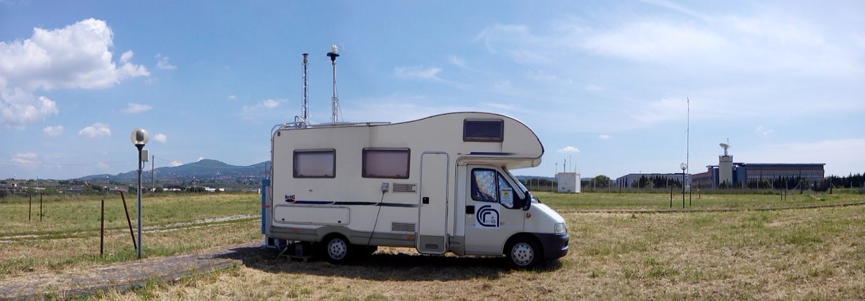
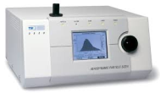
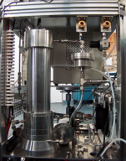

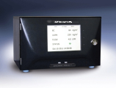
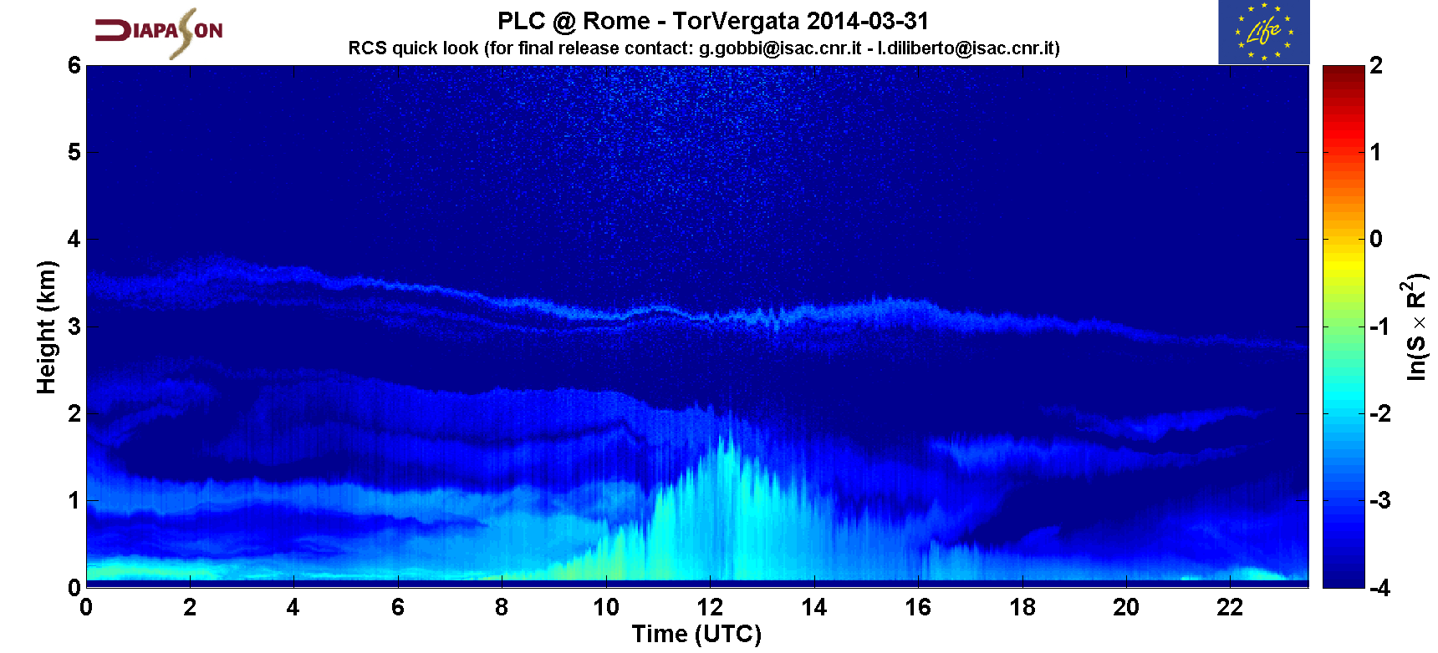
Site description 4: AEROLAB
Instrument | Measured Variable | Time Res
APS | Aerosol number size Distribution (aerodynamic diameter 500-20000 nm) | 5 min
SMPS | Aerosol number size Distribution (dm 10-800 nm) | 5 min
Nephelometer | Aerosol Scattering Coefficient @ 3 wavelengths | 1 min
Aethalometer | Aerosol Absorption Coefficient @ 7 wavelengths | 1 min
OPC | Aerosol (optical) size Distribution 250-20000 nm + derived PM10, PM2.5, PM1 | 1 min
CHM15K Lidar-Ceilometer | Range-resolved Aerosol Backscatter, MLH, Clouds, Fog | 5 min
Meteo & Radiation | Meteo Station + Pyranometer | 1 min

Slide 6
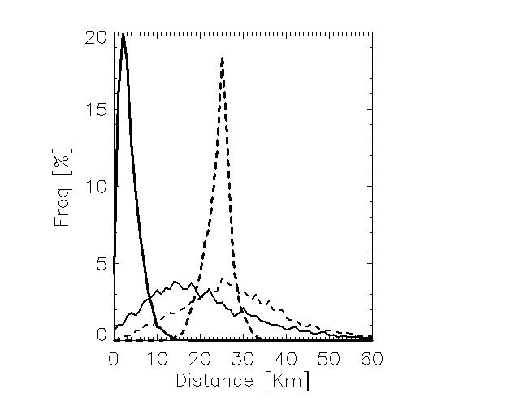
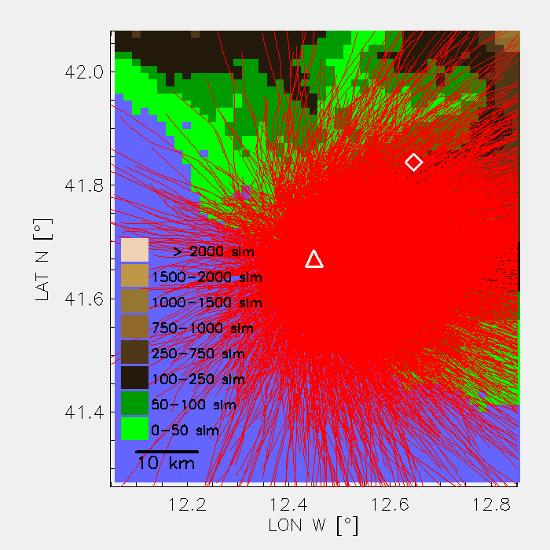
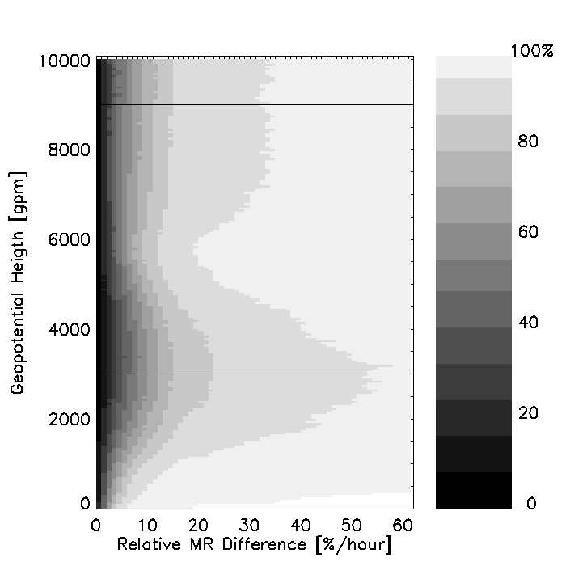
ROME ANCILLARY MEASUREMENTS 1: WMO RADIOSOUNDING
RDS (>7500) traj 3÷9 km
PRF 1
Rome
RMR
WMO#16245
Temporal variability
Histogram of distribution of the distance between WMO/RMR site (continuous/dashed lines) and the position at the surface when the radiosonde reaches the 3 (thick) and 9 (thin) km levels.(Dionisi et al. 2010)
Since 1995
00,(06),12,(18) UTC
Current: RS41-SG 1’’ sampling

Slide 7

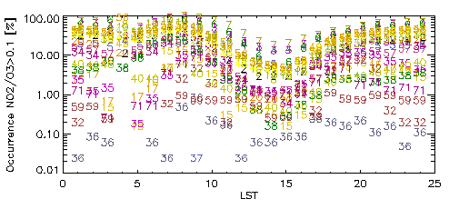
ANCILLARY MEASUREMENTS 2: ARPA-LAZIO AIR QUALITY NETWORK
PRF 1
PRF 2
PRF 3
www.arpalazio.net/main/aria/sci/basedati/chimici/chimici.php

Slide 8
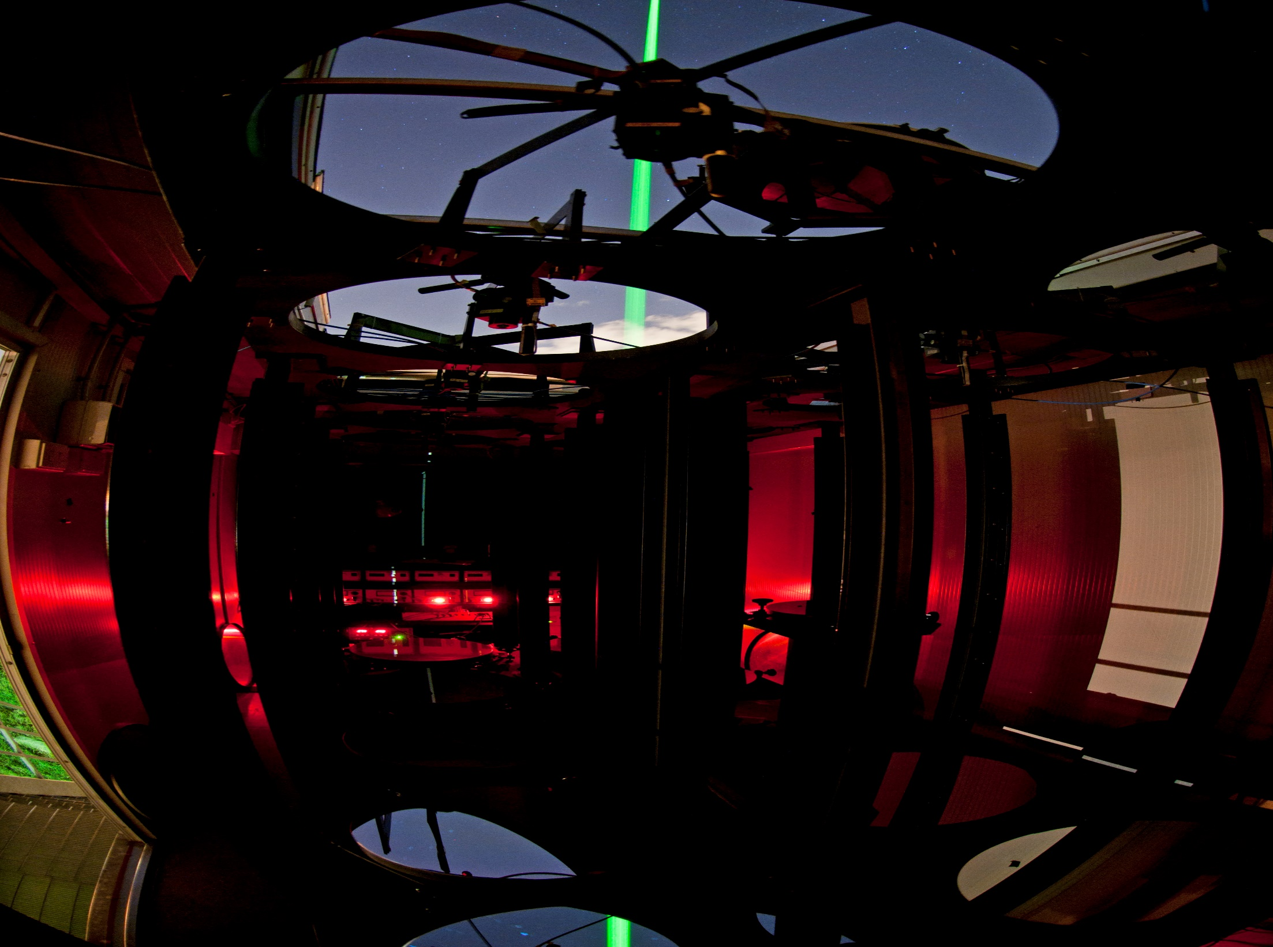
CIRAS RMR LIDAR
TRANSMITTER
Laser Nd:YAG Continuum Powerlite 8010
2 beams: 532 nm, 355 nm
Energy: 200 mJ, 400 mJ
Pulse repetition rate: 10 Hz
Pulse duration: 7 ns
Beam diameter: 45 mm
Beam divergence: 0.1 mrad
PRODUCTS
Water vapour mixing ratio profile
Cirrus Cloud base detection & optical thickness
Temperature (Raman + Rayleigh) 15-75 km
Aerosols properties (backscatter @ 532 & 355 nm, extinction @ 387 nm)
RECEIVER (11 Newtonian Telescopes)
 | T1* | T2 | T3
Ø [mm] | 9x500 Array | 300 Single | 150 Single
F-number | F3 | F3 | F3
FOV [mrad] | 0.6 | 0.9 | 1.8
SAMPLING
Range: ~100 m÷75 km
Δt: Standard 1’ (600 profiles)
Δz: Standard 75 m - 7.5 m
DATA ACQUISITION (channels#)
 | 355 | 387 | 407 | 532
T3 |  |  |  | 1
T2 | 8 | 5 | 4 | 2
T1* |  | 7 | 6 | 3
PCM: 200 MHz Bandwidth 500 ns max. resolution ADC: 12 bit, 20 Msample/s
PROJECTS/NETWORKS:
NDACC (2008, EARLINET
ESA-S5p CAL/VAL Activities
lidar.ifa.rm.cnr.it/
ndacc-lidar.org/index.php?id=105/Rome-Tor+Vergata.htm

Slide 9
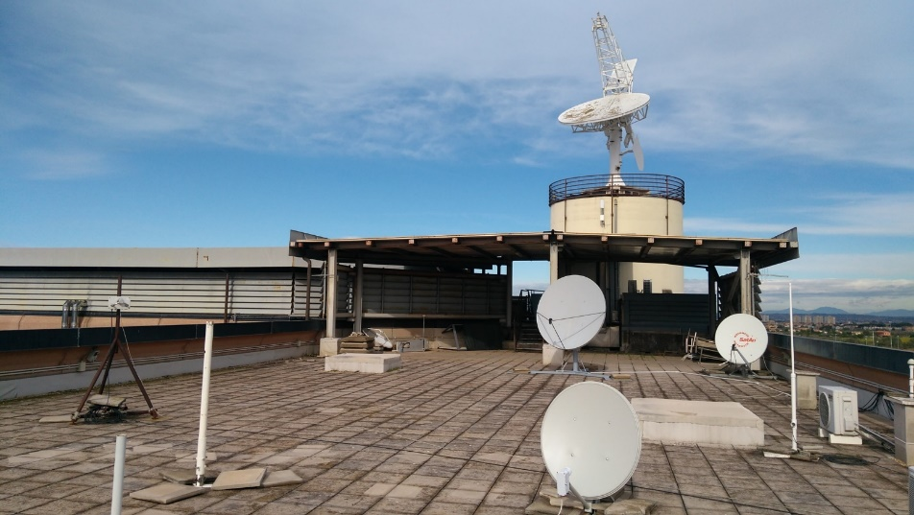
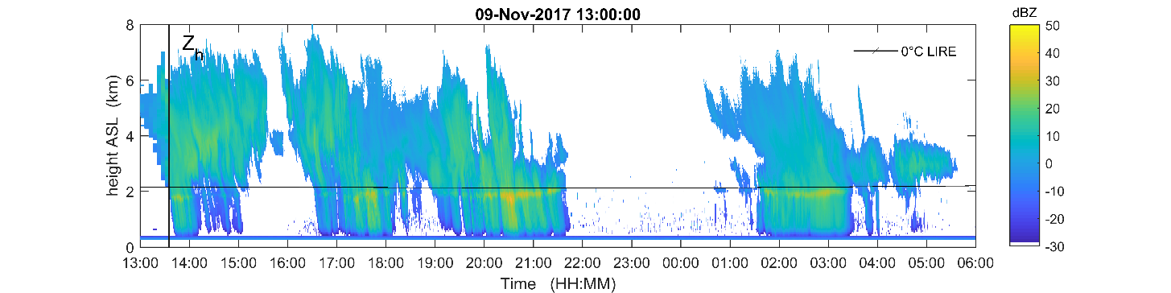
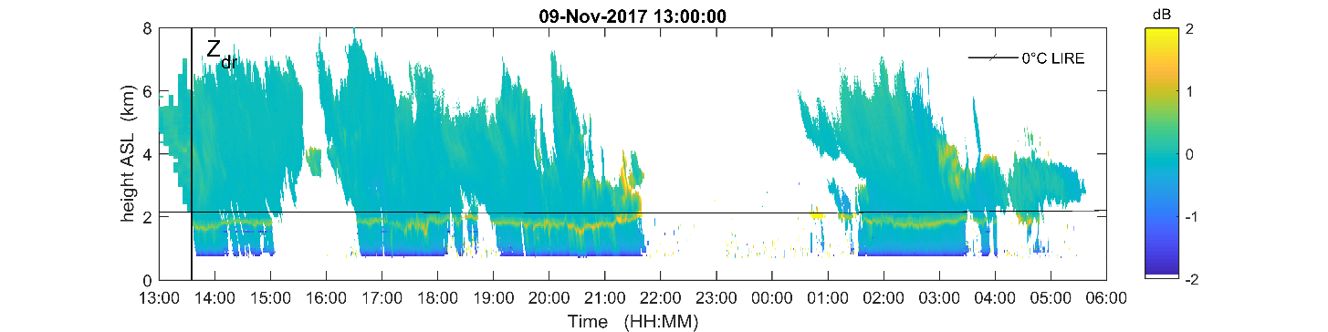
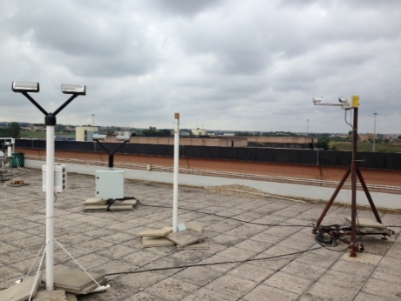
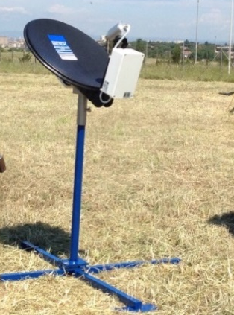
CIRAS: C-Band Dual Pol
Doppler radar
(POLAR 55C)
Antenna
Type | Offset fed Paraboloid
Feed | Corrugated horn
Aperture diameter | 4.57 m
Polarization | Horizontal and Vertical
Azimuth beamwidth | 0.92 deg
Elevation beamwidth | 1.02 deg
Gain | 45.5 dB
Sidelobe level | -32 dB
Cross Polarization | -27 dB
Transmitter
Power Amplifier | Klystron VCK 7762
Frequency | Fixed, selectable in the band 5600-5650 MHz
Peak Power | 500 kW
Pulse width (maximum) | 0.5 – 1.5 - 3.0 μs
PRF | 1200 – 600 – 300 Hz
Average Power | 300 – 450 – 450 W
Available polarizations | H and V (alternate)
Receiver
Number of channels | 2: (RX and TX sample down conversion to IF)
Noise figure | 2.0 dB from input of the first down conversion module.
Image Rejection | > 50dB
Dynamic range | > 100dB at 1dB compression
IF | 60 MHz
IF bandwidth | 2.0 – 0.7 – 0.5 MHz
Used as profiler (∼45° elevation) or for volume scanning for precipitation estimation, melting layer detection and hydrometeor classification
OTT Parsivel
Thies clima
Additional
precipitation measuring instruments
Micro Rain Radar
polar55c.artov.isac.cnr.it
OTT Parsivel 2

Slide 10
Cal/Val methodology
Optimization of Match-up criteria (variable/level/scenario dependent)
Statistical comparison
Improved estimation of total uncertainty budget contributions for the ground based observations.
Synergetic processing of observations from different instruments
Optimization of comparison statistics and validation tests
Estimation of the effective impact of urban environment
Seasonal Maps of correlation coefficient between AMSRE derived TPWV at Lampedusa and in the surrounding area (Liberti et al., 2010).
Vertical profile for the lower (left) and upper (right) channel of the integration time for which the moda of the distribution of autocorrelations computed for each single session reaches a maximum value. Symbols refer to different SNR thresholds (◊:0,Δ:5,□:10), colours to different vertical windowing (75,150, 225,375,750,1500,2250 m). The line is the average over all values.(Dionisi et al. 2012)
Notes:
There are several activities that we plan to do for EartCARE validation.
Firstly we plan to define variable/level and scenario dependent spatio-temporal match-up criteria to maximize the number of match-ups.
This will be obtained by investigating the spatial variability with satellite data and the temporal variability with the available time series of observations
This process will also produce an estimate of the contribution to the total uncertainty budget

Slide 11
Scientific issues
Impact of the urban environment and of its spatial inhomogeneity in terms of both surface and atmospheric properties.
Adequacy of adopted aerosols models with emphasis on contribution of desert dust and biomass burning aerosols (Barnaba & Gobbi 2004);
Importance of the relative impact of different aerosol types at the different levels within the atmosphere by synergism between co-located in situ (surface), vertical-resolved and total column measurements
Dionisi et al. 2018

Slide 12
Instrument | Site |  |  | EarthCARE L2 Product
D=DIRECT A=ANCILLARY P=PARAMETRIC | RMC | RMB | LMP | A-FM | M-CM | C-FMR | A-AER | A-EBD | A-ALD | M-AOT | AM-ACD | A-TC | C-TC | AC-TC | A-ICE | A-CTH | AM-CTH | M-COP | C-CD | C-CLD | ACM-CAP
Raman-Mie-Rayleigh Lidar | x | x | x | D |  |  | D | D | D |  |  | D | D | D | d | D | D |  |  |  | D
CHM15k lidar ceilometer | x |  |  | A |  |  | A | A | D |  |  | D | D | D | a | D | D |  |  |  | A
Weather Radar C-band Doppler Dual-Pol | x |  |  |  |  | d |  |  |  |  |  | D | D | D |  |  |  |  | D | D | D
Metek Micro Rain Radar-2 profiler | X |  |  |  |  | d |  |  |  |  |  | D | D | D |  |  |  |  | A | D | D
Laser disdrometers | x |  |  |  |  |  |  |  |  |  |  |  | A | A |  |  |  |  |  | P | P
Pandora | x | x |  |  |  |  | A | A | A | A | A |  |  |  |  |  |  |  |  |  | A
Brewer MKII spectrophotometer |  |  | x |  |  |  | A | A | A | A | A |  |  |  |  |  |  |  |  |  | A
SKYNET - PREDE-POM 01 |  | x |  |  |  |  | A | A | A | D | D | D |  | D |  |  |  |  |  |  | A
AERONET - CIMEL-318 | x | x | x |  |  |  | A | A | A | D | D | D |  | D |  |  |  |  |  |  | A
MFRSR-VIS |  | x | x |  |  |  | A | A | A | D | D | D |  |  |  |  |  | D |  |  | D
MWR HATPRO RPG |  |  | x |  |  |  |  |  |  |  |  | D |  |  |  |  |  | D |  | D | D
Scanning mobility particle sampler (Tropos) | x |  |  |  |  |  | P | P | P | P | P |  |  |  |  |  |  |  |  |  | P
Aerodynamic Particle Sizer (TSI) | x |  |  |  |  |  | P | P | P | P | P |  |  |  |  |  |  |  |  |  | P
Nephelometer (Ecotech) | x |  |  |  |  |  | P | P | P | P | P |  |  |  |  |  |  |  |  |  | P
Aethalometer (Magee) | x |  |  |  |  |  | P | P | P | P | P |  |  |  |  |  |  |  |  |  | P
Optical Particle Counter (Grimm) | x |  |  |  |  |  | P | P | P | P | P |  |  |  |  |  |  |  |  |  | P
All Sky Camera |  | x | x | A | A | A |  | P |  |  |  | A | A |  |  |  |  |  |  |  | A
Meteo Station | x |  | x |  |  |  | A | A | A | A | A |  |  |  |  |  |  |  |  |  | A
Notes:
EarthCARE data products that will be validated
Independent instruments and data products that you will intercompare with EarthCARE (location, accuracy, vertical sampling, etc.)

Slide 13
Status of the project & pre-launch preparatory activities
Practically in standby (no Є, launch 2021)…..but:
Search for fundings: Please, the letter ASAP!
Format and data processing: S5P Validation
Algorithms & Tools: GRASP, EartCARE Simulator (students)
Instruments upgrade (e.g. RMR-CIRAS lidar -> 532nm pol (end 2018) 1064nm (end of 2019))
Validation strategies: 3MI-SAG, S3VT, C3S (Copernicus Climate Change Services)
Site spatio/temporal variability characterization: OC vicarious calibration infrastructure proposal submitted to EUMETSAT (4/6/2018)

Slide 14
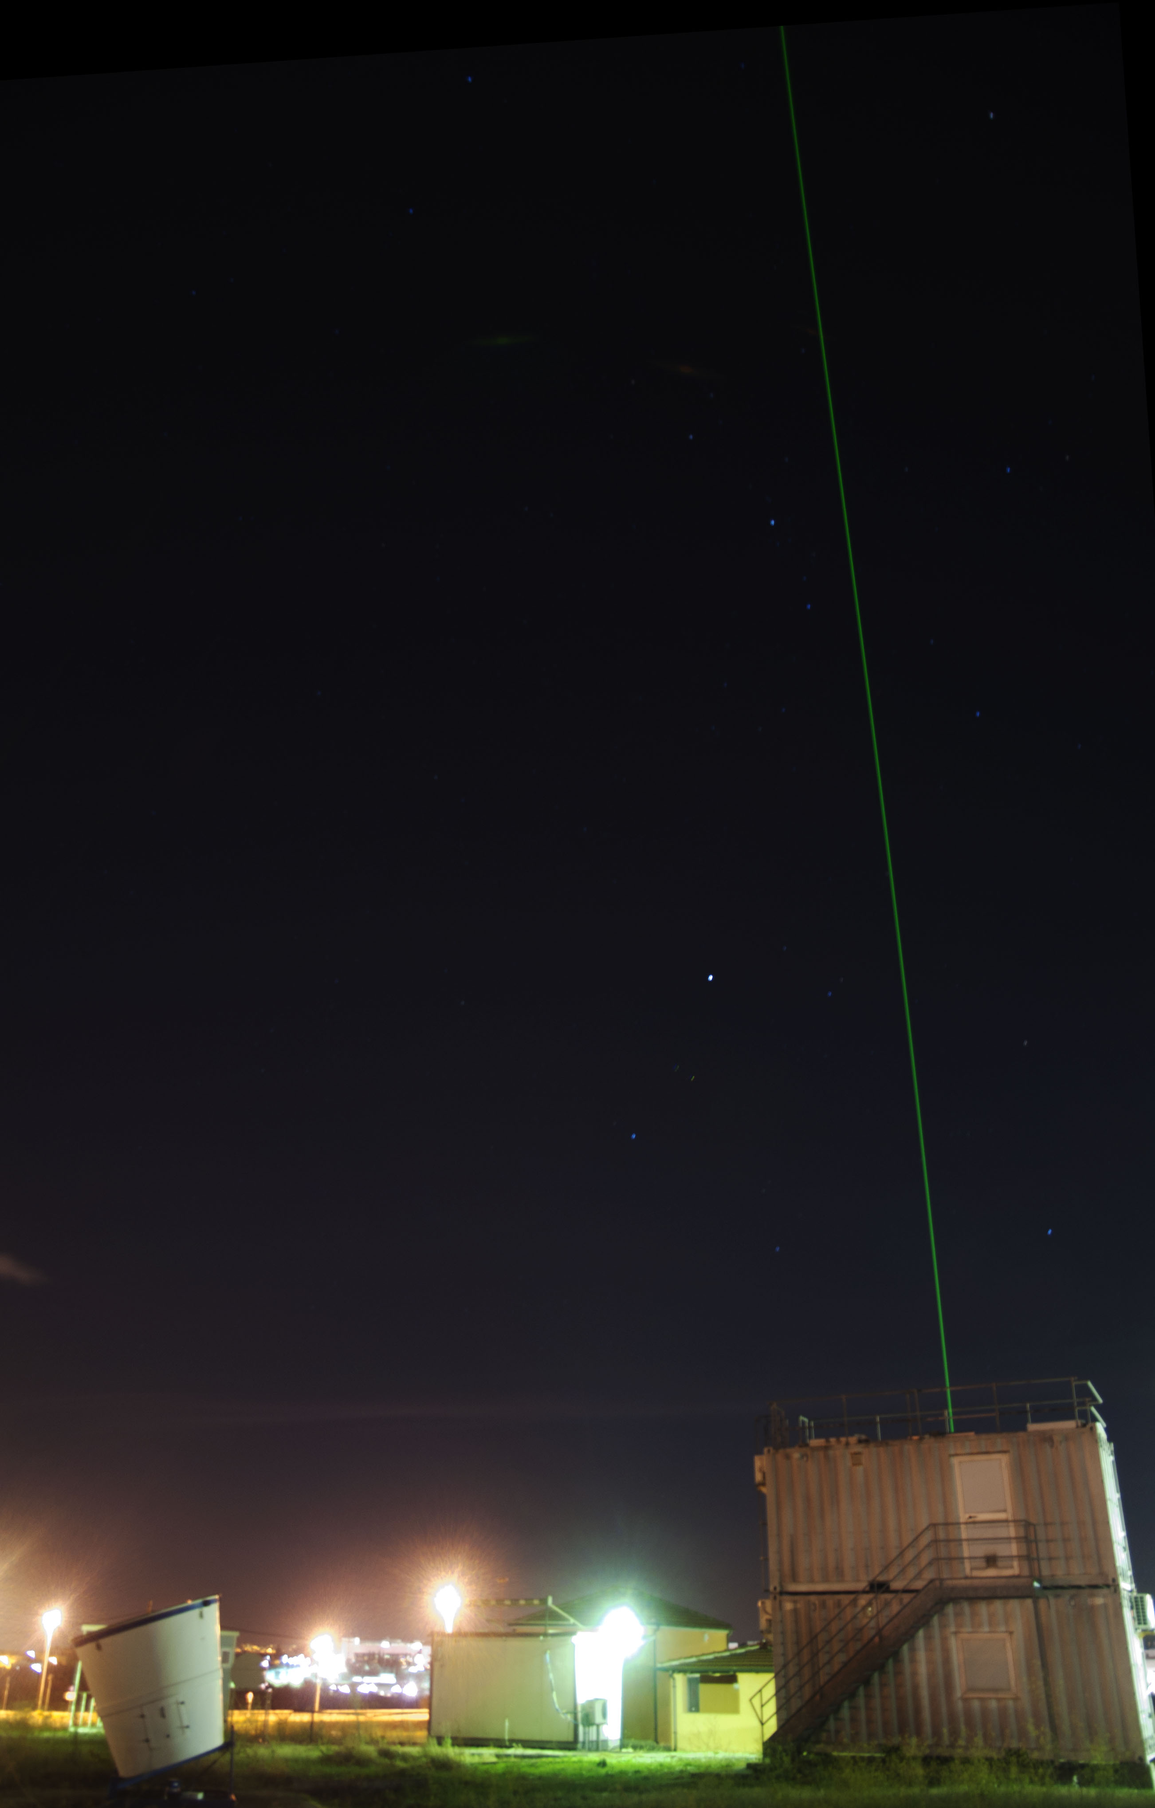
GRAZIE (THank YOU)!
g.liberti@isac.cnr.it
78
CIRAS: www.isac.cnr.it/en/infrastructures/ciras-cnr-isac-rome-atmospheric-supersite
http://oplam.artov.isac.cnr.it/oplam/open-database
http://lidar.ifa.rm.cnr.it/
LAMPEDUSA: www.lampedusa.enea.it
CEILOMETERS NETWORK: www.Alice-net.eu , https://ceilometer.e-profile.eu/
NDACC: http://ndacc-lidar.org/index.php?id=105/Rome-Tor+Vergata.htm
PANDONIA: http://pandonia.net/
AERONET: https://aeronet.gsfc.nasa.gov/new_web/index.html
EUROSKYRAD: http://www.euroskyrad.net/
EUBREWNET: http://www.eubrewnet.org/cost1207/

