Slide 1



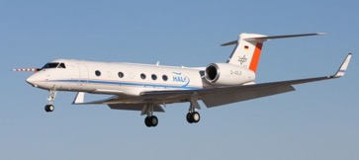
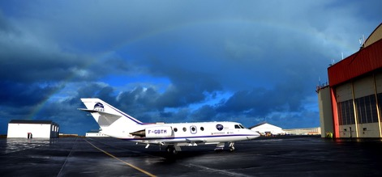
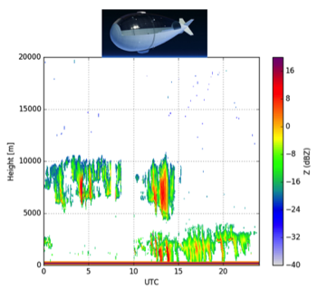



MORECALVAL
MObile Radar-Lidar-Radiometer EarthCare CAL/VAL project
PIs Julien Delanoë* Silke Gross% [ *LATMOS, %DLR]
Teams DLR/LATMOS/LSCE/SAFIRE
ID: 38810
EarthCare Workshop - 11-15 June 2018 Bonn

Slide 2
Contribution to EarthCare Mission
Target: cloud, aerosol and precipitation measurements
Calibration and validation by:
Assessing EarthCare measurements performances
Calibrating EarthCare measurements (radar Doppler velocity and reflectivity, lidar Mie and particular, depolarisation measurements)
Validating EarthCare products (L1)
Validating EarthCare synergistic products and algorithms (L2)
Targeted products:
ATLID Level 1
CPR Level 1
ATLID Level 2a (FM, AER, ICE, TC, EBD, CTH, ALD)
CPR Level 2a (FMR, CD, TC, CLD)
CPR Level 2a JAXA (ECO, CLP)
Level 2b (TC)
Level 2b (CAP, COM, 3D, RT)
EarthCare Workshop - 11-15 June 2018 Bonn

Slide 3
Objectives achieved through the following activities
Making the most of our instruments capabilities (HSRL at different wavelengths, Doppler radars with high sensitivity), with higher horizontal and vertical resolutions.
Performing independent measurements from mobile platforms with similar or extended payloads compared to EarthCare.
Comparing the measurements with direct underpasses
Comparing and interpreting the measurements by performing simulation of our "in situ" and EarthCARE HSR lidar and Doppler radar observables
Running our own retrievals combining more instruments than EarthCare or with different wavelengths.
Comparing our products to EarthCare products
EarthCare Workshop - 11-15 June 2018 Bonn

Slide 4
Instrumental set-up
French/German tandem airborne platforms with radar-lidar-radiometer and in-situ measurements. This is unique in Europe and includes very experienced teams.
Truck/Ultra Light Aircraft with radar and lidar measurements (P. Chazette) / w-band radar network
Low altitude geostationary Doppler radar (Stratobus)
EarthCare Workshop - 11-15 June 2018 Bonn

Slide 5
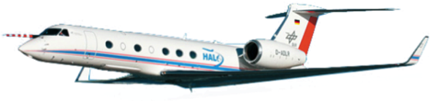
European airborne platforms (synergy)
HALO
F20 SAFIRE
Aircraft: High Altitude and LOng range
Modified Gulfstream G550 business jet
Endurance: > 10 flight hours
Maximum cruising altitude: > 15 km
Payload:
WALES High spectral resolution lidar (532 nm) and water vapor DIAL
MIRA Doppler cloud Radar (35 GHz)
Hyper-spectral radiometer (specMACS)
Microwave package
Dropsonde launching (profiles of T, p, hum, u, v)
Aircraft:
Dassault Falcon 20
Endurance: 3.5 flight hours
Maximum cruising altitude: 13 km
Payload:
LNG High spectral resolution lidar (355 nm), 532 and 1064 nm
RASTA Doppler cloud Radar (95 GHz) – up to 6 antennas
IR radiometer CLIMAT (brightness temperature 8-10-12 micron)
L/S fluxes
Dropsonde launching (profiles of T, p, hum, u, v)
P50: S. Groβ German Initiative for Validation of EarthCARE: EarthCARE-to-aircraft validation
EarthCare Workshop - 11-15 June 2018 Bonn

Slide 6
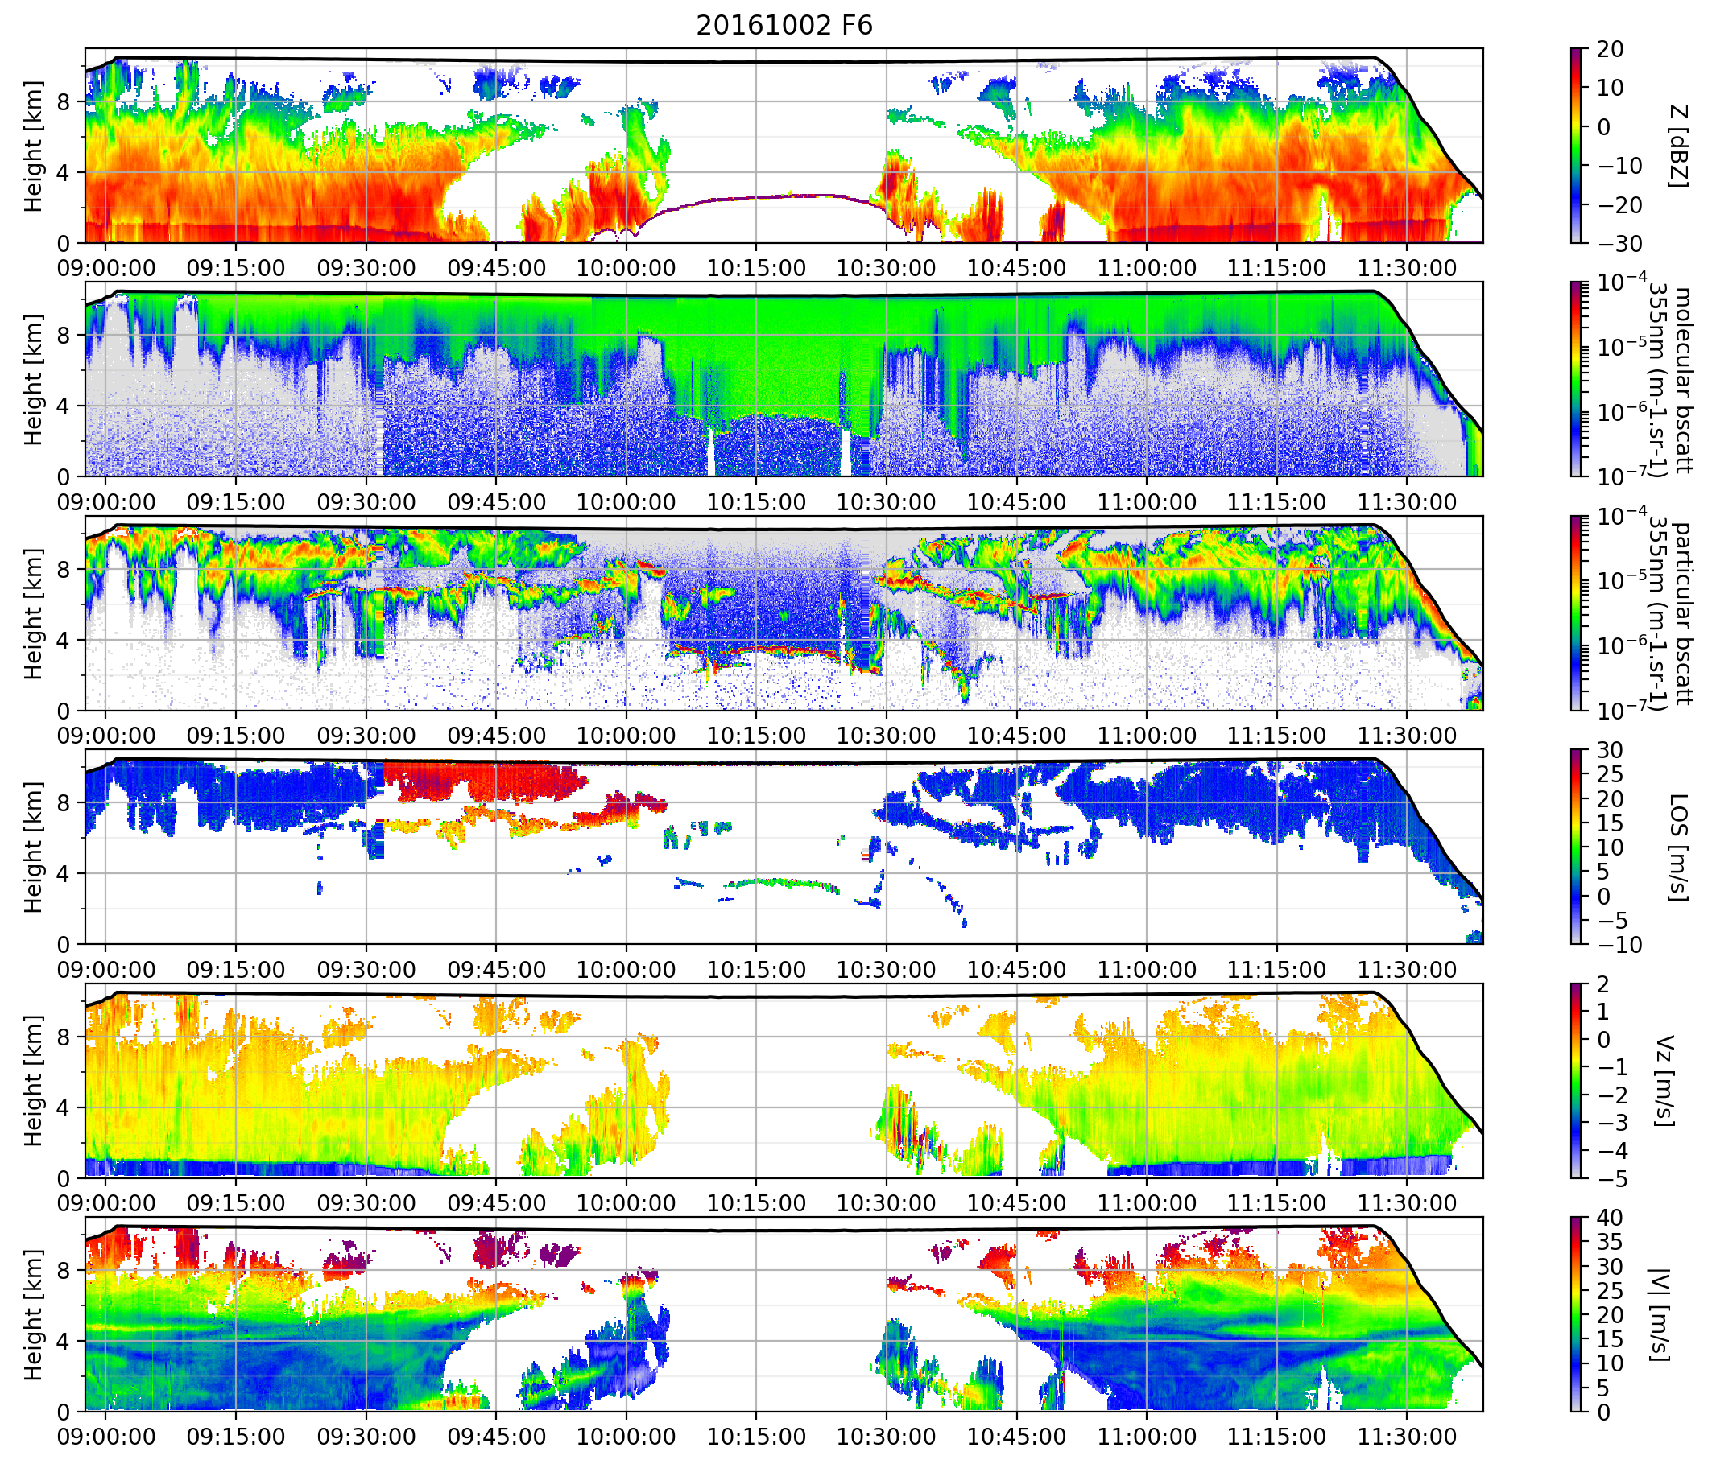
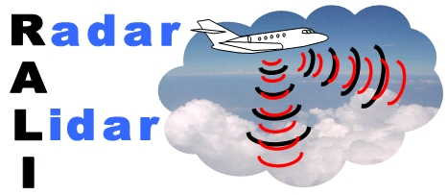
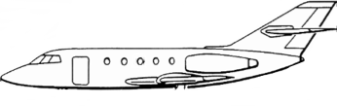
RALI: RASTA and LNG
Lidar pointing direction
Radar pointing directions
Radiative
Z, V_{d}
β,vr
Dynamics
EARTHCARE RALI NAWDEX – EPATAN - ESA Contract No. 4000119015/NL/CT/g
CNES EECLAT
INSU/Météo-France
EarthCare Workshop - 11-15 June 2018 Bonn
http://rali.projet.latmos.ipsl.fr

Slide 7
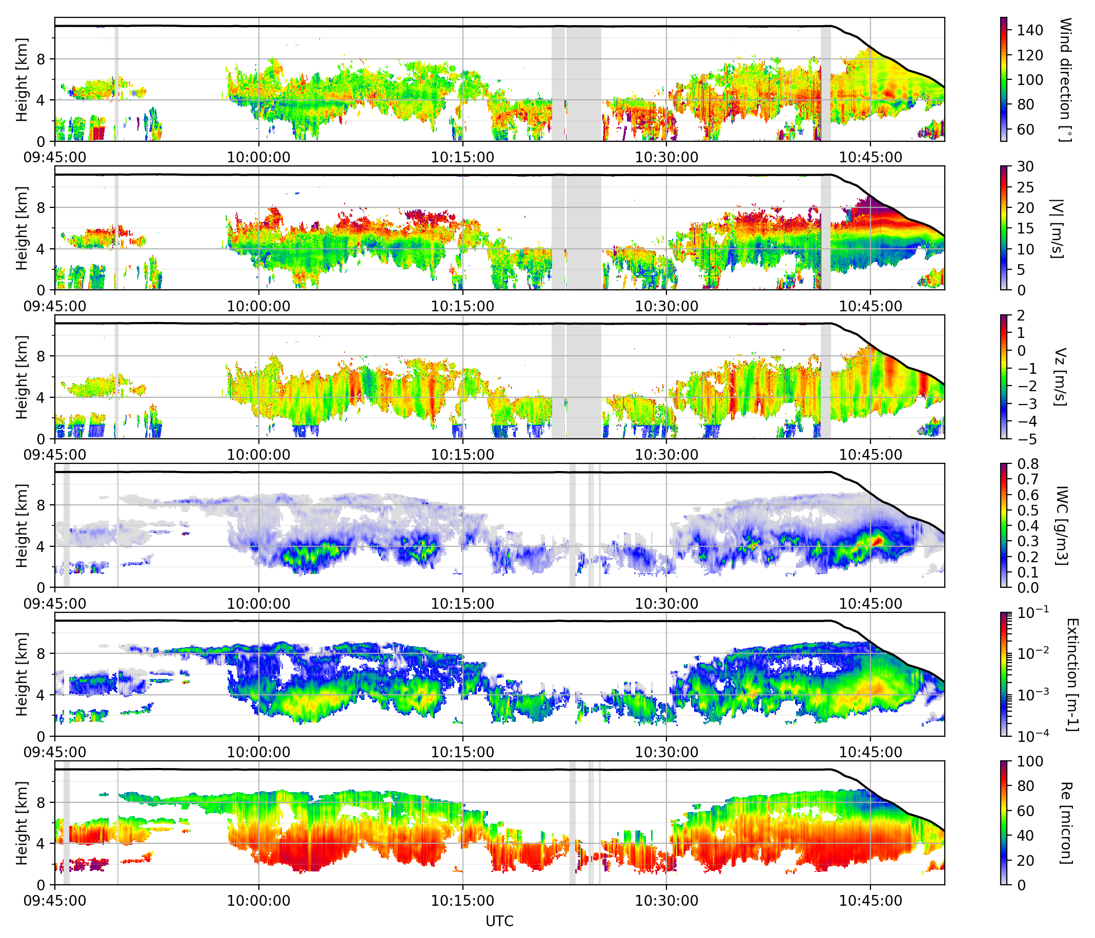
RALI retrievals
Horizontal
cloud wind direction
Horizontal
cloud wind speed
Vertical
cloud wind
Same methodology for HALO:
Radar-lidar categorisation
Radar-lidar retrieval (Varcloud)
IWC from radar-lidar
retrieval
Extinction from
radar-lidar retrieval
Re from radar-lidar
retrieval
EarthCare Workshop - 11-15 June 2018 Bonn

Slide 8
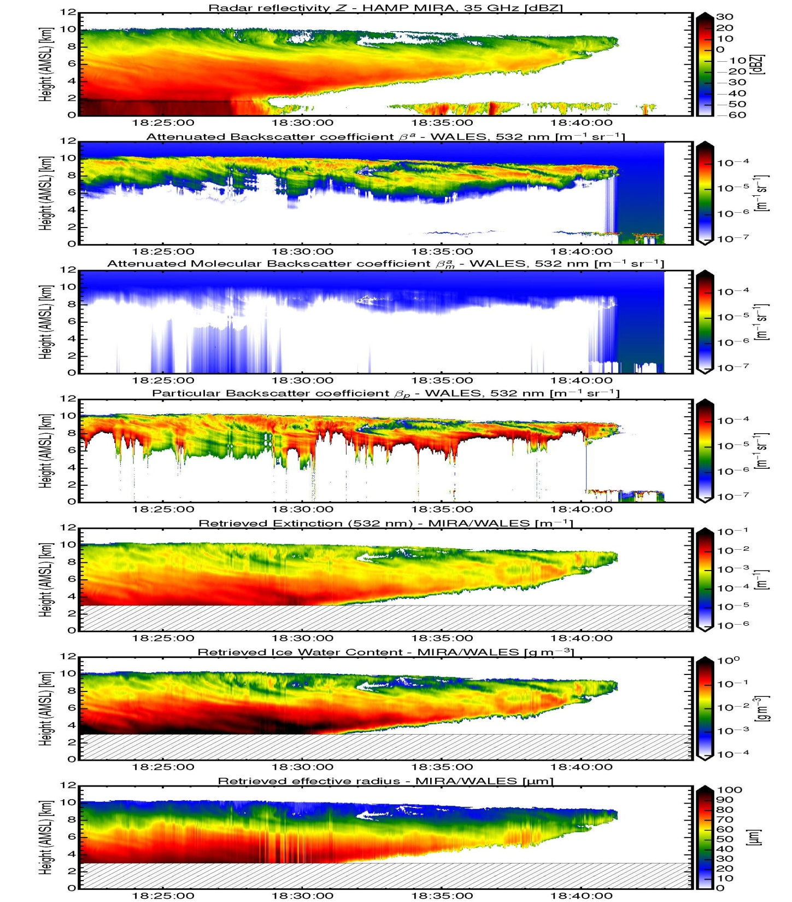
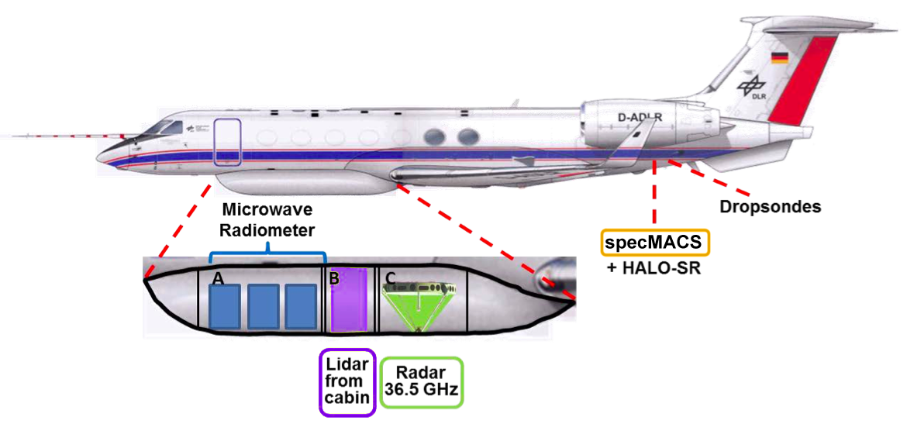


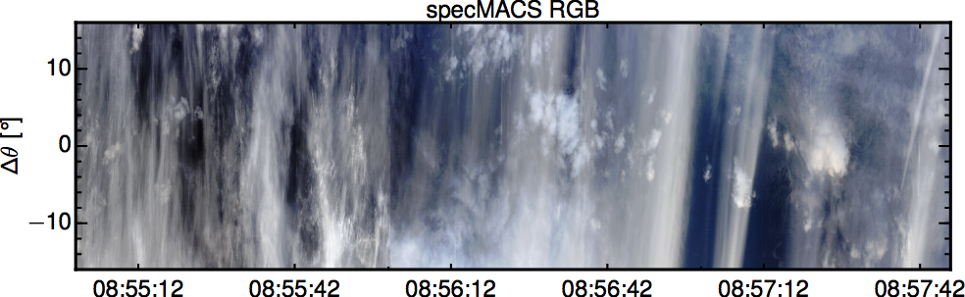
Example of HALO measurements
Radar Reflectivity
WALES
Attenuated backscatter coeff.
Molecular backscatter coeff.
Hyper-Spectral Imager 400 – 2500 nm (specMACS)
Particle backscatter coeff.
HSR-Lidar (WALES) 532 nm
Cloud Radar (MIRA) 35 GHz
Particle extinction coeff.
Ice water content
specMACS
Effective Radius
High sensitivity radar => large overlap between radar and lidar

Slide 9
Campaigns opportunities
We need to account for EC’s launch (postponed) :
  EUREC4A / MOSAIC : pre launch
Future campaigns to be announced:
    Funding for the DLR-airborne activities, e.g. for additional flight hours, additional flights beyond 2021 and for personnel related to EarthCARE Cal/Val activities will be applied by the German Science Foundation (DFG), institutional funding, and in cooperation with university partners by the German Space Administration.
    HALO campaigns mentioned in the GIVE proposal are fixed in time and location. 1 HALO campaign with EarthCARE instrumentation is scheduled:
      HALO-AC3 which is scheduled for 2021. => refer to GIVE presentation and Poster
    Funding for French F20 - To be discussed with CNES
EarthCare Workshop - 11-15 June 2018 Bonn

Slide 10
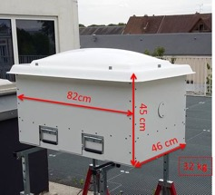
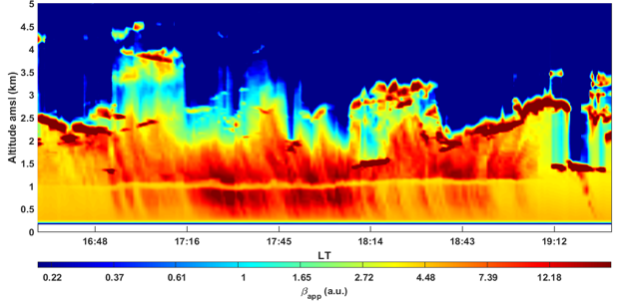
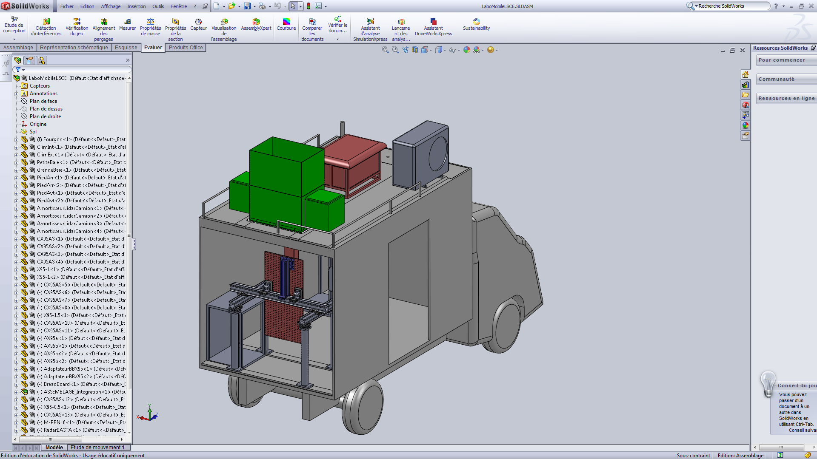
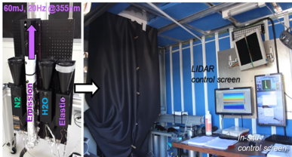
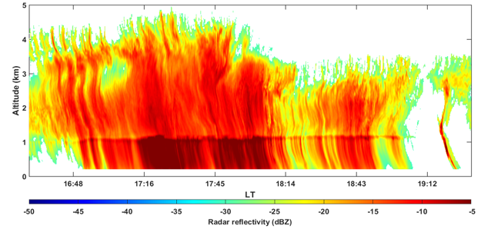
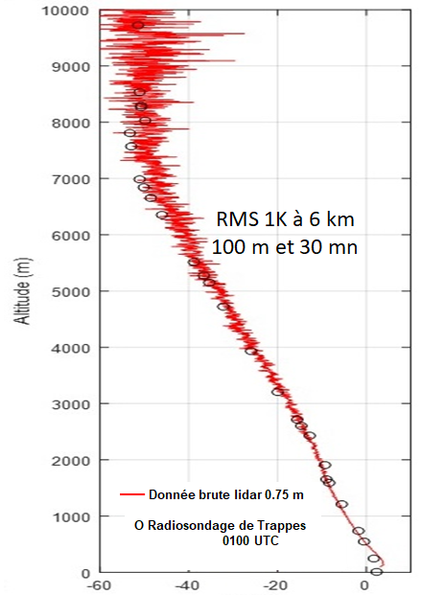
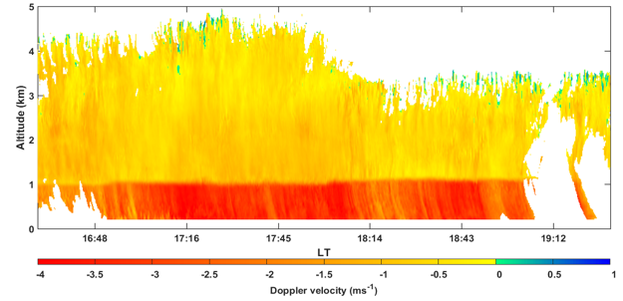

Radar-Lidar truck/ULA – Chazette et al.
Water vapor & Aerosol LIdar
Chazette et al., QJRMS, 2015 & 2016
Laser emission: 120 mJ / 20 Hz
@ 355 nm, eyesafe
Reception: 150 mm refractors
FOV: 0.6x1.8 mrad
Full overlap at 150 m
Detection: PMTs with adaptable gain
200 MHz, analog & photon-counting
Output profiles : PR², VDR/PDR,
LR = extinction/backscatter, r_{H2O} , temperature
Delanoë et al., 2016
Hammerfest
Meteorological
probe
Radar BASTA
WALI
Air conditioner
Antenna diameter | 30 cm
Emitted power | ~1 W
Emission frequency | 95 GHz
Integrated time | 0.5 à 10 s
Measurement mode | Bistatic (3 different range resolutions)
BASTA
Lidar WALI
Sunshade & blower
Electronic bay
Temperature (°C)
EarthCare Workshop - 11-15 June 2018 Bonn

Slide 11
SPACEOBS project
Space Incubator, Paris-Saclay University, leaders: Fontaine and Brogniez
Instruments on board the STRATOBUS platform (system developed by Thales):
Zeppelin flying at 20 km with a fix position
Payload : 250 kg and 5 kW
LATMOS in collaboration with IAS and ONERA => BASTA cloud radar
There are a few advantages with this configuration:
Similar to satellite observation, i.e. from the top to the ground
Surface echo can be used for rain retrieval (PIA)
Geostationary measurements: Cloud lifecycle (same location)
The first flight of STRATOBUS : 2020 and beyond (deployment on STRATOBUS is not guaranteed and will depend on external support)
Simulation of BASTA reflectivity that would be observed from STRATOBUS (20 km) and based on real measurements from ground based BASTA at La Réunion Island. Configuration: 3s integration/ 100m vertical resolution/24 km ambiguous distance
EarthCare Workshop - 11-15 June 2018 Bonn

