Slide 1

Validation of EarthCARE products by comparison with airborne measurements and global NWP predictions
F. Marenco, S. Fox, J. Langridge , C. Harlow,
P. Francis,A. Bodas-Salcedo, and C. Tsamalis

Slide 2
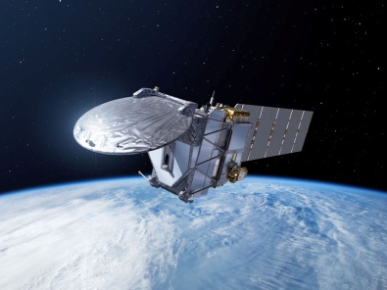
Validation of EarthCARE products by comparison with airborne measurements and global NWP predictions
Airborne activities (FAAM aircraft)
Monitoring (satellite imagery and NWP products)

Slide 3
Validation of EarthCARE products by comparison with airborne measurements and global NWP predictions
Airborne activities (FAAM aircraft)
Monitoring (satellite imagery and NWP products)

Slide 4
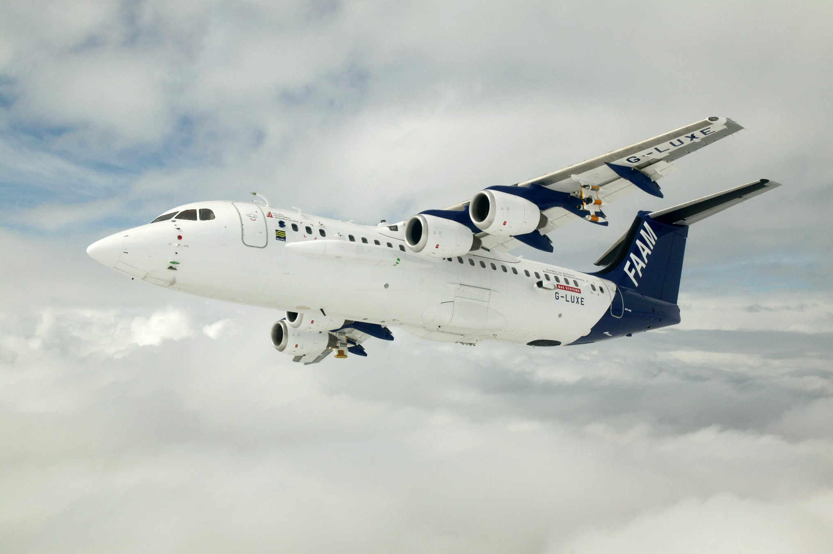



FAAM BAe–146–301
Atmospheric Research Aircraft
Upward and Forward Video Cameras
ADA on other side
SWS on other side
FAGE Inlet
CVI on other side
Air sample inlets
BBRs
SHIMS
Cloud Physics Probes
5 port turbulence probe
Total water probe
JW Liq water
Nevzerov total/liq water probe
Rosemount temp probes
Dropsonde on other side
Deimos or IR Camera
TAFTS
ARIES
BBRs
MARSS
SHIMS
Lidar
Rearward and Downward Video Cameras
Cloud Physics Probes

Slide 5
FAAM BAe–146–301
Atmospheric Research Aircraft
Crew | 2 pilots (1 cabin crew)
Scientists | 18 maximum
Length | 31m
Wingspan | 26m
Height | 8.4m (to top of tail), 4.4m (top of fuselage)
Engines | 4 Honeywell LF507-1H turbofans
Max altitude | 35,000 ft
Min altitude | 50ft (over sea)
Range | 3,700 km
Cruise Altitude | 27,000 ft
Typical endurance | 5.5 hours
Min manoeuvring speed | 90 - 115 ms⁻¹ (depending on payload)
Payload | 4,000 kg instrumentation

Slide 6
Instrumentation relevant to proposal
Instrument | Rem. Sens. / in situ | Parameter | Notes
Backscatter lidar | RS | Cloud top height, cloud fraction, aerosol extinction coefficient | Cloud: ~ 300 m footprint Aerosols: ~ 9 km footprint
ISMAR | RS | Brightness Temperature 118, 243, 325,448, 664 GHz | Precipitation / Ice ~ 600 m footprint
MARSS | RS | Brightness Temperature 89,157, 183 GHz | Precipitation / Ice ~ 600 m footprint
BBRs | RS | SW and LW fluxes
EXSCALABAR | IS | Dry and humidified extinction Absorption | Multiwavelength aerosol measurements
Nephelometer | IS | Aerosol scattering coefficient | 3 wavelengths
PSAP | IS | Aerosol Absorption
Aerosol and cloud probes | IS | Particle size distribution | 0.3 µm – several mm

Slide 7
Airborne activities (FAAM aircraft)
A few examples of what we have done

Slide 8
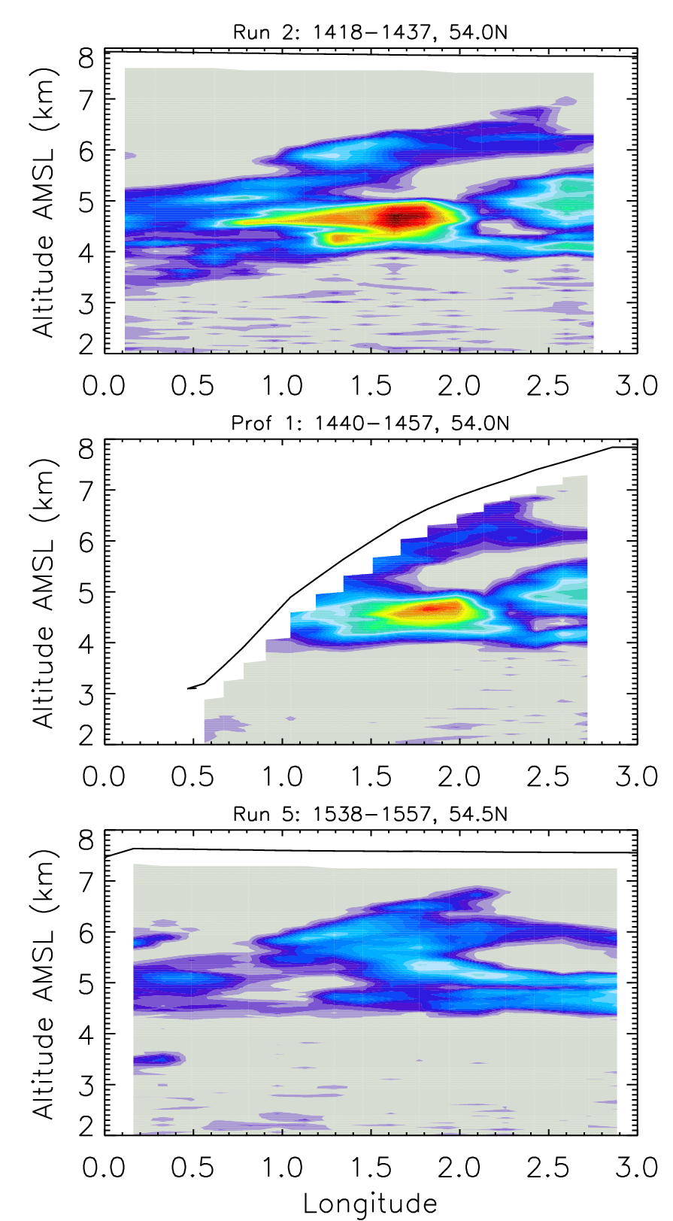
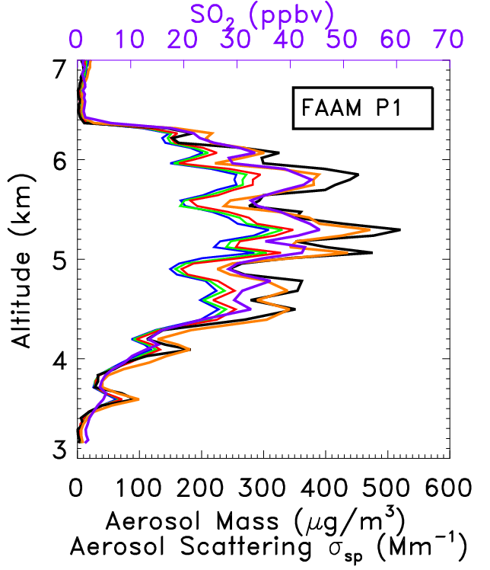
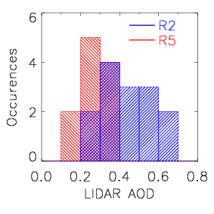
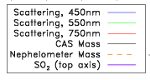
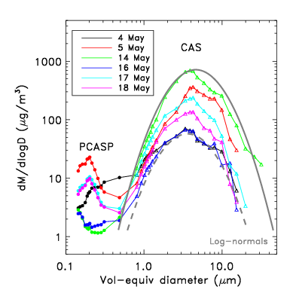
Synergy of in situ and remote sensing
Volcanic ash
NEPH
OPCs
IN-SITU
Turnbull, Johnson, Marenco, Haywood, Minikin, Weinzierl, Schlager, Schumann, Leadbetter, and Woolley, A case study of observations of volcanic ash from the Eyjafjallajökull eruption: 1. In situ airborne observations, J. Geophys Res. 117, 10.1029/2011JD016688, 2012.
Johnson, Turnbull, Brown, Burgess, Dorsey, Baran, Webster, Haywood, Cotton, Ulanowski, Hesse, Woolley, and Rosenberg, In situ observations of volcanic ash clouds from the FAAM aircraft during the eruption of Eyjafjallajökull in 2010, J. Geophys. Res. 117, 10.1029/2011JD016760, 2012.

Slide 9
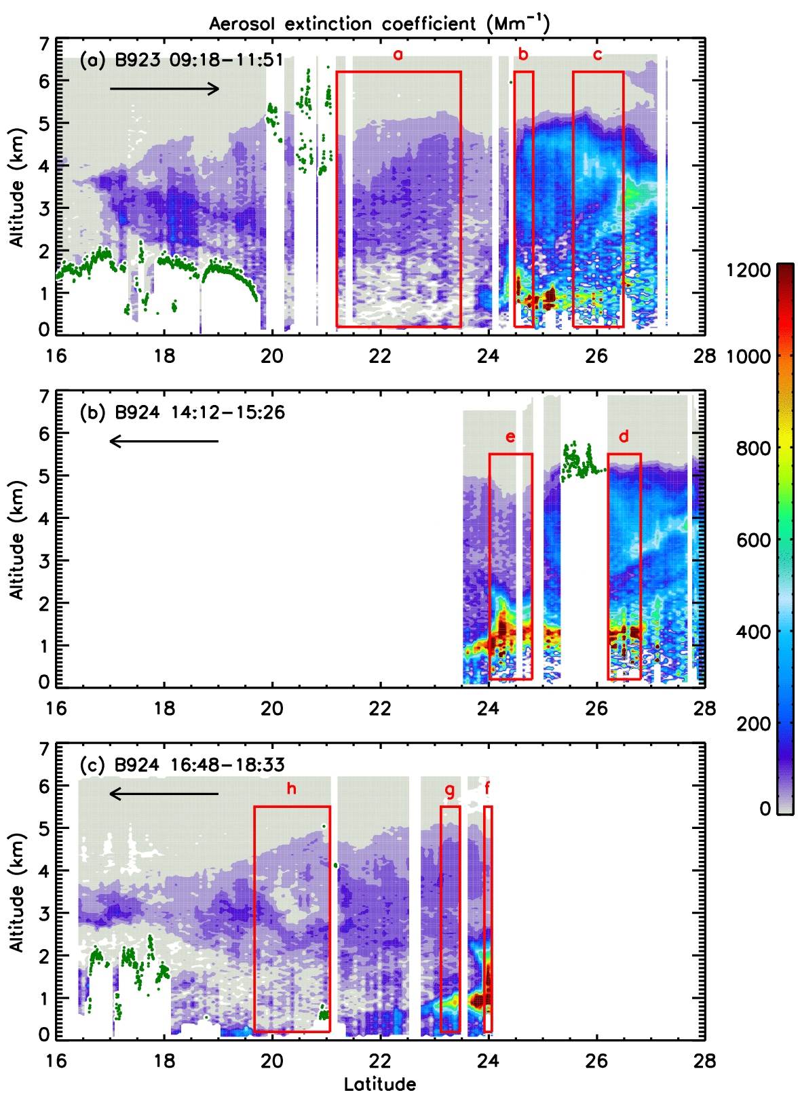
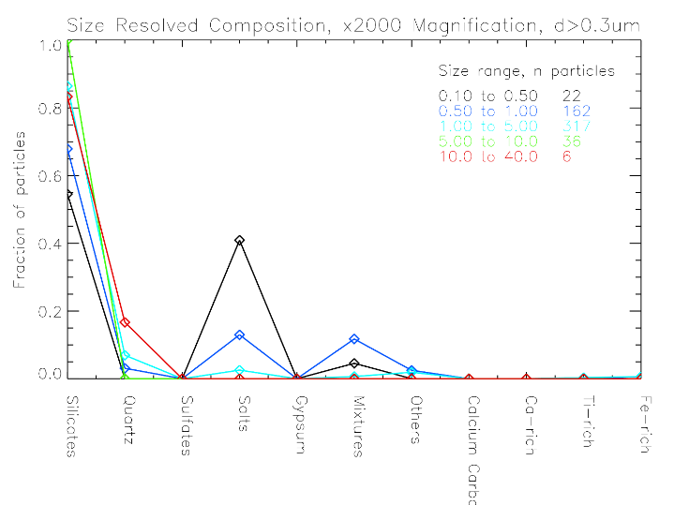
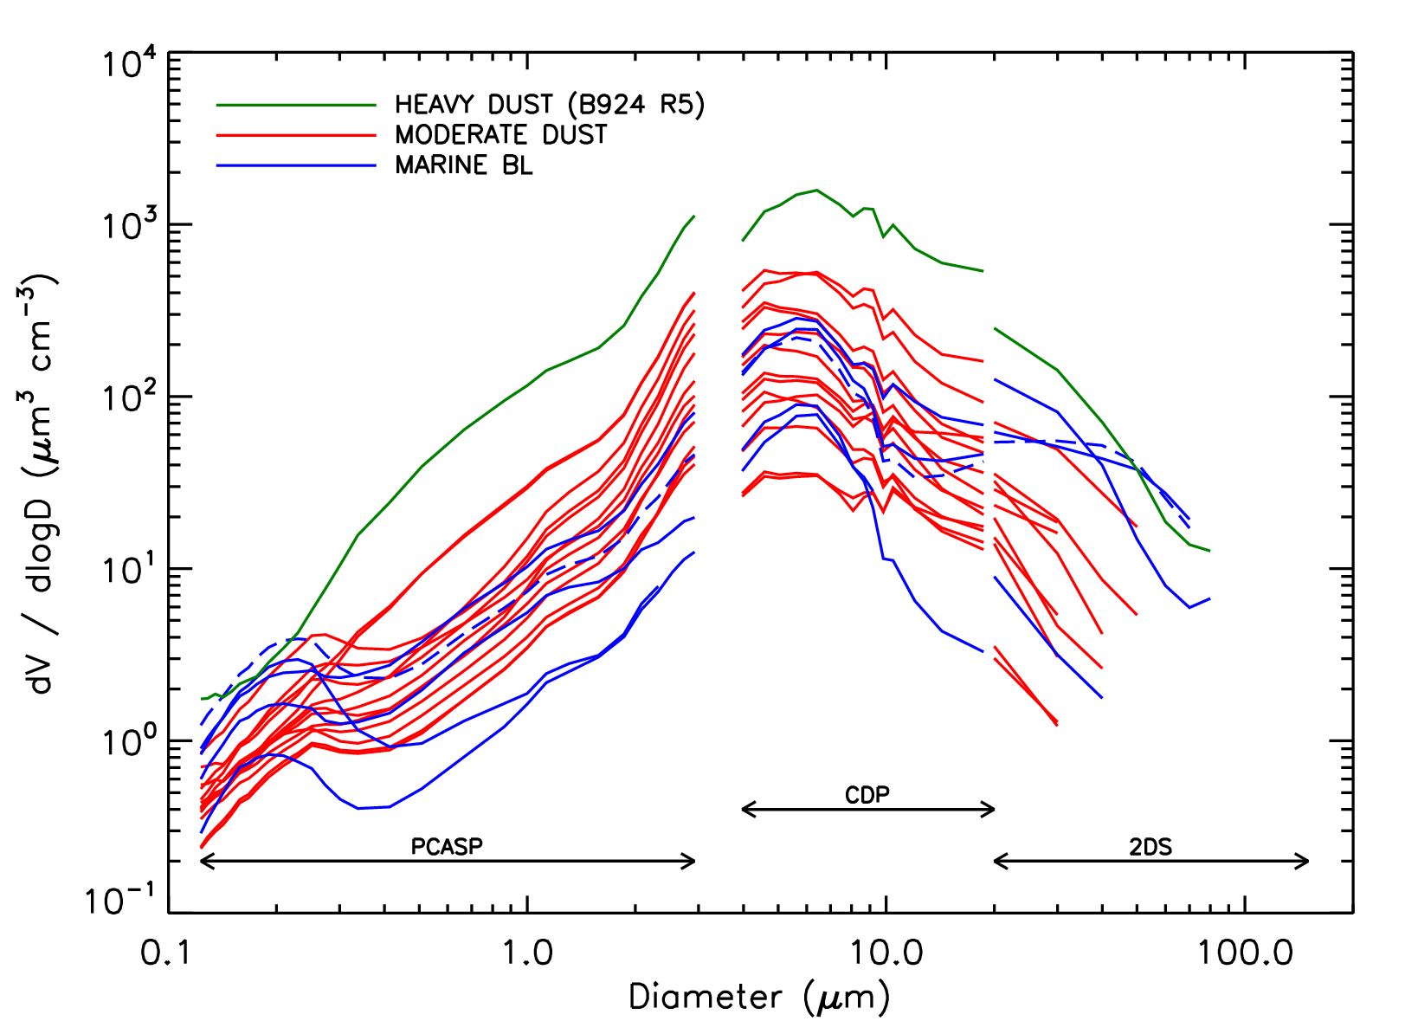
Synergy of in situ and remote sensing
Intense dust outbreak, Eastern Atlantic
B920

Slide 10
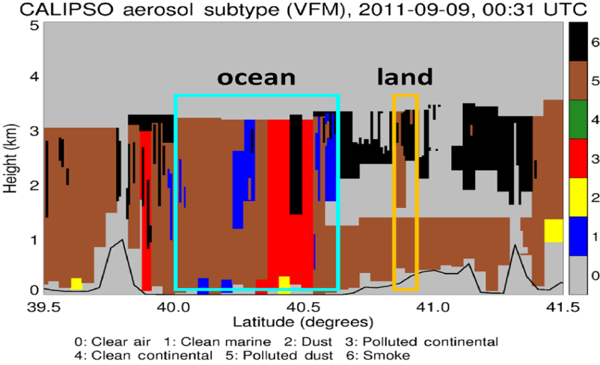
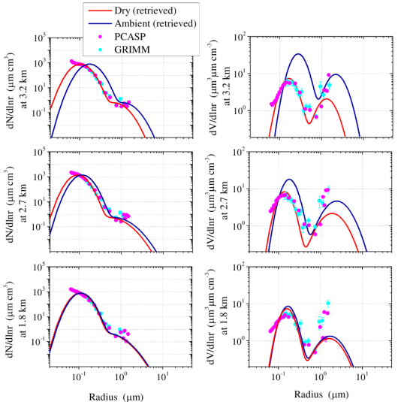
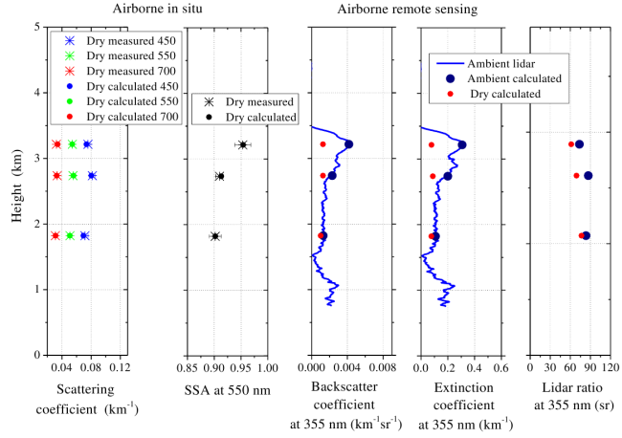
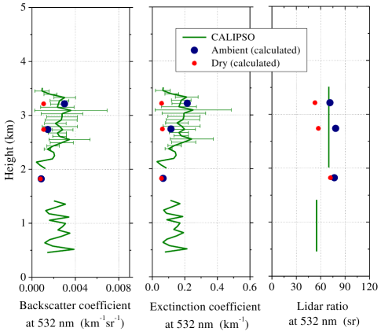
Synergy of in situ and remote sensing
Validation of CALIPSO products
CALIPSO
Tsekeri et al (2017),
Profiling aerosol optical, microphysical and hygroscopic properties in ambient conditions by combining in-situ and remote sensing,
Atm. Meas. Tech. 10, 83-107.

Slide 11
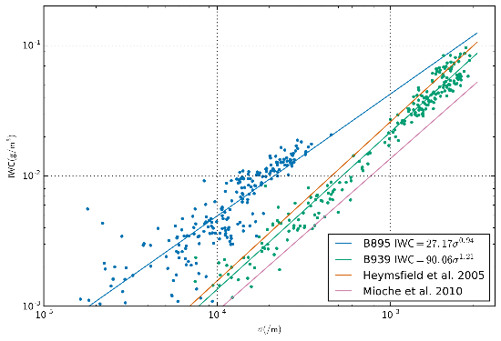
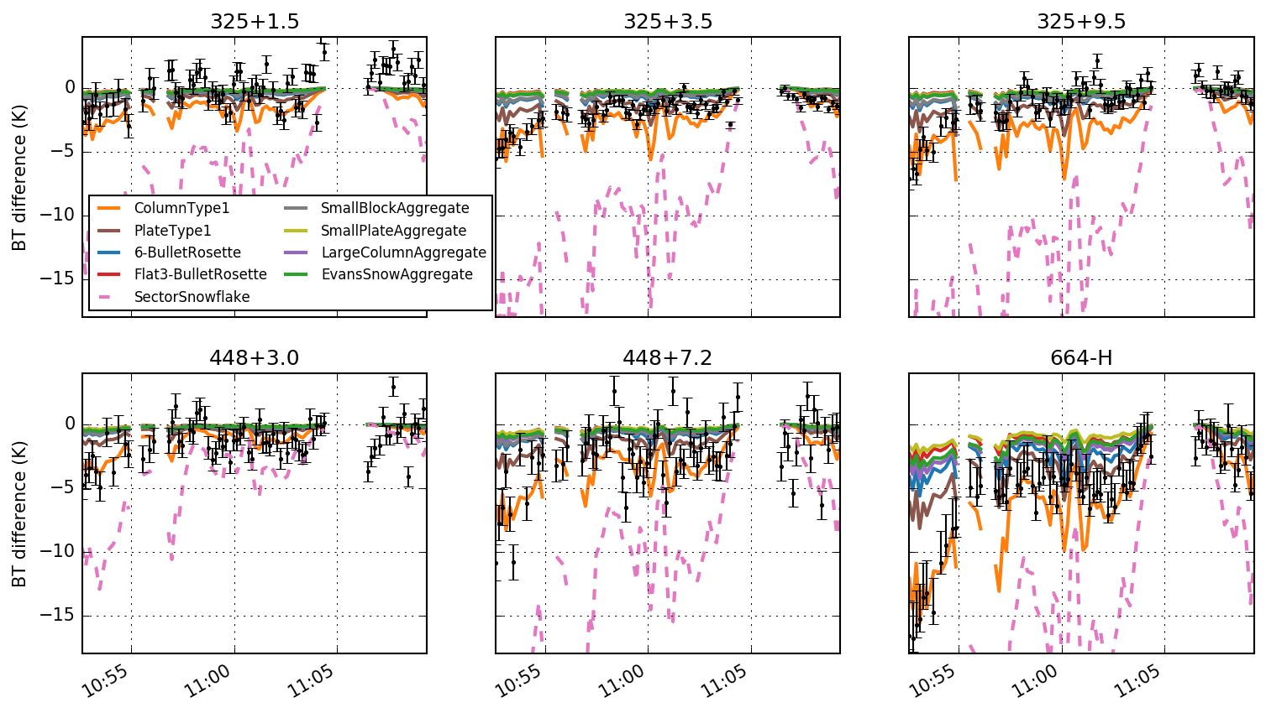
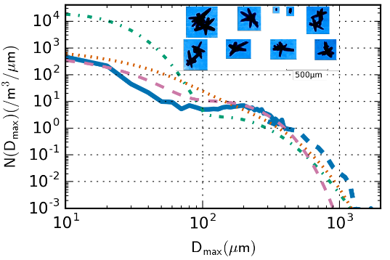
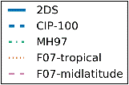
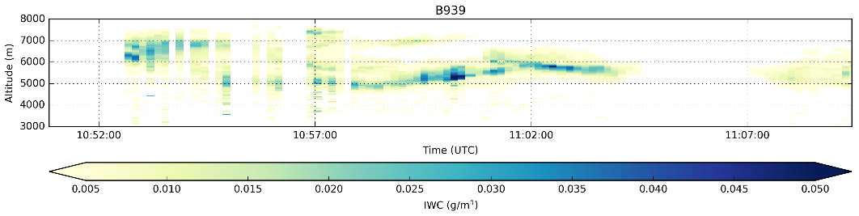
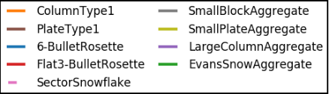
Synergy of in situ and remote sensing
IN SITU (wing probes vs. Nevzorov)
ISMAR 325±9.5 GHz
B939 – LIDAR derived IWC
ISMAR 664 GHz (H-pol)
In-situ PSDs, particle areas, and bulk IWC used to derive empirical extinction/IWC relationship
Applied to lidar extinction profiles to determine IWC
Radiative Transfer simulations using observed lidar IWC profiles compared to passive mm/submm observations
Fox et al. – in preparation

Slide 12
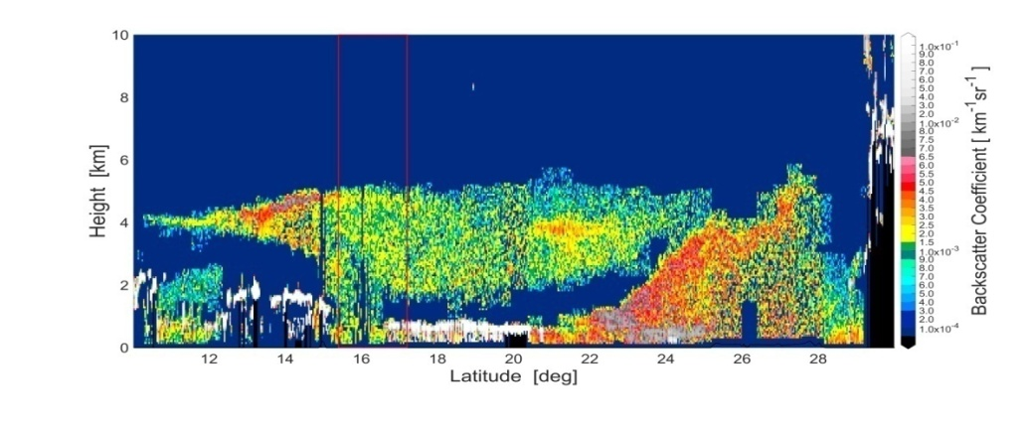
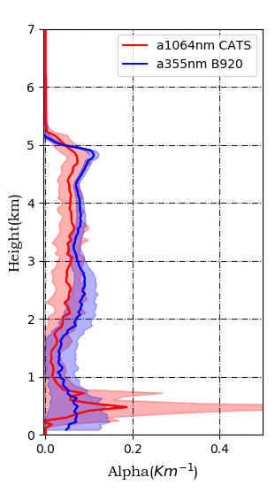
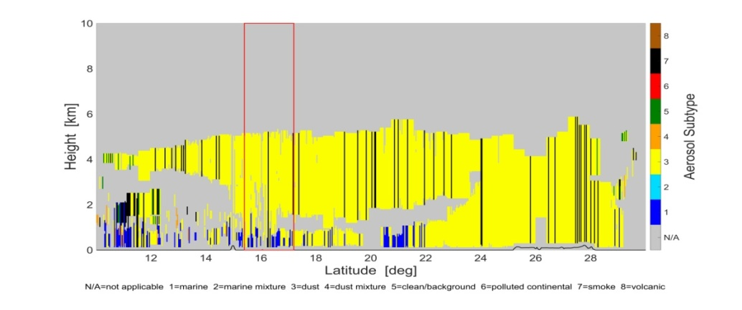
Spaceborne lidar validation efforts
CATS
Work in progress – Courtesy of E. Tetoni (NOA)

Slide 13
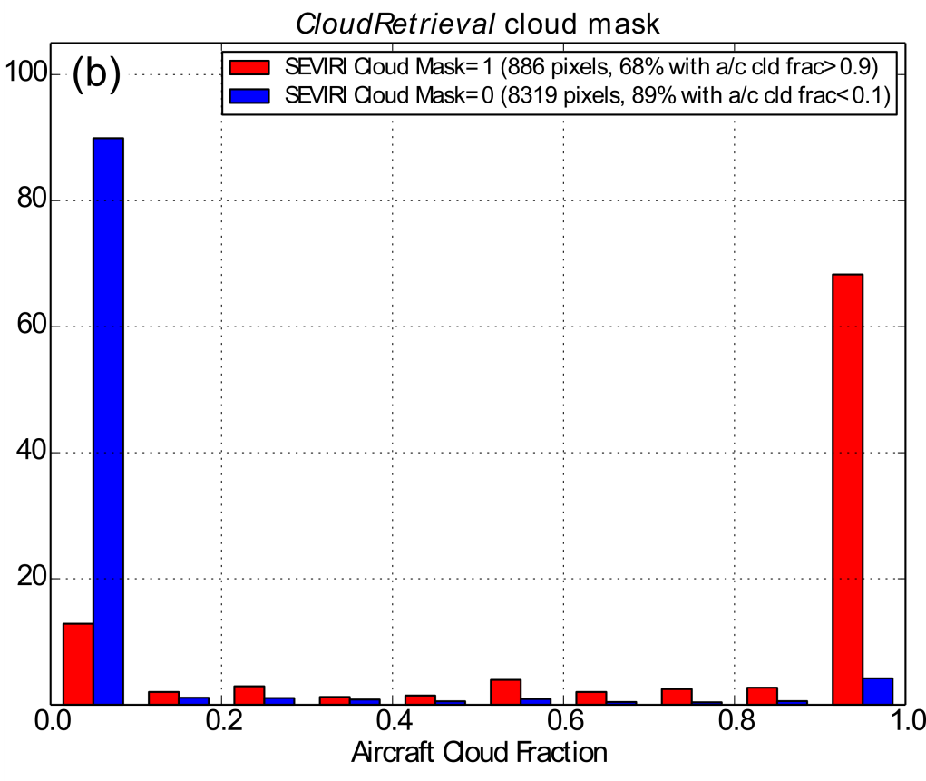
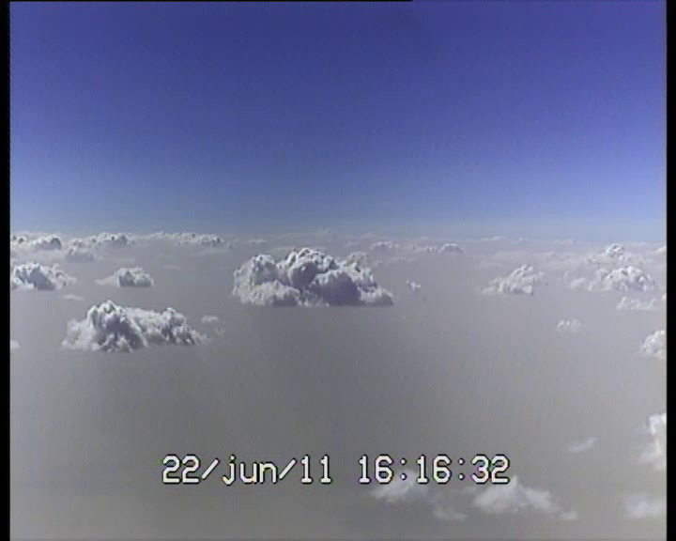
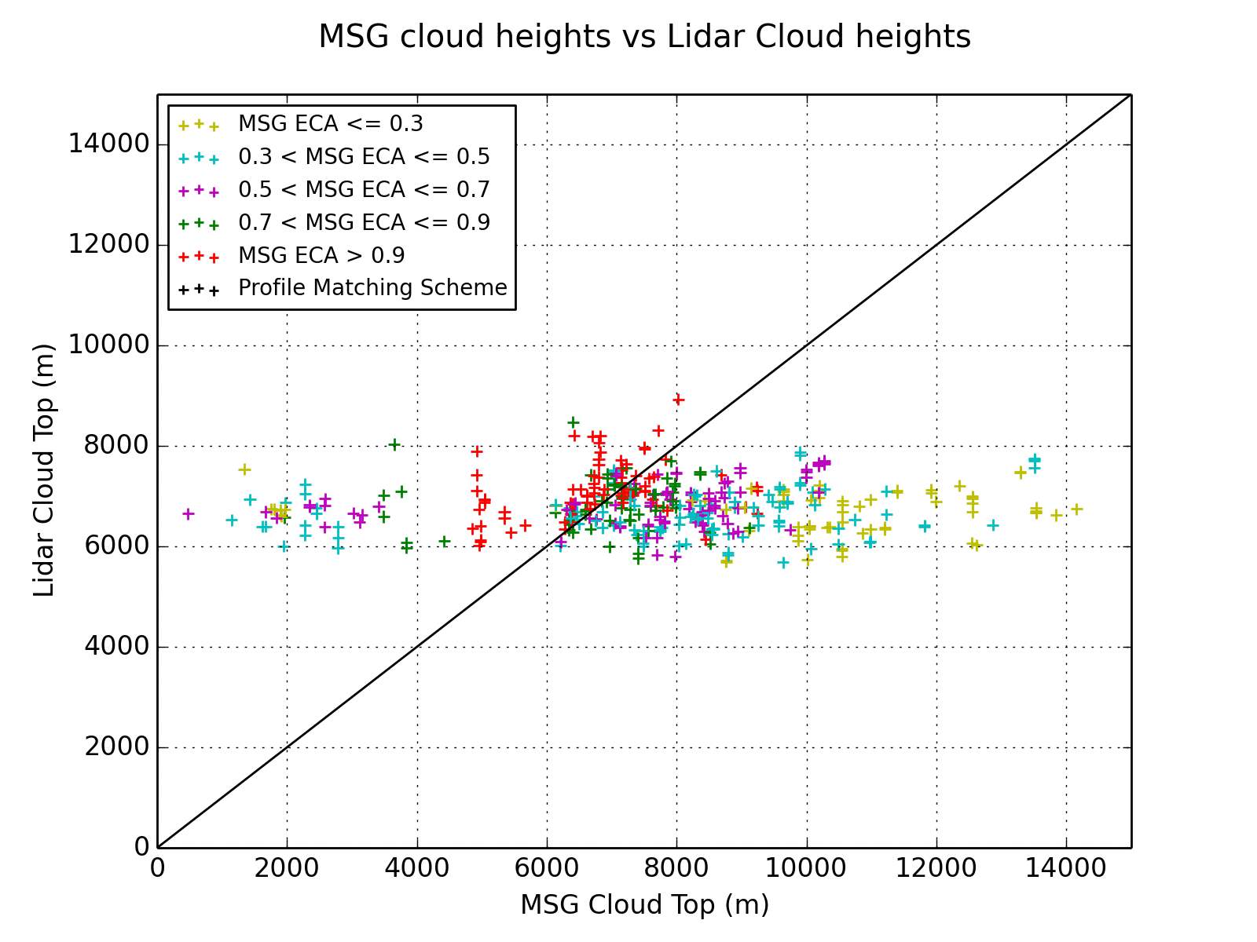
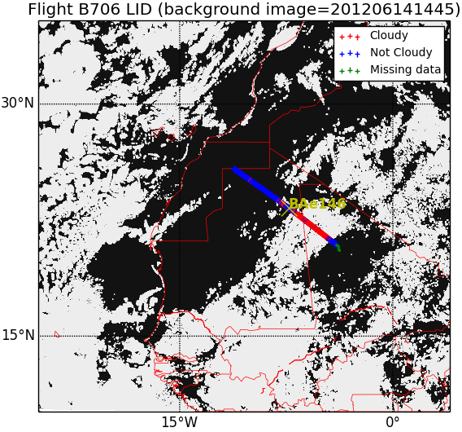
SEVIRI cloud validation efforts
Dust+Cloud scene (Sahara)
Kealy et al (2017), Clouds over the summertime Sahara: an evaluation of Met Office retrievals from Meteosat Second Generation using airborne remote sensing,
Atmos. Chem. Phys. 17, 5789-5807.

Slide 14
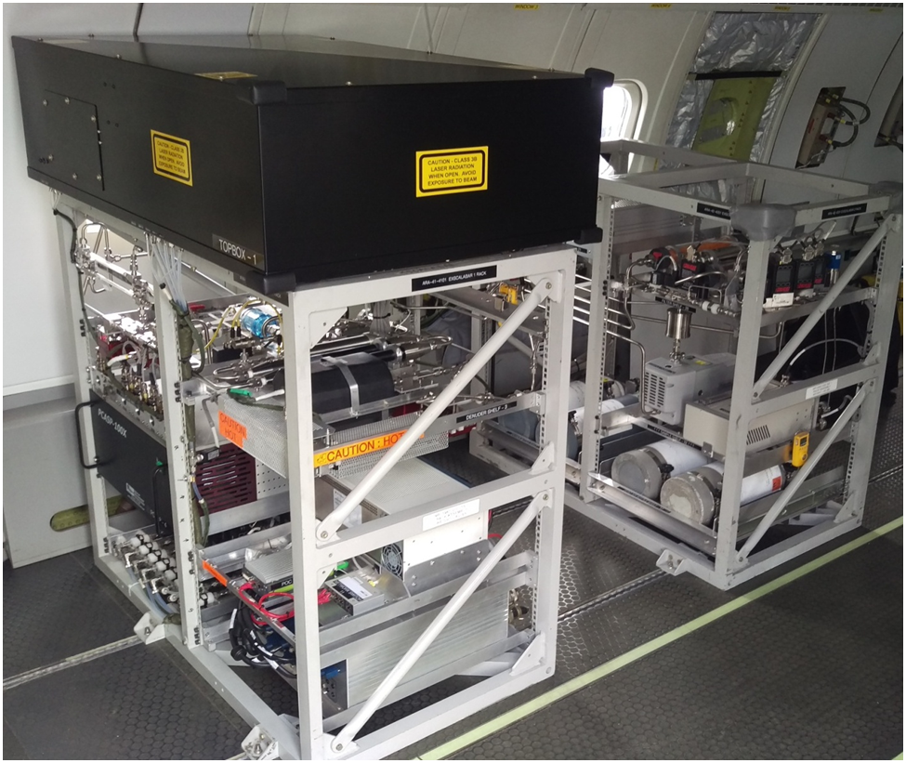
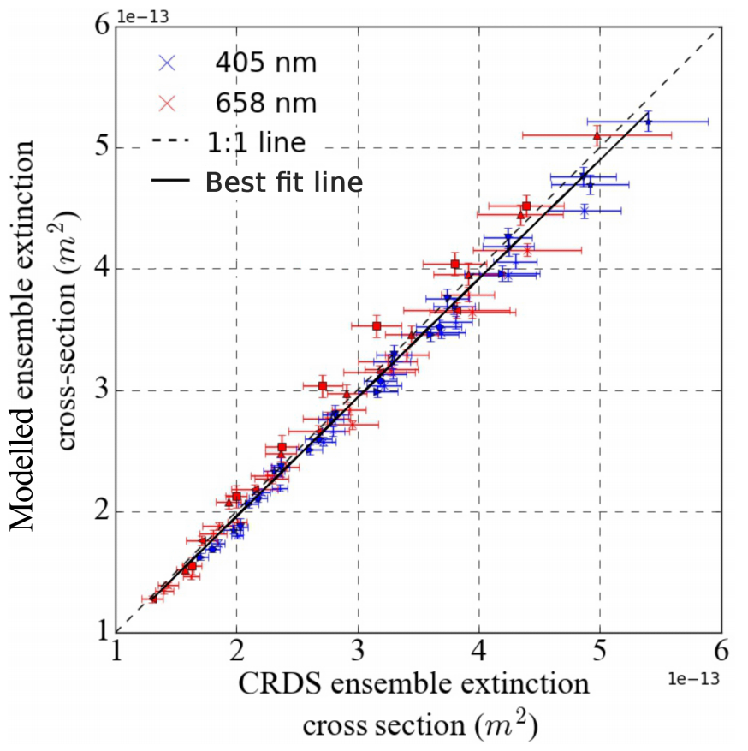
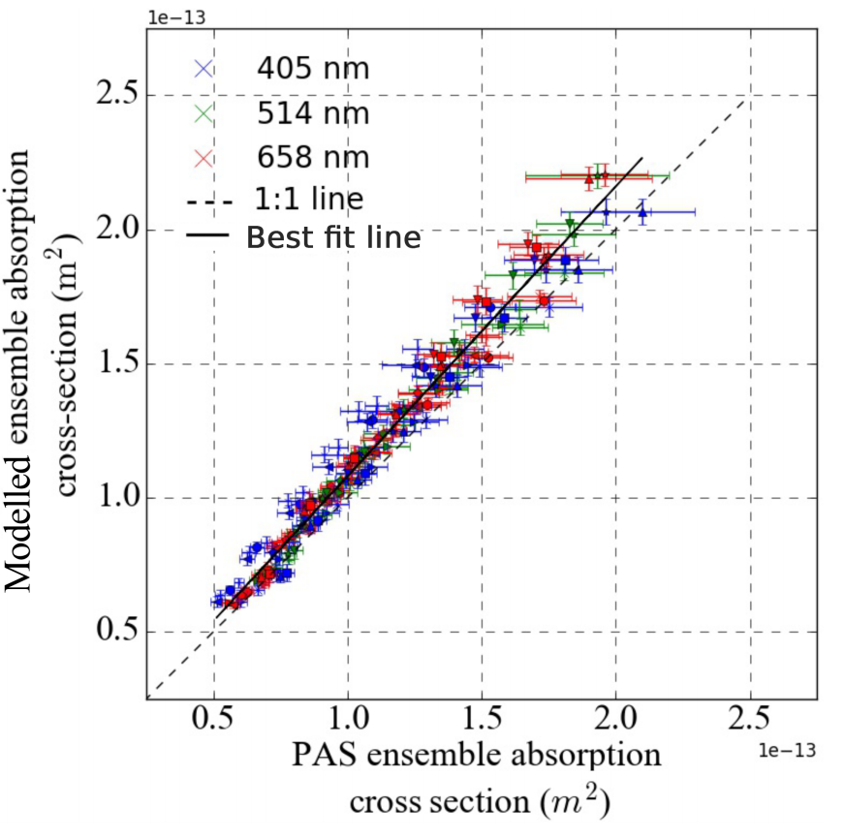
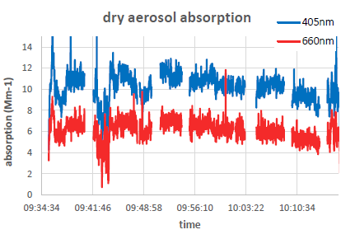
EXSCALABAR
Multi-channel aerosol spectrometer
Absorption strength
Absorption spectral dependence
Extinction strength
Absorption attribution; BC, BrC, lensing
Extinction RH dependence
Extinction wavelength dependence
Aerosol single scattering properties
EXSCALABAR
New airborne instrument for comprehensive characterisation of aerosol optical behaviour
Use of multi-wavelength photoacoustic and cavity ringdown spectroscopies offer high accuracy
Three successful airborne deployments in 2017 in Senegal, UK and Ascension Island
Davies et al, Atmos. Meas. Tech. 11, 2313 (2018)

Slide 15
Airborne activities (FAAM aircraft)
Objectives
Direct comparison of aerosol/cloud products (IS): Flight at different altitude levels under the EarthCARE flight track: in situ.
Direct comparison of aerosol/cloud products (RS): High altitude flight, under the EarthCARE flight track: remote sensing.
Studies on scene classification: layer detection, aerosol-cloud discrimination, aerosol classification (use both RS and IS)

Slide 16
Airborne activities (FAAM aircraft)
Potential location
In proximity of the United Kingdom (ad hoc)
In locations where the FAAM aircraft will be detached for larger campaigns (ad hoc)
Planned campaigns: Scotland (Jan/Feb 2019), Indonesia (Jan/Feb 2020).
In a dedicated cal/val campaign – location TBD (expensive option)

Slide 17
Validation of EarthCARE products by comparison with airborne measurements and global NWP predictions
Airborne activities (FAAM aircraft)
Monitoring (satellite imagery and NWP products)

Slide 18
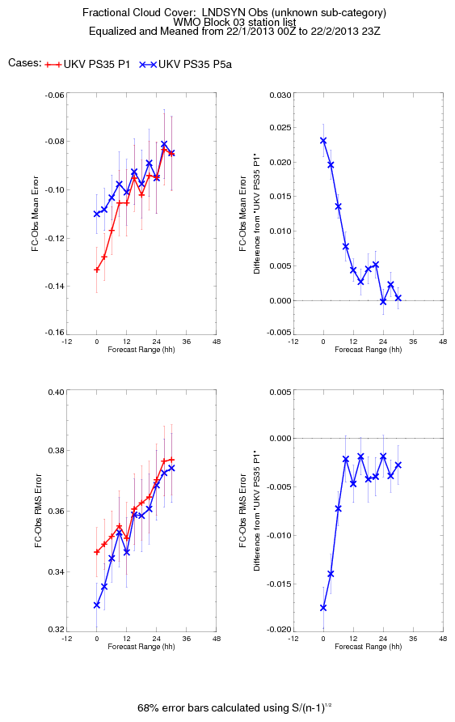
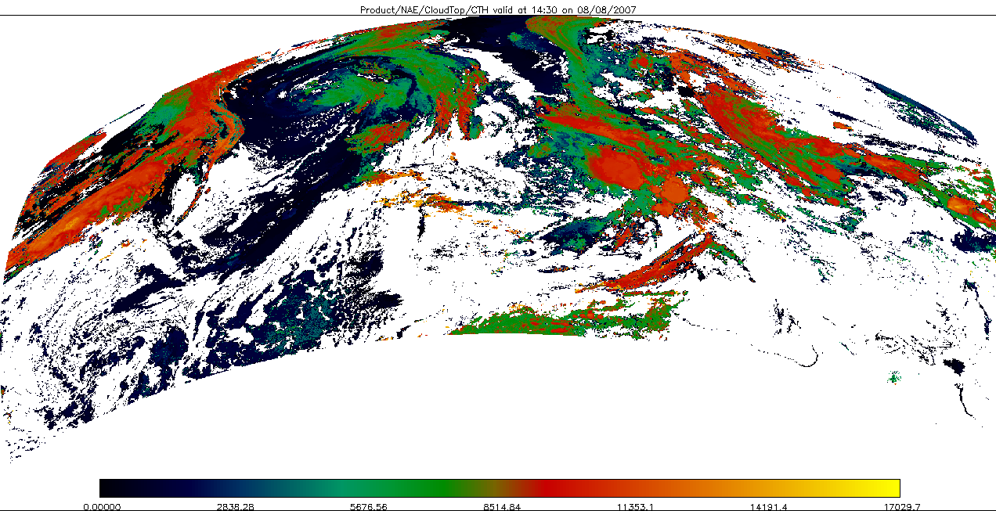
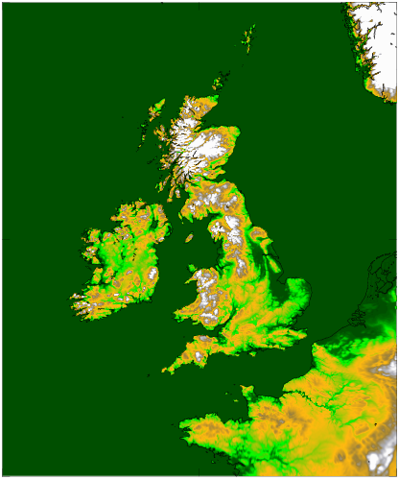
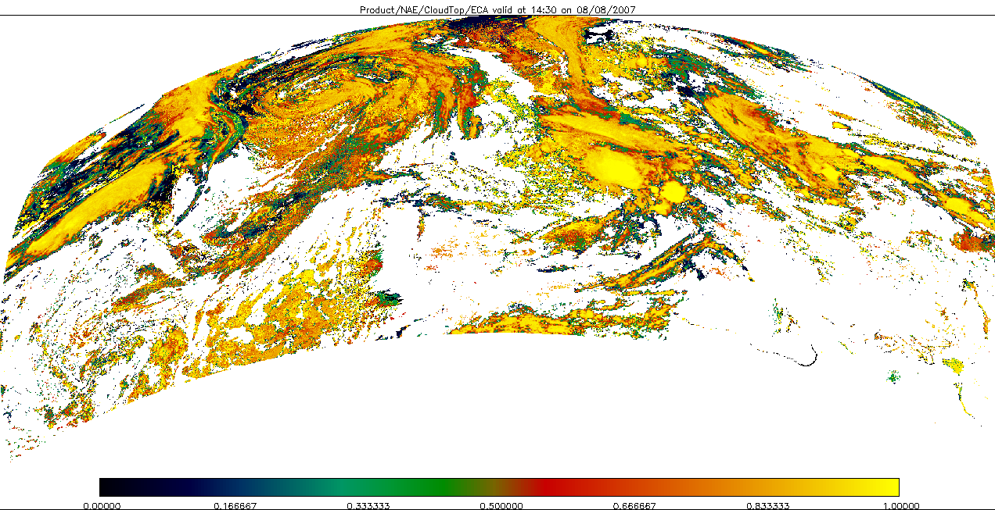
Use of SEVIRI cloud products
NWP applications
Cloud-top height and cloud amount retrievals based on MSG data used to produce column cloud fraction profiles for assimilation as humidity increments in regional NWP model
Cases: Single level Multiple levels
Cloud-Top Height
UKV
Effective Cloud Amount
Notes:
The verification panel on the left just gives an indication of the typical impact of GeoCloud assimilation in the model cloud field. In this case, it’s the difference between multi-level GeoCloud DA and single-level GeoCloud DA (rather than the difference between GeoCloud and no-GeoCloud), but it at least gives the indication that we’re aiming to reduce cloud bias and RMS error at the shorter forecast lead-times.

Slide 19
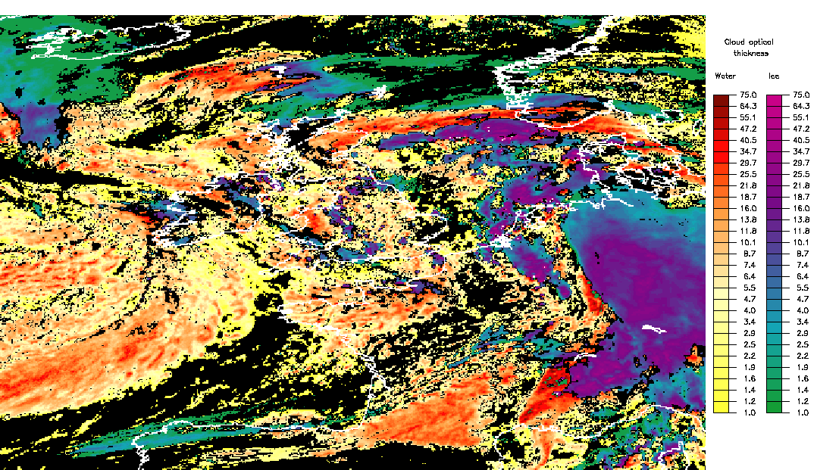
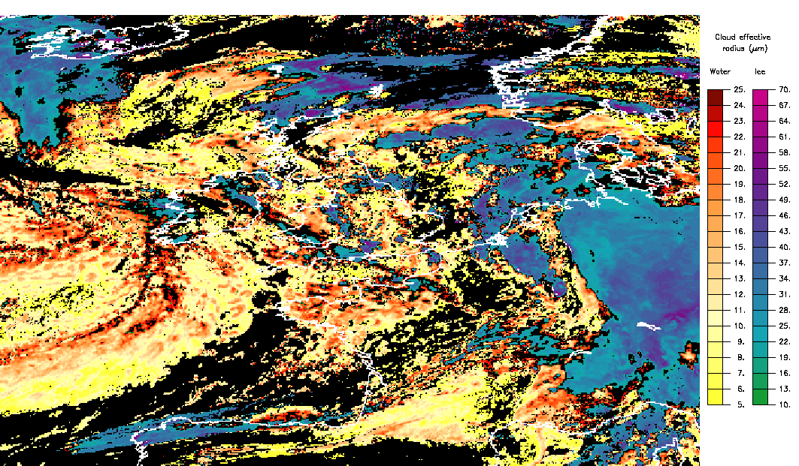
Use of SEVIRI cloud products
Aviation applications
Optical depth
Cloud liquid
water path
Effective radius

Slide 20
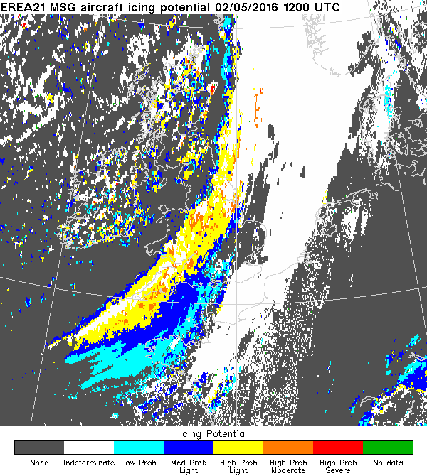
Use of SEVIRI cloud products
Aviation applications
Minnis et al. (2005) have developed a method to classify the icing potential for each pixel based on pilot reports (PIREPs).
Uses retrievals of cloud phase, optical thickness, droplet size and cloud-top temperature to arrive at an “icing potential”, a combined icing probability and icing intensity measure.
Optical depth
Cloud liquid
water path
Effective radius

Slide 21

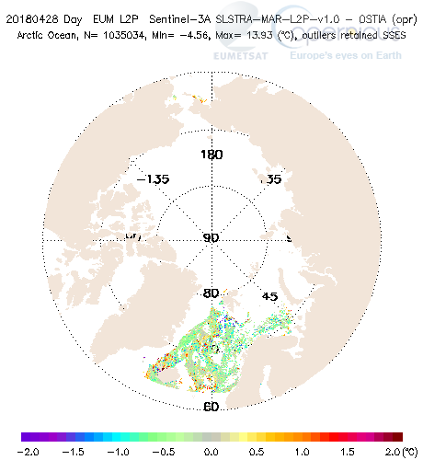
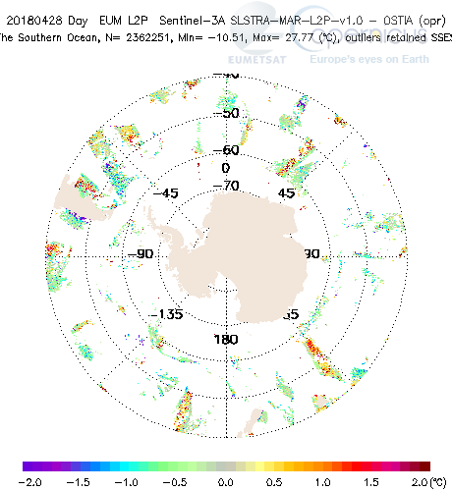
Use of SLSTR cloud masks
SST: SLSTR – OSTIA
(courtesy of Eumetsat)
Sentinel-3A and -3B carry two imagers:
  SLSTR (VIS-SWIR-TIR), dual view
  OLCI (VIS-NIR), 300 m resolution
Intercompare ATLID feature products with SLSTR and OLCI cloud masks.
Due to different orbits morning (Sentinel-3) vs. afternoon (EarthCARE) the focus will be on polar regions, where collocations are possible.
Cloud detection over polar regions is more challenging.
Arctic is the fastest warming region of the Earth.

Slide 22
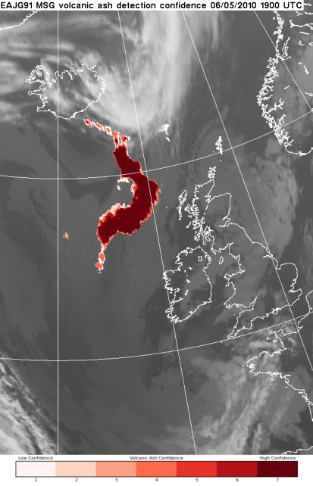
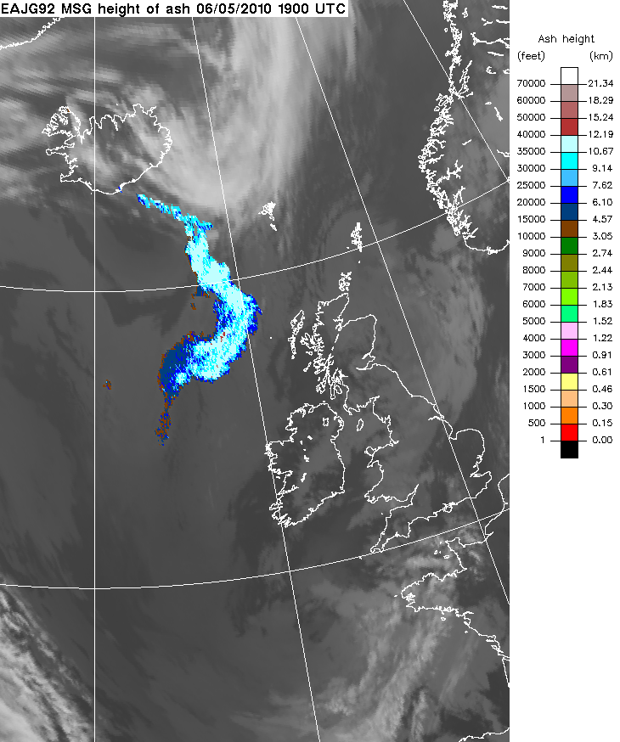
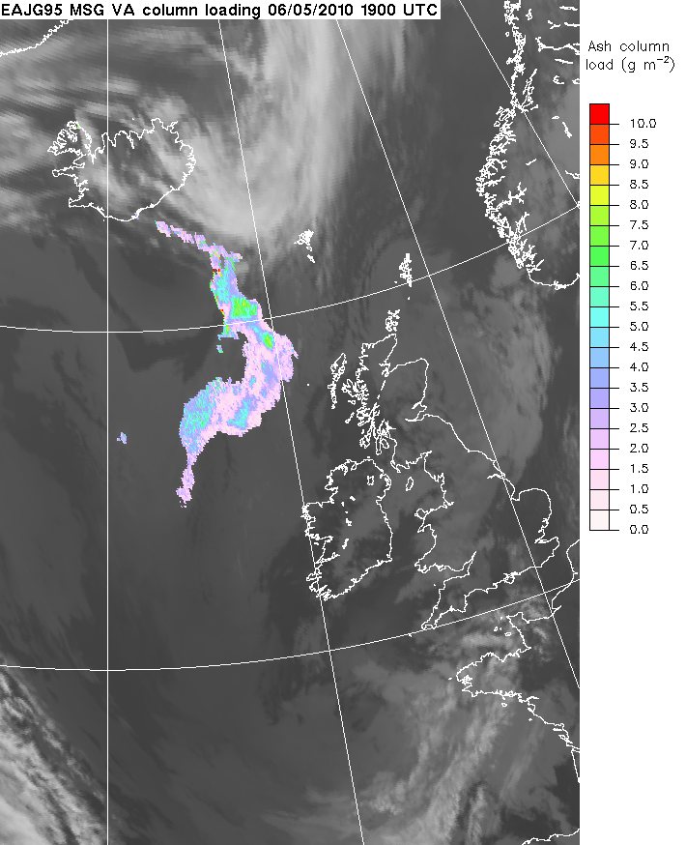
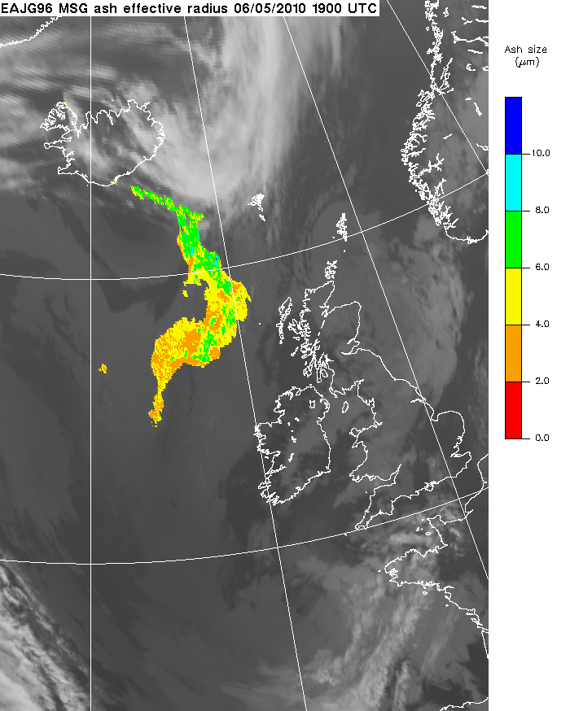
SEVIRI volcanic ash products
1D-Var scheme developed to retrieve quantitative volcanic ash information from SEVIRI data (10.8 μm, 12.0 μm and 13.4 μm)
Improved detection
Ash(-top) height
Ash column loading
Ash size
Courtesy of M. Cooke

Slide 23
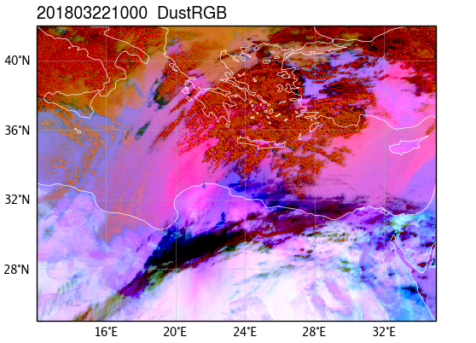
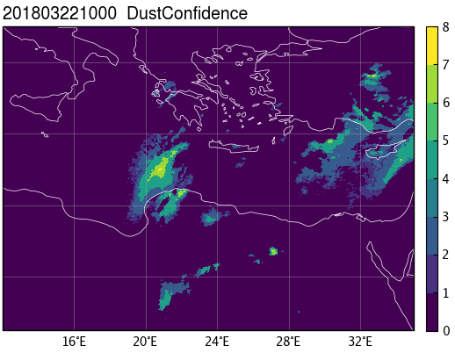
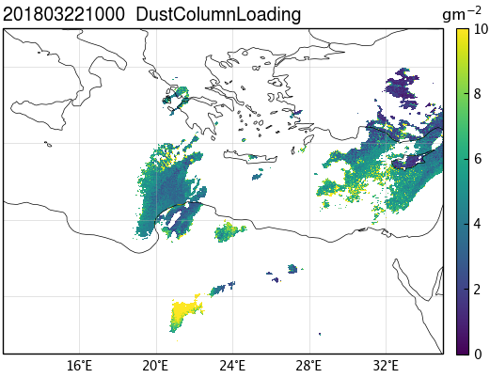
SEVIRI dust products: 1D-VAR
Detection
Dust detection confidence levels (0-7) based on a series of thresholds
Retrieval
J(x) = (x-x^{b})^{T} B⁻¹(x-x^{b}) + (y^{ob}-y(x))^{T} R⁻¹(y^{ob}-y(x))
x: atmospheric state vector (P_{dust}, L, r_{dust}) ⇒ Dust {Pressure, Loading, effective radius}
x^{b}: background state vector
y^{ob}: observation (measured BT)
y(x): vector of radiances calculated from atmospheric state x
B, R: background and measurement error covariance matrices
Courtesy of Y. Pradhan

Slide 24
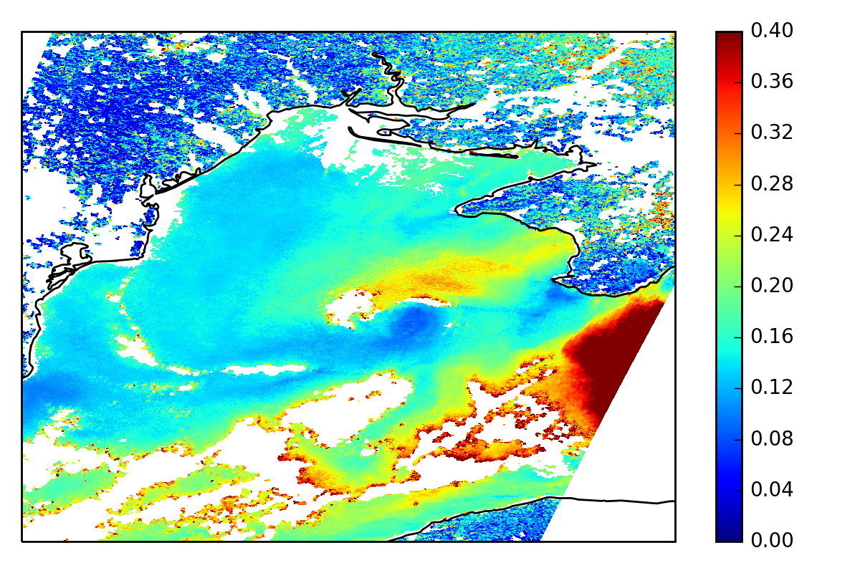
SEVIRI dust products: ORAC
Plan to experiment with setting up live SEVIRI products using the Optimal Retrieval of Aerosol and Cloud (ORAC) developed at U. Oxford and RAL
AOD
Courtesy of A. Povey (U. Oxford)

Slide 25
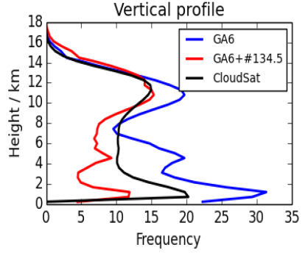
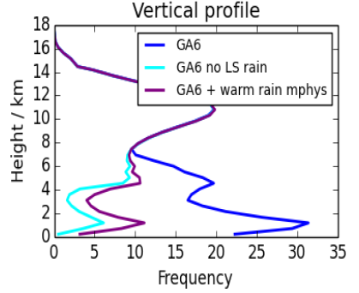
CPR forward operator
Tropics – Climate model
UM standard
UM improved
CloudSat
CloudSat: 3D cloud and precipitation global evaluation for the first time.
Very useful tool to understand sensitivities to model changes in microphysics.
Speed not suitable for DA. Need for aggressive optimisations and/or simplifications (e.g. use of look-up-tables).
Called within radiation scheme. Need to provide interface for DA.
Doppler not provided in current version.
Cloud Fraction (%)
Role of large-scale rain
UM
UM and no LS rain in FO
UM + model change
Cloud Fraction (%)
(Williams and Bodas-Salcedo, 2017)

Slide 26
Monitoring (satellite imagery / NWP products)
Objectives
Direct comparison of data products: Passive imagery and NWP fields vs. EarthCARE.
O-B monitoring: track down differences and their causes; issues of representativity and scale.
Potential for aerosol data assimilation experiments: if previous objective is successful (O-B reasonable, data quality sufficient, data delay short) this can be considered. Initially dust.
CPR forward operator: enhance existing operator of radar reflectivity; compare output to EarthCARE dataset; potential for radar reflectivity DA experiments

Slide 27

Direct comparison: Global statistics
Courtesy of
Y. Pradhan

Slide 28




Direct comparison: Scatter plots
Courtesy of
Y. Pradhan

Slide 29


Direct comparison: Time series
Bias
Standard deviation
RMS difference
Number of observations
Mean time delay in receipt
etc.
Courtesy of Y. Pradhan

Slide 30


Direct comparison: Geographical differences
Courtesy of Y. Pradhan

Slide 31

Direct comparison: AOD dependence of bias
Courtesy of
Y. Pradhan

Slide 32

NWP vs. Obs. comparison: O-A
Or similarly O-B
Courtesy of Y. Pradhan

Slide 33

NWP vs. Obs. comparison: O-A
Courtesy of
Y. Pradhan

Slide 34
Analysis report
Main focus is a record of features observed in the monitoring
  We could just provide a list……
  But ideally we want to understand the features so we can:
    identify issues with EarthCARE products
    identify improvements for quality control
    identify best variables for potential data assimilation
    (e.g. AOD, layer top/base height, vertical profile of extinction, etc.)
    carry out bespoke follow-up investigations, e.g. using case studies.

Slide 35
Assimilation trials – aerosols
  Should we become satisfied that EarthCARE datasets are sufficiently comparable to the NWP, that they are disseminated with a sufficiently short delay, and that the quality is sufficient, we will run DA trials to better understand if they can provide benefit to the Global model.
  Main focus: dust.
  An analysis of verification results will be produced.

Slide 36
Assimilation trials – clouds
  Should the comparison prove satisfactory, and should the forward operator be suitable in terms of speed, we will explore running DA experiments with assimilating the radar reflectivity.
  This can potentially help us to improving the representation of clouds and precipitation in our models, including their formation, development and evolution over different time scales.
  An analysis of verification results will be produced.

Slide 37


Timeliness of NRT products
CALIPSO: 9 Dec 2016 – 9 May 2017 (Actual: 12-72h)

Slide 38


Timeliness of NRT products
CATS: 9 Dec 2016 – 9 May 2017 (Actual: 8-36h)

Slide 39
Timeliness of NRT products
Mission | Nominal timeliness | Actual timeliness
CALIPSO | 12-72 h | 12-72 h
CATS | 6 h | 8-36 h
Aeolus | 3 h | ?
EarthCARE | 60% data within 6 h | ?
Global MetUM assimilation window is T±3h, with cutoff at T+2:40 for the main run, and T+6:15 for the update run (used as background for the following DA window).

Slide 40
EarthCARE products to validate
(tentative list)
AC-TC | ATLID/CPR target classification and detection status | Profile | L2b
A-TC | Aerosol type, Hydrometeor type | Profile | L2a
C-TC | Classification of hydrometeor, Doppler, convection, melting layer base/top, cloud layer base/top | Profile | L2a
A-FM | Probability of layer detection (scale 0-10; no aerosol/cloud separation) | Profile | L2a
A-ALD | Aerosol layer top/base, AOD, extinction, backscatter, depolarisation | Layer | L2a
A-CTH | Cloud top height | Layer | L2a
A-EBD | Extinction, backscatter and depolarisation | Profile | L2a
A-AER | Aerosol extinction, backscatter and depolarisation Aerosol type, Layer information | Profile | L2a
A-ICE | IWC and Ice effective radius | Profile | L2a
C-CLD | Cloud water content, LWP, IWP, characteristic diameters | Profile | L2a
C-FMR | Feature mask, corrected radar reflectivity, path integrated attenuation, multiple scattering flag | Profile | L2a

Slide 41
Pre-launch preparatory activities
Research flights:
Single flights: plan 3-6 months ahead
Dedicated campaign: plan 1 year ahead
Assessment with satellite retrievals and short-period forecasts:
Acquire EarthCARE sample data (from rehearsal)
Plan statistical comparison and prepare software package: begin 6-9 months before launch
Optimise forward operator of radar reflectivity: begin 6 months before launch (new science capabilities, e.g. Doppler, not covered here).
Notes:
Funding status to be clarified prior to any activity.
EarthCARE launch date to be clarified in order to plan flying activities

Slide 42
Project status
The Met Office does not have any internal funding for this activity.
The Met Office budget for use of the FAAM aircraft is being reviewed at the moment. We expect this review to complete by the end of 2018.
We plan to send our cal/val project to the UKSA to sound opportunities for funding; however, we are not aware of any specific call open at the moment.

Slide 43
Validation of EarthCARE products by comparison with airborne measurements and global NWP predictions
Thank you for your attention!

