Slide 1






Validation of EarthCARE aerosol products with a focus at high latitudes
G. Ancellet¹, J. Pelon¹, J. Jumelet¹, S. Kaykhin¹, A. Zabukovec¹, A. Bazureau¹,
¹ LATMOS, UPMC-CNRS-UVSQ, Paris, France,
I. Penner², Y. Balin², B. Belan²,
² Institute of Atmospheric Optics (IAO), Tomsk, Russia,
D. Josset⁴, Y. Hu⁵
⁴NRL, Stennis Space Center, MS USA,
⁵NASA, Hampton, VA USA
=> POSTER 61

Slide 2
Objectives :
Validation of the Atmospheric Lidar (ATLID) A-ALD data products and of synergistic aerosol data product using ground-based lidar observations at high latitudes:
1) Tomsk Russian Observatory (56N, 85E) and possibly aircraft flights above Siberia
2) Arctic Lidar Observatory for Middle Atmosphere Research (ALOMAR) in Northern Scandinavia (69°N,16°E)
3) Ice Atmosphere Ocean Observing System (IAOOS) Arctic network of buoys
4) Dumont D’Urville (DDU) French Antarctica station (66°S, 140°E)
Comparison of lidar ratio and aerosol type distribution at high latitudes retrieved from ATLID HSRL and MSI observations with similar distributions retrieved from CALIOP using either the Level (L2) operational products or the Synergized Optical Depth of Aerosols (SODA) products obtained over the ocean or above low altitude dense water clouds (SODA Depolarisation Ratio Method) .

Slide 3
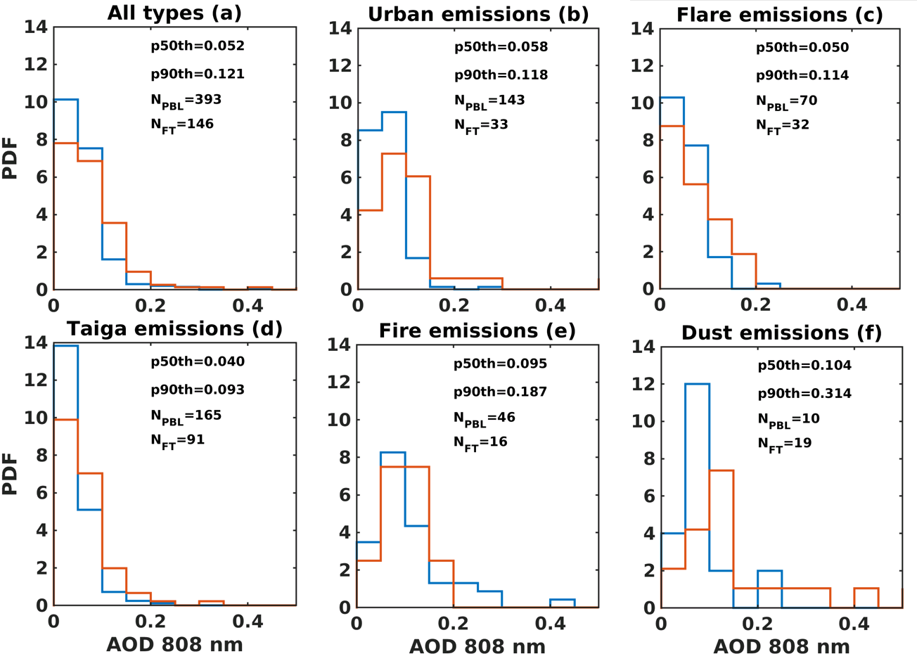
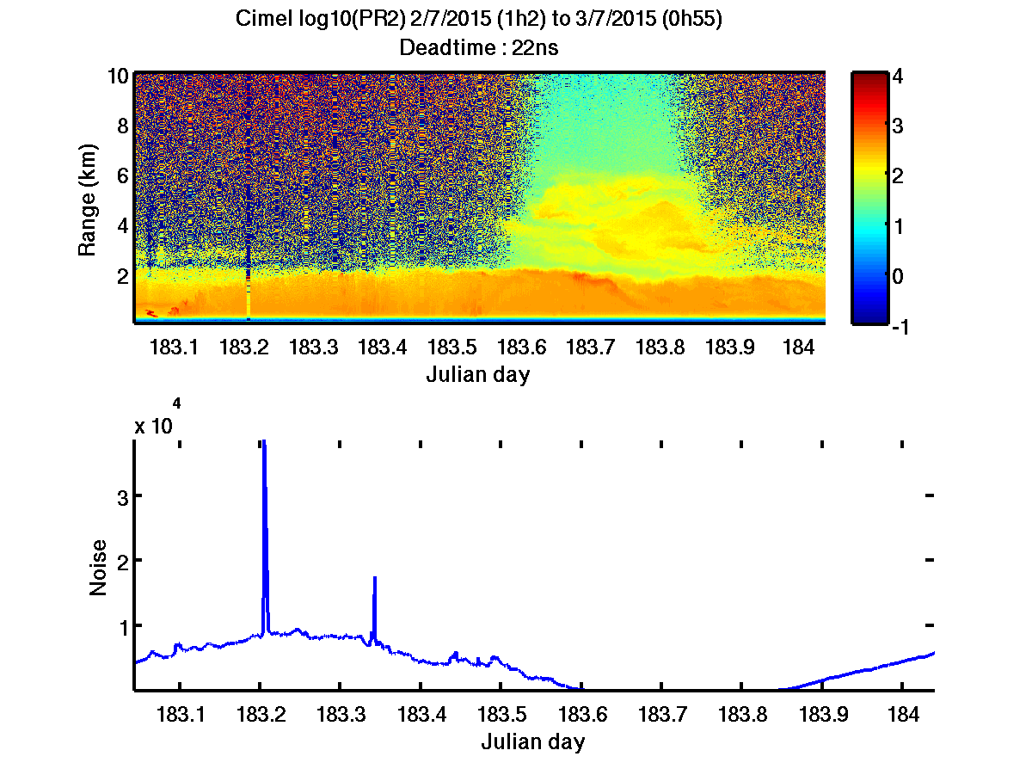
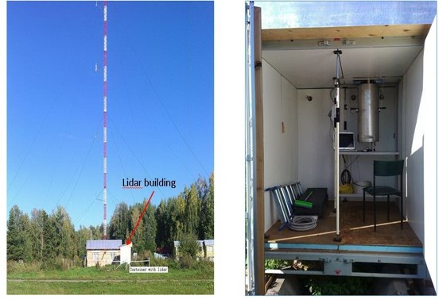
Ground-based and airborne lidar observations in Siberia
CIS-Linet 355, 532, 1064+ Raman (not run very often)
CIMEL Micropulse lidar 808 nm + cross polarization
Airborne Russian lidar LOSA 532 nm + cross polarization
+ AERONET sun photometer
Continuous observations at 808 nm 2015/2016: three 30 min cloud free profiles per day
Example of data analysis: statistical distribution of aerosol optical depth according to aerosol type (FLEXPART Lagrangian Modelling of aerosol sources)
Three aircraft campaigns with both lidars: 532 nm, 808 nm

Slide 4
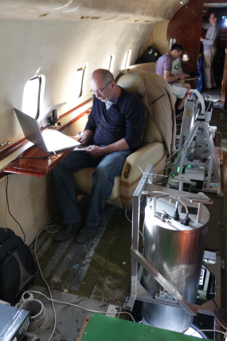
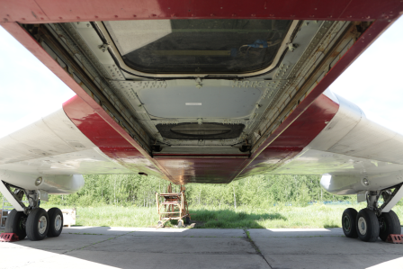
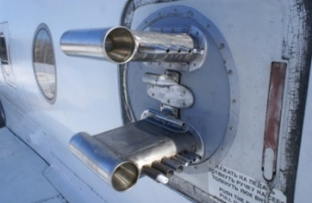



Research airborne platform
Russian TU-134 Measurement capabilities
Russian Atmaril-3 532 nm lidar with cross polarisation channel
CIMEL CE372 800 nm lidar with cross polarisation channel
and
Diffusional particle sizer (DPS) designed by IAO,
Aerosol spectrometer (Grimm Model 1.109),
Aethalometer
Nephelometer
Particulate organic matter sampling
CO/O3 analyzer (IAGOS instrument)
CO2/CH4/H2O analyzer (Picarro G2301-m)
CO2 analyzer (LI-6262) and flask sampling installation
PIs (LSCE): Philippe Ciais and Jean-Daniel Paris
PIs (LA): Philippe Nédélec
Pis (LATMOS): Gérard Ancellet, Jacques Pelon, and Kathy Law

Slide 5
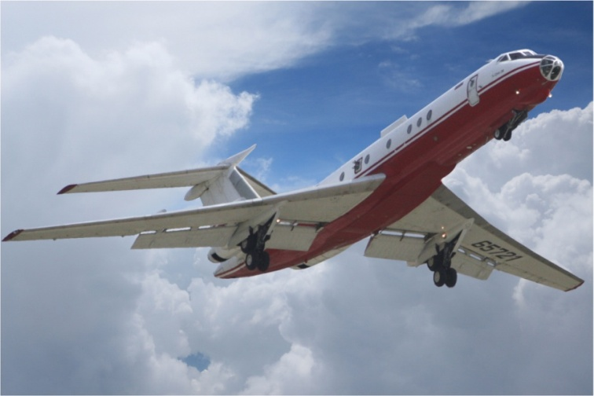
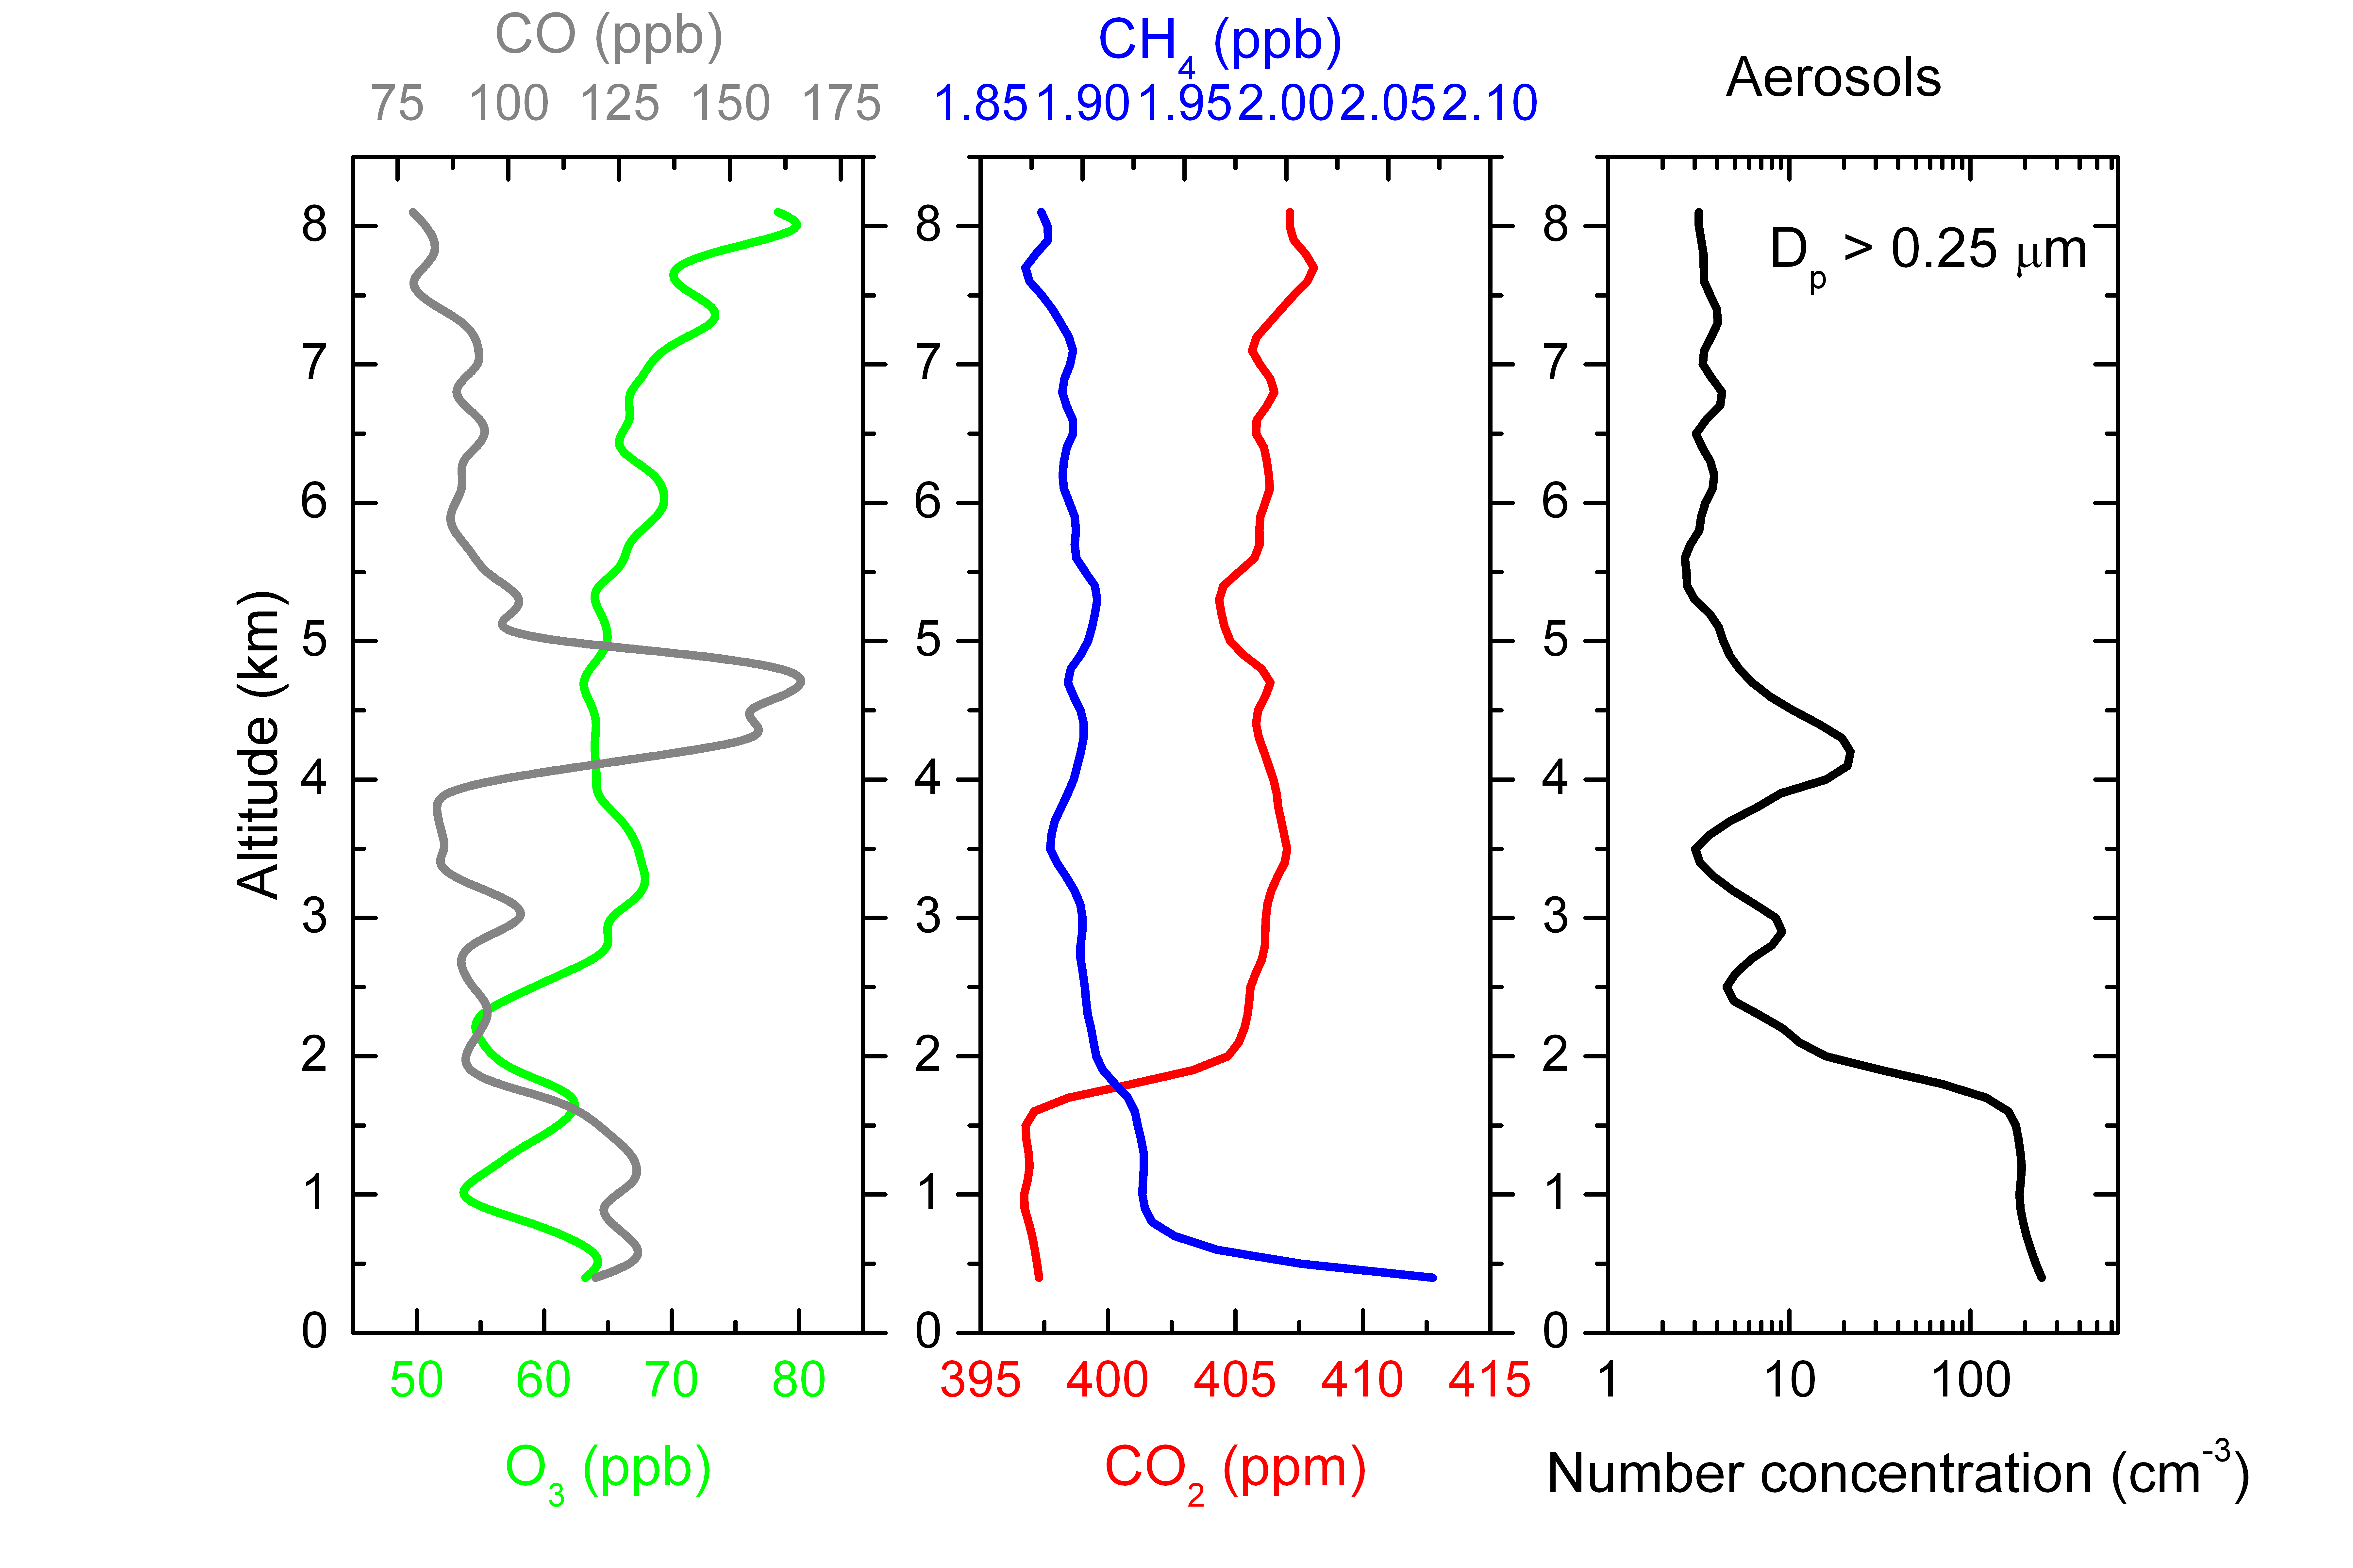
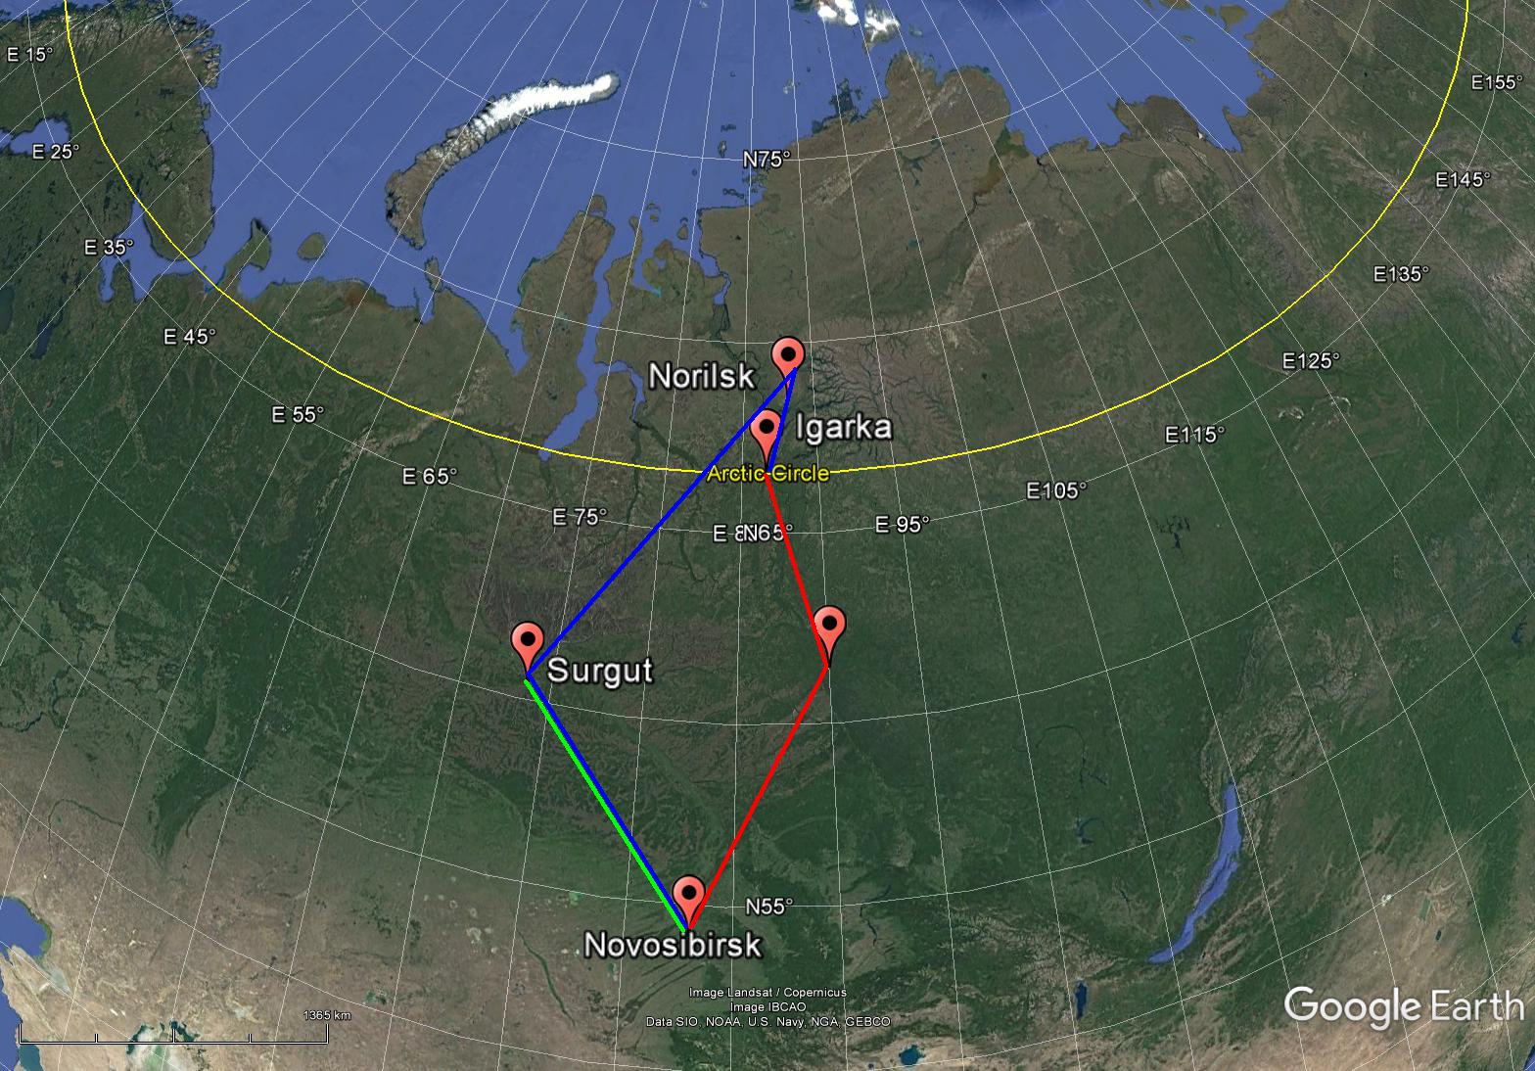
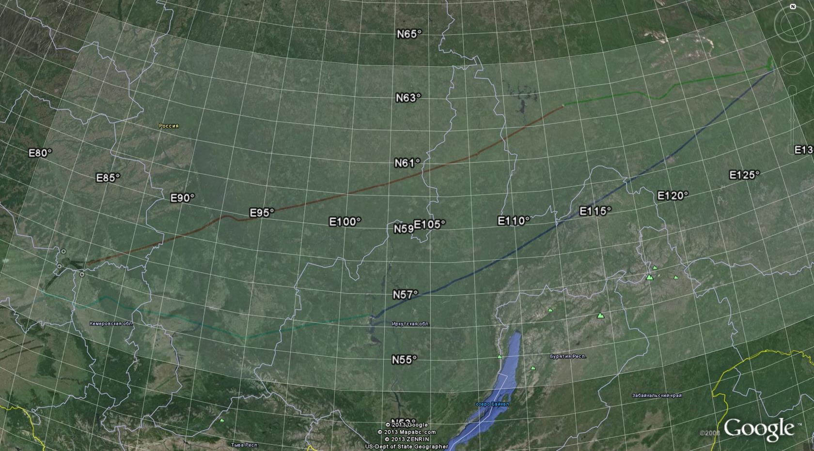
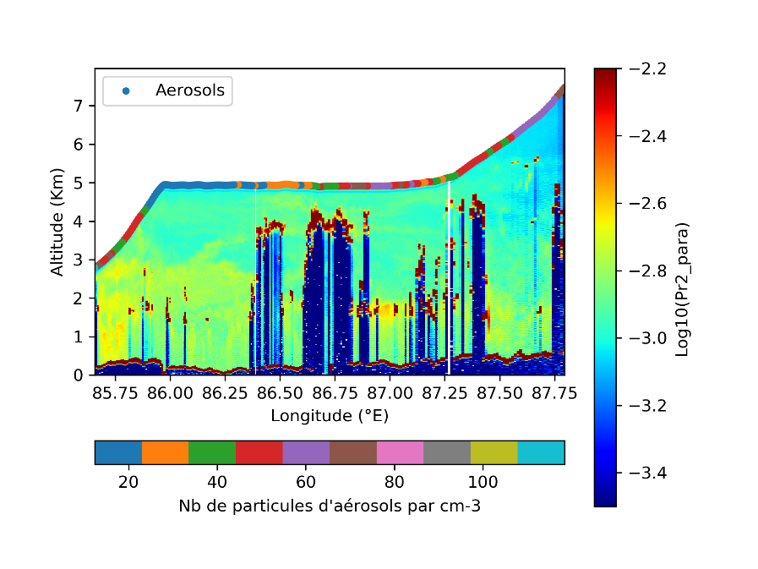
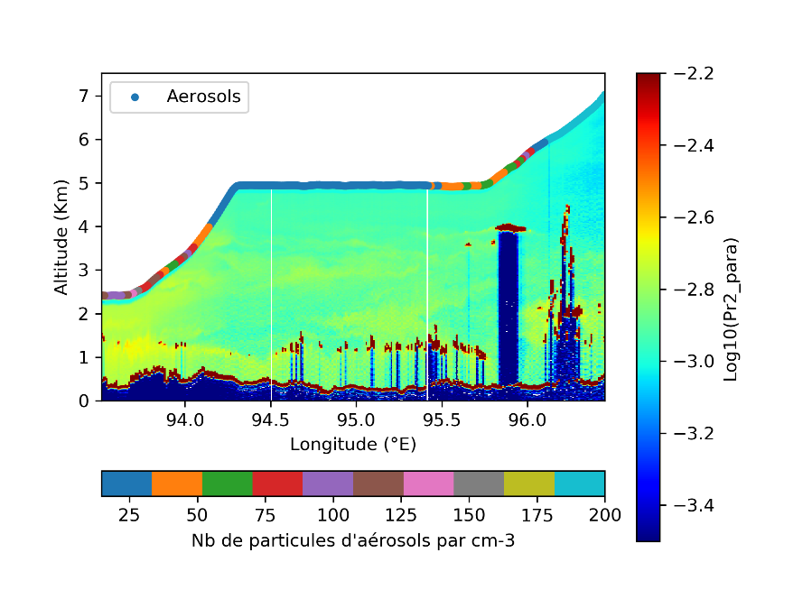
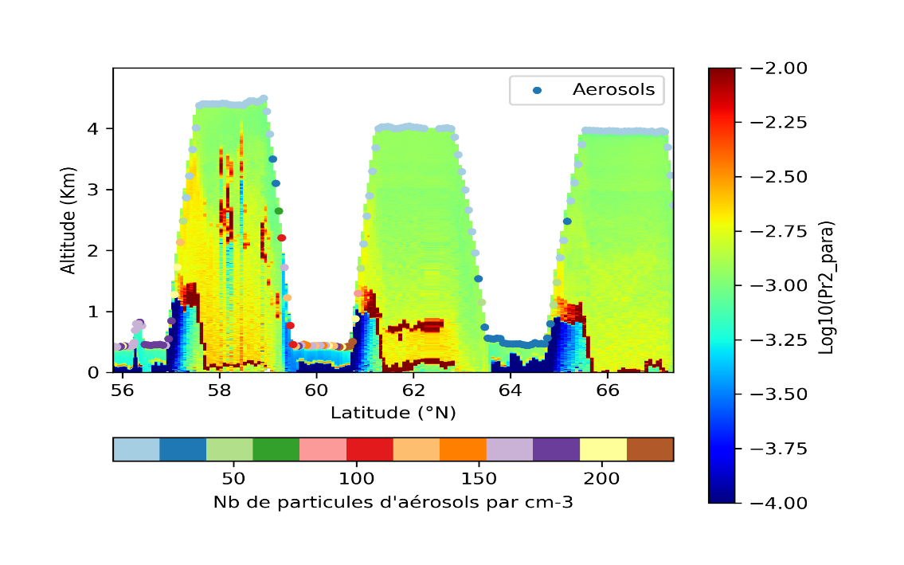
Aircraft campaigns : study of flaring and urban emission
Spring campaign (16/6 and 18/6/2017)
Summer 2013 campaign (18/7 to 20/7/2013)
Yakutsk
Tomsk
Krasnoyarsk
Novossibirsk
Bratsk
PIs (LSCE): Philippe Ciais and Jean-Daniel Paris
PIs (LA): Philippe Nédélec
Pis (LATMOS): Gérard Ancellet, Jacques Pelon, and Kathy Law
Notes:
5

Slide 6
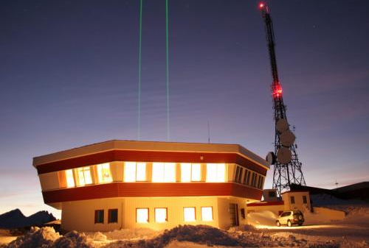
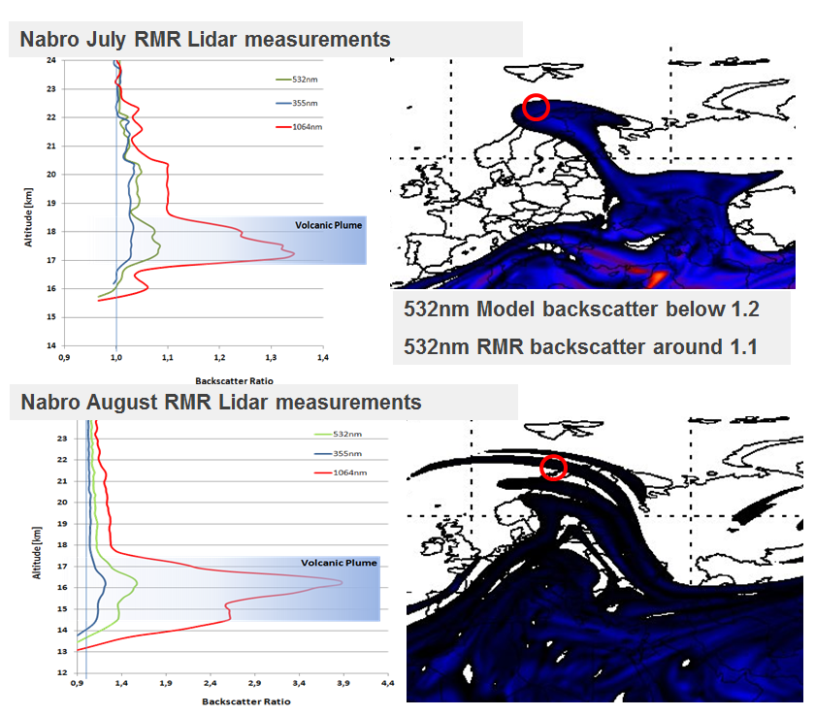
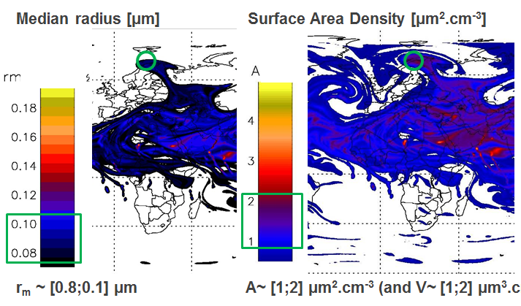
Ground-based lidar observations in Northern Scandinavia (ALOMAR)
Analysis of aerosol distribution in the upper troposphere/lower stratosphere (UTLS) at high latitudes from the ALOMAR Rayleigh/Mie/Raman lidar (69°N, 16°E)
Multispectral measurements at 355 nm, 532 nm and 1064nm, including Raman channels for molecular reference with excellent SNR in UTLS.
Color ratios and depolarisation ratios are usually used to discriminate between the different aerosol types.
Sample volcanic plume detection – Nabro plume in 2011
Left: UV/Visible/IR lidar profiles of the plume. The particle size distribution can be retrieved from 3 wavelength lidar measurements
Below: modelled backscatter using microphysical/transport modeling and explicit aerosol scheme for optical calculations

Slide 7
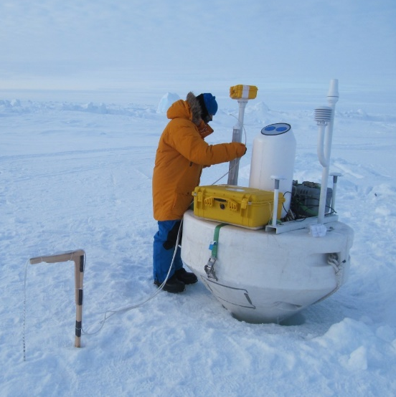
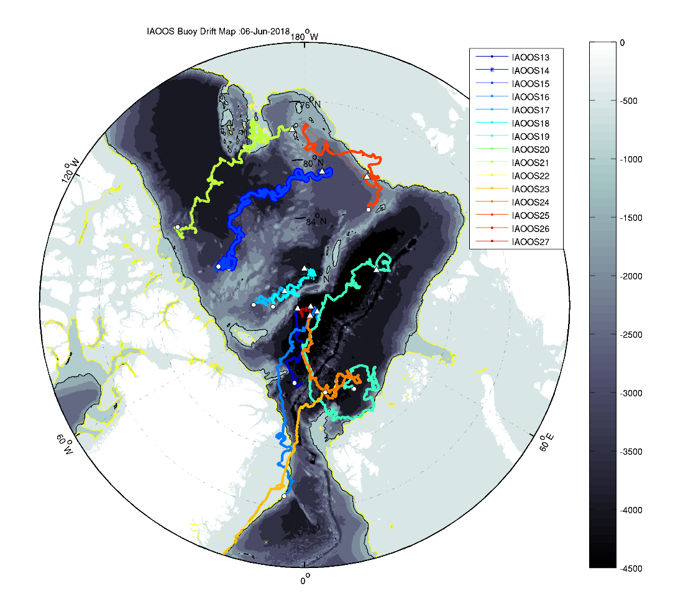
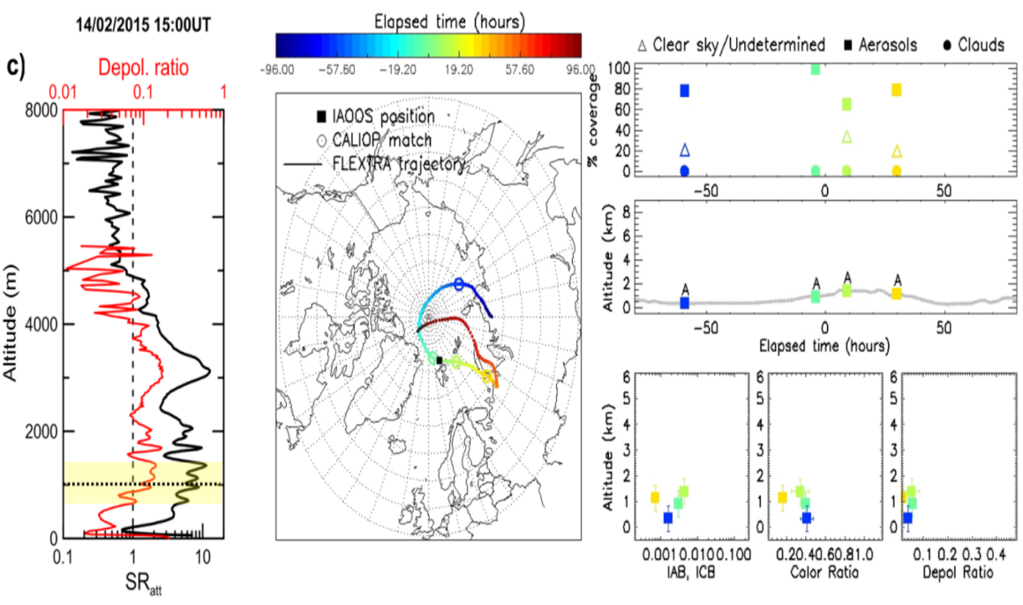
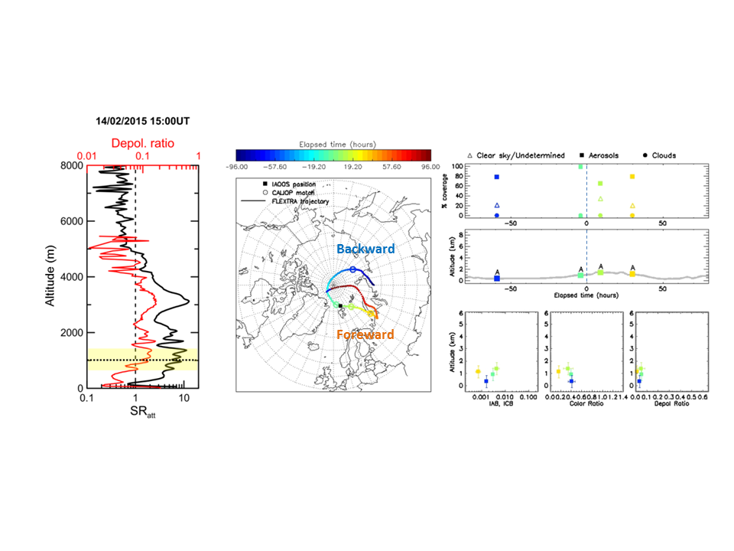
IAOOS platforms for Arctic Studies
IAOOS platforms are deployed over the Arctic and perform
Atmosphere (meteo and backscatter lidar),
Snow/Ice (T profiles)
Ocean (T, S, … profiles) measurements
Several IAOOS platforms are deployed every year over the Arctic since 2013.They are drifting with the ice accross the Arctic and exit through FRAM straight
Example of IAOOS/CALIOP comparison of aerosol vertical profiles (Di Biagio et al. JGR 2018)

Slide 8
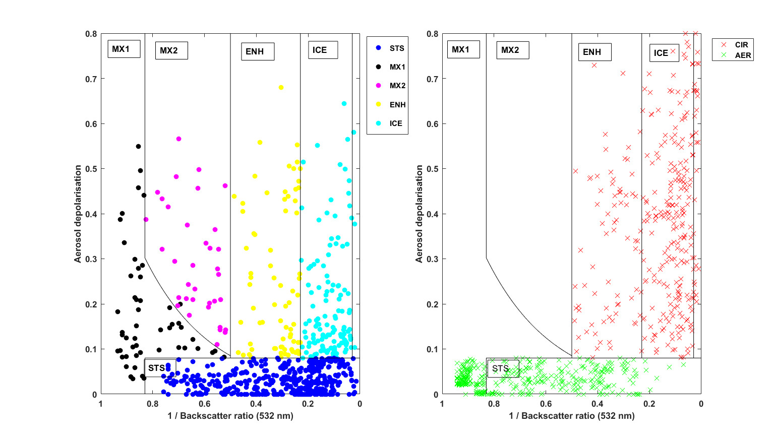
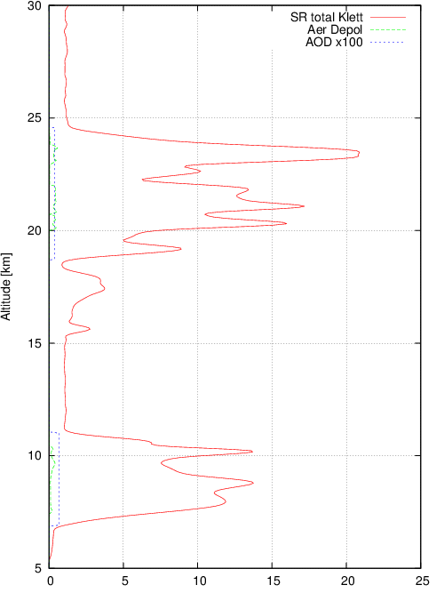
Aerosol and cloud distributions above Dumont D’Urville (DDU), Antarctica :
532 nm backscatter lidar including cross polarization and N₂ Raman measurements (UTLS aerosol)
> Impact of cirrus and stratospheric ice layers on water vapor budget during the PSC season
> Understanding the role of multiple aerosol/cirrus/PSC layers (H2SO4, HNO3 and H2O) vertical distributions above DDU.
Earthcare products:
355nm backscatter,
depolarisation + Ice water Content ?
2007-2017 lidar layer classification using backscatter/depolarisation
Cloud type (NAT, ICE, STS) Aerosol/Cirrus
Sample 2016 profile in winter season with strong cirrus and ice PSC layers
Backscatter coefficient 532nm

Slide 9
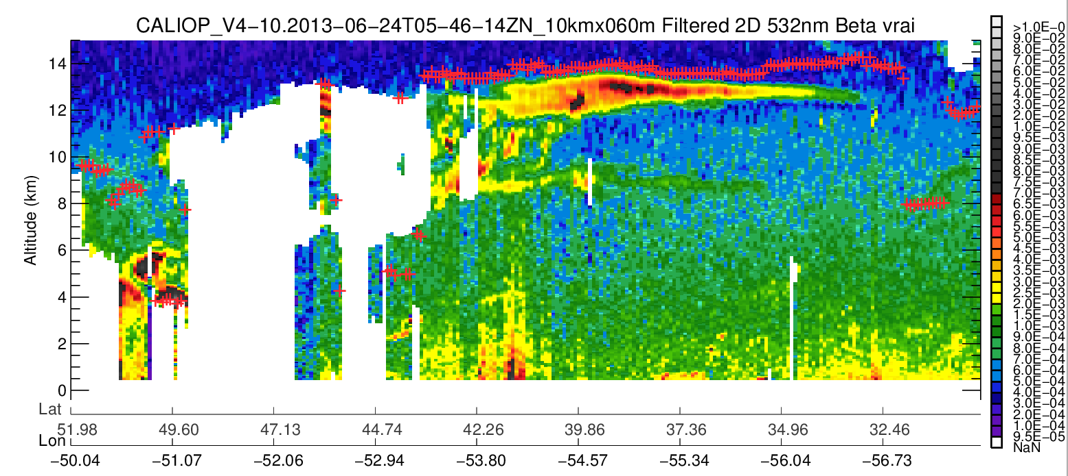
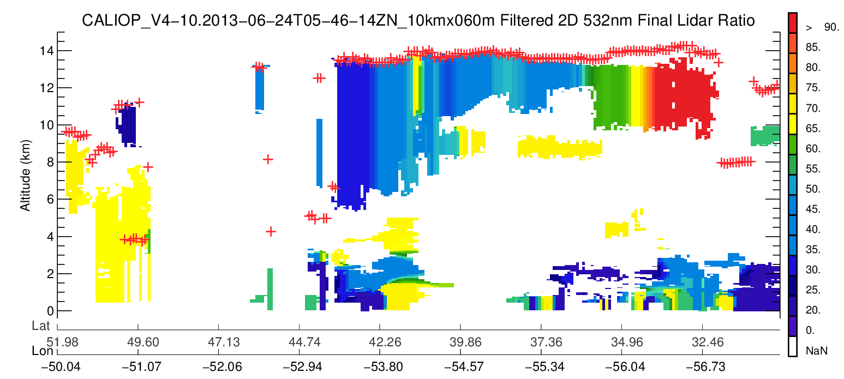
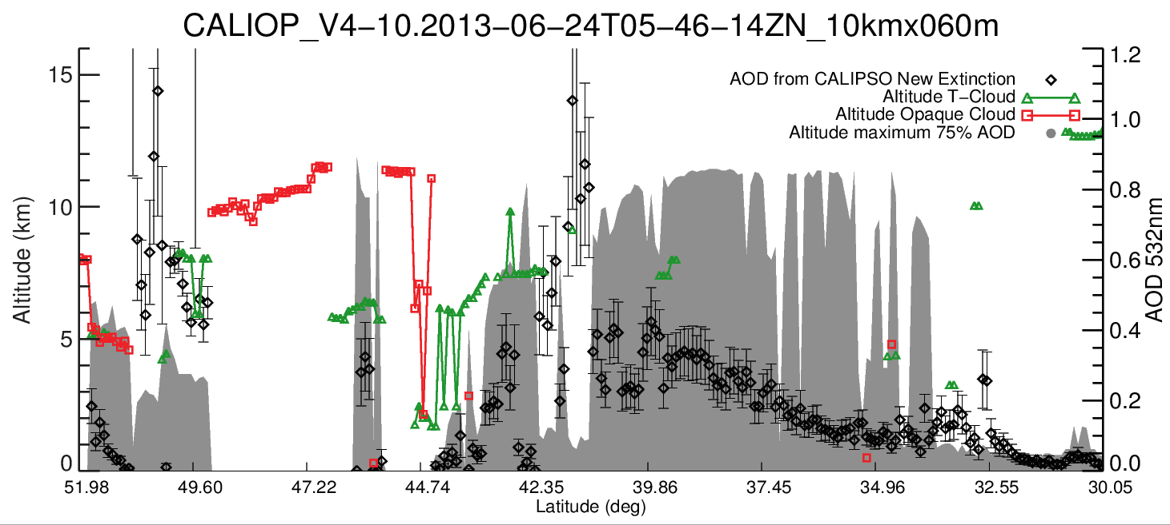
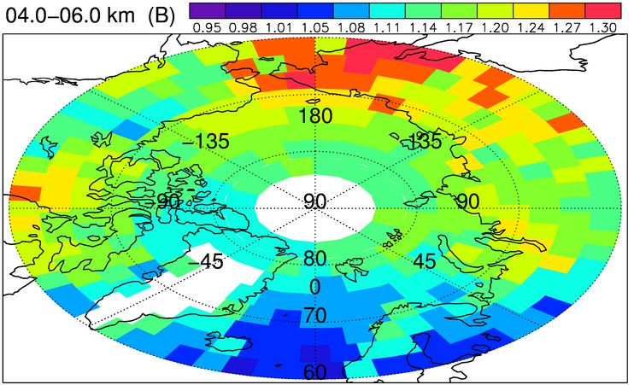
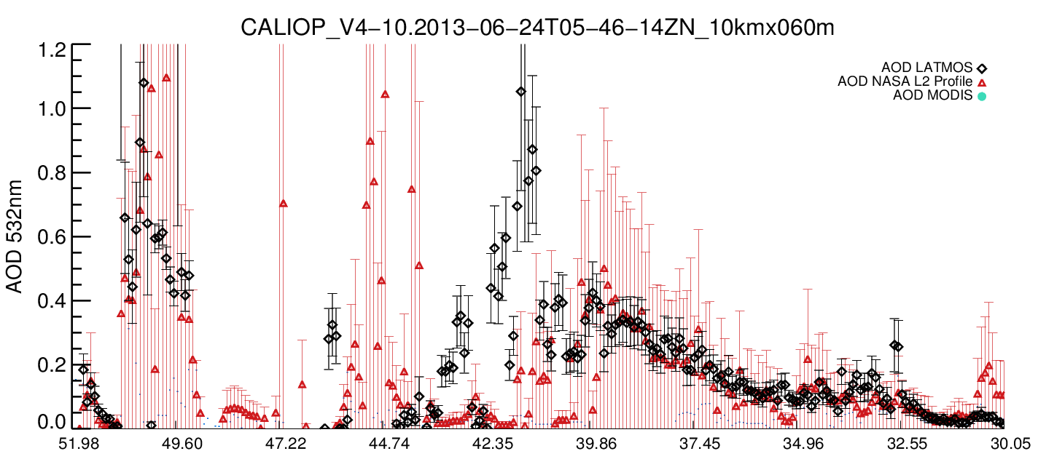
CALIOP versus ALTLID aerosol mapping at high latitudes
Analysis of Version 4 Level 1 CALIOP data for aerosol mapping at high latitudes for different regions and different seasons in order to validate similar future aerosol distributions produced by ATLID.
Removal of the cloudy pixels is based on the level 2 cloud layer CALIOP operational data product + analysis of the IIR brightness temperature.
If the lidar ratio can be constrained from lidar observations it is chosen instead of the lidar ratio of operational products.
March/April/May 2008 Ancellet et al. ACP 2014

Slide 10
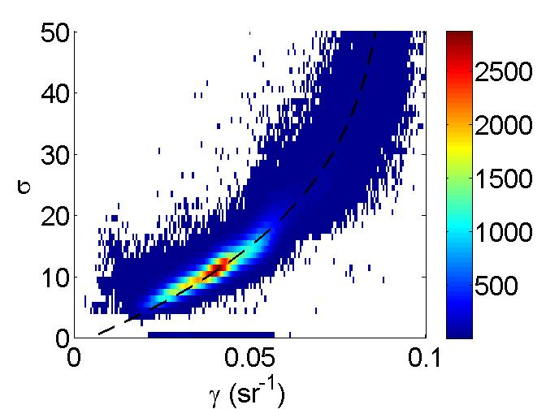
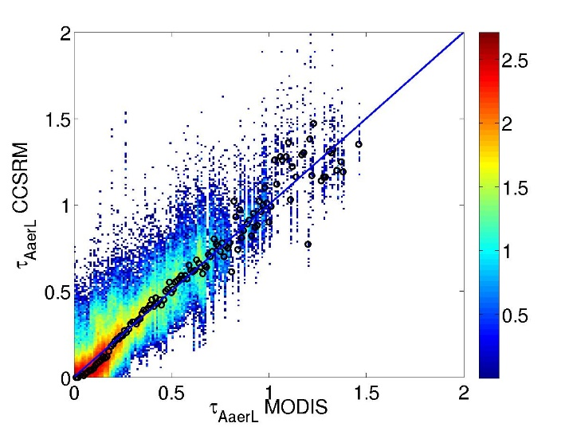
Retrieval of aerosol (and semi-transparent clouds) with SODA Synergized Optical Depth of Aerosol
CLOUDSAT
Beam
(Reference)
CloudSat radar is providing the surface reference and we analyze CALIPSO lidar IAB deviations at the surface using the observed relationship
(Josset et al. 2008, 2009, 2010, 2012)
CALIPSO
Beam
(Deviations)
H₂O
Aerosols
(or ice clouds)
ocean
CALIPSO (ϒ) vs CLOUDSAT (σ) surface echo is well defined in clearest conditions.
Deviations are linked to lidar attenuation: Total column optical depth

Slide 11
Summary
1) Validation against ground-based lidar high latitude observations: ensured measurements in 2021
Tomsk ground based lidar observations (532 nm, 808 nm + very likely 355 nm from EARLINET instrument) → collaboration CNRS/SBRAS and funding from French (CNES, CNRS) and Russian projects
Analysis of ALOMAR observations (355 nm , 532 nm, 1064 nm) in lower stratosphere → specific agreement between LATMOS and Leibnitz-IAP Kühlungsborn
DDU Antarctica observations at 532 nm (including Raman and depolarization) → funded by IPEV NDACC project
2) Validation against ground-based/airborne lidar high latitude observations: possible additional measurements in 2021
Aircraft measurements in 2021 above Siberia are possible but need additional funding (100 k€ for a 4-day Siberia survey)
IAOOS buoy release possible after 2019 (but limited). To secure measurements in 2021, need for an extension of IAOOS project
3) Validation ATLID aerosol products versus CALIOP aerosol products at high latitudes:
Comparison of 1-year ATLID+MSI aerosol data products focusing on high latitudes with aerosol mapping of aerosol layer properties derived from CALIOP+IIR observations (e.g. L2 operational aerosol products, L1 CALIOP data averaging, SODA products)

Slide 12
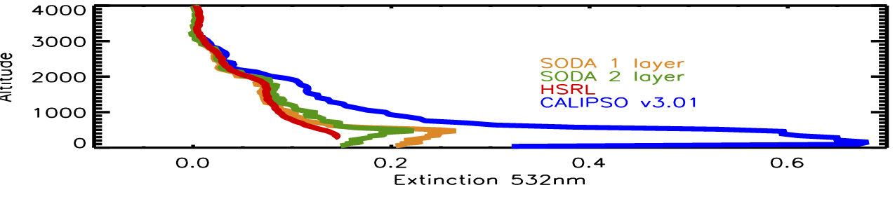
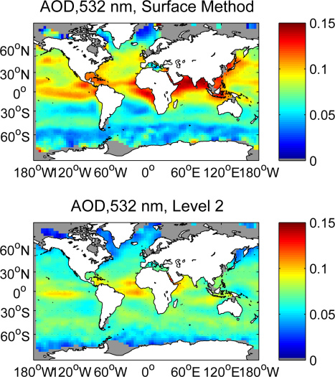
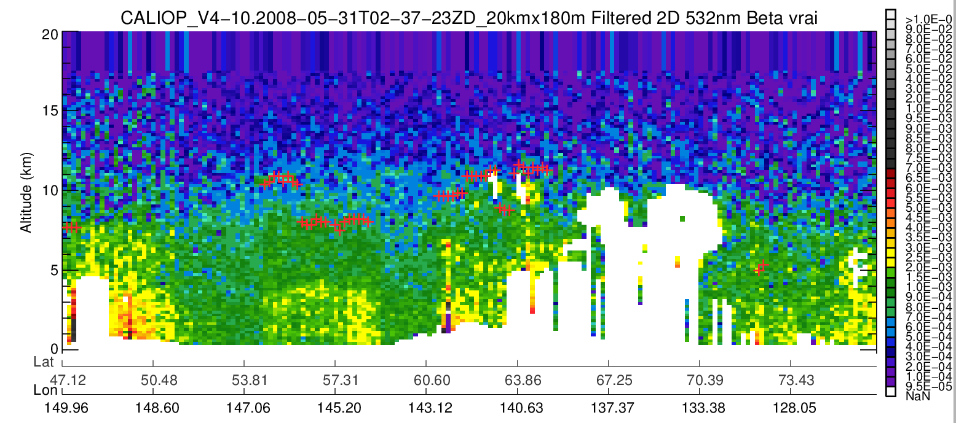
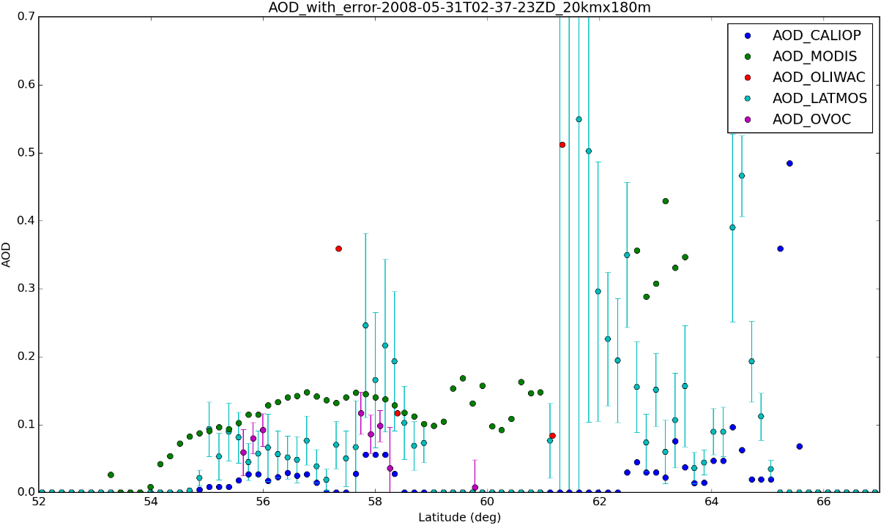
Retrieval of aerosol (and semi-transparent clouds) AOD with
Ocean surface reflectance vs CALIOP
Comparison with HSRL results (Ferrare et al.) assuming S in lower layer from SODA
(He et al., Optics Express 2016)

Slide 13
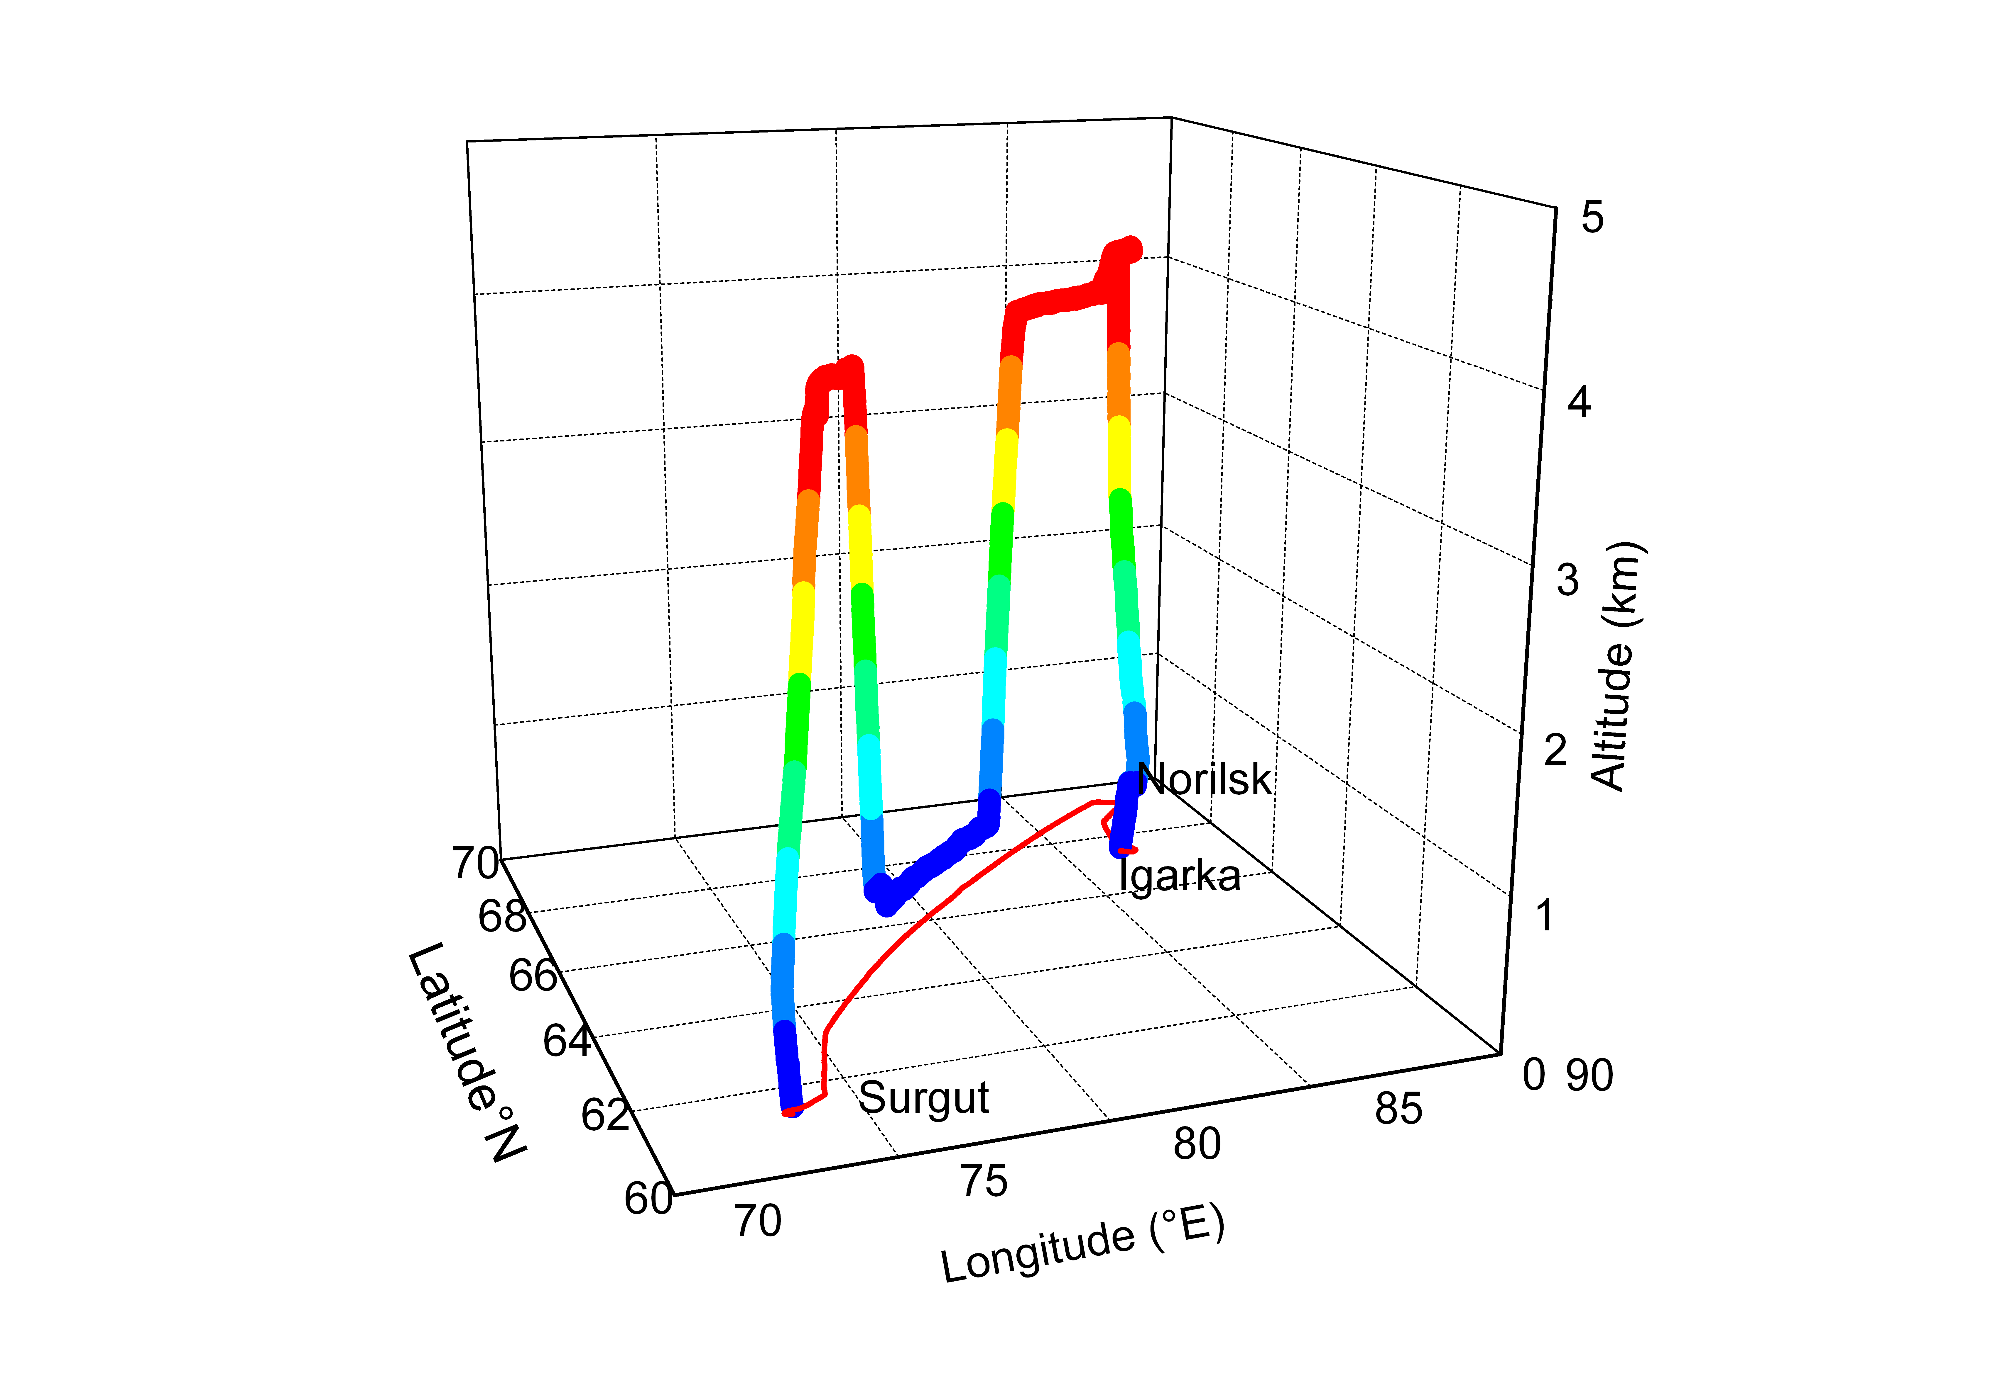
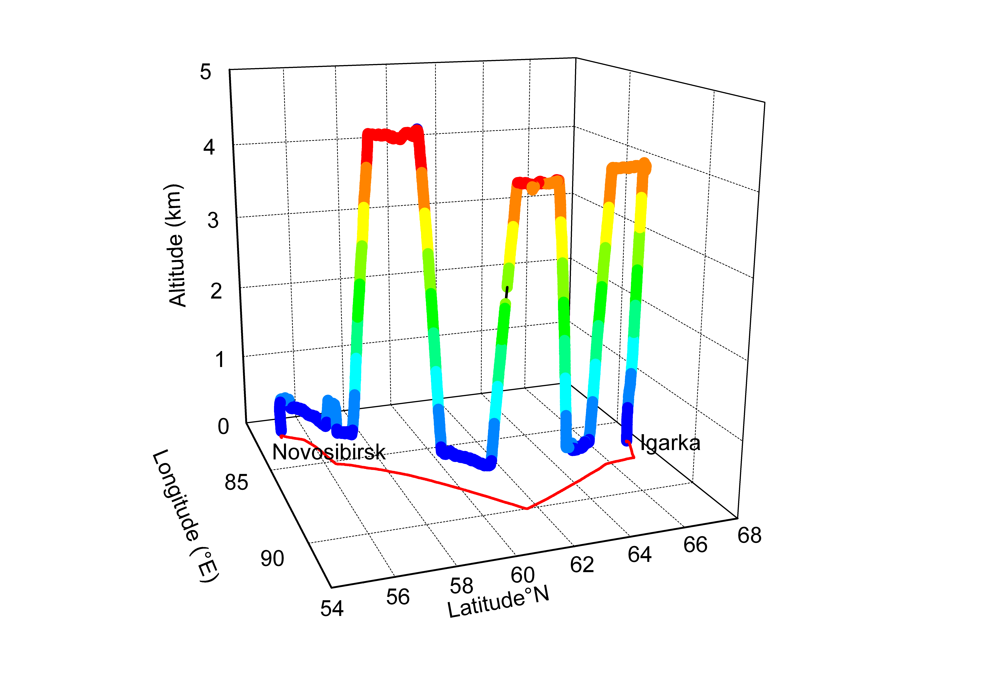
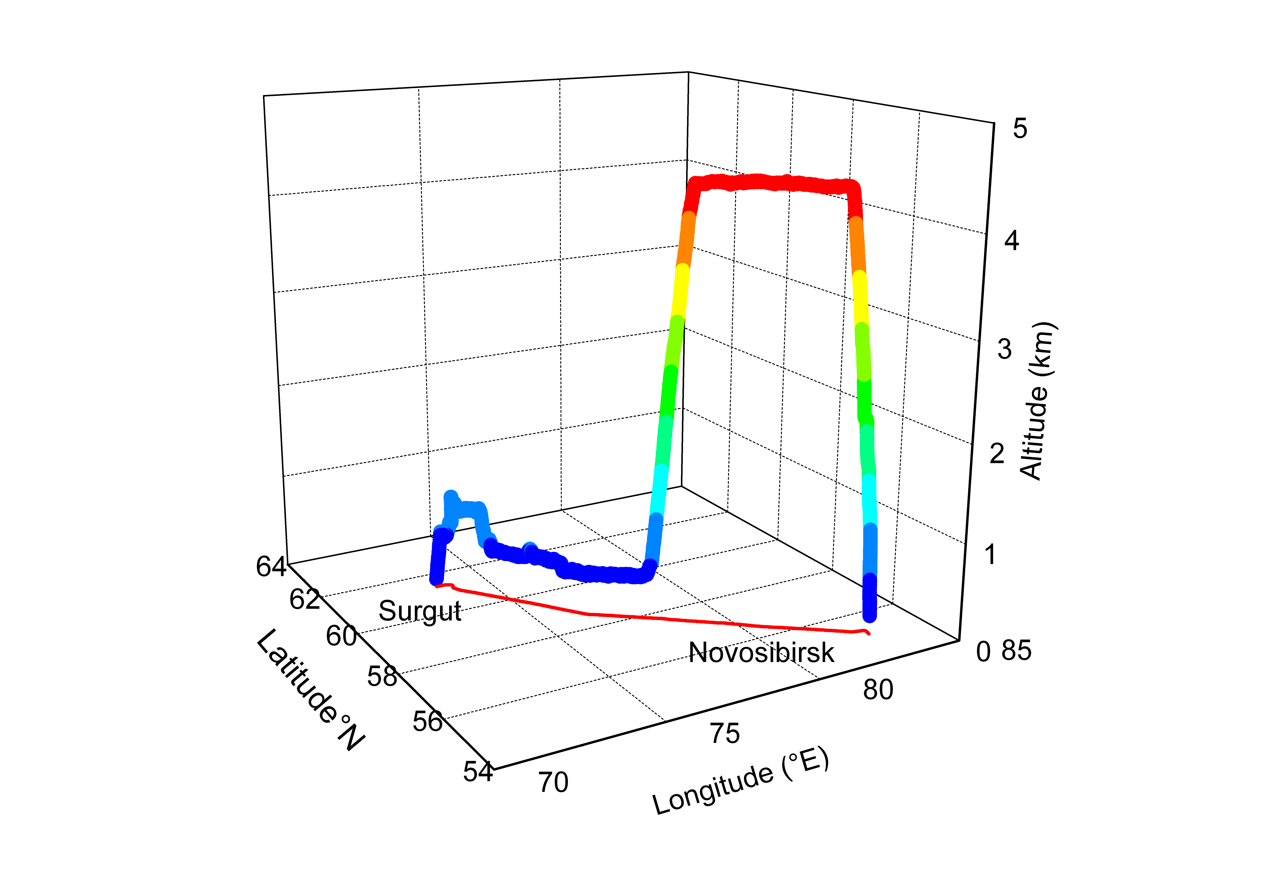
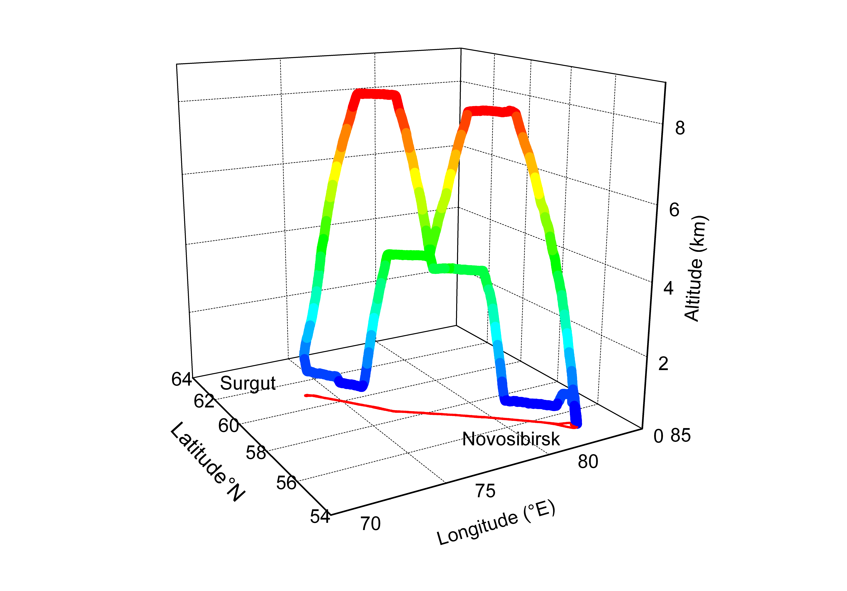
Aircraft campaign June 2017: urban pollution from Siberian cities
Flight 2
Flight 3
Spring campaign (16/6 and 18/6/2017)
IAO lidar 532 nm + depolarization channel
In-situ: CO/CO2/CH4, aerosol
Flight 4
Flight 1
PIs (LSCE): Philippe Ciais and Jean-Daniel Paris
PIs (LA): Philippe Nédélec
Pis (LATMOS): Gérard Ancellet, Jacques Pelon, and Kathy Law

