Slide 1
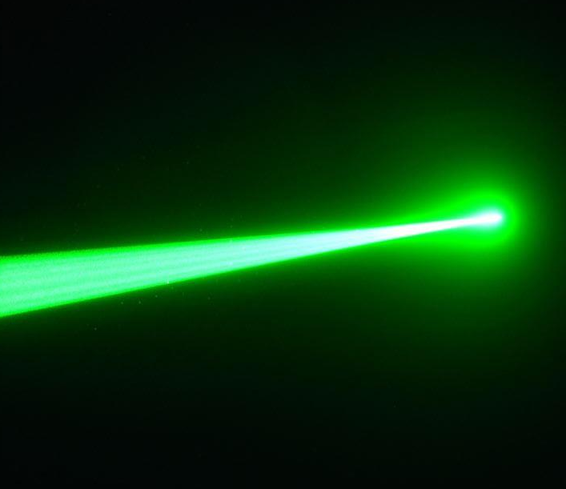
British and Korean Lidars for Atlid Validation
(BAKLAVA)
Matthias Tesche, Youngmin Noh, Sung-Kyun Shin, Boyan Tatarov, and Detlef Müller

Slide 2
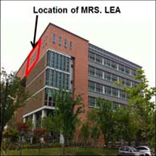
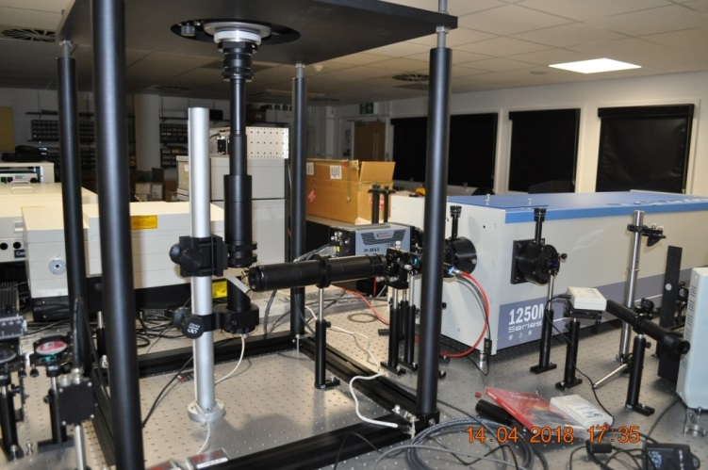
Validation of ATLID aerosol and cloud products
Multiwavelength Raman Spectrometer Lidar in East Asia (MRS.LEA)
Lidar Spectroscopy Instrument (LiSsI)
Gwangju, Republic of Korea (35.23°N,126.84°E)
Hatfield, United Kingdom (51.75°N, 0.24°W)

Slide 3
What’s so special?
Traditional multiwavelength Raman lidar
MRS.LEA, 140 mJ at 355 nm, Spectrometer lidar prototype
LiSsI, 2500 mJ at 355 nm, Spectrometer lidar testbed
Sender
Receiver
Beam separation
PMT + DAQ
Nd:YAG Laser
Telescope
32PMT + DAQ
OPO
Spectrometer
ICCD
First light in September 2017

Slide 4
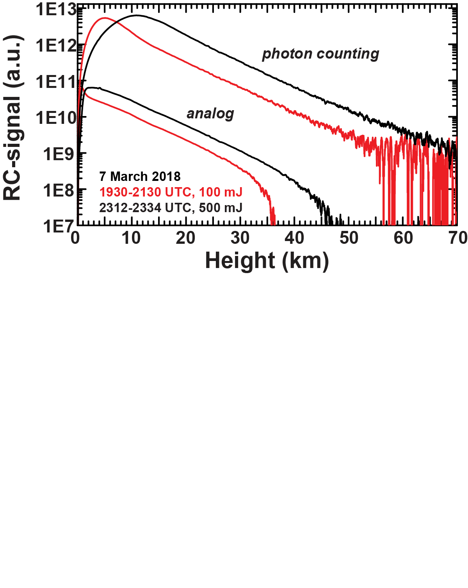
Example measurement
7 March 2018, 532 nm, 300-m smooth

Slide 5
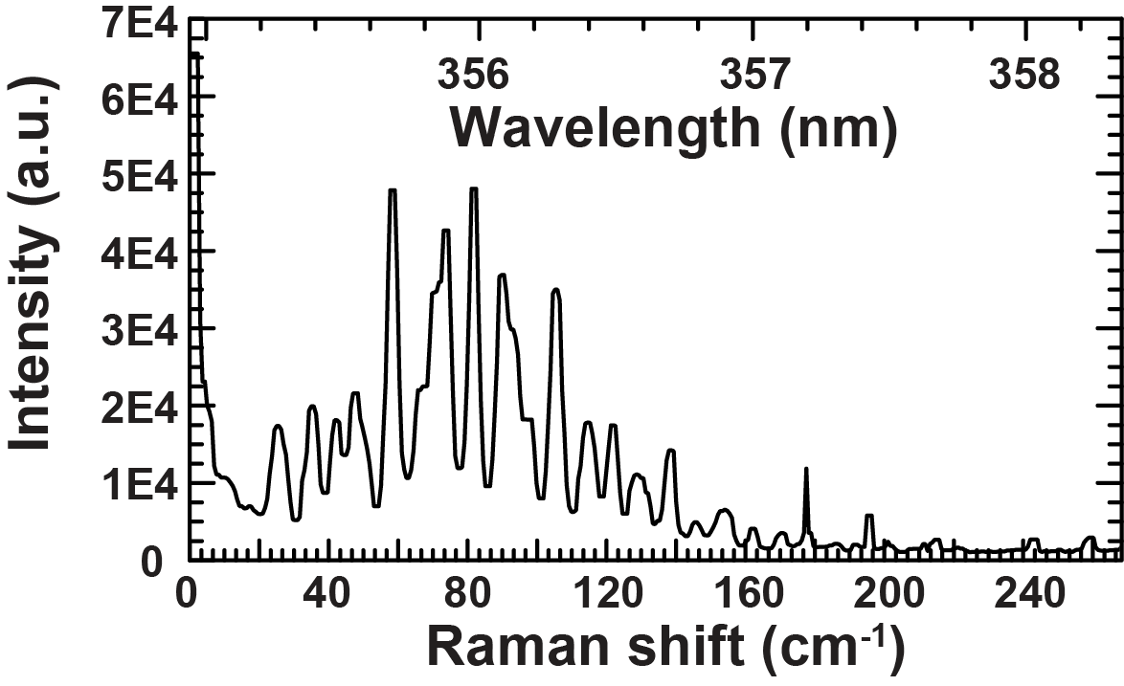
Pure rotational Raman spectrum
Air, 2017 UTC on 4 November 2017, averaged over 10 shots (1 s).
Laser power: 300 mJ at 354.9 nm. ICCD time gate: 0.03-2 µs (4.5-300 m). Grating: 1200 g/mm. Entrance slit: 50 µm. Spectral resolution ≈ 5 cm-1.

Slide 6
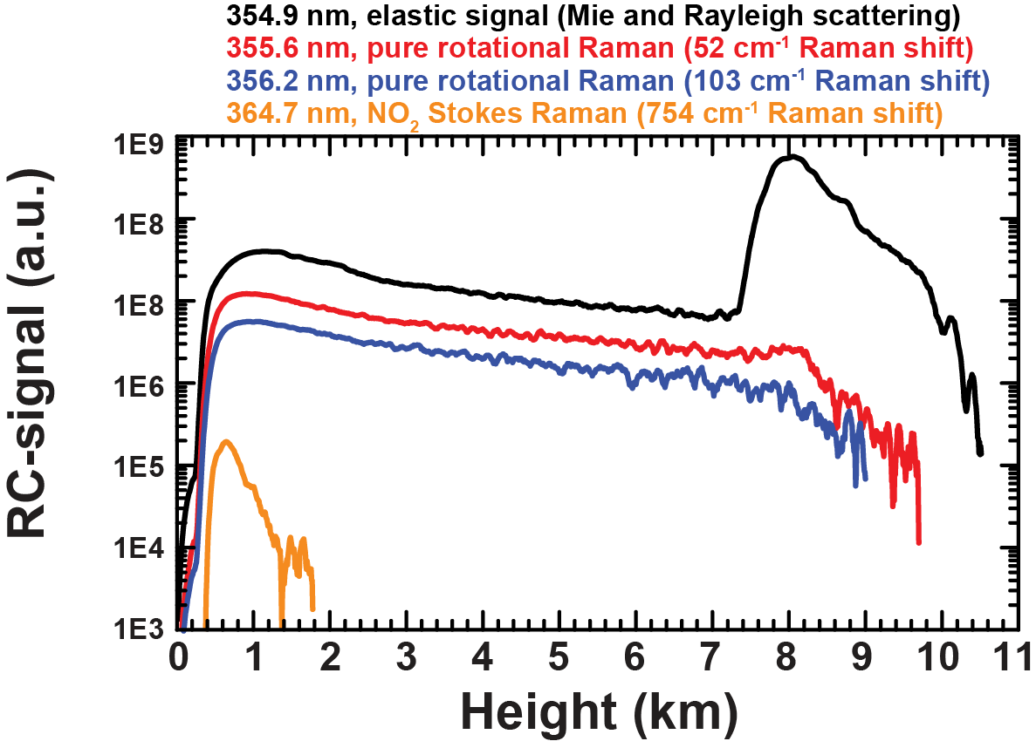
Elastic and Raman signals
1726 to 1735 UTC on 3 November 2017 averaged over 5400 shots (9 min).
Laser power: 300 mJ at 354.9 nm. Detector: 32 channel PMT. Channel size: 1 mm. Grating: 1200 g/mm. Entrance slit: 50 µm. Spectral resolution ≈ 0.667 nm.

Slide 7
Measurement capabilities
 | LiSsI |  |  | MRS.LEA
Wavelength (nm) | 355 | 532 | 1064 | 355 | 532 | 1064
Backscatter coefficient | X | X | X | X | X | X
Extinction coefficient | X | X |  | X | X
Lidar ratio | X | X |  | X | X
Depolarisation ratio | X | (X) |  | X | X
Stokes vector | (X) |  |  | (X)
Evaluation of confidence in:
clear sky detections (A-FM),
detection of attenuated regions (A-FM)
detection of aerosol type (A-TC).
10+ km A-AER products
1-km A-EBD products
Boundaries and optical depth of aerosol and cloud layers

