Slide 1
Calibration and Validation for EarthCARE Cloud Profiling Radar (CPR) using Ground Based, and Satellite Weather Radar Observations
V. Chandrasekar,
Annakaisa von Leber and
Ari-Matti Harri

Slide 2
Outline
EarthCare Mission Overview
Calibration and Validation Requirements
Finnish Meteorological Institute (FMI) Radar Network
NEXRAD, CSU-CHILL and NPOL Observations
GPM DPR Observations
Calibration and Validation Activities
Project Plan

Slide 3
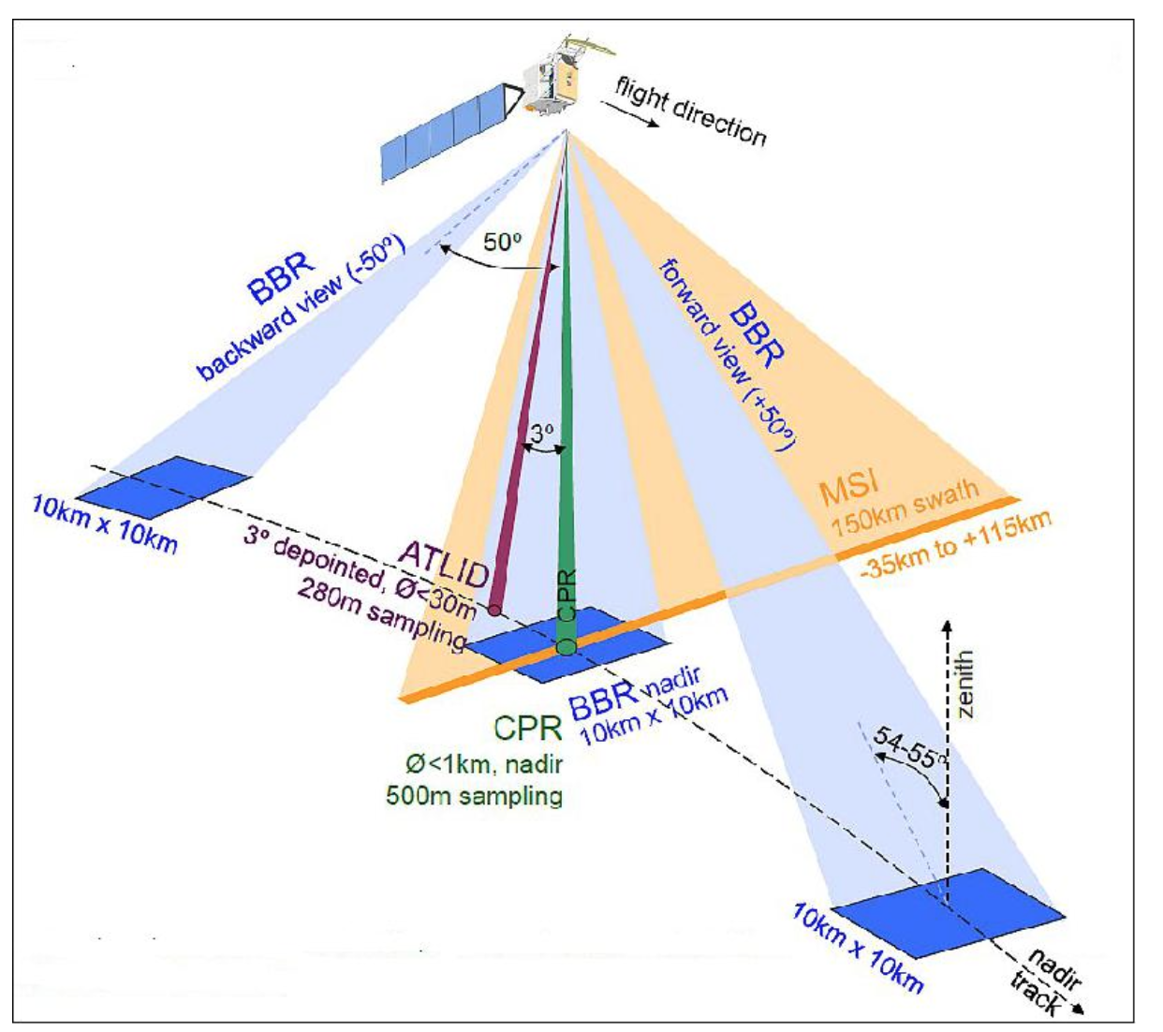
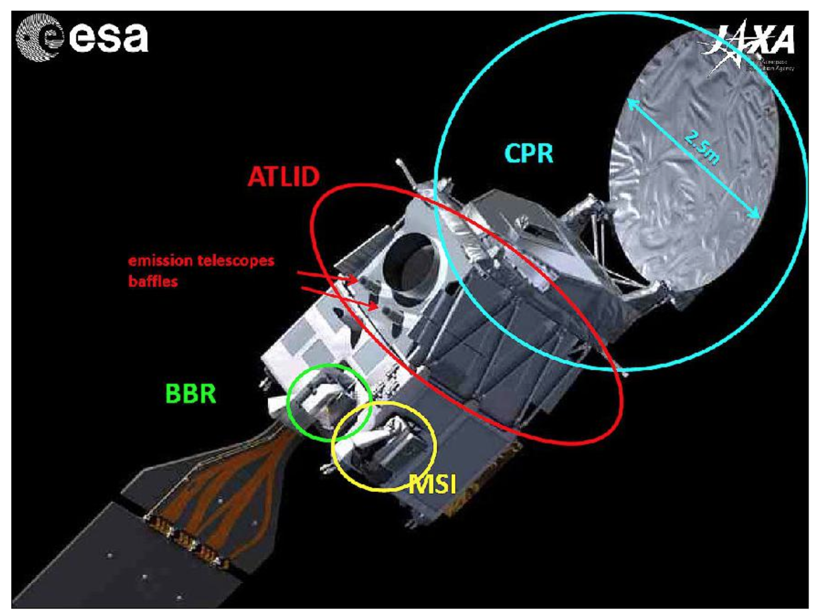
EarthCare Mission Overview

Slide 4
Calibration and Validation Requirements
In the EarthCare satellite mission, the principal means to provide estimates of uncertainty are by comparison to independent ground-based, airborne, and satellite-based measurements and to models, combined with detailed investigations of the retrieval methods.
Specific validation areas include:
validation using other satellite, airborne or ground-based experiments providing independent measurements;
experiments to assess accuracy, resolution, and stability of the EarthCARE instruments;
assessment and validation of the EarthCARE retrieval and processing.
In calibration and validation activities with CPR in EarthCare, we can provide external calibration and validation of CPR using GPM DPR radar observations, dual-polarization radar network at Finland, NEXRAD radar, CSU-CHILL radar as well as NPOL. These activities include but not limited to radar measurements calibration, error specifications, hydrometeor identification cross-validation, and Doppler velocity calibration etc.
CPR is a core instrument of EarthCare, which is a nadir-looking active instrument operating at W- band (94 GHz)

Slide 5
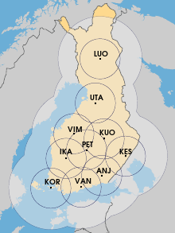
Finnish Meteorological Institute (FMI) Radar Network
The Finnish Meteorological Institute has a network of ten radars, which covers most of the country.
The radars in the network consist of 9 dual-polarization C-Band Doppler radars: Vantaa, Anjalankoski, Ikaalinen, Korpo, Kuopio, Utajärvi, Luosto (upgraded 2009-2014), Kesälahti (built 2014) and Petäjävesi (built 2015) and one single-polarization C-Band Doppler radar: Vimpeli (built 2005).
It is a fully automated radar network designed, planned, maintained and operated by FMI. This radar network is a useful and important validation tool for radar on the EarthCare.
The map of radar network at Finland.

Slide 6
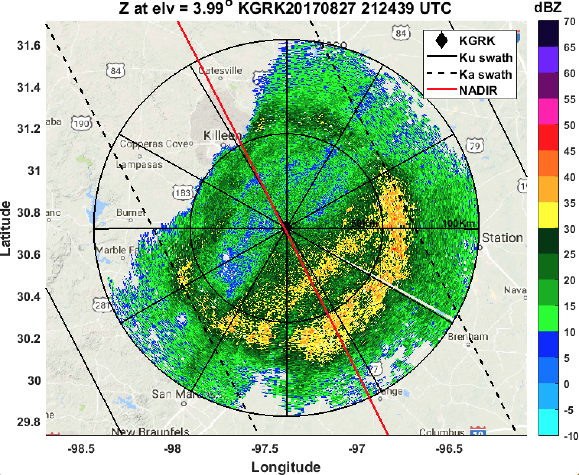
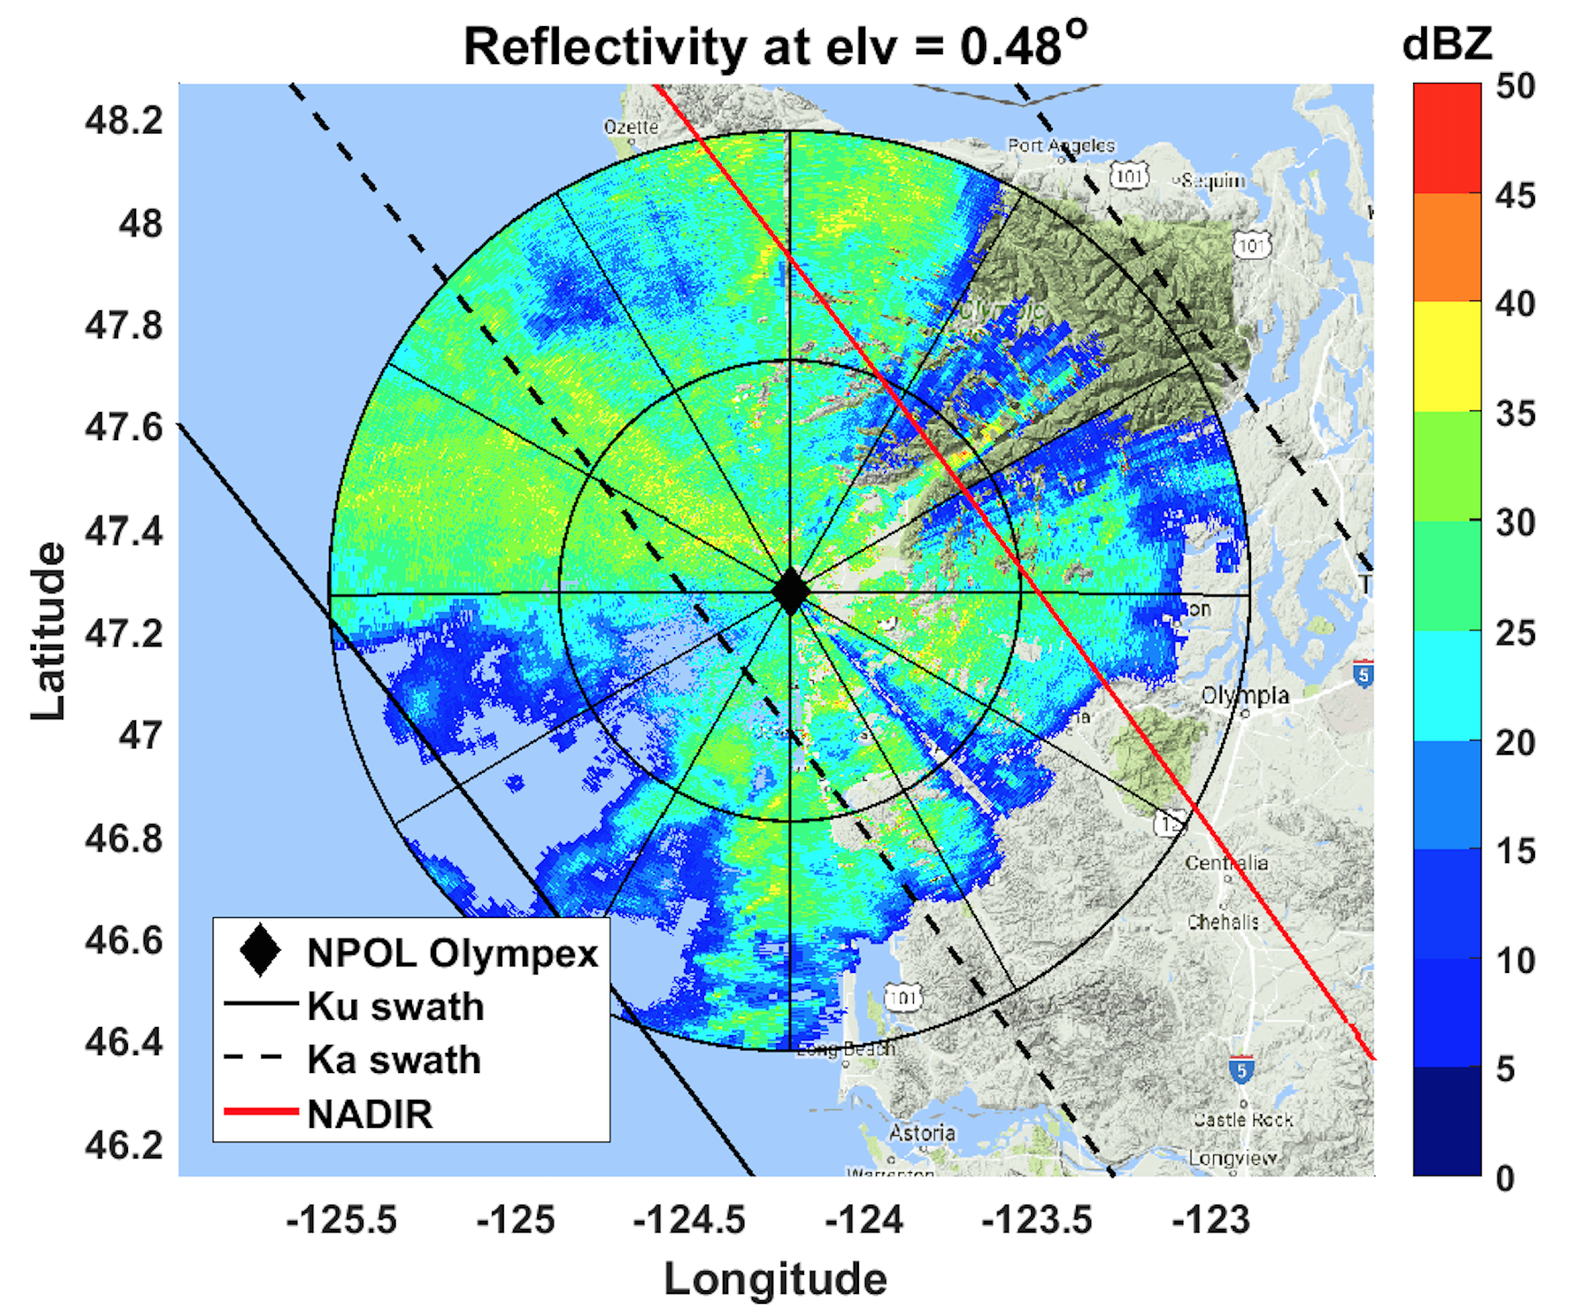
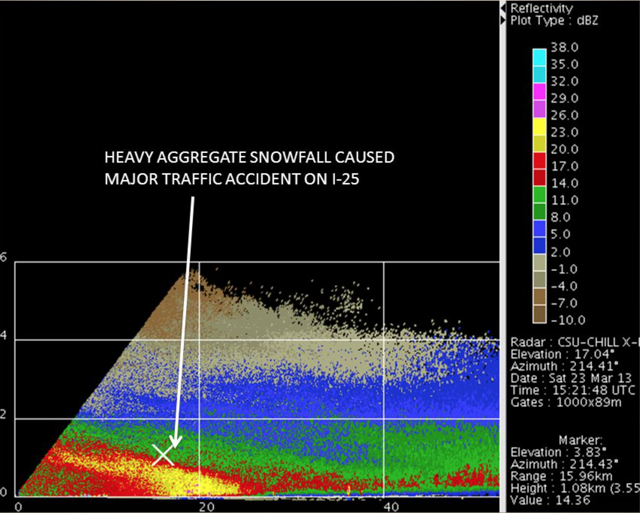
NEXRAD, CSU-CHILL and NPOL Observations
Sample observation of NEXRAD KGRK (Fort Hood, Texas) radar on 08/27/2017.
Sample observation of NPOL radar on 12/03/2015 during Olympex campaign in Washington state.
NEXRAD or Nexrad (Next-Generation Radar) is a network of 158 high-resolution Doppler weather radars operated by the National Weather Service, an agency of the National Oceanic and Atmospheric Administration (NOAA) within the United States Department of Commerce. The CSU-CHILL National Weather Radar Facility, located in Greeley, CO, is an advanced, dual-polarized , dual frequency S-band and X band weather radar system.
Sample RHI scan of CSU-CHILL radar at Greeley, Colorado.

Slide 7
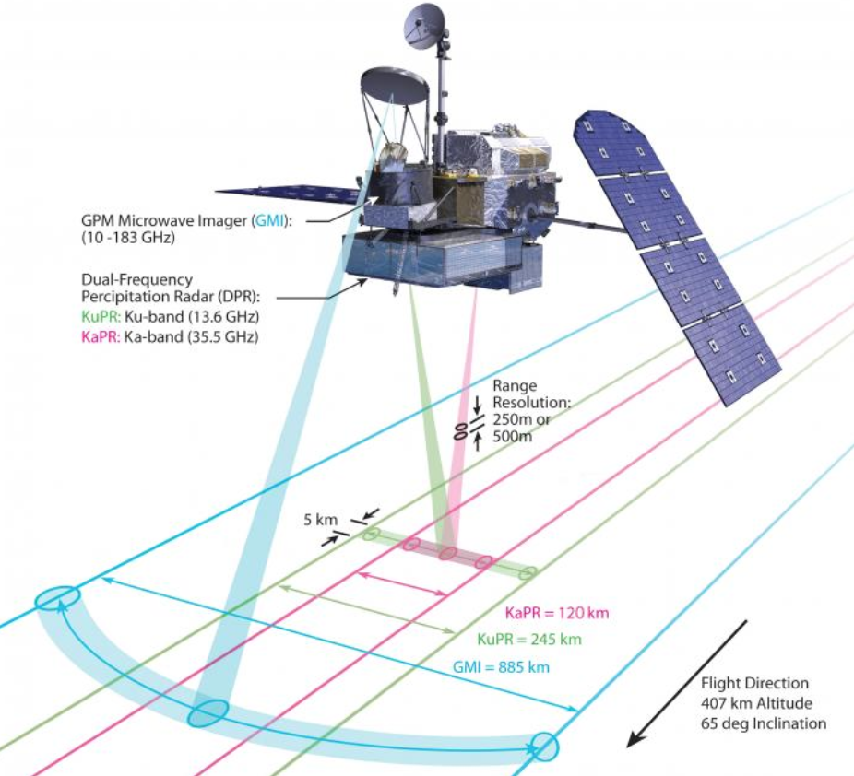
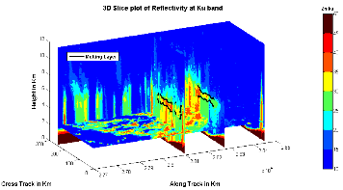
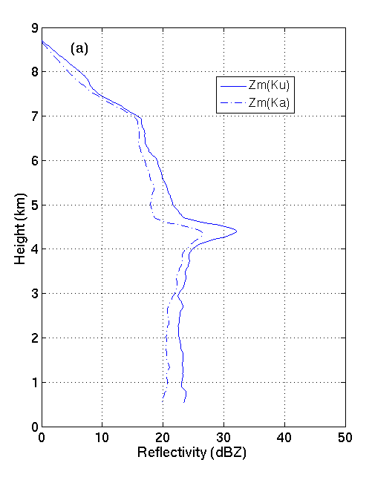
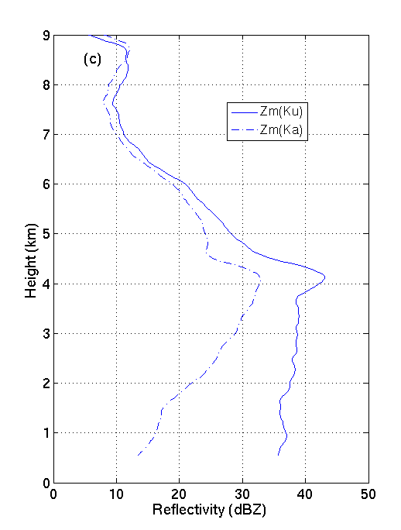
GPM DPR Observations
GPM (Global Precipitation Measurement) core satellite was successfully launched on Feb 27, 2014 from Japan. It is a science mission with application goals for advancing the knowledge of more accurate global precipitation than TRMM (Tropical Rainfall Measurement Mission).
GPM provides 4-dimensional measurements of space-time variability of global precipitation to help to quantify regional and global water cycle processes.
The GPM core satellite is equipped with a dual-frequency precipitation radar (DPR) operating at Ku- (13.6 GHz) and Ka- (35.5 GHz) band. DPR on board the GPM core satellite improves our knowledge of precipitation processes relative to the single-frequency (Ku- band) radar used in TRMM by providing greater dynamic range, more detailed information on microphysics, and better accuracies in rainfall and liquid water content retrievals. Ka- band observations of DPR help improve the detection thresholds for light rain and snow (Hou et al. 2014)
Top: Swath covered by GPM sensors. Middle: 3D structure measurements from DPR. Bottom: Typical vertical profile of reflectivity at Ku and Ka band.

Slide 8
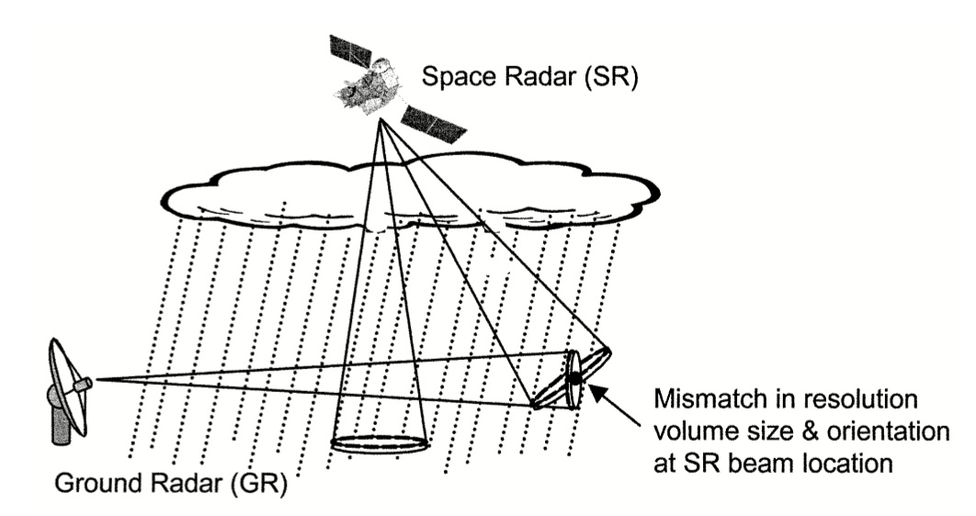
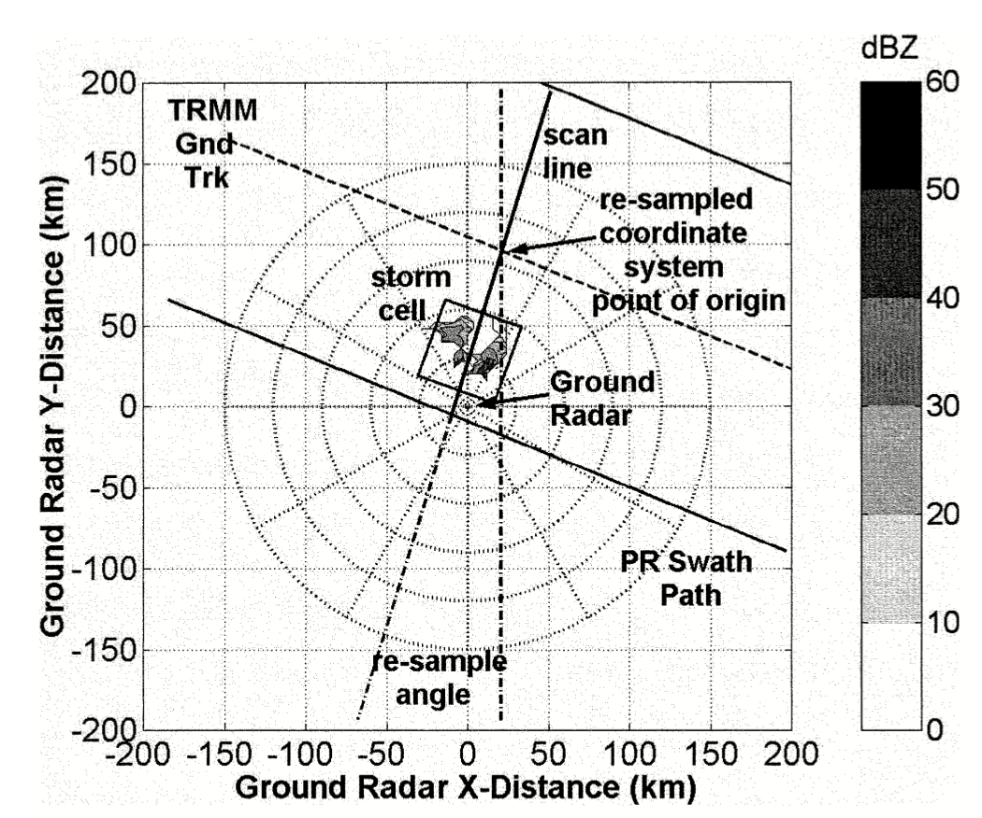
Calibration and Validation Activities----Volume matching technique
Direct inter-comparisons between space- and ground-based radar measurements can be a challenging task. Differences in viewing aspects between space and earth observations, propagation paths, frequencies, resolution volume size, and time synchronization mismatch between space- and ground-based observations can contribute to direct point-by-point inter-comparison errors.
Bolen and Chandrasekar, (2003) developed a method to align measurements between these two systems.
The space radar is a nadir downward-pointing instrument. In contrast, the ground radar is pointing only a few degrees off horizontal and can be modeled as a horizontally pointing instrument. This technique re-maps horizontal pointing ground radar measurements to vertical pointing space radar measurements.
The viewing geometry of space and ground radars.
Radar data remapping to space radar centered Cartesian coordinate system.

Slide 9
Calibration and Validation Activities----Volume matching technique
An example of volume matching between GPM DPR and NEXRAD radar PHMO (located in Hawaii) during hurricane Ana in 2014 using the methodology described above.
Left top: GPM-DPR overpass with NEXRAD PHMO located at Molokai, Hawaii and Hurricane Ana after landfall on 19th Oct, 2014 at 18:48:12 UTC. Right top: volume matched Zeku. Left bottom: volume matched Zeka. Right bottom: volume matched Zs.

Slide 10
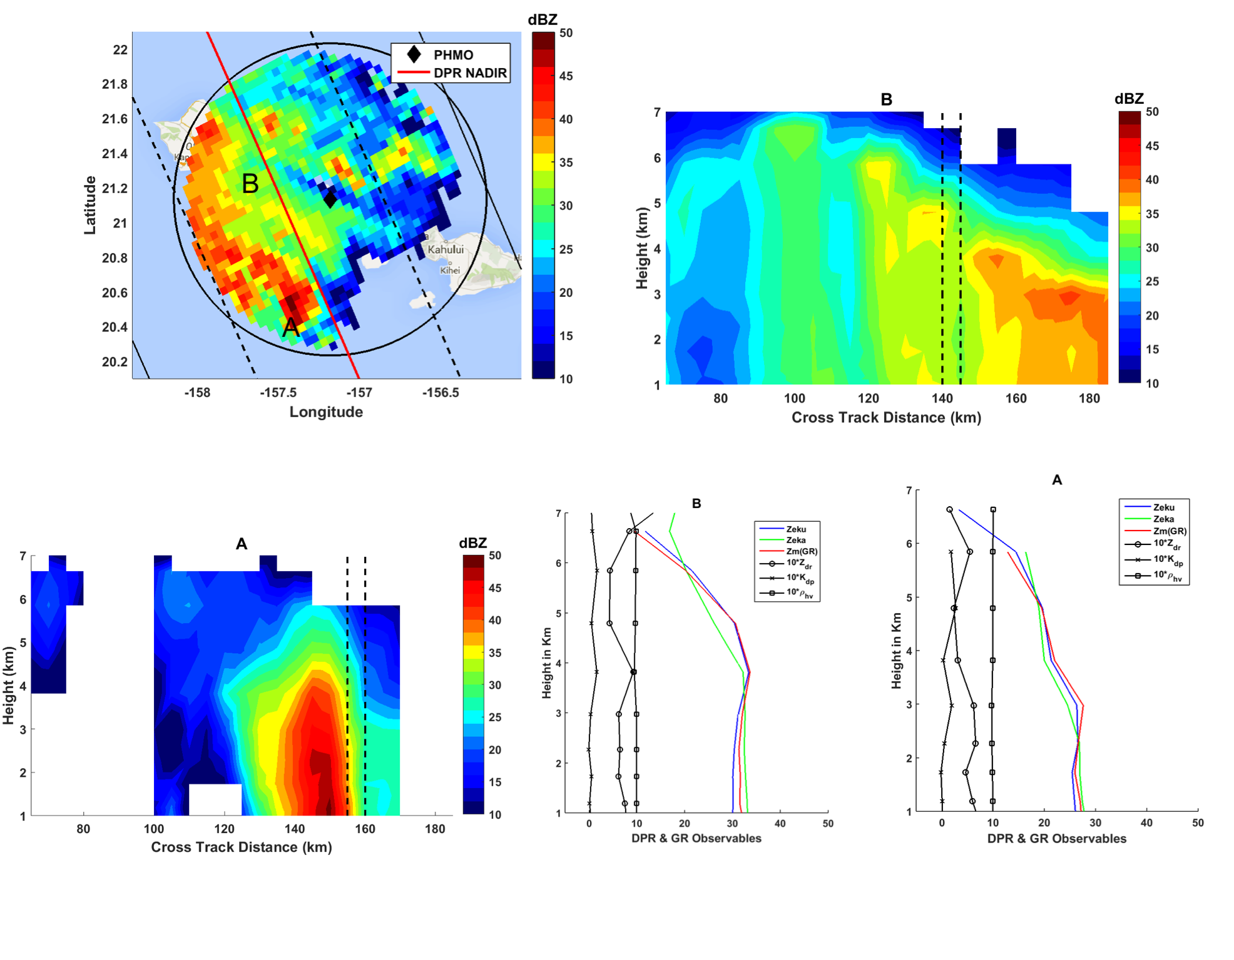
Calibration and Validation Activities----Volume matching technique
Left Top: Volume matched Zs , same as figure on previous slide. Right top: Cross track cross section at B. Left bottom: Cross track cross section at A. Right bottom: comparison of matched vertical profiles from DPR and S band, PHMO radar.

Slide 11
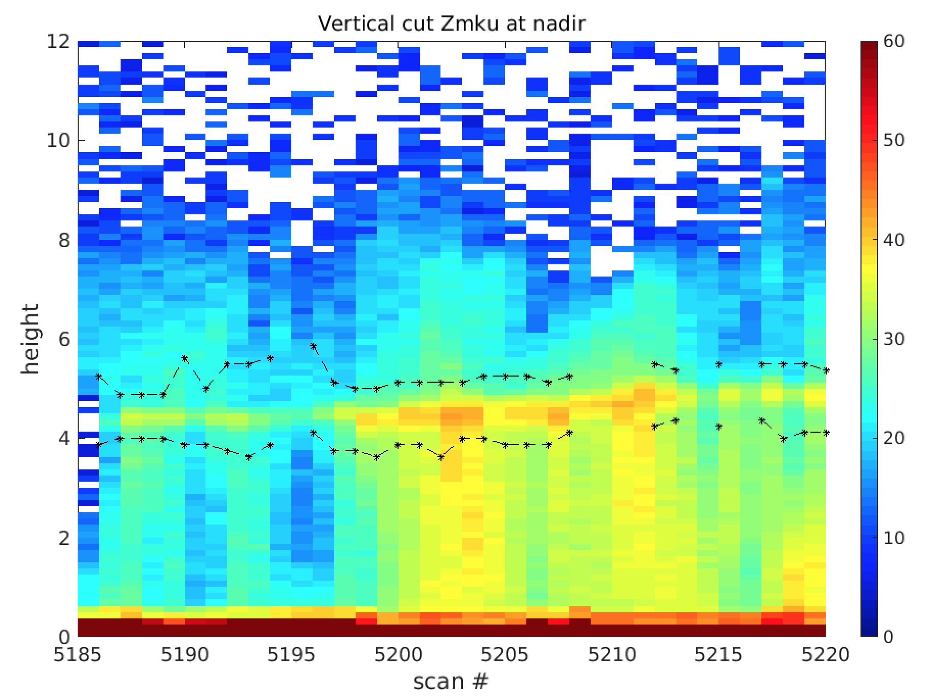
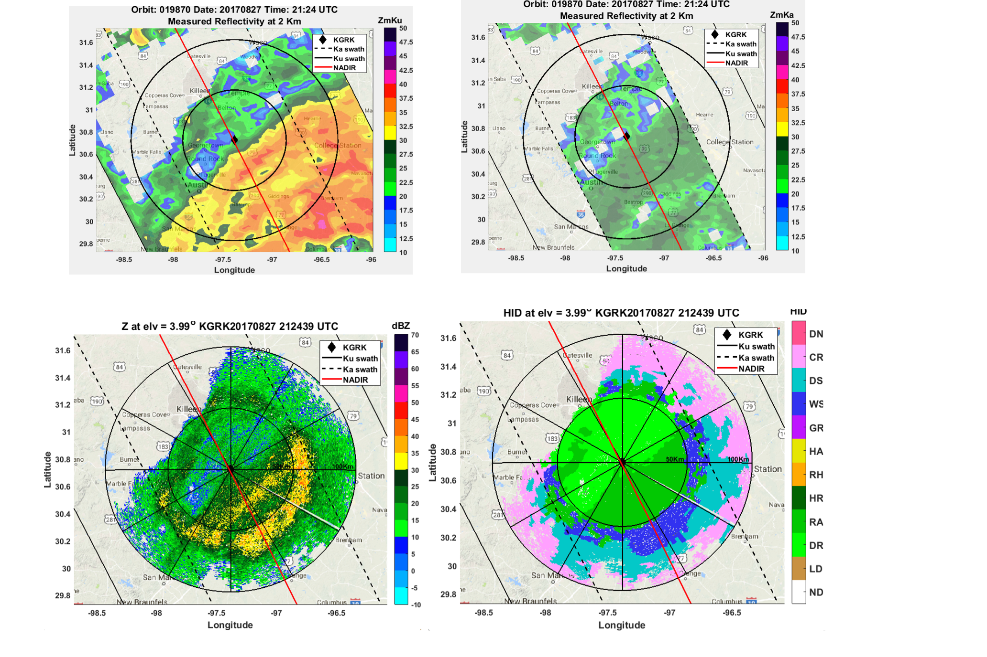
Calibration and Validation Activities----Hydrometeor type classification
DPR observes 3D structures of precipitation and phase transitions. Dual –frequency Ku and Ka band provides a unique approach to study hydrometeor identification using the difference between measurements. We have developed algorithms to detect ice phase, melting phase and liquid phase based on observations and show promising results (Le and Chandrasekar, 2016).
Figures show a sample comparison of the hydrometeor identification from DPR radar as well as ground based NEXRAD radar during hurricane Harvey. CPR radar on board the EarthCare is a down-looking W-band radar. Strong attenuation is expected from heavy precipitation.
DPR overpass overlap with KGRK radar during hurricane Harvey. Top row: Zmku and Zmka observations at 2 km from DPR on 08/27/2017 at 21:24 UTC. Middle row: PPI scan of KGRK radar at angle of 4 degree and hydrometeor identification of the PPI (Bechini and Chandrasekar, 2015).
Vertical cut of DPR observation at nadir. Black dashed lines are melting layer top and bottom detected from DPR observation.

Slide 12
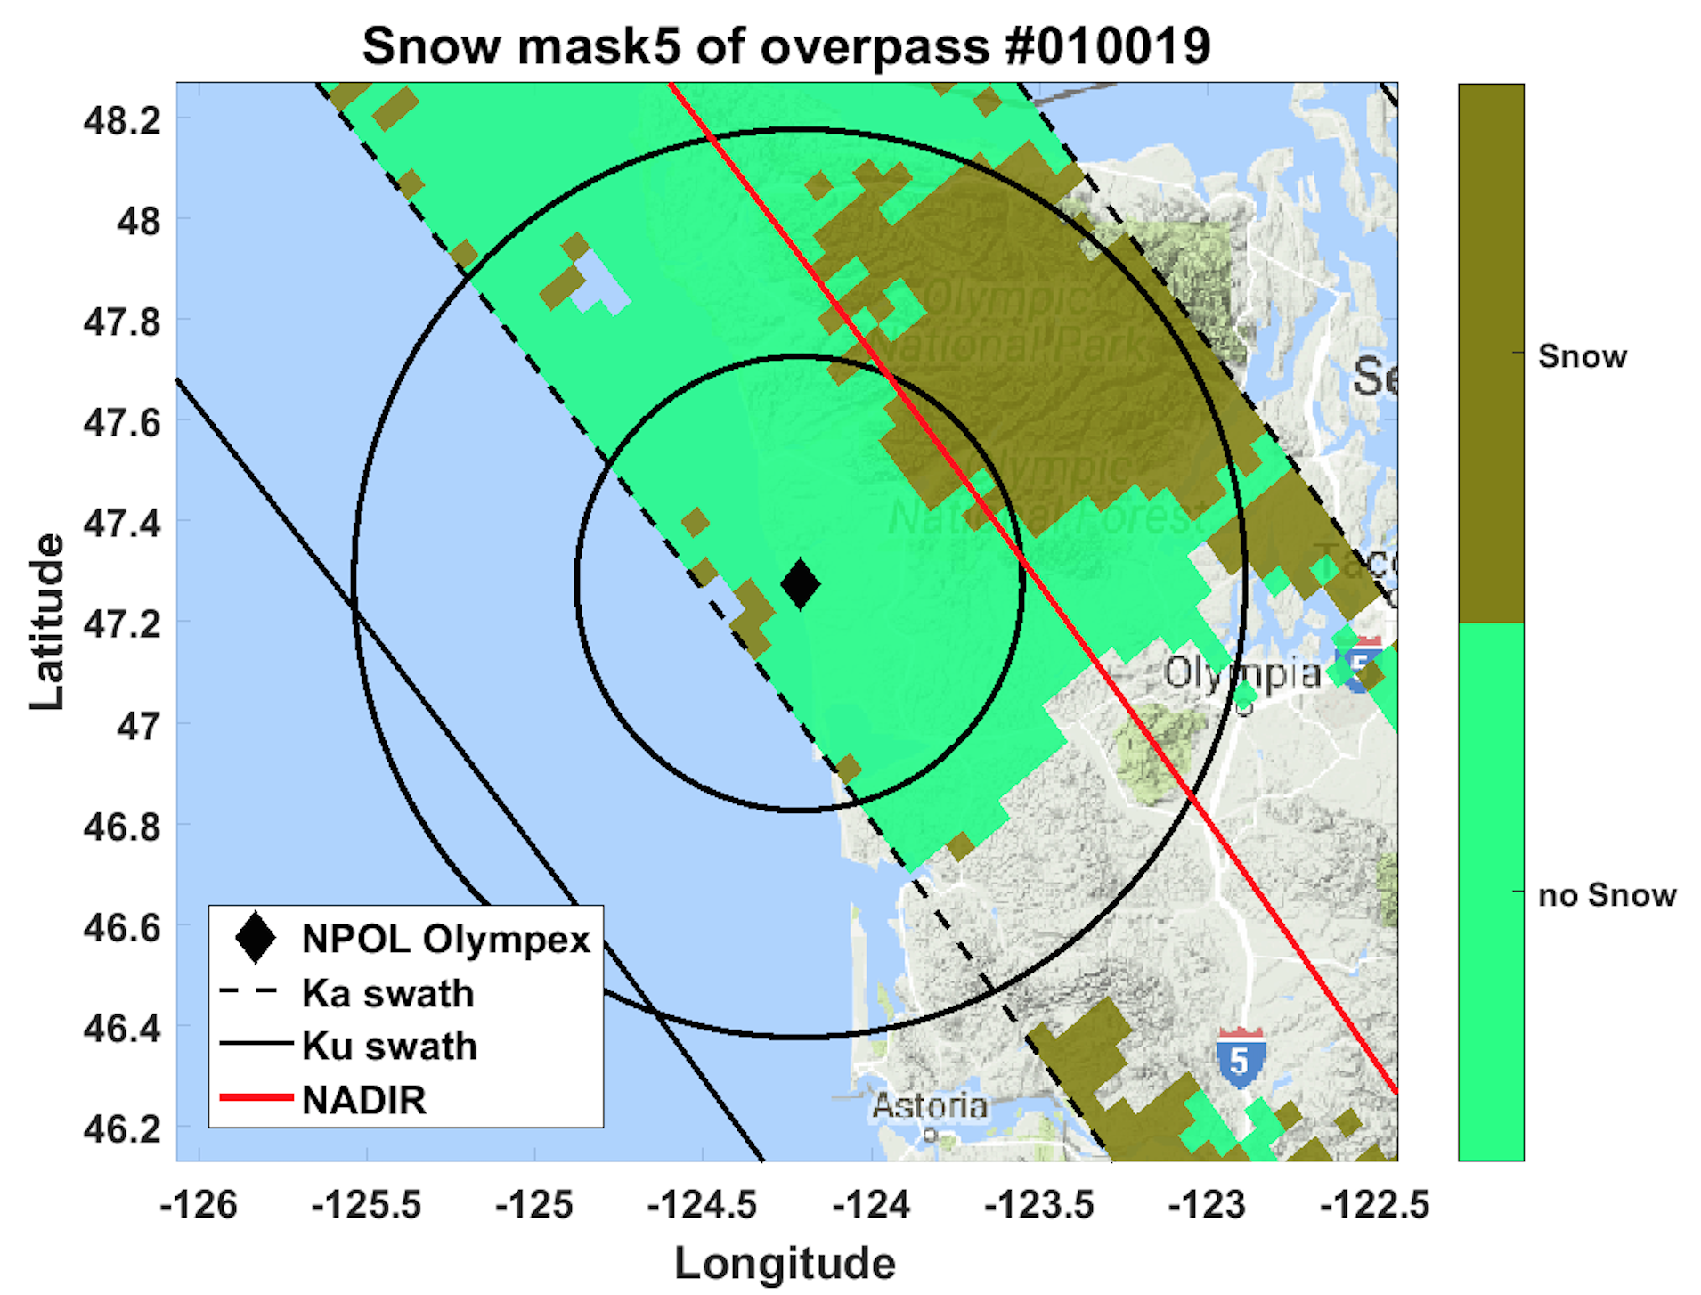
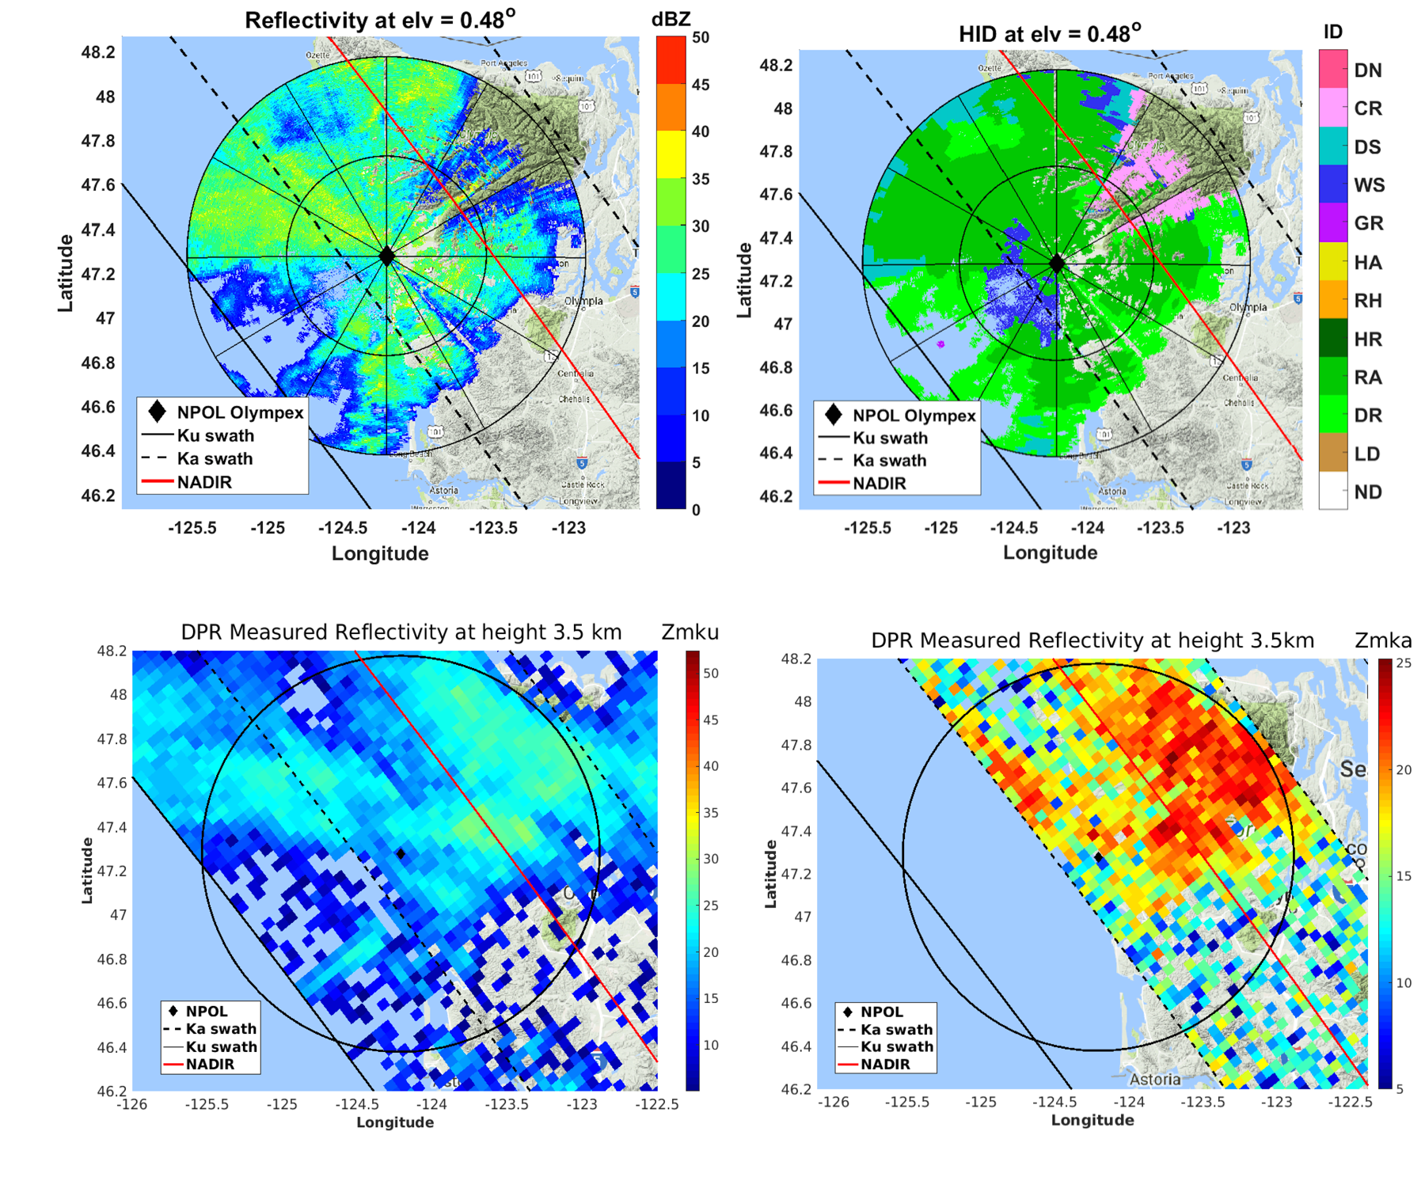
Calibration and Validation Activities----Surface snowfall validation
A surface snowfall identification algorithm for DPR (Le and Chandrasekar, 2017) and validates well with ground radars.
Figures show a sample successful cross validation using DPR and NPOL radar observation during Olympex campaign. W-band radar on EarthCare is capable of detecting frozen particles such as snow and ice.
snow
DPR overpass overlap with NPOL radar during Olympex campaign on 12/03/2015. Top row: observation of NPOL and hydrometeor identification. Middle row: DPR observation at 3.5 km. Bottom row: surface snowfall detection.
not snow

Slide 13
Cross validation with ARM radars
These radars will be used specifically for cross validation of reflectivity with W band radar profiles.

Slide 14
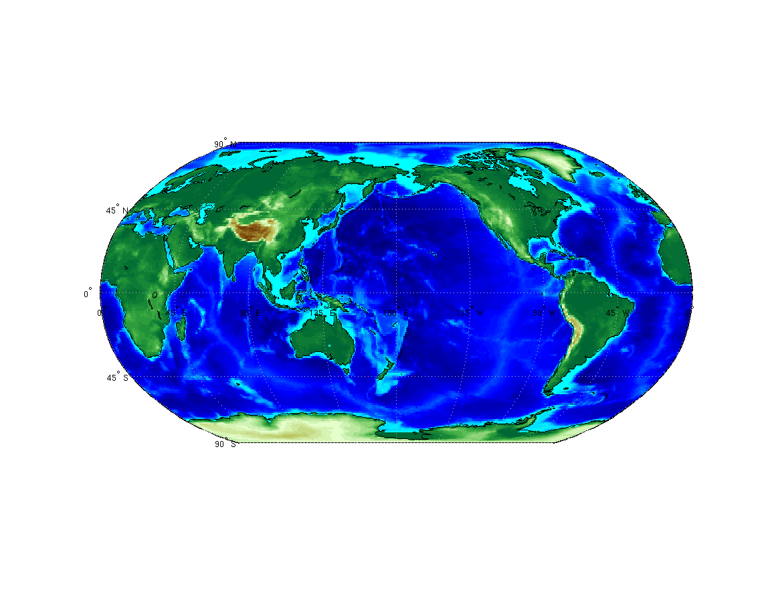
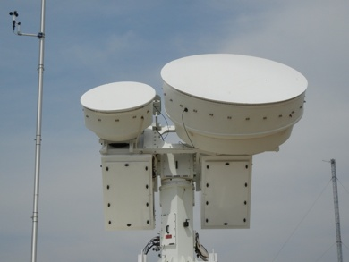
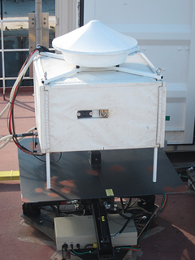
ARM W-band Radars
MWACR
Mobile site 2020
W-SACR
Mobile site 2020
W-SACR
Fixed site
AMF2
AMF1
NSA
ENA
W-SACR
Fixed site
SGP
W-SACR
Fixed site
W-SACR
W-Band Scanning ARM Cloud Radar
MWACR
Marine W-Band ARM Cloud Radar

Slide 15
Plan
We will use EarthCare datasets, and perform similar calibration and validation activities as we performed with GPM datasets using ground based radar observations.
These activities include: ( CPR- Level 2 products)
Coordinate physical validation of vertical structures
Validations based on hydrometeor classification ( C-TC)
Snowfall identification and cross validation.
Quantitative comparisons from top of the cloud.
Doppler velocity related cross validation.

Slide 16
Thanks

