Slide 1

EarthCARE BBR L1 and L2 Products Assessment
1st ESA EarthCARE Validation Workshop, 11 - 15 June 2018, Bonn, Germany
Nicolas Clerbaux* , Almudena Velazquez Blazquez * , Edward Baudrez * , Helen Brindley°, Jacqui Russell°, Richard Bantges°, Kory Priestley⁺, Anum Barki Ashraf⁺, Ernesto Lopez-Baeza#, Catalan Alcober Domingo#
(*) Royal Meteorological Institute of Belgium (RMIB)
(°) Imperial College London
(⁺) NASA Langley Research Center
(#) Universitat De València.
Notes:
All about the BBR instrument
Team with 4 inst
Have been working on similar from previous instrument (GERB, CERES, ScaRaB)

Slide 2
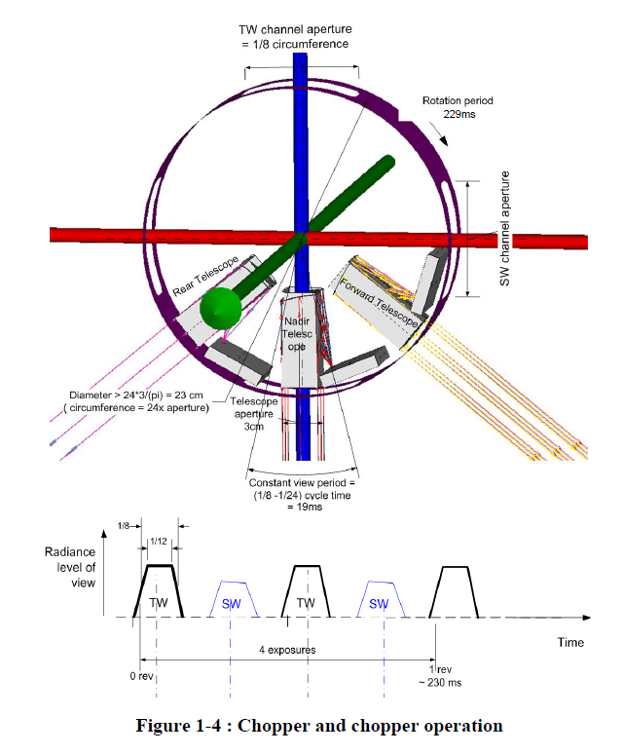
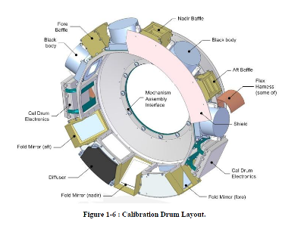
Objectives to this Cal/Val activity
Thorough assessment of BBR instrument performance and product quality
Establish the quality of the level 1 instrument radiances (B-NOM and B-SNG) : spatial and radiometric accuracy, consistency, stability, noise and anomalous behavior.
Establish the quality of the level 2 instrument radiances (BM-RAD) and fluxes (BMA-FLX)
Methods involved in the project include:
  Earth reference targets
  coastlines,
  co-incident MSI observations
  comparisons against CERES, GERB or ScaRaB.
  Radiative transfer modelling over instrumented sites
  (…)
Notes:
BBR instrument performance and prod…
Propagation of error
Show flow chart with WPs
So, not only a system level assessment of the flux for closure

Slide 3
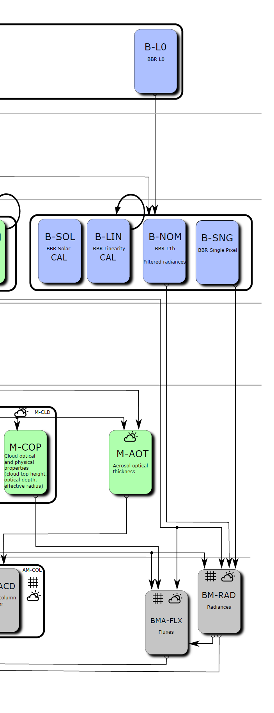
5 work-packages
WP1 : Baseline data integrity of level 1b products
WP2 : Radiometric quality assessment of L1b filtered radiance products
WP3 : Accuracy assessment of unfiltered radiances L2 BM-RAD product
WP4 : Level 2 fluxes basic quality verification
WP 5: Quantitative evaluation of level 2 flux products, closure analysis
WP1
WP2
WP3
WP4, WP5

Slide 4
WP1 : Baseline data integrity of level 1b products – objective 1
Objective 1: Anomaly survey and assessment of data quality indicators/flags, baseline pixel response statistics:
statistical analysis of unflagged data from several orbits to highlight outliers,
effect of observational conditions and differences between telescopes and pixels,
relationships to MSI data will inform the analysis,
studies of extreme and challenging conditions e.g. glint, high contrast changes during or close to the acquisition period.
Deliverables: Identification of unflagged anomalies. Summary statistics for each telescope view channel and, for the B-SNG, each pixel, to define a baseline observational state for future reference (e.g. range, mean, geographical variation and relationship to MSI observations). Assessment of measurement performance for extreme conditions.

Slide 5
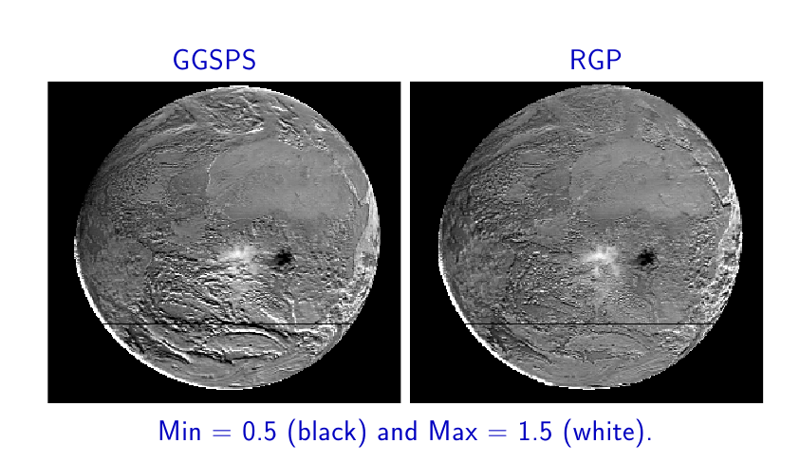
WP1 : Baseline data integrity of level 1b products – objective 2
Objective 2: Spatial characteristics of level 1b products including geolocation, point spread function (PSF), pixel cross talk and view colocation
Methods developed for GERB geolocation, co-location with imager and pixel PSF assessment will be adapted for BBR.
High contrast edges e.g. clear ocean/land transitions, will be used to verify geolocation, PSF and pixel cross talk for B-SNG SW (TW geolocation assessment follows with SW subtraction assessment in WP2).
Ratio between GERB-2 and GERB-like (based on SEVIRI) SW radiance -> indicated some geolocation uncertainty that have been mitigated by matching in the SEVIRI frame.
(original geolocation) (geolocation optimized with SEVIRI)

Slide 6
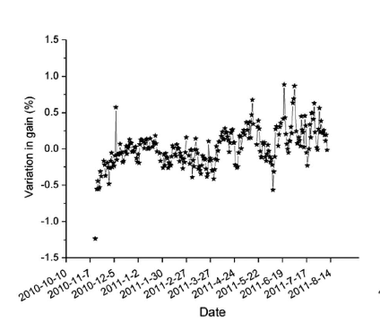
WP2 : Radiometric quality assessment of L1b filtered radiance products – objective 1
Objective 1: Gain characteristics/linearity, noise, stability and pixel to pixel variation.
MSI identified high cold cloud at night provides SW observations for noise and offset assessment and a challenging TW reference observation outside temperature and chopper drum mechanism (CDM) speed will be assessed for this scene in the B-SNG at pixel level and averaged in B-NOM.
Deliverables: noise, stability and offset quality indicators for each pixel, view, channel and product, and assessment of their dependence on data characteristics e.g. the on-board calibration range. Influence of internal black body temperature, scene viewing history, instrument temperature, CDM speed, …
FY-3B TW gain variation (NFOV)

Slide 7
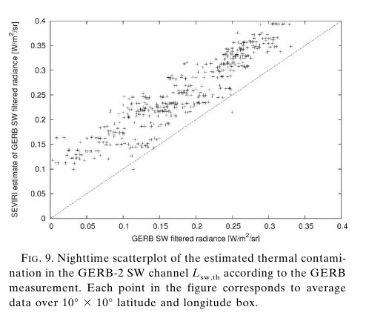
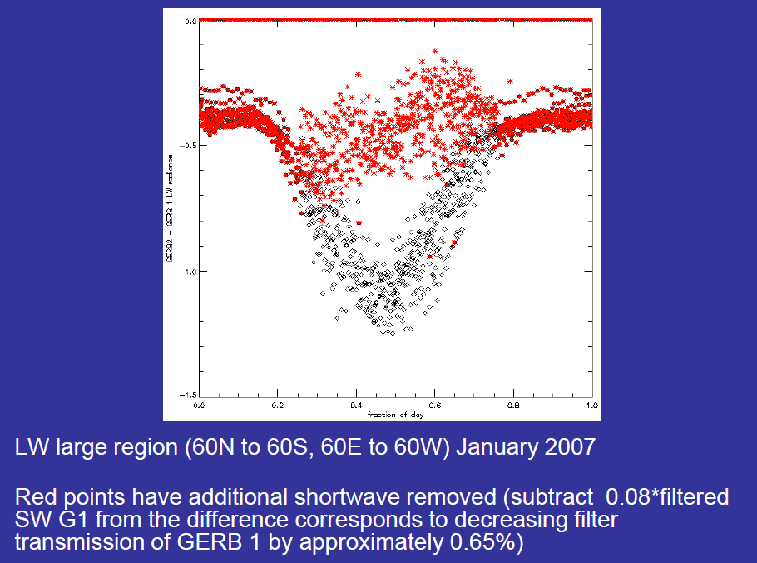
WP2 : Radiometric quality assessment of L1b filtered radiance products – objective 2
Objective 2: SW subtraction accuracy and effect of CDM speed.
Analysis of relation between the B-NOM LW and corresponding BB estimates from MSI
identify issues specific to the daytime BB LW whose accuracy relies on accurate subtraction of the SW component from the TW.
Quick detection of gross issues, including CDM speed effects, by comparison for all scenes.
Restricting comparison to cold, high deep convective cloud avoids influence of day/night scene composition changes and enables sensitive quantitative assessment of the SW subtraction error.
Extensive relatively homogenous scenes enable SW filter transmission accuracy to be isolated from colocation effects. Inhomogeneous scenes provide additional colocation assessment. GERB studies show filter transmission can be verified to the sub 0.1% level by this technique.
Analysis performed for the three views to assess radiometric consistency.
Deliverables: Verification of SW filter transmission. Quantification of colocation and CDM speed effects.

Slide 8
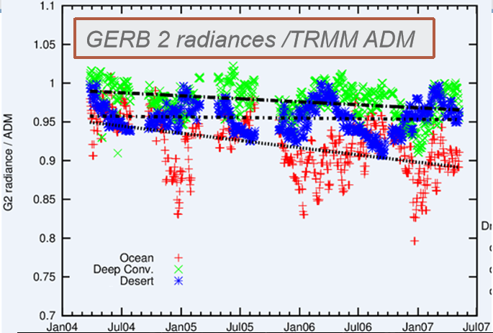
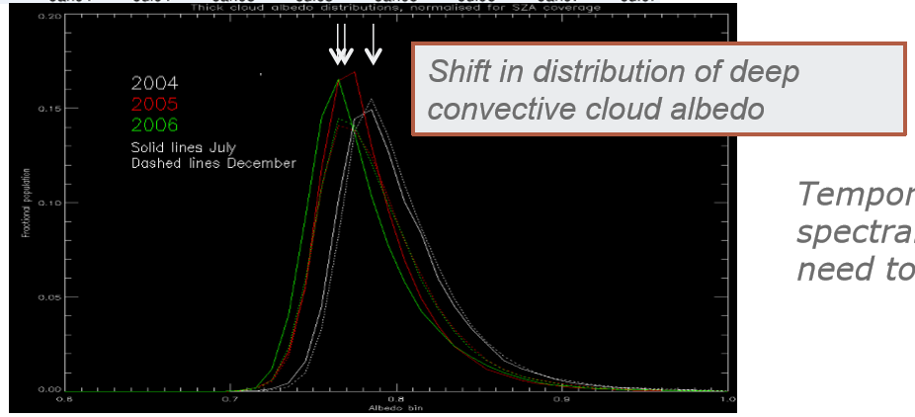
WP2 : Radiometric quality assessment of L1b filtered radiance products – objective 3
Objective 3: Reference scene responses and scene response curves.
Establish and monitor reference scene observations for each telescope (and each B-SNG pixel).
Cold thick high cloud in TW at night and SW during day will be used as GERB, CERES and ScaRaB studies have shown this to provide a good reference.
Additionally, all scene response curves will be used to compare the response of different pixels and views and monitor any temporal evolution of spectral response following methods employed for the GERB response monitoring.
Deliverables: Consistency and evolution of pixel absolute level (for reference scenes) and spectral response (from scenes response curves) for each view, pixel and product.

Slide 9
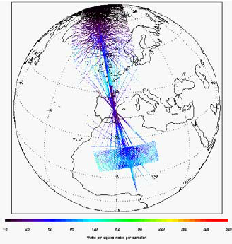
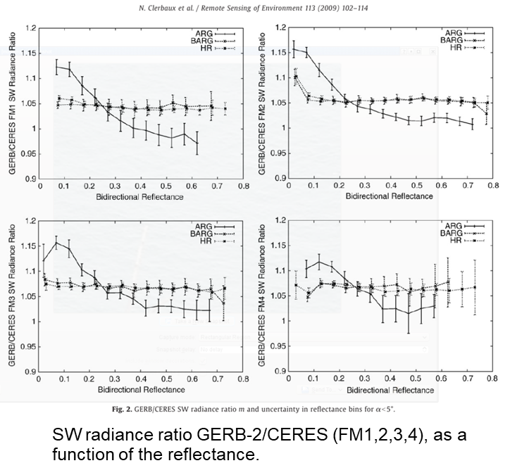
WP3 : Accuracy assessment of unfiltered radiances L2 BM-RAD product
Objectives: Evaluation of the L2 BM-RAD radiance product, so establishing input data quality for the BBR flux estimation
Note that this is additional validation of the L1 products and implicit verification of in-flight BBR SR
Comparison of coangular radiance observations with ScaRaB (MT), GERB and CERES and CLARREO PathFinder (if available) following techniques developed for GERB and ScaRaB.
absolute level (calibration) and scene type consistency (spectral response/unfiltering) assessed using co-angular matches.
Analysis for specific target Earth and scenes classified by unfiltering factor in the SW (Parfitt et al., 2016) and by filtered radiance in the LW.
off-line BM-RAD processor used to assess updates.
Establish consistency of BBR radiances with the ACM-RT Monte Carlo simulations for well modelled scenes (e.g. plane parallel scenes, low aerosol).
Monitor long term stability of the instrument response using stable Earth targets.
Deliverables: Matched database of coangular radiances for reference and further analysis. L2 radiance validation and monitoring protocol and accuracy and quality statements for the BM-RAD product throughout the mission.
CERES PAPS (Programmable Azimuth Plane Scanning) over the Valencia Anchor Station (June 2003)

Slide 10
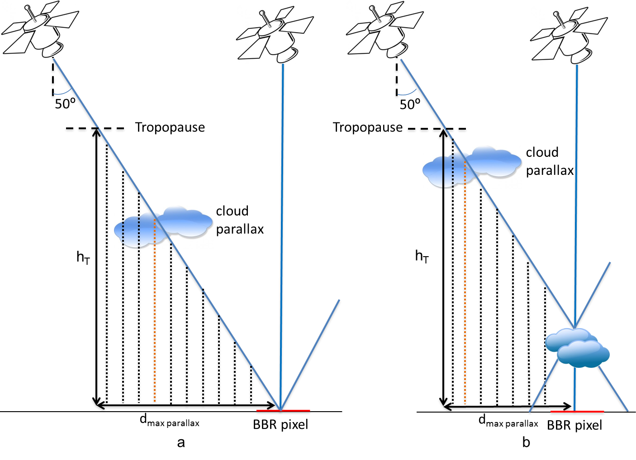
WP4 : Level 2 fluxes basic quality verification
Objectives: Integrity assessment of BMA-FLX products, including validation of the 3 views merging and consideration of parallax data flagging and effects of CDM speed on accuracy.
Assess data flagging including parallax flagging.
Assess the effect of cloud contamination in the oblique views over different surface types from a statistical analysis.
Assess reference level determination using A-CTH.
Assess the consistency between fluxes from the 3 views.
Evaluation of uncertainty on the combined flux as a function of scene type (e.g. plane parallel versus 3D, clear versus cloudy) and illumination conditions.
Quantify the effect of CDM speed on the consistency between views.
Verify consistency between the actual scene type and inputs used for the ADM training/fitting
Deliverables: BMA-FLX validation and monitoring protocol definition. Quality verification statement for BMA-FLX product and accuracy CDM speed evaluation results establishing if flux consistency can be maintained at a reduced speed.

Slide 11
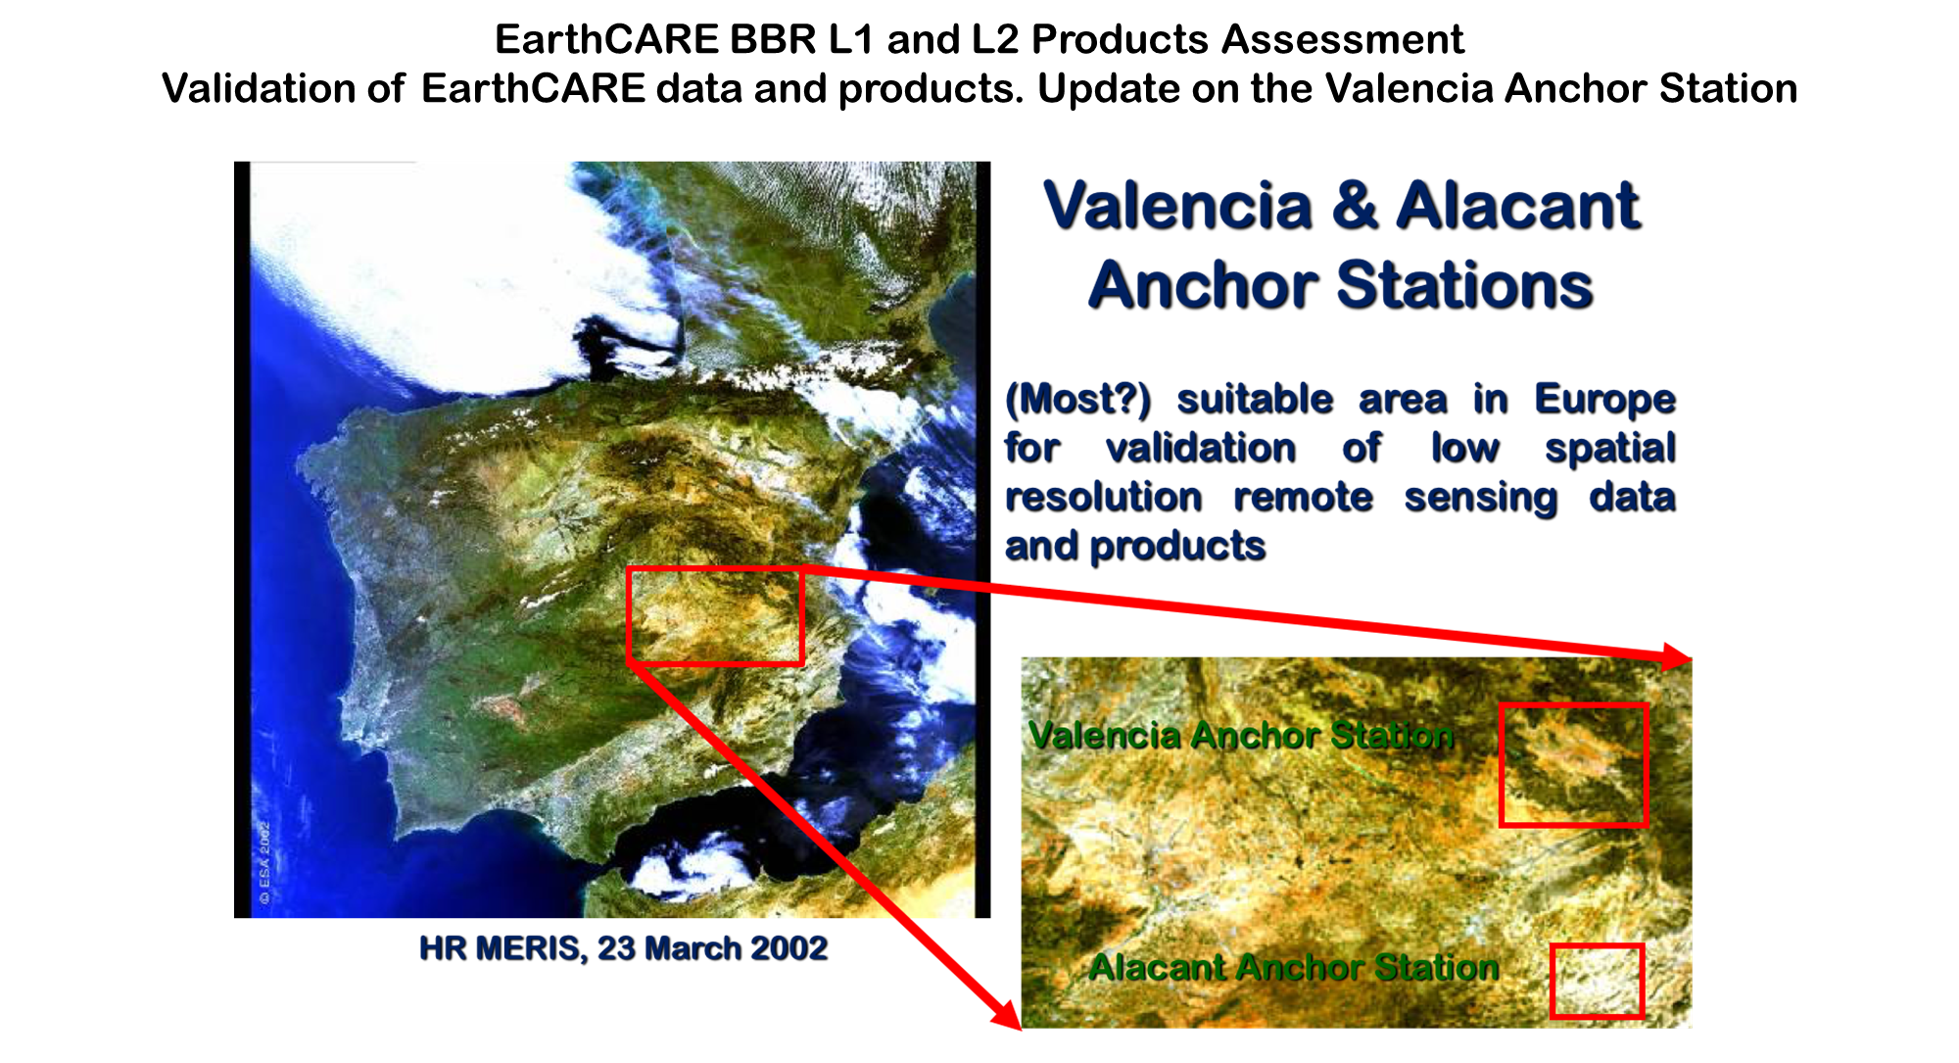
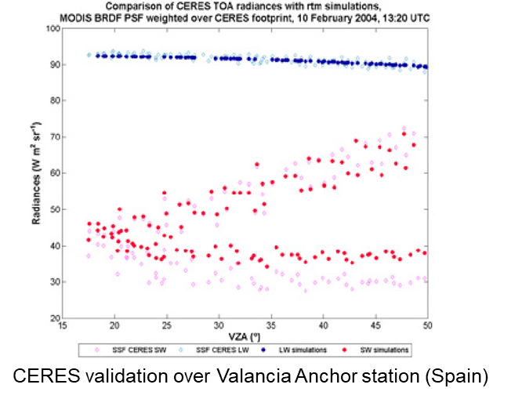
WP 5: Quantitative evaluation of level 2 flux products, closure analysis
Objectives: Quantitative assessment of the BBR combined fluxes accuracy with respect to the scientific requirement of 10 W/m² closure.
Flux evaluation and closure assessment at TOA and surface using radiative transfer simulations of radiances and fluxes at instrumented sites (e.g. Valencia Anchor station).
Verify closure between BBR fluxes and ACM-RT fluxes.
Consider separately scenes for which simulated radiances agree with the 3 view observations.
Fluxes intercomparison, using the collocated database from WP3
Comprehensive analysis as function of scene, homogeneity, solar zenith angle and observation conditions.
Deliverables: L2 flux verification and monitoring protocol definition. Flux closure results and consistency report including uncertainty to which closure is achieved.

Slide 12
Overall schedule and deliverables
18-month pre-launch period : develop tools and techniques and plan data acquisition. This will build on the expertise of the partners in calibration /validation of the GERB, CERES and ScaRaB instruments. Adaptation of existing tools and techniques and developing new ones where needed. An EarthCARE Validation Plan detailing the proposed validation studies will be delivered 4 months before launch at the Cal/Val Readiness Review.
6 months commissioning phase : assessment will put primary focus on the level 1 data to establish basic data integrity, noise characteristics, gain stability and the effect of chopper drum speed on the science products. Results will inform discussions on the optimum operating configuration and provide recommendations for the lifetime of the mission. A preliminary BBR validation report will document the results for the Commissioning Phase review.
3+ year mission : products will be further evaluated and monitored, with changes to instrument response regularly assessed. Dedicated analysis of level 2 products may result in recommendations for updates to the level 2 processing (BM-RAD and BMA-FLX processors). All findings will be consolidated in a BBR validation report regularly updated.
The team has extensive expertise in calibration/validation and operation of broadband radiometer instruments and access to existing tools which will support the planned validation studies.

Slide 13
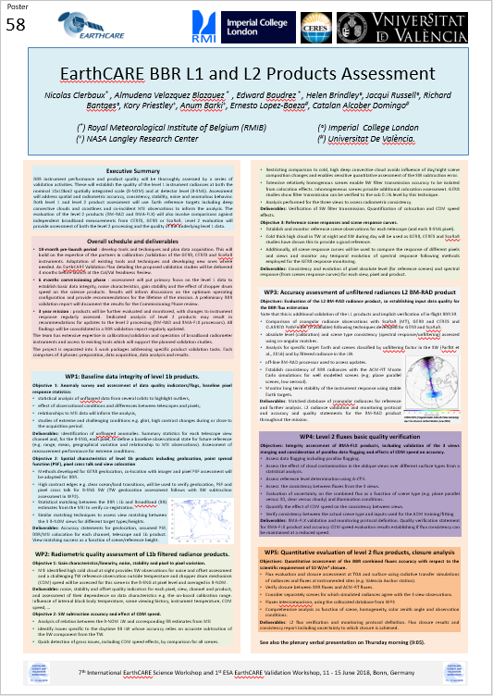
In summary
Comprehensive assessment of BBR instrument performance and product quality
Document the BBR product quality (kind of “Quality Summary”)
Hopefully, will make the BBR products useful for a larger community than the EarthCARE mission.
Details on Poster 58
Notes:
BBR useful for NB -> BB
Geo-ring

